Slide 1
Does it Live in Utah?

Slide 2
Welcome Aboard!
Hi there, Utah Nature Explorers! Today, we are going to test your knowledge of which trees and birds are native to Utah, and which are not.
We use the word ‘native’ to describe a plant or an animal that is naturally living in Utah, and ‘non-native’ to describe a plant or animal that was introduced to Utah, usually by people.

Slide 3
Instructions
Each of the following slides will have the name and picture of a bird or tree.
You will need to decide whether or not this bird or tree is native to Utah. If you think that the bird or tree IS native to Utah, then you should make a big ‘U’ with your arms. If you think it is NOT native to Utah, make a big ‘X’ with your arms.
When everyone has made a decision, your teacher will reveal the answer!
If you are keeping points, each slide is worth 10 points. That means there are 170 points available!
Have fun!

Slide 4
Quaking Aspen Tree
YES!

Slide 5
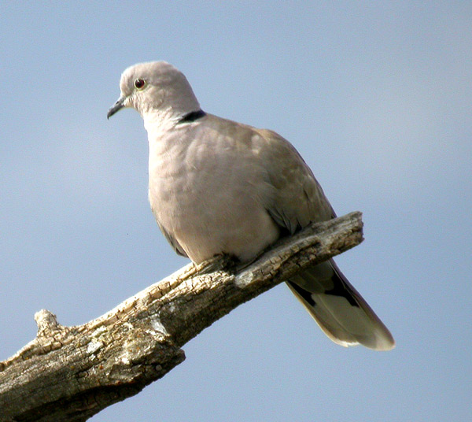
Eurasian Collared Dove
NO!

Slide 6
Mallard Duck
YES!

Slide 7
Juniper Tree
YES!

Slide 8
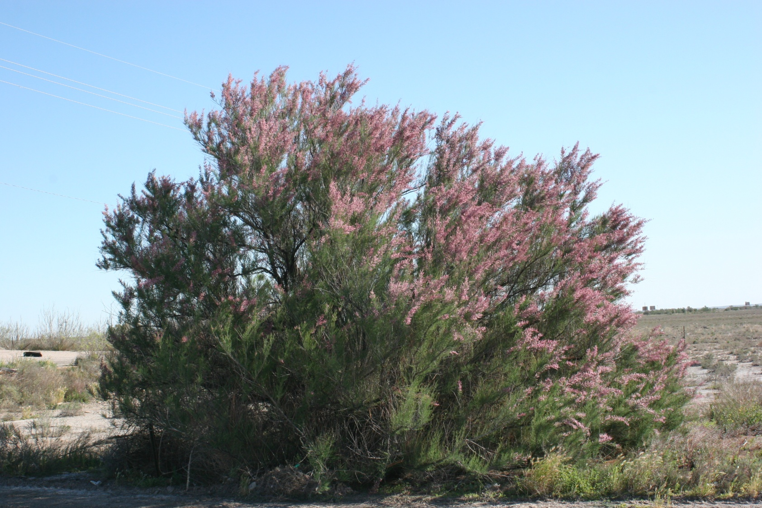
Tamarisk or Salt Cedar
NO!

Slide 9
Bald Eagle
YES!

Slide 10
Great Blue Heron
YES!

Slide 11
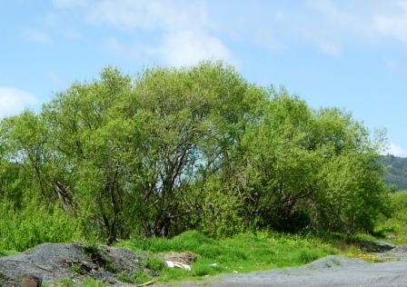
Crack Willow Tree
NO!

Slide 12
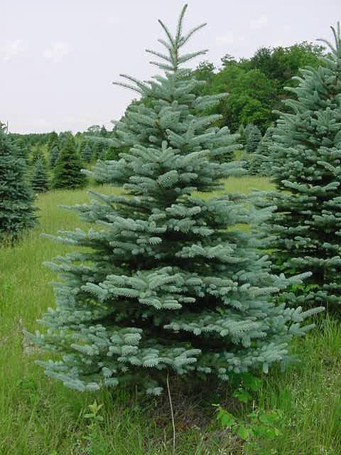
Colorado Blue Spruce
YES!

Slide 13
Lodgepole Pine Tree
YES!

Slide 14
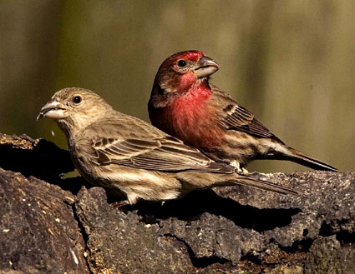
House Finch
NO!

Slide 15
Mountain Bluebird
YES!

Slide 16
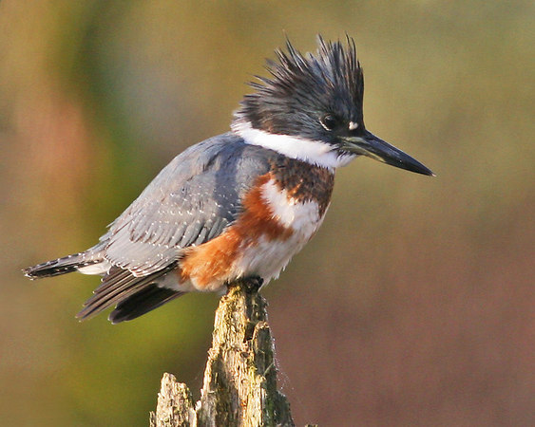
Belted Kingfisher
YES!

Slide 17
Douglas-fir Tree
YES!

Slide 18
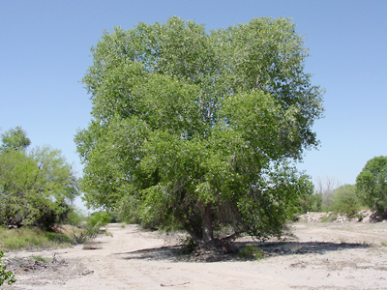
Fremont Cottonwood Tree
YES!

Slide 19
Red-Winged Blackbird
YES!

Slide 20
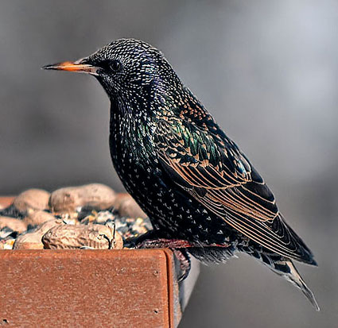
European Starling
NO!

Slide 21
Limber Pine
YES!

Slide 22
See you later…
How did you do? Did you learn a lot about the birds and trees of Utah? We sure hope so!
We had a great time learning with you today. Hope to see you again soon!
Sincerely,
The Utah Nature Explorers Team

Slide 23
Picture Citations
The following websites were used in the development of this slideshow.
https://extension.usu.edu/utahmasternaturalist/htm/learn/resources
www.utahbirds.org
essmextension.tamu.edu
www.forestviewtreefarms.com
www.allaboutbirds.org
www.hanoverconservancy.org

