Slide 1
Cookies Powered By the Sun
4-H Youth Air Force Summer Camp

Slide 2
Solar ovens use solar energy—light and heat emitted from the sun—to cook food. They can also be used to pasteurize water or even sterilize instruments. How does a solar oven work? The simple answer is that it is designed to absorb more heat than it releases. The plastic "window" works like a greenhouse roof, allowing (direct and reflected) sunlight to pass into the box, while also retaining heat. At the bottom of the box, you placed the black paper. This will act as a heat sink that absorbs direct and reflected sunlight to warm it, which will heat food placed on top of it.
Background

Slide 3
Review Questions
There are a lot of variables that you can try to tweak in your oven design to make it even better.
Can you make your solar oven more efficient by changing the angle of the reflector flap, using different materials to insulate it or changing its shape or size?
Use a thermometer to quantify how efficient your oven is; record the temperature readings inside your oven over time. How hot can it get?
How does this compare with a real oven?

Slide 4
I hope you enjoyed that activity as much as I did and got some delicious cookies from the sun’s energy!
The rest of this presentation is going to be focused on explaining renewable energy, some cool emerging technologies, and a way to test your own environmental impact!

Slide 5
Renewable Energy Overview
Take a moment to think to yourself or chat with a friend or family member about what you already know about renewable energy!
What does “renewable” mean?
What sort of renewable technologies to you know about?
How is this energy used in our society?

Slide 6
What is Renewable Energy?
It is energy from a source that is not depleted when used, meaning is will not run out
Renewable energy is generated from natural sources, such as sunlight, wind, rain, waves, and geothermal heat
This energy can be used in place of carbon sources of energy, such as coal or natural gas, to power homes, buildings, cars, industrial processes, and everything else that requires energy!

Slide 7
Interesting Statistics on Energy Use and Renewable Energy
Energy use in America is doubling every 20 years
The United States has more nuclear reactors, more nuclear power capacity and generates more nuclear power than any other country in the world
The average U.S. household consumes about 11,000 kilowatt hours (kWh) per year
The largest wind turbine in the UK can power up to 80,000 homes per year!
Texas ranks first in the U.S. for installed wind capacity, with a capacity of 18,531 MW and an under construction wind capacity of 5,040 MW. This is the equivalent of powering 4.1 million homes
Germany has the most installed solar panels, producing 32,000 MW

Slide 8
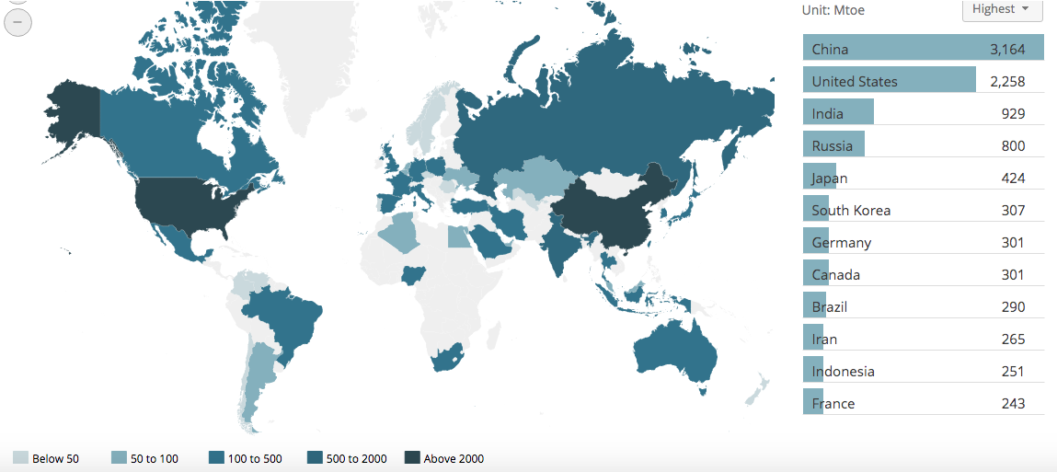
Worldwide Energy Consumption in Mtoe (million of tons of oil equivalent)

Slide 9
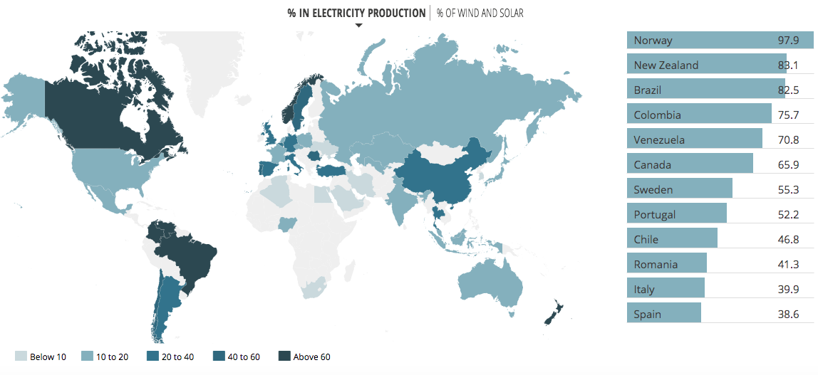
Worldwide Percent Electricity Production
Notice that the US only has 10-20% renewable production but is the second largest world consumer of energy.

Slide 10
Can you name all the various types of renewable energy technology?
There are SIX main types of renewable energy. Try to name them all, then click to the next slide to reveal the answers!

Slide 11
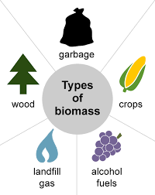
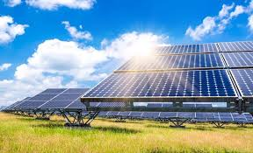
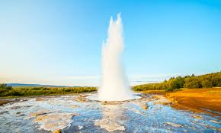
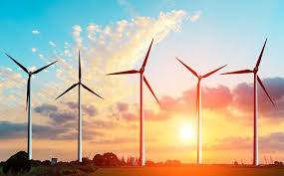
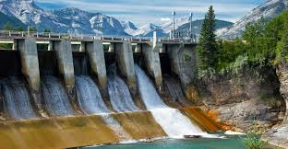
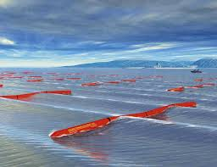
Types of Renewable Energy
Solar
Geothermal
Biomass
Wind
Hydroelectric
Wave/Tidal

Slide 12
Solar Energy
A technology of obtaining usable energy from the light of the sun
Solar energy is used to heat buildings, electricity generation, desalination of seawater, heating water, and much more
It is the cheapest and most abundant renewable energy source
Concentrated solar power systems use lenses or mirrors and solar tracking systems to focus a large area of sunlight into a small beam
In 2018, the US produced 62.5 gigawatts, enough capacity to power the equivalent of 12 million average American homes

Slide 13
Wind Energy
Wind power captures the energy of the wind and uses turbines to change that power into electricity
It has been used since ancient times to pump water or grind grain into flour
In 2019, the US produced 300 billion kWh (killawatt hours) from wind generation
7.3% of total U.S. utility-scale electricity generation
12 states produce almost 80% of the US total wind power, including: Texas, Iowa, California, Oklahoma, Illinois, Kansas, Minnesota, Oregon, Colorado, Wyoming, Washington, and North Dakota

Slide 14
Biomass
Biomass is plant or animal material used for energy production
Sources can be wood, grass clippings, corn, cow dung, sugarcane, municipal waste, alcohol fuels, and landfill gases
Biomass is commonly used as a fuel in underdeveloped countries for cooking and heat
The US uses biomass to create liquid biofuels to power cars, such as ethanol and biodiesel
Biomass fuels provided about 5% of total primary energy use in the United States in 2017. Of that 5%, about 47% was from biofuels, 44% was from wood and wood-derived biomass, and 10% was from the biomass in municipal waste

Slide 15
Geothermal Energy
Geothermal energy is obtained by tapping into the nature heat produced from the earth, in the form of hot water and steam to create electricity
Iceland’s electricity sector is completely powered by geothermal generation, but the US is the largest geothermal energy producer in the world
Geothermal power plants can produce electricity consistently, running 24 hours per day / 7 days per week, regardless of weather conditions
In 2019, there were geothermal power plants in seven states, which produced about 16 billion kWh, equal to 0.4% of total US electricity generation

Slide 16
Wave & Tidal Energy
Wave power is produced by the up and down motion of floating devices placed on the surface of the ocean
These high-tech devices capture the natural movements of ocean currents and can produce electricity, desalination water, and pump water
Theoretical annual energy potential of waves off the coasts of the United States is estimated to be as much as 64% of U.S. electricity generation in 2018
Tidal generators are very similar to wind turbines except their below the water surface. The turbine and generator converts the movement of water from the change in tides, the kinetic energy, into electricity
Both of these technologies are still in development in the US, but have very large potential to contribute to electricity generation

Slide 17
Hydroelectric Energy
Hydropower is changing the energy of moving water into electricity
The largest generation of hydropower is from dams that use the falling water, due to gravity, to turn turbines and produce electricity
There are three main types of hydropower; impoundment facilities(dams), pumped storage facilities(from lower to higher reservoir), and run-of-river facilities(natural)
In 2019, hydroelectricity accounted for about 6.6% of total US electricity generation and 38% of total utility-scale renewable electricity generation

Slide 18
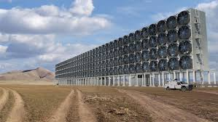
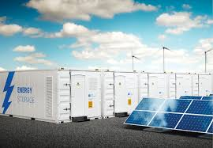
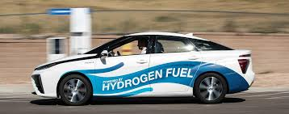
Cool Emerging Technologies to Check Out!
Carbon Capture
https://carbonengineering.com/
Hydrogen Powered Vehicles
https://www.toyota.com/mirai/fcv.html
Energy Storage
https://www.h2gopower.com/

Slide 19
Ecological Footprint
What is an ecological footprint?
A method of measuring a humans impact on the environment by quantifying the amount of natural resources it takes to maintain their quality of lifestyle
Why does it matter?
Being aware of your personal ecological footprint can help you to make more informed decisions about your lifestyle to help maintain the planet for all humans!
Calculate your personal ecological footprint @
https://www.footprintcalculator.org/

Slide 20
Link to Survey with a
Do and Snap Picture Challenge!
https://tinyurl.com/CookiesPoweredbySun

Slide 21
Hope You Enjoyed Cookies Powered By the Sun!

