Slide 1


Pathways Towards Success
Copyright Marline E. Pearson, M.A. All rights reserved.
Notes:
The lesson begins by inviting students to reflect on their own personal hopes, dreams, and goals for their future. This immediately engages participants and encourages them to apply the following principles to their lives and individual circumstances.
❖ Today we’re going to focus on your future. Research has revealed that there are specific pathways to follow towards success that are more likely to get you there.
❖ Before I share with you these “secret ingredients for success,” I first want to introduce you to a concept called Decide, Don't Slide.
❖ Before I share with you these “secret ingredients for success,” Let’s talk about your own personal hopes, dreams, and goals.

Slide 2

What do ​you want your life to look
like at age 30?​
Copyright Marline E. Pearson, M.A. All rights reserved.
Notes:
❖ Imagine yourself at age 30. Go ahead and close your eyes, if you want. What kind of life do you hope you have? What kind of relationship? Income/lifestyle? Family? (Give students 30 seconds or so to envision.)
❖ Let’s open our eyes. Would a few of you mind sharing? What did you see? (Pause for a few responses.)
Instructor Note: Students may share different visions, but you will likely notice some common themes such as stability, love, and purpose. Examples could include having a comfortable middle-class lifestyle, having a good marriage, having a good income, having a happy family, etc.
❖ Thank you so much for sharing your thoughts. Now, not everyone has the same dreams for their future, and that’s okay! The important thing to recognize is that regardless of where you hope to wind up, you are building your future right now with the choices you are making. The more intentional we are about those choices, the more likely we are to create the life we want.

Slide 3


Are you Sliding...
or Deciding?
Copyright Marline E. Pearson, M.A. All rights reserved.
Notes:
This section introduces the important concept: Decide, Don’t Slide. This concept is an essential piece of following success pathways to build teens’ sense of control and self-determination and to empower them to shape the future they envision for themselves.
❖ Let’s discuss this a little more in-depth. I want to introduce you to a concept called Decide, Don’t Slide.
- By sliding, I mean just going along in life and kind of just letting things happen.
- Deciding, on the other hand, is about being intentional, gathering information, making clear decisions, and then taking steps to get to where you want to go. This can be applied to lots of things in life.
❖ When we slide into our choices without stopping to think ahead, we run the risk of winding up in places we never planned to be—sometimes with some serious high-cost consequences.
❖ On the other hand, when we make intentional choices that align with our personal goals rather than just letting things happen to us, it opens up our options for the future. Deciding is a much safer way to go when it comes to important things that can be life-altering, like finishing high school, preparing for a career, or starting a family.
❖ Let’s take a look, for example, at how this works in our romantic relationships. This is one area where deciding rather than sliding can make a big difference.

Slide 4


Why do people end up in relationships that don’t work?
Copyright Marline E. Pearson, M.A. All rights reserved.
Notes:
❖ How many of you know someone one who got romantically involved with another person and then later regretted it? (Pause for show of hands.)
❖ Or someone who stayed way too long in a bad relationship?
❖ Like, “What was I thinking? Why did I ever get involved with this person?”
❖ Do you know anyone who found themselves in a complicated relationship—an unhealthy, maybe even an abusive relationship?
❖ Have you ever wondered why this happens? Certainly no one goes into a relationship wanting it to be bad or painful.

Slide 5

The “love chemicals”
Copyright Marline E. Pearson, M.A. All rights reserved.
Notes:
❖ When you first start to feel attracted to someone, your brain triggers a very real chemical reaction in your body by releasing a flood of hormones including norepinephrine, dopamine, oxytocin and more.
❖ These hormones produce great feelings and energy—even euphoria. It may feel like all you can think about is this person. But this surge of hormones can also cloud your judgement. It takes a while for this “chemical mix” to settle a bit before you’ll see a person more clearly—usually somewhere between 3-9 months.
(Shake a glitter bottle)
❖ It’s like this at the start—exciting, glittering, beautiful—but you can’t see through it clearly. This is why someone (maybe your friend or a sibling) could be falling for a total loser—or someone who is just all wrong for them—and they just can't see it. "Oh, he or she is different with me," or “They’ll change for me, I just know it. They’re a really great person underneath.”
❖ But if you put the glitter bottle down and let it settle for a while, you’ll see more clearly.
❖ When a person “slides” quickly into getting involved with someone—especially physically involved—before learning more about who that person really is, it increases their chances of winding up in a relationship that doesn’t work out or has more serious consequences.
❖ That’s why, in our relationships, it’s so important to slow down, wait for the glitter to settle, and decide on the next step instead of just sliding into it.

Slide 6

ACTIVITY: Turn back the clock ​on a High-Cost Slide​
1. How well did they know each other?
2. What was the slide?
3. What could they have done differently?
Now go back in time. What steps might have been taken, information gathered, and decisions made to have avoided the high-cost slide?
Copyright Marline E. Pearson, M.A. All rights reserved.
Notes:
❖ Let’s do an activity to get an idea of what this might look like in some real-life situations.
Select one or two High-Cost Slides activity cards (attached) that you feel will engage your students. Work on them together as a whole group. If you have more time, divide into small groups and use one card per group.
❖ I am going to read aloud a relationship scenario that involves some sliding rather than deciding and then tell you what happened for that person later on.
❖ Your job is to imagine the person in the scenario has a “do-over” opportunity. So, turn back the clock and think about what this person could have done differently to avoid what happened.
❖ While I’m reading, consider these questions:
- What was the “slide”?
- What red flags or warning signs were missed?
- What might they have done differently?
- How would have deciding, instead of sliding, helped this turn out differently?
❖ Turn back the clock. Identify decisions, steps, or actions that could have made a difference.
Work your way through your chosen scenarios one at a time. Listen to their answers and then what the person could have done differently. (Perhaps they’ll say, “The slide happened when…, A red flag was…,They could have talked about… done this or that….”)
Activity Debrief
❖ Okay, so, what do we learn from these scenarios? (Pause for a few responses.)
❖ Sliding through big decisions may feel easier in the moment—but it often leads to consequences you didn’t expect. Choosing to decide—to pause, plan, and act with intention—gives you more control, more freedom, and a better shot at the life and relationships you actually want.
❖ So what does this have to do with your life right now? These decisions may seem far off, but they’re shaped by the habits you’re building today—how you handle friendships, how you set boundaries, how you talk about your future.

Slide 7
Share with Your Neighbor:
What’s one area of your life—friendships, dating, school, or even social media—where you want to make more intentional decisions instead of just going with the flow?​
Copyright Marline E. Pearson, M.A. All rights reserved.
Notes:
❖ Turn to the person next to you and take turns sharing: What’s one area of your life—friendships, dating, school, or even social media—where you want to make more intentional decisions instead of just going with the flow?
❖ I’d love to hear what you came up with. Would two or three of you mind sharing with the class? (Pause for responses.)
❖ Thanks so much for sharing your thoughts. I hope our discussion today has helped you recognize the importance of deciding rather than sliding, especially when it comes to your relationships.
❖ Next time, we’ll dig into how to pace relationships in healthier ways, recognize red flags, and make intentional choices to avoid regret. You’ll also learn about a research-backed path that gives people the best chance at long-term success—in relationships, in parenting, and in staying out of poverty. You won’t want to miss it!

Slide 8
Healthy Relationships &
the Success Sequence
Copyright Marline E. Pearson, M.A. All rights reserved.
Notes:
This section builds on the concept of Decide, Don't Slide, and introduces a more intentional and positive way students can approach decisions related to romantic relationships.
❖ Welcome back! Let’s start off class with a little review of what we discussed last time. Could I have one person give me a summary in their own words of what it means to decide rather than slide?
❖ Thank you! Now who remembers our activity from last class where we applied deciding rather than sliding to some different relationship scenarios? (Pause for a raise of hands.)
❖ Through these examples, we saw how sliding through relationship decisions can bring unexpected outcomes. Now, today, we’re going to look at how to pace our relationships and our lives more thoughtfully—how to decide, rather than slide, every step of the way.

Slide 9

Some Common Relationship Slides
Moving too fast physically or emotionally
Ignoring warning signs or values misalignment
Staying in an unhealthy relationship because of fear or attachment
Copyright Marline E. Pearson, M.A. All rights reserved.
Notes:
❖ As we saw in our scenarios, sliding in relationships is easy to do, and is a lot more common than you might think. Some of the most common relationship slides include:
- Letting things move too fast physically or emotionally—getting caught up in the swirling glitter.
- Ignoring warning signs or values misalignment. These often take time to identify, which is why it’s important to take things slow!
- Staying in a relationship that isn’t healthy because of attachment or fear. It’s easy to slide into a relationship, but it’s unlikely that you’ll slide out of one that is toxic or involves abuse.
❖ You don’t have to fall into these relationship slides. There is another, healthier, way to go about romantic relationships to reduce your odds of having risky involvement that potentially could derail you as you make your way to a successful adulthood. It’s called the Low-Risk Deciding Approach.

Slide 10
Low-Risk Deciding Approach
Attraction
Learn More About Each Other...
Then Decide...
Agree to a Plan
Notes:
❖ This means taking things slow, getting to know the person, and then making intentional decisions about getting involved.
❖ Take a look at our slides here, and notice the first column, labeled “Attraction”.
- What do you recall about the brain chemistry of attraction?
Pause for responses. Pull out the glitter bottle visual aid from last class and hold it up for the class to see.
❖ You’ll remember that these colors represent the hormones norepinephrine, dopamine, oxytocin and more which are released with romantic attraction and produce amazingly wonderful feelings. But they also keep you from seeing clearly.
- What tips would you offer someone who is in the middle of that swirling glitter?
Pause and listen. Then, click to populate the first column.

Slide 11
Low-Risk Deciding Approach
Attraction
Learn More About Each Other...
Then Decide...
Agree to a Plan
Enjoy it! Have fun.
Don’t read too much into it yet.
Remember the “love chemicals” surge 3-9 months​
Clearly communicate your desire to take things slowly; your boundaries on physical intimacy​
Notes:
Add to their responses any ideas they might have missed from the PowerPoint.
❖ Now look at the second column, labeled “Learn More About Each Other”.
- What kinds of things should you be finding out and asking yourself to see if this person is a good match for you? Give me your thoughts please.
Pause and listen. Then, click to populate the second column.

Slide 12
Low-Risk Deciding Approach
Attraction
Learn More About Each Other...
Then Decide...
Agree to a Plan
Common interests?​
Find each other interesting?​
Do you have fun? ​
Values in sync?​
Enjoy it! Have fun.
Don’t read too much into it yet.
Remember the “love chemicals” surge 3-9 months​
Enjoy each other’s personality?​
Talk easily? Fight fairly? ​
Do your differences work together? ​
Detect any problem behaviors?​
Is person mature?​
Treat you well?​
Have you met each other’s
friends, family? ​
Clearly communicate your desire to take things slowly; your boundaries on physical intimacy​
Notes:
Add as needed:
❖ Go out and do fun things that will allow you to talk and get to know each other.
❖ What interests do you each have? Any common interests? Find out if your values are in sync.
❖ Do you find this person interesting, and vice-versa? Are you picking up vibes that they find you interesting to talk to? For example, do they make eye contact, or are they on their cell all the time? Do they ask about you or just talk about themselves?
❖ Do your differences and individual strengths work well together—complement and balance each other?
❖ Do your personalities work well together? Find out how compatible you are.
❖ Can you talk easily about anything?
❖ Can you disagree safely and respectfully?
❖ Have you met each other’s family? Friends? What might you learn from meeting each other’s family and friends? What might that tell you?
❖ Keep your eyes open to detect problem behaviors.
❖ Tip: Build trust and knowledge of each other before disclosing things that are personal and sensitive. Balance time together, time with friends, and time apart.
Bring students’ attention to the point “Detect any problem behaviors?”
❖ Let’s take a minute to discuss problem behaviors or what are sometimes referred to as “red flags” in relationships. What might some of these behaviors be? What are some things you should look out for in a relationship that would indicate that a person is not a smart or safe choice for a partner? (Pause for responses.)
Instructor Note: Possible answers to these questions include, “They treat others unkindly,” “They don’t respect my personal lines or boundaries,” “They can’t control their anger,” etc.)
❖ What can you do if you notice any of these red flags as you start getting to know someone you’re attracted to? What about if you are already emotionally or physically involved with them? Pause for responses.
❖ It’s a lot easier to get out of a potentially toxic or unhealthy relationship if you are going slow and making intentional decisions along the way rather than sliding into deeper involvement.
Before moving onto the next slide, wrap up with these important points:
❖ So, when you are in this phase of a relationship, remember: It takes time to learn about a person.
❖ It takes a lot of talk—conversations—to know what you have in common to learn how you communicate and how you handle your emotions.
❖ It takes a lot of experiences together in different situations to see how and what a person really is; to learn about their character and values and level of maturity. To discover if you really enjoy each other.
❖ Now, let’s turn our focus on columns “Then Decide” and “Agree to a Plan”.
❖ Now that you have more information, you are in a better place to make some decisions.
❖ Let’s brainstorm the kinds of decisions and agreements that can be made at this stage of a relationship.
Click to populate the third and fourth columns.

Slide 13
Low-Risk Deciding Approach
Attraction
Learn More About Each Other...
Then Decide...
Agree to a Plan
Common interests?​
Find each other interesting?​
Do you have fun? ​
Values in sync?​
Do you want to be in a relationship?
To be exclusive? Faithful?​
Enjoy it! Have fun.
Don’t read too much into it yet.
Agree on expectations ​
for relationship
Remember the “love chemicals” surge 3-9 months​
Enjoy each other’s personality?​
Talk easily? Fight fairly? ​
Do your differences work together? ​
Are your feelings for each other mutual? And how do you know? ​
With clear rules to help you pace things slowly and enjoy your relationship without adding sex.
Detect any problem behaviors?​
Is person mature?​
Treat you well?​
Have you met each other’s
friends, family? ​
Where do you draw your line on physical intimacy?
How do you want to pace the relationship?​
Clearly communicate your desire to take things slowly; your boundaries on physical intimacy​
If sexually involved, a plan to avoid pregnancy and/or STDs.
Best to avoid a pregnancy until life is more settled with education, employment and a dedicated
partner — married. ​
When & under what conditions would you move your line? ​
Notes:
❖ Decide:
- Do I want to be in a relationship? Be exclusive?
- What tells me the feelings are mutual?
- How do I want to pace the relationship? Where do I draw my line?
❖ Discuss and Agree:
- On values and goals for the future.
- On expectations for the relationship. What sorts of expectations should be talked about?
- On physical and sexual boundaries. What are our lines?
- On a plan that respects my values and goals, my boundaries, how I want to pace things.
❖ How might the Low-Risk Deciding Approach protect the future of each person? (Pause for responses.)

Slide 14

Expectations for Your Future
Copyright Marline E. Pearson, M.A. All rights reserved.
Notes:
This section will introduce the Success Sequence and will briefly review the research illustrating how it impacts finances and relationships.
❖ We’ve talked about how important it is to decide rather than slide—especially when emotions are high or the stakes are real. But even if you’re trying to make smart choices, it’s hard to know what the best next step is unless you’ve got solid information to guide you.
❖ That’s where this next section comes in. We’re going to look at what research tells us about the life paths that tend to lead to stability—especially in relationships, parenting, and building the kind of future you want.
❖ To start, I want you to think back on that vision you have for yourself (and maybe your family, if that's included in your goals), and I want to ask about some of your specific expectations:
- When you think about your future adult life, how many of you expect or desire to have children someday and provide them with a stable family life—parents who stay together in a satisfying, loving relationship? (Pause for show of hands.)
- When you think about your future adult life, how many of you expect or hope to have enough money to live on? To avoid being poor? To live a comfortable middle-class life? (Pause for show of hands.)
Instructor Note: While you can expect everyone to say they want financial wellbeing for their futures, you will have a greater diversity with the first expectation question. Acknowledge the fact that while everyone wants to avoid poverty in adulthood, not everyone expects/desires to have children.
❖ Thanks for sharing your expectations.
- Do you have any ideas of what things a person can do to up their chances of achieving one or both of these expectations? (Pause for brief responses.)
❖ If you hope to have a middle-class income or higher and avoid being poor by the time you're in your 30s, research has shown that achieving certain combinations of life’s big milestones can increase your odds.
❖ They may also be associated with either increasing or decreasing your chances of family stability by your 30s.
❖ In other words, success doesn’t happen by accident. It happens when people make intentional decisions (remember deciding rather than sliding?) that help them hit a few key milestones—and often, the order or sequence matters too. Let’s take a look at what these steps are, and how they can shape your future.

Slide 15
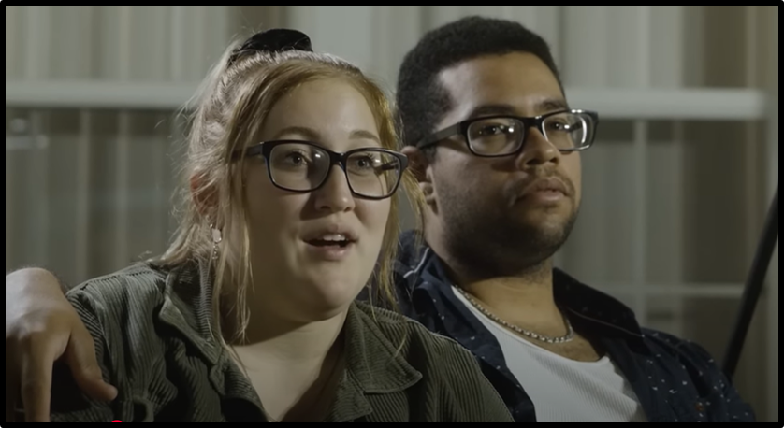
The Success Sequence: Their Story
Copyright Marline E. Pearson, M.A. All rights reserved.
Notes:
❖ We’re going to watch a short video that will introduce these steps with a real-life example. Let’s see if our instincts were correct.
Click on the image to play the video. (https://www.youtube.com/watch?v=vi8qmY3-oOA)
Instructor Note: This video is part of a series produced by the Institute for Family Studies featuring the stories of real young adults who are seeking to follow the Success Sequence or working on getting back on track. In this video, Kaylie and Carlos share their struggles as young parents and how they wished they had done things differently. Their experience is contrasted with another young couple who has decided to wait until marriage to have children.
Video Debrief:
❖ Before we get into these steps to success, I want to point out a few things. The video mentioned that those who are unmarried at time of birth but go on to marry are half as likely to break up as couples who just continue to live together. While that is true, the take home message here is not to just run out and get married if you have an unintended pregnancy.
❖ This is a time to assess the relationship. Is it safe? Is it healthy? It may not be, which can have major consequences for both parents and kids. But if it is healthy, marriage is a very smart decision. And so is a commitment to work together to strengthen that relationship. There are young parents who do just that, as we saw with Kaylie and Carlos. Yes, they have challenges, but they are committed, and their child will benefit.
❖ We’ll talk more about the benefits of healthy marriages for parents and kids next class. But for now, let’s focus in on these steps to success. Were your guesses right? What were the steps that were mentioned?
❖ Let’s break these down one by one and talk about why they matter so much—especially when it comes to your future ability to build a healthy marriage and support yourself and a family, if that’s part of your goals.

Slide 16






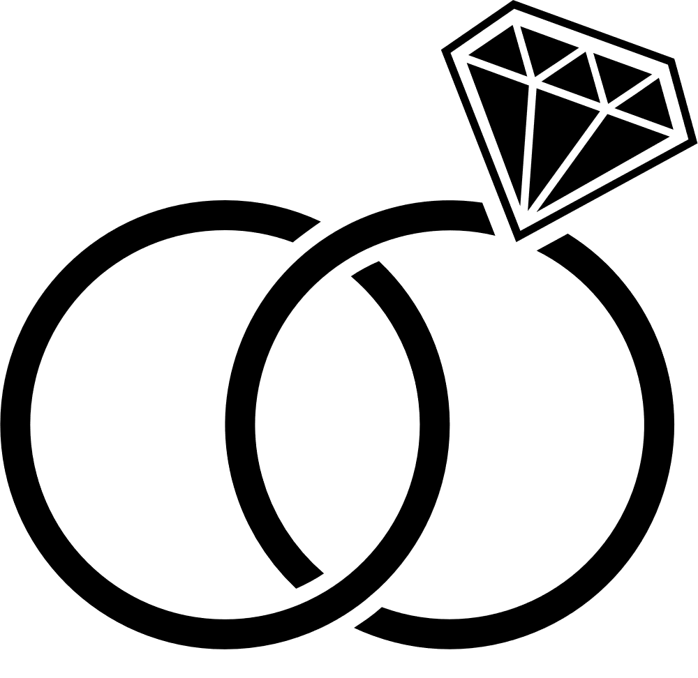






Milestones
A certain number, combination, and sequence can matter
Copyright Marline E. Pearson, M.A. All rights reserved.
Notes:
❖ These milestones are:
- Completing high school (or even further education or training)
- Beginning full-time employment
- Getting married before having children
❖ As you will learn in more depth in your Financial Literacy course, almost all young people who follow this Success Sequence avoid being poor and are more likely to land in the middle to upper-income groups by the time they are in their 30s, whether born rich or poor.

Slide 17

Key Essentials for Increasing Your Odds
of Higher Income
Education/Training
Full-time Employment
Copyright Marline E. Pearson, M.A. All rights reserved.
Notes:
❖ Finishing high school (or even more education or training) and full-time employment by age 25 (or enrolled in further training/education) are key actions for having better financial outcomes by your early 30s.

Slide 18
Adding to Income
Copyright Marline E. Pearson, M.A. All rights reserved.
Notes:
❖ A healthy marriage can also add to income level. Marriage can mean the combining of two potential incomes, and those combined earnings can build over the years.
❖ Adults who achieve these three steps – education, employment, and marriage – almost always achieve a middle-class lifestyle and avoid being poor by their early 30s.

Slide 19

When Children are Part of Your Vision
Marriage before baby
Advantage of Combination and Sequence
Copyright Marline E. Pearson, M.A. All rights reserved.
Notes:
❖ Finally, waiting to have children until after you are married has been linked to some major financial and emotional benefits for both parents and children. We will talk about this more in-depth next class period, but for now, I just want to emphasize the fact that, when it comes to successful futures, marriage before kids matters.

Slide 20

What were your key takeaways from today?
Copyright Marline E. Pearson, M.A. All rights reserved.
Notes:
❖ We’re almost out of time for today, but before we go, I want to ask:
- What were your key takeaways from this class period? Out of everything that we discussed, what were the things that stood out to you the most? (Have 3-5 students share their key takeaways.)
❖ Thank you for sharing the things that stood out to you.
❖ Next time, we’ll take a closer look at the family and relationship piece—how your relationship choices now can shape your future marriage, parenting, and stability, especially if you hope to have kids someday.

Slide 21
Family, Marriage &
Moving Forward
Copyright Marline E. Pearson, M.A. All rights reserved.
Notes:
This section further explores how following the Success Sequence (particularly achieving the marriage milestone before having children) impacts children and marriage and family relationships.
❖ Welcome! Last class we discussed some important principles that can help you prepare for a successful future. What do you remember from our discussion? (Pause for 3-5 responses.)
❖ Thanks you so much for sharing what you remember from our last class period.

Slide 22
The Success Sequence
Copyright Marline E. Pearson, M.A. All rights reserved.
Notes:
❖ Now that we know the main steps of the Success Sequence—graduating from high school (or even further education or training), getting a full-time job, and getting married before choosing to have children—we are going to dive a little deeper into why these steps make such a difference. Particularly, what a healthy marriage can do for your future and the future of your children (if that’s part of your goals).
❖ Let’s start off with an activity. We’re going to do some brainstorming together to create a wish list for a child who is about to be born. Let’s pretend that you are a child looking for a family, and you need to write an ad that includes a list of needs and wants you hope your future parents will provide.
❖ Let’s not only think about what this child will need when they are first born—let’s see if we can include things that would be helpful for growth and development throughout their life.
❖ Our list can include material things—the basics like food, shelter, etc., but also include social, emotional, and physical needs of children at these different stages that will help a child grow up healthy, safe, and happy.

Slide 23

Child Wants & Needs at Different Stages of Life—Infant, Toddler, School-age, Teenager ​
Basics/material needs ​
What contributes to child’s physical health? ​
To a child’s social & emotional health?​
What helps develop a child’s self-esteem? Feel confident?​
What helps a child succeed in school?​
As a teenager what helps them stay out of trouble and on track? Build abilities?​
Parenting skills; discipline style? ​
Education/finances/parents’ relationship​
Anything else you can think of! ​
Copyright Marline E. Pearson, M.A. All rights reserved.
Notes:
❖ Here are some prompts to get your creative juices flowing (read prompts displayed in PowerPoint out loud):
- What contributes to a child’s physical health?
- To their social development and emotional health?
- What helps develop a child’s self-esteem—feeling good about themselves?
- What helps a child feel confident? What helps them succeed in school?
- As a teenager, what helps them stay on track? And stay out of trouble?
Instructor Note: Spend no more than 5 minutes on brainstorming list.
❖ Great work. I think we’ve come up with a pretty solid list, here.
❖ Now, let me ask you: Using what you’ve learned so far about sliding and deciding, healthy relationship pacing, and the Success Sequence, what do you think are some things that would help a parent to provide these items on our list? (Pause for responses.)
Instructor Note: Possible answers to this question could include emotional maturity, completing education or vocational training, healthy communication and conflict management skills, a full-time job, a committed relationship between parents, etc.

Slide 24
When Children are Part of Your Vision
Marriage before baby
Advantage of Combination and Sequence
Copyright Marline E. Pearson, M.A. All rights reserved.
Notes:
❖ Now, how do you think being in a healthy marriage might help? (Pause for responses.)
❖ In research, the marriage milestone has been consistently linked with family stability. What does this look like?
Instructor Note: Family stability is measured as 1) the presence of 2 adults in the home, 2) the number of residential partner transitions (i.e., none or few break-ups or divorces), and 3) relationship satisfaction as measured by reported happiness in their relationship.

Slide 25


Emotional and Social Benefits ​
of a Healthy Relationship​
The time and energy of two to provide nurture and care​
Two to play, read to the child, discipline, help with schoolwork ​
Less stress than if alone ​
Feeling loved and supported by partner contributes to emotional health​
Married couples are more likely to receive support from both extended families ​
Copyright Marline E. Pearson, M.A. All rights reserved.
Notes:
❖ Having a stable environment lead by two adults who are committed to each other and who are satisfied with their relationship offers a lot of social and emotional benefits for children. (Note: Only advance the first bullet.)
❖ First off, it provides children with the time and energy of two parents. What on our wish list would relate to this? (Pause to listen, and then advance the 2nd bullet.)
❖ Raising a child involves a lot—care, feeding, play, reading, stimulation and encouragement, limit-setting/discipline, homework, extra activities, along with providing, work, cooking, cleaning, etc. When both parents are invested in each other and in their kids, it makes the work of parenting a lot more manageable.
❖ Advance 3rd & 4th bullets: The support of a loving and caring partner who is committed can reduce a parents’ stress, which creates ripple effects that help the entire family. Parents who are less stressed are usually more likely to practice healthy and positive parenting. Also, support from both extended families can help lower stress levels.
❖ These are only some of the powerful benefits of getting married before having kids and would likely improve your chances of providing your children with the life you envision for them.
❖ Not to mention the financial benefits of having two adults who can help provide for the family’s material needs.

Slide 26


Children are affected by parents’ relationships
Copyright Marline E. Pearson, M.A. All rights reserved.
Notes:
❖ Now, I do want to stress that, yes—absolutely—single parents raise healthy and happy children. Many parents on their own are working very hard to provide for and raise their children well.
❖ And research has shown that having a stable, single parent, like the mom you see in this picture, is far better for a child than a destructive or abusive relationship or going in and out of relationships.
❖ Destructive and dangerous relationships and marriages harm children. It’s also hard on a child for parents to go from one relationship to another—that kind of instability can negatively impact a child’s development.
❖ At the end of the day, the take-home message here is NOT to stay in a destructive or abusive relationship—or to run out and get married if a person is pregnant. In just a bit, we’ll discuss what young parents can do to get back on track if they aren’t currently following the success sequence. But I’ll give you a clue: the answer is not to slide into a marriage.
❖ Instead, deciding if and when you are ready to have a child, and with whom, and what you want to have achieved before then really matters. Finishing high school, getting additional training or education, obtaining employment and establishing a healthy marriage, is a pathway to increase your odds of greater financial success, family stability, and the wellbeing of a child.

Slide 27

Does when you marry matter?
Copyright Marline E. Pearson, M.A. All rights reserved.
Notes:
Instructor Note: Be sure to present this information in a respectful way that simply relates the research and avoids moralizing students’ choices for when to marry and start a family.
❖ It’s important to note that in some communities—including here in Utah—young adults often marry and start families earlier than national averages. That isn’t a bad thing. In fact, marriage can offer emotional support and stability that help people through challenges.
❖ And although a lot of people these days think that it’s best to wait until your late 20s or 30s to marry and settle down, recent research finds that couples who marry in their early-to-mid 20s have just as healthy and satisfying relationships, on average, as those who marry later. (Marrying in your teens, however, still comes with a higher risk of a divorce.)
❖ At the same time, research shows that finishing education and getting established in the workforce first can give you a stronger foundation. It doesn’t mean you have to delay family life forever—just that planning and preparation help ensure your family goals and financial goals can work together, not compete.
❖ So, if you do want to marry and have children early, it’s even more important to think about how you’ll complete your education, build career momentum, and plan for childcare and expenses. Deciding—rather than sliding—into these milestones gives you more flexibility, more financial security, and more peace of mind.
❖ If someone wants to get married and start a family in their early 20s, what are some things they could plan or prepare now to make that path work well? (Pause for responses.)

Slide 28
When Children are Part of Your Vision
Marriage before baby
Advantage of Combination and Sequence
Copyright Marline E. Pearson, M.A. All rights reserved.
Notes:
❖ Now, why do we include marriage as a milestone for those who desire children and financial stability, and not, let’s say, just living together? A few points:
- First, research finds the majority of couples who cohabit pretty much “slide” into it rather than making a well-thought-out, intentional decision about it and what it means for the future.
- Also, the research shows these good financial outcomes for marriage but not for cohabitation. One reason for this may be that cohabiting couples are more likely to break up than married couples, causing them to lose the benefit of combined incomes.
- Third, we know from research that cohabiting relationships are much more unstable—there are more break-ups and re-partnering. As more young adults enter into and end cohabiting relationships, a pattern of multiple or serial cohabitations has increased.
-- Perhaps an upside to this is that young people may be learning to end cohabiting relationships that aren’t working.
-- But the downside is that if the cohabiting relationship includes children (as 54% do), and the relationship ends and is followed by another relationship (and possibly another), all those changes in people and homes—all that instability—can be rough on a child.
❖ When you are trying to provide your family with emotional (and financial) stability, a healthy marriage is going to be the best option in most cases.

Slide 29

What do I do if I get off track?
Copyright Marline E. Pearson, M.A. All rights reserved.
Notes:
This section provides insights into what students can do to get back on track when they have failed to follow the Success Sequence. It also includes thoughts on preventing unintended pregnancy and explains important steps that young parents can follow to get their life back in order.
❖ So, what happens if we stumble on our pathway to success? We are bound to make mistakes and slide into some decisions that have unwanted consequences. Maybe we aren’t on track to graduate. Maybe we get stuck in an unhealthy relationship. Maybe we get started on a career path that turns out to be a dead end.
❖ Unfortunately, we can’t turn back the clock like we imagined in our "High Cost Slides” activity from a few periods ago. Is there hope for when we slip up?
❖ In these situations, it’s important to: (Click to show points 1&2 on the slide)

Slide 30
What do I do if I get off track?
Focus on what’s in your control.​
Seek support.
Copyright Marline E. Pearson, M.A. All rights reserved.
Notes:
- Focus on what is in our control, and
- Seek support.
❖ It’s okay to struggle! The important thing is that we do what’s in our power to get back on track.
❖ Let’s discuss a couple of scenarios and look how we might apply these two principles.
❖ Imagine you’re in your senior year, you’re coming up on your third semester, and you aren’t on track to graduate because you failed one of your core classes. What’s in your control in this situation? What can you do about it? (Pause for responses.)
❖ What kinds of obstacles might make it difficult to fix this problem on your own? (Pause for responses.)
❖ What about our second point? What resources are available to you where you can seek support to help you get back on track? (Pause for responses.)
❖ Great, thanks for sharing your ideas. Now, let’s apply these principles to a relationship situation. Imagine you have a romantic partner that you’ve been dating for several months. At first, they were super sweet, they sent you lots of thoughtful texts, they walked you to class, they even bought you your favorite snacks. But recently, you’ve noticed that this person has some habits that are obvious red flags. They get annoyed when you spend time with your friends, they want to know where you are all the time, and they alternate between blowing up at you and giving you the silent treatment when they’re upset.
❖ What’s in your control in this situation? What could you do to change the circumstances? (Pause for responses.)
❖ What obstacles might you be facing here? What might make it hard to change your current path? (Pause for responses.)
❖ Now, what kinds of resources might you lean on for support in this situation? Who or what could help you get back on track? (Pause for responses.)

Slide 31

Handling Roadblocks
Copyright Marline E. Pearson, M.A. All rights reserved.
Notes:
❖ We’ve acknowledged in these examples that there are likely going to be obstacles in your way as you are trying to follow the Success Sequence. Completing high school, acquiring further education or training, and obtaining stable employment can all be challenging, for sure.
❖ Being determined—no matter what—to do so, and getting the support you need along the way, will increase the odds of your success.
❖ And there is one thing you can all do that is key for this path to success. And, that is to avoid a pregnancy—that’s something that is very likely going to be within your control.
Instructor Note: It would be appropriate to mention that pregnancy is not always in a person’s control, such as in cases of abuse or trafficking.
❖ This is true whether or not children are part of your vision:
- Not part of your vision: If you aren’t planning to have kids in the future, avoiding an unintended pregnancy while you work towards achieving your education/training and secure full-time employment will mean fewer barriers on your pathway to your future goals.
- Part of your vision: And for those of you who do want kids, avoiding a pregnancy until your life is more settled with your education/training, employment, and a committed partner—a spouse—will also mean fewer challenges as you travel on the path towards your future goals.

Slide 32

Avoiding a pregnancy is possible
Decide not to have sex now – enjoy the benefits!​
​
Avoid risky situations; pace your physical involvements more slowly. Decide, don’t slide in your relationships.​
​
It’s good to understand the effectiveness rates, risks, and limitations of different contraceptive devices, and learn how to get them.​
You can do this!
Copyright Marline E. Pearson, M.A. All rights reserved.
Notes:
❖ A person can avoid a pregnancy several ways. You've got this!
- Decide not to have sex now—enjoy the physical, mental, emotional, and social benefits of leaving sex out of your teen relationships.
- Avoid risky situations; pace your physical involvements more slowly. Make clear decisions, don’t slide.
- It’s good to understand the effectiveness rates, risks, and limitations of different contraceptive devices, and learn how to get them.
❖ However you choose to avoid an unintended pregnancy, it takes motivation—knowing why it really matters—to follow through. And the things we’ve discussed today have hopefully helped you see why avoiding an unintended or a poorly timed pregnancy can make a real difference.
❖ Now, we understand that sometimes, despite a person’s best intentions, including the possibility of birth control failure, a pregnancy can occur. At some point, you may find yourself becoming a parent before you intended.

Slide 33
Success for Young Parents Combinations and Sequences
1. Focus on being the best parent you can be.
2. Finish high school and get as much college or training as you can.
3. Obtain employment.
4. Decide, don’t slide with your love life. Have a committed partner—a spouse—BEFORE having a second child.
Copyright Marline E. Pearson, M.A. All rights reserved.
Notes:
❖ For young parents, research shows that there are milestones and a sequence that can increase the odds of having the life you want:
❖ 1. Focus on being the best parent you can be. There are resources here in Utah to help you build up your parenting knowledge and skills. Healthy Relationships Utah (https://extension.usu.edu/hru/) offers free parenting and relationship classes all over the state, and the Utah Marriage Commission (https://extension.usu.edu/strongermarriage/) has lots of free online classes and resources for parents. You can also reach out to a family resource center or the public health department in your area for programs for health, nutrition, and financial assistance for young parents.
❖ 2. Finish high school and get as much college or training as you can to help you obtain better employment. Seek support from a caring teacher or school counselor who may be able to help you stay on track or get back on track for graduation or obtain a high school equivalency. See a career counselor at your local community college to learn more about vocational, technical, apprenticeship.
❖ 3. And most importantly: Decide, don’t slide with your love life. Make wise relationship choices. Avoid sliding into an unstable or unhealthy relationship or a second pregnancy.
Instructor Note: Be familiar with the resources and supports in your community for young parents.

Slide 34
Key Takeaways
What were your key takeaways?
Copyright Marline E. Pearson, M.A. All rights reserved.
Notes:
This final part of the lesson reinforces the importance of planning and intentional decision-making which is crucial to developing agency—and ultimately to following a pathway towards success.
❖ We’ve discussed a lot over the last few class periods to help you know how to set yourself up for relationship and financial success in the future. So, what are our key takeaways? What stood out to you? (Pause for responses. When students are through sharing, click to advance the slide to reveal the key takeaways.)

Slide 35
Key Takeaways
1. Following the Success Sequence significantly increases your chances of not being poor and of having a more stable and happy family life by your mid-30s.
2. If you want to have kids, marriage matters.
3. It’s never too late to get back on track.
Copyright Marline E. Pearson, M.A. All rights reserved.
Notes:
❖ 1. Research shows that making three major life decisions in a specific order significantly increases your chances of not being poor and of having a more stable and happy family life by your mid-30s. These results are true regardless of your race and financial or family background. This is referred to as the “Success Sequence,” and it includes:
a. Completing high school (and even further education or training);
b. Gaining full-time employment; and
c. Getting married before having children.
❖ 2. If you want to have kids, marriage matters. It usually provides a more emotionally and financially stable family situation for children.
❖ 3. If you get off track, don’t give up on yourself. It’s never too late to make changes and get your life back in line with your vision.
❖ Planning now—deciding instead of sliding—can help you build the foundation for your future, step by step.

Slide 36

My Success Plans
Copyright Marline E. Pearson, M.A. All rights reserved.
Notes:
❖ Now that we’ve seen what the research says and discussed some of the key life decisions that can affect your future, it’s time to turn the spotlight back on you.
Pass out attached worksheet, My Success Plans. Give students 10-15 minutes to complete the worksheet.
Directions:
❖ This worksheet is made up of questions to help you think through and apply the principles you’ve learned in our last few classes to your own goals for the future. Think carefully about your answers and fill out as much as you can for the remainder of the class period.
❖ It’s okay if you’re not sure about some of these answers yet. Just do your best to be honest and thoughtful. If you have any questions, I’m happy to help.
Activity Debrief
After they are done, ask:
1. How do you think having a plan—about school, money, or relationships and family—could help you avoid sliding?
2. What’s one choice you want to be more intentional about—whether in school, friendships, or relationships—after what we’ve talked about today?

Slide 37
Homework
Share your success plans with a parent or trusted adult. Talk with them about what you learned today, and discuss this question:
“What advice would you give your 16-year-old self about relationships and life choices?”​
Copyright Marline E. Pearson, M.A. All rights reserved.
Notes:
Instructor Note: Discussing goals and plans with a trusted adult can help students feel more accountable and can also provide opportunities for important connection and relationship-building at home. You can assign this task for points or simply invite the students to share what they learned in class.
❖ Your homework for today is to go and share your success plan with a trusted adult. Talk with them about what you learned today, and discuss this question:
❖ “What advice would you give your 16-year-old self about relationships and life choices?”

Slide 38
This PowerPoint Presentation was adapted by the Utah Marriage Commission from “Love Notes: Relationship Skills for Love, Life, and Work”. Used with permission of the author, Marline E. Pearson, M.A.
Presentation created in Canva.
Photos and clipart used with permission from Canva and AdobeStock. All Rights Reserved.
Copyright Marline E. Pearson, M.A.
Copyright Marline E. Pearson, M.A. All rights reserved.

