Slide 1
Fighting “science” with science

Slide 2
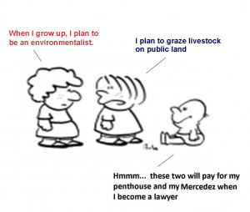
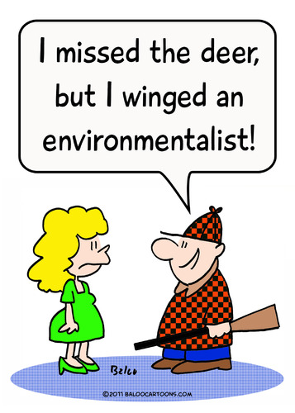
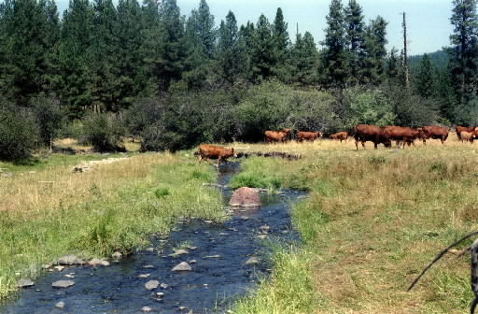
Limited Resources
Tired of Waste

Slide 3
Ambiguous Terms
. . . traditional domestic livestock grazing
Livestock grazing as commonly practiced
. . . traditional range management
Grazing capacity
. . . for a significant period
. . . other range management facilities
Grazing, in addition to other factors
The removal of native species from interspaces by cattle, in conjunction with other factors,
roads

Slide 4
Dubious Reviews: Fleischner (1994)
Cutain (2002): “is generally not considered a comprehensive review.”
Jones (2000): “almost exclusively cited studies on harmful effects of grazing and sought to make a case against grazing.”
Brown & McDonald (1995)
References biased against livestock grazing (10 poor design)
Studies little or no impact of livestock grazing not cited.
Native grazing mammals same effect as livestock (9 studies)
Changes due to grazing not necessarily unnatural or detrimental.
Historical landscapes changes blamed on humans no proof
Brussard et al. (1994): Refutes the idea of scientists supporting environmental activists

Slide 5
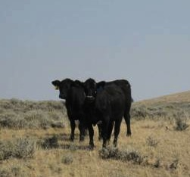
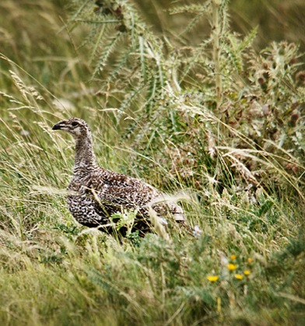
Dubious Reviews: Beck and Mitchell (2000)
Positive
Grazing improved use and increased forbs
Rest-rotation grazing improved forb recovery
New leks on sheep salting grounds.
Reducing dense sage improves understory.
Negative
Destroys sagebrush needed in heavy snows.
Trampling destroyed eggs.
Sheep and cattle caused nest desertions.
Overgrazing deteriorates meadows
Conversion of sagebrush to grass.
Quit nesting in areas treated with herbicides.
Winter sagebrush cover converted to grass.
Grazing promotes alien weeds.

Slide 6
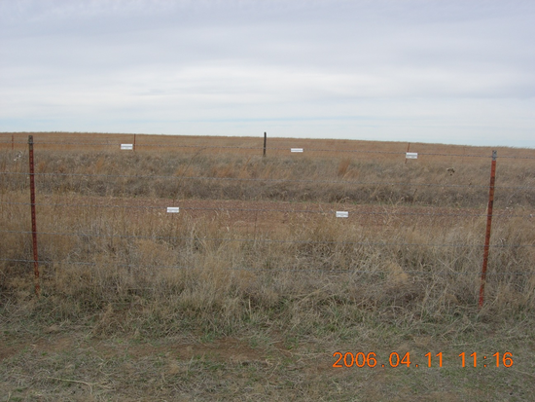
References Don’t Match Text
“Indirect influence on sage grouse includes the construction and operation of fences, water pipelines, roads, troughs, and other range management facilities.”
(Stevens 2011; Danvir 2002; Fink and Watkins 2010; Wolf et al. 2000; Defenders of Wildlife 2009; Groen 2010; Christiansen 2009).
All references above about fences and some on marking fences to reduce sagegrouse collisions

Slide 7
References Don’t Match Text
“Livestock may directly compete with sage-grouse for grasses, forbs and shrub species; trample vegetation and sage-grouse nests; disturb individual birds and cause nest abandonment “
Vallentine 1990: Book – not original research
Pederson et al. 2003: a modeling paper, no data
Holloran and Anderson 2005: distribution of nests and no livestock grazing.
Coates 2007: no livestock grazing, nest depredation (badger and raven).
Connelly and Braun (1997) “There is little scientific data linking grazing practices to sage-grouse population levels.”

Slide 8
Citing the Wrong Author
“Livestock grazing as commonly practiced in the West disturbs the soil, removes native vegetation and spreads invasive species in sagebrush steppe (Knick et al. 2005).”
From Knick et al. (2005): “Livestock grazing can increase the frequency of fires by disturbing soils and reducing competition from native grasses to facilitate spread of the highly flammable cheatgrass (Shaw et al. 1999).”
Attributing a statement to a reference that cited another reference is not an accepted practice.

Slide 9
Omitting Info to Fit Agenda
“Jones (2000) found that 11 of 16 analyses of the effects of livestock grazing in arid ecosystems revealed significant negative effects on a range of ecological components from livestock grazing”
From Jones: “Nearly 54 studies analyzed were found to be quasi-experiments …. Because of this, I do not infer causation between results presented in this review and western rangelands in general.”

Slide 10
Omitting Info to Fit Agenda
"if livestock grazing is permitted on public rangelands, it is to not exceed 25-30% utilization of herbaceous forage each year.”
“Holechek et al. (1999) … recommended no more than 30-35% use of annual herbaceous production.”
“Cattle grazed at “conservative” levels in sagebrush steppe in the northern Great Basin initially selected bunchgrasses in interspaces between sagebrush plants (France et al. 2008).”
“Our data suggest that conservative forage use, approaching 40% by weight, will affect a majority (about 70%) of interspace tussocks and a lesser proportion (about 15%) of potential nest-screening tussocks beneath sagebrush. “

Slide 11
Wrong
“condition of greater sage-grouse nesting habitat is likely affected negatively by livestock grazing, among other influences.” Moynahan et al. (2007) Except they didn’t look at grazing.
“The removal of cheatgrass by grazing may also increase cheatgrass seed production the following year (Chambers et al. 2007).”Except the study didn’t examine removal cheatgrass and grazing cheatgrass usually decreases seed production.
Holloran et al. (2005: 648) “annual grazing in nesting habitat, regardless of the timing, could negatively impact the following year’s nesting success.” I couldn’t find the reference Holloran et al. (2005). However, this quote appears in Connelly et al. 2007.

Slide 12
Opinion as Science
“Some scientists have recommended that 20% of public lands be closed to livestock grazing for mitigation and restoration.”
This paper is an opinion piece and not a research paper even though it’s in a peer-reviewed journal.
Some scientist in this case means three.
No peer-reviewed work to back-up this statement.
Bock et al. (1993) Conservation Biology 7:731-733. Depart Environmental, Population, and Organismic Biology University of Colorado; Boulder, CO

Slide 13
Half-truth?
“Anderson and Inouye (2001) working in sagebrush steppe in southern Idaho determined that native perennial grasses were recovering after 45 years of livestock exclusion and the increasing trend of these native grasses was inversely correlated to non-native invasive species such as cheatgrass.”
Recovery from sever drought & removal of grazing
In 1950, Cheatgrass not found on core plots.
In 1975, Cheatgrass recorded on 17 core plots.
In 1995, it was recorded on 26 of 47 core plots
In 1995, it accounted for 6% of plant cover
In 1995, there was a strong negative relationship cover of cheatgrass between native species .

Slide 14
Exclosure Study 65 Years
Composition, cover, density, production similar
14% of measurements were different.
Different (2 cases) cheatgrass density was greater inside than outside exclosures.
Protection from grazing didn’t prevent cheatgrass invasion.

Slide 15
Exclosure Study 67 Years
Grazing excluded in 1936
Before burning the presence of cheatgrass was minimal (<0.5% cover)
Vegetation similar between grazed and ungrazed.
Litter twice in ungrazed vs. grazed areas
Burning grazed – no increase cheatgrass nor decrease perennial bunchgrasses
Burning ungrazed - reduced perennial bunchgrasses and increased cheatgrass

Slide 16
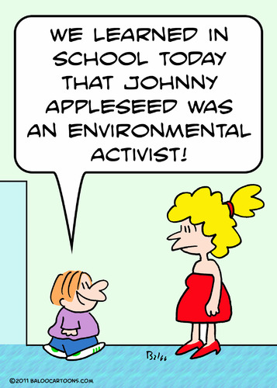
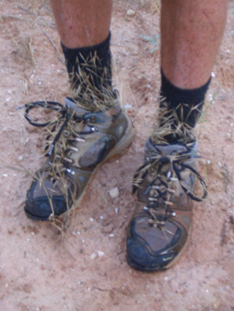
Cheatgrass – Blame Livestock
“Cheatgrass incursion in sagebrush steppe began in the 1850s with the introduction of domestic livestock,”
Mack (1981) - Cheatgrass introduced in 1889:
wheat plantings
alfalfa fields
straw to pack dry goods
cattle bedding
the dung of transported cattle.
Planted Pullman, WA in 1897 for overgrazed range.
Planted in 1915 as 100-day grass.
Over-grazing and abandoned grain fields led to the breakdown of soil crusts and invasion of annual grasses.
Johnny Appleseed planted non-natives
Chamber et al. (2007) used herbicide to remove perennials

Slide 17
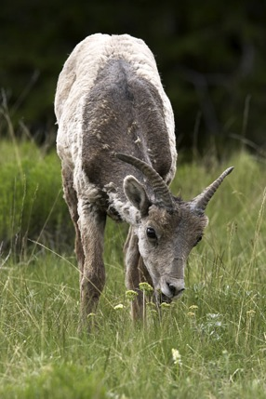
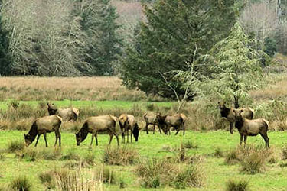
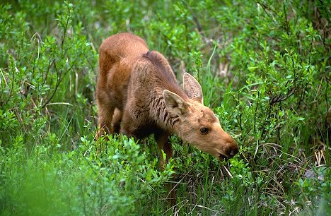
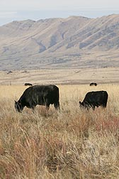
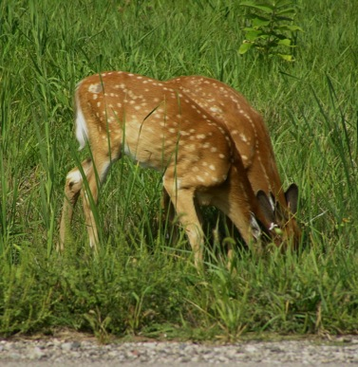
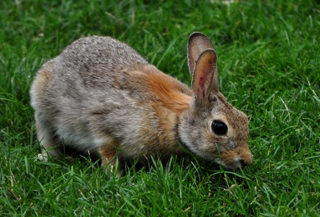
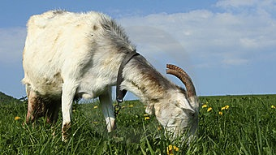
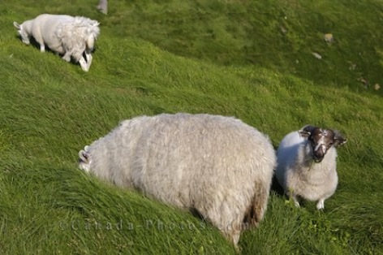
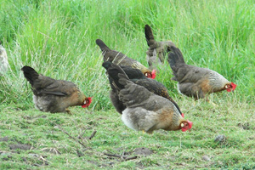
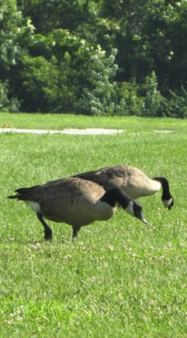
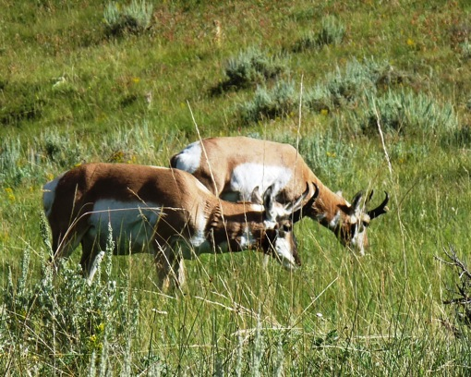
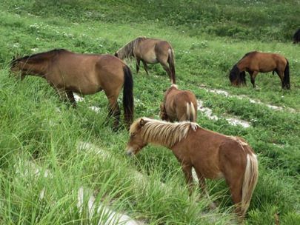
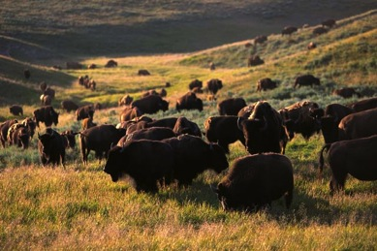
Grazing is Natural
Notes:
Grazing is natrual

Slide 18
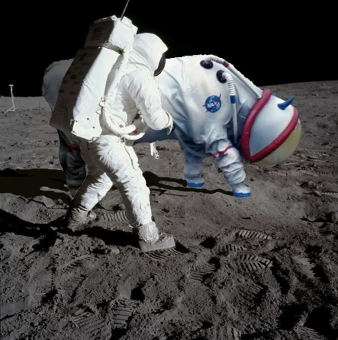
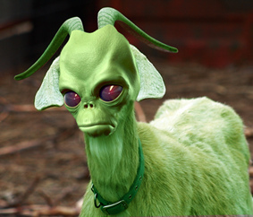
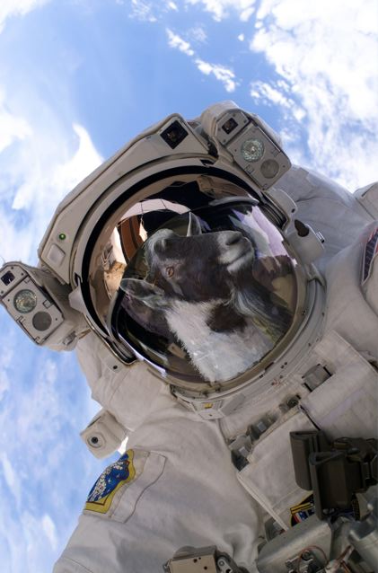
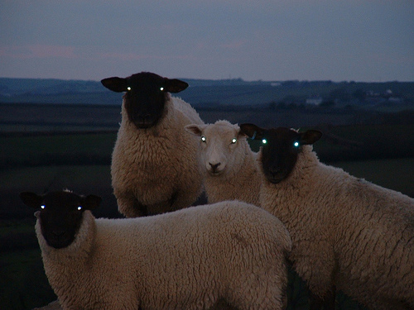
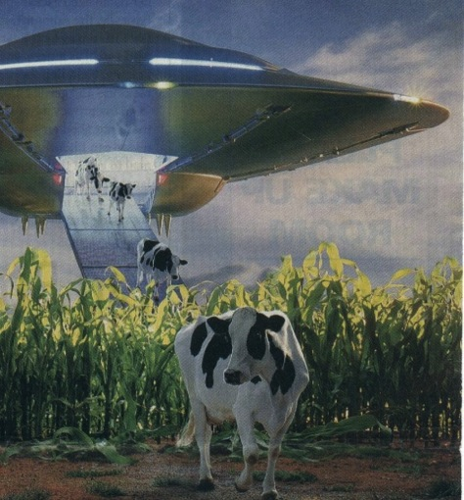
Notes:
We are not introducing alien species

Slide 19
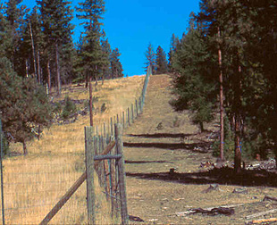
Wildlife Can Overgraze

Slide 20
Grazing vs No Grazing

Slide 21
Grazing can be Good
Deer and Cattle
No Grazing
Browsing Deer
Deer and Cattle

Slide 22
Tired of Waste
Limited Resources

Slide 23
website: extension.usu.edu/rangelands/
email: beth.burritt@usu.edu
Notes:
I’d like to see cooperation and solve problems instead of adversity, wasting time and winners and losers.

