Slide 1
IPM
An
Effective, Common Sense,
Low-Cost Approach
To
Pest Management
RYAN DAVIS

Slide 2
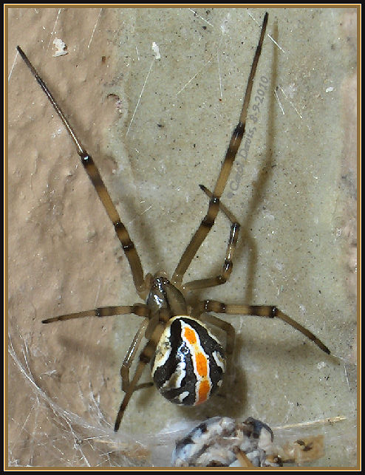
Outline
IPM Basics
School Rule
Why IPM
Next Steps

Slide 3
What is IPM?
prevention of pests or their damage through a combination of techniques, including education, improved sanitation, exclusion, habitat manipulation, modification of cultural practices/habits, biological control, etc.
Pesticides are used only after monitoring indicates they are needed and only as a last resort.
Pest control materials are selected and applied in a manner that minimizes risks to human health, beneficial and non-target organisms, and the environment.
Notes:
Compare “long-term prevention” approach to the current “reactionary” pest control approach taken by many schools.

Slide 4
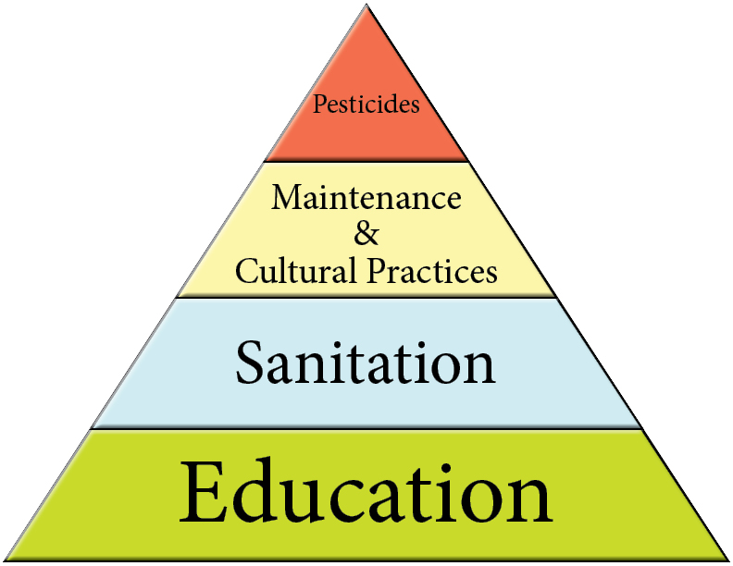
Basic Concept of School IPM:
Minimize pesticide use by managing pests using pro-active, non-chemical strategies first
Key IPM Principles
Notes:
There are many definitions of IPM. Below is one example:
Integrated pest management (IPM) is an ecosystem-based strategy that focuses on long-term prevention of pests or their damage through a combination of techniques such as biological control, habitat manipulation, modification of cultural practices, and use of resistant varieties. Pesticides are used only after monitoring indicates they are needed according to established guidelines, and treatments are made with the goal of removing only the target organism. Pest control materials are selected and applied in a manner that minimizes risks to human health, beneficial and nontarget organisms, and the environment.
Before we get into the core IPM Principals and Practices, we will discuss some of the underlying Key IPM Elements upon which a successful IPM program is built.

Slide 5
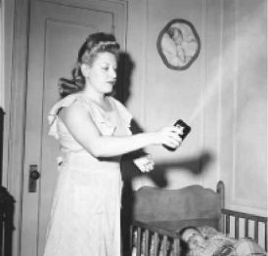
History of IPM
200,000 BC
1939 AD
1970’s
2015
1962
1990’s
IPM USED
DDT
Silent Spring
School IPM
IPM
Notes:
IPM is a long phrase that really encompasses using common sense to help prevent and manage pests.
You or your district likely already practice some basic IPM principles every day.
Can you give me a few daily practices at work that you think would help prevent or manage pests without pesticides?
(Have audience list some examples. Point out that IPM is already part of their daily tasks and IPM can be built into
Their daily activities by simply changing they way they do some activities.)

Slide 6
Current Model
Don’t really think about it
Hire a “guy” who “handles it”
Apply pesticides as a “preventive”
Use chemicals to kill pest when complaints are made
Notes:
There are many definitions of IPM. Below is one example:
Integrated pest management (IPM) is an ecosystem-based strategy that focuses on long-term prevention of pests or their damage through a combination of techniques such as biological control, habitat manipulation, modification of cultural practices, and use of resistant varieties. Pesticides are used only after monitoring indicates they are needed according to established guidelines, and treatments are made with the goal of removing only the target organism. Pest control materials are selected and applied in a manner that minimizes risks to human health, beneficial and nontarget organisms, and the environment.
Before we get into the core IPM Principals and Practices, we will discuss some of the underlying Key IPM Elements upon which a successful IPM program is built.

Slide 7
School IPM Model
Notes:
There are many definitions of IPM. Below is one example:
Integrated pest management (IPM) is an ecosystem-based strategy that focuses on long-term prevention of pests or their damage through a combination of techniques such as biological control, habitat manipulation, modification of cultural practices, and use of resistant varieties. Pesticides are used only after monitoring indicates they are needed according to established guidelines, and treatments are made with the goal of removing only the target organism. Pest control materials are selected and applied in a manner that minimizes risks to human health, beneficial and nontarget organisms, and the environment.
Before we get into the core IPM Principals and Practices, we will discuss some of the underlying Key IPM Elements upon which a successful IPM program is built.

Slide 8
Integrated Pest Management (IPM)
Common
Sense
Sound and prudent judgment based on a simple perception of the situation or facts.
Notes:
IPM is a long phrase that really encompasses using common sense to help prevent and manage pests.
You or your district likely already practice some basic IPM principles every day.
Can you give me a few daily practices at work that you think would help prevent or manage pests without pesticides?
(Have audience list some examples. Point out that IPM is already part of their daily tasks and IPM can be built into
Their daily activities by simply changing they way they do some activities.)

Slide 9
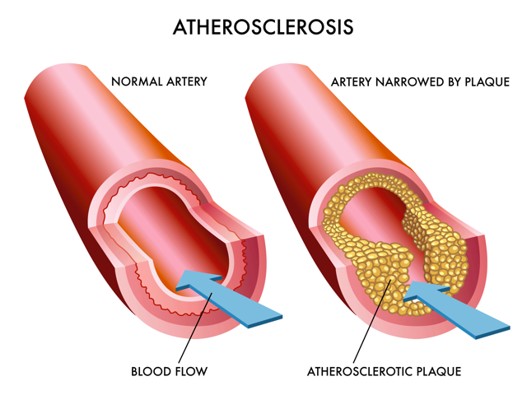
High Cholesterol
Notes:
IPM is a long phrase that really encompasses using common sense to help prevent and manage pests.
You or your district likely already practice some basic IPM principles every day.
Can you give me a few daily practices at work that you think would help prevent or manage pests without pesticides?
(Have audience list some examples. Point out that IPM is already part of their daily tasks and IPM can be built into
Their daily activities by simply changing they way they do some activities.)

Slide 10





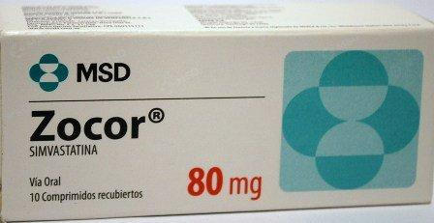
Common Sense?
Use Multiple Strategies!
Ryan Davis, Utah State University Extension
Notes:
IPM is a long phrase that really encompasses using common sense to help prevent and manage pests.
You or your district likely already practice some basic IPM principles every day.
Can you give me a few daily practices at work that you think would help prevent or manage pests without pesticides?
(Have audience list some examples. Point out that IPM is already part of their daily tasks and IPM can be built into
Their daily activities by simply changing they way they do some activities.)

Slide 11

Leaking Roof
Notes:
IPM is a long phrase that really encompasses using common sense to help prevent and manage pests.
You or your district likely already practice some basic IPM principles every day.
Can you give me a few daily practices at work that you think would help prevent or manage pests without pesticides?
(Have audience list some examples. Point out that IPM is already part of their daily tasks and IPM can be built into
Their daily activities by simply changing they way they do some activities.)

Slide 12
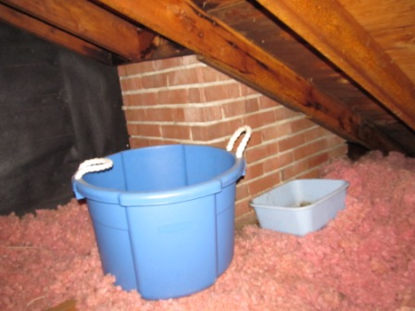

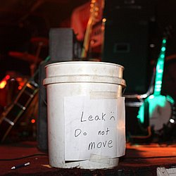

Common Sense?
Common Sense! Repair Leak
Ryan Davis, Utah State University Extension
Notes:
If we used our typical approach to pest control as a model, we would just place a bucket under the hole when it rained. Make sense? Why not?
No, we would go up on the room, diagnose the problem, and solve the problem!
We handle many problems correctly, but when it comes to pest control we often choose the “bucket” method: we simply treat the symptoms
Instead of solving the underlying issue.

Slide 13
Why Isn’t
Common Sense
Used When
Managing Pests?
Notes:
IPM is a long phrase that really encompasses using common sense to help prevent and manage pests.
You or your district likely already practice some basic IPM principles every day.
Can you give me a few daily practices at work that you think would help prevent or manage pests without pesticides?
(Have audience list some examples. Point out that IPM is already part of their daily tasks and IPM can be built into
Their daily activities by simply changing they way they do some activities.)

Slide 14
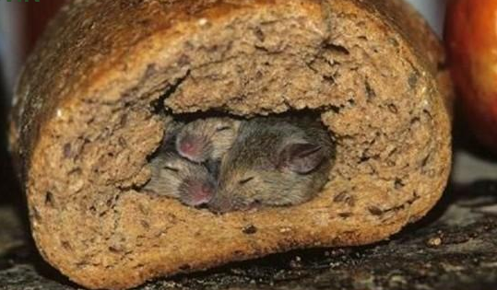
Mice
Notes:
IPM is a long phrase that really encompasses using common sense to help prevent and manage pests.
You or your district likely already practice some basic IPM principles every day.
Can you give me a few daily practices at work that you think would help prevent or manage pests without pesticides?
(Have audience list some examples. Point out that IPM is already part of their daily tasks and IPM can be built into
Their daily activities by simply changing they way they do some activities.)

Slide 15

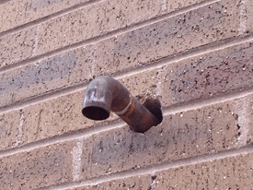

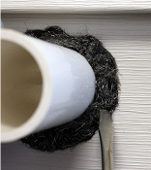

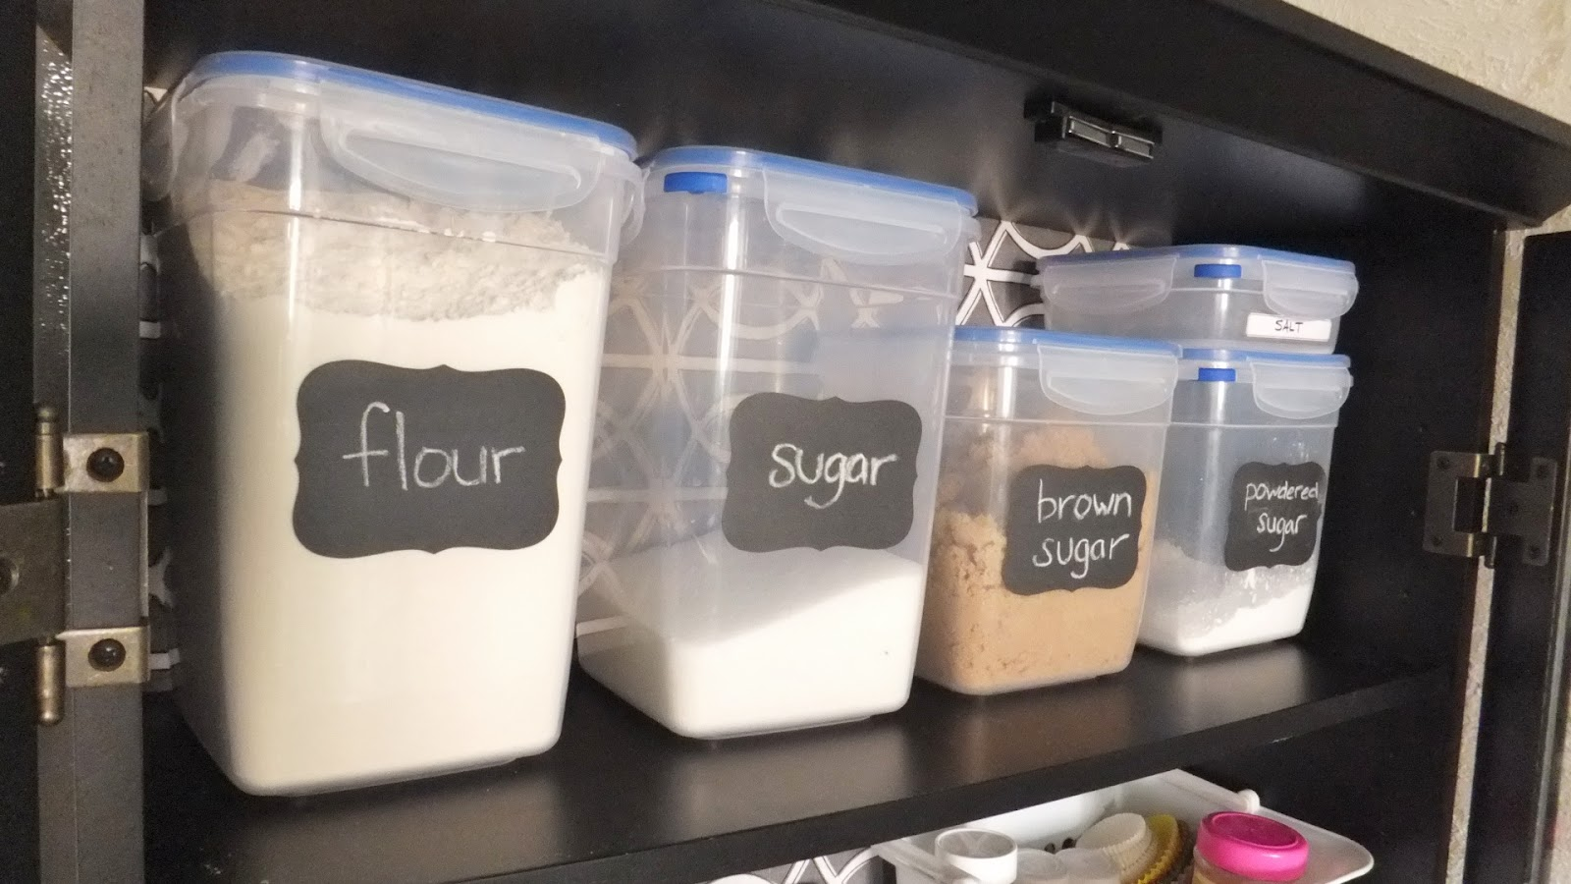
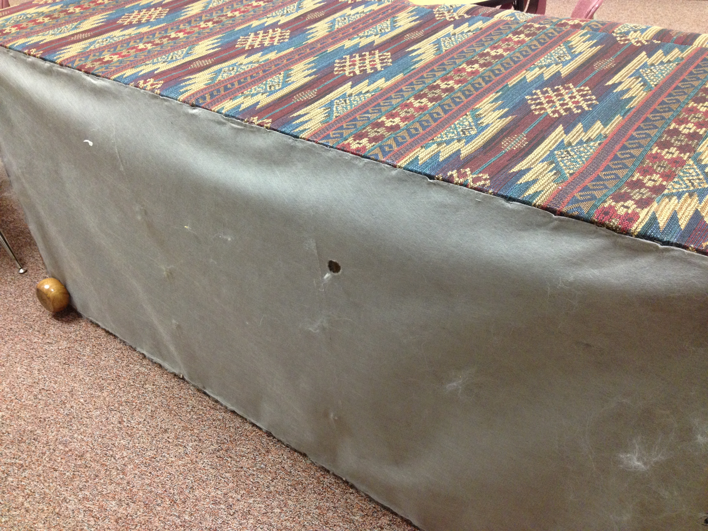
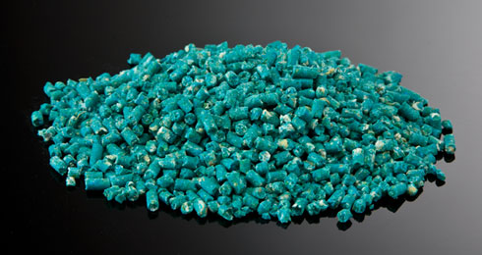
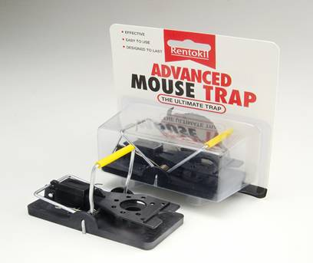
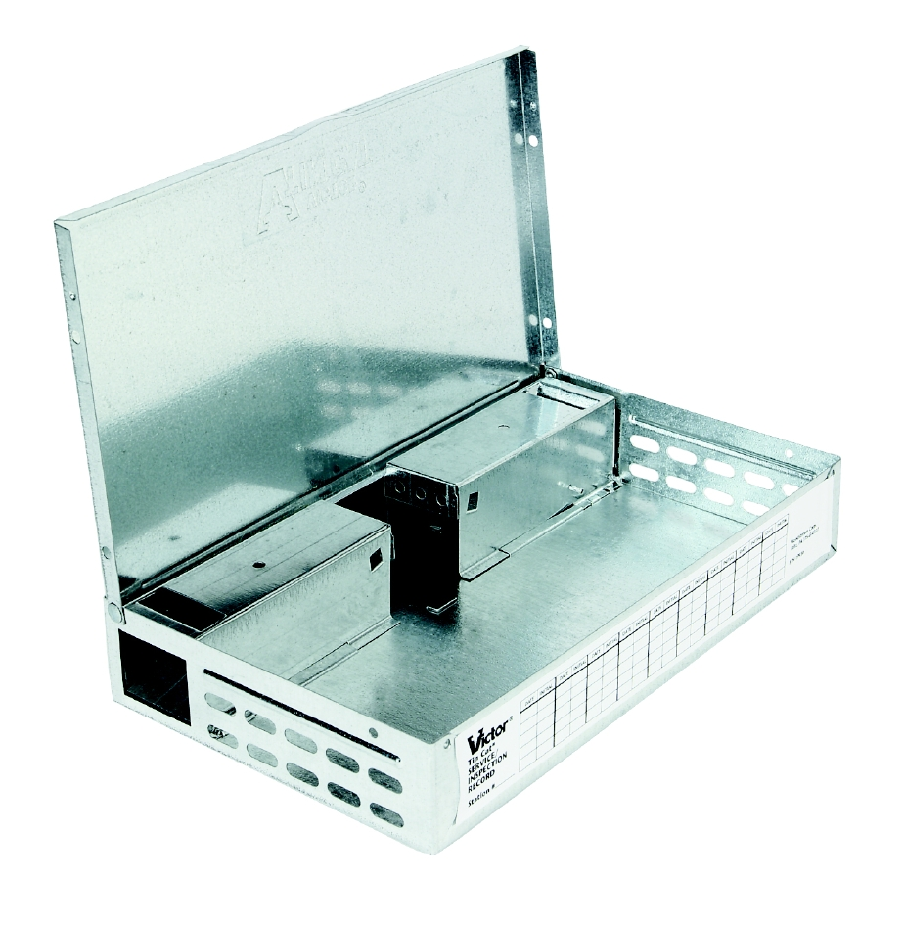

Common Sense?
Common Sense!
The Usual Solution!
Ryan Davis, Utah State University Extension
Notes:
How do we deal with mice?
The typical approach is to do nothing until there is a problem. We leave everything as is, we keep up with poor habits (improperly stored food, poor sanitation, door
Sweeps in ill repair, easy entry points into buildings for mice, eat food in places we should not eat food, etc.), and then we just attempt to poison or kill the mice
As they come in. Does this make sense at all? Why not keep them out in the first place?
The proper approach: Inspect building. Find all areas where mice could enter. Fix those areas (exclusion), find all possible food sources and make sure they are cleaned up (sanitation), or made inaccessible by properly storing food in pest-proof containers (cultural), remove potential nesting habitat (cultural/harborage removal), use mechanical traps, and lastly, if needed use tamper resistant baiting stations to: 1. Monitor for mice using non-toxic detex blocks, and/or 2. use rodenticide blocks properly applied in the bait box to aid the overall program.

Slide 16
70-90%
Notes:
IPM is a long phrase that really encompasses using common sense to help prevent and manage pests.
You or your district likely already practice some basic IPM principles every day.
Can you give me a few daily practices at work that you think would help prevent or manage pests without pesticides?
(Have audience list some examples. Point out that IPM is already part of their daily tasks and IPM can be built into
Their daily activities by simply changing they way they do some activities.)

Slide 17
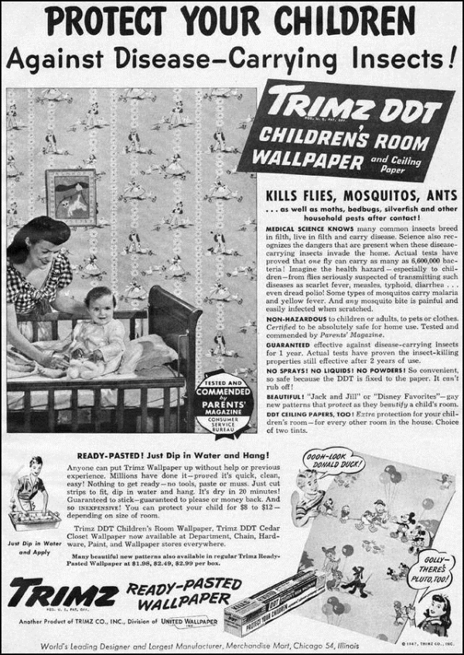
Why Use IPM?
It’s a Health Dept. Reg.
It’s the most effective way to manage pests
It is a cheaper way to manage pests
Improves the environmental health/air quality of the school
Keep kids safe
Notes:
R392. Health, Disease Control and Prevention, Environmental Services.
200. Design, Construction, Operation, Sanitation, and Safety of Schools.
7. Sanitary Facilities and Control
12. Pest Management (a-e)
The governing body shall minimize in school buildings or on school grounds the presence of pests that are vectors for disease, carry allergens that are likely to affect individuals with allergies or respiratory problems, or may sting or bite causing mild to serious reactions in some individuals.
(b) The governing body shall adopt integrated pest management (IPM) practices and principles to prevent unacceptable levels of pest activity with the least possible hazard to people, property, and the environment.
(c) The governing body shall have a written integrated pest management plan written by the governing body or provided by the contracted pest management contractor whether IPM is implemented as an internal process or contracted to a pest management professional. The plan shall include sections that cover the following topics: an IPM policy statement; IPM implementation and education; pest identification, monitoring procedures, reporting and control practices; approved pesticides; procedures for pesticide use; a policy for the notification of students, parents, and staff; and applicator requirements. Guidance for an IPM plan can be found in publications of the IPM Institute of North America. The Department or the Local Health Officer may require changes in a school's IPM plan if the plan neglects or causes a threat to the health or safety of the occupants of a school.
(d) The governing body shall use non-chemical management methods whenever possible to provide the desired control. The governing body shall use a full range of control alternatives including: identification and removal or repair of conditions that are conducive to pests; structural repair and sealing; improved sanitation; removal of clutter or harborage; elimination of food sources; exclusionary measures to protect doors, windows and any other opening to the outside against the entrance of insects, rodents, and other animals. A no-action alternative shall also be considered in cases where the pest has no public health or property damage significance.
(e) If the governing body chooses to not use a contracted pest control contractor, school personnel who apply pesticides shall follow the Utah Dept. of Agriculture pesticide regulation R68-7. The applicator shall apply all products according to the pesticide label directions.

Slide 18

Utah Administrative Code
R392-200-7(12)
Health Dept. Reg.
Passed in Aug. 2013
Requires IPM
Public, private, charter, attached preschools
Enforced by local health departments
Carries the weight of law
Notes:
R392. Health, Disease Control and Prevention, Environmental Services.
200. Design, Construction, Operation, Sanitation, and Safety of Schools.
7. Sanitary Facilities and Control
12. Pest Management (a-e)
The governing body shall minimize in school buildings or on school grounds the presence of pests that are vectors for disease, carry allergens that are likely to affect individuals with allergies or respiratory problems, or may sting or bite causing mild to serious reactions in some individuals.
(b) The governing body shall adopt integrated pest management (IPM) practices and principles to prevent unacceptable levels of pest activity with the least possible hazard to people, property, and the environment.
(c) The governing body shall have a written integrated pest management plan written by the governing body or provided by the contracted pest management contractor whether IPM is implemented as an internal process or contracted to a pest management professional. The plan shall include sections that cover the following topics: an IPM policy statement; IPM implementation and education; pest identification, monitoring procedures, reporting and control practices; approved pesticides; procedures for pesticide use; a policy for the notification of students, parents, and staff; and applicator requirements. Guidance for an IPM plan can be found in publications of the IPM Institute of North America. The Department or the Local Health Officer may require changes in a school's IPM plan if the plan neglects or causes a threat to the health or safety of the occupants of a school.
(d) The governing body shall use non-chemical management methods whenever possible to provide the desired control. The governing body shall use a full range of control alternatives including: identification and removal or repair of conditions that are conducive to pests; structural repair and sealing; improved sanitation; removal of clutter or harborage; elimination of food sources; exclusionary measures to protect doors, windows and any other opening to the outside against the entrance of insects, rodents, and other animals. A no-action alternative shall also be considered in cases where the pest has no public health or property damage significance.
(e) If the governing body chooses to not use a contracted pest control contractor, school personnel who apply pesticides shall follow the Utah Dept. of Agriculture pesticide regulation R68-7. The applicator shall apply all products according to the pesticide label directions.

Slide 19
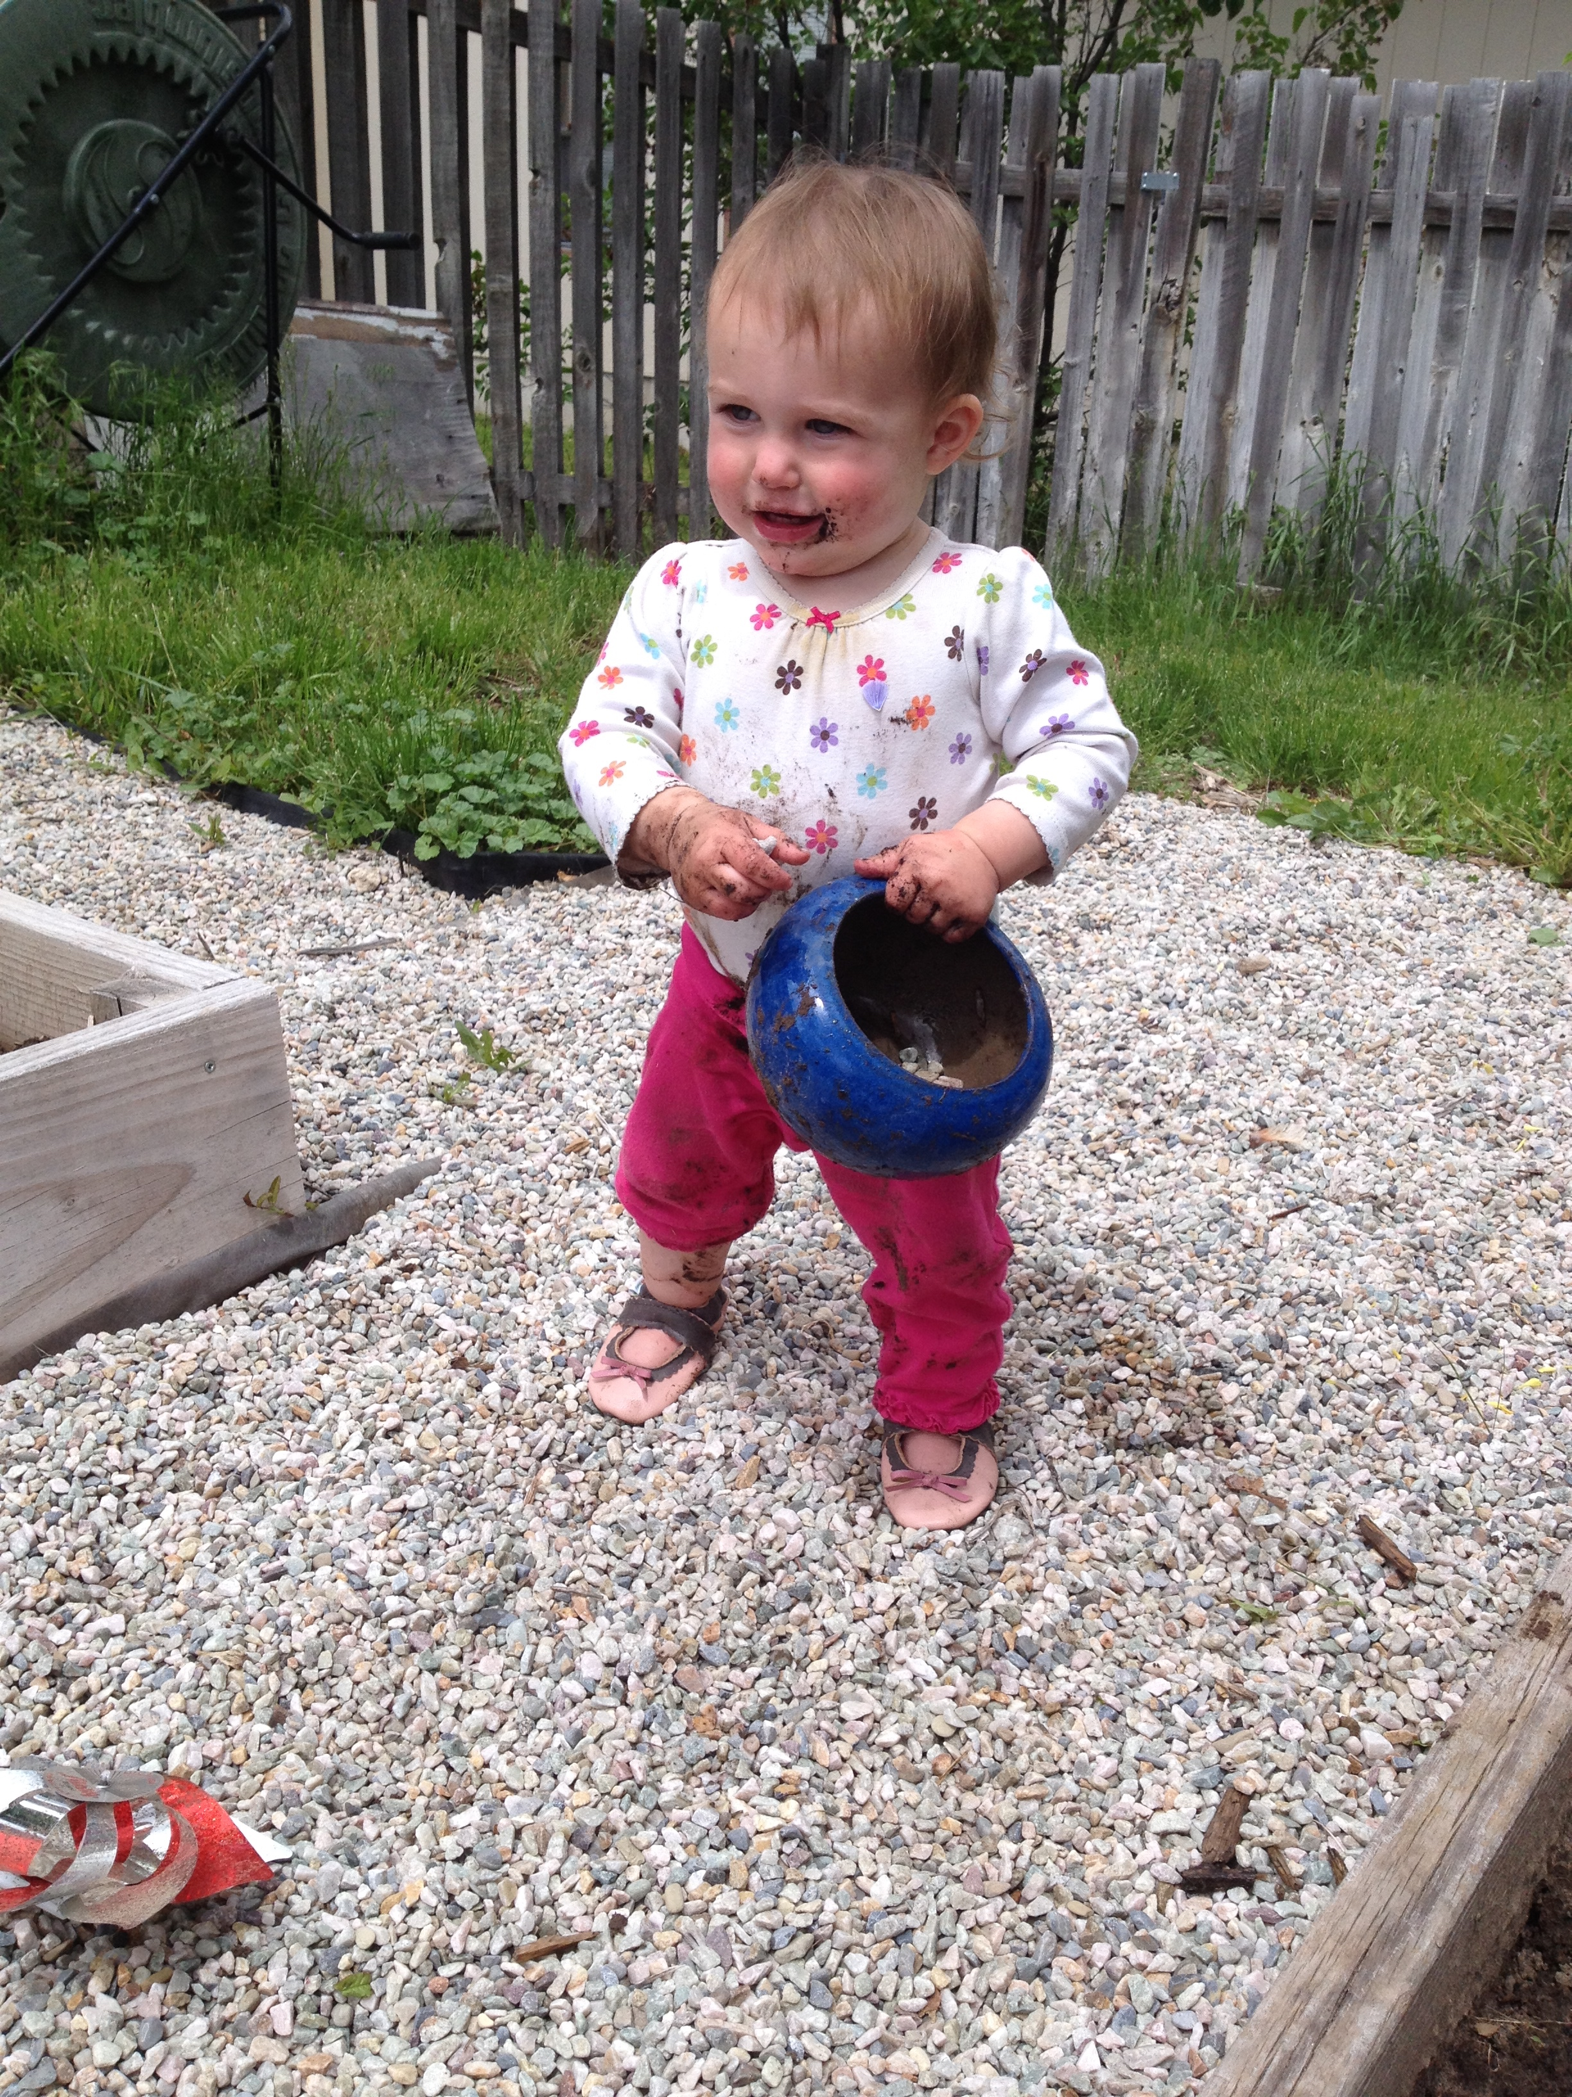

We Work in Schools
Create and maintain a healthy learning environment.
Notes:
Print a copy of this document to help you through the whole IPM implementation process.
Pick up document and highlight some of the features of this publication:
How to develop and IPM program
How to write an IPM Policy and Plan
Designating Roles
Pest-specific action plans
Example forms
Example pest control contract

Slide 20
Why Change?
American Academy of Pediatrics
62,000 primary care pediatricians, pediatric medical sub-specialists and pediatric surgical specialists
Most of the pest problems that occur indoors as well as control of lawn and garden pests can be addressed with least toxic approaches, including integrated pest management (IPM) techniques.”
“…[pediatricians should] work with schools and governmental agencies to advocate for application of least toxic pesticides by using IPM principles...”
http://pediatrics.aappublications.org/content/130/6/e1757.full.html
Notes:
“…use of pesticides in and around the home and other settings where children spend time (child care, school, and playgrounds and sports fields) is an important influence on the chronic and cumulative exposure to pesticides among US children…
Children are constantly growing. They breathe more air, consume more food, and drink more water than adults do, in proportion to their weight.
Children's central nervous, immune, reproductive, and digestive systems are still developing. At certain early stages of development, exposure to environmental toxicants can lead to irreversible damage.
Children behave differently from adults and have different patterns of exposure. Young children crawl on the ground where they can be exposed to dust and chemicals that accumulate on floors and soils.
Children have little control over their environment. Unlike adults, they may be both unaware of risks and unable to make choices to protect their health.
Policy Statement
Pesticide Exposure in Children
COUNCIL ON ENVIRONMENTAL HEALTH
Next Section
ABSTRACT
This statement presents the position of the American Academy of Pediatrics on pesticides. Pesticides are a collective term for chemicals intended to kill unwanted insects, plants, molds, and rodents. Children encounter pesticides daily and have unique susceptibilities to their potential toxicity. Acute poisoning risks are clear, and understanding of chronic health implications from both acute and chronic exposure are emerging. Epidemiologic evidence demonstrates associations between early life exposure to pesticides and pediatric cancers, decreased cognitive function, and behavioral problems. Related animal toxicology studies provide supportive biological plausibility for these findings. Recognizing and reducing problematic exposures will require attention to current inadequacies in medical training, public health tracking, and regulatory action on pesticides. Ongoing research describing toxicologic vulnerabilities and exposure factors across the life span are needed to inform regulatory needs and appropriate interventions. Policies that promote integrated pest management, comprehensive pesticide labeling, and marketing practices that incorporate child health considerations will enhance safe use.
KEY WORDS
pesticides toxicity children pest control integrated pest management
INTRODUCTION
Pesticides represent a large group of products designed to kill or harm living organisms from insects to rodents to unwanted plants or animals (eg, rodents), making them inherently toxic (Table 1). Beyond acute poisoning, the influences of low-level exposures on child health are of increasing concern. This policy statement presents the position of the American Academy of Pediatrics on exposure to these products. It was developed in conjunction with a technical report that provides a thorough review of topics presented here: steps that pediatricians should take to identify pesticide poisoning, evaluate patients for pesticide-related illness, provide appropriate treatment, and prevent unnecessary exposure and poisoning.¹ Recommendations for a regulatory agenda are provided as well, recognizing the role of federal agencies in ensuring the safety of children while balancing the positive attributes of pesticides. Repellents reviewed previously (eg, N,N-diethyl-meta-toluamide, commonly known as DEET; picaridin) are not discussed.²
View this table:
In this window In a new window
TABLE 1
Categories of Pesticides and Major Classes
SOURCES AND MECHANISMS OF EXPOSURE
Children encounter pesticides daily in air, food, dust, and soil and on surfaces through home and public lawn or garden application, household insecticide use, application to pets, and agricultural product residues.^{3–9} For many children, diet may be the most influential source, as illustrated by an intervention study that placed children on an organic diet (produced without pesticide) and observed drastic and immediate decrease in urinary excretion of pesticide metabolites.¹⁰ In agricultural settings, pesticide spray drift is important for residences near treated crops or by take-home exposure on clothing and footwear of agricultural workers.^{9,11,12} Teen workers may have occupational exposures on the farm or in lawn care.^{13–15} Heavy use of pesticides may also occur in urban pest control.¹⁶
Most serious acute poisoning occurs after unintentional ingestion, although poisoning may also follow inhalational exposure (particularly from fumigants) or significant dermal exposure.¹⁷
Previous Section
ACUTE PESTICIDE TOXICITY
Clinical Signs and Symptoms
High-dose pesticide exposure may result in immediate, devastating, even lethal consequences. Table 2 summarizes features of clinical toxicity for the major pesticides classes. It highlights the similarities of common classes of pesticides (eg, organophosphates, carbamates, and pyrethroids) and underscores the importance of discriminating among them because treatment modalities differ. Having an index of suspicion based on familiarity with toxic mechanisms and taking an environmental history provides the opportunity for discerning a pesticide’s role in clinical decision-making.¹⁸ Pediatric care providers have a poor track record for recognition of acute pesticide poisoning.^{19–21} This reflects their self-reported lack of medical education and self-efficacy on the topic.^{22–26} More in-depth review of acute toxicity and management can be found in the accompanying technical report or recommended resources in Table 3.
View this table:
In this window In a new window
TABLE 2
Common Pesticides: Signs, Symptoms, and Management Considerationsª
View this table:
In this window In a new window
TABLE 3
Pesticide and Child Health Resources for the Pediatrician
The local or regional poison control center plays an important role as a resource for any suspected pesticide poisoning.
There is no current reliable way to determine the incidence of pesticide exposure and illness in US children. Existing data systems, such as the American Association of Poison Control Centers' National Poison Data System or the National Institute for Occupational Safety and Health’s Sentinel Event Notification System for Occupational Risks,^{27,28} capture limited information about acute poisoning and trends over time.
There is also no national systematic reporting on the use of pesticides by consumers or licensed professionals. The last national survey of consumer pesticide use in homes and gardens was in 1993 (Research Triangle Institute study).²⁹
Improved physician education, accessible and reliable biomarkers, and better diagnostic testing methods to readily identify suspected pesticide illness would significantly improve reporting and surveillance. Such tools would be equally important in improving clinical decision-making and reassuring families if pesticides can be eliminated from the differential diagnosis.
The Pesticide Label
The pesticide label contains information for understanding and preventing acute health consequences: the active ingredient; signal words identifying acute toxicity potential; US Environmental Protection Agency (EPA) registration number; directions for use, including protective equipment recommendations, storage, and disposal; and manufacturer’s contact information.³⁰ Basic first aid advice is provided, and some labels contain a “note for physicians” with specific relevant medical information. The label does not specify the pesticide class or “other”/“inert” ingredients that may have significant toxicity and can account for up to 99% of the product.
Chronic toxicity information is not included, and labels are predominantly available in English. There is significant use of illegal pesticides (especially in immigrant communities), off-label use, and overuse, underscoring the importance of education, monitoring, and enforcement.³¹
CHRONIC EFFECTS
Dosing experiments in animals clearly demonstrate the acute and chronic toxicity potential of multiple pesticides. Many pesticide chemicals are classified by the US EPA as carcinogens. The past decade has seen an expansion of the epidemiologic evidence base supporting adverse effects after acute and chronic pesticide exposure in children. This includes increasingly sophisticated studies addressing combined exposures and genetic susceptibility.¹
Chronic toxicity end points identified in epidemiologic studies include adverse birth outcomes including preterm birth, low birth weight, and congenital anomalies, pediatric cancers, neurobehavioral and cognitive deficits, and asthma. These are reviewed in the accompanying technical report. The evidence base is most robust for associations to pediatric cancer and adverse neurodevelopment. Multiple case-control studies and evidence reviews support a role for insecticides in risk of brain tumors and acute lymphocytic leukemia. Prospective contemporary birth cohort studies in the United States link early-life exposure to organophosphate insecticides with reductions in IQ and abnormal behaviors associated with attention-deficit/hyperactivity disorder and autism. The need to better understand the health implications of ongoing pesticide use practices on child health has benefited from these observational epidemiologic data.³²
EXPOSURE PREVENTION APPROACHES
The concerning and expanding evidence base of chronic health consequences of pesticide exposure underscores the importance of efforts aimed at decreasing exposure.
Integrated pest management (IPM) is an established but undersupported approach to pest control designed to minimize and, in some cases, replace the use of pesticide chemicals while achieving acceptable control of pest populations.³³ IPM programs and knowledge have been implemented in agriculture and to address weeds and pest control in residential settings and schools, commercial structures, lawn and turf, and community gardens. Reliable resources are available from the US EPA and University of California—Davis (Table 3). Other local policy approaches in use are posting warning signs of pesticide use, restricting spray zone buffers at schools, or restricting specific types of pesticide products in schools. Pediatricians can play a role in promotion of development of model programs and practices in the communities and schools of their patients.
RECOMMENDATIONS
Three overarching principles can be identified: (1) pesticide exposures are common and cause both acute and chronic effects; (2) pediatricians need to be knowledgeable in pesticide identification, counseling, and management; and (3) governmental actions to improve pesticide safety are needed. Whenever new public policy is developed or existing policy is revised, the wide range of consequences of pesticide use on children and their families should be considered. The American Academy of Pediatrics, through its chapters, committees, councils, sections, and staff, can provide information and support for public policy advocacy efforts. See http://www.aap.org/advocacy.html for additional information or contact chapter leadership.
Recommendations to Pediatricians
Acute exposures: become familiar with the clinical signs and symptoms of acute intoxication from the major types of pesticides. Be able to translate clinical knowledge about pesticide hazards into an appropriate exposure history for pesticide poisoning.
Chronic exposures: become familiar with the subclinical effects of chronic exposures and routes of exposures from the major types of pesticides.
Resource identification: know locally available resources for acute toxicity management and chronic low-dose exposure (see Table 3).
Pesticide labeling knowledge: Understand the usefulness and limitations of pesticide chemical information on pesticide product labels.
Counseling: Ask parents about pesticide use in or around the home to help determine the need for providing targeted anticipatory guidance. Recommend use of minimal-risk products, safe storage practices, and application of IPM (least toxic methods), whenever possible.
Advocacy: work with schools and governmental agencies to advocate for application of least toxic pesticides by using IPM principles. Promote community right-to-know procedures when pesticide spraying occurs in public areas.
Recommendations to Government
Marketing: ensure that pesticide products as marketed are not attractive to children.
Labeling: include chemical ingredient identity on the label and/or the manufacturer’s Web site for all product constituents, including inert ingredients, carriers, and solvents. Include a label section specific to “Risks to children,” which informs users whether there is evidence that the active or inert ingredients have any known chronic or developmental health concerns for children. Enforce labeling practices that ensure users have adequate information on product contents, acute and chronic toxicity potential, and emergency information. Consider printing or making available labels in Spanish in addition to English.
Exposure reduction: set goal to reduce exposure overall. Promote application methods and practices that minimize children’s exposure, such as using bait stations and gels, advising against overuse of pediculicides. Promote education regarding proper storage of product.
Reporting: make pesticide-related suspected poisoning universally reportable and support a systematic central repository of such incidents to optimize national surveillance.
Exportation: aid in identification of least toxic alternatives to pesticide use internationally, and unless safer alternatives are not available or are impossible to implement, ban export of products that are banned or restricted for toxicity concerns in the United States.
Safety: continue to evaluate pesticide safety. Enforce community right-to-know procedures when pesticide spraying occurs in public areas. Develop, strengthen, and enforce standards of removal of concerning products for home or child product use. Require development of a human biomarker, such as a urinary or blood measure, that can be used to identify exposure and/or early health implications with new pesticide chemical registration or reregistration of existing products. Developmental toxicity, including endocrine disruption, should be a priority when evaluating new chemicals for licensing or reregistration of existing products.
Advance less toxic pesticide alternatives: increase economic incentives for growers who adopt IPM, including less toxic pesticides. Support research to expand and improve IPM in agriculture and nonagricultural pest control.
Research: support toxicologic and epidemiologic research to better identify and understand health risks associated with children’s exposure to pesticides. Consider supporting another national study of pesticide use in the home and garden setting of US households as a targeted initiative or through cooperation with existing research opportunities (eg, National Children’s Study, NHANES).
Health provider education and support: support educational efforts to increase the capacity of pediatric health care providers to diagnose and manage acute pesticide poisoning and reduce pesticide exposure and potential chronic pesticide effects in children. Provide support to systems such as Poison Control Centers to provide timely, expert advice on exposures. Require the development of diagnostic tests to assist providers with diagnosing (and ruling out) pesticide poisoning.

Slide 21
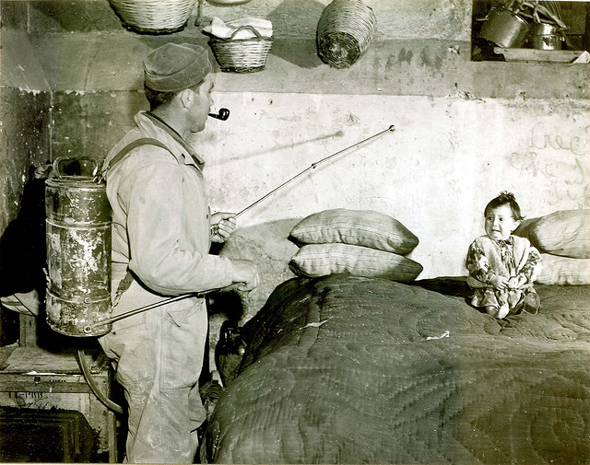
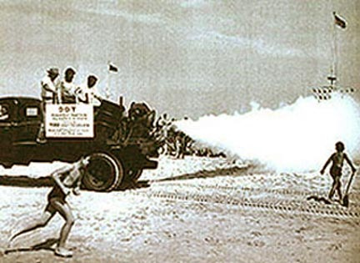
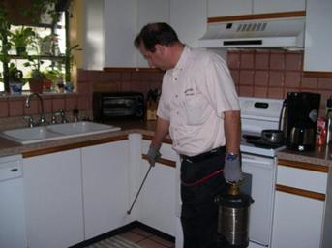
Overcoming Hurdles
Mentally, we have to overcome generations of using traditional pest control approaches
Notes:
Print a copy of this document to help you through the whole IPM implementation process.
Pick up document and highlight some of the features of this publication:
How to develop and IPM program
How to write an IPM Policy and Plan
Designating Roles
Pest-specific action plans
Example forms
Example pest control contract

Slide 22
Overcoming Hurdles
No access to pesticides
Time/Staff
Lack of Expertise
Expense
Lack of education & training opportunities
Notes:
Print a copy of this document to help you through the whole IPM implementation process.
Pick up document and highlight some of the features of this publication:
How to develop and IPM program
How to write an IPM Policy and Plan
Designating Roles
Pest-specific action plans
Example forms
Example pest control contract

Slide 23
IPM is a PROCESS
NOT
A Miracle
Notes:
Print a copy of this document to help you through the whole IPM implementation process.
Pick up document and highlight some of the features of this publication:
How to develop and IPM program
How to write an IPM Policy and Plan
Designating Roles
Pest-specific action plans
Example forms
Example pest control contract

Slide 24
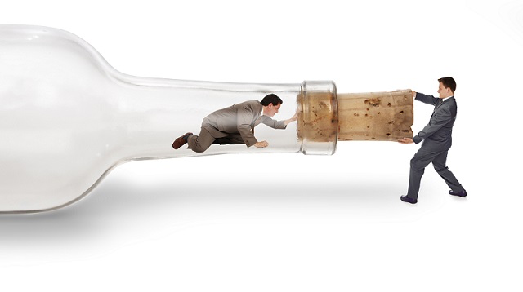
Administration Next Steps
Allow IPM
Appoint IPM Coordinator
IPM Policy
Inform
Institutionalize IPM
Notes:
Print a copy of this document to help you through the whole IPM implementation process.
Pick up document and highlight some of the features of this publication:
How to develop and IPM program
How to write an IPM Policy and Plan
Designating Roles
Pest-specific action plans
Example forms
Example pest control contract

Slide 25

WE WILL HELP!!!!
IPM Plans
Site visit/training
USU School IPM website.
SIPM Coalition
SLCSD
ryan.davis@usu.edu
Notes:
Print a copy of this document to help you through the whole IPM implementation process.
Pick up document and highlight some of the features of this publication:
How to develop and IPM program
How to write an IPM Policy and Plan
Designating Roles
Pest-specific action plans
Example forms
Example pest control contract

Slide 26
IPM is a PROCESS
NOT
A Miracle
Notes:
Print a copy of this document to help you through the whole IPM implementation process.
Pick up document and highlight some of the features of this publication:
How to develop and IPM program
How to write an IPM Policy and Plan
Designating Roles
Pest-specific action plans
Example forms
Example pest control contract

Slide 27
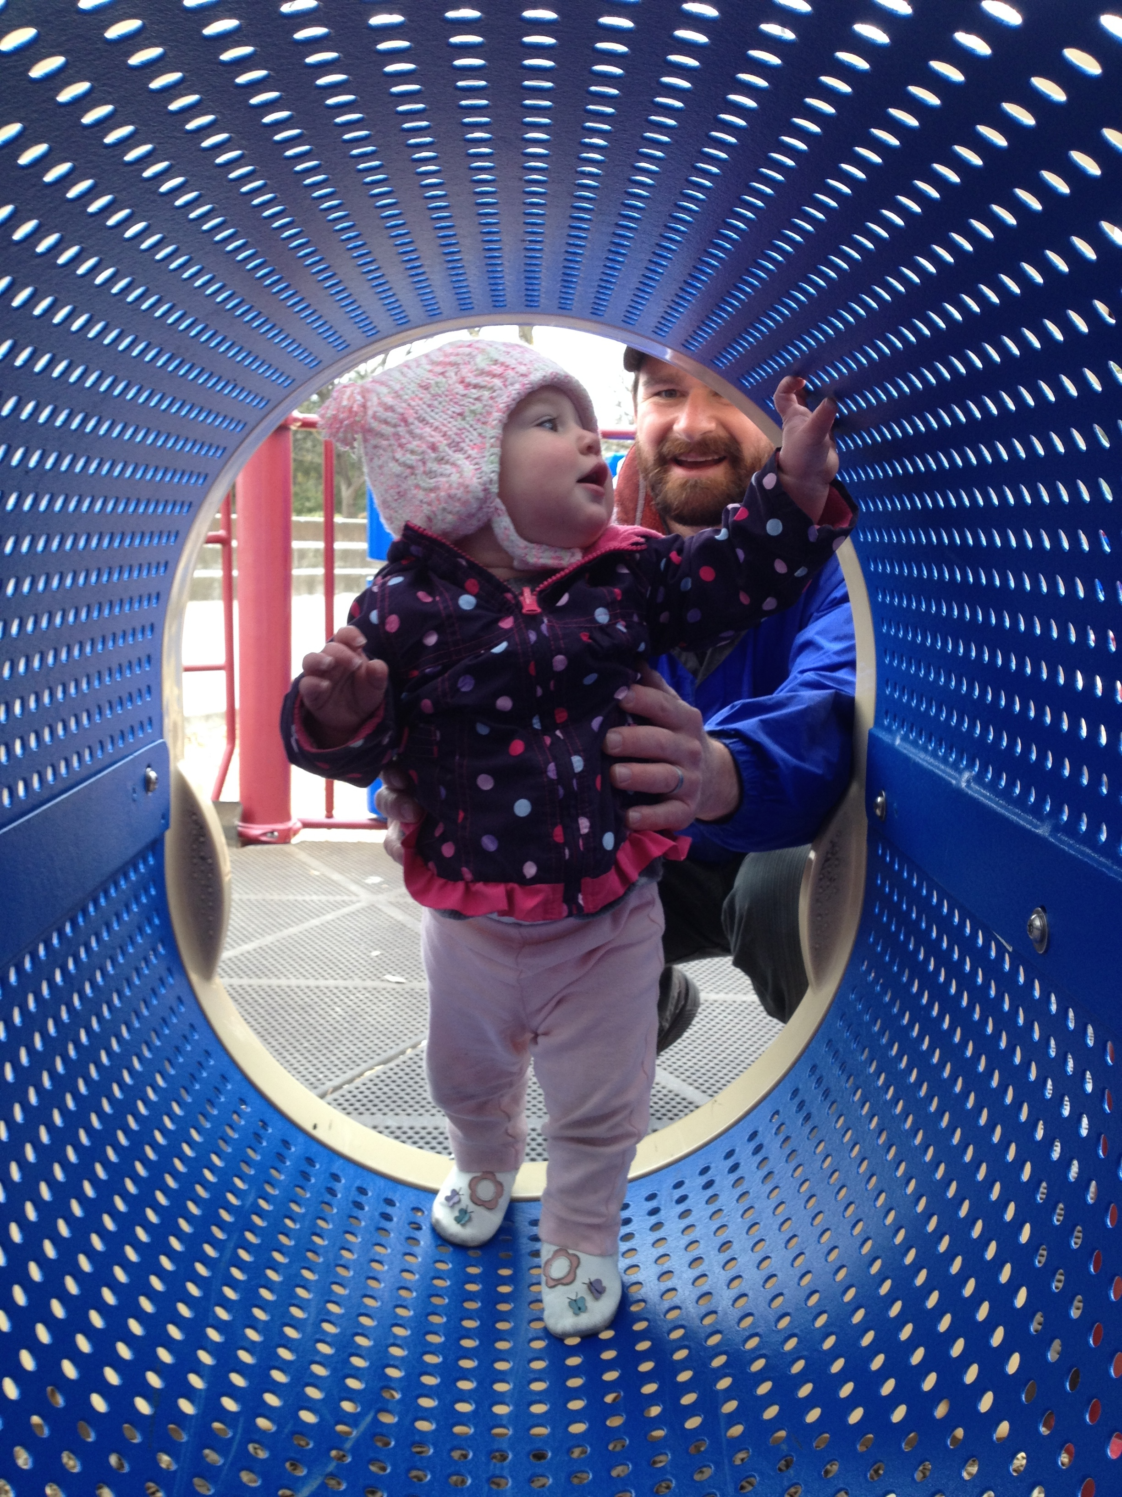
END
I am available to help.
Ryan Davis
435-797-2435
ryan.davis@usu.edu
utahpests.usu.edu
Notes:
Print a copy of this document to help you through the whole IPM implementation process.
Pick up document and highlight some of the features of this publication:
How to develop and IPM program
How to write an IPM Policy and Plan
Designating Roles
Pest-specific action plans
Example forms
Example pest control contract

Slide 28
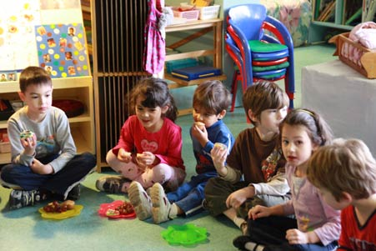

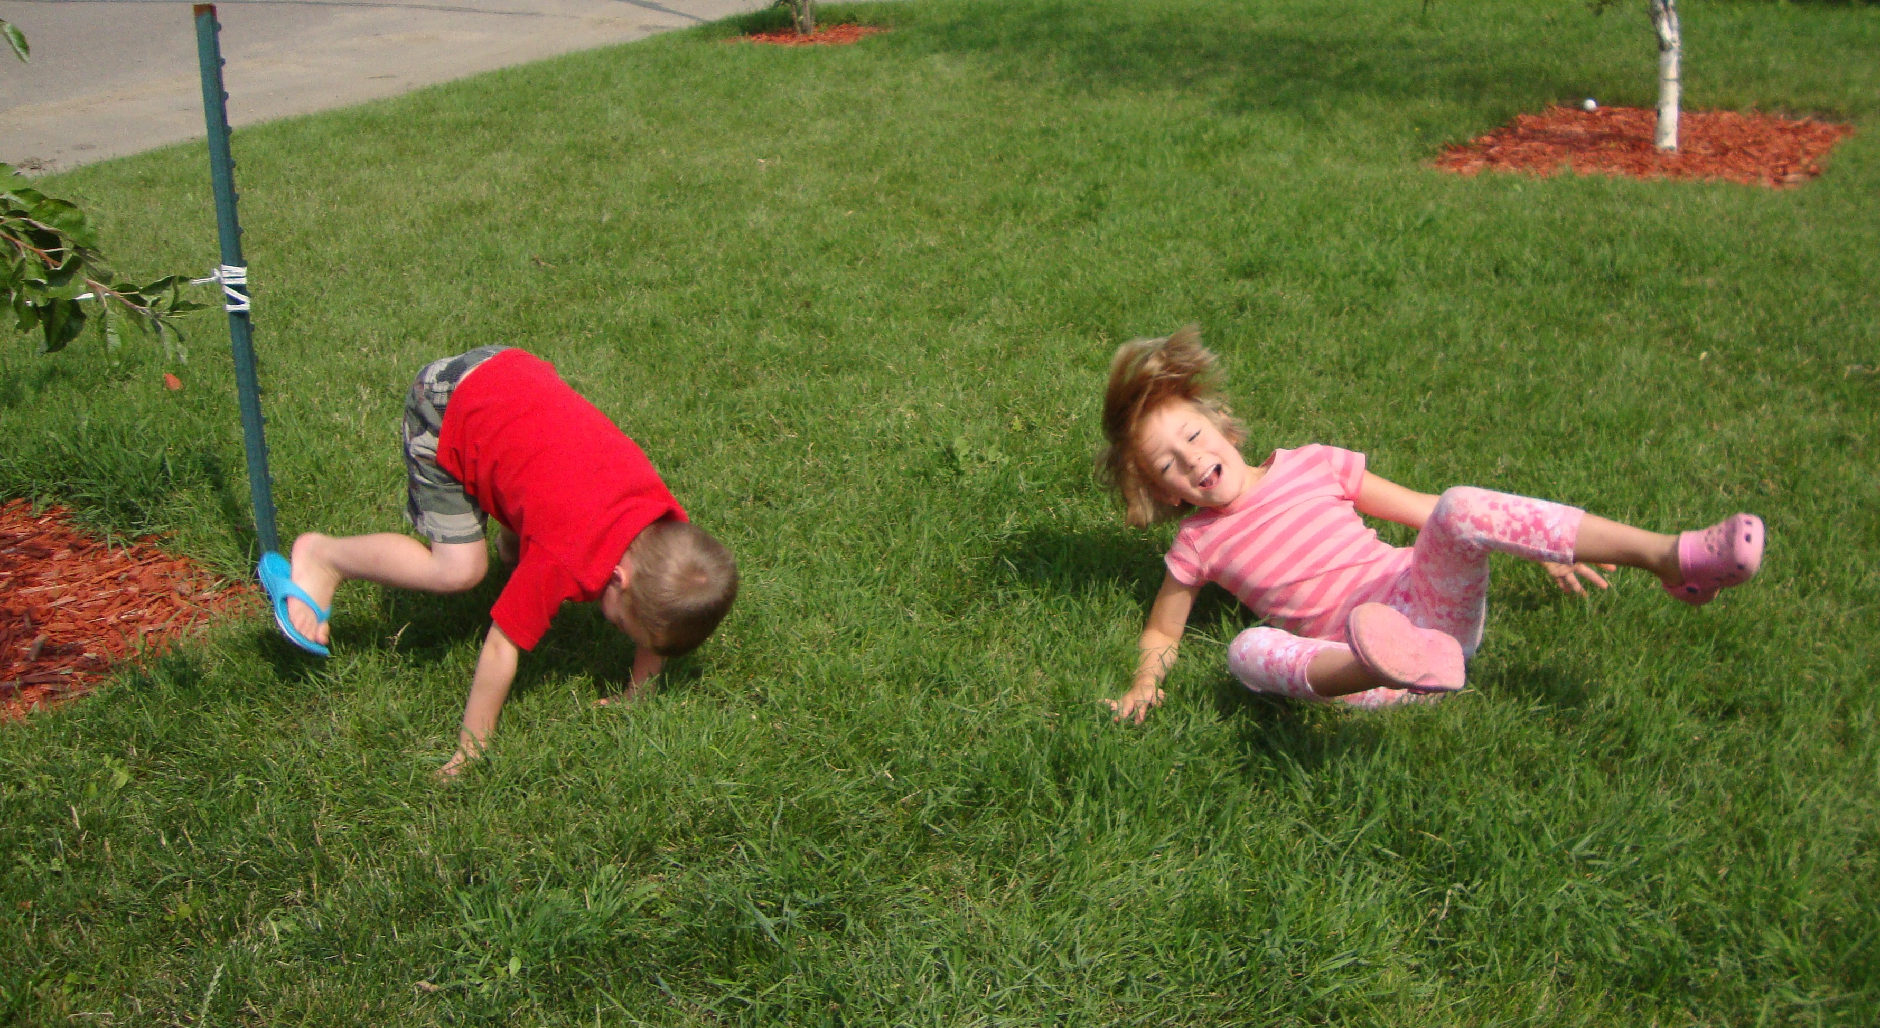
Why Change?
Differences in physiology
- nervous, immune, digestive and other systems are still developing
- can’t detoxify like adults
- breathe in more air than adults, inhaling almost 2 times as many pollutants
- smaller bodies
Differences in behavior
- spend more time playing where pesticides may be present
- crawl on floors, etc.
- hand-to-mouth contact more frequent
Exposure time per room
Kids > 6hrs per day (>1000 hrs/yr)
- Playing fields/turf???
From EPA fact sheet: EPA 735-F-07-003
Notes:
Children are constantly growing. They breathe more air, consume more food, and drink more water than adults do, in proportion to their weight.
Children's central nervous, immune, reproductive, and digestive systems are still developing. At certain early stages of development, exposure to environmental toxicants can lead to irreversible damage.
Children behave differently from adults and have different patterns of exposure. Young children crawl on the ground where they can be exposed to dust and chemicals that accumulate on floors and soils.
Children have little control over their environment. Unlike adults, they may be both unaware of risks and unable to make choices to protect their health.

Slide 29
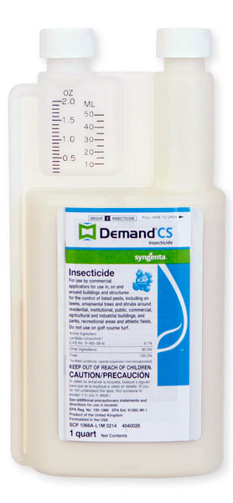

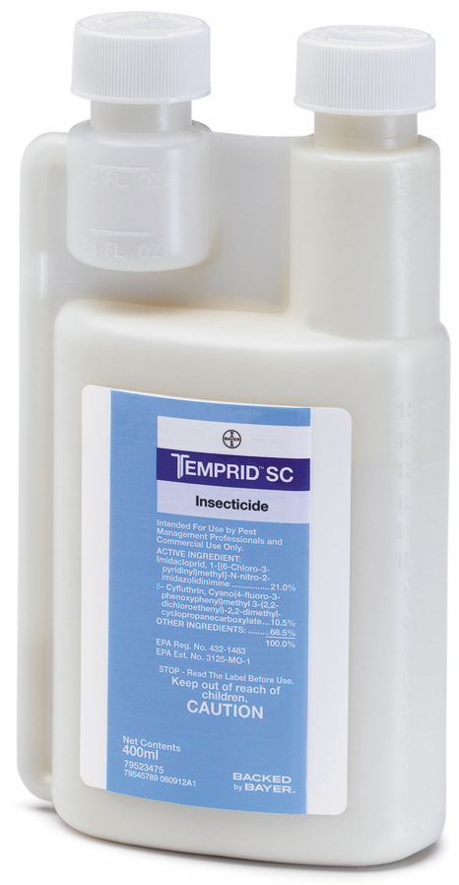
Why Change?
Would you spray this here?
Notes:
“…use of pesticides in and around the home and other settings where children spend time (child care, school, and playgrounds and sports fields) is an important influence on the chronic and cumulative exposure to pesticides among US children…
Children are constantly growing. They breathe more air, consume more food, and drink more water than adults do, in proportion to their weight.
Children's central nervous, immune, reproductive, and digestive systems are still developing. At certain early stages of development, exposure to environmental toxicants can lead to irreversible damage.
Children behave differently from adults and have different patterns of exposure. Young children crawl on the ground where they can be exposed to dust and chemicals that accumulate on floors and soils.
Children have little control over their environment. Unlike adults, they may be both unaware of risks and unable to make choices to protect their health.
Policy Statement
Pesticide Exposure in Children
COUNCIL ON ENVIRONMENTAL HEALTH
Next Section
ABSTRACT
This statement presents the position of the American Academy of Pediatrics on pesticides. Pesticides are a collective term for chemicals intended to kill unwanted insects, plants, molds, and rodents. Children encounter pesticides daily and have unique susceptibilities to their potential toxicity. Acute poisoning risks are clear, and understanding of chronic health implications from both acute and chronic exposure are emerging. Epidemiologic evidence demonstrates associations between early life exposure to pesticides and pediatric cancers, decreased cognitive function, and behavioral problems. Related animal toxicology studies provide supportive biological plausibility for these findings. Recognizing and reducing problematic exposures will require attention to current inadequacies in medical training, public health tracking, and regulatory action on pesticides. Ongoing research describing toxicologic vulnerabilities and exposure factors across the life span are needed to inform regulatory needs and appropriate interventions. Policies that promote integrated pest management, comprehensive pesticide labeling, and marketing practices that incorporate child health considerations will enhance safe use.
KEY WORDS
pesticides toxicity children pest control integrated pest management
INTRODUCTION
Pesticides represent a large group of products designed to kill or harm living organisms from insects to rodents to unwanted plants or animals (eg, rodents), making them inherently toxic (Table 1). Beyond acute poisoning, the influences of low-level exposures on child health are of increasing concern. This policy statement presents the position of the American Academy of Pediatrics on exposure to these products. It was developed in conjunction with a technical report that provides a thorough review of topics presented here: steps that pediatricians should take to identify pesticide poisoning, evaluate patients for pesticide-related illness, provide appropriate treatment, and prevent unnecessary exposure and poisoning.¹ Recommendations for a regulatory agenda are provided as well, recognizing the role of federal agencies in ensuring the safety of children while balancing the positive attributes of pesticides. Repellents reviewed previously (eg, N,N-diethyl-meta-toluamide, commonly known as DEET; picaridin) are not discussed.²
View this table:
In this window In a new window
TABLE 1
Categories of Pesticides and Major Classes
SOURCES AND MECHANISMS OF EXPOSURE
Children encounter pesticides daily in air, food, dust, and soil and on surfaces through home and public lawn or garden application, household insecticide use, application to pets, and agricultural product residues.^{3–9} For many children, diet may be the most influential source, as illustrated by an intervention study that placed children on an organic diet (produced without pesticide) and observed drastic and immediate decrease in urinary excretion of pesticide metabolites.¹⁰ In agricultural settings, pesticide spray drift is important for residences near treated crops or by take-home exposure on clothing and footwear of agricultural workers.^{9,11,12} Teen workers may have occupational exposures on the farm or in lawn care.^{13–15} Heavy use of pesticides may also occur in urban pest control.¹⁶
Most serious acute poisoning occurs after unintentional ingestion, although poisoning may also follow inhalational exposure (particularly from fumigants) or significant dermal exposure.¹⁷
Previous Section
ACUTE PESTICIDE TOXICITY
Clinical Signs and Symptoms
High-dose pesticide exposure may result in immediate, devastating, even lethal consequences. Table 2 summarizes features of clinical toxicity for the major pesticides classes. It highlights the similarities of common classes of pesticides (eg, organophosphates, carbamates, and pyrethroids) and underscores the importance of discriminating among them because treatment modalities differ. Having an index of suspicion based on familiarity with toxic mechanisms and taking an environmental history provides the opportunity for discerning a pesticide’s role in clinical decision-making.¹⁸ Pediatric care providers have a poor track record for recognition of acute pesticide poisoning.^{19–21} This reflects their self-reported lack of medical education and self-efficacy on the topic.^{22–26} More in-depth review of acute toxicity and management can be found in the accompanying technical report or recommended resources in Table 3.
View this table:
In this window In a new window
TABLE 2
Common Pesticides: Signs, Symptoms, and Management Considerationsª
View this table:
In this window In a new window
TABLE 3
Pesticide and Child Health Resources for the Pediatrician
The local or regional poison control center plays an important role as a resource for any suspected pesticide poisoning.
There is no current reliable way to determine the incidence of pesticide exposure and illness in US children. Existing data systems, such as the American Association of Poison Control Centers' National Poison Data System or the National Institute for Occupational Safety and Health’s Sentinel Event Notification System for Occupational Risks,^{27,28} capture limited information about acute poisoning and trends over time.
There is also no national systematic reporting on the use of pesticides by consumers or licensed professionals. The last national survey of consumer pesticide use in homes and gardens was in 1993 (Research Triangle Institute study).²⁹
Improved physician education, accessible and reliable biomarkers, and better diagnostic testing methods to readily identify suspected pesticide illness would significantly improve reporting and surveillance. Such tools would be equally important in improving clinical decision-making and reassuring families if pesticides can be eliminated from the differential diagnosis.
The Pesticide Label
The pesticide label contains information for understanding and preventing acute health consequences: the active ingredient; signal words identifying acute toxicity potential; US Environmental Protection Agency (EPA) registration number; directions for use, including protective equipment recommendations, storage, and disposal; and manufacturer’s contact information.³⁰ Basic first aid advice is provided, and some labels contain a “note for physicians” with specific relevant medical information. The label does not specify the pesticide class or “other”/“inert” ingredients that may have significant toxicity and can account for up to 99% of the product.
Chronic toxicity information is not included, and labels are predominantly available in English. There is significant use of illegal pesticides (especially in immigrant communities), off-label use, and overuse, underscoring the importance of education, monitoring, and enforcement.³¹
CHRONIC EFFECTS
Dosing experiments in animals clearly demonstrate the acute and chronic toxicity potential of multiple pesticides. Many pesticide chemicals are classified by the US EPA as carcinogens. The past decade has seen an expansion of the epidemiologic evidence base supporting adverse effects after acute and chronic pesticide exposure in children. This includes increasingly sophisticated studies addressing combined exposures and genetic susceptibility.¹
Chronic toxicity end points identified in epidemiologic studies include adverse birth outcomes including preterm birth, low birth weight, and congenital anomalies, pediatric cancers, neurobehavioral and cognitive deficits, and asthma. These are reviewed in the accompanying technical report. The evidence base is most robust for associations to pediatric cancer and adverse neurodevelopment. Multiple case-control studies and evidence reviews support a role for insecticides in risk of brain tumors and acute lymphocytic leukemia. Prospective contemporary birth cohort studies in the United States link early-life exposure to organophosphate insecticides with reductions in IQ and abnormal behaviors associated with attention-deficit/hyperactivity disorder and autism. The need to better understand the health implications of ongoing pesticide use practices on child health has benefited from these observational epidemiologic data.³²
EXPOSURE PREVENTION APPROACHES
The concerning and expanding evidence base of chronic health consequences of pesticide exposure underscores the importance of efforts aimed at decreasing exposure.
Integrated pest management (IPM) is an established but undersupported approach to pest control designed to minimize and, in some cases, replace the use of pesticide chemicals while achieving acceptable control of pest populations.³³ IPM programs and knowledge have been implemented in agriculture and to address weeds and pest control in residential settings and schools, commercial structures, lawn and turf, and community gardens. Reliable resources are available from the US EPA and University of California—Davis (Table 3). Other local policy approaches in use are posting warning signs of pesticide use, restricting spray zone buffers at schools, or restricting specific types of pesticide products in schools. Pediatricians can play a role in promotion of development of model programs and practices in the communities and schools of their patients.
RECOMMENDATIONS
Three overarching principles can be identified: (1) pesticide exposures are common and cause both acute and chronic effects; (2) pediatricians need to be knowledgeable in pesticide identification, counseling, and management; and (3) governmental actions to improve pesticide safety are needed. Whenever new public policy is developed or existing policy is revised, the wide range of consequences of pesticide use on children and their families should be considered. The American Academy of Pediatrics, through its chapters, committees, councils, sections, and staff, can provide information and support for public policy advocacy efforts. See http://www.aap.org/advocacy.html for additional information or contact chapter leadership.
Recommendations to Pediatricians
Acute exposures: become familiar with the clinical signs and symptoms of acute intoxication from the major types of pesticides. Be able to translate clinical knowledge about pesticide hazards into an appropriate exposure history for pesticide poisoning.
Chronic exposures: become familiar with the subclinical effects of chronic exposures and routes of exposures from the major types of pesticides.
Resource identification: know locally available resources for acute toxicity management and chronic low-dose exposure (see Table 3).
Pesticide labeling knowledge: Understand the usefulness and limitations of pesticide chemical information on pesticide product labels.
Counseling: Ask parents about pesticide use in or around the home to help determine the need for providing targeted anticipatory guidance. Recommend use of minimal-risk products, safe storage practices, and application of IPM (least toxic methods), whenever possible.
Advocacy: work with schools and governmental agencies to advocate for application of least toxic pesticides by using IPM principles. Promote community right-to-know procedures when pesticide spraying occurs in public areas.
Recommendations to Government
Marketing: ensure that pesticide products as marketed are not attractive to children.
Labeling: include chemical ingredient identity on the label and/or the manufacturer’s Web site for all product constituents, including inert ingredients, carriers, and solvents. Include a label section specific to “Risks to children,” which informs users whether there is evidence that the active or inert ingredients have any known chronic or developmental health concerns for children. Enforce labeling practices that ensure users have adequate information on product contents, acute and chronic toxicity potential, and emergency information. Consider printing or making available labels in Spanish in addition to English.
Exposure reduction: set goal to reduce exposure overall. Promote application methods and practices that minimize children’s exposure, such as using bait stations and gels, advising against overuse of pediculicides. Promote education regarding proper storage of product.
Reporting: make pesticide-related suspected poisoning universally reportable and support a systematic central repository of such incidents to optimize national surveillance.
Exportation: aid in identification of least toxic alternatives to pesticide use internationally, and unless safer alternatives are not available or are impossible to implement, ban export of products that are banned or restricted for toxicity concerns in the United States.
Safety: continue to evaluate pesticide safety. Enforce community right-to-know procedures when pesticide spraying occurs in public areas. Develop, strengthen, and enforce standards of removal of concerning products for home or child product use. Require development of a human biomarker, such as a urinary or blood measure, that can be used to identify exposure and/or early health implications with new pesticide chemical registration or reregistration of existing products. Developmental toxicity, including endocrine disruption, should be a priority when evaluating new chemicals for licensing or reregistration of existing products.
Advance less toxic pesticide alternatives: increase economic incentives for growers who adopt IPM, including less toxic pesticides. Support research to expand and improve IPM in agriculture and nonagricultural pest control.
Research: support toxicologic and epidemiologic research to better identify and understand health risks associated with children’s exposure to pesticides. Consider supporting another national study of pesticide use in the home and garden setting of US households as a targeted initiative or through cooperation with existing research opportunities (eg, National Children’s Study, NHANES).
Health provider education and support: support educational efforts to increase the capacity of pediatric health care providers to diagnose and manage acute pesticide poisoning and reduce pesticide exposure and potential chronic pesticide effects in children. Provide support to systems such as Poison Control Centers to provide timely, expert advice on exposures. Require the development of diagnostic tests to assist providers with diagnosing (and ruling out) pesticide poisoning.

Slide 30


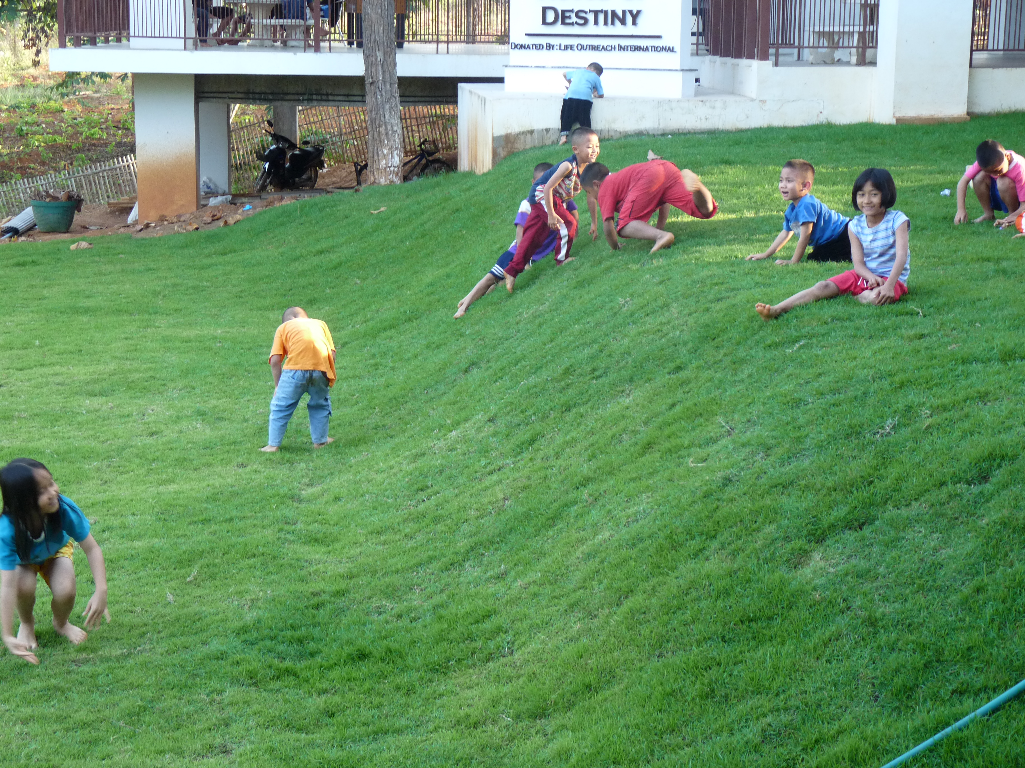
What about here?
Notes:
“…use of pesticides in and around the home and other settings where children spend time (child care, school, and playgrounds and sports fields) is an important influence on the chronic and cumulative exposure to pesticides among US children…
Children are constantly growing. They breathe more air, consume more food, and drink more water than adults do, in proportion to their weight.
Children's central nervous, immune, reproductive, and digestive systems are still developing. At certain early stages of development, exposure to environmental toxicants can lead to irreversible damage.
Children behave differently from adults and have different patterns of exposure. Young children crawl on the ground where they can be exposed to dust and chemicals that accumulate on floors and soils.
Children have little control over their environment. Unlike adults, they may be both unaware of risks and unable to make choices to protect their health.
Policy Statement
Pesticide Exposure in Children
COUNCIL ON ENVIRONMENTAL HEALTH
Next Section
ABSTRACT
This statement presents the position of the American Academy of Pediatrics on pesticides. Pesticides are a collective term for chemicals intended to kill unwanted insects, plants, molds, and rodents. Children encounter pesticides daily and have unique susceptibilities to their potential toxicity. Acute poisoning risks are clear, and understanding of chronic health implications from both acute and chronic exposure are emerging. Epidemiologic evidence demonstrates associations between early life exposure to pesticides and pediatric cancers, decreased cognitive function, and behavioral problems. Related animal toxicology studies provide supportive biological plausibility for these findings. Recognizing and reducing problematic exposures will require attention to current inadequacies in medical training, public health tracking, and regulatory action on pesticides. Ongoing research describing toxicologic vulnerabilities and exposure factors across the life span are needed to inform regulatory needs and appropriate interventions. Policies that promote integrated pest management, comprehensive pesticide labeling, and marketing practices that incorporate child health considerations will enhance safe use.
KEY WORDS
pesticides toxicity children pest control integrated pest management
INTRODUCTION
Pesticides represent a large group of products designed to kill or harm living organisms from insects to rodents to unwanted plants or animals (eg, rodents), making them inherently toxic (Table 1). Beyond acute poisoning, the influences of low-level exposures on child health are of increasing concern. This policy statement presents the position of the American Academy of Pediatrics on exposure to these products. It was developed in conjunction with a technical report that provides a thorough review of topics presented here: steps that pediatricians should take to identify pesticide poisoning, evaluate patients for pesticide-related illness, provide appropriate treatment, and prevent unnecessary exposure and poisoning.¹ Recommendations for a regulatory agenda are provided as well, recognizing the role of federal agencies in ensuring the safety of children while balancing the positive attributes of pesticides. Repellents reviewed previously (eg, N,N-diethyl-meta-toluamide, commonly known as DEET; picaridin) are not discussed.²
View this table:
In this window In a new window
TABLE 1
Categories of Pesticides and Major Classes
SOURCES AND MECHANISMS OF EXPOSURE
Children encounter pesticides daily in air, food, dust, and soil and on surfaces through home and public lawn or garden application, household insecticide use, application to pets, and agricultural product residues.^{3–9} For many children, diet may be the most influential source, as illustrated by an intervention study that placed children on an organic diet (produced without pesticide) and observed drastic and immediate decrease in urinary excretion of pesticide metabolites.¹⁰ In agricultural settings, pesticide spray drift is important for residences near treated crops or by take-home exposure on clothing and footwear of agricultural workers.^{9,11,12} Teen workers may have occupational exposures on the farm or in lawn care.^{13–15} Heavy use of pesticides may also occur in urban pest control.¹⁶
Most serious acute poisoning occurs after unintentional ingestion, although poisoning may also follow inhalational exposure (particularly from fumigants) or significant dermal exposure.¹⁷
Previous Section
ACUTE PESTICIDE TOXICITY
Clinical Signs and Symptoms
High-dose pesticide exposure may result in immediate, devastating, even lethal consequences. Table 2 summarizes features of clinical toxicity for the major pesticides classes. It highlights the similarities of common classes of pesticides (eg, organophosphates, carbamates, and pyrethroids) and underscores the importance of discriminating among them because treatment modalities differ. Having an index of suspicion based on familiarity with toxic mechanisms and taking an environmental history provides the opportunity for discerning a pesticide’s role in clinical decision-making.¹⁸ Pediatric care providers have a poor track record for recognition of acute pesticide poisoning.^{19–21} This reflects their self-reported lack of medical education and self-efficacy on the topic.^{22–26} More in-depth review of acute toxicity and management can be found in the accompanying technical report or recommended resources in Table 3.
View this table:
In this window In a new window
TABLE 2
Common Pesticides: Signs, Symptoms, and Management Considerationsª
View this table:
In this window In a new window
TABLE 3
Pesticide and Child Health Resources for the Pediatrician
The local or regional poison control center plays an important role as a resource for any suspected pesticide poisoning.
There is no current reliable way to determine the incidence of pesticide exposure and illness in US children. Existing data systems, such as the American Association of Poison Control Centers' National Poison Data System or the National Institute for Occupational Safety and Health’s Sentinel Event Notification System for Occupational Risks,^{27,28} capture limited information about acute poisoning and trends over time.
There is also no national systematic reporting on the use of pesticides by consumers or licensed professionals. The last national survey of consumer pesticide use in homes and gardens was in 1993 (Research Triangle Institute study).²⁹
Improved physician education, accessible and reliable biomarkers, and better diagnostic testing methods to readily identify suspected pesticide illness would significantly improve reporting and surveillance. Such tools would be equally important in improving clinical decision-making and reassuring families if pesticides can be eliminated from the differential diagnosis.
The Pesticide Label
The pesticide label contains information for understanding and preventing acute health consequences: the active ingredient; signal words identifying acute toxicity potential; US Environmental Protection Agency (EPA) registration number; directions for use, including protective equipment recommendations, storage, and disposal; and manufacturer’s contact information.³⁰ Basic first aid advice is provided, and some labels contain a “note for physicians” with specific relevant medical information. The label does not specify the pesticide class or “other”/“inert” ingredients that may have significant toxicity and can account for up to 99% of the product.
Chronic toxicity information is not included, and labels are predominantly available in English. There is significant use of illegal pesticides (especially in immigrant communities), off-label use, and overuse, underscoring the importance of education, monitoring, and enforcement.³¹
CHRONIC EFFECTS
Dosing experiments in animals clearly demonstrate the acute and chronic toxicity potential of multiple pesticides. Many pesticide chemicals are classified by the US EPA as carcinogens. The past decade has seen an expansion of the epidemiologic evidence base supporting adverse effects after acute and chronic pesticide exposure in children. This includes increasingly sophisticated studies addressing combined exposures and genetic susceptibility.¹
Chronic toxicity end points identified in epidemiologic studies include adverse birth outcomes including preterm birth, low birth weight, and congenital anomalies, pediatric cancers, neurobehavioral and cognitive deficits, and asthma. These are reviewed in the accompanying technical report. The evidence base is most robust for associations to pediatric cancer and adverse neurodevelopment. Multiple case-control studies and evidence reviews support a role for insecticides in risk of brain tumors and acute lymphocytic leukemia. Prospective contemporary birth cohort studies in the United States link early-life exposure to organophosphate insecticides with reductions in IQ and abnormal behaviors associated with attention-deficit/hyperactivity disorder and autism. The need to better understand the health implications of ongoing pesticide use practices on child health has benefited from these observational epidemiologic data.³²
EXPOSURE PREVENTION APPROACHES
The concerning and expanding evidence base of chronic health consequences of pesticide exposure underscores the importance of efforts aimed at decreasing exposure.
Integrated pest management (IPM) is an established but undersupported approach to pest control designed to minimize and, in some cases, replace the use of pesticide chemicals while achieving acceptable control of pest populations.³³ IPM programs and knowledge have been implemented in agriculture and to address weeds and pest control in residential settings and schools, commercial structures, lawn and turf, and community gardens. Reliable resources are available from the US EPA and University of California—Davis (Table 3). Other local policy approaches in use are posting warning signs of pesticide use, restricting spray zone buffers at schools, or restricting specific types of pesticide products in schools. Pediatricians can play a role in promotion of development of model programs and practices in the communities and schools of their patients.
RECOMMENDATIONS
Three overarching principles can be identified: (1) pesticide exposures are common and cause both acute and chronic effects; (2) pediatricians need to be knowledgeable in pesticide identification, counseling, and management; and (3) governmental actions to improve pesticide safety are needed. Whenever new public policy is developed or existing policy is revised, the wide range of consequences of pesticide use on children and their families should be considered. The American Academy of Pediatrics, through its chapters, committees, councils, sections, and staff, can provide information and support for public policy advocacy efforts. See http://www.aap.org/advocacy.html for additional information or contact chapter leadership.
Recommendations to Pediatricians
Acute exposures: become familiar with the clinical signs and symptoms of acute intoxication from the major types of pesticides. Be able to translate clinical knowledge about pesticide hazards into an appropriate exposure history for pesticide poisoning.
Chronic exposures: become familiar with the subclinical effects of chronic exposures and routes of exposures from the major types of pesticides.
Resource identification: know locally available resources for acute toxicity management and chronic low-dose exposure (see Table 3).
Pesticide labeling knowledge: Understand the usefulness and limitations of pesticide chemical information on pesticide product labels.
Counseling: Ask parents about pesticide use in or around the home to help determine the need for providing targeted anticipatory guidance. Recommend use of minimal-risk products, safe storage practices, and application of IPM (least toxic methods), whenever possible.
Advocacy: work with schools and governmental agencies to advocate for application of least toxic pesticides by using IPM principles. Promote community right-to-know procedures when pesticide spraying occurs in public areas.
Recommendations to Government
Marketing: ensure that pesticide products as marketed are not attractive to children.
Labeling: include chemical ingredient identity on the label and/or the manufacturer’s Web site for all product constituents, including inert ingredients, carriers, and solvents. Include a label section specific to “Risks to children,” which informs users whether there is evidence that the active or inert ingredients have any known chronic or developmental health concerns for children. Enforce labeling practices that ensure users have adequate information on product contents, acute and chronic toxicity potential, and emergency information. Consider printing or making available labels in Spanish in addition to English.
Exposure reduction: set goal to reduce exposure overall. Promote application methods and practices that minimize children’s exposure, such as using bait stations and gels, advising against overuse of pediculicides. Promote education regarding proper storage of product.
Reporting: make pesticide-related suspected poisoning universally reportable and support a systematic central repository of such incidents to optimize national surveillance.
Exportation: aid in identification of least toxic alternatives to pesticide use internationally, and unless safer alternatives are not available or are impossible to implement, ban export of products that are banned or restricted for toxicity concerns in the United States.
Safety: continue to evaluate pesticide safety. Enforce community right-to-know procedures when pesticide spraying occurs in public areas. Develop, strengthen, and enforce standards of removal of concerning products for home or child product use. Require development of a human biomarker, such as a urinary or blood measure, that can be used to identify exposure and/or early health implications with new pesticide chemical registration or reregistration of existing products. Developmental toxicity, including endocrine disruption, should be a priority when evaluating new chemicals for licensing or reregistration of existing products.
Advance less toxic pesticide alternatives: increase economic incentives for growers who adopt IPM, including less toxic pesticides. Support research to expand and improve IPM in agriculture and nonagricultural pest control.
Research: support toxicologic and epidemiologic research to better identify and understand health risks associated with children’s exposure to pesticides. Consider supporting another national study of pesticide use in the home and garden setting of US households as a targeted initiative or through cooperation with existing research opportunities (eg, National Children’s Study, NHANES).
Health provider education and support: support educational efforts to increase the capacity of pediatric health care providers to diagnose and manage acute pesticide poisoning and reduce pesticide exposure and potential chronic pesticide effects in children. Provide support to systems such as Poison Control Centers to provide timely, expert advice on exposures. Require the development of diagnostic tests to assist providers with diagnosing (and ruling out) pesticide poisoning.

