Slide 1


Integrated Pest
Management

Slide 2
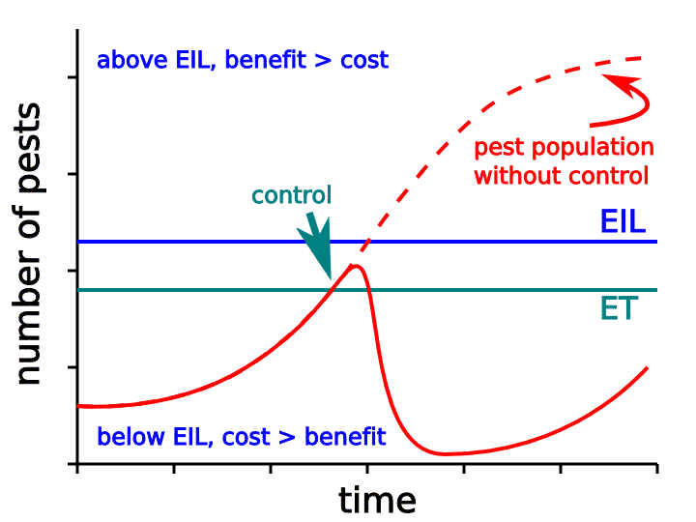
IPM Overview
Pest Identification
Monitoring for Signs & Symptoms
Control Action Guidelines
Economic Injury Level – The lowest population density of a pest that will cause economic damage; or the amount of pest injury which will justify the cost of control.
Action Threshold – The point at which a pest control action must be taken to prevent unacceptable damage.

Slide 3
Identifying Windows of Opportunity
Adult
Pupa
Egg
Immature
(Nymph or Larvae)

Slide 4
Cultural Control
Land + Water Management | Sanitation | Habitat Diversification | Tolerant Species + Cultivars | Soils & Nutrition
Maintain the ecosystem in a healthy state to minimize competitiveness of pests. Avoid over/under watering to reduce plant stress Control water levels (diseases, mosquitos, aquatic weeds, etc.). | Remove plants and debris that can serve as protective or overwintering sites for pests e.g. pruning, burning, etc. | In monoculture situations (e.g. agricultural fields, orchards, landscapes, etc.) diversification of vegetation may increase the presence of beneficial and pest organisms. | Select insect and disease resistant species and cultivars of plants whenever they are available. Grow cold hardy perennials, as winter damaged plants are more susceptible to pest attacks. | Monitor soil nutrient levels. Over or under fertilization can be attractive to aphids and other foliage pests. Increasing organic matter of soil can improve the growth and health of plants.
D. G. Alston, Important Components of a Successful Pest Management Program, USU Fact Sheet, July 2011
D. G. Alston, Important Components of a Successful Pest Management Program, USU Fact Sheet, July 2011

Slide 5
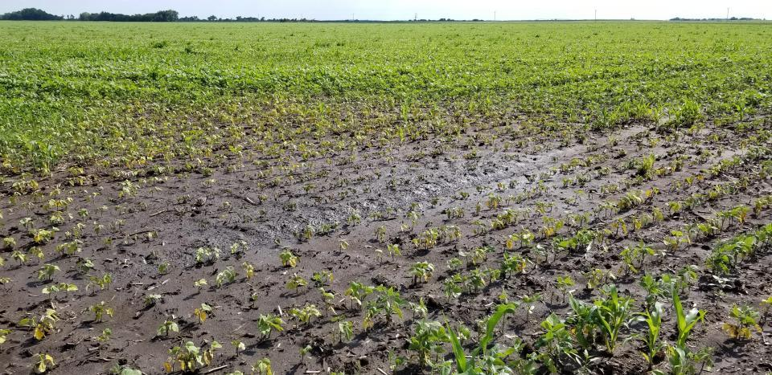
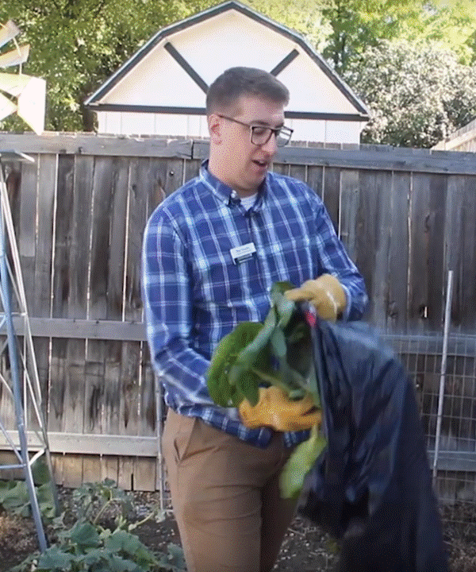

Slide 6
Mechanical Control
Hand Removal | Mowing | Traps | Physical Barriers
Hand pull weeds. Physically remove the pest from the plant. | Mow down weeds within an area before they produce seeds. | Traps are primarily used to monitor and control insect and vertebrate pests. Attractive traps usually use visual cues (color) and/or odors (pheromones, food baits) to attract pests to them. Passive traps are placed in areas with pest activity or use wind currents to catch pest. | Floating Row Covers are used to protect row crops. Sticky bands can be placed around tree trunks to prevent insects crawling up.
D. G. Alston, Important Components of a Successful Pest Management Program, USU Fact Sheet, July 2011

Slide 7
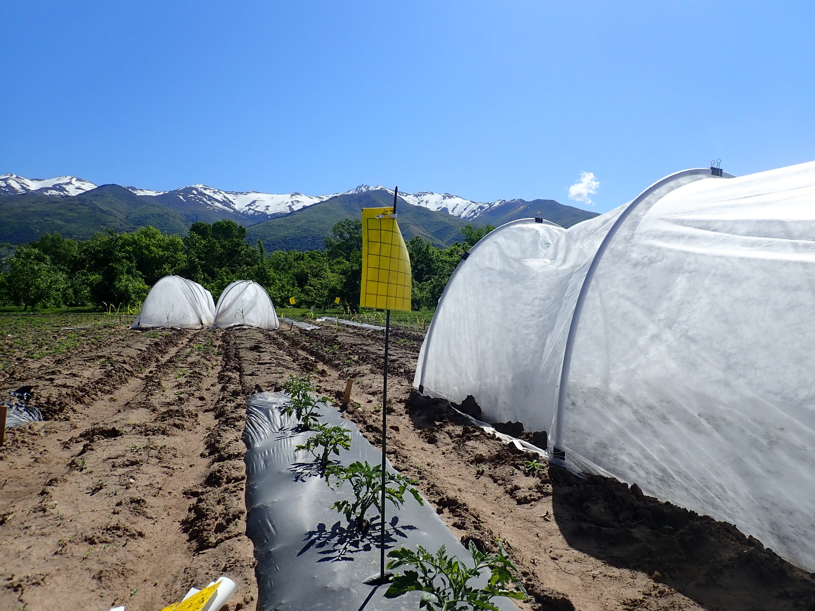
YELLOW STICKY TRAP
ROW COVER
PLASTIC “MULCH”
WEED BARRIER

Slide 8
Biological Control
Predators | Parasites | Pathogens | Herbivorous Insects of Weeds
Organisms that eats or kills another (e.g. predatory insects, mites, birds, mammals, reptiles, etc.). | Organism that lives in or on another and kills it while completing its life cycle (e.g., parasitoid). | Microbial agent that attacks and invades another organism (e.g. bacteria, virus, nematode). | Plant feeding insect tat attacks weeds.
D. G. Alston, Important Components of a Successful Pest Management Program, USU Fact Sheet, July 2011

Slide 9
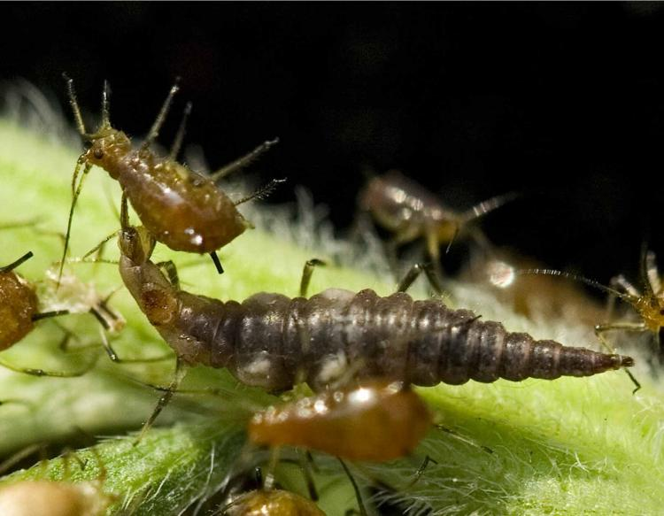
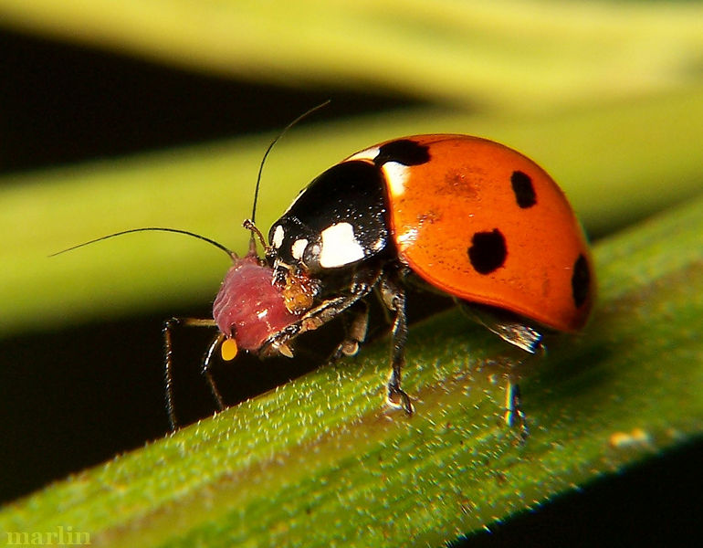

Slide 10
Chemical Control
Synthetic Pesticides | Organic Pesticides | Biological Pesticides | Insect Growth Regulators
Human-made in a laboratory; chemically joined compounds or elements (e.g. most herbicides, diazinon, malathion, carbaryl, benomyl, streptomycin, etc.) | Derived from plant, animal, or naturally occurring rock or petroleum oil sources (e.g., rotenone, sabadila, ryania, nicotine sulfate, pyrethrum, soaps, oils, microbial agents, lime sulfur, copper, etc.) | A subset of organics that specifically refers to products developed from naturally occurring microbial agents such as bacteria, viruses, and fungi (e.g., Bacillus thuringiensis, a bacterial pathogen of many insects. | Kills insects by interfering with the normal process of juvenile development; common IGRs disrupt either the insect’s hormonal process or exoskeleton development.
D. G. Alston, Important Components of a Successful Pest Management Program, USU Fact Sheet, July 2011

Slide 11
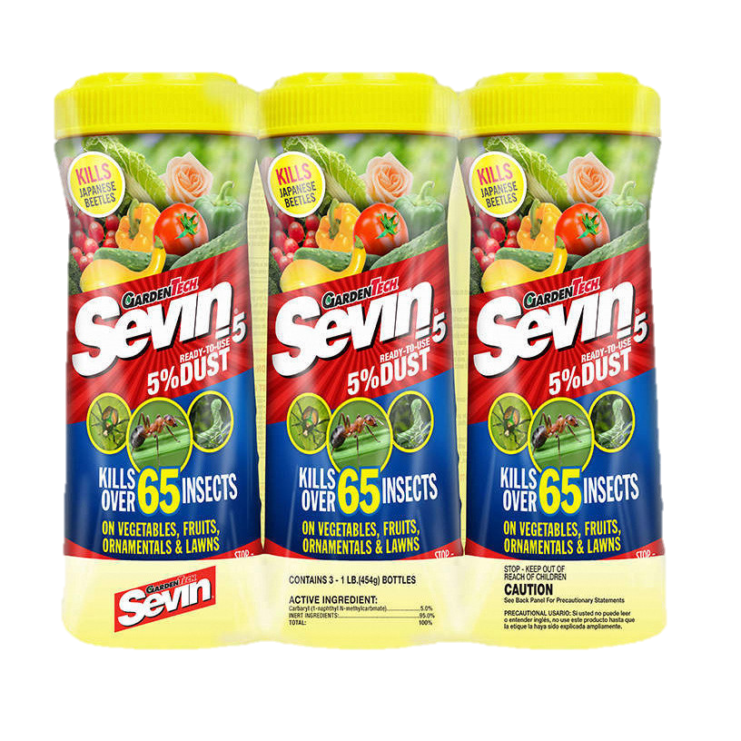
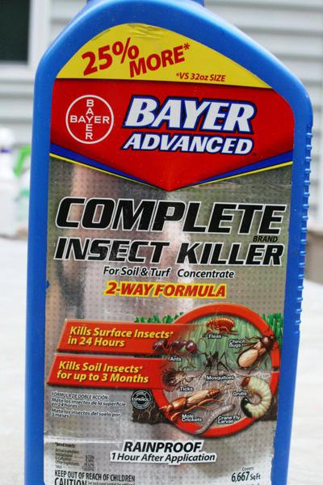
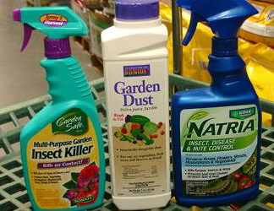
https://www.environmentalscience.bayer.us/-/media/prfunitedstates/documents/resource-library/product-labels/sevin-sl.ashx

Slide 12


Slide 13
Pest Resistance

Slide 14
Pest Resistance – Occurs when a pest population builds up a tolerance to a specific chemical, or group of chemicals with the same Mode of Action (MoA).
Mode of Action – the sum of anatomical, physiological and biochemical interactions and response that result in toxic action of chemical, as well as the physical (location) and molecular (degradation) fate of the chemical in the organism.

Slide 15
Mode of Action (MoA)
The way a pesticide works. Specifically how it affects the target site within an organism. Typically a critical protein or enzyme in the insect.
Nerve & Muscle | Growth
Most current insecticides act on nerve and muscle targets. Insecticides that act on these targets are generally fast acting. | Insect development is controlled by juvenile hormone and ecdysone, by directly perturbing cuticle formation/deposition or lipid biosynthesis. Such insect growth regulators are generally slow to moderately slow acting.
Respiration | Mid-Gut
Several insecticides are known to interfere with mitochondrial respiration by the inhibition of electron transport and/or oxidative phosphorylation. Such insecticides are generally fast to moderately fast acting. | Lepidopteran-specific microbial toxins that are sprayed or expressed in transgenic crop varieties.
https://www.irac-online.org/modes-of-action/

Slide 16
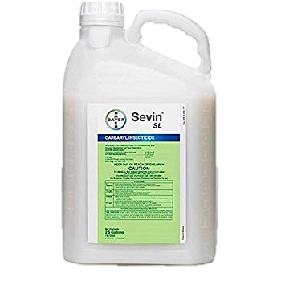
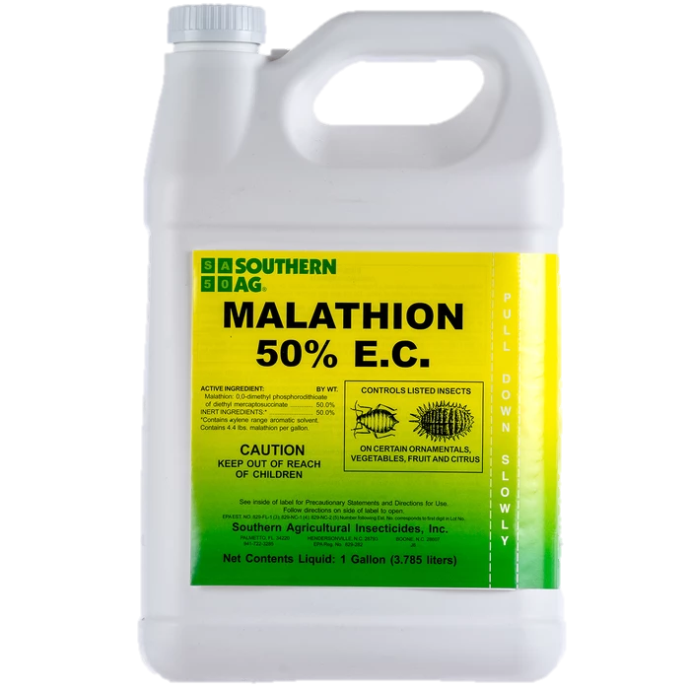
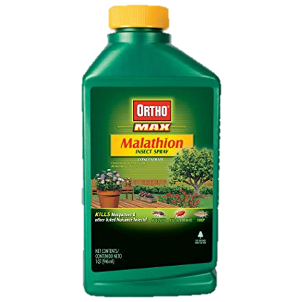
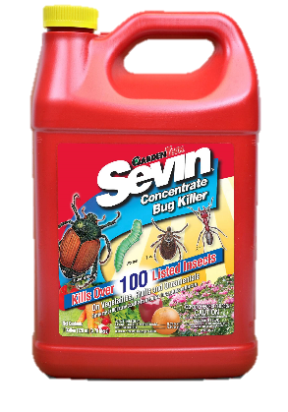
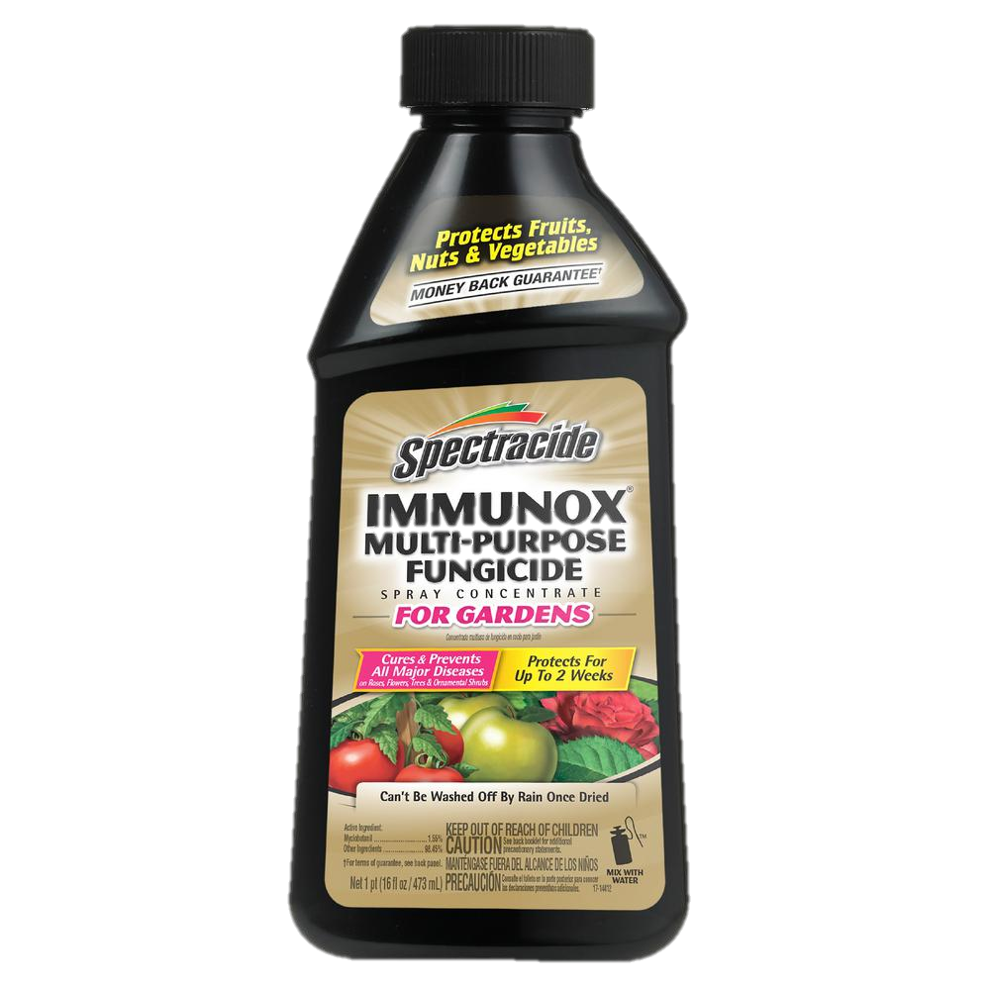
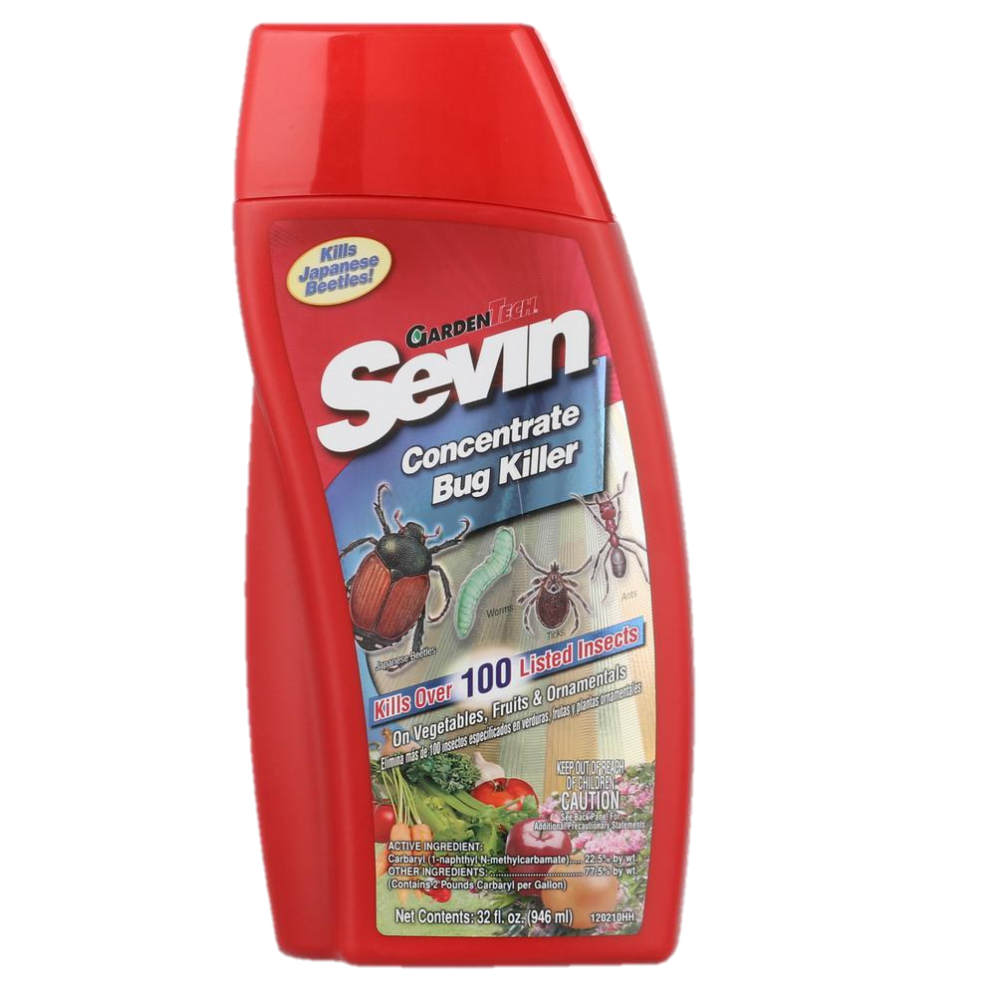
MoA Organization Example
1A) carbamates
MoA 1) Acetylcholinesterase (Ache) Inhibitors
1B) organophosphates
O
O
H₃C
O
O
NH
O
Main Group
Chemical Sub-Group
Active Ingredients
Products
CH₃
H₃C
O
P
S
O
CH₃
S
O
carbaryl
malathion

Slide 17
How to reduce pest resistance to insecticide
minimize insecticide use by using early-maturing or pest-tolerant crops
use non-chemical techniques first (biological, mechanical, cultural)
select insecticides and management tools which preserve natural enemies
use well-maintained equipment to achieve full and proper coverage
target younger, more susceptible insect stages
R. Davis, Insecticide Mode of Resistance Presentation, Utah Pests In-Service Training, 2009

Slide 18
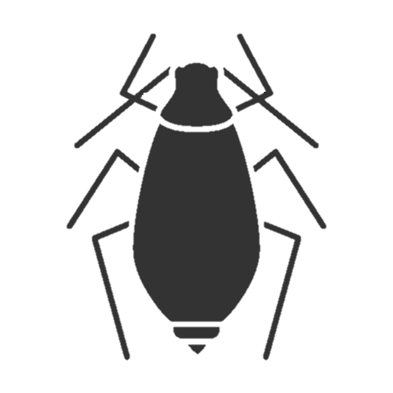
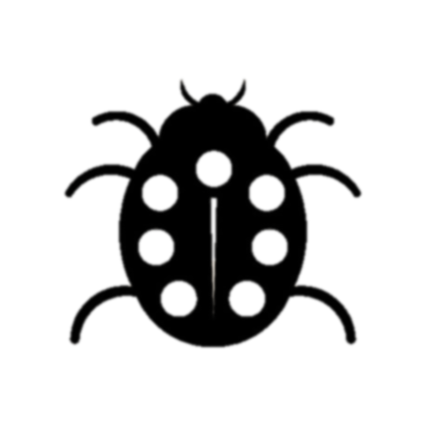
Insect Resistance Stage I
susceptible resistant beneficial

Slide 19
Insect Resistance Stage II
susceptible resistant beneficial

Slide 20
Insect Resistance Stage III
susceptible resistant beneficial

Slide 21
Insect Resistance Stage IV
susceptible resistant beneficial

Slide 22
How to reduce pest resistance to insecticide
use appropriate local economic thresholds and spray intervals
follow label or extension recommendations on rotating different classes (MoA’s of insecticides)
when multiple applications per year are needed rotate different MoA’s
if control is not achieved do NOT spray the same insecticide, switch to one with a different MoA
do NOT mix chemicals for use against one target pest
use insecticides that are specific to your target pests
R. Davis, Insecticide Mode of Resistance Presentation, Utah Pests In-Service Training, 2009

Slide 23

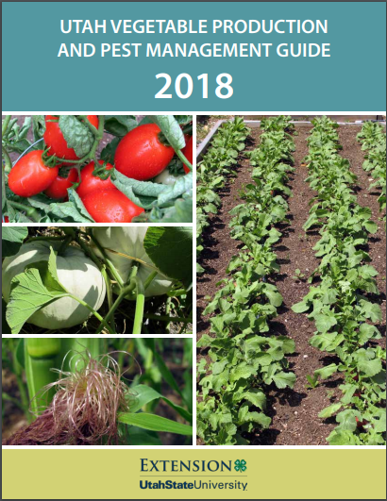
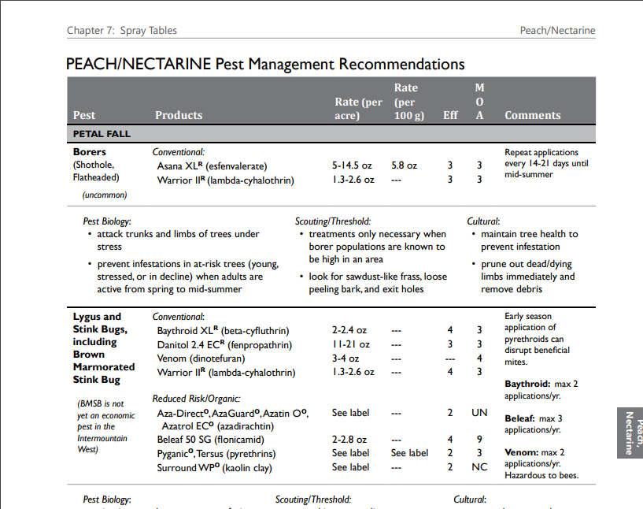
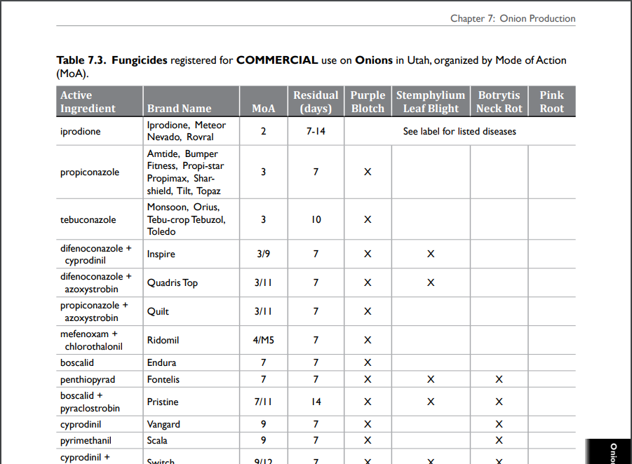
Resources

Slide 24

Contact Me
☏ 435.797.0319
✉ nick.volesky@usu.edu
💻 utahpests.usu.edu/ipm

