Slide 1
Administrative Rule 392-200 and Integrated Pest Management An Overview of IPM and Suggestions for Complying with the Rule
UFOMA
October 8, 2013
Gregg Smith, P.E.
Director of Facility Services
Salt Lake City School District

Slide 2
Agenda
What is Integrated Pest Management
Our Experience with IPM
State Laws and Rules
Suggestions for Complying with R392-200
Resources
Questions
Notes:
Caveat – The compliance suggestions offered herein are based on the presenter’s reading and interpretation of the Administrative Rule and the experiences of Salt Lake City School District in implementing and operating a successful IPM program. School districts are encouraged to understand the requirements of the rule and to determine how they will ensure compliance accordingly. Local Health Departments will be responsible for determining if the districts in their enforcement area are in compliance with the rule.

Slide 3
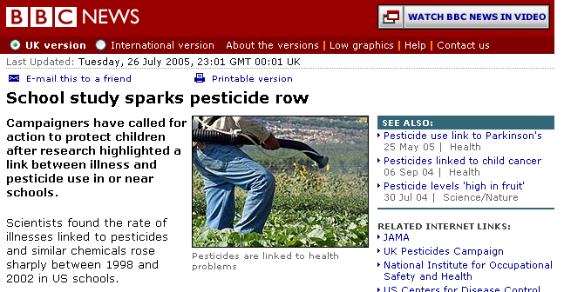
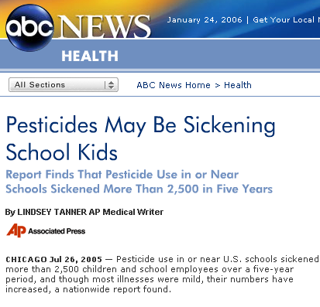
Integrated Pest Management
Notes:
Last month, a middle school student in Texas died from an allergic reaction to fire ant bites. The adults in charge did all the WRONG things in responding to this incident, including; 1) trying to eliminate the fire ants when it was convenient for the grounds staff instead of when the ants were most vulnerable to effective treatment, 2) ignoring warnings about the student’s allergies, and 3) trying to wash the ants off the student with water which only caused them to hang on for survival and exacerbate their bite.
IPM training may have prevented this tragedy.

Slide 4
What is Integrated Pest Management?
A safer, usually less costly option for effective pest management in the school community
Employs common-sense strategies to reduce sources of food, water and shelter for pests in buildings and on grounds
Manages pests by focusing on eliminating the reasons pests are present
Takes advantage of all pest management strategies, including the judicious use of pesticides*
* Weeds are also considered pests as part of IPM because pesticides are often used for control.

Slide 5
It’s what the parents and community wants for their kids
Green
A Safe Environment
Safe from:
Pest allergens, allergic reactions, bites and stings
Arthropod and vertebrate vectored diseases
Inappropriate pesticide use
Notes:
We will not be discussing the health and safety risks associated with pesticides. Refer to the various references at the end of this presentation for more information.

Slide 6
Integrated Pest Management
You are already doing most, if not all, of these things…
Pesticides
Exclusion &
Mechanical Controls
Now, if you change the level of effort and the order in which things happen – it becomes IPM!
Behavior Changes
& Housekeeping Practices
Education, Training & Communication
Notes:
These are the four basic principles of IPM.

Slide 7
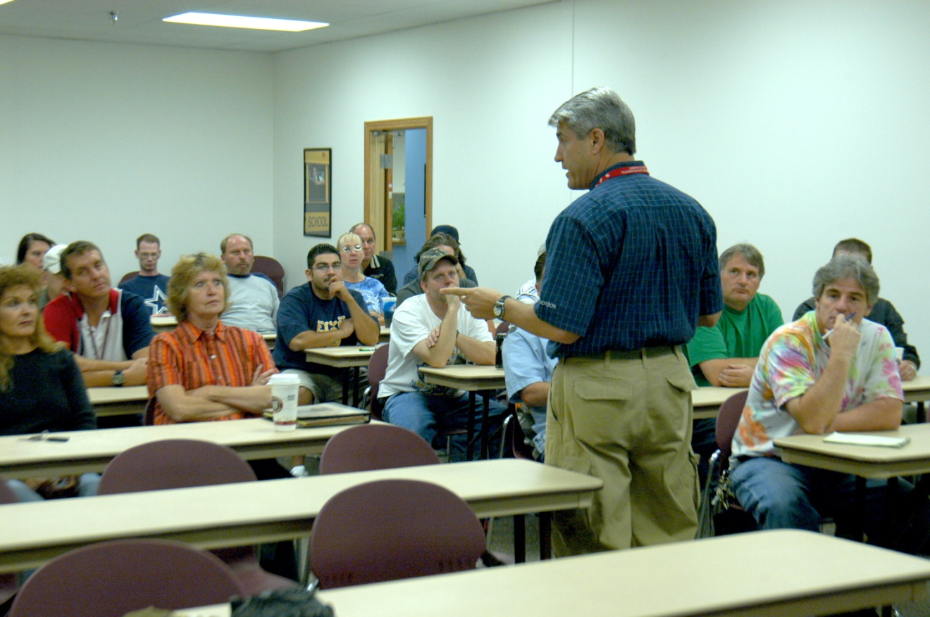
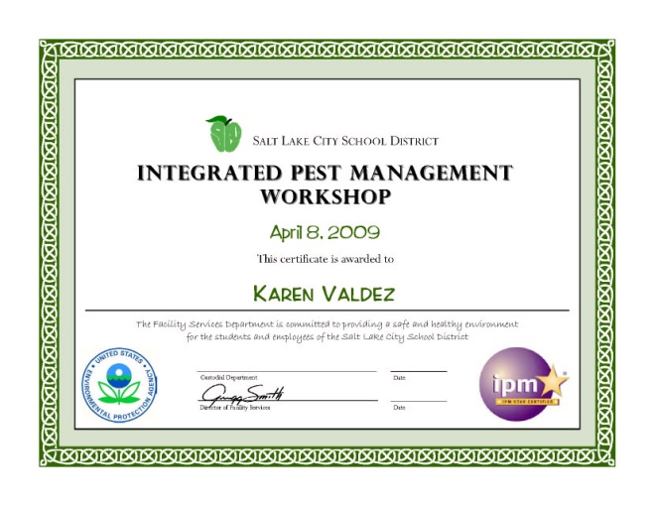
Education
IPM is a cooperative effort that requires sustained public relations for success. In order for IPM to work, EVERYONE…
Custodians
Kitchen personnel
Maintenance and Grounds personnel
Teachers and Principals
must understand the basic concepts and receive on-going training
Notes:
Education, training and communication are the foundation of any program, including IPM.

Slide 8
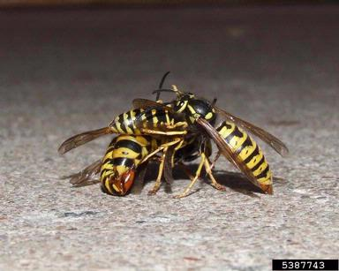
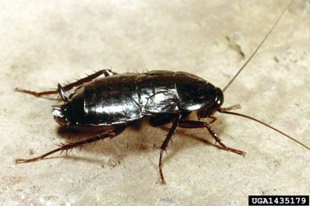
Training
Pest identification
Proper identification aids in selecting suitable IPM strategies
Pest biology
Pest behavior
Habitat preferences
Food preferences
Seasonal and reproductive cycles
Monitoring and Reporting Pests
Critical to the success of an IPM program because “you can’t manage if you don’t measure”
You need data to evaluate the success of your program

Slide 9
Communication
Notes:
These are examples of how we have communicated our IPM program. They help to create awareness about pests, their behavior and how the occupants of our buildings have a huge role in preventing and controlling them in our buildings.

Slide 10
Communication
We periodically publish Pest Press topics for educational purposes and distribution to teachers and staff
Pest Press content is readily available from a variety of sources for use by school districts
We have relied upon expert content from Universities of Arizona and Florida
Utah specific content is available from Utah State University Extension
Our Pest Presses are available on our Department website
Notes:
Pest Press documents are commonly used by the IPM community to provide quick and easy information about pests, their behavior and how to manage them. Pest Press content can be downloaded from a number of Internet sites and incorporated into school district publications.
We also feature a regular “Bug Off” column in Fresh Paint, our bi-monthly Department newsletter.

Slide 11
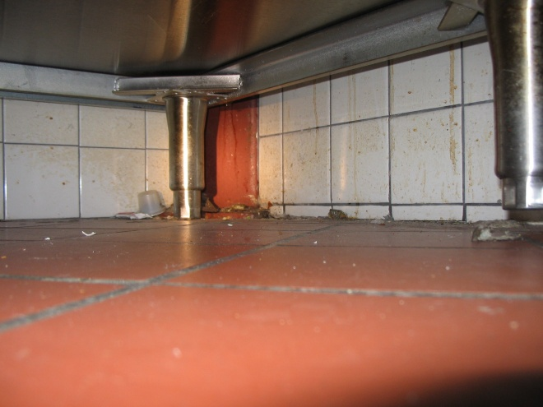
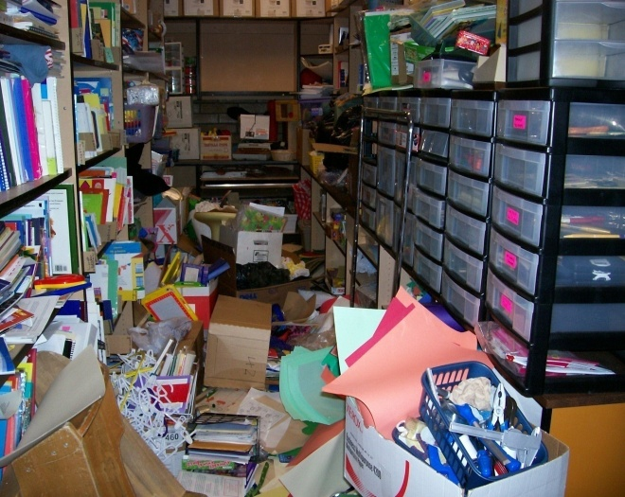
Behavior Changes and Housekeeping Practices
Eliminate Pest Conducive Conditions where pests can find:
Food
Shelter
Water
Pay attention to Pest Vulnerable Areas where such Pest Conducive Conditions are typically found:
Kitchen, pantry and cafeteria
Dumpsters
Teacher’s Lounge
Custodial closets
Special Ed / Classrooms / Nursery
Restrooms
Grounds
Food
Shelter
Notes:
We track HOW each pest problem was eventually resolved. Without fail, housekeeping and sanitation are the number one reasons and means by which pest problems are solved.

Slide 12
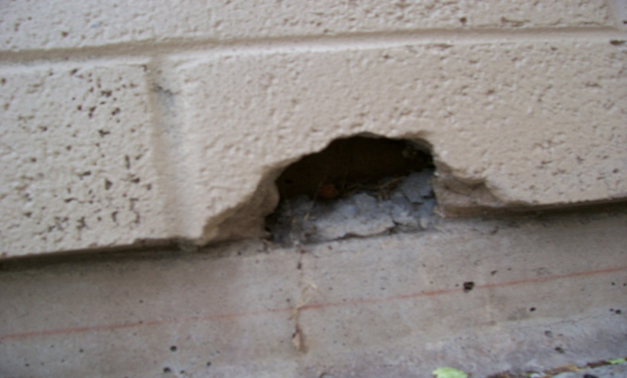
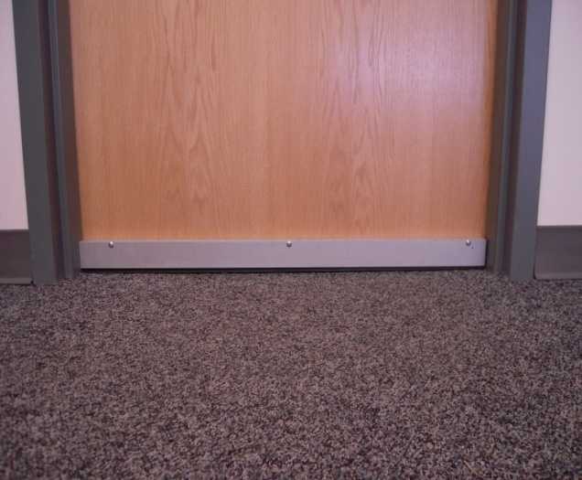
Exclusion and Mechanical Controls
The goal is to seal the building from pests. The level of effort and the associated costs will vary greatly depending upon:
Age and condition of the building
Severity of the pest problem
Level of maintenance
Maintenance budget
Notes:
Note, however, that we found no statistical correlation between the age of the building and pest problems. A new building can have just as many pest issues and an older building.

Slide 13
Pesticides
Use only when appropriate and after all other options have been tried
Apply the least toxic pesticide available
Use the absolute minimum required
Base the timing and coverage on the targeted pest
Require pre-application notification
Require all in-house applicators to be trained and licensed
Treat every pesticide like it might be banned tomorrow… be cautious!
Notes:
Note, the bullets beginning with “Require…” are recommendations. School districts should consult State laws and rules for specific requirements. We have incorporated these two requirements into our IPM program as a matter of best practice, safety and to minimize the risks associated with the improper use of pesticides.

Slide 14
What are Pesticides?
The general term “pesticides” applies to a large group of chemicals that are used to control different types of pests, including weeds and noxious plants. The four groups of chemicals typically used in schools include:
Insecticides – Raid, Bug-B-Gon, Maxforce, Sevin
Rodenticides – Tomcat, d-CON, Warfarin, Revolver
Herbicides – Roundup, Crossbow, Milestone, Weed-B-Gon
Fungicides – Headway, Heritage
Notes:
There are many other classes of chemicals, known as pesticides, including: acaricides, algicides, avicides, bactericides, biocides, miticides, molluscicides, nematicides, virucides, etc.
Herbicides will likely account for the greatest quantity (measured in pounds or gallons) of any pesticide used by a school district. The indoor environment receives all the attention but is the easiest to control without pesticides while the outdoor environment receives no attention but is routinely and unknowingly inundated with pesticides.

Slide 15
Pesticide Labeling
Pesticides are also labeled according to their toxicity. In the US, the EPA uses four toxicity classes – I thru IV. “Signal words” are used to identify these classes as follows:
Class I – Most toxic, DANGER-POISON label
Class II – Moderately toxic, WARNING label
Class III – Slightly toxic, CAUTION label
Class IV – Least toxic, no signal word required
Notes:
Even class III CAUTION label pesticides are dangerous. Typically the signal word is followed by “Harmful if swallowed”, “May be harmful if absorbed through the skin”, “May be harmful in inhaled”, or “May irritate eyes, nose, throat and skin”. Class III materials are estimated to be fatal to an adult human at some doses in excess of 30 grams.

Slide 16
Pesticide Restrictions
The EPA also restricts who can apply pesticides.
General use – A license is not required for these “over-the-counter” retail products
Restricted use – Only a licensed applicator can purchase and apply these products
Notes:
There are fifteen classifications of Commercial and Non-Commercial pesticide applicators in Utah. Applicators most commonly found in the school environment will be licensed in Ornamental and Turf Pest Control, Structural and Health-Related Pest Control and Vertebrate Animal Control.

Slide 17
But… does IPM work?
Notes:
Here’s the question on everyone’s mind.

Slide 18
Our Experience with IPM

Slide 19
What We Have Learned
No additional personnel were required to implement IPM
Completely eliminated the need for a contracted Pest Management Professional or PMP saving $28,000 per year
On-going IPM program costs range from $2,500-$4,000 per year
Pesticide use has dropped significantly – Less than 1 oz of pesticide was used in the ENTIRE District in FY 2011-12*
IPM education and training efforts (initial and on-going) are REQUIRED
The level of expertise of our IPM program personnel continues to increase
Overall pest control has been equal to or better than when we contracted a PMP to routinely spray our buildings on a monthly basis
Pest numbers based on monitoring and reporting continue to decline
* Indoors
Notes:
Start up costs included $2,400 for tools and training and an initial expenditure of $2,000 to fix known exclusion issues.
In 2010, we estimated our on-going costs for IPM to range from $1,500-$1,800/year for monitoring supplies (sticky traps) and $1,000-$2,000 for occasional exclusion issues handled as Work Orders. These costs continue to decline.
We no longer budget for pesticides for indoor use. Herbicide expenditures have remained about the same.
IPM has increased the responsibilities, knowledge and learning expectations and added some new tasks for our supervisors and to a lesser degree to our staff but overall the program has not been burdensome.

Slide 20
Notes:
Most pests exhibit seasonal trends, i.e., they tend to be in our buildings in warmer or colder weather or when food sources from kids and kitchens (crumbs) are at their peak.
This chart also shows the overall downward trend in cockroaches found in our buildings. IPM gives our staff the knowledge to recognize problem areas and how take effective action to prevent or eliminate these pests.
Ants and mice are the other pests most commonly sighted in our schools and they also show a similar downward trend in sighting numbers.

Slide 21
State Laws and Rules
Utah is now one of 34 states that have school IPM laws/rules
Notes:
This is an excellent document that discusses the dangers of pesticides and lists those states that have enacted school IPM laws and rules.

Slide 22
Administrative Rule R392-200
R392-200 Design, Construction, Operation, Sanitation, and Safety of Schools
In Utah, Administrative Rules are “the law”
Last substantive amendment to R392 was August 26, 2013
Entire Rule includes ten sections that cover a wide range of topics
IPM is found under section R392-200-7 paragraph 12
Compliance is easier than you might think
You have options because the Rule on IPM is flexible
The entire Rule can be found at: http://www.rules.utah.gov/publicat/code/r392/r392-200.htm
Notes:
R392 - Health, Disease Control and Prevention, Environmental Services is the main title, under which R392-200 is found. It’s not likely you’d think to look there.
The latest version of R392-200 is a substantive amendment to a rule that has been around for many years.
Other sections of this rule cover topics such as:
Site Standards
School Grounds
Food Service
Sanitary Facilities and Controls
Construction and Maintenance
Health and Safety
Access

Slide 23
Previous Version
K. Insect and Rodent Control
1. General. Effective measures intended to minimize the presence of rodents, flies, cockroaches, bedbugs, lice, or other vermin on the premises shall be utilized. The premises shall be maintained so that propagation, harborage, or feeding of vermin is prevented.
2. Openings. Openings to the outside shall be effectively protected against the entrance of insects, rodents, and other animals. Screens for windows, doors, skylights, intake and exhaust air ducts, and other openings to the outside shall be tight fitting and free of breaks. Screening material shall not be less than sixteen mesh to the inch.
3. Pesticide Application. Restricted-use pesticides shall not be used within buildings or on the grounds unless formulated and dispensed by a pesticide applicator certified by the Utah State Department of Agriculture. All labeled directions for use shall be specifically followed, and products without label directions are prohibited from use.
Notes:
This is the section/paragraph dealing with pests from the previous version of R392.

Slide 24
Compliance Suggestions
(12) Pest Management.
a) “The governing body shall minimize in school buildings or on school grounds the presence of pests that are vectors for disease, carry allergens that are likely to affect individuals with allergies or respiratory problems, or may sting or bite causing mild to serious reactions in some individuals.”
Options/Suggestions:
Contract with a Pest Management Professional or PMP to handle all or some inside and/or outside* pest related problems
Handle some or all inside and outside pest related problems with in-house personnel * Contracted landscaping services must be licensed to apply restricted use herbicides for weed control
Notes:
This is paragraph 12 of section 7 of the new rule that deals with IPM. We’ll cover each of the five sub-sections of the paragraph individually and discus options and possible suggestions for compliance.

Slide 25
Compliance Suggestions
b) “The governing body shall adopt integrated pest management (IPM) practices and principles to prevent unacceptable levels of pest activity with the least possible hazard to people, property, and the environment.”
Options/Suggestions:
Contract with a PMP who understands and practices IPM and can implement and manage a comprehensive program that meets all the requirements of the Rule
Develop, implement and manage an in-house IPM program that meets all the requirements of the Rule

Slide 26
Compliance Suggestions
c) “The governing body shall have a written integrated pest management plan written by the governing body or provided by the contracted pest management contractor whether IPM is implemented as an internal process or contracted to a pest management professional. The plan shall include sections that cover the following topics: an IPM policy statement; IPM implementation and education; pest identification, monitoring procedures, reporting and control practices; approved pesticides; procedures for pesticide use; a policy for the notification of students, parents, and staff; and applicator requirements. Guidance for an IPM plan can be found in publications of the IPM Institute of North America. The Department or the Local Health Officer may require changes in a school's IPM plan if the plan neglects or causes a threat to the health or safety of the occupants of a school.”
Options/Suggestions:
Sample plans are available from Internet resources
A written plan is required for in-house or contracted IPM programs
The written plan needs to address each of the elements described above

Slide 27
Compliance Suggestions
c) “The governing body shall have a written integrated pest management plan written by the governing body or provided by the contracted pest management contractor whether IPM is implemented as an internal process or contracted to a pest management professional. The plan shall include sections that cover the following topics: an IPM policy statement; IPM implementation and education; pest identification, monitoring procedures, reporting and control practices; approved pesticides; procedures for pesticide use; a policy for the notification of students, parents, and staff; and applicator requirements. Guidance for an IPM plan can be found in publications of the IPM Institute of North America. The Department or the Local Health Officer may require changes in a school's IPM plan if the plan neglects or causes a threat to the health or safety of the occupants of a school.”
Options/Suggestions:
Sample policy statements are available from Internet resources
A policy statement conveys the “intent” of your IPM program
A policy statement typically references the procedures to be followed
Procedures describe the details of “how” your IPM program will accomplish your intent

Slide 28
Compliance Suggestions
c) “The governing body shall have a written integrated pest management plan written by the governing body or provided by the contracted pest management contractor whether IPM is implemented as an internal process or contracted to a pest management professional. The plan shall include sections that cover the following topics: an IPM policy statement; IPM implementation and education; pest identification, monitoring procedures, reporting and control practices; approved pesticides; procedures for pesticide use; a policy for the notification of students, parents, and staff; and applicator requirements. Guidance for an IPM plan can be found in publications of the IPM Institute of North America. The Department or the Local Health Officer may require changes in a school's IPM plan if the plan neglects or causes a threat to the health or safety of the occupants of a school.”
Options/Suggestions:
Describe a general overview of your IPM program
Describe by who and how your IPM program will be managed
Describe the roles, responsibilities and expectations for teachers and staff
Describe how you will train and educate administrators, teachers and staff both initially and on-going into the future

Slide 29
Compliance Suggestions
c) “The governing body shall have a written integrated pest management plan written by the governing body or provided by the contracted pest management contractor whether IPM is implemented as an internal process or contracted to a pest management professional. The plan shall include sections that cover the following topics: an IPM policy statement; IPM implementation and education; pest identification, monitoring procedures, reporting and control practices; approved pesticides; procedures for pesticide use; a policy for the notification of students, parents, and staff; and applicator requirements. Guidance for an IPM plan can be found in publications of the IPM Institute of North America. The Department or the Local Health Officer may require changes in a school's IPM plan if the plan neglects or causes a threat to the health or safety of the occupants of a school.”
Options/Suggestions:
Describe how your IPM program will educate teachers and staff about pests, their habits/to properly identify
Describe how your IPM program will monitor for pests or pest activity, how this information will be used and how it will be reported to a contracted PMP or to in-house personnel, e.g., IPM Coordinator
Describe the steps your IPM program will use to control pests

Slide 30
Compliance Suggestions
c) “The governing body shall have a written integrated pest management plan written by the governing body or provided by the contracted pest management contractor whether IPM is implemented as an internal process or contracted to a pest management professional. The plan shall include sections that cover the following topics: an IPM policy statement; IPM implementation and education; pest identification, monitoring procedures, reporting and control practices; approved pesticides; procedures for pesticide use; a policy for the notification of students, parents, and staff; and applicator requirements. Guidance for an IPM plan can be found in publications of the IPM Institute of North America. The Department or the Local Health Officer may require changes in a school's IPM plan if the plan neglects or causes a threat to the health or safety of the occupants of a school.”
Options/ Suggestions:
Develop and list those pesticides, including insecticides, rodenticides, herbicides and fungicides that your District will approve for application either by a contracted PMP or in-house personnel
Minimize risk by selecting only pesticides with the lowest level of toxicity for the intended application

Slide 31
Compliance Suggestions
c) “The governing body shall have a written integrated pest management plan written by the governing body or provided by the contracted pest management contractor whether IPM is implemented as an internal process or contracted to a pest management professional. The plan shall include sections that cover the following topics: an IPM policy statement; IPM implementation and education; pest identification, monitoring procedures, reporting and control practices; approved pesticides; procedures for pesticide use; a policy for the notification of students, parents, and staff; and applicator requirements. Guidance for an IPM plan can be found in publications of the IPM Institute of North America. The Department or the Local Health Officer may require changes in a school's IPM plan if the plan neglects or causes a threat to the health or safety of the occupants of a school.”
Options/Suggestions:
Describe how pesticides will be stored, used, applied, who applies and how they are accounted for in your District

Slide 32
Compliance Suggestions
c) “The governing body shall have a written integrated pest management plan written by the governing body or provided by the contracted pest management contractor whether IPM is implemented as an internal process or contracted to a pest management professional. The plan shall include sections that cover the following topics: an IPM policy statement; IPM implementation and education; pest identification, monitoring procedures, reporting and control practices; approved pesticides; procedures for pesticide use; a policy for the notification of students, parents, and staff; and applicator requirements. Guidance for an IPM plan can be found in publications of the IPM Institute of North America. The Department or the Local Health Officer may require changes in a school's IPM plan if the plan neglects or causes a threat to the health or safety of the occupants of a school.”
Options/Suggestions:
Describe where, how and when students, parents and staff will be notified prior to the application of pesticides by either a contracted PMP or in-house personnel

Slide 33
Compliance Suggestions
c) “The governing body shall have a written integrated pest management plan written by the governing body or provided by the contracted pest management contractor whether IPM is implemented as an internal process or contracted to a pest management professional. The plan shall include sections that cover the following topics: an IPM policy statement; IPM implementation and education; pest identification, monitoring procedures, reporting and control practices; approved pesticides; procedures for pesticide use; a policy for the notification of students, parents, and staff; and applicator requirements. Guidance for an IPM plan can be found in publications of the IPM Institute of North America. The Department or the Local Health Officer may require changes in a school's IPM plan if the plan neglects or causes a threat to the health or safety of the occupants of a school.”
Options/Suggestions:
Describe licensing requirements, if any, for in-house pesticide applicators
However:
Licensing is recommend to ensure applicators are knowledgeable and competent
Costs $20/person for initial training and licensing examination
Requires 24 hours of CEU credit during the 3 year term or re-examination
Requires license renewal every three years
Notes:
Under current laws in Utah, anyone can apply off-the-shelf (General use) pesticides. Because of our commitment to IPM we believe our Custodial supervisors and Grounds staff must have a higher level of knowledge of pesticides and herbicides. The ironic thing is, by following IPM principles we don’t expect to ever need to apply pesticides!
Contact Utah Department of Agriculture and Food, Licensing and Regulation for information on pesticide applicator training and licensing.
Because weeds are pests too, herbicides are applied more routinely.

Slide 34
Compliance Suggestions
d) “The governing body shall use non-chemical management methods whenever possible to provide the desired control. The governing body shall use a full range of control alternatives including: identification and removal or repair of conditions that are conducive to pests; structural repair and sealing; improved sanitation; removal of clutter or harborage; elimination of food sources; exclusionary measures to protect doors, windows and any other opening to the outside against the entrance of insects, rodents, and other animals. A no-action alternative shall also be considered in cases where the pest has no public health or property damage significance.”
Options/Suggestions:
A full range of control alternatives includes the basic IPM principles:
Educational efforts – Communicate how reducing pest conducive conditions reduces pest problems in pest vulnerable areas
Behavior/cultural changes – Focus on better housekeeping, improved sanitation and less clutter, particularly in pest venerable areas
Mechanical controls – Install screens, door sweeps and caulking as needed
Pesticides – Use the least toxic available, targeted to the specific pest and used in the least amount possible after all other controls have be tried
Develop tolerance for incidental pests

Slide 35
Compliance Suggestions
e) “If the governing body chooses to not use a contracted pest control contractor, school personnel who apply pesticides shall follow the Utah Dept. of Agriculture pesticide regulation R68-7. The applicator shall apply all products according to the pesticide label directions.”
Options/Suggestions:
R68-7 does NOT require in-house personnel to be licensed unless applying Restricted Use pesticides
R68-7 does require that anyone applying a Restricted Use pesticide is licensed

Slide 36
Challenges to Success
Find a “champion” to lead your program
Ensure the administration is aware of the new Rule and the requirements
Decide how to approach the rule requirements – “Top down/Bottom up”
Gain “buy in” and cooperation from other departments
Reach out and communicate your message and goals to teachers and staff
Sustain your on-going educational and training efforts
Track and communicate your results to validate success
Recognize pest management expenditures are typically insignificant and receive little or no scrutiny during budget preparation
Evaluate your organizational structure
Recognize outdoor pests will be a greater IPM challenge than indoor pests
Be aware of your circumstances, e.g., geography, building age, staffing, etc.

Slide 37
National Resources
EPA http://www.epa.gov/pesticides/ipm/
IPM Institute of North America http://www.ipminstitute.org/
National Pesticide Information Center http://npic.orst.edu/
School IPM 2015 http://www.ipminstitute.org/school_ipm_2015/
University of Florida http://schoolipm.ifas.ufl.edu/
University of Arizona http://ag.arizona.edu/urbanipm/
Texas A&M http://schoolipm.tamu.edu/
University of California, Davis http://www.ipm.ucdavis.edu/
Western IPM Center http://www.wrpmc.ucdavis.edu/
Beyond Pesticides http://www.beyondpesticides.org/

Slide 38
State and Local Resources
Utah Department of Agriculture and Food
http://ag.utah.gov/
Scott Oldham
Pesticide Program Manager
soldham@utah.gov
801 538-7183
Utah State University Extension
http://utahpests.usu.edu/ipm/
For assistance with your IPM program and pest identification, contact:
Ryan Davis
Arthropod Diagnostician Utah Plant Pest Diagnostic Lab ryan.davis@usu.edu
(435) 797-2435
Ryan Davis

Slide 39
Utah IPM Coalition
Organized in 2007 by the Salt Lake City School District to share IPM experiences
The Coalition usually met 1 or 2 times per year
Participation was limited to greater Wasatch Front school districts to minimize travel time for others
The new rule creates a need to continue the Coalition
Possible ideas for improving and perpetuating the Utah IPM coalition:
Share hosting and agenda responsibilities
Solicit participation and involvement from local health departments
Become a regular session at UFOMA meetings
Form a southern Utah IPM Coalition
Notes:
We’ve been remiss over the past year or so in holding meetings but the new rule has created need to reinvigorate the Coalition.

Slide 40
Questions?

