Slide 1
Gunnison G-Hill
Observations and Concepts

Slide 2
Presentation Overview
Role and Mission of USU LAEP Extension
Approach to the G-Hill Project
Observations and Impressions
Design Process – Network to Site Scale

Slide 3
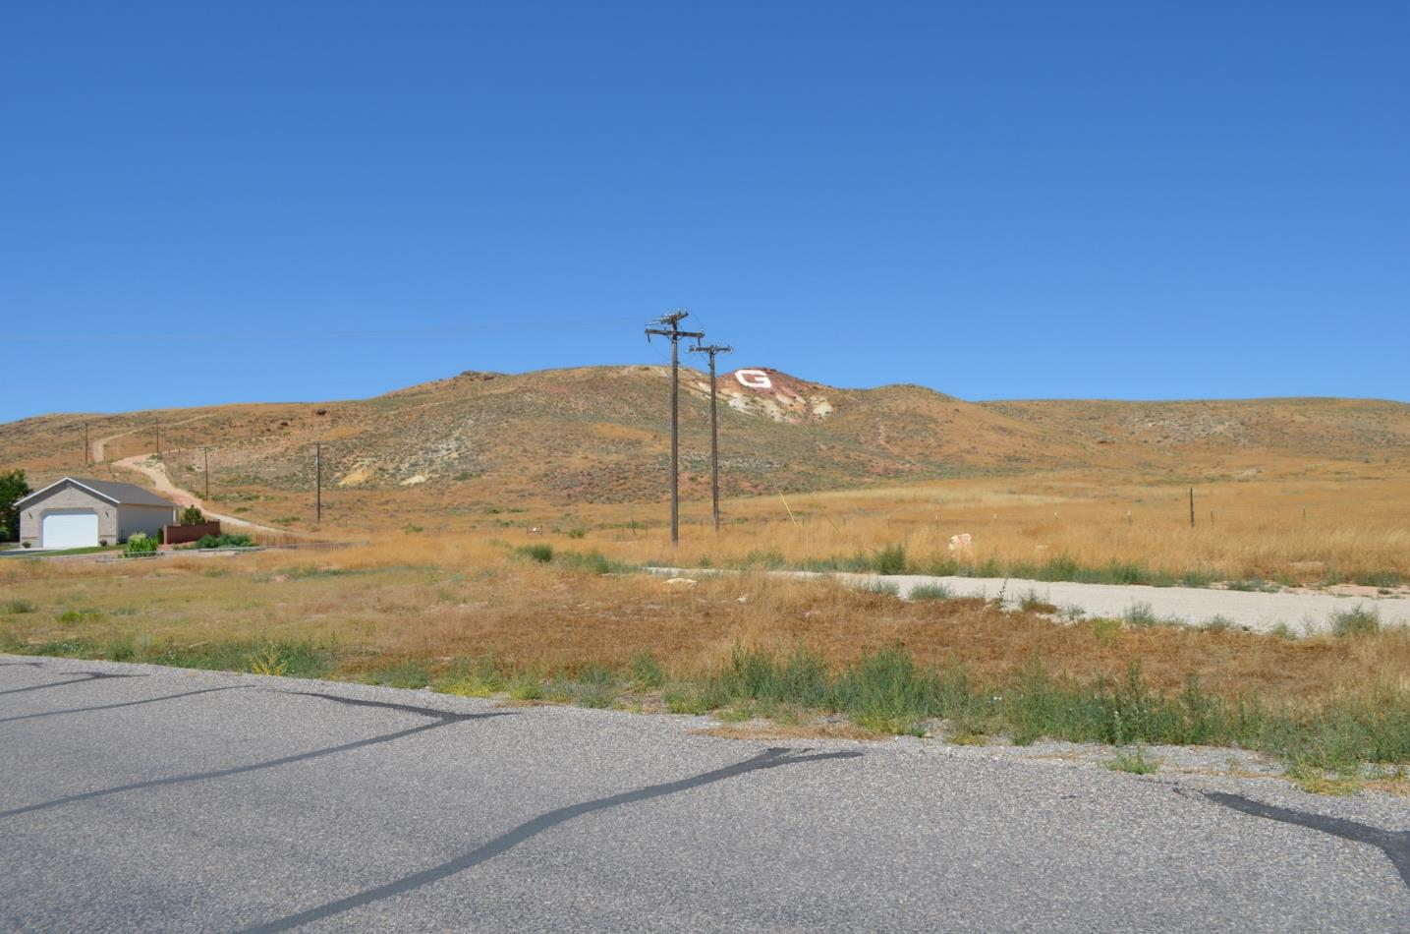

Slide 4
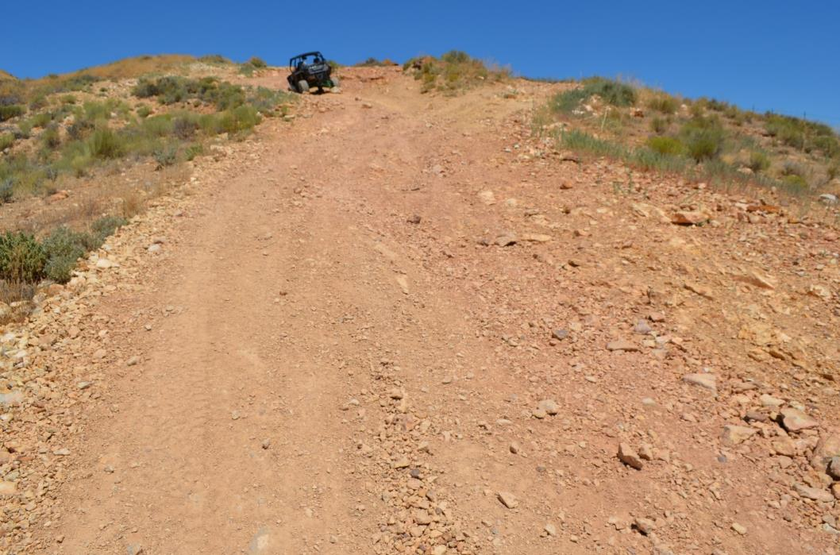
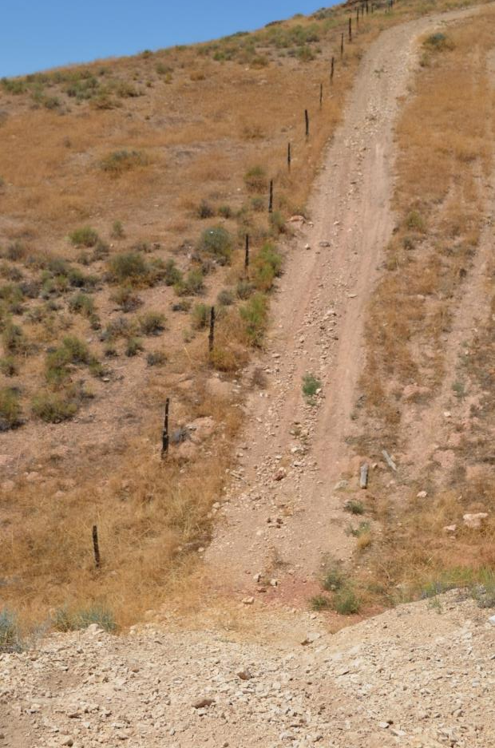

Slide 5
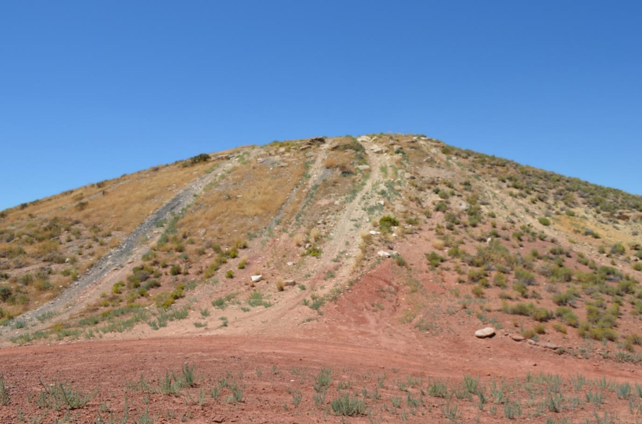

Slide 6
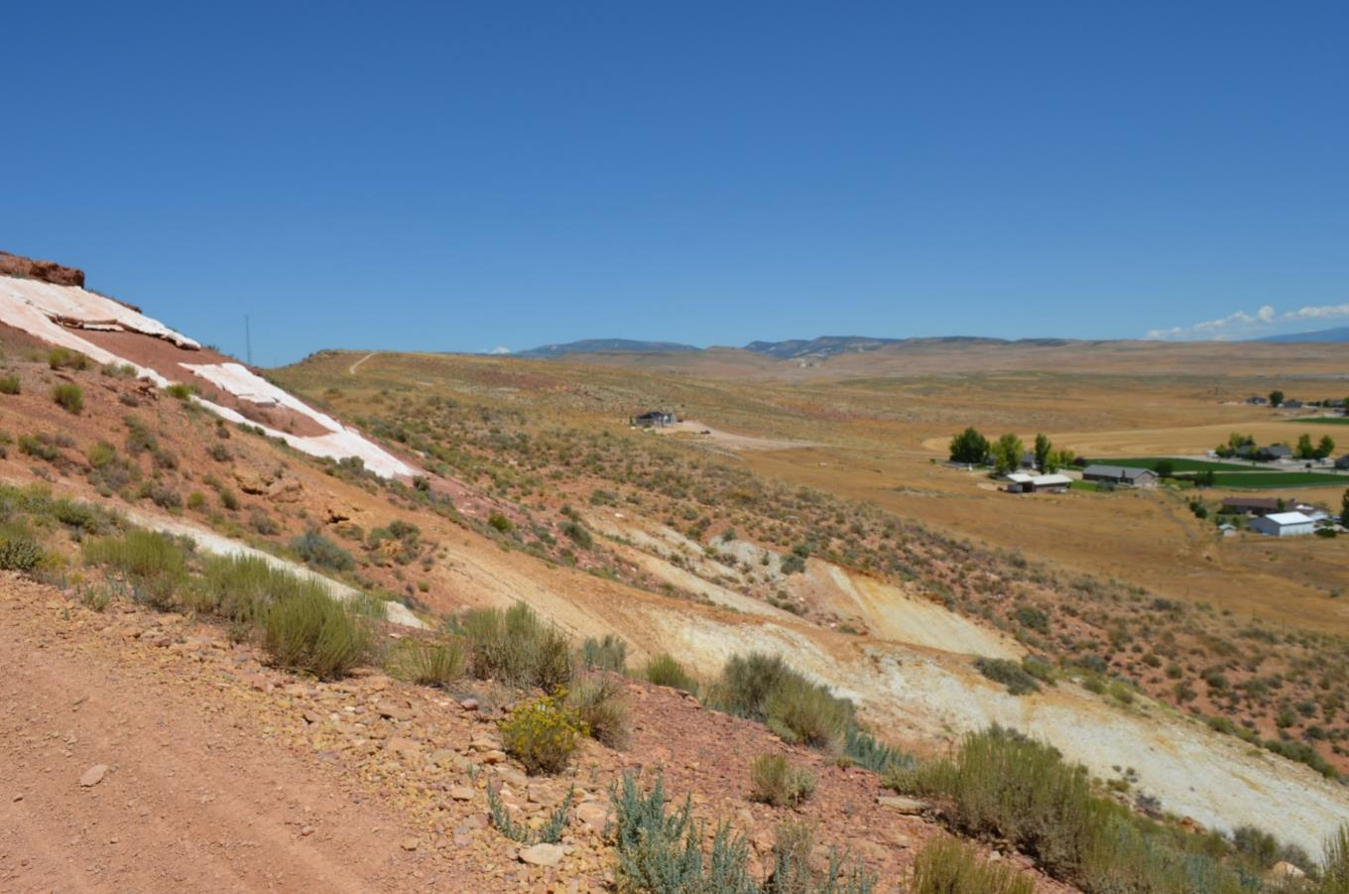

Slide 7
Trail Network Concepts
Existing Conditions

Slide 8
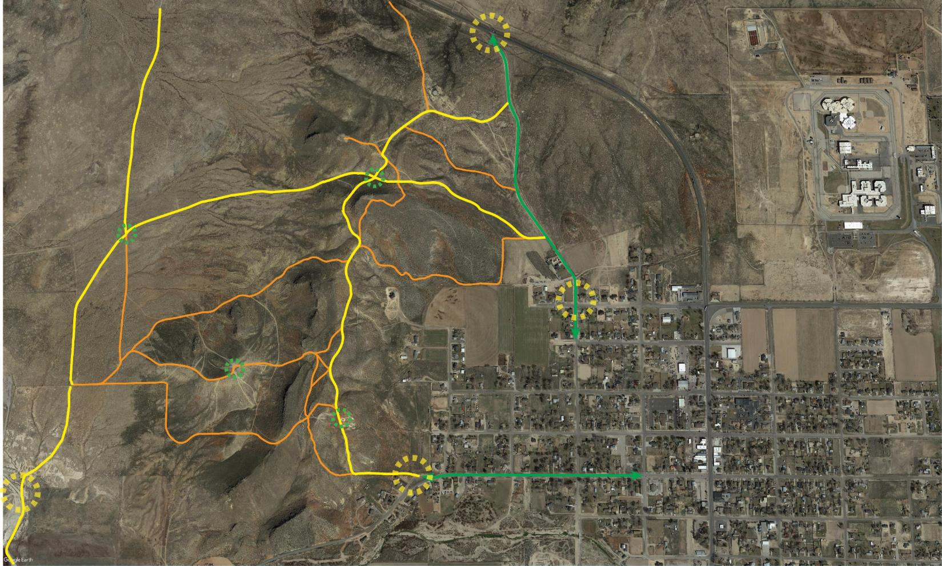
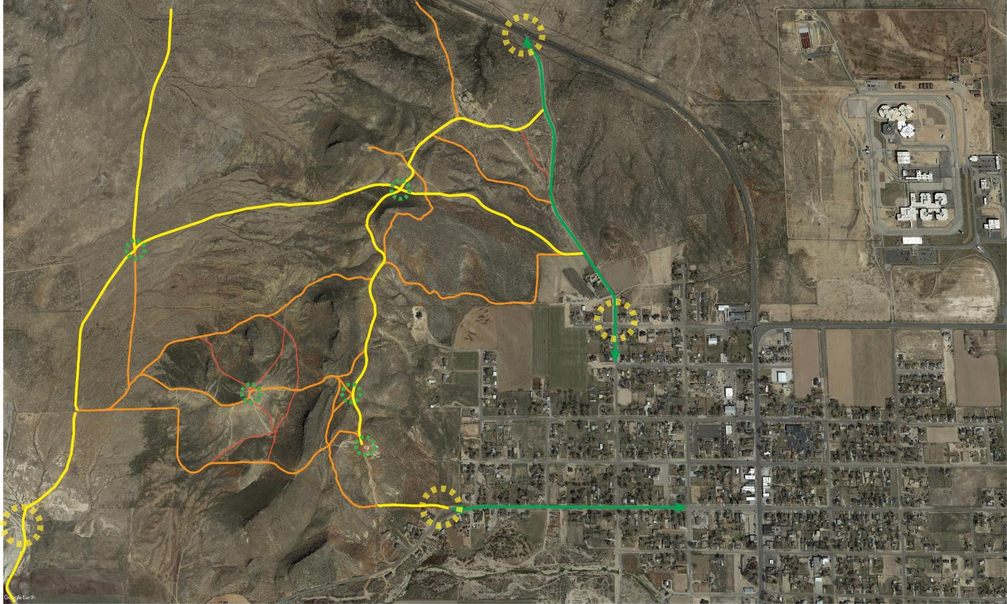
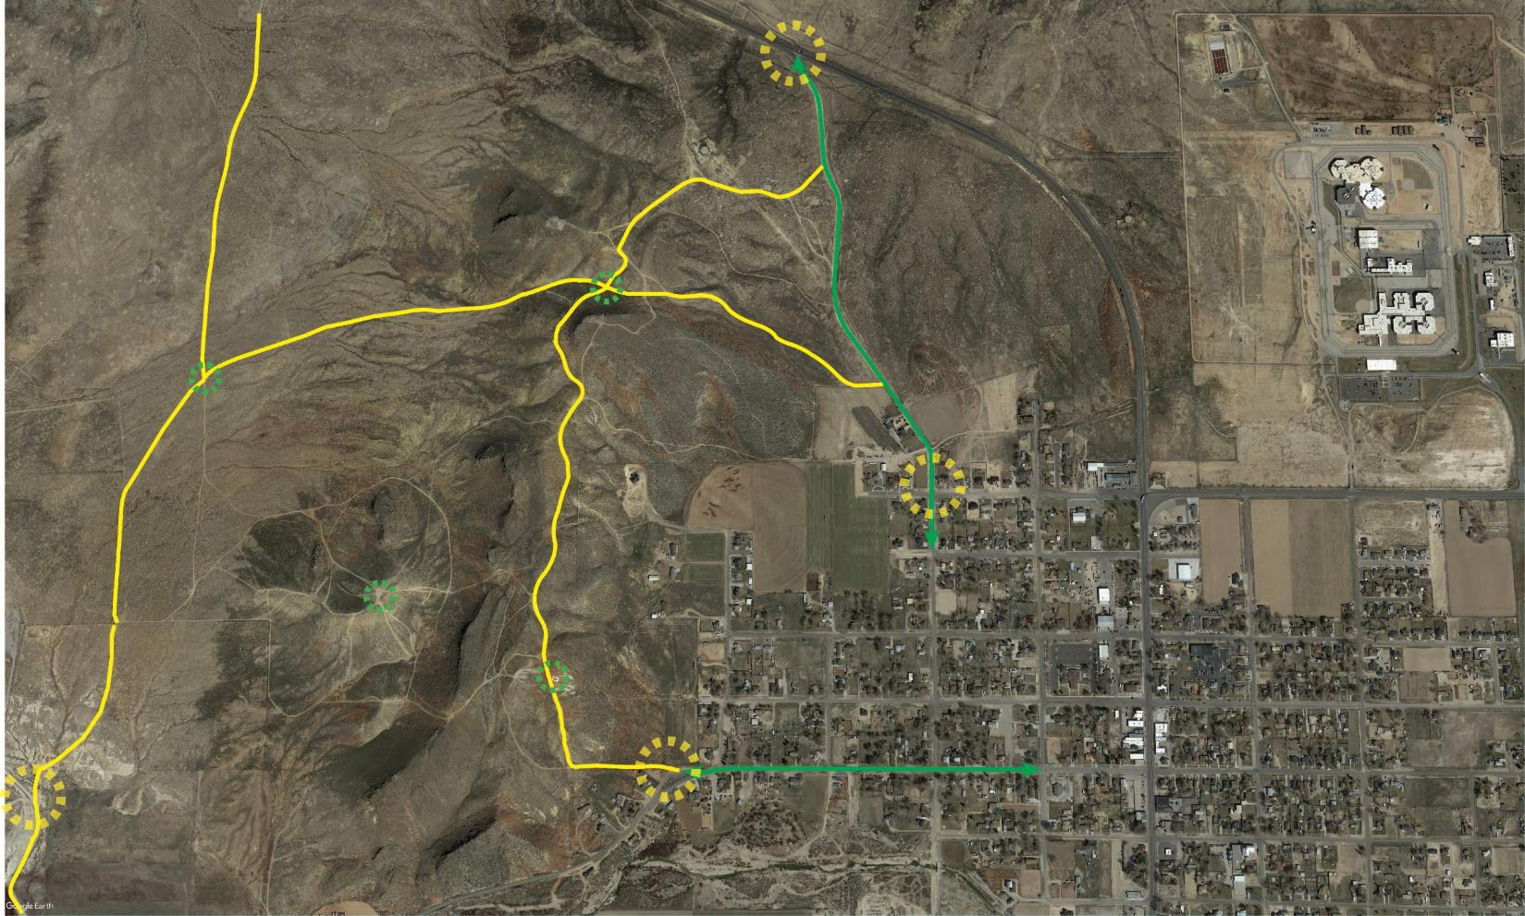
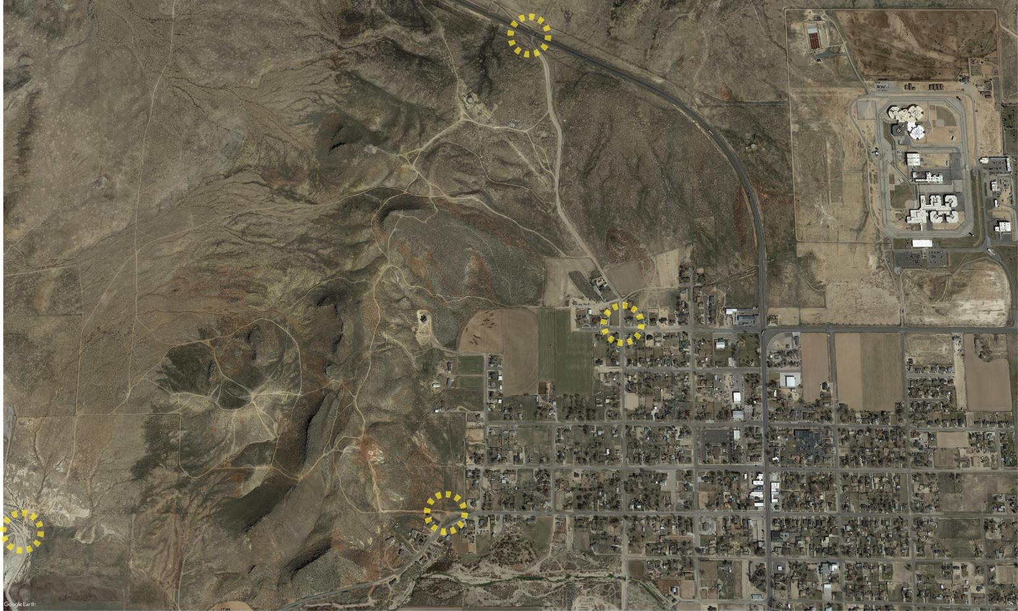
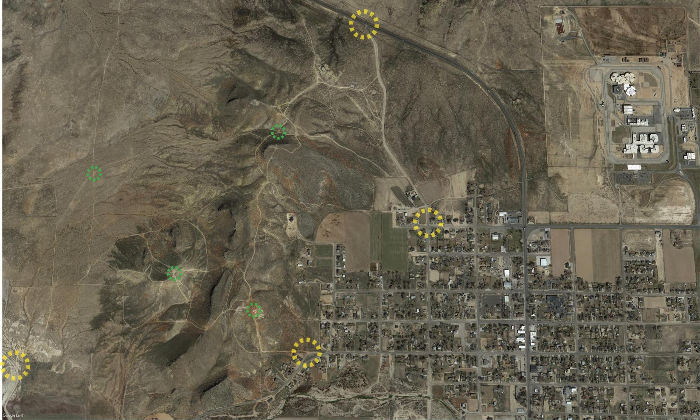

Slide 9
Trail Network Concepts
Proposed Networks

Slide 10
Trail user overview

Slide 11
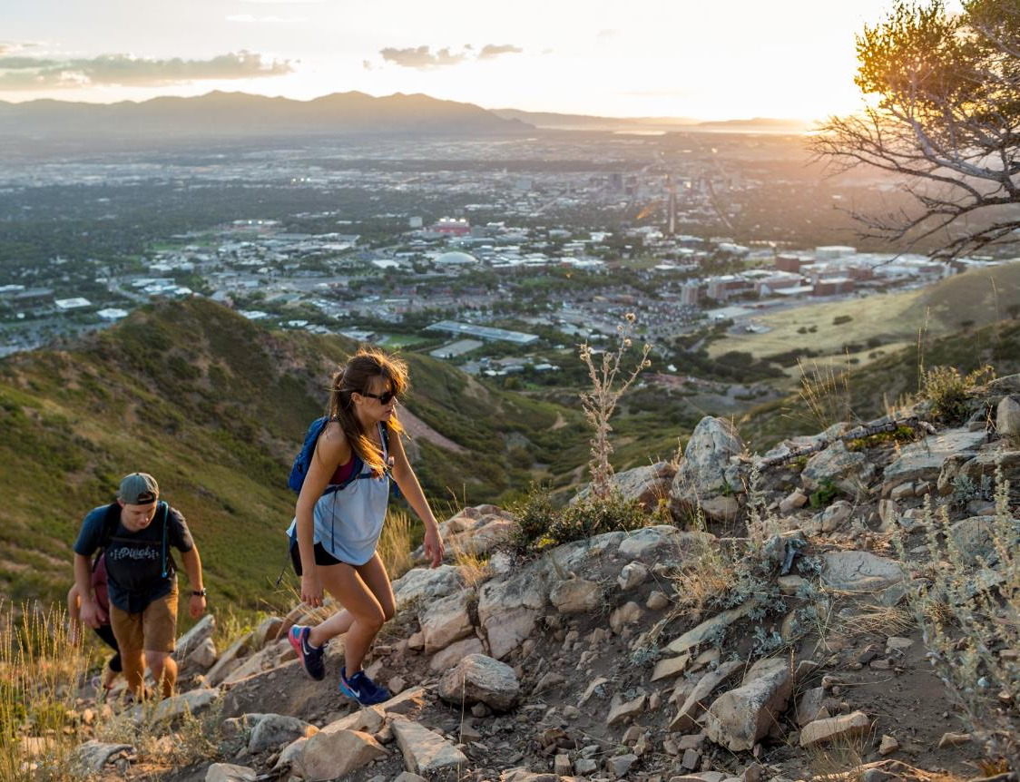
Hikers
Visual and Auditory Impact
Climate Sensitivity
Trail Slope Sensitivity
Distance Preference
Conflict Sensitivity
Desires

Slide 12
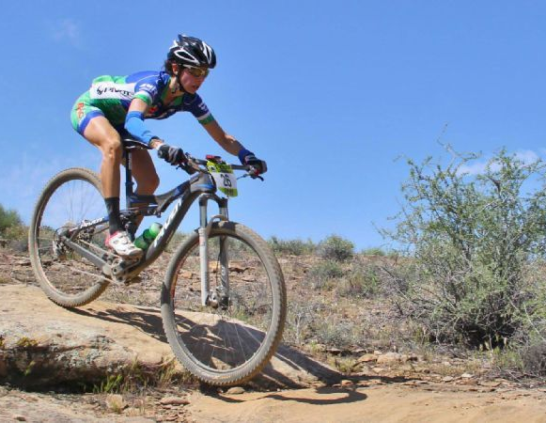
Bikers
Visual and Auditory Impact
Climate Sensitivity
Trail Slope Sensitivity
Distance Preference
Conflict Sensitivity
Desires

Slide 13
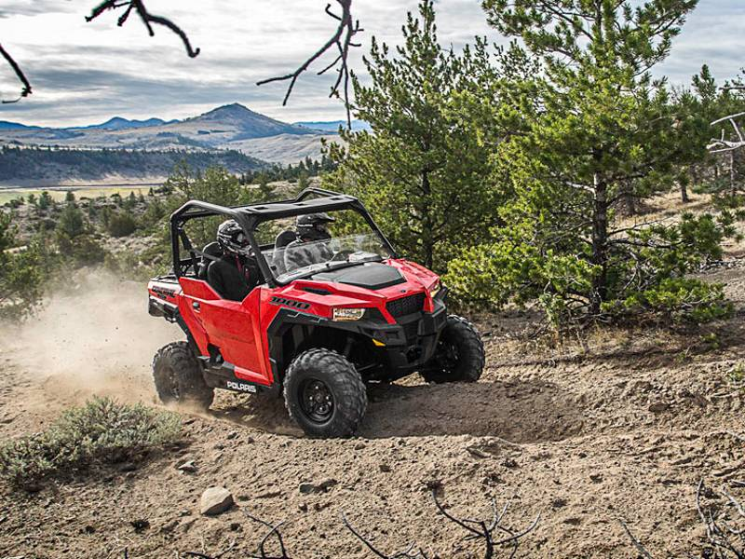
Motorized
Visual and Auditory Impact
Climate Sensitivity
Trail Slope Sensitivity
Distance Preference
Conflict Sensitivity
Desires

Slide 14
Managing
Conflicting
Uses
Motorized
Biking
Hiking

Slide 15
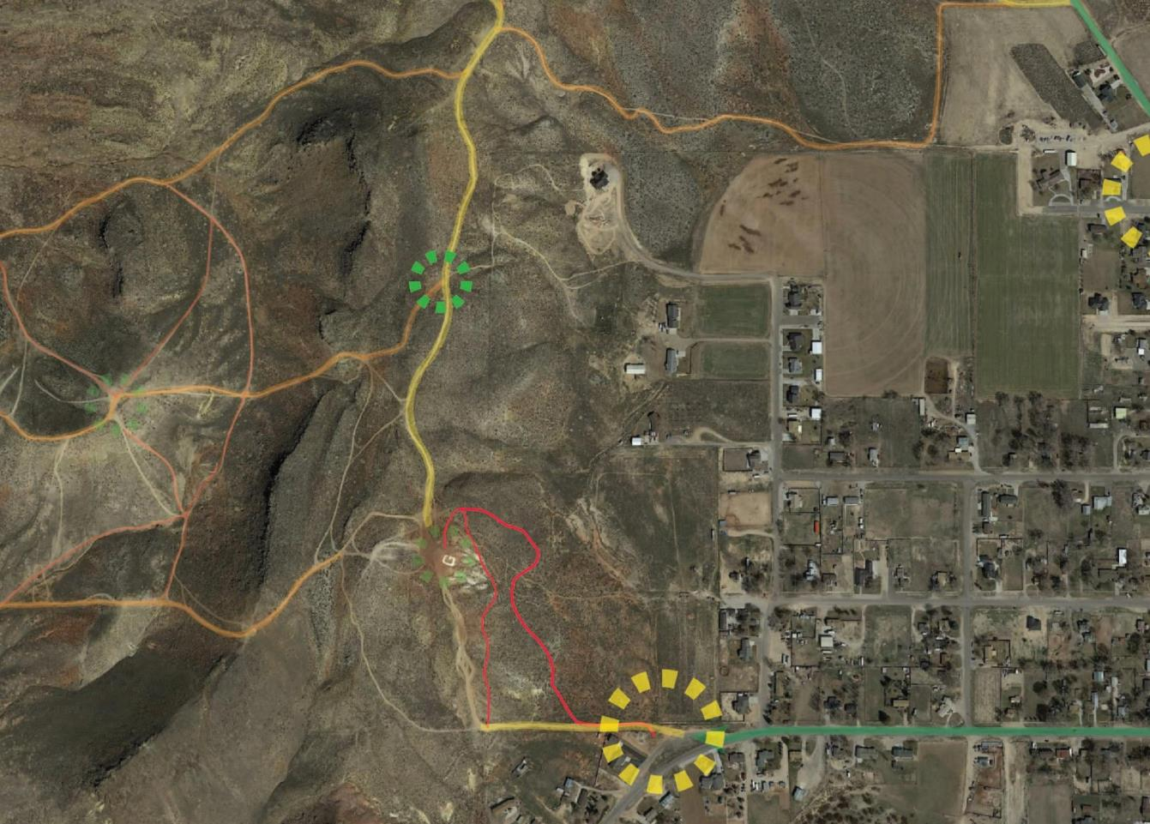
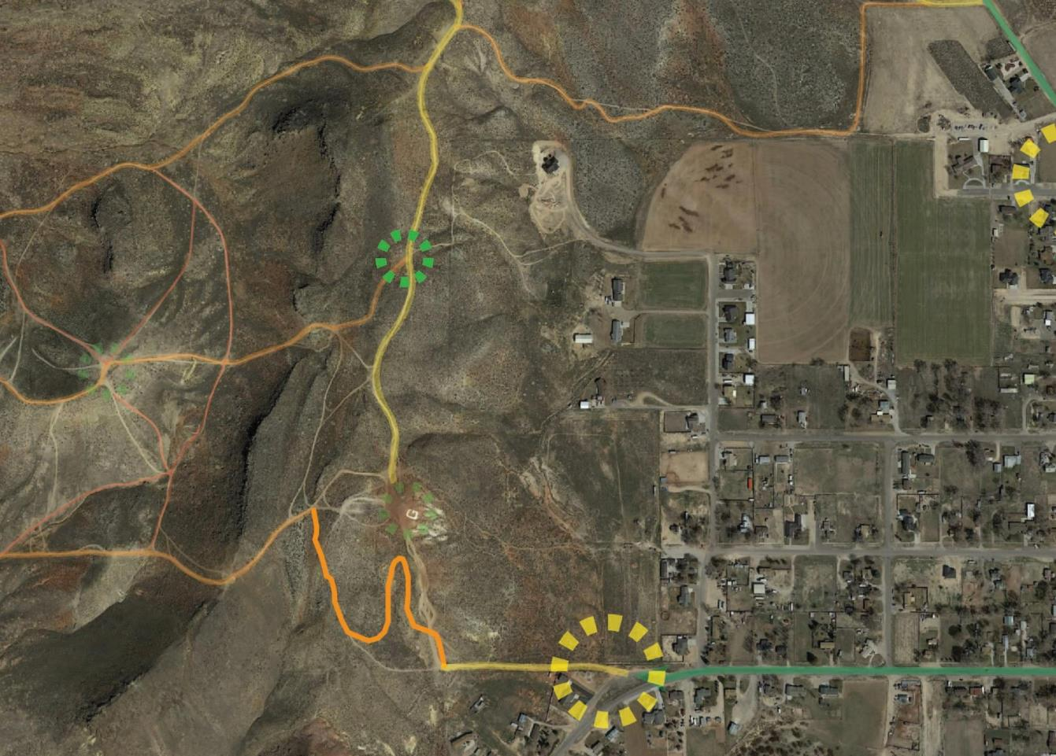
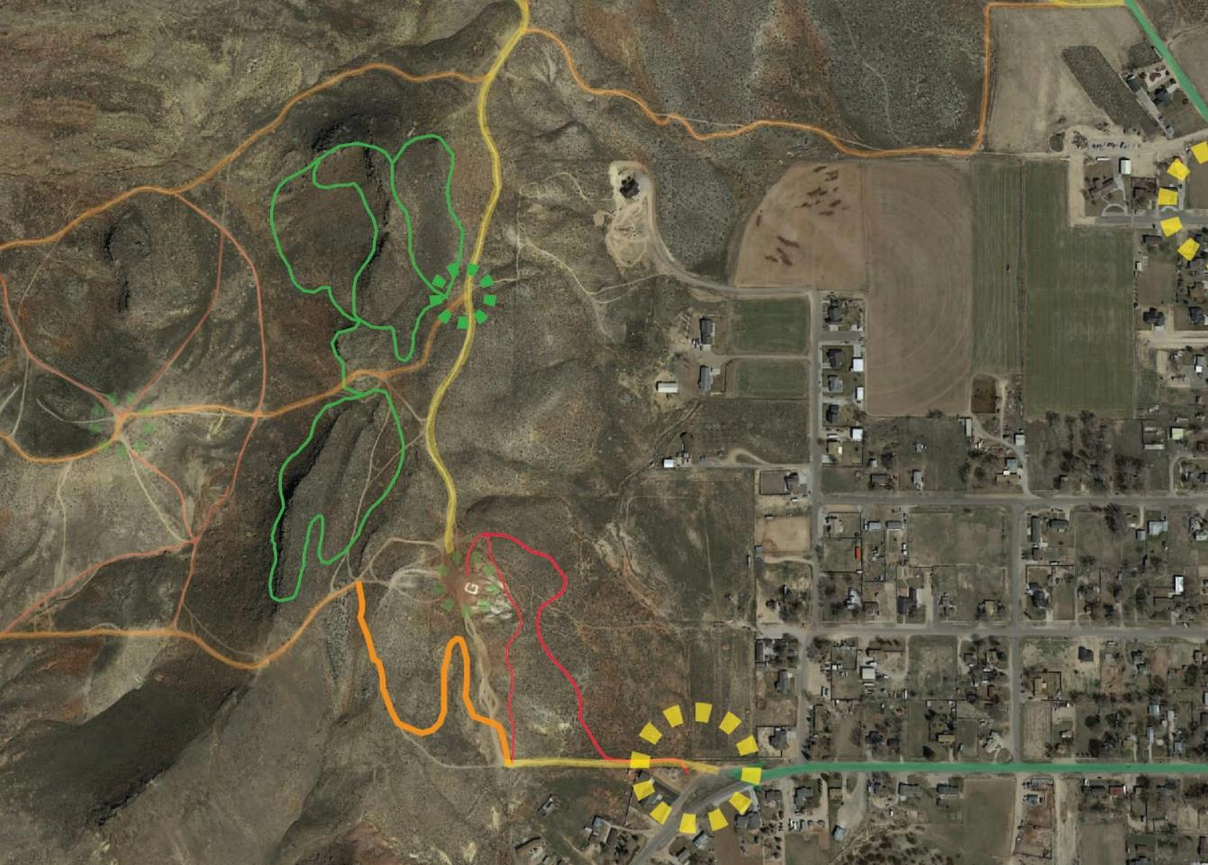
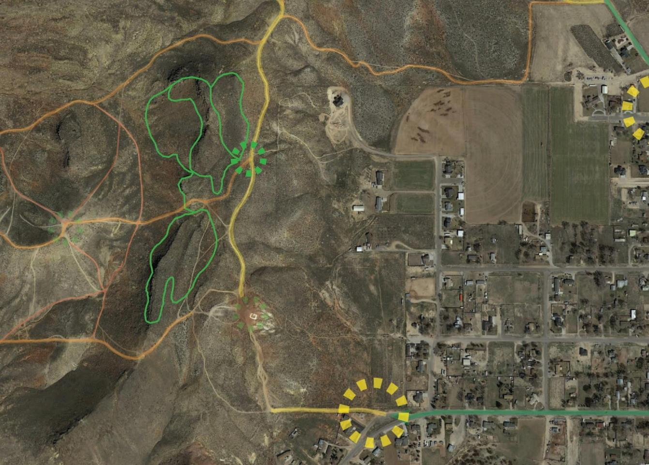

Slide 16
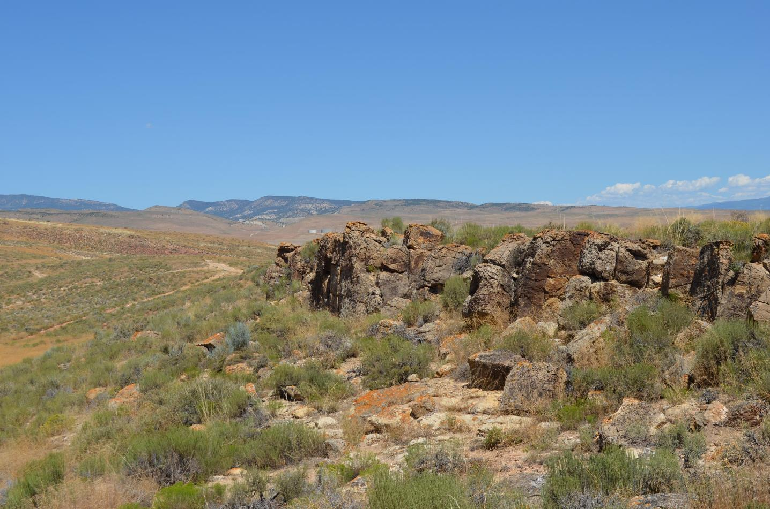
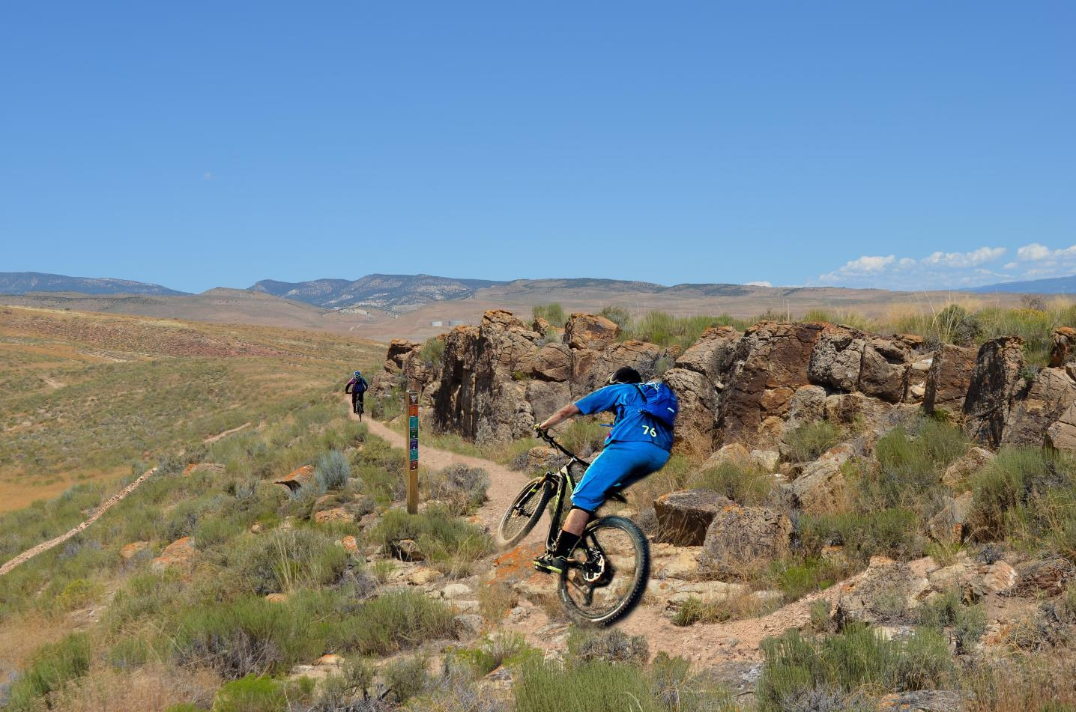

Slide 17
Northern Access Point
Concepts

Slide 18
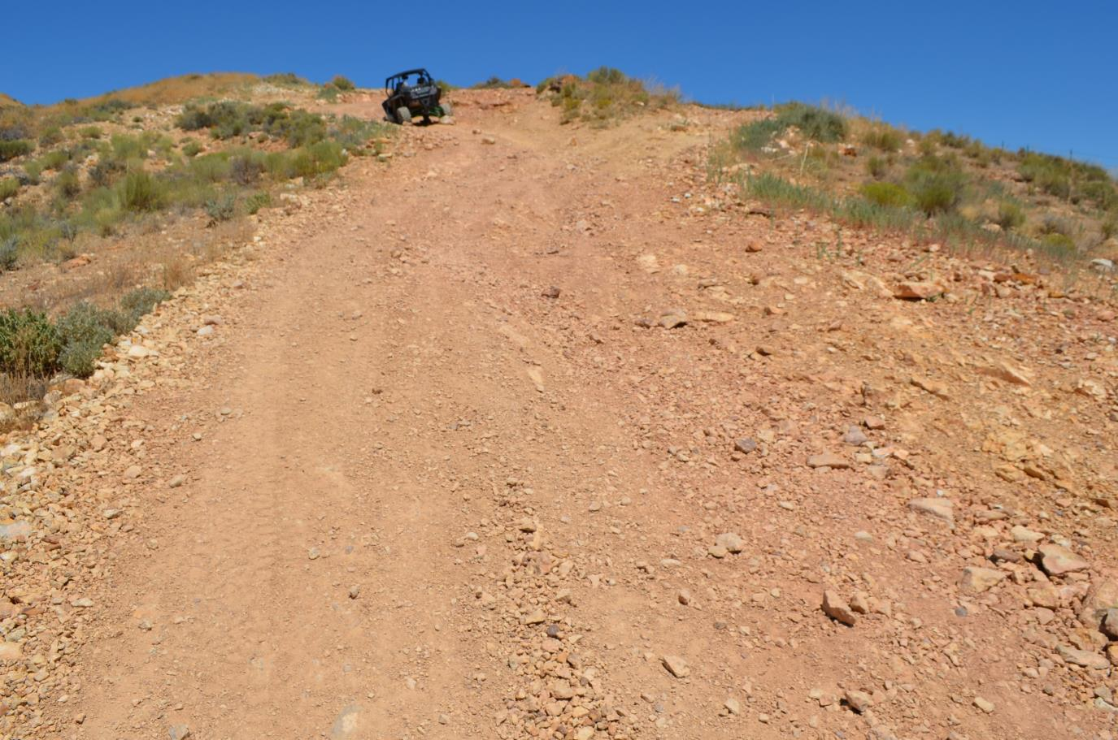
G-Hill Journey

Slide 19
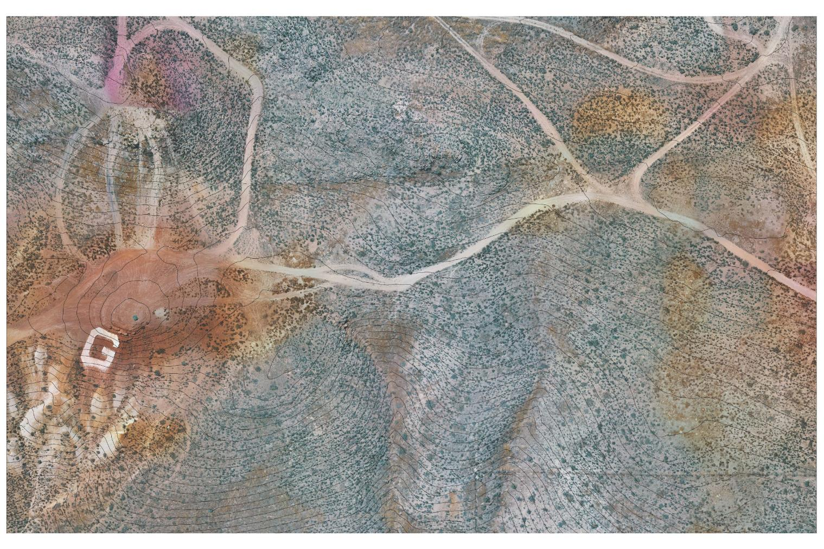
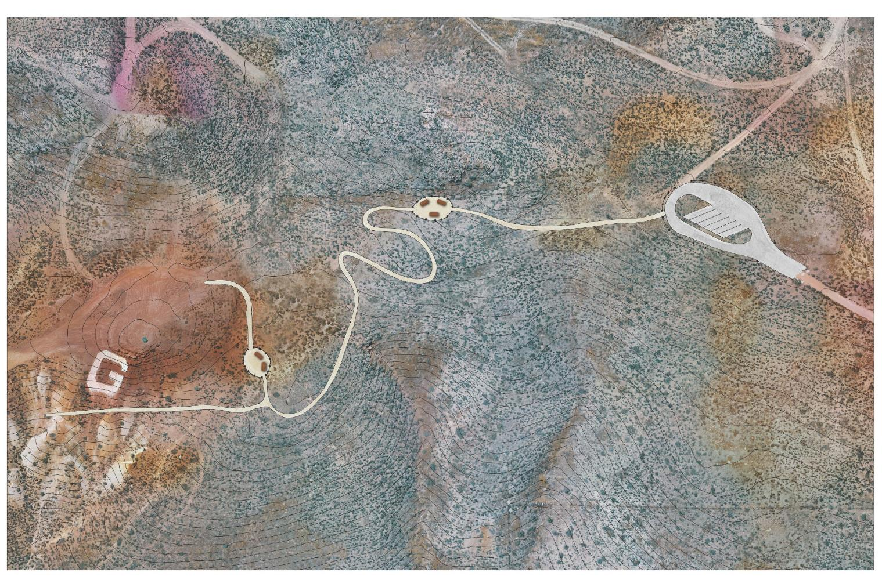
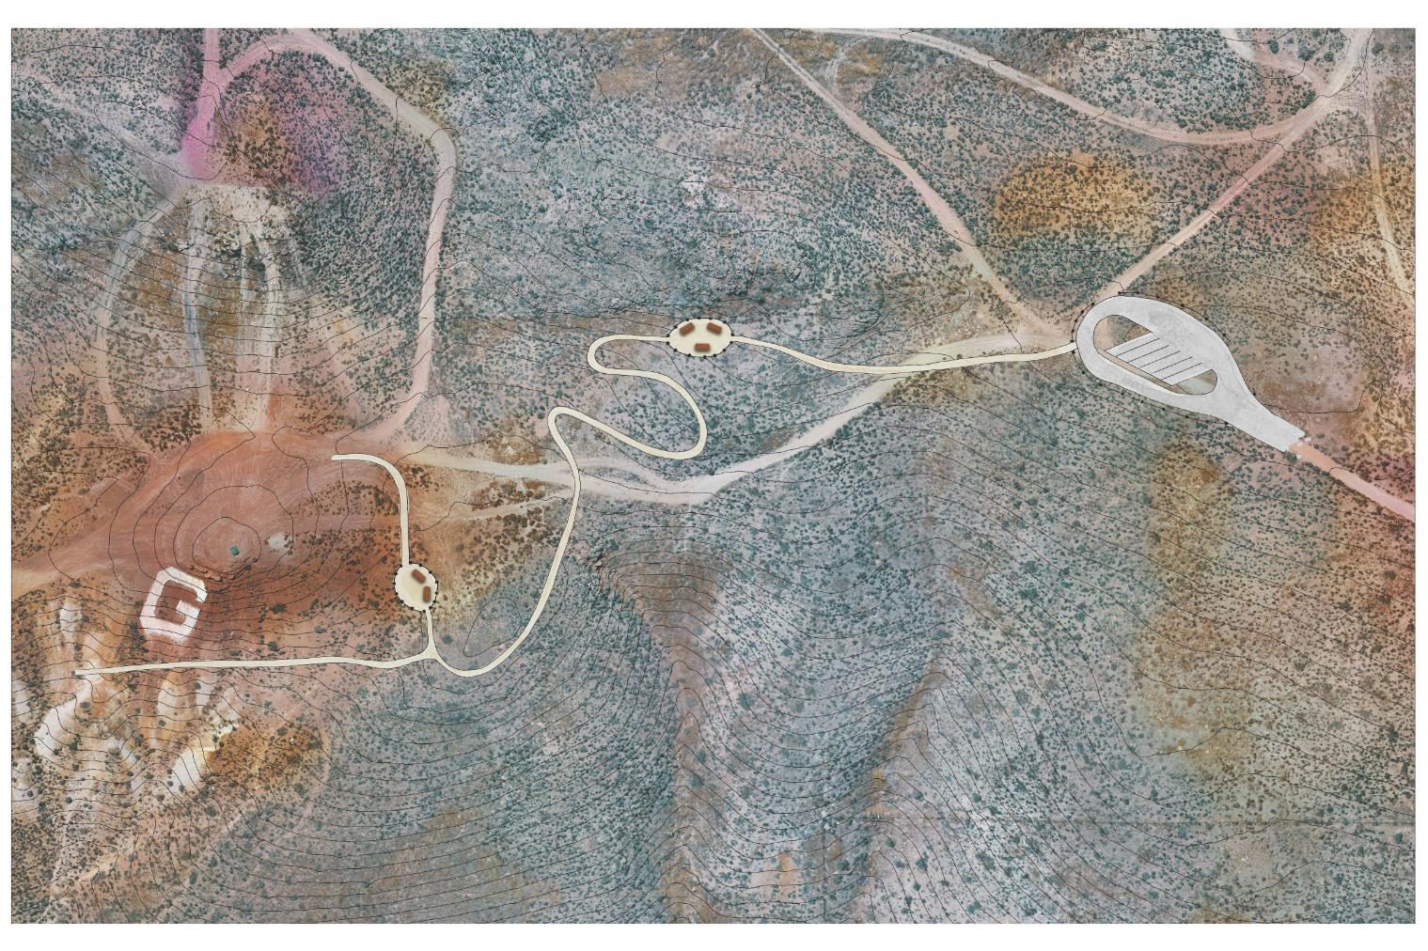
G-Hill Journey

Slide 20
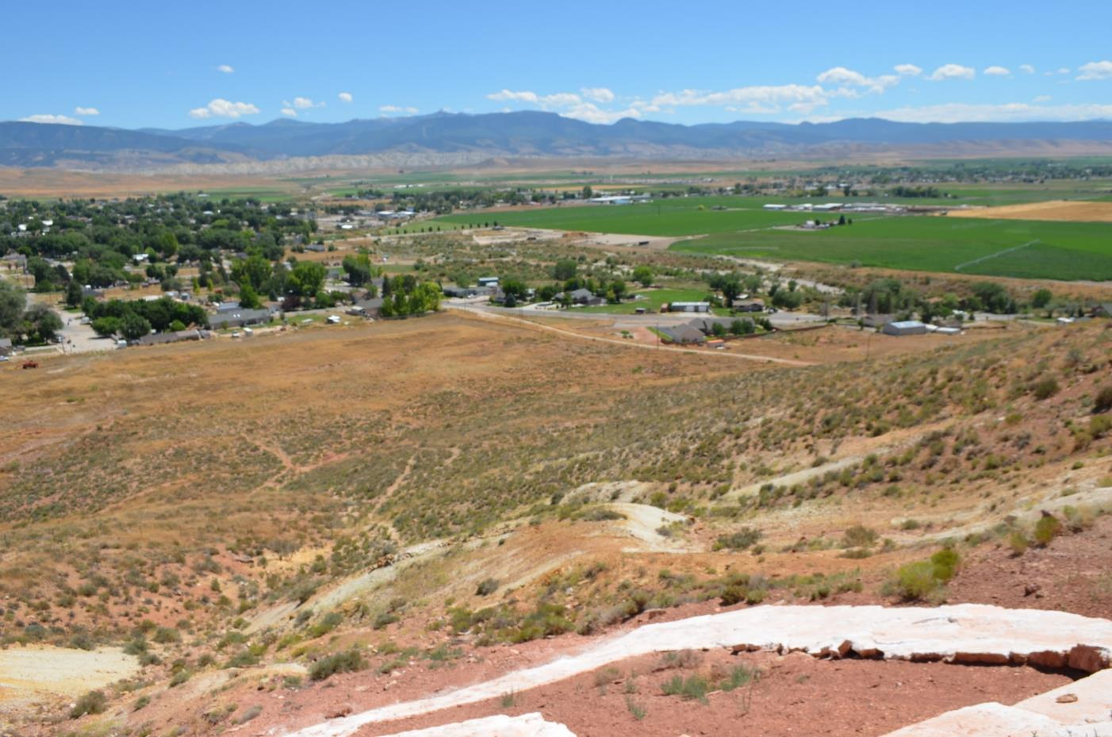
Views

Slide 21
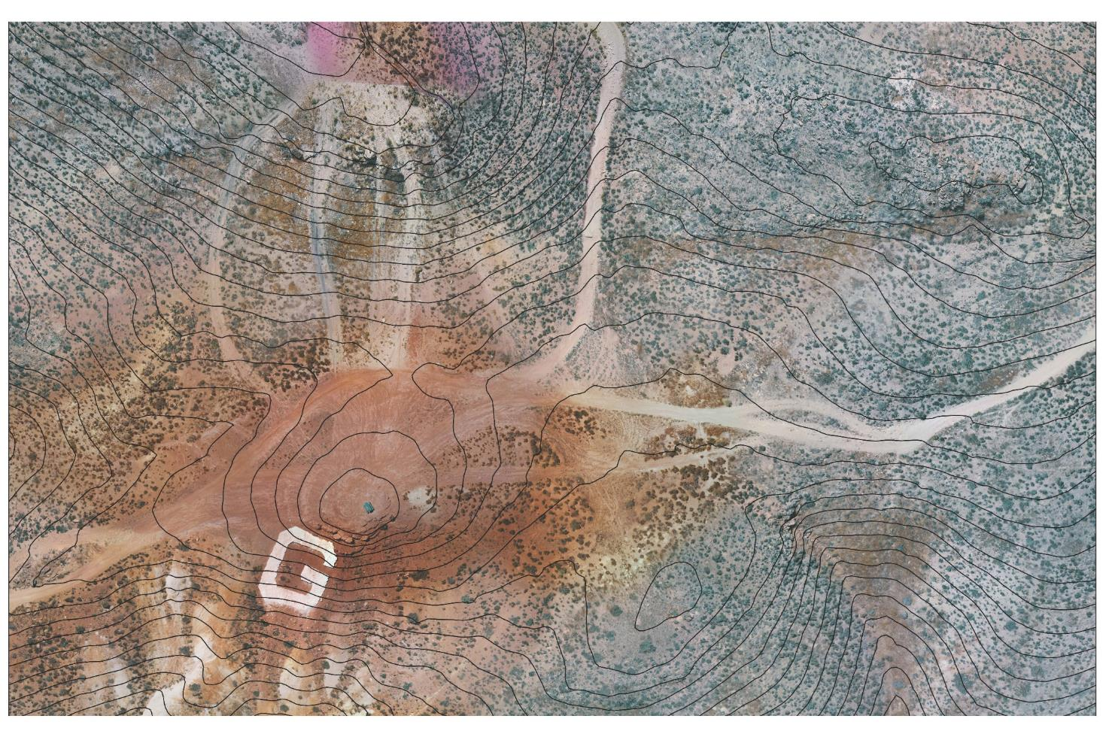
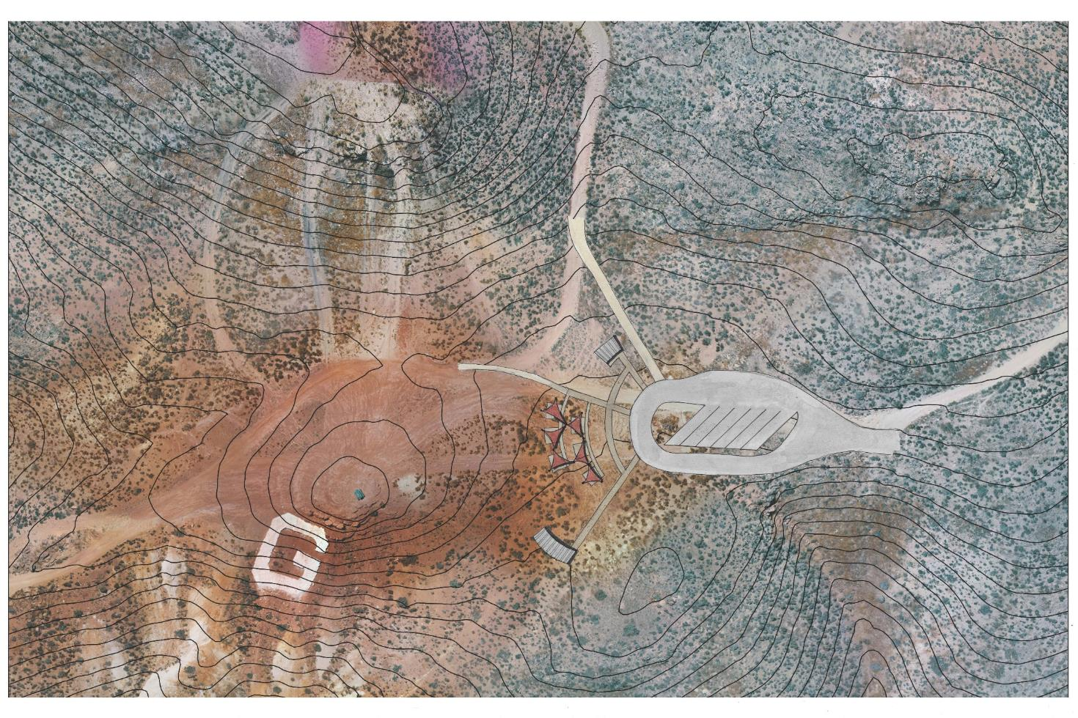
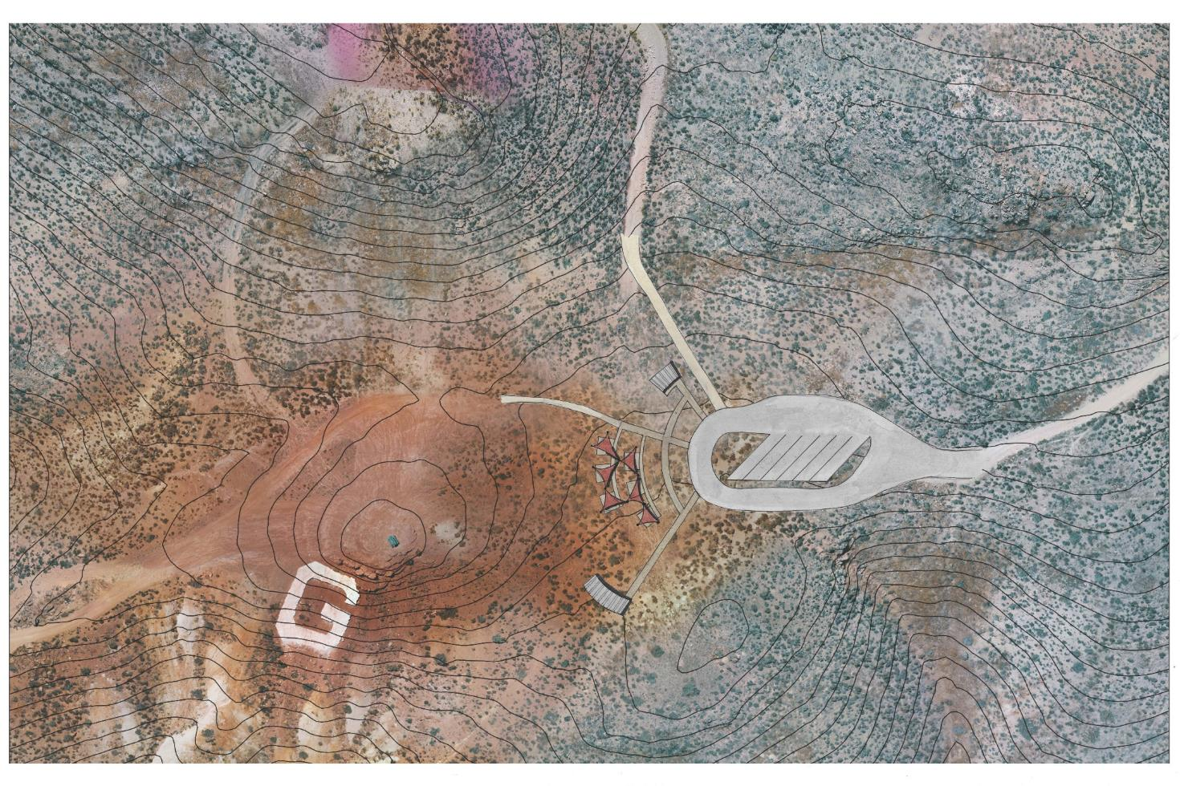
Views

Slide 22
Agricultural Legacy

Slide 23
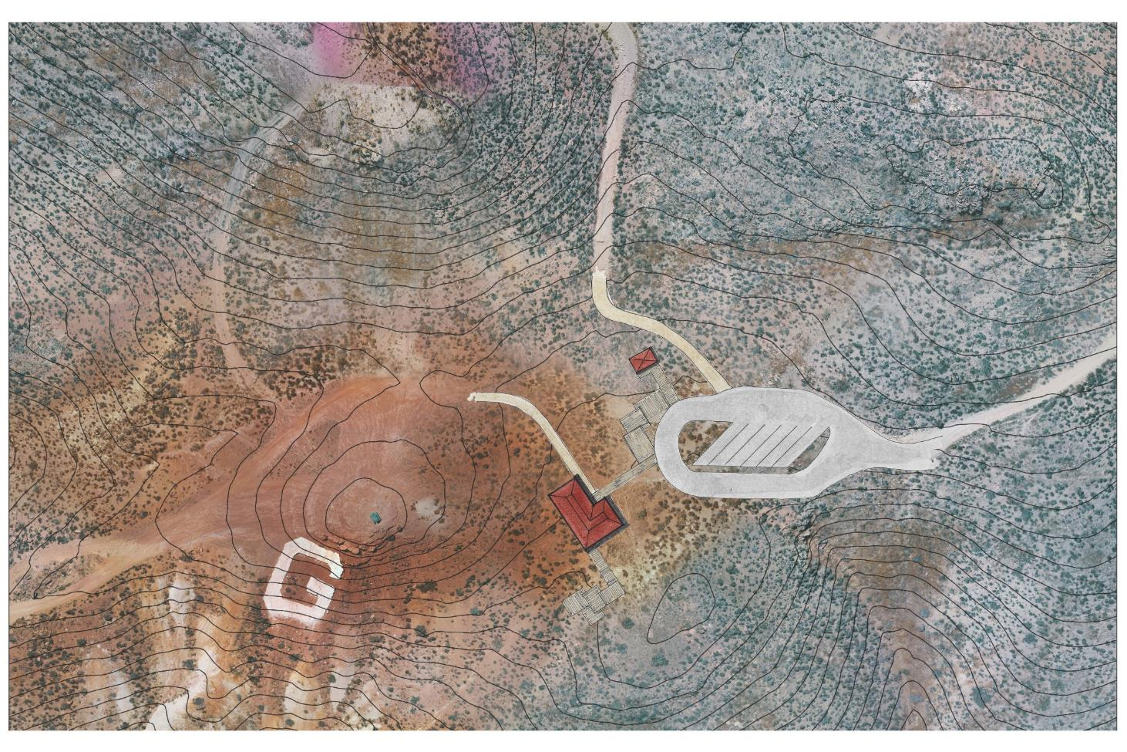
Agricultural Legacy

Slide 24
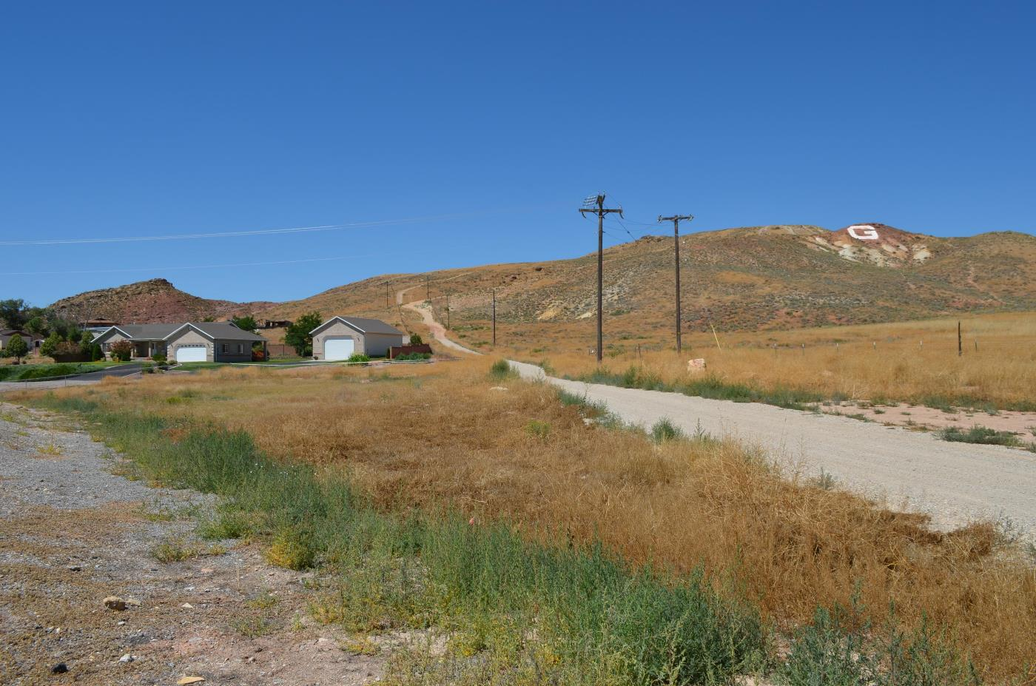
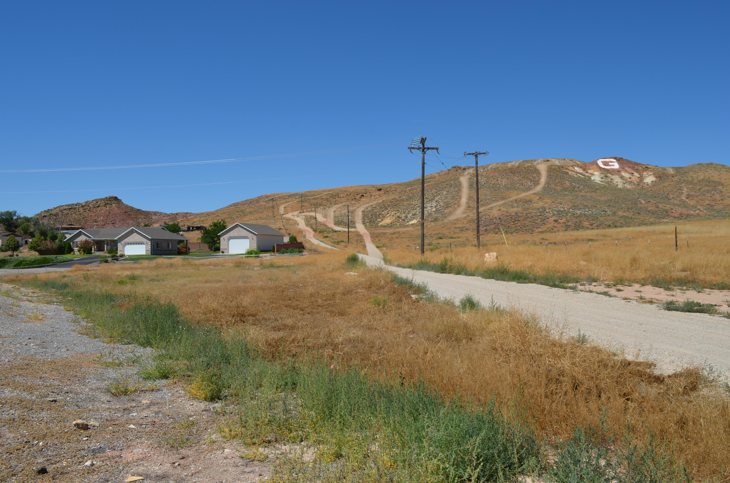
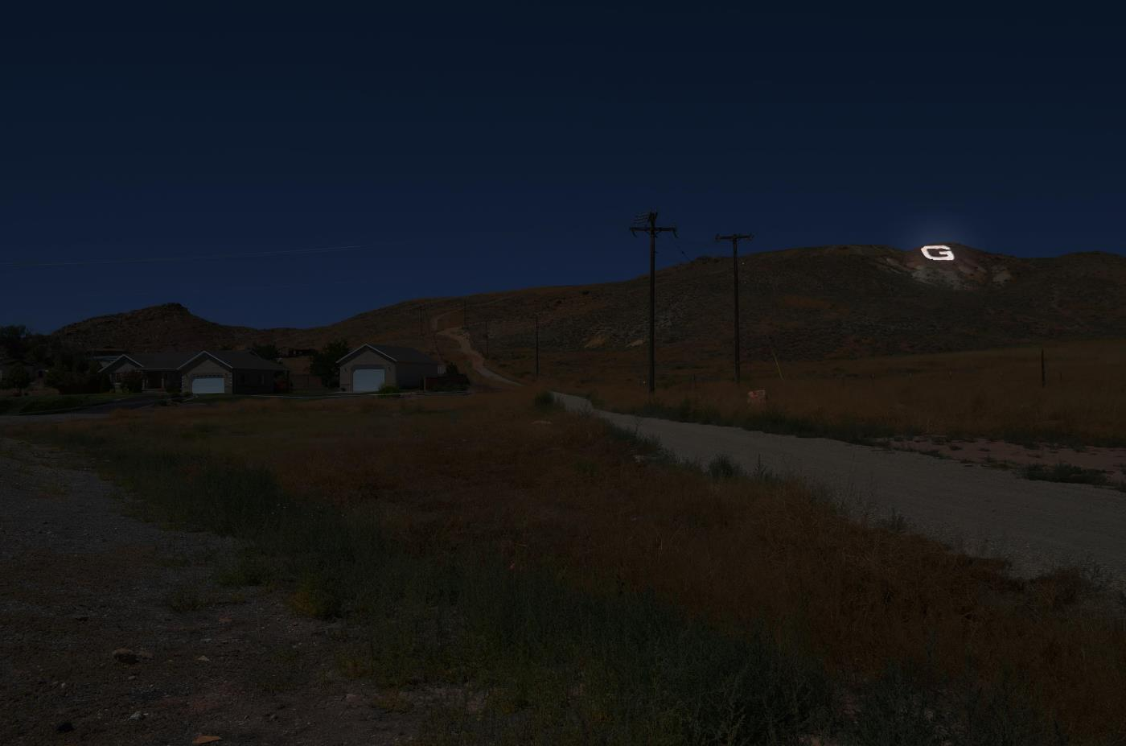
G-Hill – An opportunity for:
Overuse?
Restoration?
Preservation and Enhancement of a Community Icon

Slide 25
Jake Powell
Extension Specialist
Jake.Powell@usu.edu

