Slide 2
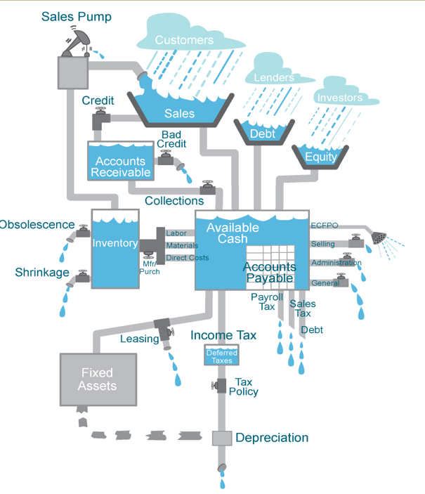
Cash Flow Diagram
How can you increase sales revenue at your business?
How could you negotiate a better deal with vendors and suppliers?
How can you plan for seasonal ups and downs?
Is it wise for you to use a credit card to offset cash flow issues?
Notes:
SBA’s Office of Credit Risk Management continues to focus on the adequacy of lenders’ underwriting and documentation of working capital disbursements on their 7(a) loans.
Lenders are required to thoroughly underwrite the adequacy of a borrower’s working capital needs as part of its approval process. An analysis of the Borrower’s cash flow cycle, including its needs for permanent working capital, should be thoroughly discussed and analyzed. SOP 50 10 6 requires lenders to include an “[a]nalysis of working capital adequacy, at a minimum over the next 12 months” for each borrower obtaining a loan in excess of $350,000. SOP 50 10 6, Part 2, Section B, Chapter 1., Subparagraph C. 2. A. i., g). Furthermore, for all 7a loans, regardless of size, SBA requires that “When 50 percent or more of the loan proceeds will be used for working capital, Lender must explain in its credit memorandum why this level of working capital is necessary and appropriate for the subject business” SOP 50 10 6, Part 2, Section B, Chapter 1., Subparagraph C. 2. a. i., k) ii) and C. 2. b. ii. b.
SOP 50 10 6, Part 2, Section B, Chapter 5., Subparagraph D. 3. a. iii. requires SBA lenders to obtain documentary evidence that loan proceeds were used for their authorized purposes, and further notes that “[i]f the Authorization identifies working capital as a use of proceeds and those proceeds will be used to pay normal operating expenses (e.g., payroll, utilities, etc.), then the working capital disbursement does not need to be documented.” This then is the rub: if a lender does not adequately underwrite the borrower’s need for working capital for “normal operating expenses” and then further does not document what the working capital proceeds were actually disbursed for, then the lender has failed to meet its burden to obtain evidence that loan proceeds were disbursed for their authorized purposes, the likely result of which is a repair of the guaranty.
OCRM has identified instances where lenders have not provided a comprehensive analysis of borrowers’ working capital needs in their credit analyses, and that some lenders appear to be using working capital allocations to make other types of disbursements (such as debt refinance, equipment purchases, etc.). These discrepancies have raised concern with the SBA that working capital allocations may be being used to mask otherwise ineligible uses of proceeds, or that there is not enough oversight of working capital disbursements being made by lenders to ensure that proceeds are being used for eligible purposes.
In light of this feedback from OCRM, SBA lenders would be well advised to either ensure that they are thoroughly underwriting their Borrower’s working capital needs in order to demonstrate that the working capital allocation is for “normal operating expenses”, or lenders should begin multi-disbursing their working capital disbursements to borrowers with documentation for each such disbursement evidencing that the proceeds were used for eligible working capital purposes. Failure to properly underwrite and document working capital disbursement can lead to audit findings and repairs or denials of you SBA guaranty. For more information regarding SBA compliance matters, contact the attorneys at Starfield & Smith at 215.542.7070.

Slide 3
SBA - Addressing Small Business Needs
Capital; Guaranteed Business Loans thru lenders
Home & Business Disaster loans
Federal Government Contracting
Free business Counseling
https://disasterloanassistance.sba.gov/ela/s/search-declarations
Entrepreneurial
Customer Centric
Technology Forward
Equitable
E-Tran, EIDL, 1502
Updated Surety Bond and Community Advantage programs
New Community Navigator Pilot Program
More Grants through partners
COVID Relief Closed May 2022; PPP, EIDL, RRF, SVOG
Notes:
The capital of a business is the money it has available to pay for its day-to-day operations and to fund its future growth.
The four major types of capital include (1) working capital, (2) debt, (3) equity, and (4) trading capital. Trading capital is used by brokerages and other financial institutions
Capital helps small businesses start, grow, and sustain business operations
SBA’s mission is to help make capital available through banks and other lending partners to small businesses that would not be able to access credit conventionally.
SBA loan programs offer the following incentives:
(1) SBA guarantees business loans. For example - if a borrower fails to repay the loan, the lender can recover 50 to 85 percent of the outstanding loan balance from the SBA. The borrower, however, remains obligated for the full amount due. This reduces the lender's risk so they are more willing to approve the loan.
(2) Lower equity requirement. While some equity is always required to show owner's commitment to the business, commercial lenders generally require more equity on a conventional loan than with an SBA guaranteed loan.
(3) Scoring. The SBA guarantee can help credit-worthy borrowers overcome the problem of a weak loan application associated with inadequate collateral. To secure the loan, you must pledge sufficient assets to the extent they are reasonably available. However, no loan will be declined for insufficient collateral alone, as long as all available and worthwhile collateral (both business and personal) is pledge as security for the loan.
(4) Terms. Next, lenders like to get their money back as soon as possible to reduce the risk of non-payment. With SBA support, most lenders are willing to stretch the payment terms out over a longer period. This reduces the monthly payment amount and eases the cash drain on the business.
(5) Stable. Finally, with an SBA guaranty you are assured to have a fully amortizing loan - no balloon payments. SBA's philosophy is to give borrowers confidence, knowing that the payment will be relatively stable without having a large payment at the end.
With debt financing, SBA lender will perform a Cash Flow analysis:
SBA lenders will look at your business tax returns and run a cash flow analysis on your most recent tax filings to determine if you make more money then the loan costs on an annual basis.
Calculate your EBITDA (earnings before interest, taxes, depreciation, and amortization) to get an accurate idea of how much cash you have available on an annual basis to service any potential new debt. If your EBITDA comes out 15%- 25% greater than the annual cost of the loan, the likelihood of approval is very high.

Slide 4
SBA Loan Programs Comparison
Loan program | Loan size | Interest rate | Maturity | Use of proceeds
7(a) loan | $50,000 - $5 million | Negotiated between borrower and lender | Up to 25 years for real estate Up to 10 years for business acquisition, equipment 5-7 years for working capital Weighted average for mixed-use requests | Purchase machinery, equipment, supplies, furniture, fixtures Make lease-hold improvements, expand or renovate facilities Purchase permanent working capital, inventory Acquire a business Start a business Acquire land and build a location Refinance certain existing debt
CDC/504 loan | $25,000 - $5.5 million | Fixed interest | 20 years for real estate 10 years for equipment | Purchase or renovate capital assets (land, buildings, equipment) Refinancing permitted
Microloan | Maximum of $50,000 | Negotiated between borrower and intermediary | No more than 6 years | Purchase working capital Purchase furniture, fixtures, supplies, materials, equipment
Community Advantage | Maximum of $350,000 | Maximum of Prime +6% | Up to 25 years for real estate Up to 10 years for business acquisition, equipment 5-7 years for working capital Weighted average for mixed-use requests | Purchase machinery, equipment, supplies, furniture, fixtures Make lease-hold improvements, expand or renovate facilities Purchase permanent working capital, inventory Acquire a business Start a business Acquire land and build a location Refinance certain existing debt

Slide 5
Access to Capital – Who’s your Lender?
Three key situations for obtaining SBA capital
New Business – b/c lack track record, < 2 yrs
Businesses needing longer terms
Term:
Working capital – 10 years maximum
Equipment – 10 yrs (15 yrs if IRS asset class useful life supports it)
Real estate – 25 yrs (plus period necessary to complete construction)
Refinance – based on collateral
When collateral is insufficient to fully secure loan
SBA helps businesses unable to obtain conventional financing on reasonable terms; Reducing lender’s risk and enabling them to approve quality loans
Notes:
General Credit Requirements SBA and private lenders consider the following criteria to test credit worthiness.
Repayment Ability: You must show that you can meet business expenses, owners draw, and loan payments from the earnings of the business. This is usually demonstrated through historical performance and/or thoroughly documented cash fl ow projections. (
Management: You must show ability to operate the business successfully. For a start-up, you should have experience in the type of business you propose to start, as well as some significant work experience at a management level.
Equity: The owners must have enough of their own money at stake in the business: (a) For a New Business (or when buying a business) you should have approximately one dollar of cash or business assets for each three dollars of the loan. (b) For an Established Firm, the after-the-loan business balance sheet should show no more than four dollars of total debt for each dollar of net worth (i.e., a 4:1 Debt/Equity ratio - may vary by industry). Definition of Equity: You may be required to pledge nonbusiness assets (often a second mortgage on your personal residence may be required for collateral). However, this should not be confused with equity in the sense it is used here. As used here, the equity is the owner’s net investment in the business.
Credit History: Your personal and company credit histories will be reviewed. Prudent lenders prefer applicants who have a history of meeting their obligations. If your credit record has blemishes but there are extenuating circumstances, prepare to explain fully.
Guarantee Portion - Under the 7(a) guaranteed loan program SBA typically guarantees from 50% to 85% of an eligible bank loan up to a maximum guaranty amount of $3,750,000. The exact percentage of the guaranty depends on a variety of factors such as size of loan and which SBA program is to be used. This will be worked out between the SBA and your bank. Amounts - The maximum loan amount is $5 million. The total SBA guarantee for any one borrower may not exceed $3,750,000.
Maturity - Up to 25 years for real estate acquisition or construction. Most other SBA loans are limited to 10 years. Working capital loans are generally limited to seven years.

Slide 6
Run Your “What if” Scenarios
What if you injected $20K, 50K, 100K, $500K, $2M, or $5M?
How much money do you need for equipment or services?
What does your credit profile look like?
How will you use the money?
How will you repay the loan?
Does your business have the ability to make the loan payments ?
Can you put up any collateral?
What banking services do you need?
What does your personal and business credit score?
What lender offers the support you need?
Gather docs: Personal Background and Financial Statement, Business Certificate/License, Tax Returns, Resumes, Business Overview and History, Business Lease …

