Slide 1
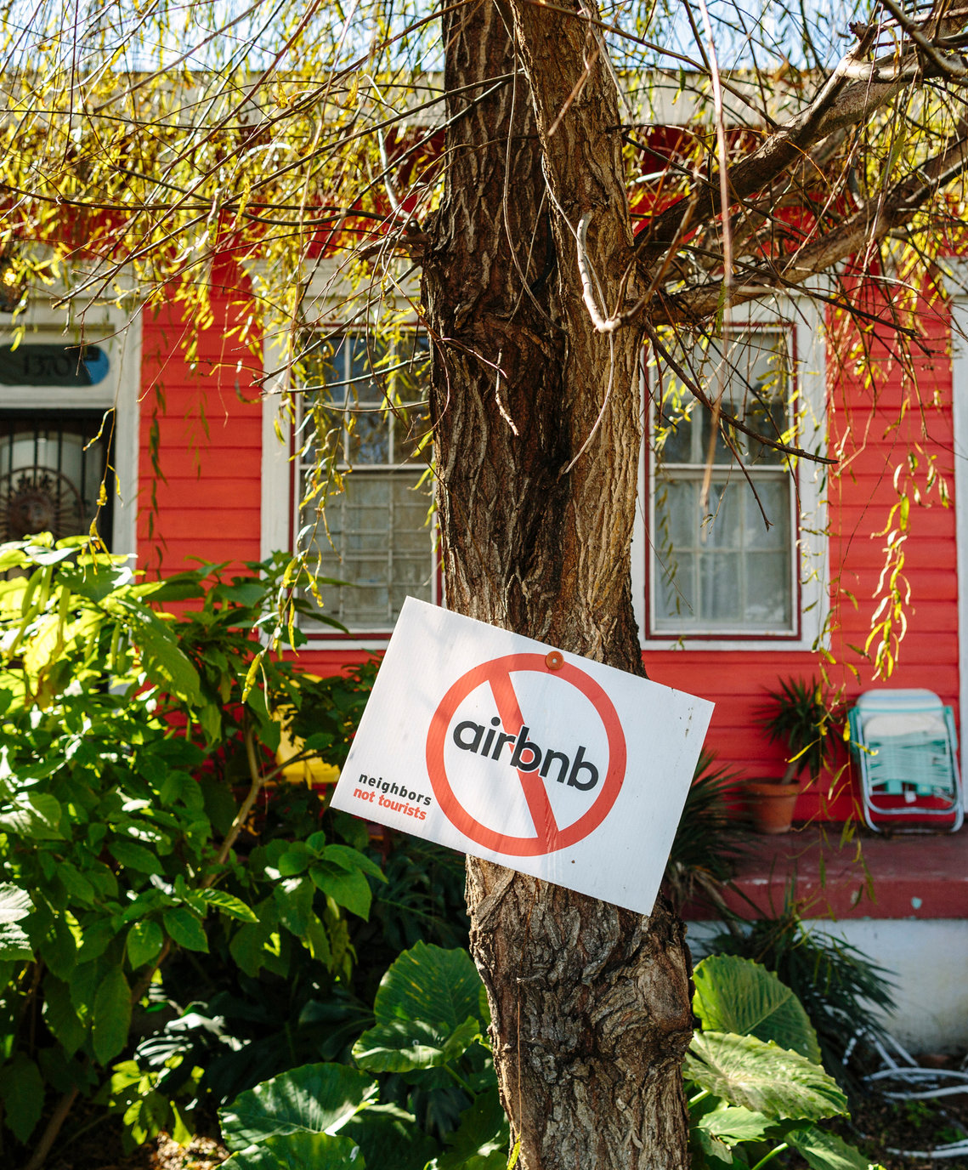
Educated Guests Make Better Neighbors: How to Education Short-Term Rental Guests
With Support from:

Slide 2
Quick Poll
What are some things you wish guests knew before coming to your community?

Slide 3
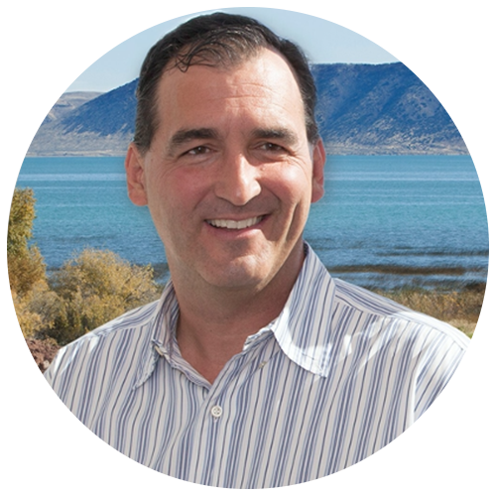
Introductions
Who’s Who…
John Spuhler
SymLiv
John is a community consultant and serial entrepreneur. He has been dealing first-hand with the challenges of short-term rental compliance while being the Mayor of Garden City from 2010-2018 and serving on numerous boards including the Bear River Association of Governments.
Brumby Mcleod
College of Charleston
Brumby McLeod is an associate professor at the College of Charleston, School of Business in the Department of Hospitality & Tourism Management. He is a research fellow with the Office of Tourism Analysis and the Riley Center for Livable Communities. The focus of his research is in overnight accommodation and revenue management.
Taylor James
Wasatch Group
Taylor helps develop tech-enabled solutions for the Wasatch Groups, a $4B Utah-based alternative asset manager with over 16K multifamily units under management. His work includes solving community livability issues related to both long- and short-term rentals.

Slide 4
Agenda
Introduction
Quick Poll of attendees
Panelist Discussion of Poll Results
Guest Communication Deep Dive – Brumby Mcleod
Why do we need to educate STR guests?
Responsibility in educating guests
Perspectives as a Mayor, Citizen, and Business Owner in Garden City, UT – John Spuhler
Engaging and educating visitors
A unique use case in multi-family – Taylor James
Tools to Educate Your Visitors – John Spuhler
Best Practices
SymLiv free platform
Closing
Q & A

Slide 5
Quick Poll Questions – Y/N
Does your community struggle with visitor noise after 10PM?
Do you struggle with trash collection in short-term rentals?
Does your community struggle with parking due to visitors?
Do you see environmental impacts to your community due to visitors?
Do you have information going out to guests before they arrive?

Slide 6
Growth in STRs After COVID

Slide 7
The Benefits of STRs

Slide 8
Current Trends
Notes:
Has your approach to visitors changed or ben
What innovative things have you seen GNAR communities try to communicate the values, opportunities and culture to the vistitors
Has COVID-19 changed the urgency or approach in the way you provide information to Guests presents for GNAR communities?

Slide 9
A Short-Term Rental Crisis

Slide 10
Case & Point
Notes:
A recent survey of nearly 1,000 people across the country by home services marketplace platform Porch outlines some of the common issues neighbors have with short-term rentals next door.Educating visitors Make Better Neighbors Who is Responsible for Communications? Hosts
Hotels
Guests themselves
Convention and Tourism Boards
City/County
Platforms
All of the above

Slide 11
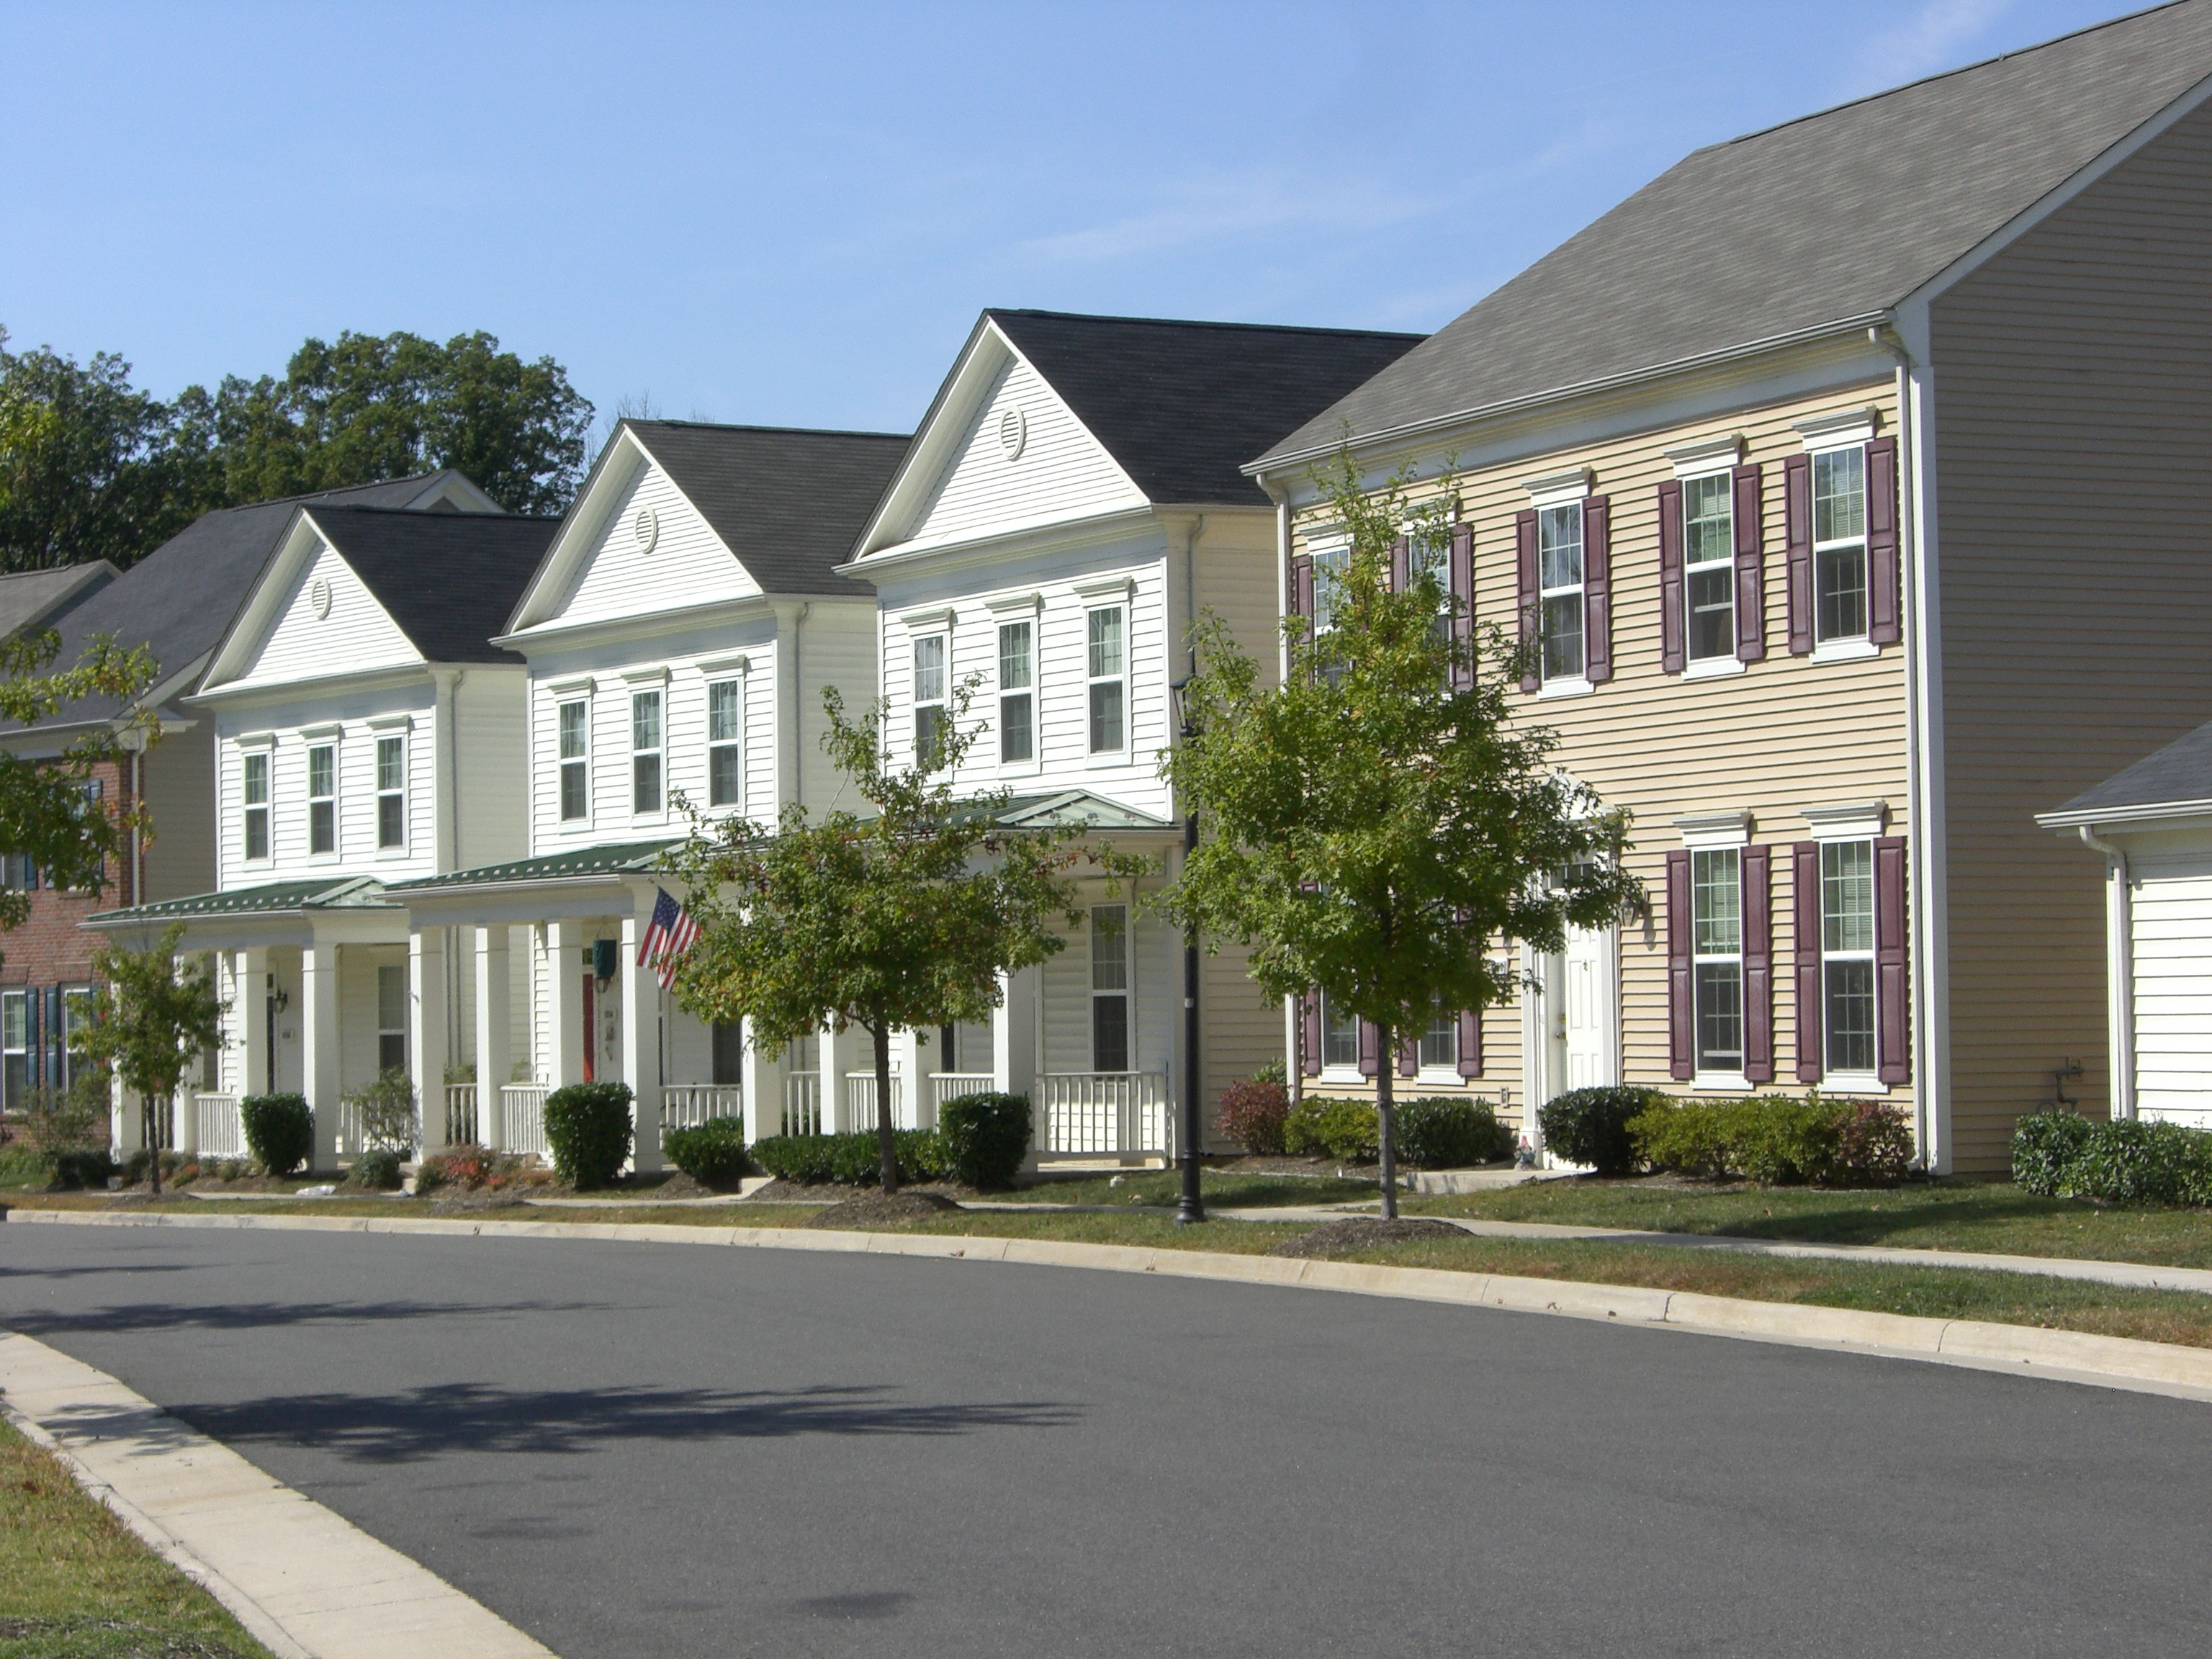
The Problem
People often break rules and may damage community livability because they are not informed
The phenomenal growth of the Short-Term Rentals has been a major catalyst for visitors, especially in small towns and cities outside of national parks, scenic public lands, and other natural amenities throughout the western United States.
Notes:
Has your approach to visitors changed a the result of growth.
What innovative things have you seen GNAR communities try to communicate the values, opportunities and culture to the visitors
Has COVID-19 changed the urgency or approach in the way you provide information to Guests presents for GNAR communities?

Slide 12
The Results of Bad STR Guests

Slide 13
Questions to Ponder
How are you educating visitors before their arrival?
What educational requirements do you put on owners? Property management companies? Booking platforms? Guests?
What innovative things have you seen GNAR communities do to try to communicate the values, opportunities and culture to the visitors?
Why does this matter?
Notes:
Brumby’s Questions

Slide 14
Tourism is an export, much like selling locally manufactured goods and services abroad. The cash flow from selling tourism services is an inflow to the community.
Tourism Economics
Notes:
Brumby’s Questions

Slide 15
Entity Optimization
Strategy
Accountability
Operational
Excellence
Notes:
Brumby’s Questions

Slide 16
Travel Experience Optimization
B
C
G
Notes:
Brumby’s Questions

Slide 17
Who is Responsible for Communication?
Communities Face a Livability Crisis
Short-term rentals can get stuck in a vicious cycle of violations and complaints that results in a lose-lose situation for all stakeholders involved
Social License to Operate
Unfair Regulation
Resistance
Positive Community Reaction
Visitor Arrivals $$$ or Impact
Negative Community Reaction
Virtuous Loop
Vicious Loop
Economic Growth & Jobs
Noise/Trash Bad Apples
Notes:
Guests, Hosts, Cities, Visitor Bureaus (Transient Room Taxes),

Slide 18
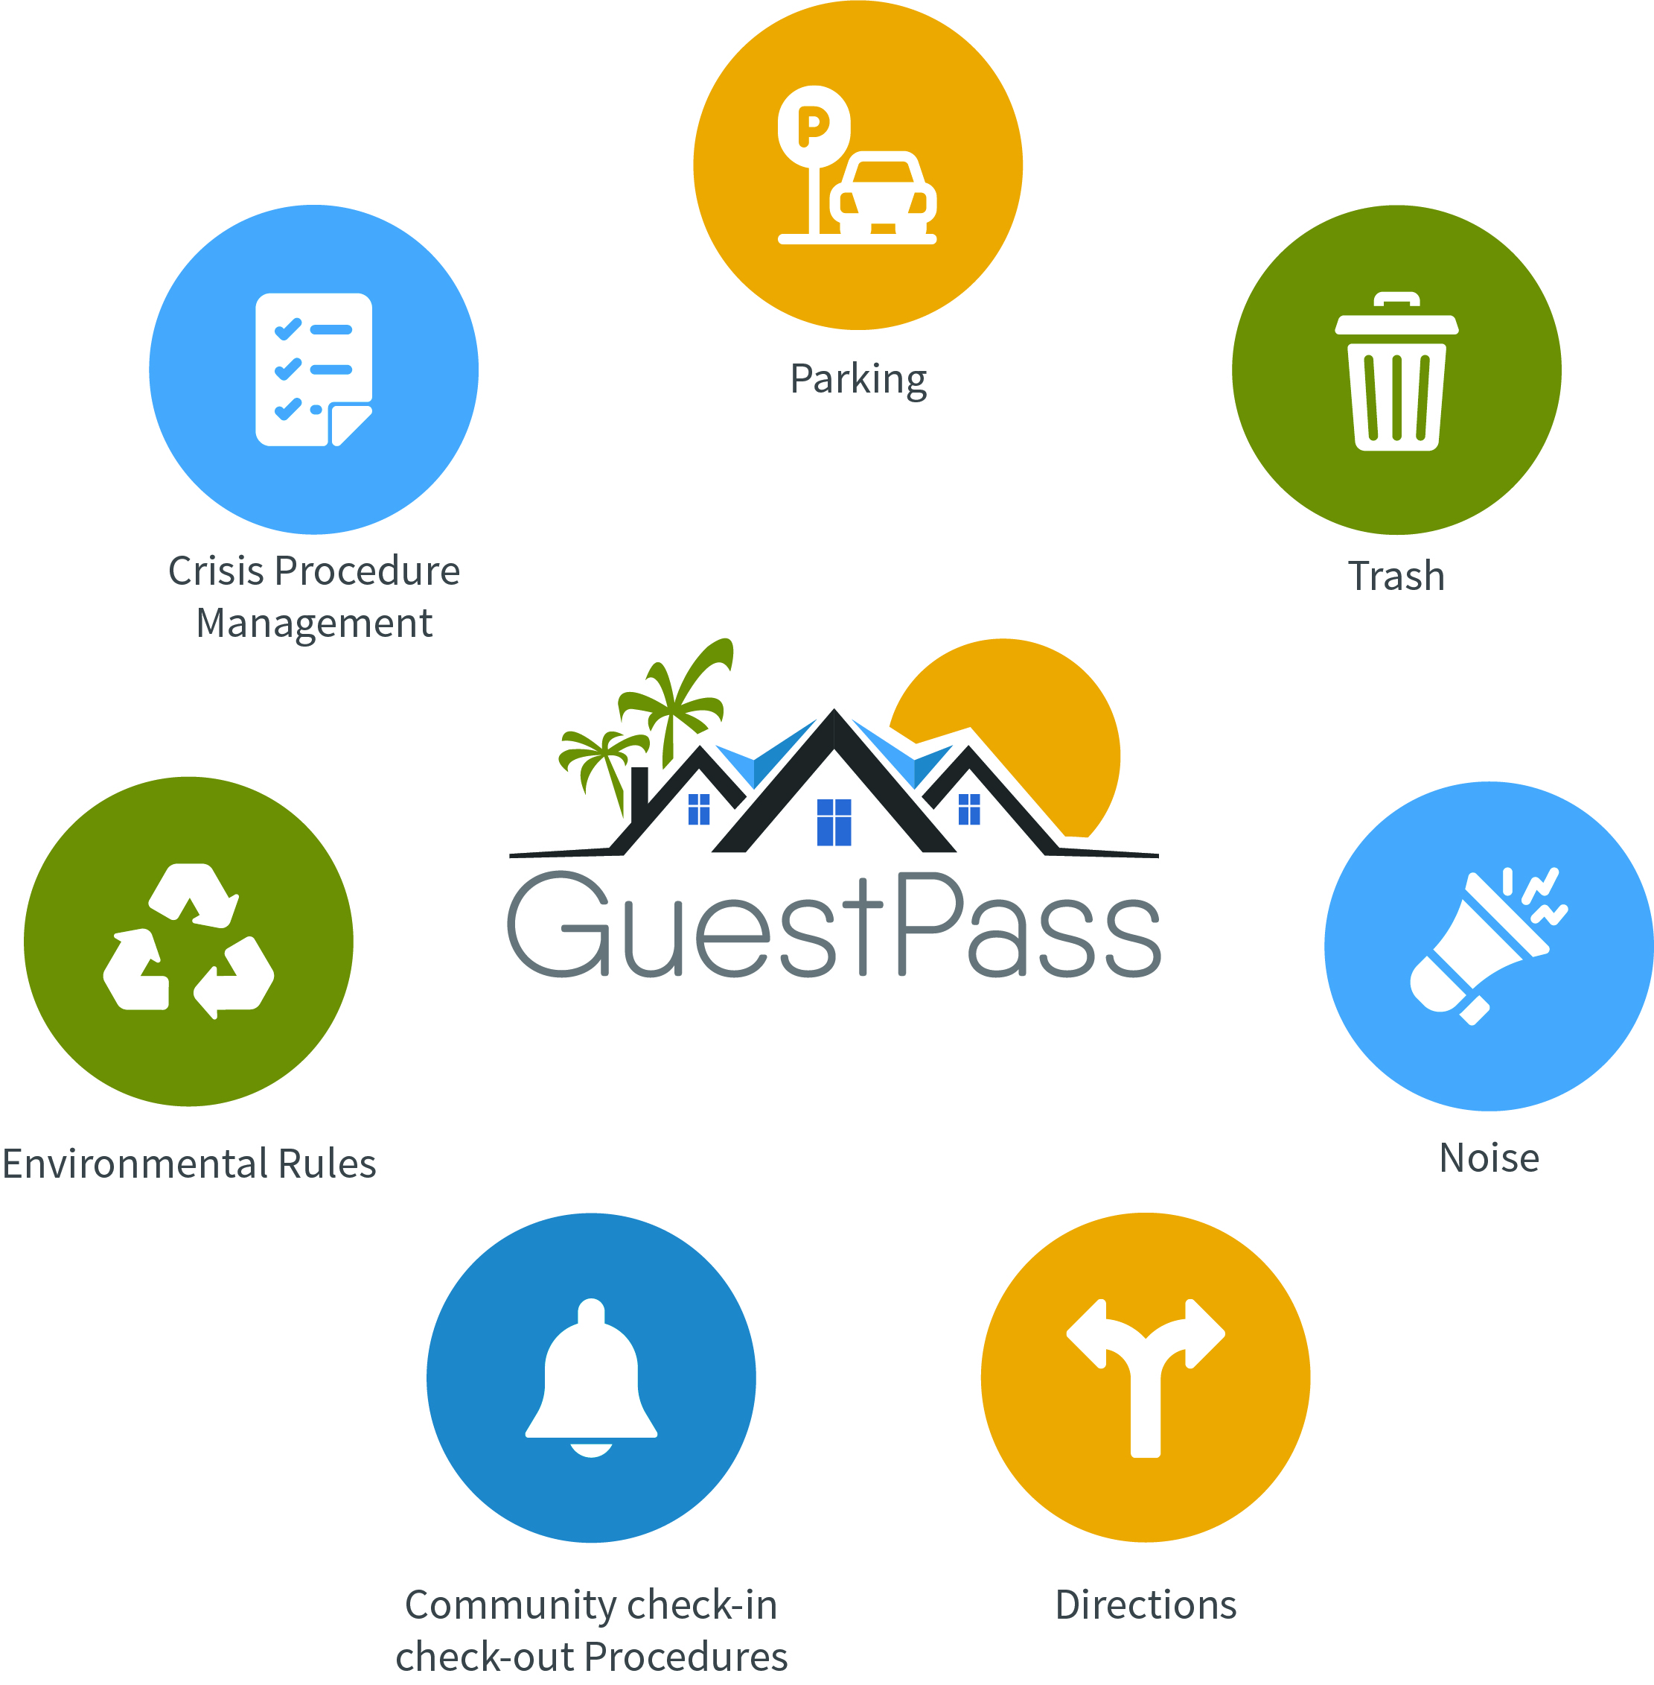
What are your goals?
Reduce parking problems
Protects guest and residents during crises and emergencies
Ensure community safety
Reduce trash problems
Increase community livability
Reduce STR's impact on neighborhood character
Reduce Noise problems
Eliminate party houses
Less neighbor complaints
Save time and money
Efficient and effect communication to the guest prior to arrival
Reduce tension between guests and their neighbors

Slide 19
What we can learn from Property Managers and Student Housing
- Digital tools make hosting guests easier and less time-consuming -
Less complaints
Guests are more independent
Cleaner Facilities
Better Reviews
Saves Time and Money
Greater Control
Efficient & effective communication with guest prior to arrival
Less Damage to Rentals
Better guests = less work
Notes:
Taylor @ Wasatch Property Management

Slide 20
Managing Visitor Behavior
- Managing Guest Behavior Begins with Incentives -
Step 1
Incentivize Visitor & Hosts to Change
Deals, Coupons, Discounts
Integrated in the Community
Vacation Enhancement
Step 2
Register visitors using digital tools
Digital Recognition of Rules
Orientation Certification
Tied to Booking
Step 3
Educate visitors during the registration process
Digital
Tied to Booking
Step 4
Communicate with visitors during their time in the community
Individual
Groups
Violations Enforcement
Marketing

Slide 21
Why Guests Need and Want Information
Enhance the vacation experience and
Streamlined Parking and Arrival
Enhanced Vacation Experience
Feels more a part of the community
Reduce tension between guests and neighbors
Saves Time and Money
Knows available Amenities
Understands and can easily follow the rules
Easy Communication with Host and Community Members
Understands emergency protocols

Slide 22
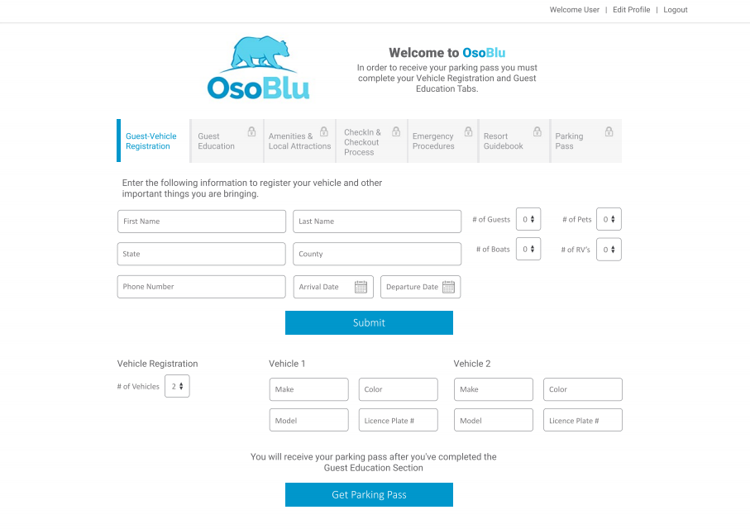
SymLiv Platform Overview
Make Residents Happier With One Solution
The Complete Community Livability Management Platform
SymLiv combines online-enabled registration, orientation, communication, and incentives to drive guest and vendor behavior.
Guest & Vendor registration & orientation
Streamlined parking administration & enforcement
Automated Communication via text & email
Modern, Cloud-Based Access Control Software & Hardware for gated communities
The Leader In Community Livability Solutions

Slide 23
How SymLiv Helps Cities Manage Visitors
- Online-enabled guest education, registration, and vehicle and parking administration-
Step 1
Guest Books Rental
Required Orientation by Ordinance
After a guest books their rental via an online platform like AirBnB or VRBO, they receive a link to a community-branded online portal where they are registered with the community database and provide details about the community rules business directory and attractions like parks, museums, and nearby hidden Gems
Step 2
Guest & Vehicle are Registered via Online Portal
GuestPass administers registration and pass issuance. Information can be collected on the person’s length of stay, rental address, number of pets, number in party, vehicles, and other information for emergency purposes.
Step 3
Guest is Educated
Guest is guided through online educational modules covering community rules, policies, amenities, as well local business information and any other instructions deemed necessary by the community.
Step 4
Guest Collects Identifier or Parking Pass for Arrival
After completing the guest registration and education, they’re issued a QR code or digital documents via text or email. This can be used as an identifier upon arrival or as a scannable discount pass to local attractions, businesses

Slide 24
Thank You!
- Educated Guests Make Better Neighbors
For more resources, visit www.symliv.com
John Spuhler
john.spuhler@symliv.com

