Slide 1
Create a soup
Food $ense
Notes:
Nothing says comfort like soup! In this lesson, we will learn the basic techniques to create a wholesome and nutritious soup from foods already found in the pantry and fridge. We will discuss meal planning and grocery shopping strategies that ensure we always have good foods on hand. We will also discuss the difference between whole foods and refined foods, and why whole is a better choice.

Slide 2
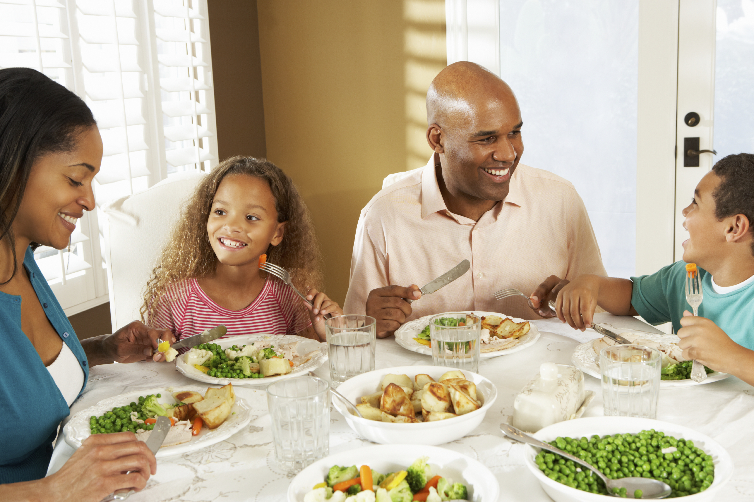
Introduction
Family Mealtime is important
Notes:
Family mealtime is important because it promotes family bonding. Families that eat together also generally have better nutrition and thus have less of a chance of developing eating disorders. And lastly, studies have shown that when a family eats together, it can increase grades and behavior in children while diminishing the chances of becoming involved in drugs, alcohol and sexual activity.

Slide 3
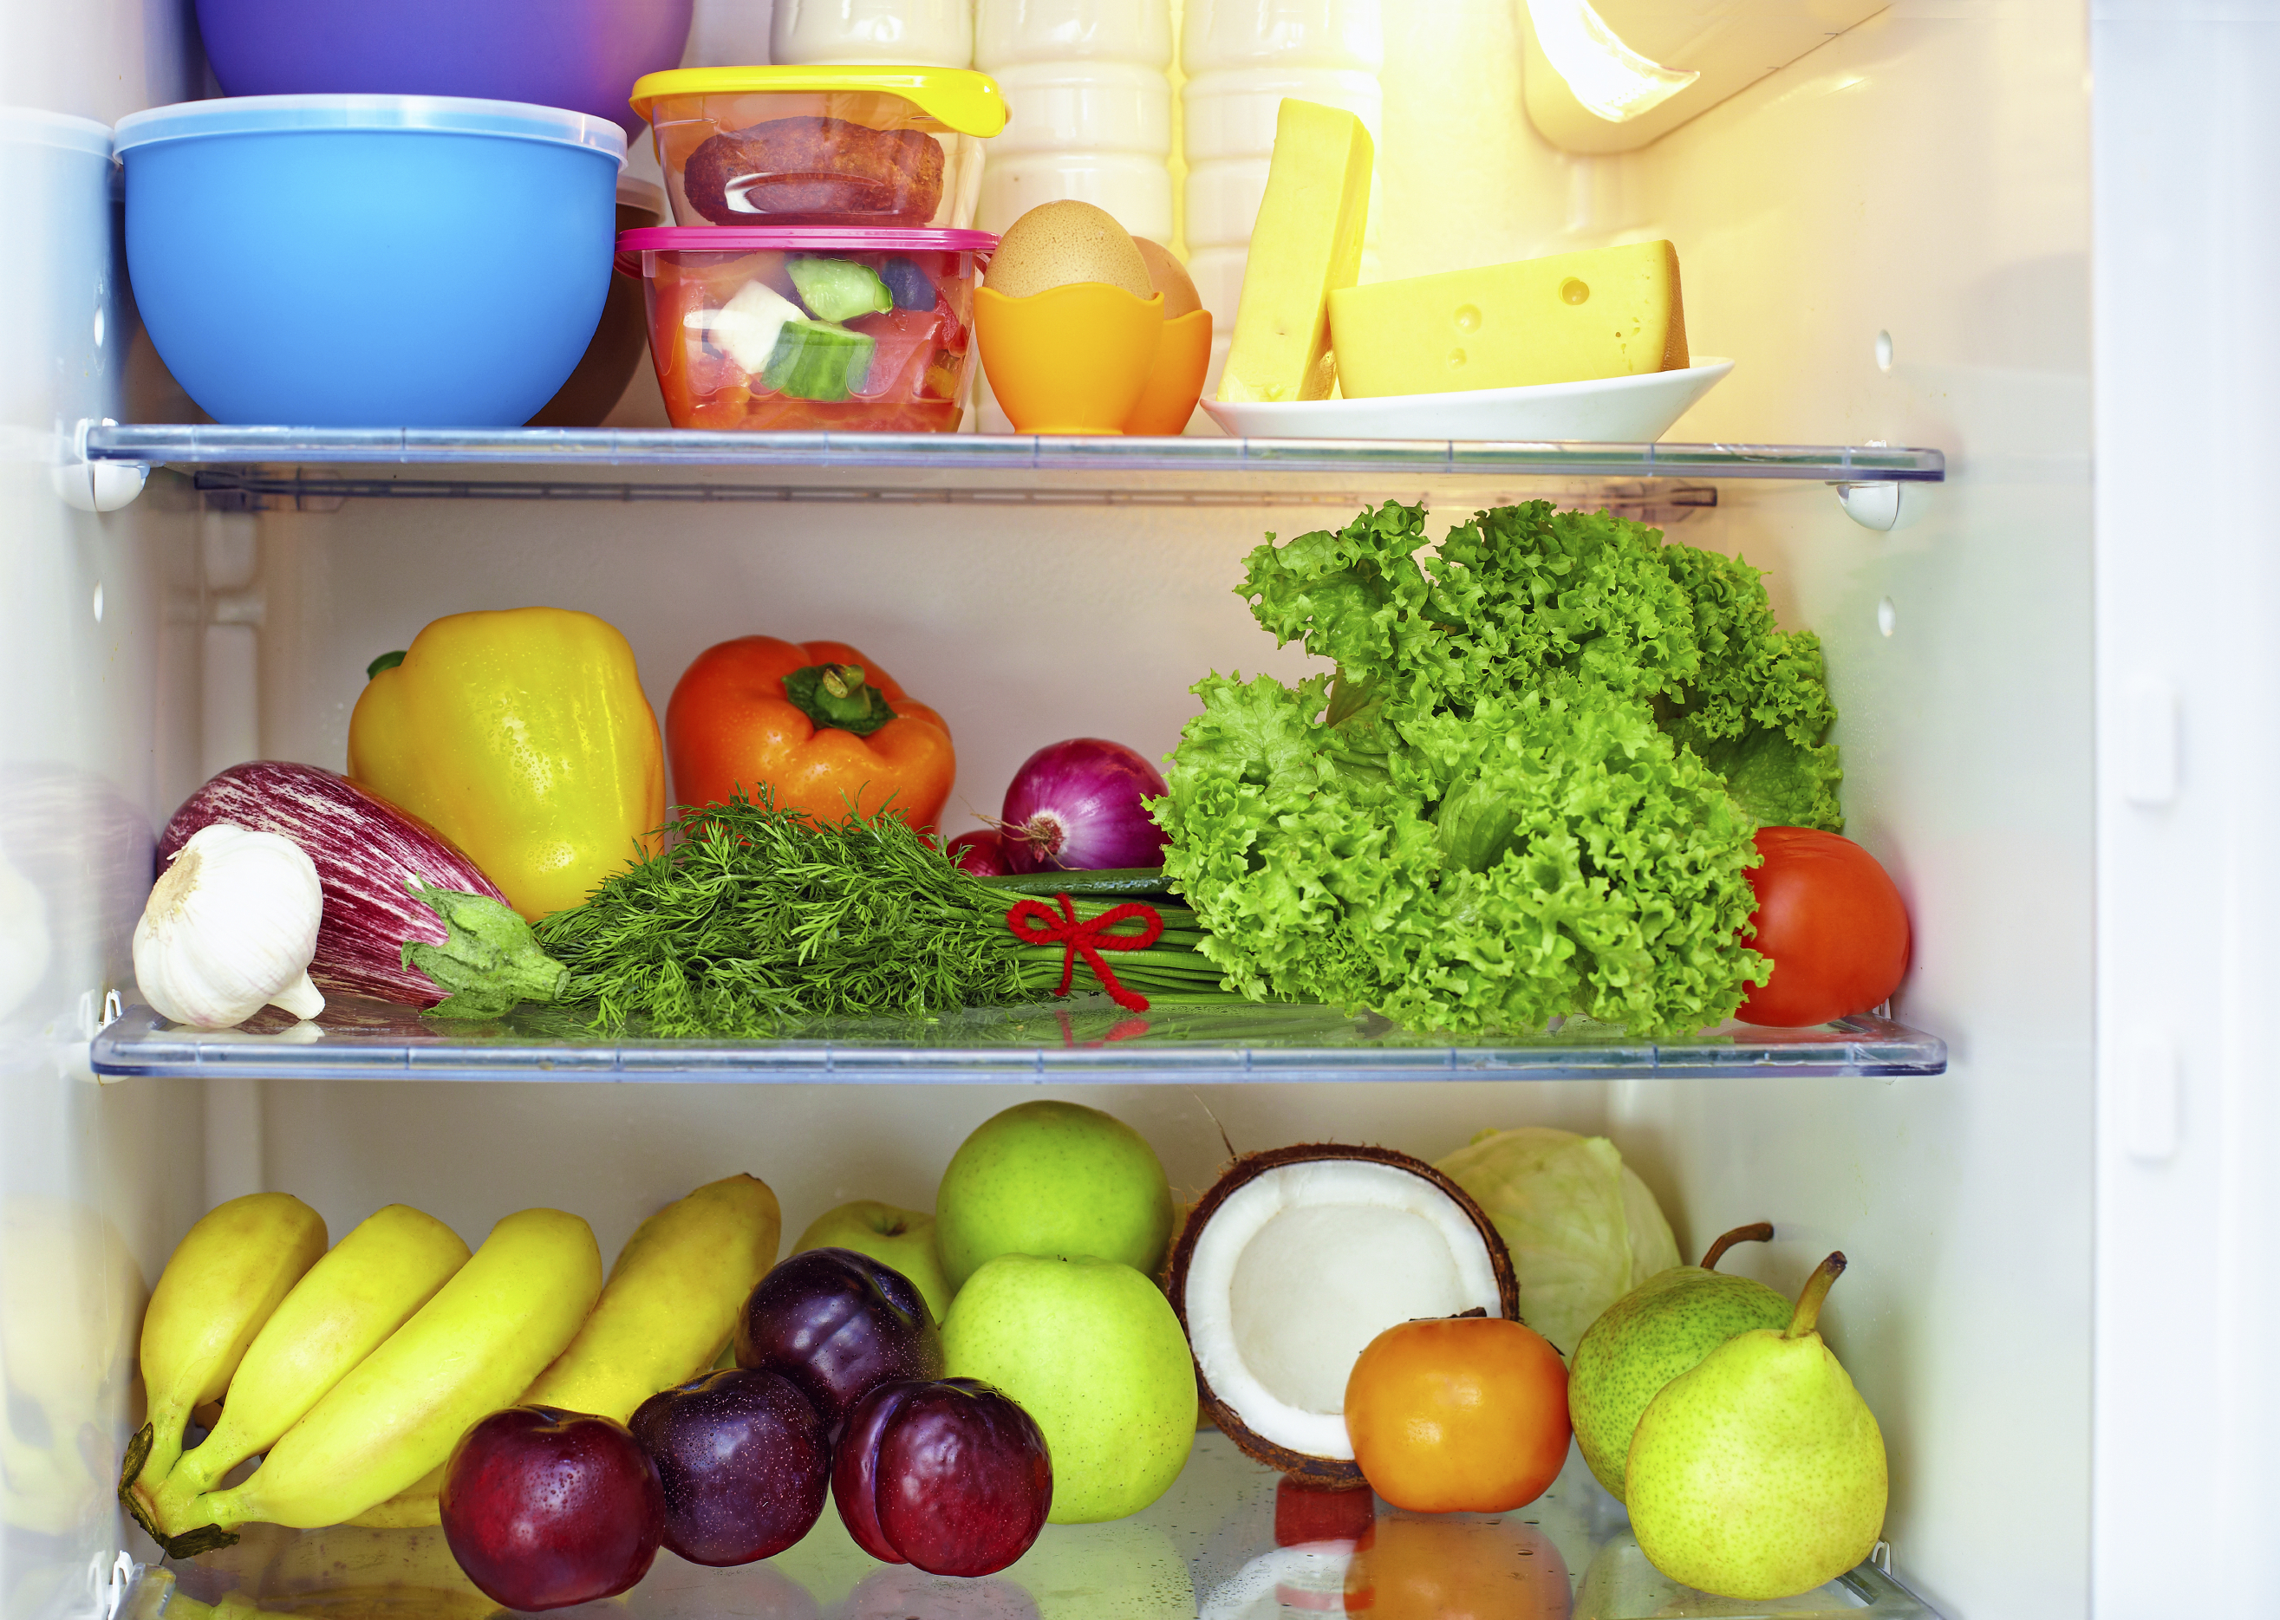
Introduction
Questions:
What is a whole food
diet?
Why is a well-stocked
pantry important?
Notes:
So what is whole food? A whole food is as close to the original source as possible meaning minimal processing and refining of foods. An example might be a potato vs. a potato chip. Remember that ¾ of MyPlate is plant based and that a diet rich in whole plant foods is related to less chronic disease and obesity. On the other hand, a diet high in refined foods with added fats, sugar and salt is related to increased chronic disease and obesity. Because Whole foods are generally full of fiber and water, it leaves you feeling satisfied and full on less calories.
A well stocked pantry reduces the temptation to eat out or make unhealthy choices because you already have food available. You don’t even need a recipe or a plan so long as your pantry has good food in it and you understand the techniques of how to put food together. Focus on buying whole foods that are minimally processed. Shop for ads, sales or with coupons and make sure to shop the entire perimeter of the store.

Slide 4
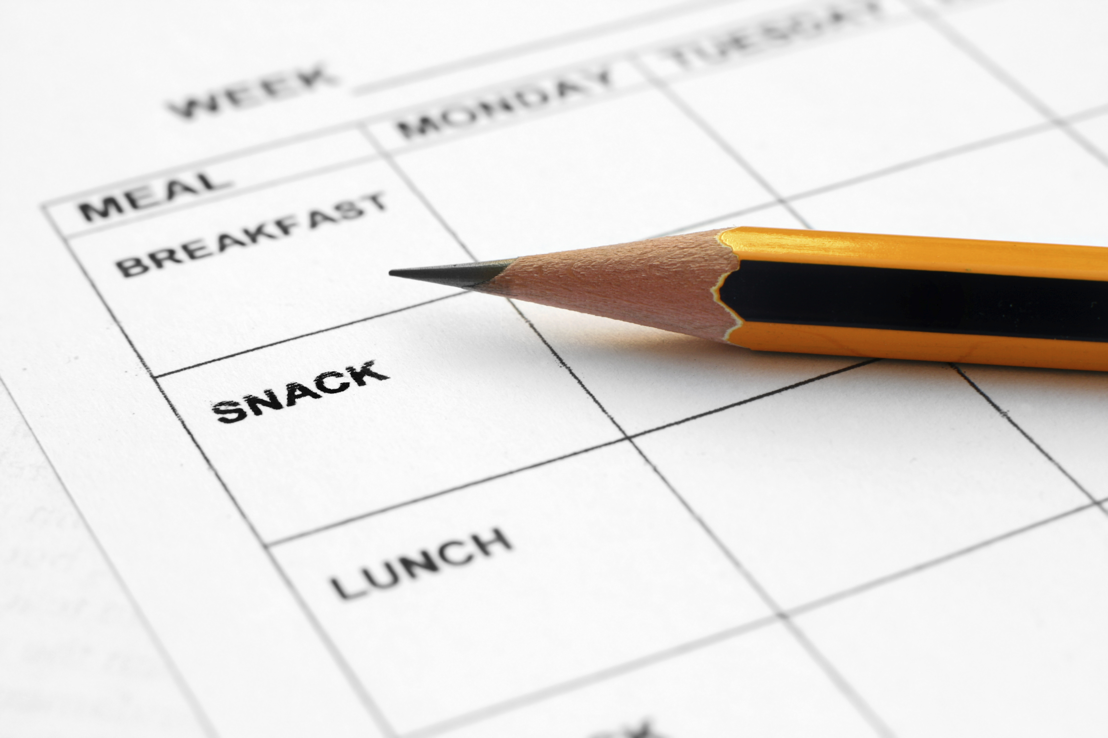
Introduction
Meal Planning
-Save time and
money
- Steps/tips
Notes:
When it comes to meal planning, this might intimidate some people, but if you practice enough, you will find it just becomes second nature. Consider making meals you will look forward to such as a themed night. You could have Taco Tuesdays, or Italian food on Wednesdays.

Slide 5
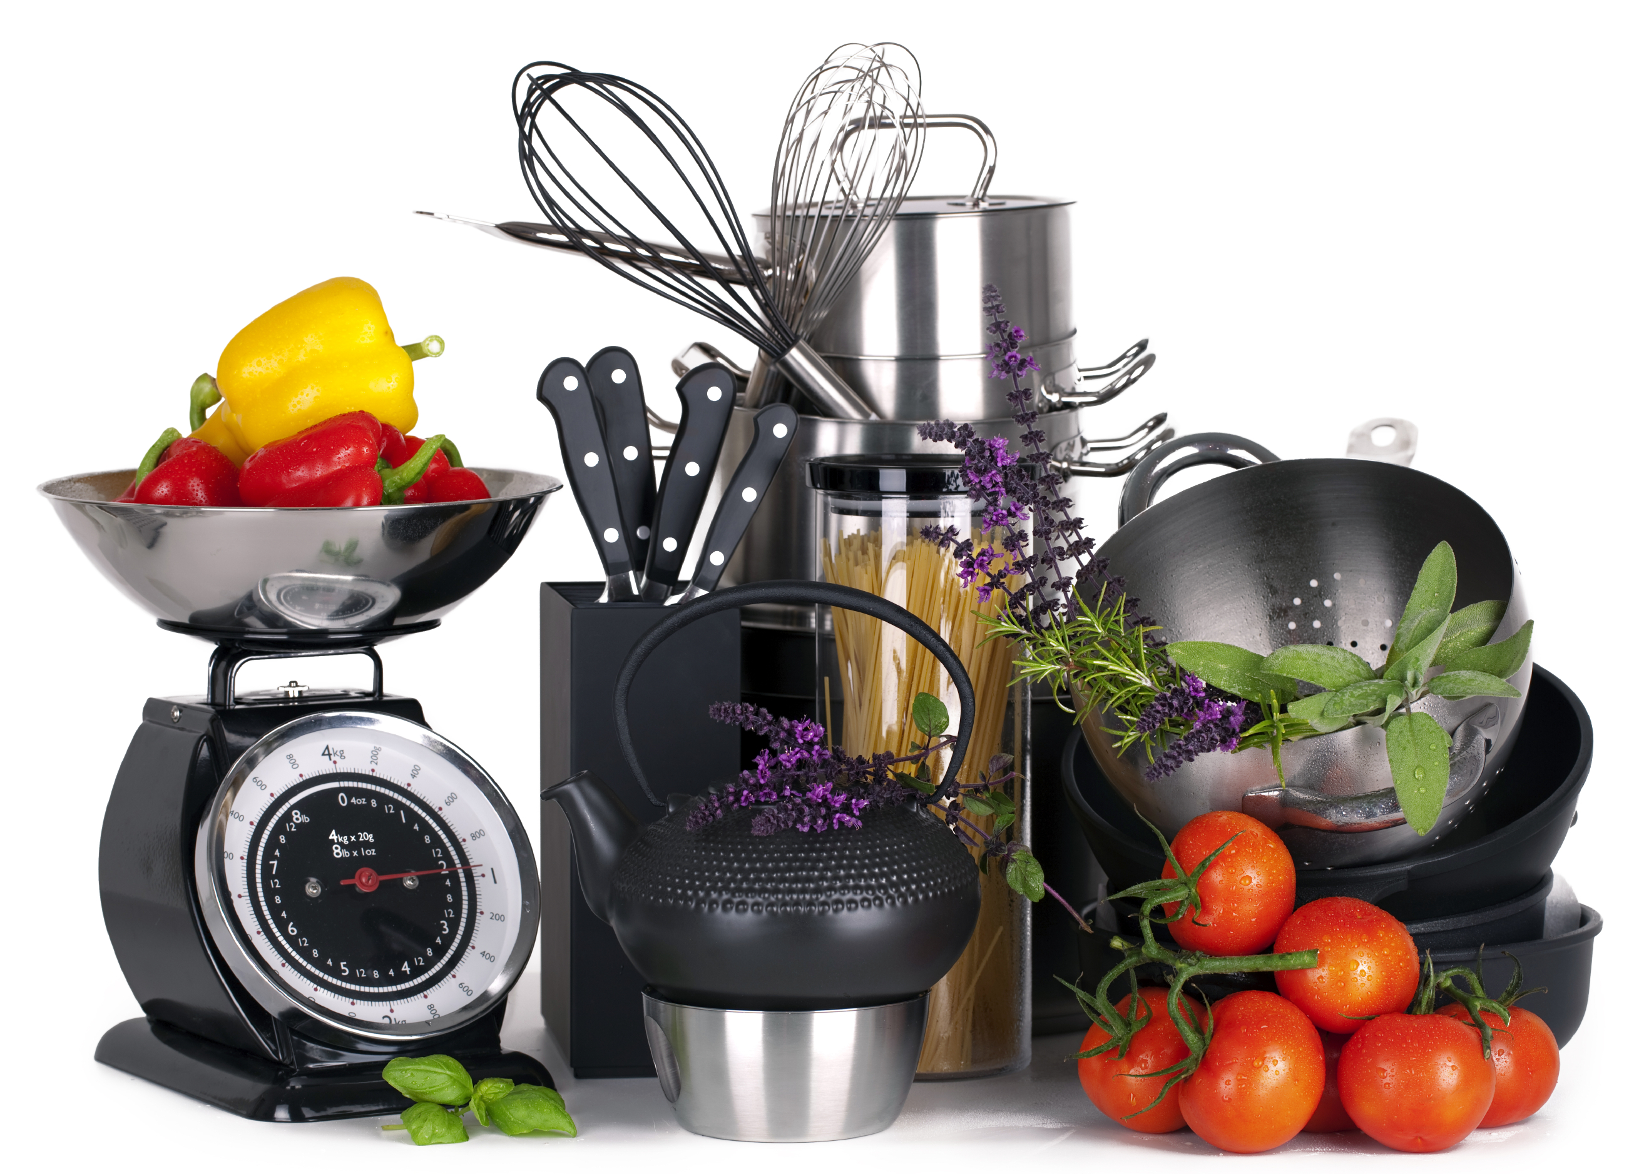
Create a Soup
Before Starting:
Choose whole foods
Make sure to have
needed equipment
Notes:
What is the nutritional difference between a soup made with cream vs broth? How might it improve the nutritional value of your soup to include fresh veggies and beans instead of a lot of cheese and processed cheese? The following equipment may be needed in preparing your soup: sharp knife, soup pot, potato peeler, cutting board etc.

Slide 6
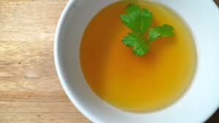
CREATE a Soup
Step 1: Prepare a Broth/Base
Options?
Clear broth vs. cream
Clear broth=cheap
Healthy creamy base
Notes:
What does a broth or a base add to our soup? Lots and lots of flavor. Oftentimes people use a lot of butter or cream to add a lot of flavor to their soup, and while having some fat in your soup is very tasty, you don’t need a ton to create great flavor. (Discuss how to make clear broth for a fraction of the cost and discuss/show how to make a healthy creamy base. SOS-define and explain; demo if time and circumstances permit).

Slide 7
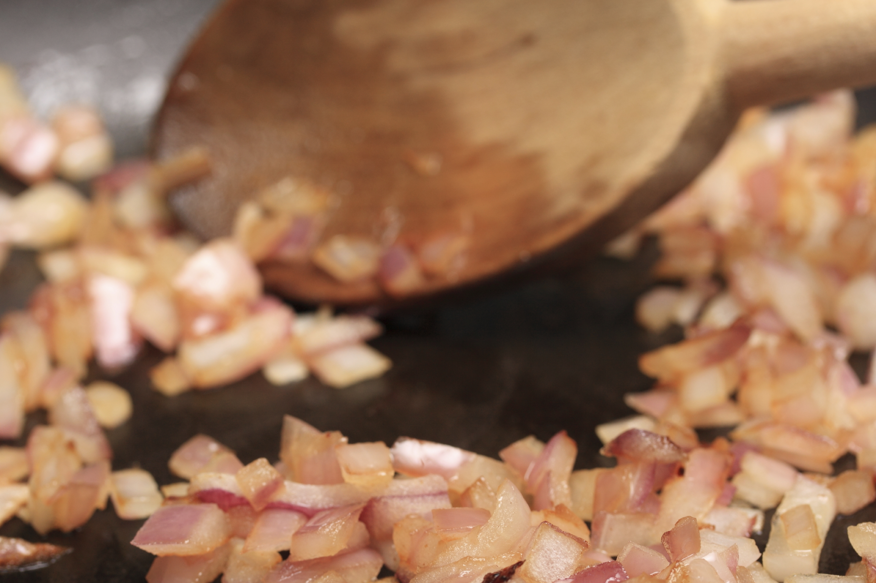
CREATE a Soup
Step 2: cook onion
provides flavor
Notes:
Cooking onion before adding other ingredients provides best flavor. Consider other flavor enhancers as well such as garlic or fresh herbs and spices.

Slide 8
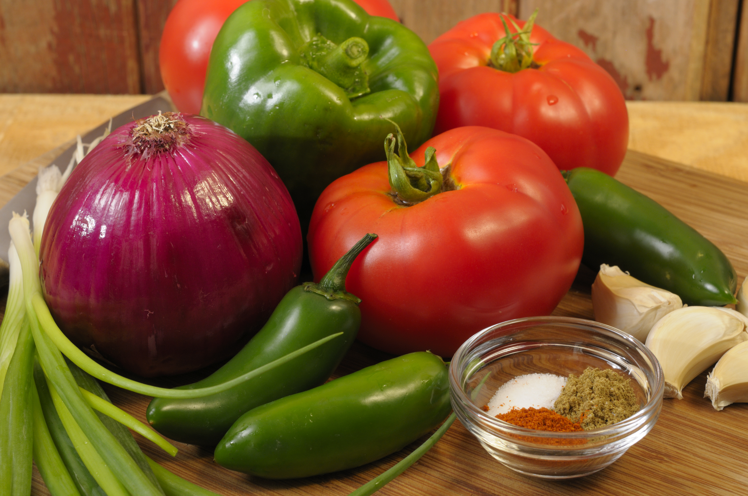
Create a Soup
Step 3: Prepare vegetables
options?
rich in vitamins and
minerals
more volume for less
calories
Notes:
What are some common and not so common vegetables? Vegetables are naturally rich in vitamins, minerals, antioxidants, and phytochemicals. Vegetables add more volume to the dish and nutrients without adding the extra calories.

Slide 9
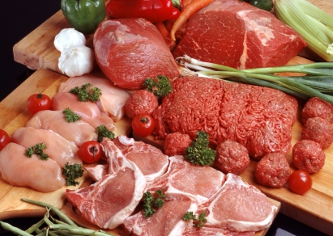
CREATE a Soup
Step 4: prepare protein
Options?
Food safety
Notes:
What other sources of protein can you think of besides meat? What are some plant based proteins? When dealing with meat, it is important to avoid cross contamination. Make sure that none of the ready to eat foods that you are preparing with your meal touch any raw meat. Also make sure that you are practicing proper hygiene and checking to make sure that all of your food is at the correct temperature before using in your soup. After you have made your soup or are storing any left over meat that you didn’t use, make sure that it is properly stored in an airtight container that won’t leak meat juice over any of your other foods inside the fridge.

Slide 10
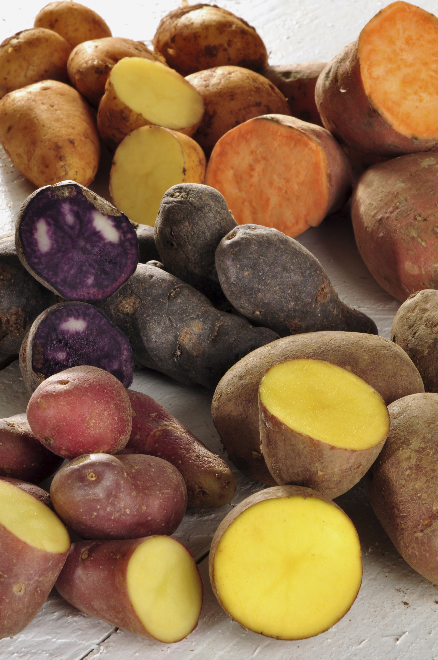
CREATE a Soup
Step 5: Prepare a Starch
Options?
Fast cooking vs. slow
Notes:
What starches do each of you have in your pantry and usually use? What are some other choices of starches that we could make? It is generally better to pick fast cooking starches such as potatoes, pasta, or pre-cooked beans.

Slide 11
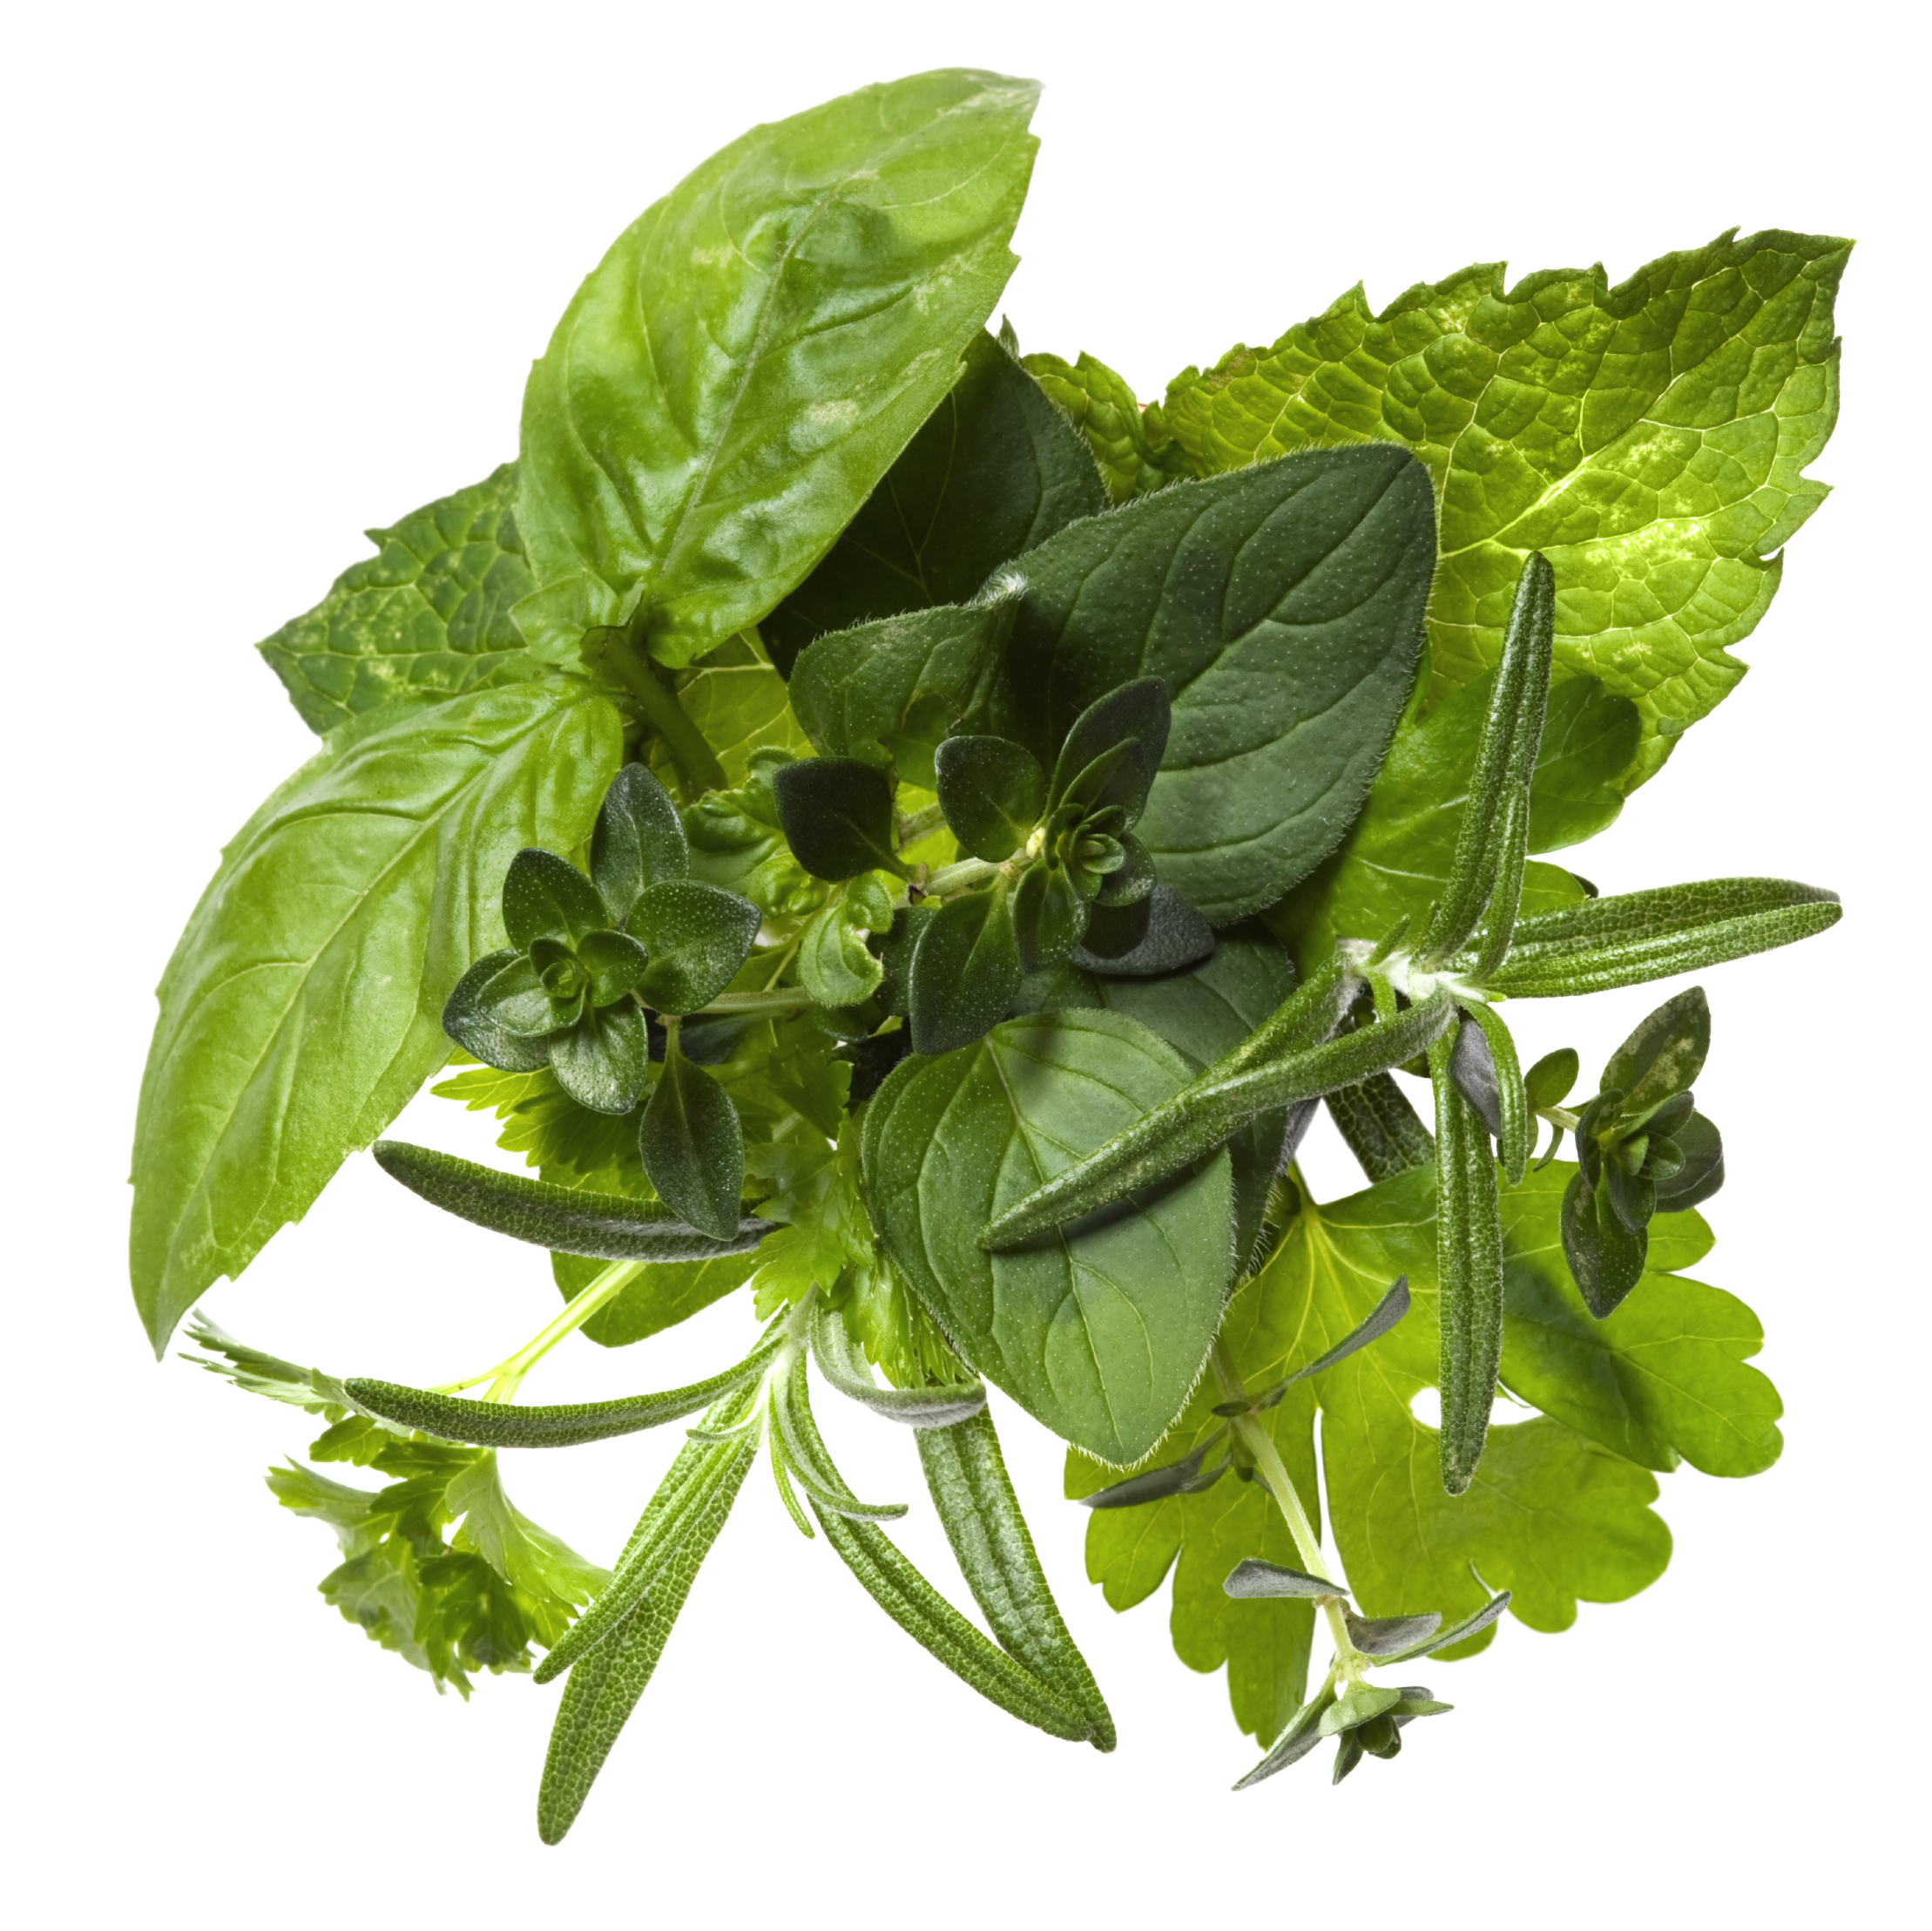
CREATE a Soup
Step 6: Prepare Seasonings
Choose spices according
to other ingredients
-Mexican: cumin
-Italian: basil
-Asian: Soy sauce
Notes:
Choose spices/herbs according to other ingredients (example- use Mexican spices if soup has black beans, onion, garlic, tomatoes, and corn; use Italian spices if soup has pasta, tomatoes, zucchini; savory spices if chicken noodle; etc)
a.) Mexican: cumin, oregano, chili powder, cilantro, garlic
b.) Italian: basil, oregano, parsley, garlic
c.) Asian: soy sauce, ginger, garlic, chilies, tumeric
d.) Savory/thanksgiving: rosemary, sage, thyme, parsley

Slide 12
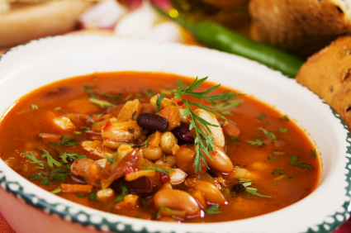
CREATE a Soup
Step 7: put ingredients in large pot and let simmer until meat is cooked and vegetables tender
Notes:
Start by heating a saucepan and cooking the onions until they are softened. Add broth, meat/beans and vegetables until cooked.

Slide 13
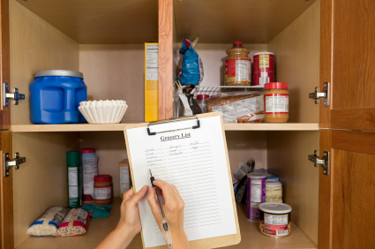
Practice
Pantry items from home
Possible soup options from pantry ingredients
Notes:
(Show pantry items brought from home and ask participants what foods could be used in the soup) Ask class members what foods they have in their pantries and create as many soups as possible from what they already have.

Slide 14
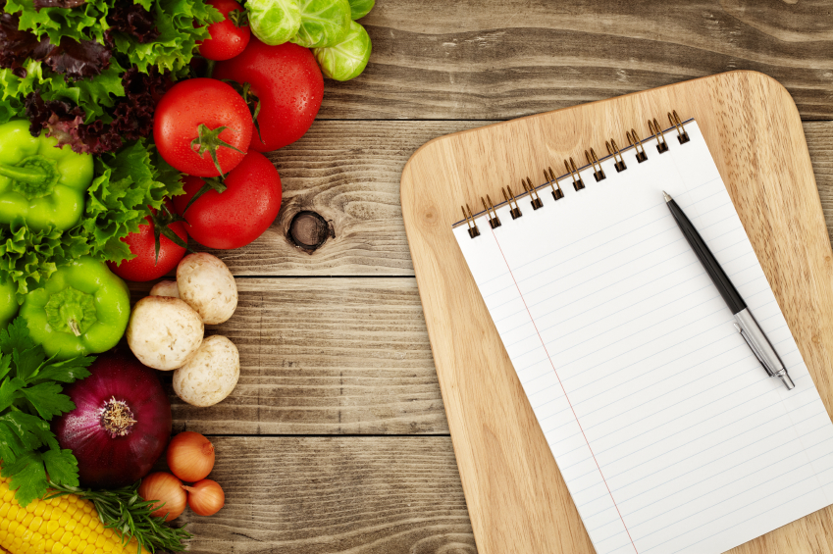
Incorporating MyPlate
What components does soup have?
What can be added?
Notes:
What components of MyPlate does soup already have? What can we add to our plate to round out the meal?

Slide 15
Don’t Forget To Move
Weekly exercise plan
Notes:
Don’t forget to move! What can/will you do this week to move your body?

Slide 16
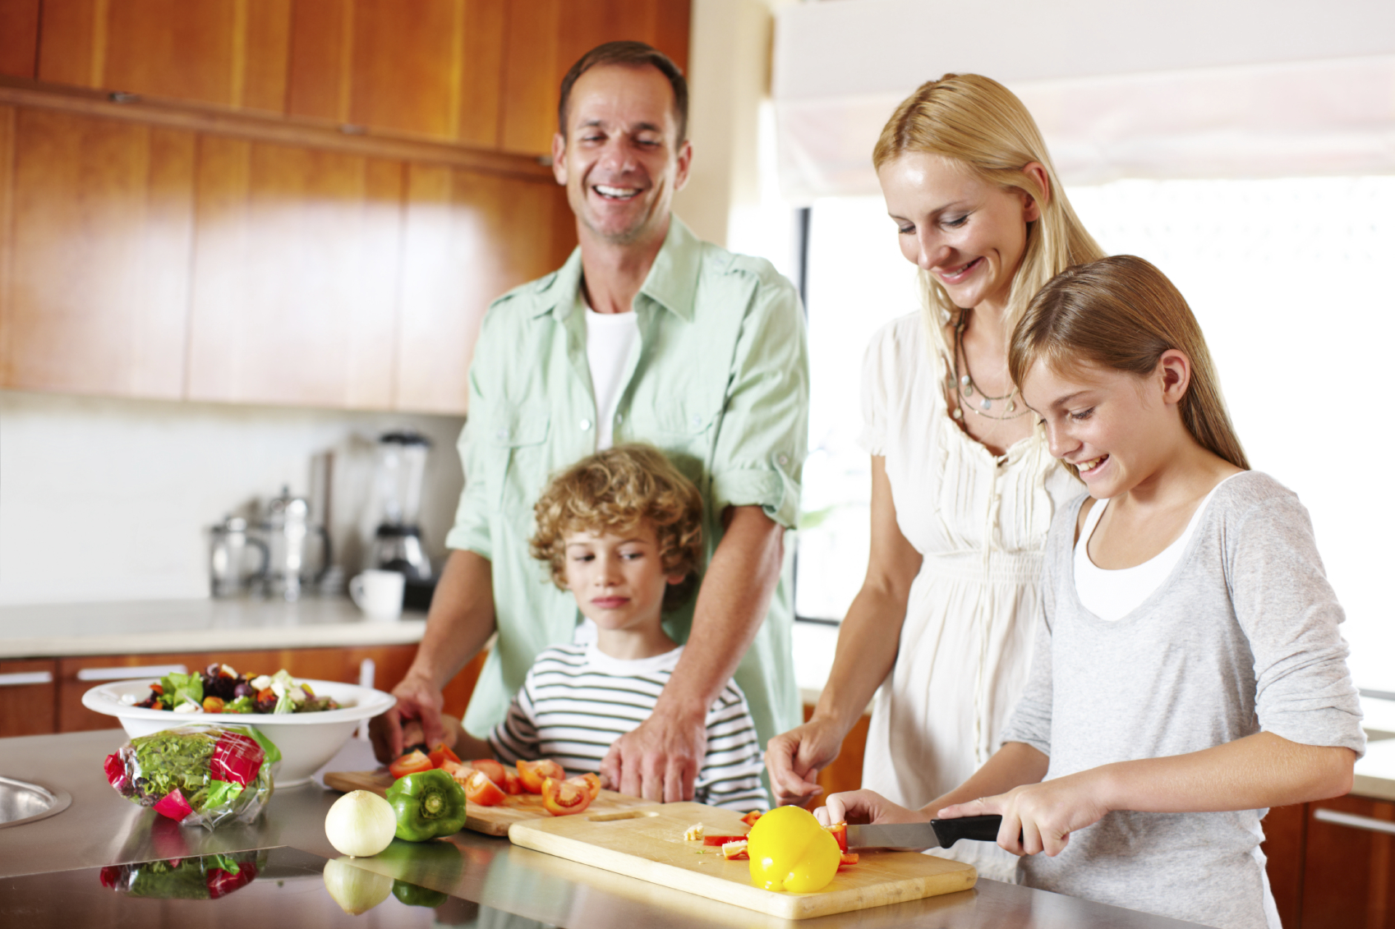
Conclusion
All you need – basic equipment and food from pantry
Notes:
You don’t need a state-of-the-art kitchen, a degree from culinary school, or tons of time. You just need some basic equipment and food in the pantry to create a delicious soup that your family will want to come home to!

