Slide 1
Create a omelet
Food $ense
Notes:
NOTES: Script for the power point in quotations. “This lesson teaches how quick and easy it is to put together a delicious omelet from ingredients you already have.”

Slide 2

Goal
Stock a Healthy Pantry
Create Tasty Skillet Meals
Understand how to use a “Whole Foods Approach” following MyPlate guidelines
Notes:
This lesson teaches how quick and easy it is to put together a tasty omelet from ingredients you already have. After this lesson, the goal is to be able to demonstrate the skills needed to stock your pantry with nutritious foods and to use those foods to create tasty omelets using a whole foods approach that follows MyPlate meal plans.

Slide 3

Importance of Family Mealtime
Family Bonding
Better Nutrition
Better Grades and Behavior
Notes:
Discuss why family mealtime is important.
Ask for opinions/ input on importance.
Include examples:
Family Bonding
Better nutrition with less chance of eating disorders
Better grades and behavior with less chance of drugs, alcohol, and sexual activity

Slide 4
Importance of whole food diets
What are whole food diets?
Whole Food Diets: As close to original source as possible
¾ MyPlate is plant based
What diets lead to?
Benefits of whole plant foods
Notes:
Define a whole food diet and discuss why it is important.
* Whole Food Definition: as close to original source as possible with minimal processing and refining ( potatoes vs. potato chips)
* Ask participants on what they believe a whole food diet could include.
Discuss how ¾ of MyPlate is plant based
Benefits of Whole Plant Foods
* A diet rich in whole plant food is related to less chronic disease and obesity
* A diet rich in refined foods with added fats, sugar, and salt is related to increased chronic disease and obesity
* Whole plant foods full of fiber and water leave you feeling satisfied and full on less calories

Slide 5
Having a Well-Stocked Pantry
Food Availability Type = Food Decision
Healthy vs. Unhealthy
No Need for a Recipe!
Buy Whole Foods
Ad/Sales
Shop Perimeter of Stores
Notes:
Discuss the necessity of a well-stocked pantry and how to make that happen:
*Temptation to eat out or make unhealthy choices is greatly increased if healthy, easy, and fast options are not available. The food readily available affects our food decisions
You don’t have to have a recipe or even a plan( although both are good) as long as your pantry has good food in it and you understand the techniques of how to put food together
Buy whole foods that are minimally processed or refined
Shop ads/sales
Shop perimeter of the store to avoid buying processed foods

Slide 6

Discussion: Meal Plans
Create a menu
Theme nights
Notes:
Discuss meal plans and how they save time and money
Step to create a menu:
Look at ingredients already in pantry or fridge
Look through recipes/ come up with combinations to use food
Put together a menu for each meal
Extra Tips
Consider having theme nights: Monday is Mexican food, Tuesday is Italian, etc)

Slide 7
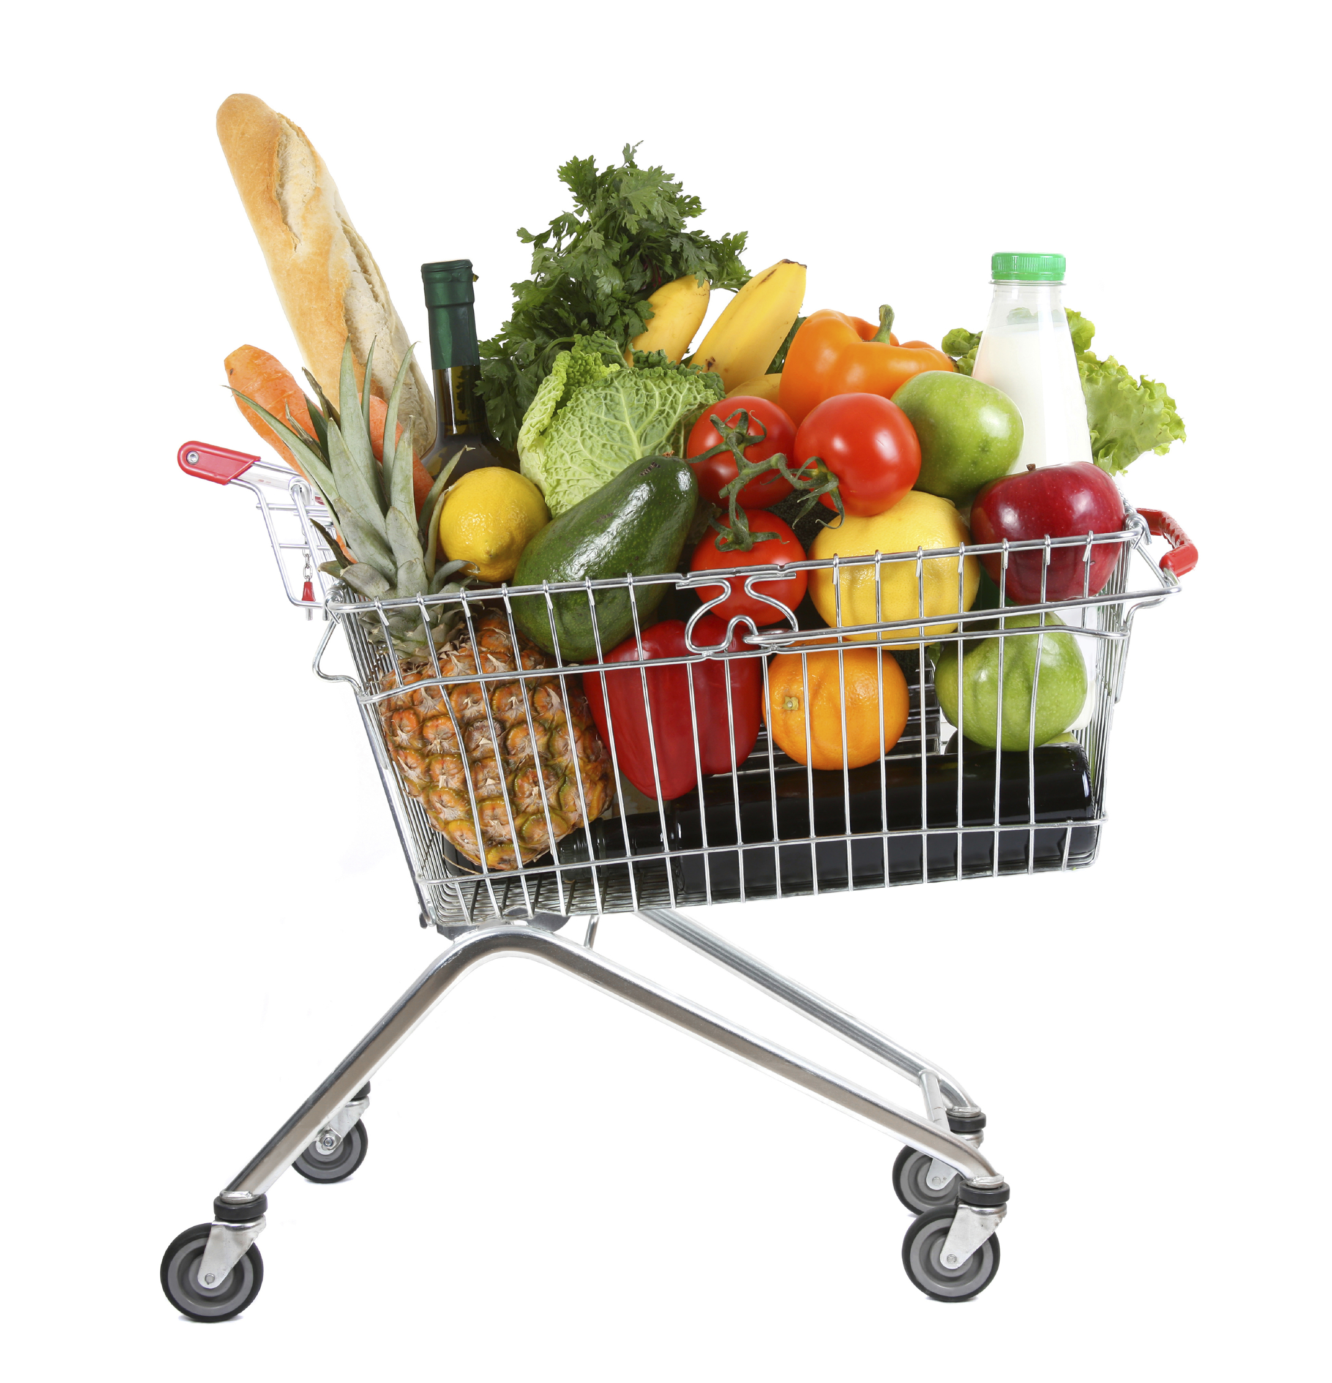
Create an Omelet
Preparation:
Whole Foods
Equipment needed
Notes:
Preparation for creating an omelet:
Choose mostly whole foods and reduce highly refined processed foods
Show and explain equipment needed and how to use it: sharp knife, cutting board, vegetable peeler, vegetable/ cheese grater, mixing bowl, mixing cups and spoons, whisk, nonstick skillet, etc.

Slide 8
Create an Omelet
Step 1: Prepare fillings of choice
Options: common vs. uncommon
Nutrition of vegetables
Vegetables give volume not calories
Knife Skills needed
Watch out for hidden fats
Notes:
Steps: Prepare fillings
Options: Discuss options, what do participants typically use, what are common and not so common
Vegetable Nutrition: Discuss how veggies are naturally rich in vitamins, minerals, antioxidants, and phytochemicals
Volume vs. calories: Discuss how veggies will give the dish more volume but not calories
Knife skills: Demonstrate knife skills as you cut up veggies
Hidden fats: Watch out for hidden fats (butter, cheese, etc.)

Slide 9

Create an Omelet
Step 2: Crack Eggs
Food Safety
Notes:
Steps: Crack eggs
Discuss food safety- when to worry about cross contamination, proper hygiene, temperature, and storage

Slide 10
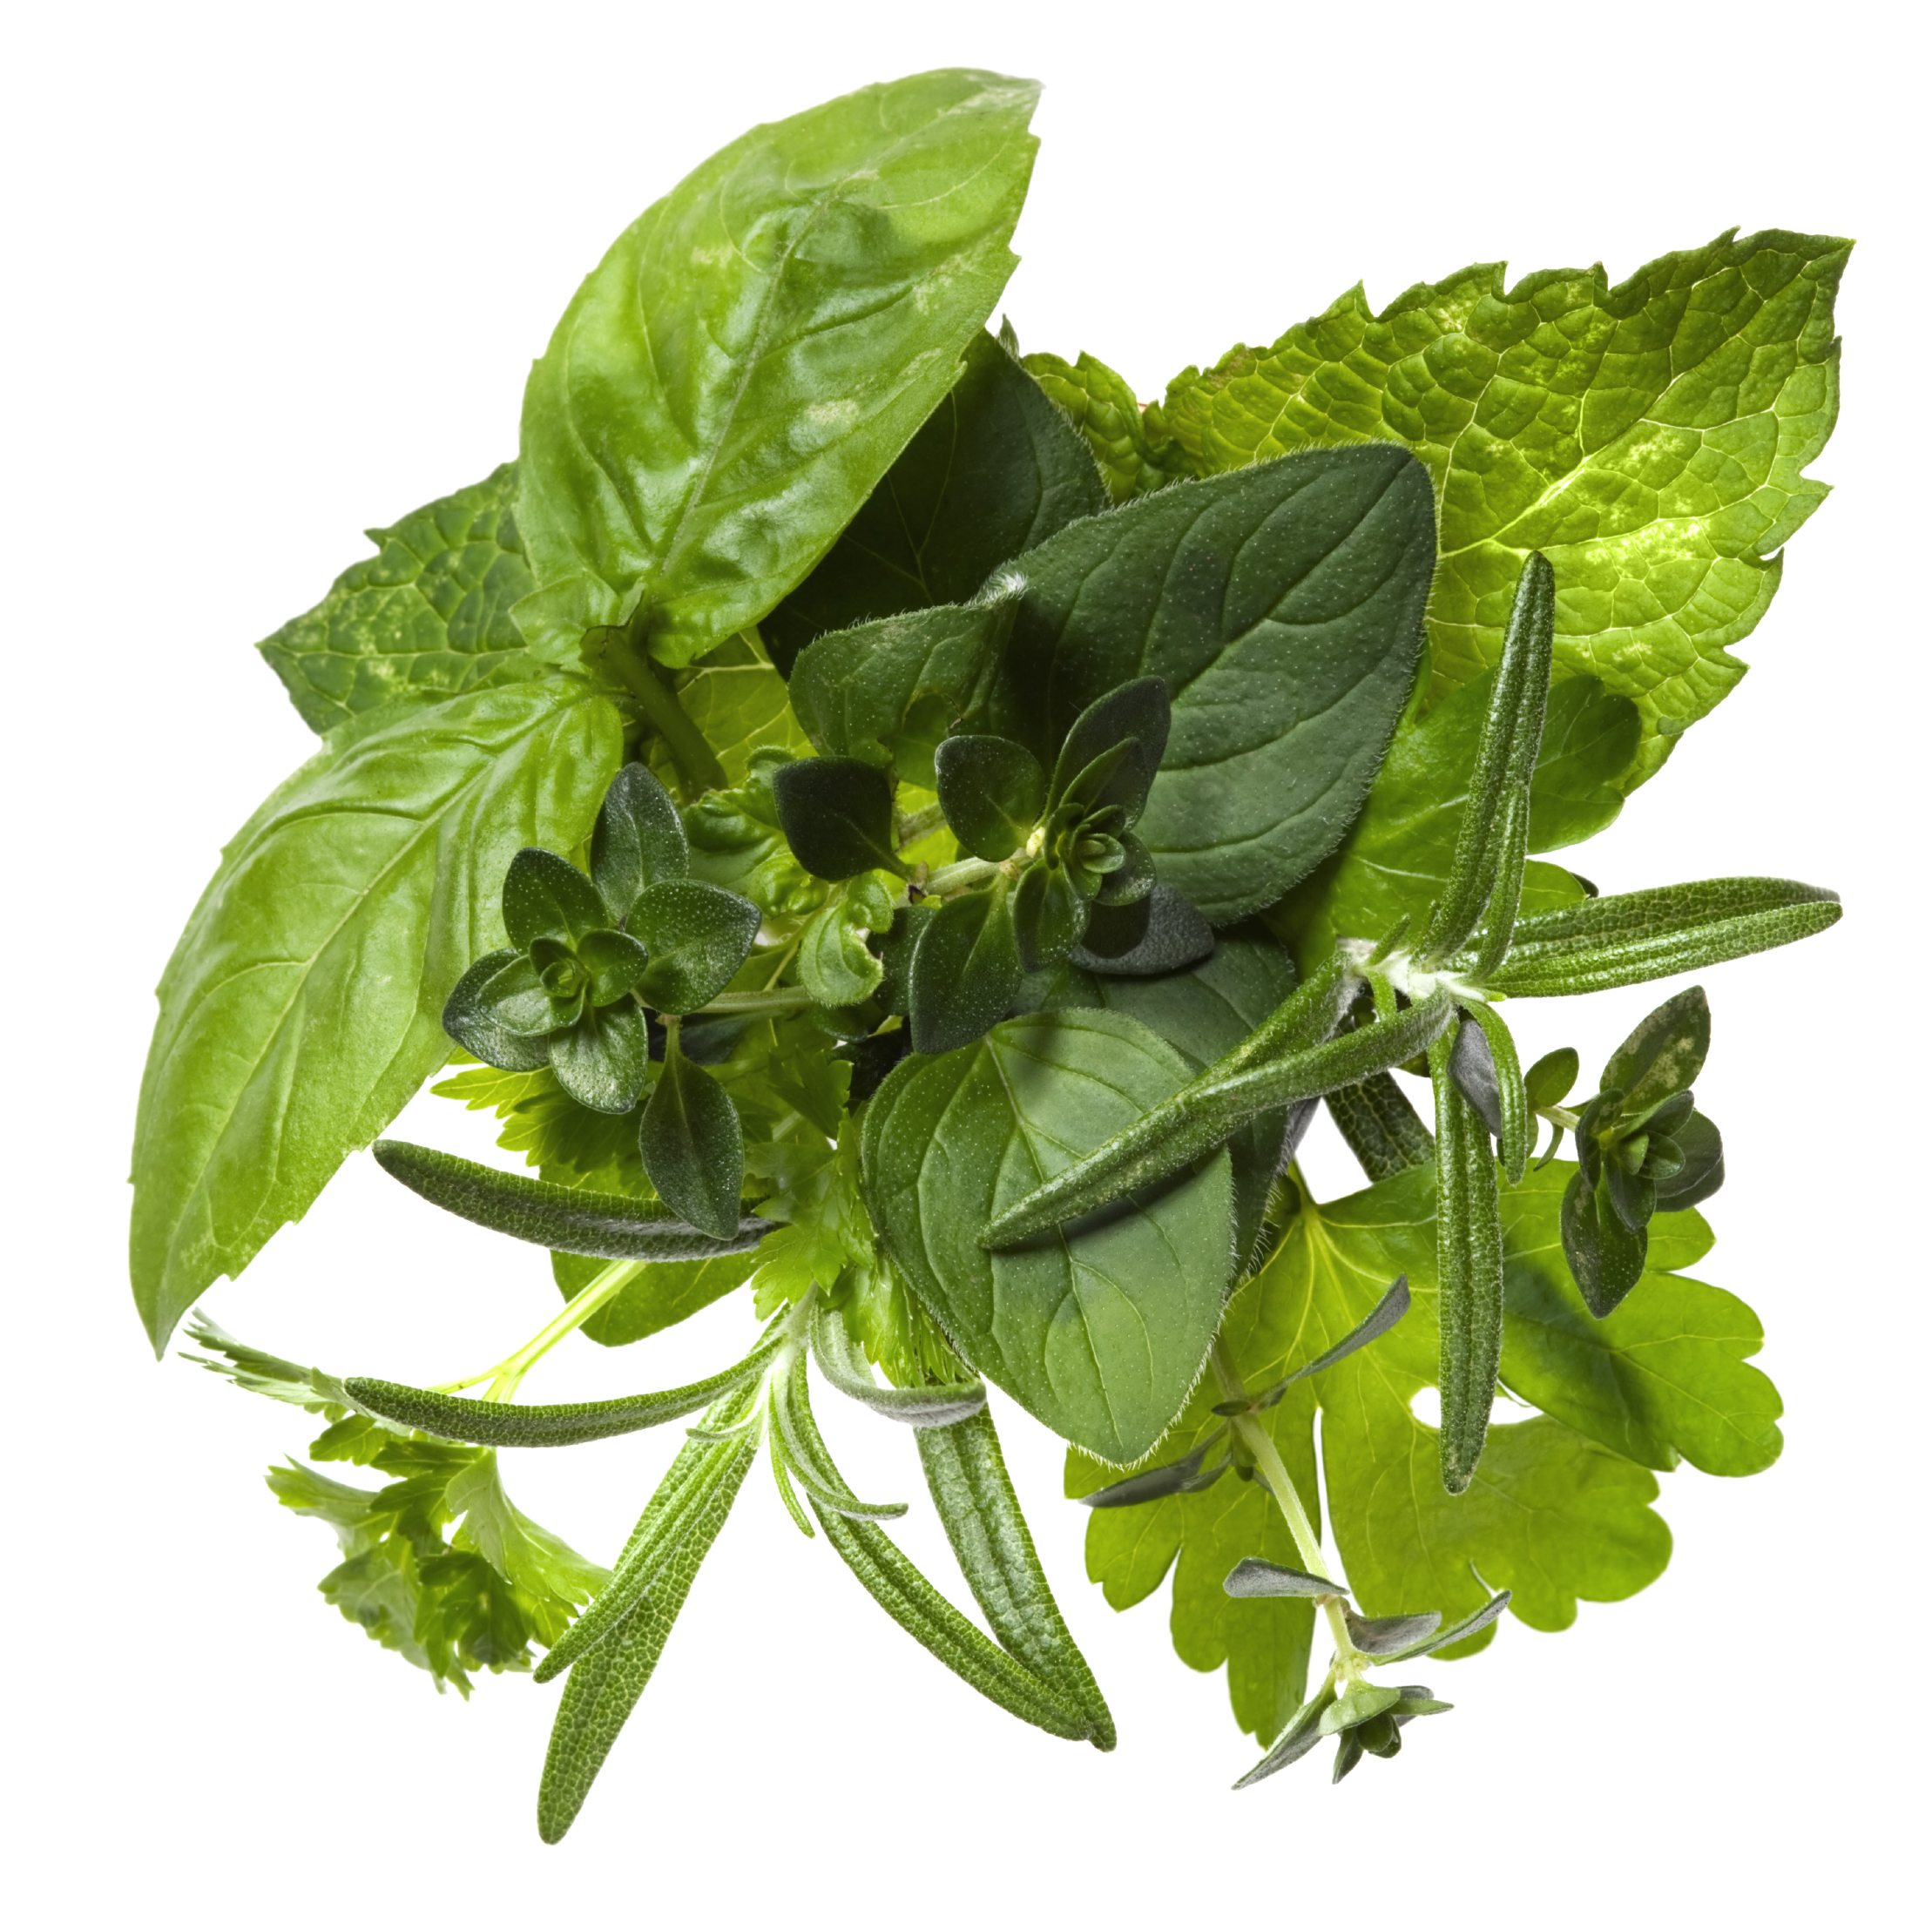
Create an Omelet
Step 3: Add herbs/spices
Salt, pepper, water, herbs
Notes:
Steps: herbs/spices
What herbs and spices can you use?
Add salt, pepper, water, and herbs of choice

Slide 11
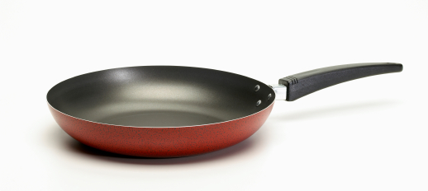
Create an Omelet
Step 4: Cooking
Heat pan, add cooking spray
Add eggs to pan
Pull cooked eggs from edges
Add filling
Fold and slide off plate
Notes:
Steps: Cooking
Demonstrate process:
Heat pan, add cooking spray
Add eggs to pan
Pull cooked eggs from edges
Add filling
Fold and slide off plate

Slide 12

Practice, Practice, Practice
Notes:
Bring pantry items from home and have class members come up with as many ideas for skillet meals as possible from those foods
Have class members think about their own pantry and create a list of meals using the ingredients they already have

Slide 13
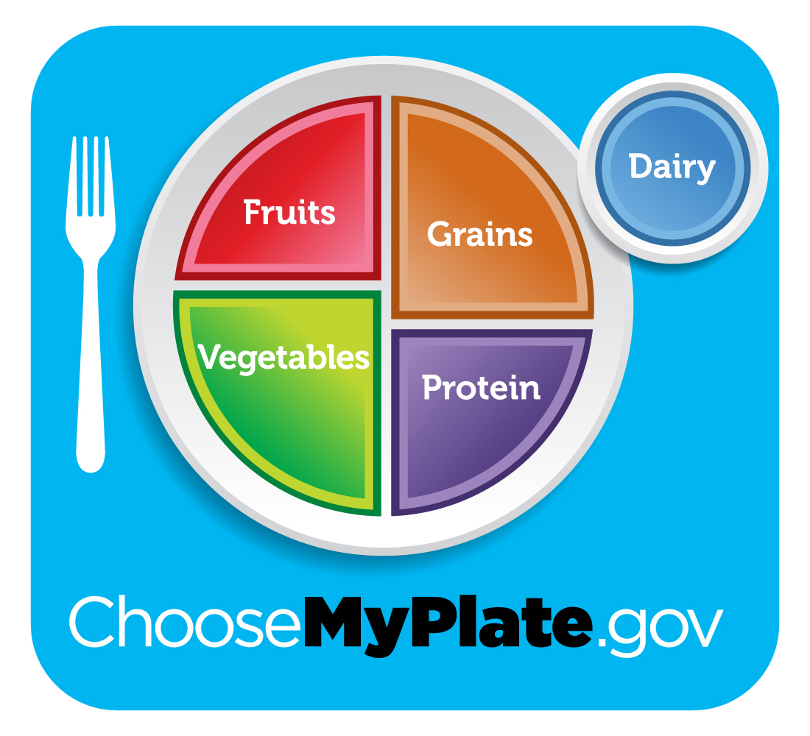
Incorporating MyPlate
What components of MyPlate does an omelet already have?
What can we add to our plate to round out the meal?
Notes:
Discussion Questions:
What components of MyPlate does a skillet meal creation already have?
What can we add to our plate to round out the meal?

Slide 14

Don’t Forget to Move!
What will you do this week to move your body?
Notes:
Being active is another important part of being healthy. What are some ways you will move around and be active this week?

Slide 15

Conclusion
You don’t need:
a state of the art kitchen
a degree from culinary school
Or tons of time
All you need is:
Basic equipment
Food in the Pantry
Notes:
You don’t need a start of the art kitchen, a degree from culinary school, or tons of time. You just need some basic equipment and food in the pantry to create a healthy omelet that your family will want to come home to!

