Slide 1
CREATE a Wrap/sandwich
Food $ense
Notes:
NOTES: Script for the power point in quotations. “This lesson teaches how quick and easy it is to put together a delicious wrap/sandwich from ingredients you already have.”

Slide 2
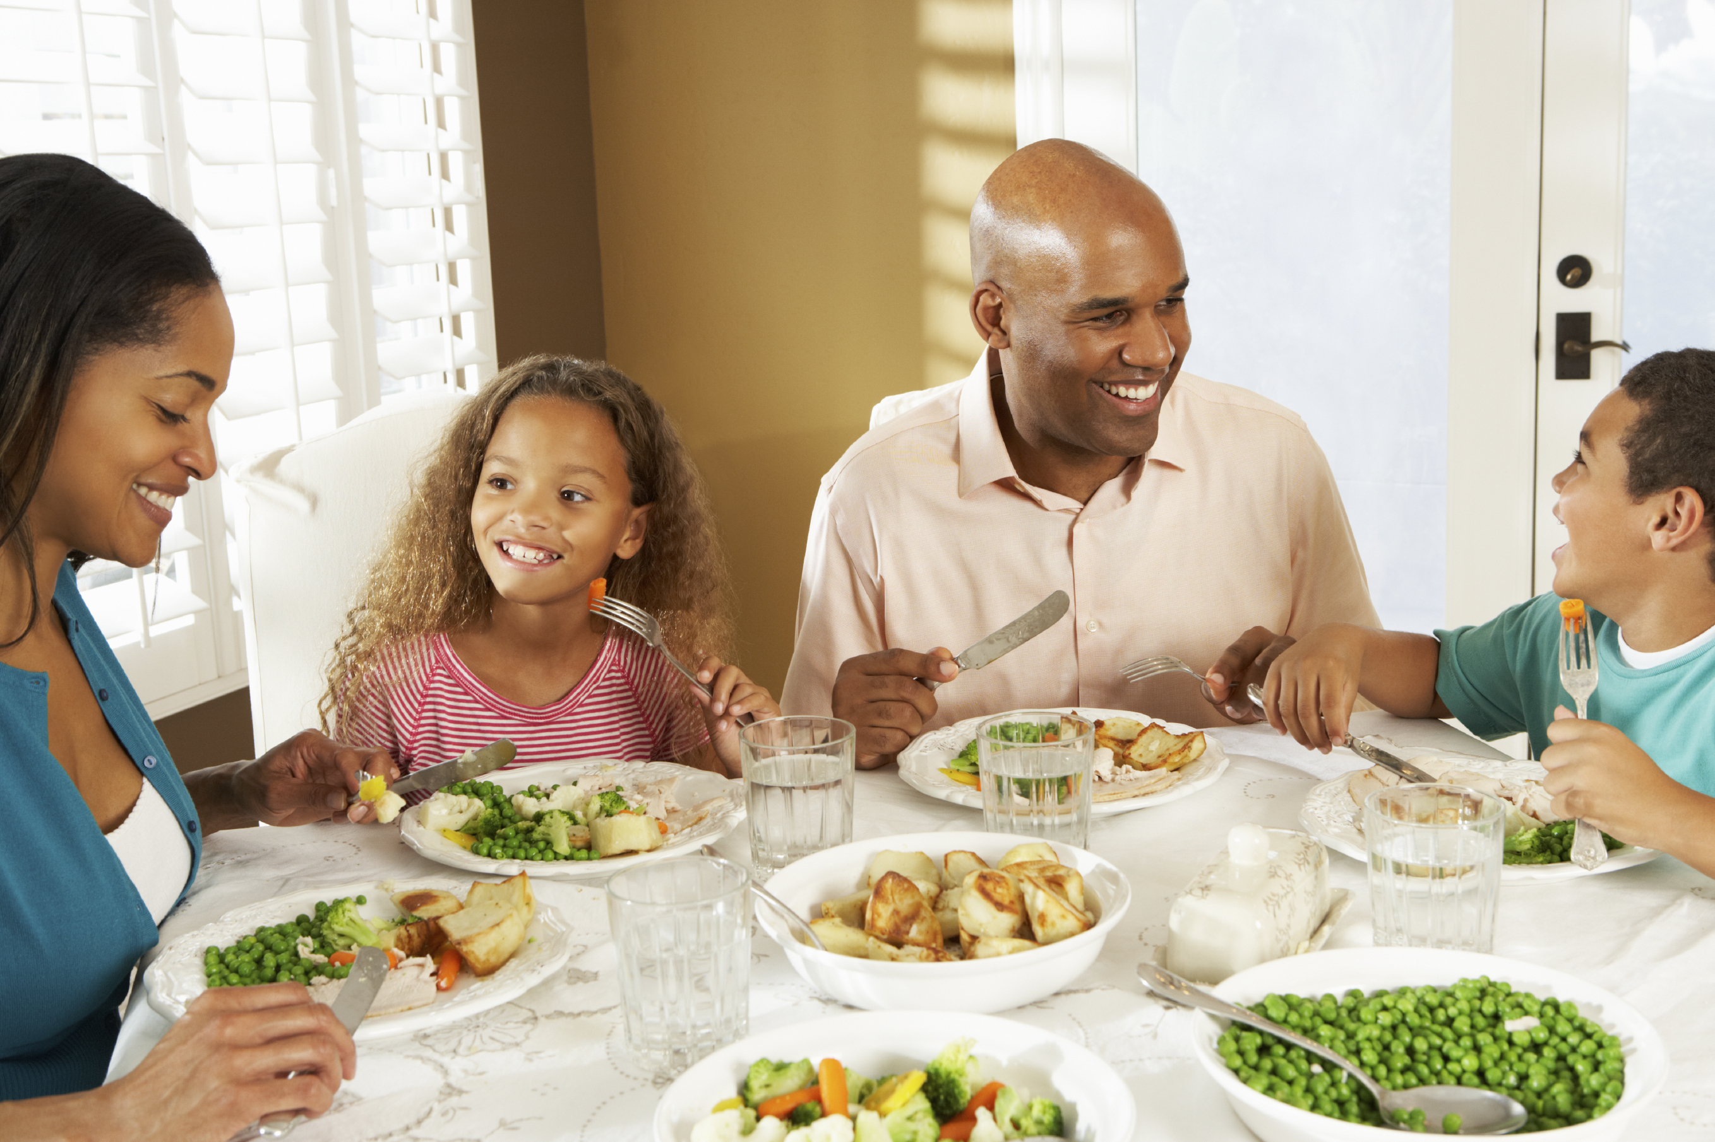
Introduction
Family Mealtime is important
Notes:
Discuss why family mealtime is important:
“Family mealtime offers a lot of advantages. It allows for family bonding, which can lead to better behavior in children. This includes better grades and behavior, as well as less chance of drugs, alcohol, and sexual activity. Family mealtime also betters nutrition, and decreases the chance of eating disorders.”

Slide 3

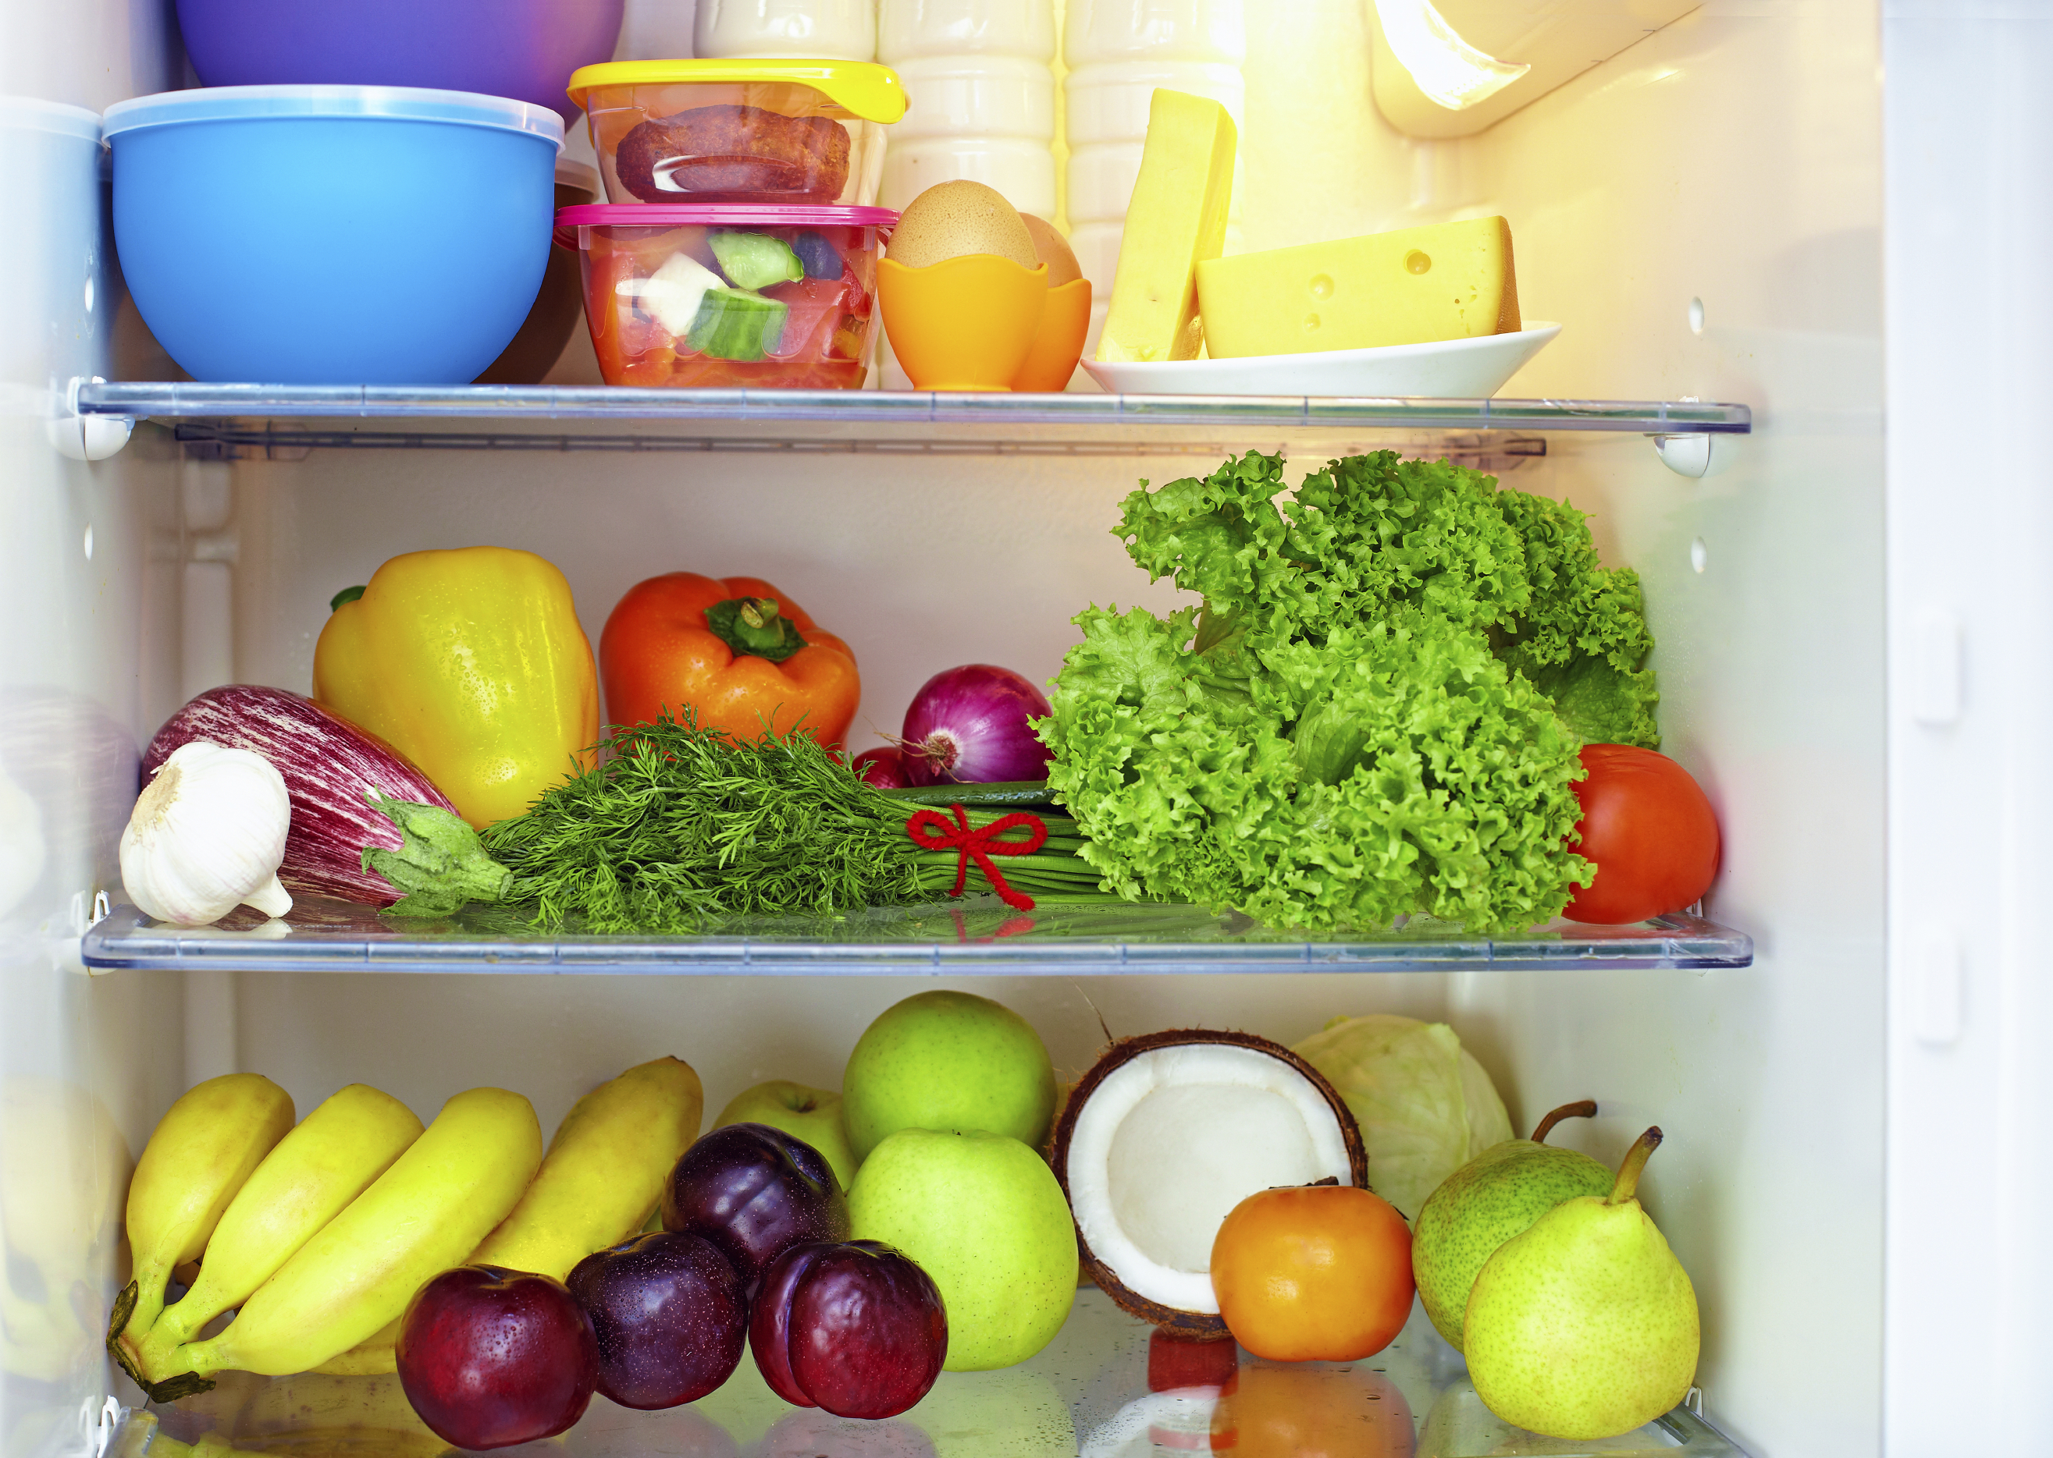
Introduction
Questions:
What is a whole food diet?
Why is a well-stocked
pantry important?
Notes:
Ask the first question of what is a whole food diet:
“Whole food is defined as close to the original source as possible, with minimal processing and refining; an example of this is a potato versus a potato chip. Three-fourths of MyPlate is plant based, which can help you have a whole food diet. There are many reasons why this diet is important and helpful. A diet rich in whole plant foods is related to less chronic disease and obesity. A diet rich in refined foods with added fats, sugar, and salt is related to increased chronic disease and obesity. Whole plant foods full of fiber and water leave you feeling satisfied and full on less calories.”
Ask the second question of why a well-stocked pantry is important: “Temptation to eat out or make unhealthy choices is greatly increased if healthy, easy and fast options are not available. You don’t have to have a recipe or even a plan, although both are fine, as long as your pantry has good food in it and you understand the techniques of how to put food together. There are several tips you can follow on how to make this happen. Buy whole foods that are minimally processed or refined, shop ads/sales, and shop the perimeter of the store [explain].

Slide 4
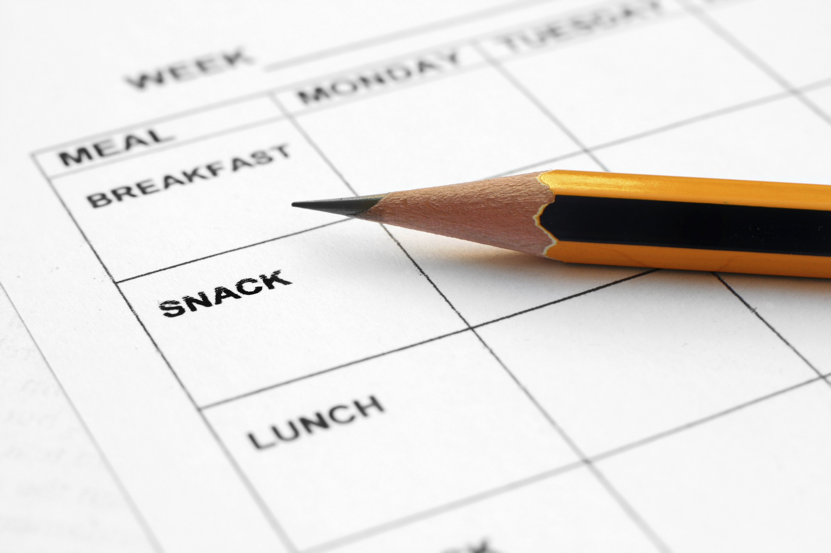
Introduction
Meal planning
Save time and money
Steps/tips
Notes:
Discuss meal planning:
“Meal planning is setting a schedule of what you are going to prepare for meals throughout the week. Meal Planning is a good idea because it saves a lot of time and money.
Let’s talk about steps to create a menu [discuss and get responses, explain].
One tip you can consider is having theme nights, for example having Monday be Mexican food, Tuesday Italian, etc.”

Slide 5
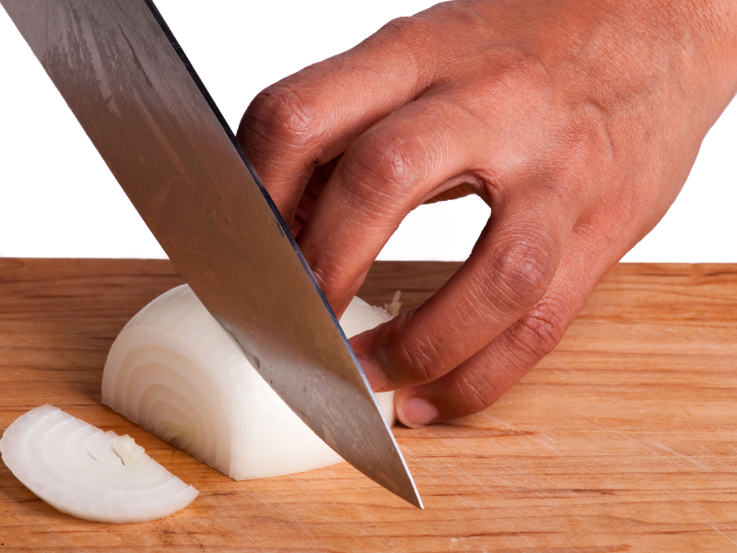
Create a wrap/sandwich
Before Starting:
Choose whole foods
Make sure to have needed
equipment
Notes:
Choose whole foods as often as you can:
Now we will begin talking about Creating a sandwich/wrap. It is important to use whole foods as often as you can. Lets discuss the difference between a wrap made with processed meat and cheese versus one full of hummus and fresh veggies. What are the benefits of the latter?
Equipment needed:
We also need to make sure we have the necessary equipment.” [Show and explain equipment: sharp knife, cutting board, vegetable peeler, vegetable grater, etc.]

Slide 6
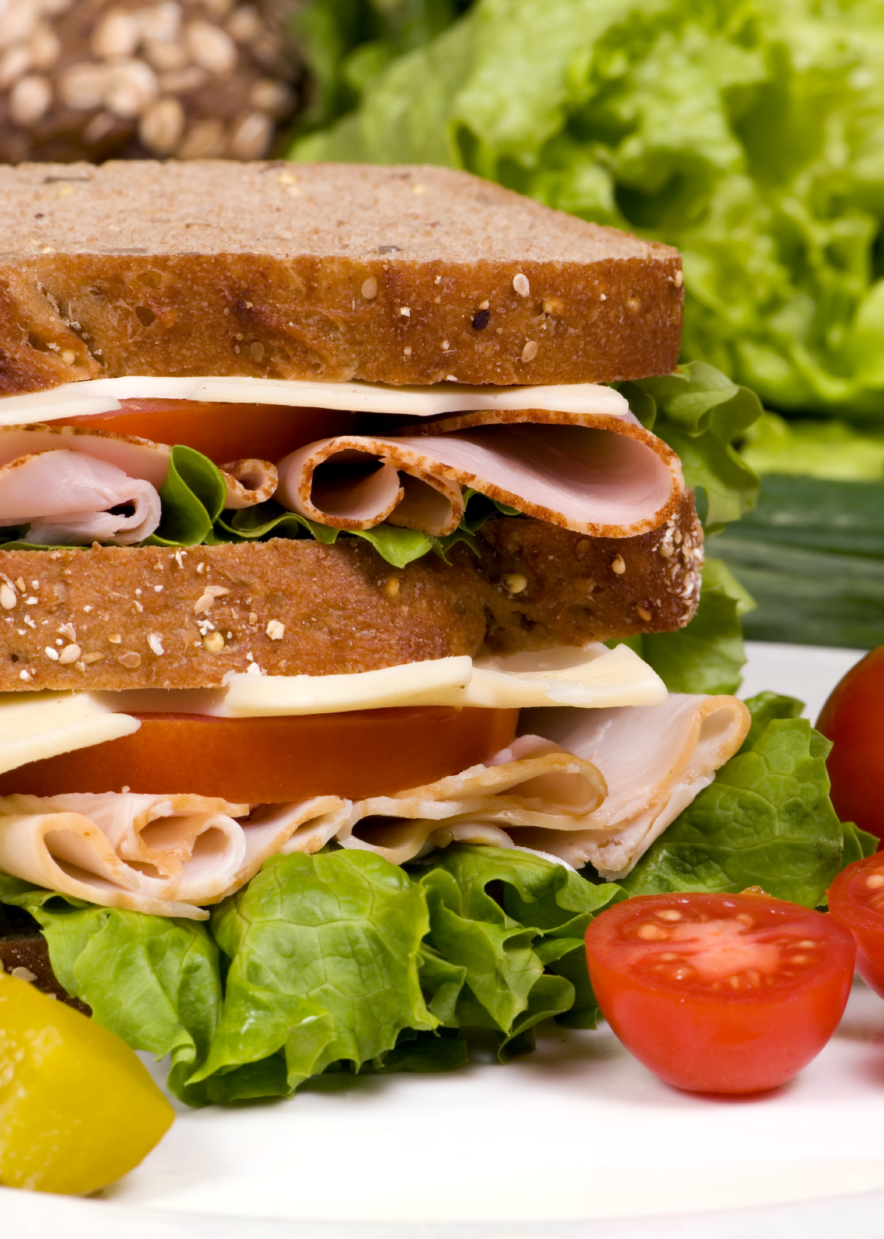
Create a wrap/sandwich
Wrap/bread
Options
Whole grain
Notes:
When creating a wrap or sandwich, what type of bread or wrap do you use? What could be some healthier options? There is a large difference between whole and refined grains. Refined grans are essentially grain kernels that have had the outer part of it removed to give it a finer texture. These refined grains do not provide the nutritional benefits that whole grains can provide. Whole grains, which contain the outside of the kernel that has been reduced to much less processing, still contains vital nutrients such as Vitamin b12 and iron.

Slide 7
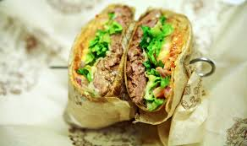
Create a wrap/sandwich
Protein
Options?
Food Safety
Cut same size
Notes:
What are some options for protein? What do you like to use? What could be some healthier options? Food safety is a big subject when we talk about proteins. We need to make sure that we are avoiding any cross contamination, practicing proper hygiene, storing the ingredients at a proper temperature, and safely storing them in the appropriate areas.

Slide 8
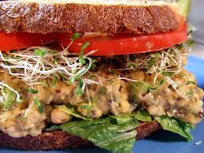
Create a wrap/sandwich
Filling
Prep before (cutting/slicing)
Vegetables
Cheese
Notes:
Discuss some common and not so common fillings you might put in a sandwich or a wrap. Discuss how veggies are naturally rich in vitamins, minerals, antioxidants and phytochemicals. Veggies will give the dish more volume but not calories. Demonstrate knife skills as you cut up the veggies.

Slide 9
Create a wrap/sandwich
Spread
Discuss options: mustard, hummus, dressing etc.
Discuss hidden fats and healthier
options
Notes:
Discuss options for different spreads-mustard, ketchup, low-fat mayonnaise, ranch dressing, Italian dressing, hummus, bean dip, etc. Get ideas for new spreads. Discuss identifying hidden fats in these spreads and considering healthier options.

Slide 10
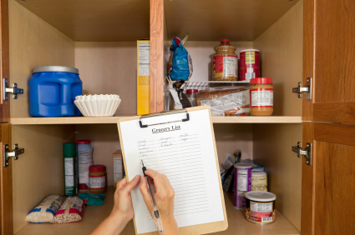
Practice
Pantry items from home
Possible wrap/sandwich options from pantry ingredients
Notes:
Bring pantry items from home and have class members come up with as many ideas for wraps/sandwiches as possible from those foods.
Have class members think about their own pantry and create as many meal options as possible from what they already have.

Slide 11

Incorporating MyPlate
What components does a wrap/sandwich have?
What can be added?
Notes:
What components of MyPlate does a sandwich/wrap already have?
What can we add to our plate to round out the meal?

Slide 12


Don’t Forget to Move
Weekly exercise plan
Notes:
Being active is another important part of being healthy. What are some ways you will move around and be active this week?

Slide 13

Conclusion
All you need – basic equipment and food from pantry
Notes:
You don’t need a start of the art kitchen, a degree from culinary school, or tons of time. You just need some basic equipment and food in the pantry to create a healthy wrap/sandwich that your family will want to come home to!

