Slide 1
CREATE A STIR-FRY
Food $ense
Notes:
“This lesson teaches how quick and easy it is to put together a delicious stir fry from ingredients you already have.”

Slide 2
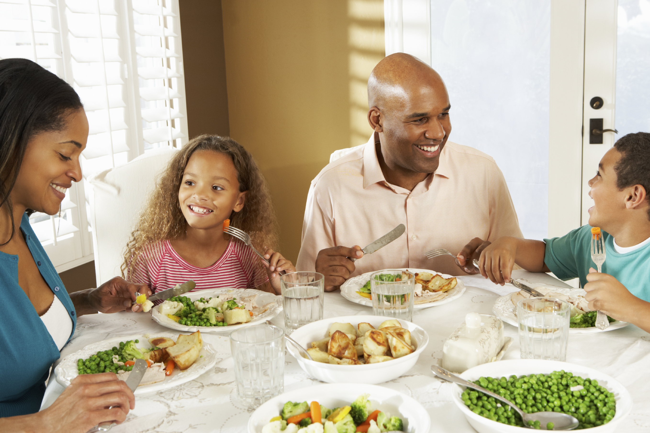
Introduction
Family Mealtime is important
Notes:
Discuss why family mealtime is important: “Family mealtime offers a lot of advantages. It allows for family bonding, which can lead to better behavior in children. This includes better grades and behavior, as well as less chance of drugs, alcohol, and sexual activity. Family mealtime also betters nutrition, and decreases the chance of eating disorders.”

Slide 3

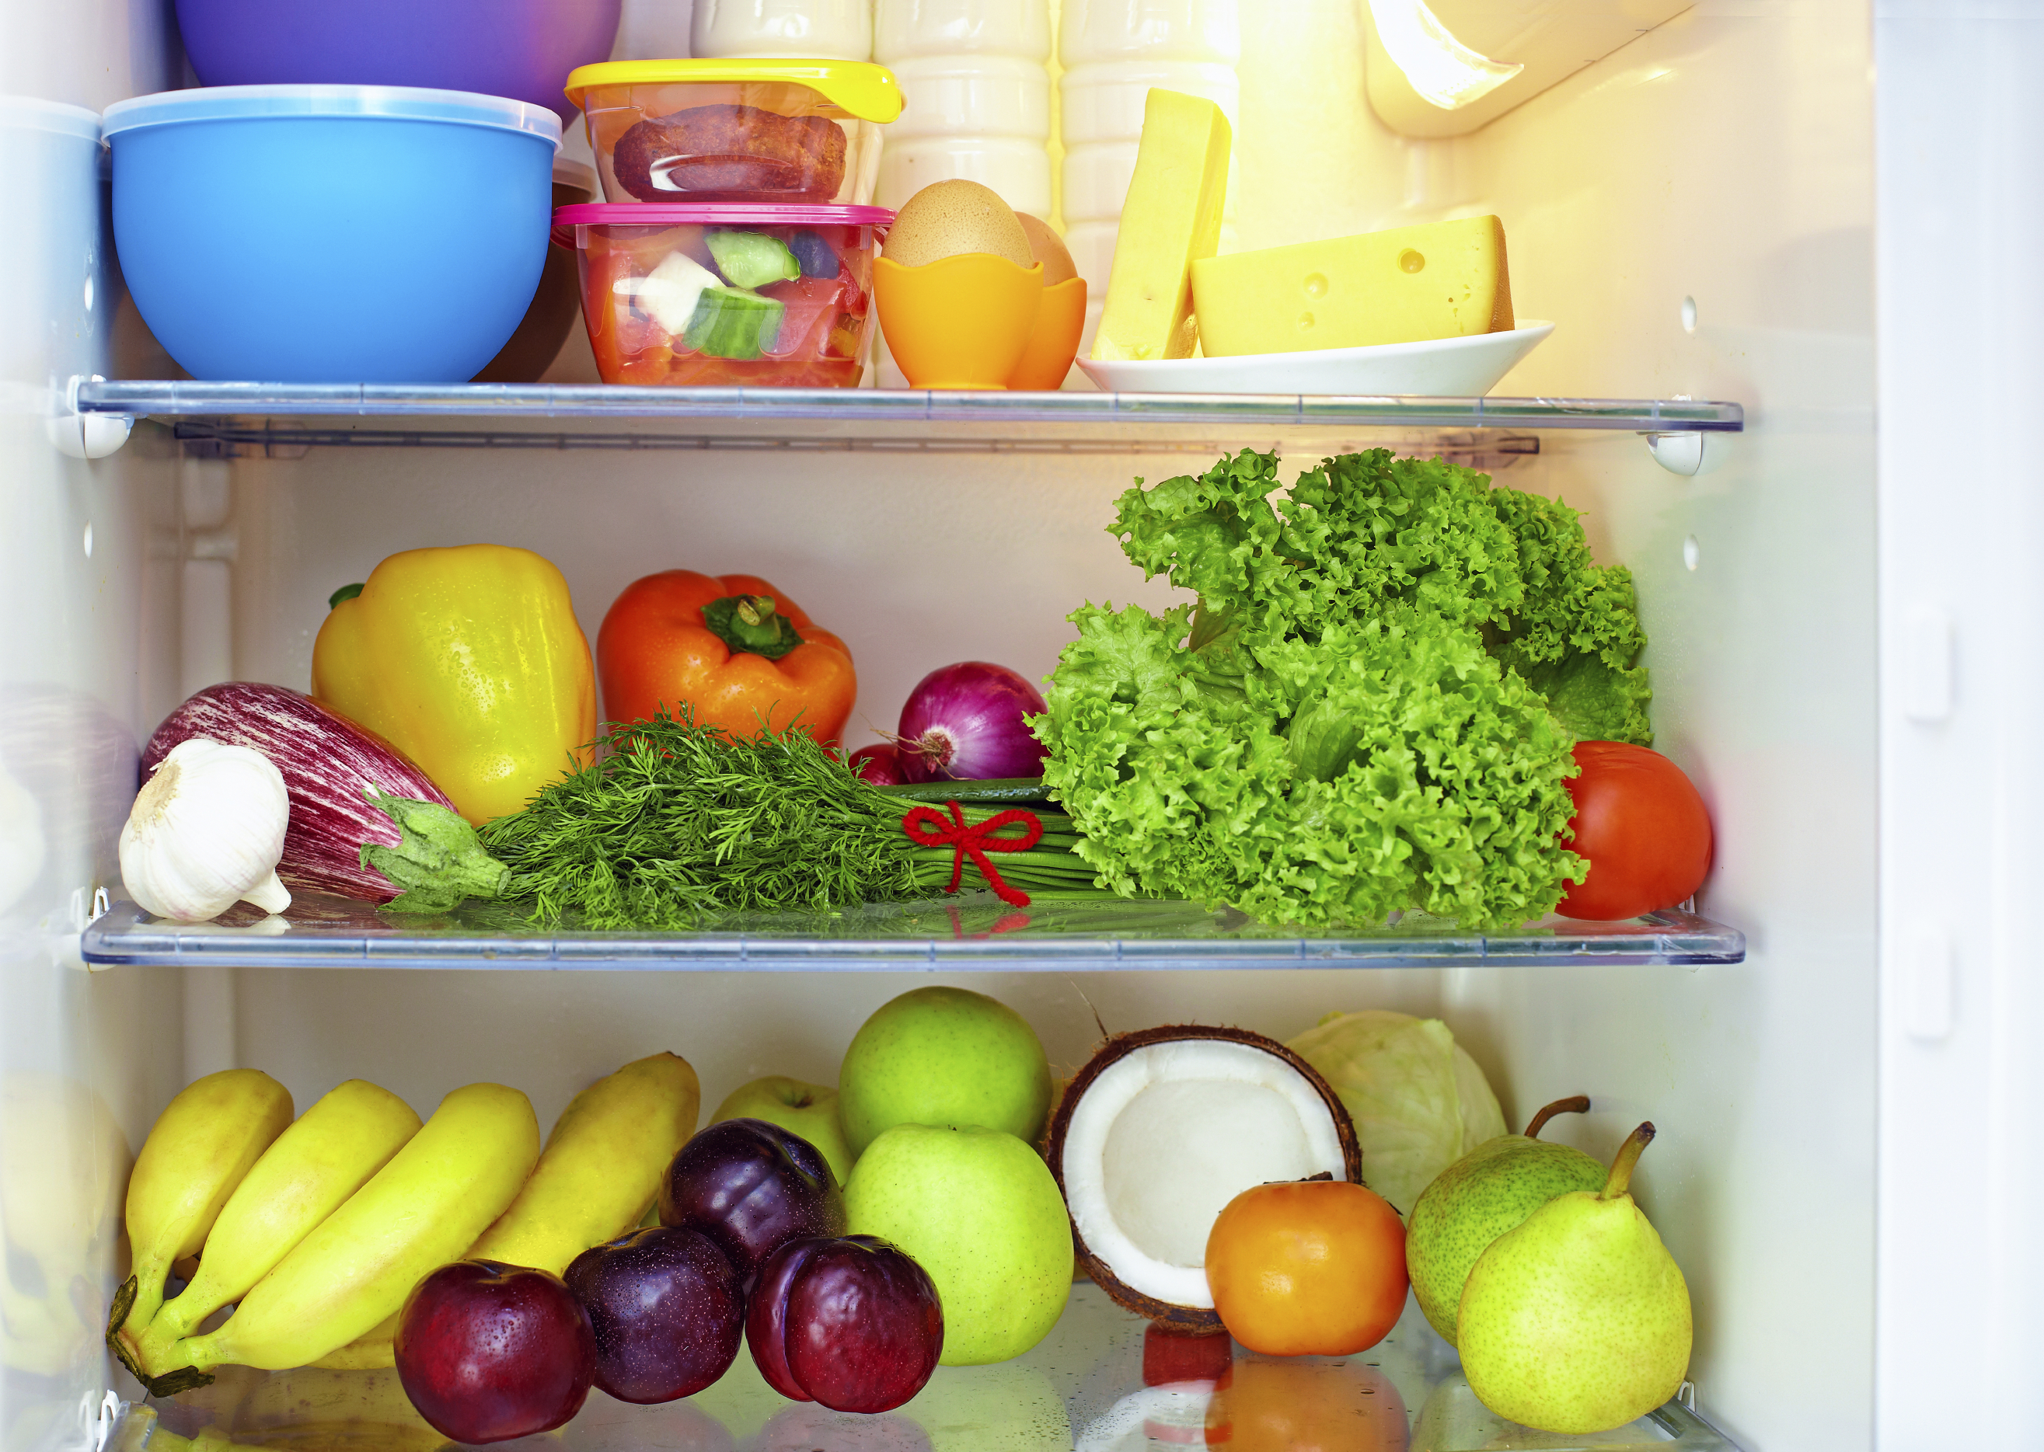
Introduction
Questions:
What is a whole food diet?
Why is a well-stocked pantry important?
Notes:
Ask the first question of what is a whole food diet and wait for responses: “Whole food is defined as close to the original source as possible, with minimal processing and refining; an example of this is a potato versus a potato chip. Three-fourths of MyPlate is plant based, which can help you have a whole food diet. There are many reasons why this diet is important and helpful. A diet rich in whole plant foods is related to less chronic disease and obesity. A diet rich in refined foods with added fats, sugar, and salt is related to increased chronic disease and obesity. Whole plant foods full of fiber and water leave you feeling satisfied and full on less calories.”
Ask the second question of why a well-stocked pantry is important, wait for responses and then say: “Temptation to eat out or make unhealthy choices is greatly increased if healthy, easy and fast options are not available. You don’t have to have a recipe or even a plan, although both are fine, as long as your pantry has good food in it and you understand the techniques of how to put food together. There are several tips you can follow on how to make this happen. Buy whole foods that are minimally processed or refined, shop ads/sales, and shop the perimeter of the store [explain].

Slide 4
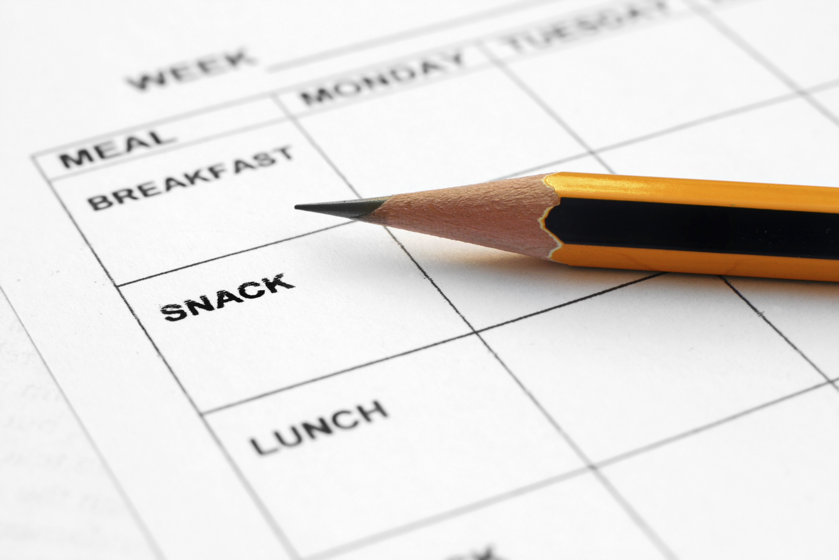
Introduction
Meal Planning
  Save time and money
  Steps/tips
Notes:
Discuss meal planning: “Meal planning is setting a schedule of what you are going to prepare for meals throughout the week. Meal Planning is a good idea because it saves a lot of time and money.
Let’s talk about steps to create a menu [discuss and get responses, explain].
One tip you can consider is having theme nights, for example having Monday be Mexican food, Tuesday Italian, etc.”

Slide 5
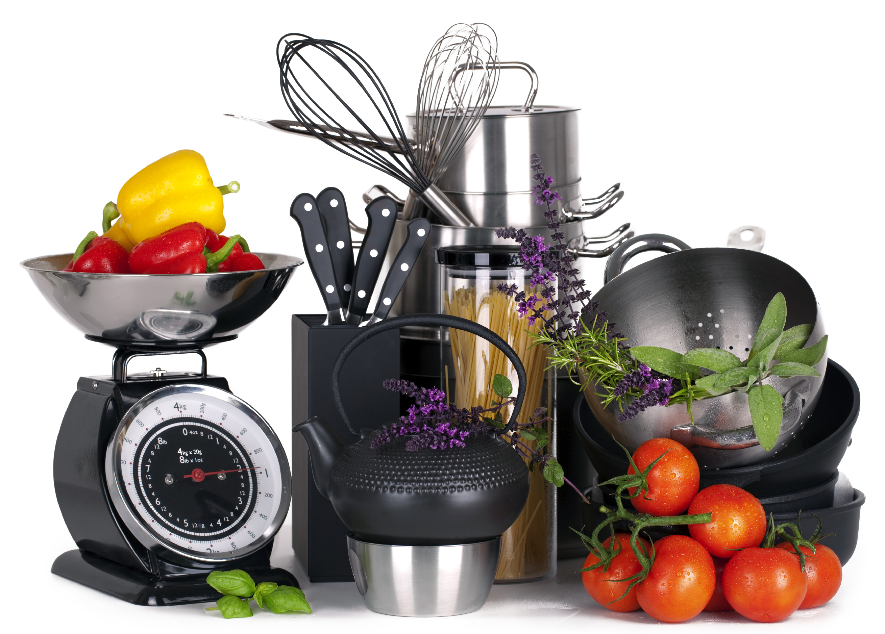
CREATE a Stir-Fry
Before Starting:
Choose whole foods
Make sure to have needed equipment
Notes:
“Now we will begin talking about Creating a Stir Fry. You should first choose whole foods for this recipe – It is easier to cook with whole foods when making a stir-fry than any other dish. We automatically think of fresh veggies!
We also need to make sure we have the necessary equipment.” [Show and explain equipment: sharp knife, cutting board, vegetable peeler, vegetable grater, large mixing bowl, mixing cups and spoons, large skillet or wok, etc.]

Slide 6
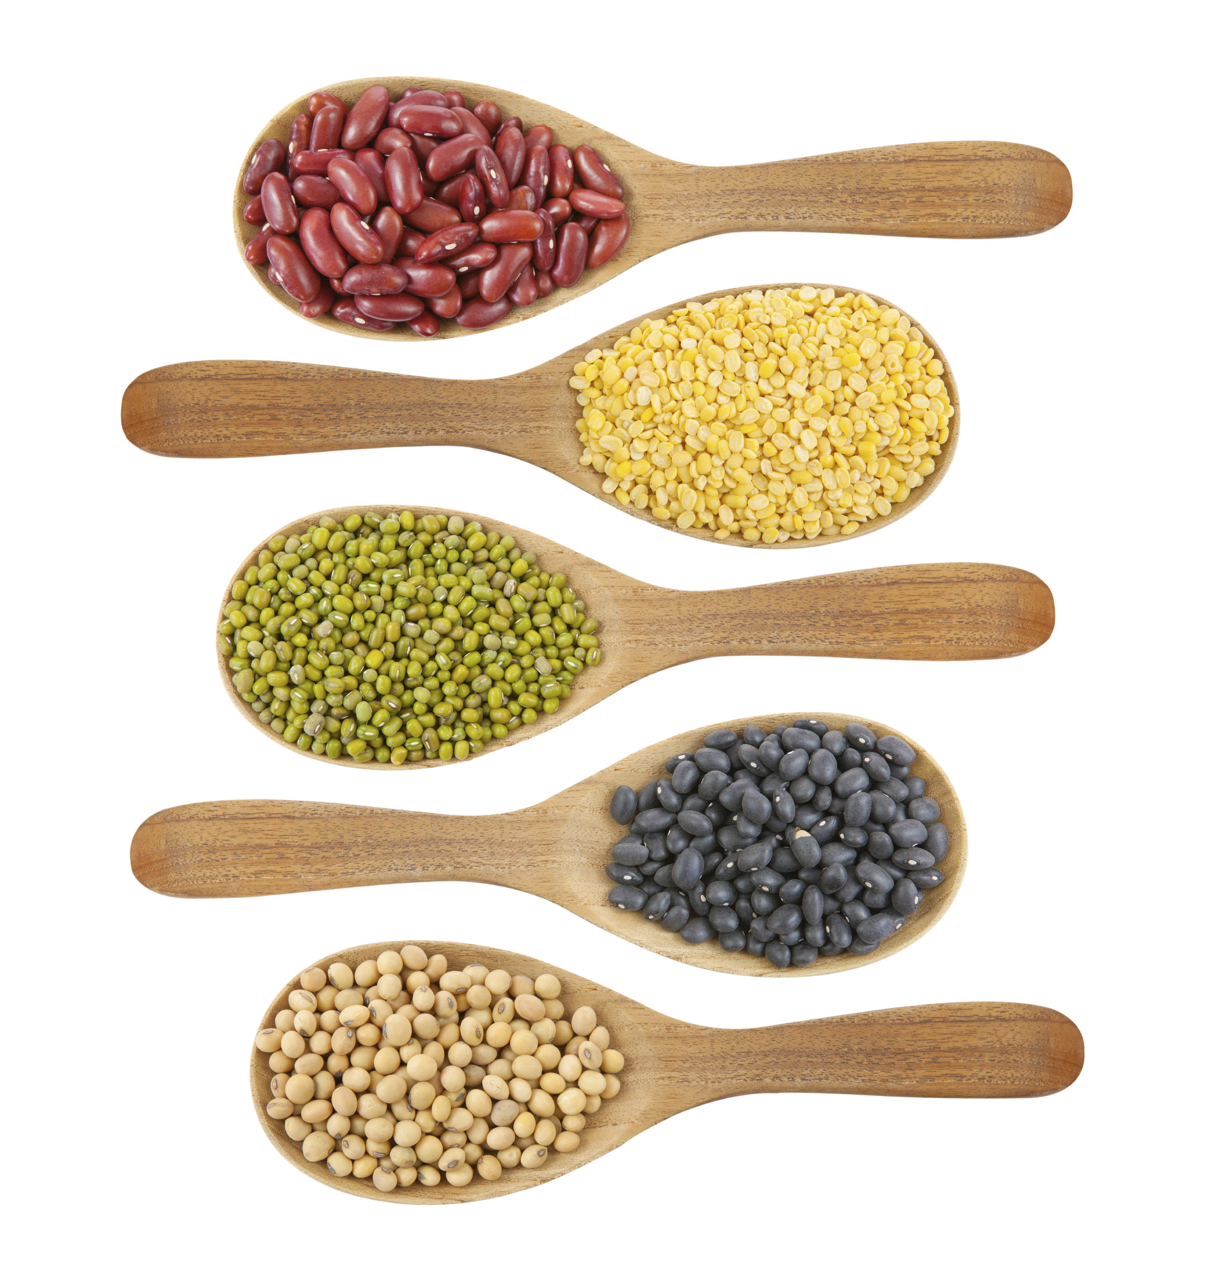
CREATE a Stir-Fry
Step 1: Prep ingredients
Notes:
“Now we will discuss the first step in creating a Stir Fry – prepping ingredients. It is important for all ingredients, which include the protein, marinade, veggies, sauce and glaze, to be prepared before you start cooking. Once you start, you work quite quickly through each step.
[Demonstrate prepping ingredients for recipe as time permits]

Slide 7
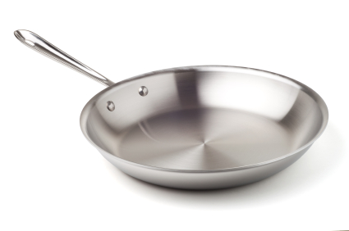
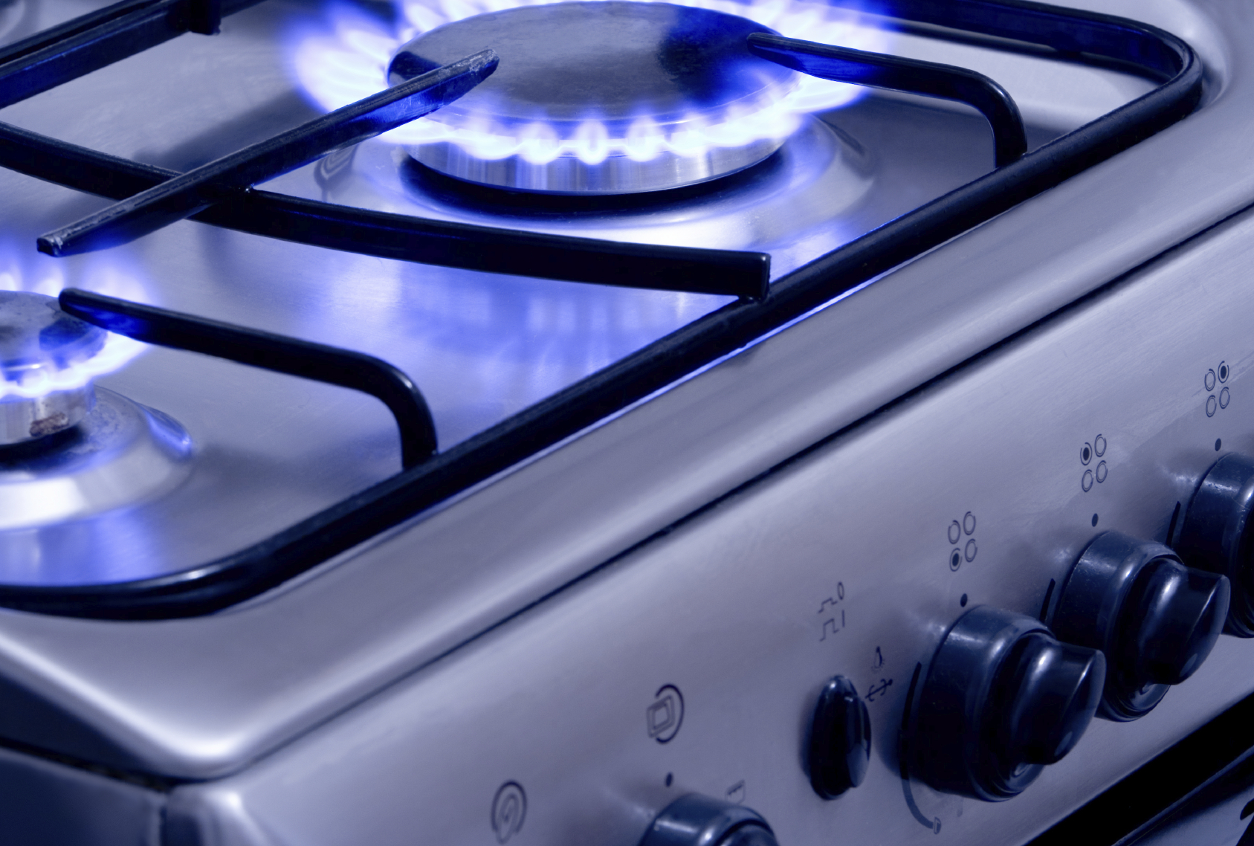
CREATE a Stir-Fry
Step 2: Warm skillet over low heat
Notes:
“The second step is warming a skillet over low heat. Make sure to start with the low heat because extreme and fast temperatures changes are hard on pans.”
[Demonstrate warming skillet for recipe as time permits]

Slide 8
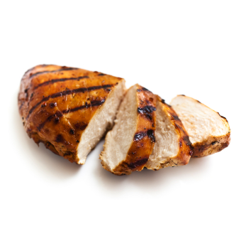
CREATE a Stir-Fry
Step 3: Prepare protein
    Options?
    Food Safety
    Cut same size
Notes:
“The third step in creating a Stir Fry is preparing the protein. Let’s discuss our options – both meat and plant based. [Discuss and introduce meat option being used in demonstration.]
Now let’s discuss food safety – when should we worry about cross contamination? Proper hygiene? Acceptable temperatures? As well as safe storage? [Introduce each topic, discuss if needed.]
Last, let’s discuss cutting all foods in the stir fry about the same size. This allows for even cooking times.”

Slide 9
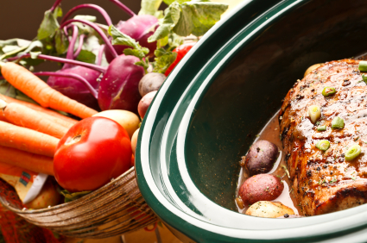
CREATE a Stir-Fry
Step 4: Marinade
    Adds flavor
    Don’t reuse – cross contamination
Notes:
“The fourth step is preparing the marinade. The marinade is important because it adds flavor to the protein and the rest of the stir fry.
Also, be aware of cross-contamination and meat. Make sure to throw the marinade out and don’t reuse.”

Slide 10
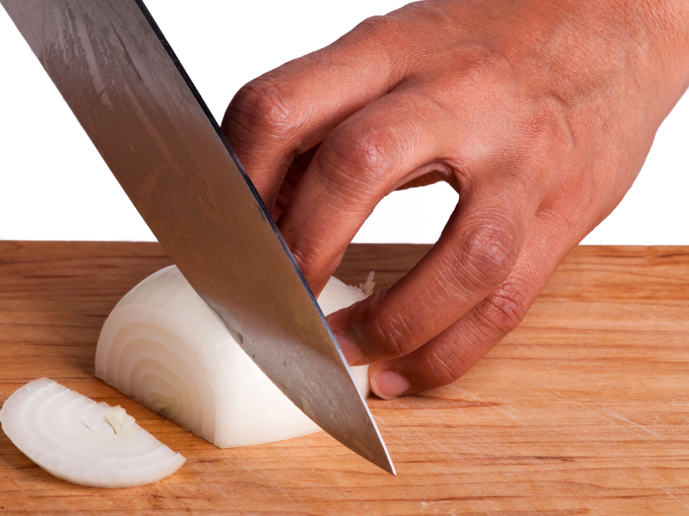
CREATE a Stir-Fry
Step 5: Vegetables
    Rich in nutrients
    More volume not calories
    How to cut
    Flavor vs. Volume
Notes:
“The fifth step is preparing the vegetables. Vegetables are good to add to the stir fry because veggies are naturally rich in vitamins, minerals, antioxidants, and phytochemicals. Also, veggies will give the dish more volume but not calories.
Now let’s discuss how to cut the vegetables, carefully. [Demonstrate cutting vegetables for recipe as time permits]
Some veggies play different roles in the stir fry. Onion and garlic add flavor, while other veggies provide volume and flavor.”

Slide 11
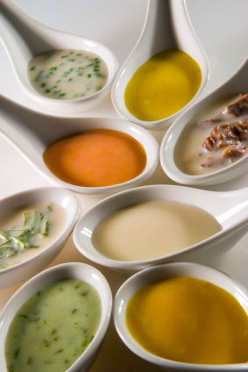
CREATE a Stir-Fry
Step 6: Sauce/glaze
    Sauce = flavor
    Glaze = flavor, texture
Notes:
“The sixth step is preparing the sauce and/or glaze for the stir fry. The sauce adds flavor, while the glaze provides more flavor, gives texture, and holds the stir fry together.”
[Demonstrate preparing the sauce/glaze for recipe as time permits]

Slide 12
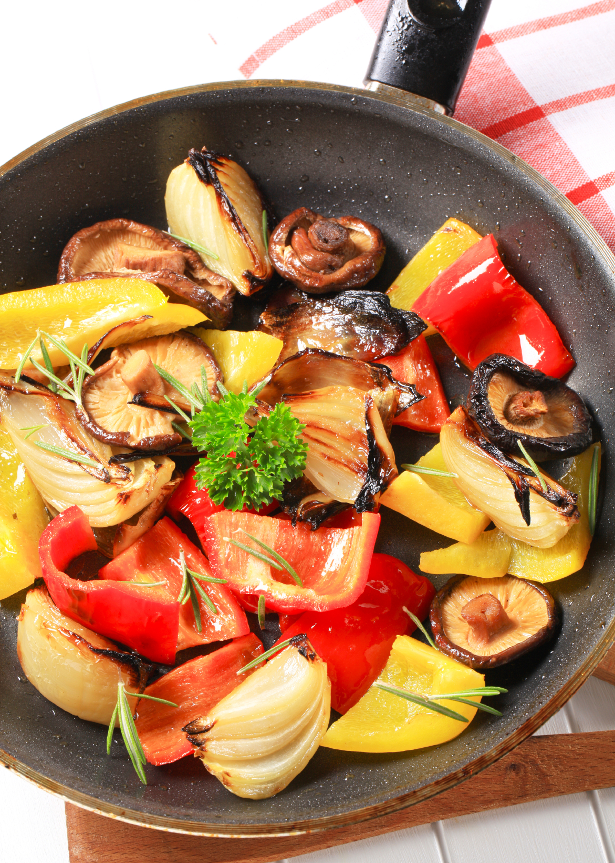
CREATE a Stir-Fry
Step 7: Cook on medium heat
    Reduce heat if sticking, add water
Notes:
“The seventh step is cooking the sir fry on medium heat. Cooking on medium high heat in batches keeps the pan hot.
It is very easy to use too much fat – if food is sticking to pan, reduce heat a little and add very small amount of water or broth.”
[Demonstrate cooking recipe as time permits]

Slide 13
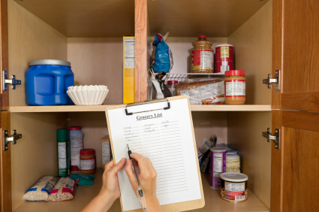
Practice
Bring pantry items from home
Possible stir fry options from pantry ingredients
Notes:
“Now that we are done preparing our recipe, let’s discuss practice for the future.
For practice next time, let’s have class members bring pantry items from home and we will come up with as many ideas for different stir fries as possible from those foods.
[Discuss]
Right now, let’s think about your own pantries at home and create as many stir fry meal options as possible from what you already have.”
[Discuss]

Slide 14
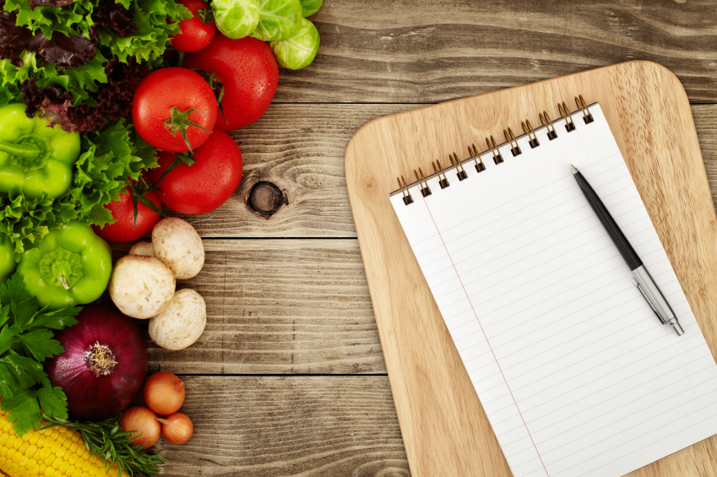
Incorporating MyPlate
What components does Stir Fry have?
What can be added?
Notes:
“Let discuss these questions – what components of MyPlate does Stir Fry have?
[Discuss]
What can be added?”
[Discuss]

Slide 15


Don’t Forget To Move
Weekly exercise plan
Notes:
“And remember guys – don’t forget to move! Make sure to plan your weekly exercise plan to incorporate physical activity into your weekly activities.”

Slide 16
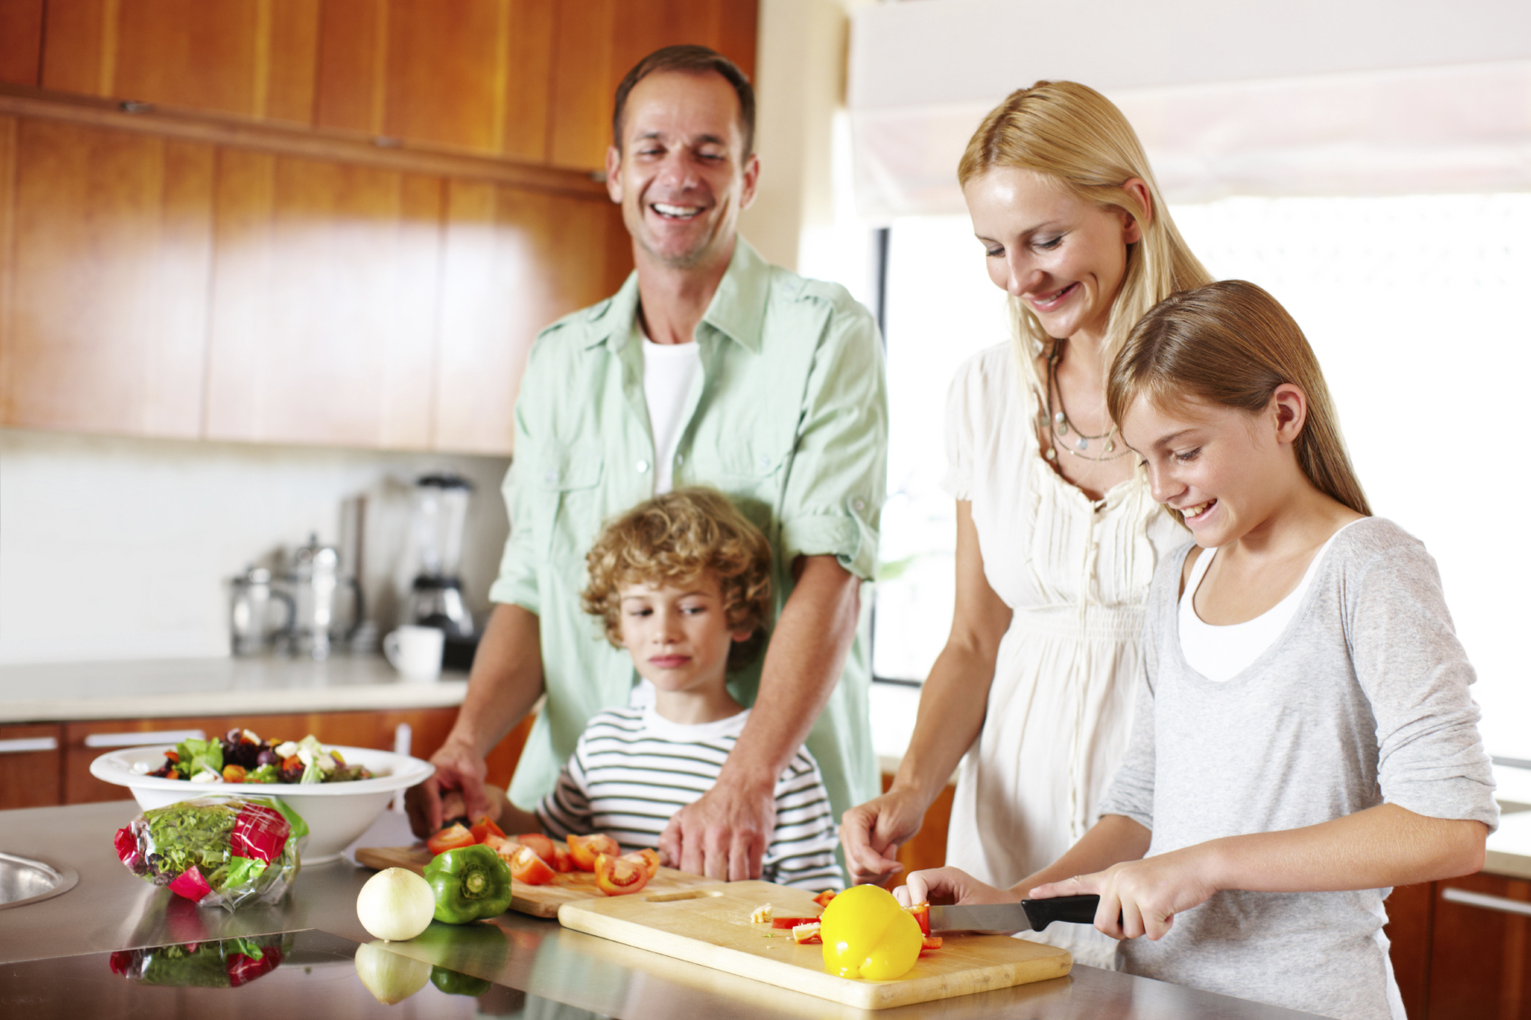
Conclusion
All you need – basic equipment and food from pantry
Notes:
“I’d like to conclude by saying, you don’t need a state-of-the-art kitchen, a degree from culinary school, or tons of time. You just need some basic equipment and food in the pantry to create a delicious stir fry that your family will want to come home to!”
[Taste creation and answer any questions.]
[Schedule/remind of next appointment.]

