Slide 1
CREATE a Smoothie
Food $ense

Slide 2
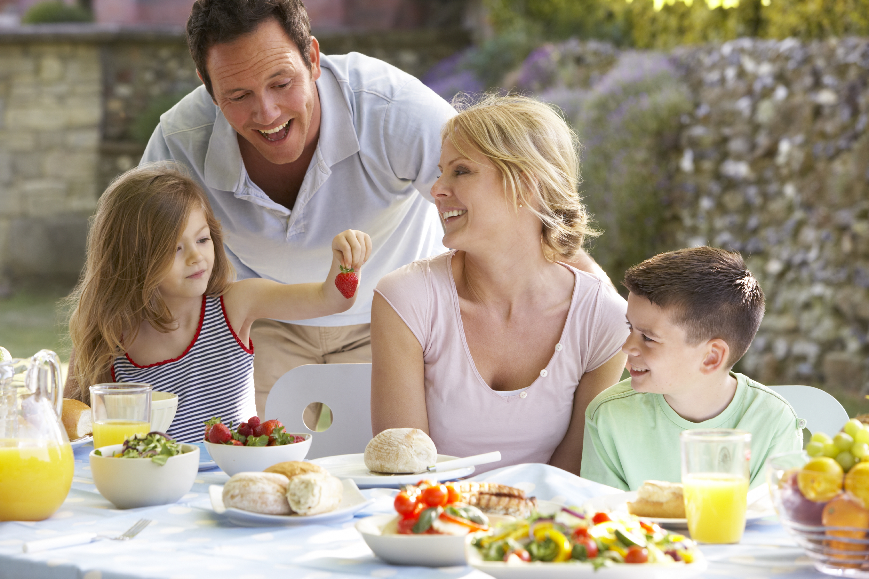
Introduction
Family Mealtime is important
Notes:
Discuss why family mealtime is important.
Ask for opinions/ input on importance.
Include examples:
Family Bonding
Better nutrition with less chance of eating disorders
Better grades and behavior with less chance of drugs, alcohol, and sexual activity

Slide 3
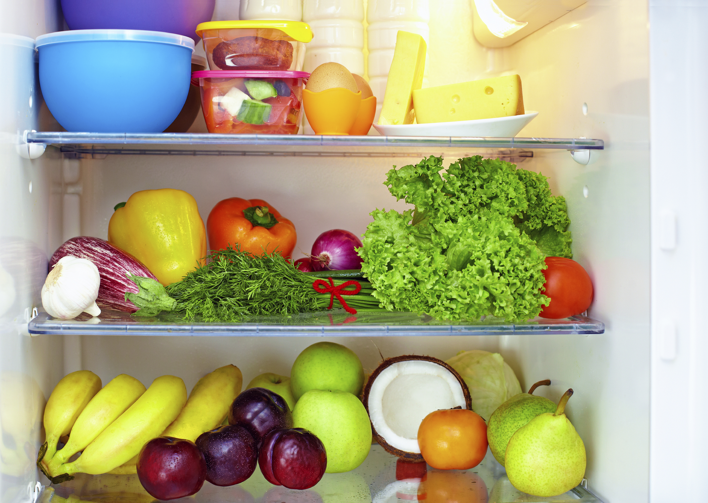

Introduction
Questions:
What is a whole food diet?
Why is a well-stocked pantry important?
Notes:
Define a whole food diet and discuss why it is important.
* Whole Food Definition: as close to original source as possible with minimal processing and refining ( potatoes vs. potato chips)
* Ask participants on what they believe a whole food diet could include.
Discuss how ¾ of MyPlate is plant based
Benefits of Whole Plant Foods
* A diet rich in whole plant food is related to less chronic disease and obesity
* A diet rich in refined foods with added fats, sugar, and salt is related to increased chronic disease and obesity
* Whole plant foods full of fiber and water leave you feeling satisfied and full on less calories

Slide 4
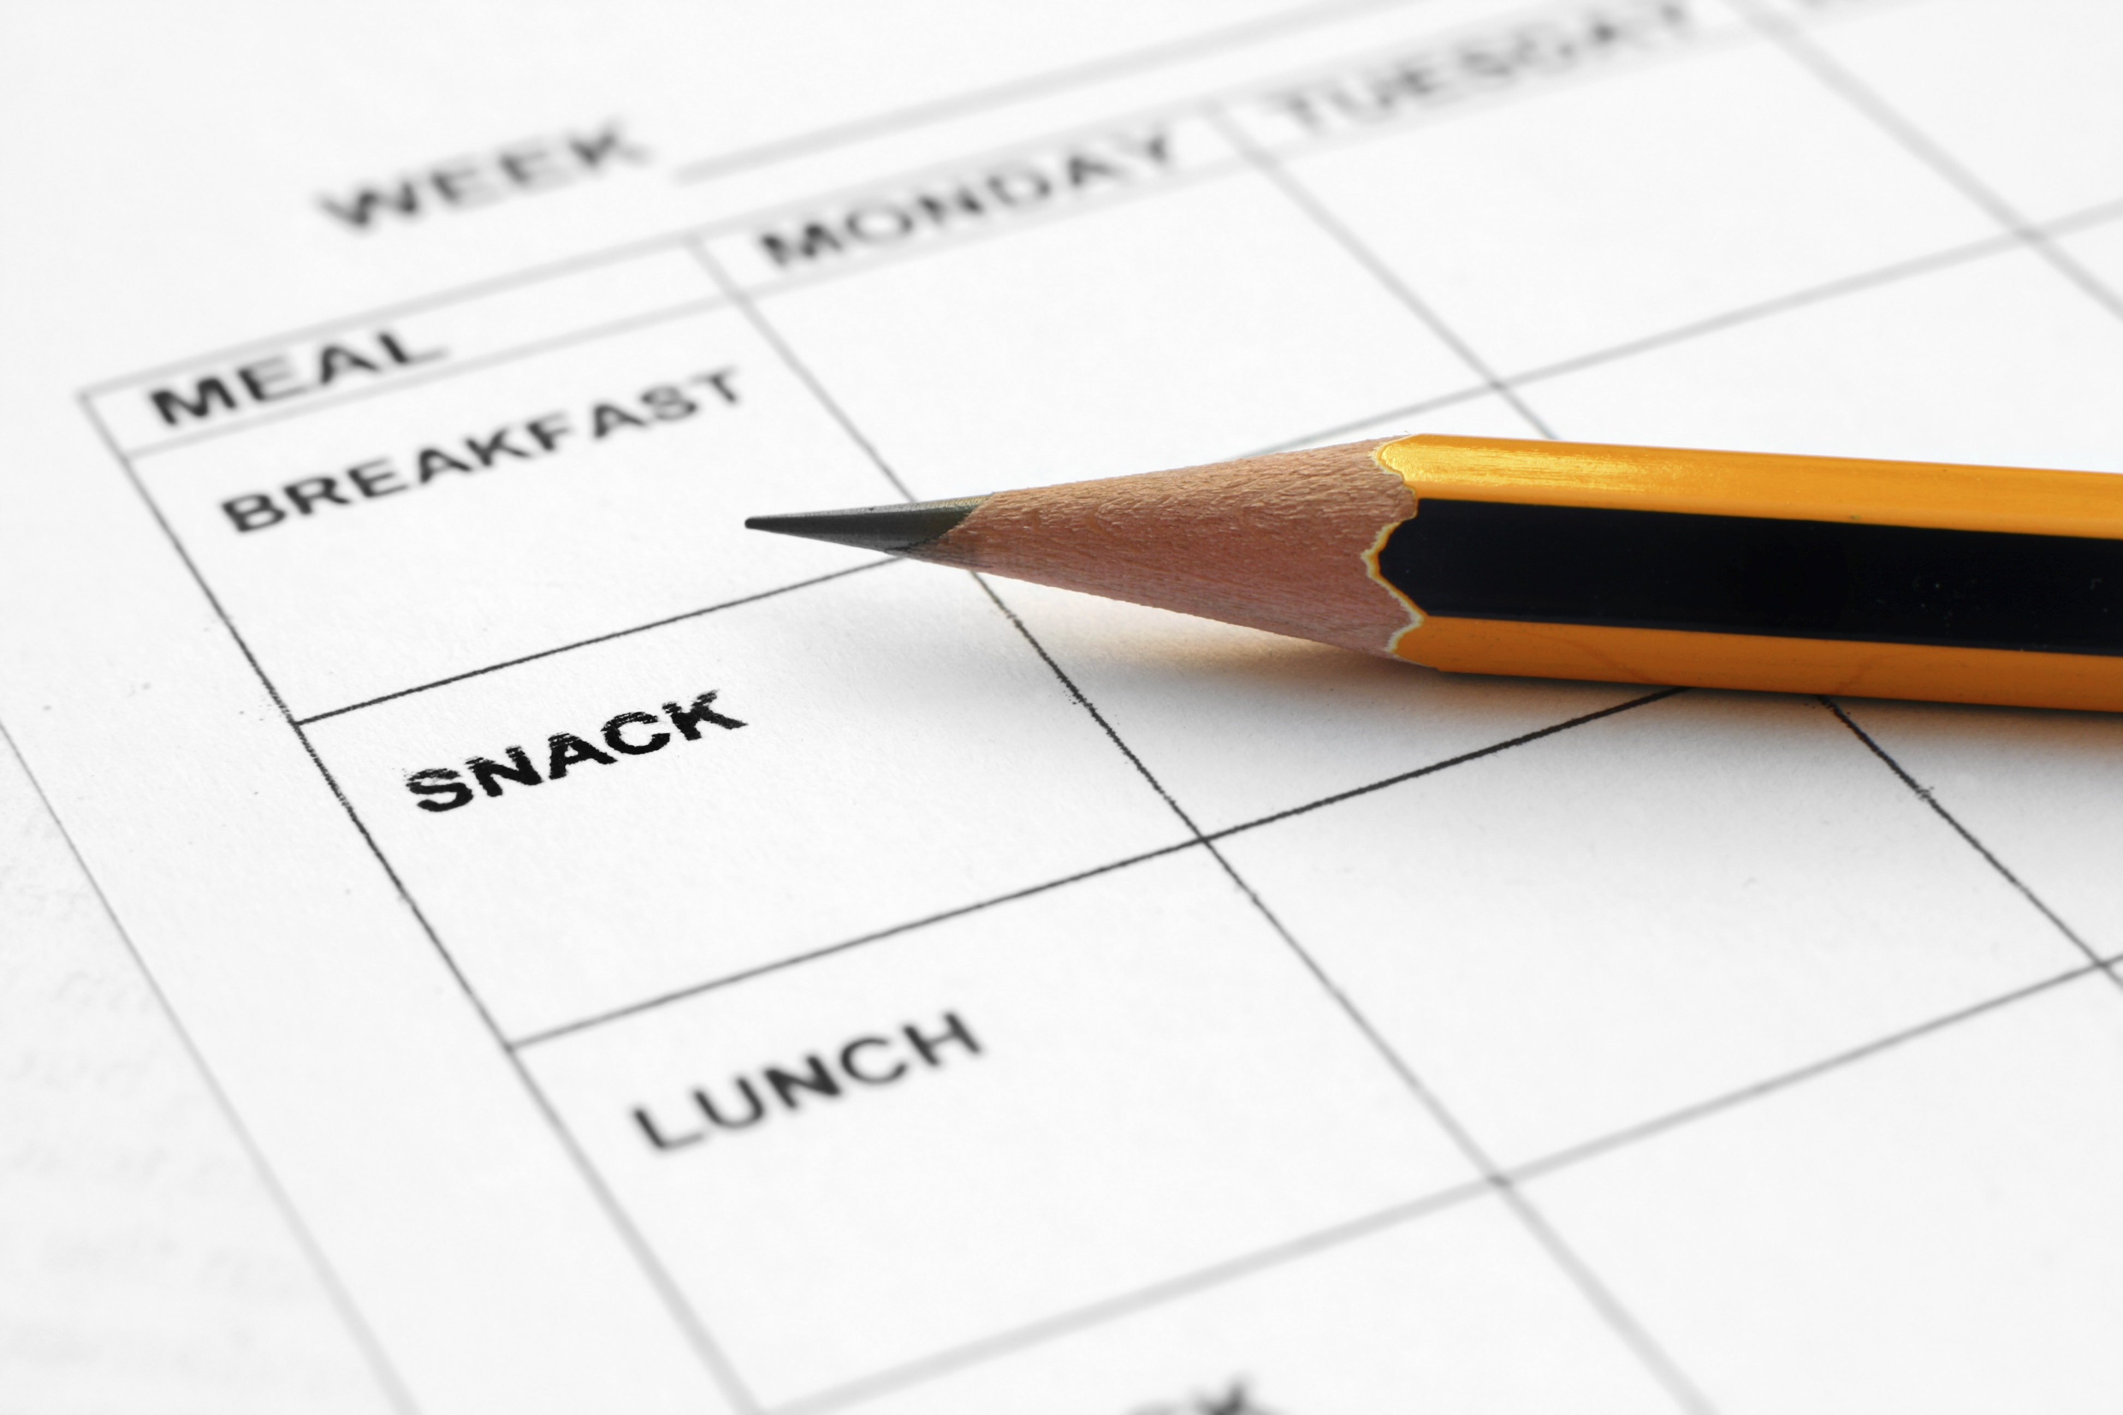
Introduction
Meal Planning
Save time and money
Steps/tips
Notes:
When it comes to meal planning, this might intimidate some people, but if you practice enough, you will find it just becomes second nature. Consider making meals you will look forward to such as a themed night. You could have Taco Tuesdays, or Italian food on Wednesdays.

Slide 5
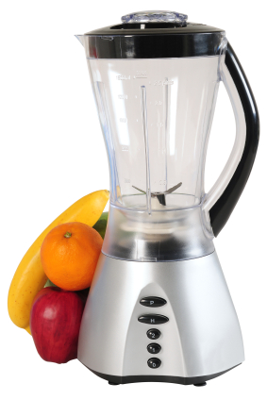
CREATE a Smoothie
Before Starting:
Choose whole foods
Make sure to have
needed equipment
Notes:
Choose whole foods as often as you can. Discuss the difference between a smoothie made with ice cream, chocolate syrup, and a candy bar versus one with fresh or frozen fruit, spinach, and fat-free milk or a milk alternative.

Slide 6
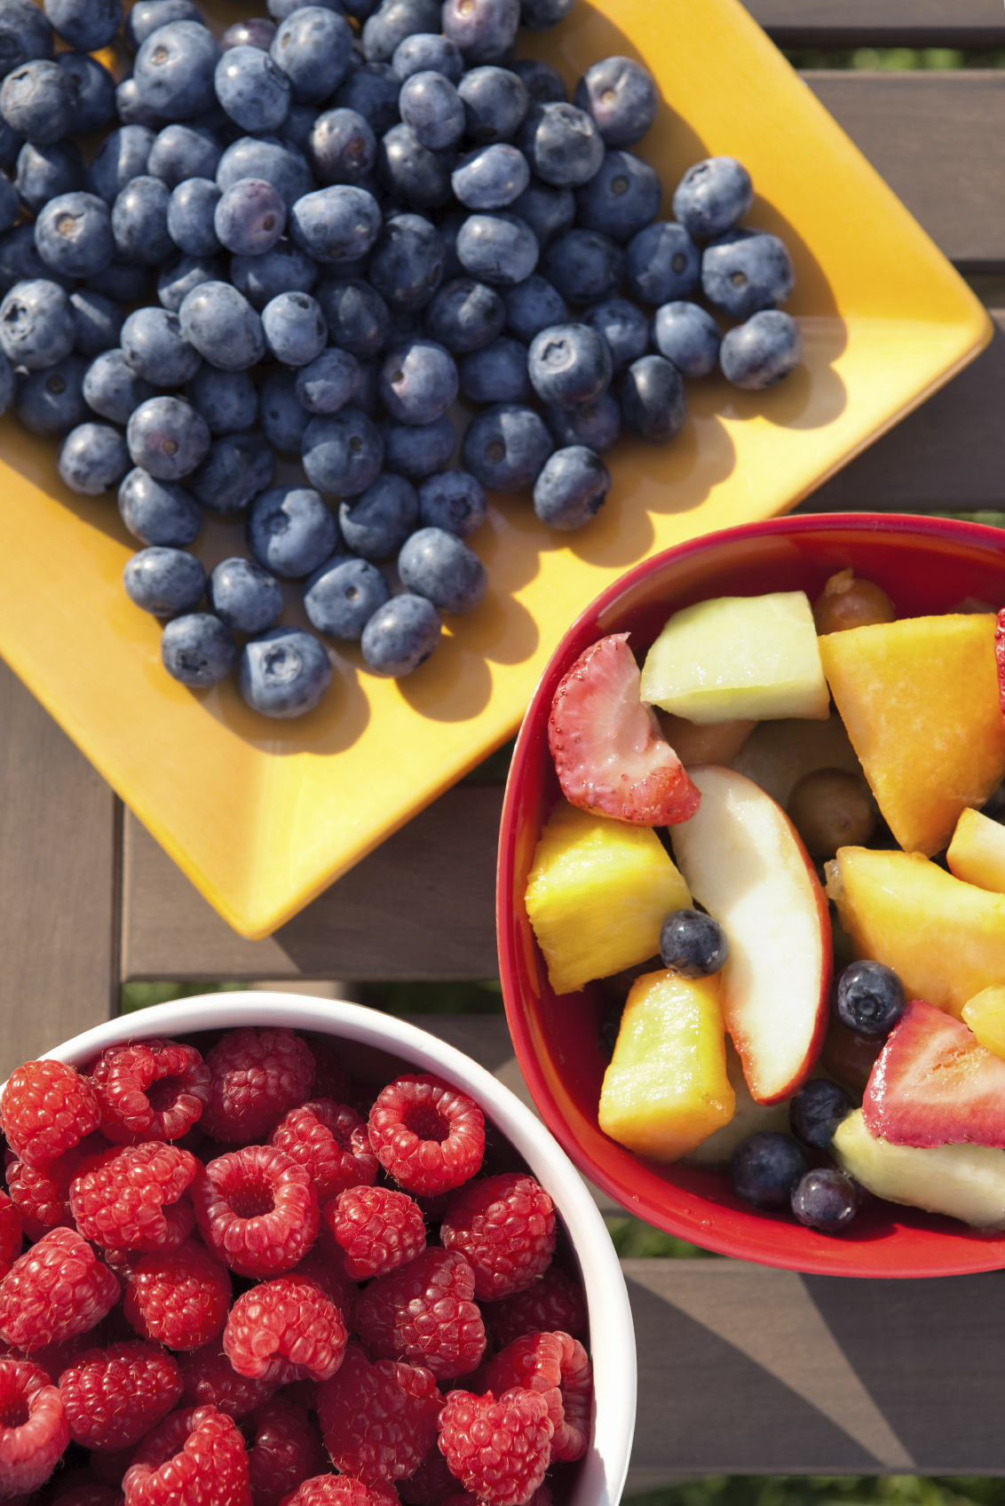
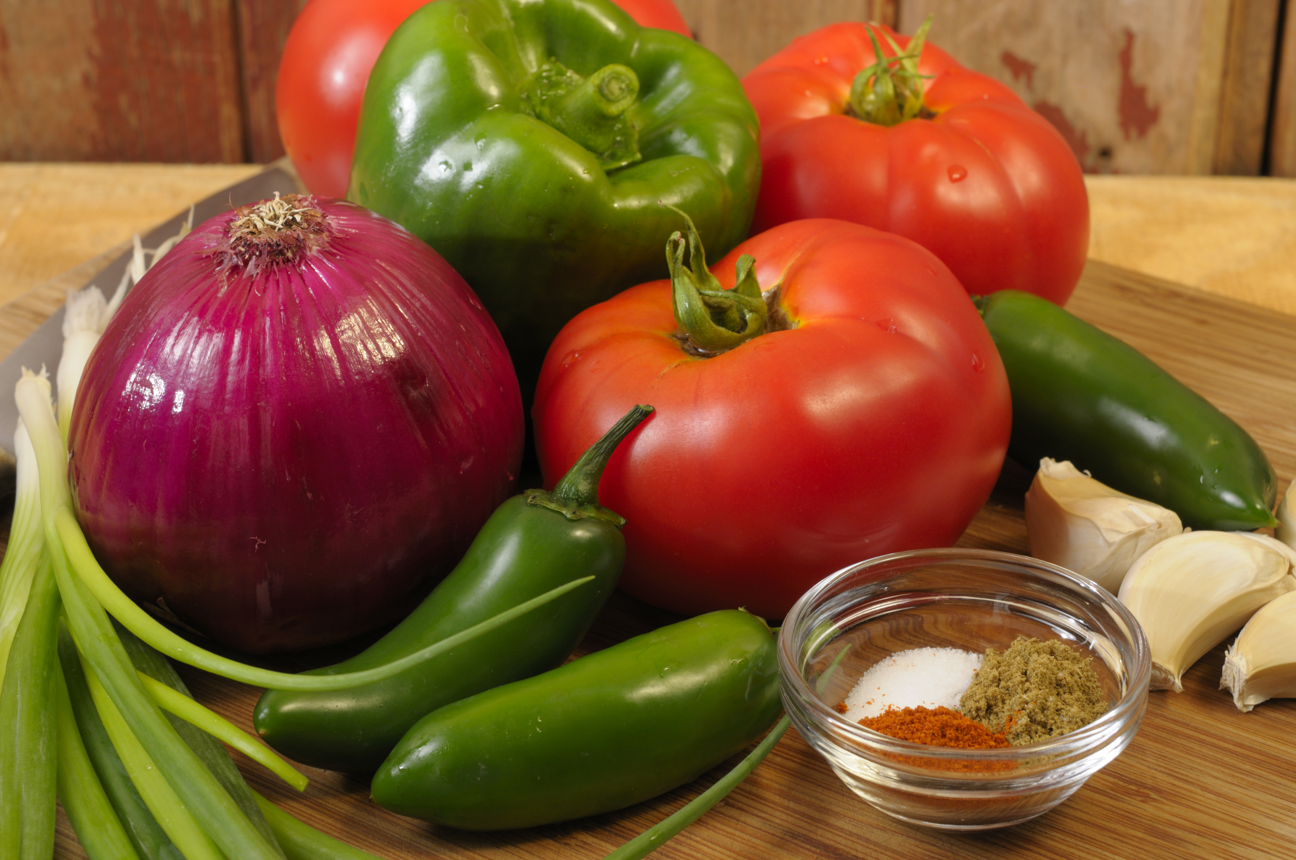
CREATE a Smoothie
Step 1: Produce
Best options
Fresh vs. Frozen
Fruits and vegetables rich in nutrients
Gives more vol. not calories
Notes:
When it comes to produce, discuss options and talk about what participants usually use and what better choices they could make. Discuss fresh, frozen, and canned alternatives. Discuss how fruits and veggies are naturally rich in vitamins, minerals, antioxidants, and phytochemicals. Fruits and veggies will give the smoothie more volume but not the calories.

Slide 7
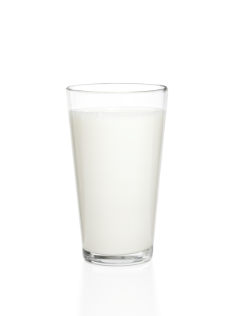
Create a Smoothie
Step 2: Liquid
Best options
Notes:
Talk about different liquid options used in smoothies that participants use. Talk about healthier options than cream, ice cream or juice.

Slide 8
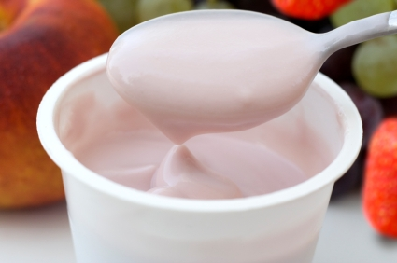
Create a Smoothie
Step 3: Extras
Discuss options
Notes:
What are some common extras you put in your smoothies? What are some new options we can come up with? Granola?

Slide 9
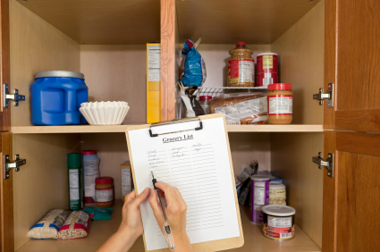
Practice
Pantry items to make smoothies
Think about your pantry items and possible smoothie options
Notes:
Bring pantry items from home and have class members come up with as many ideas for smoothies as possible from those foods. Have class members think about their own pantry and create as many smoothie options as possible from what they already have.

Slide 10
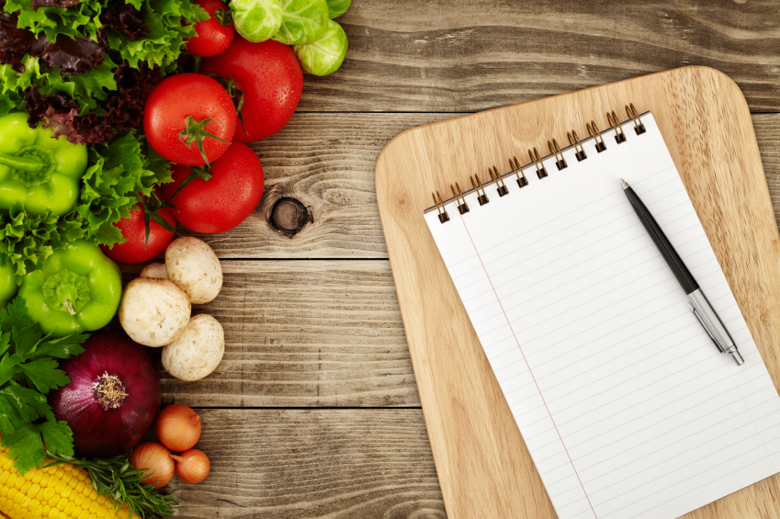
Incorporating MyPlate
Components of MyPlate in a smoothie
What can be added?
Notes:
What components of MyPlate does a smoothie already have?
What can we add to our plate to round out the meal?

Slide 11
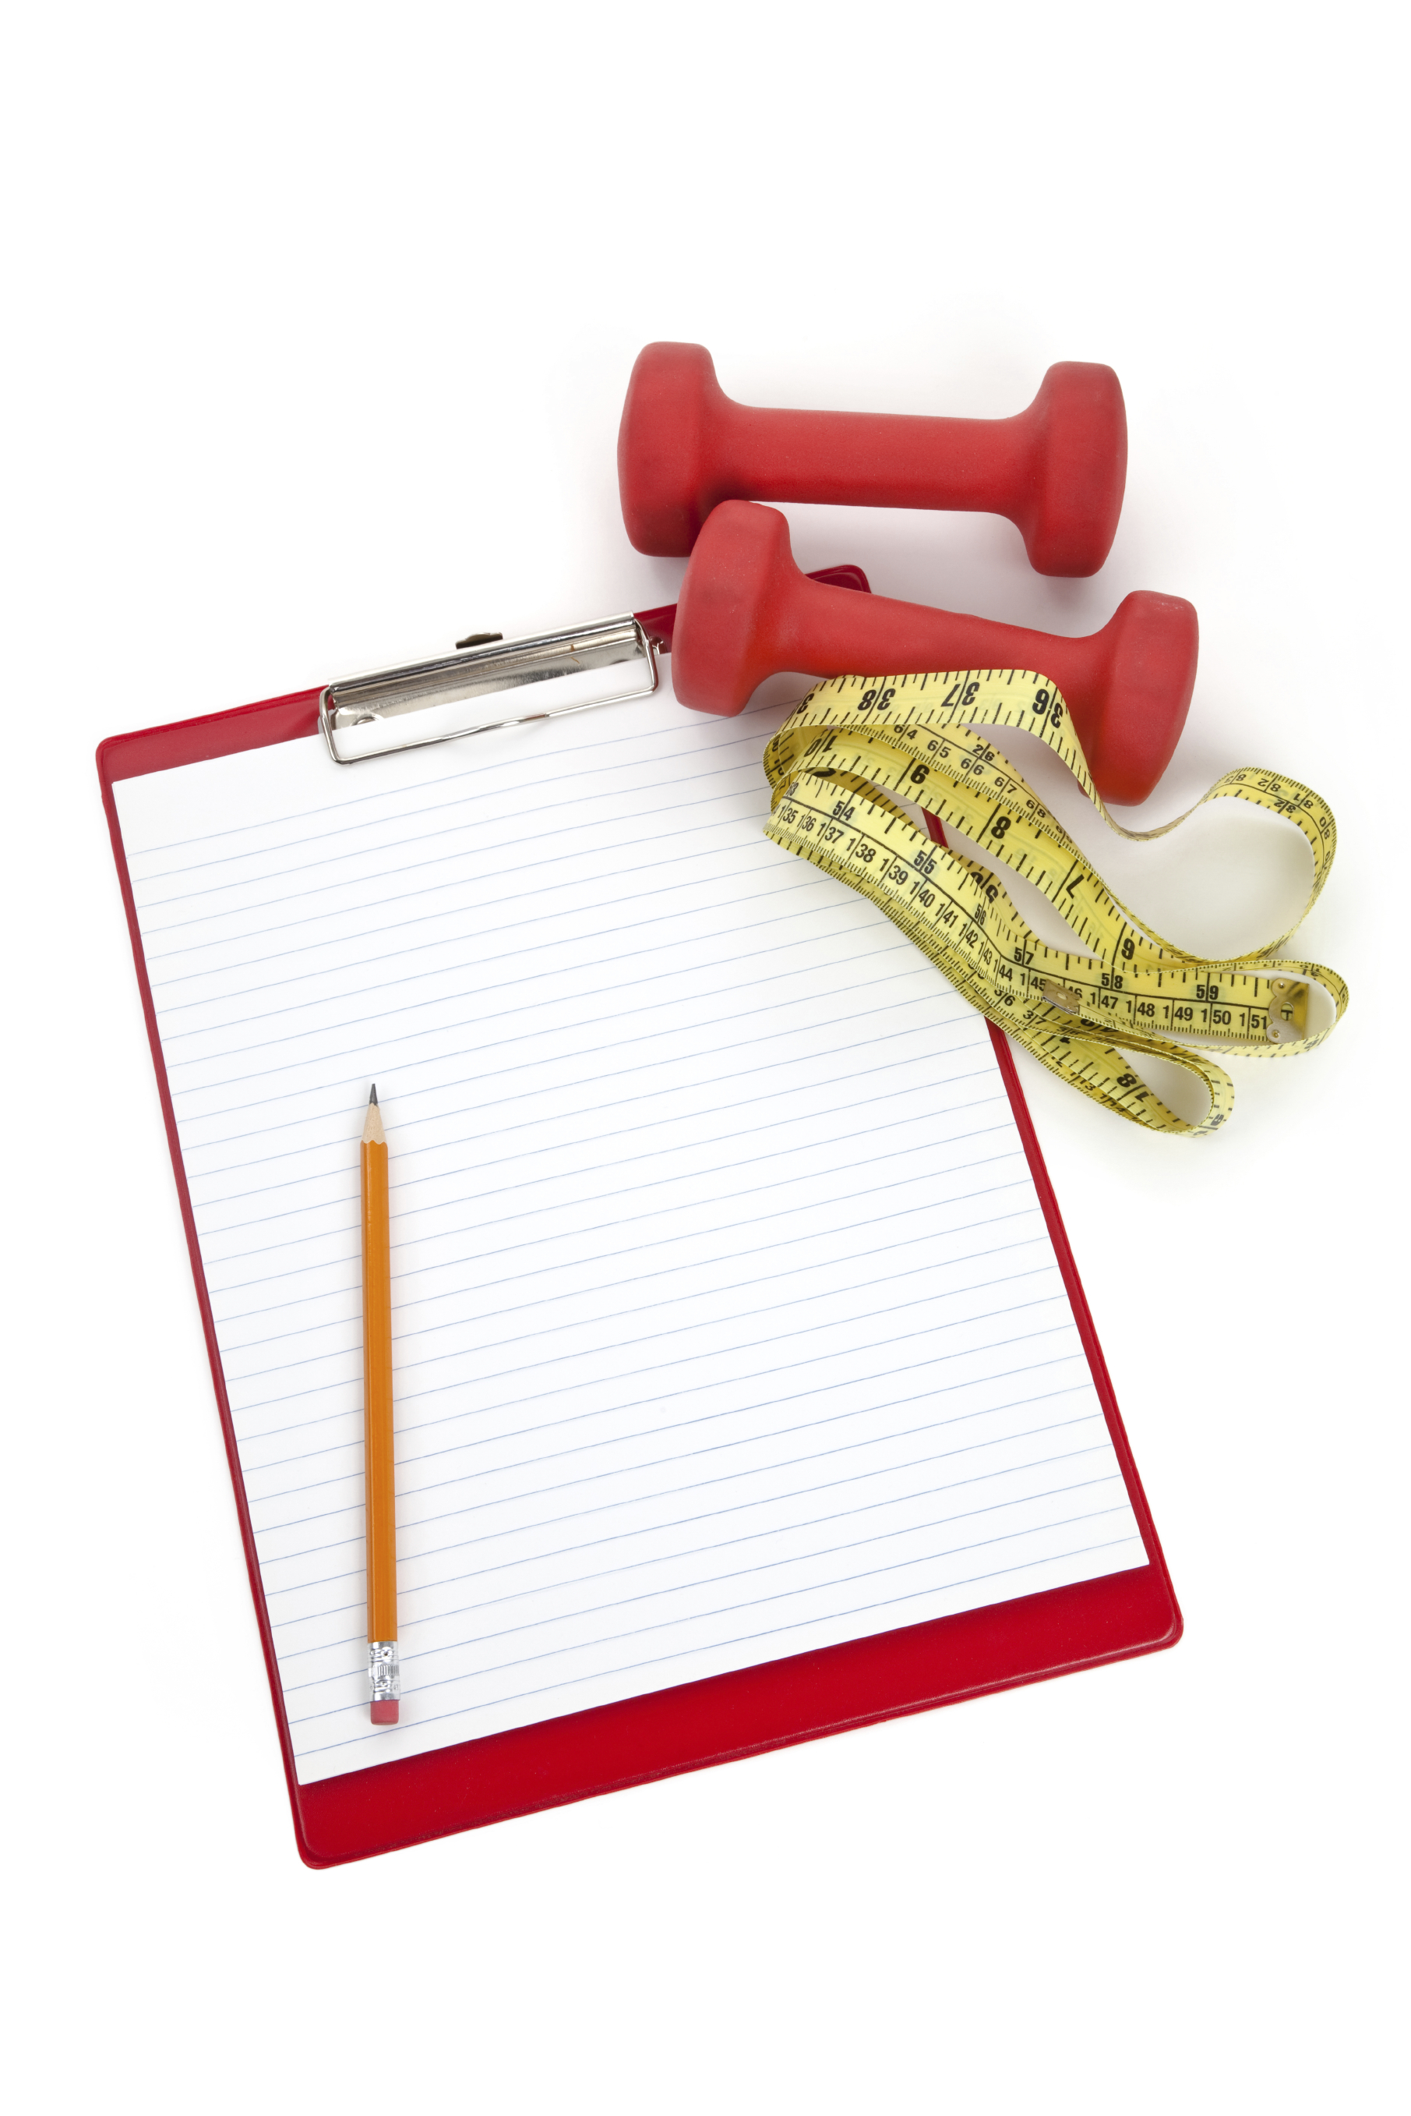
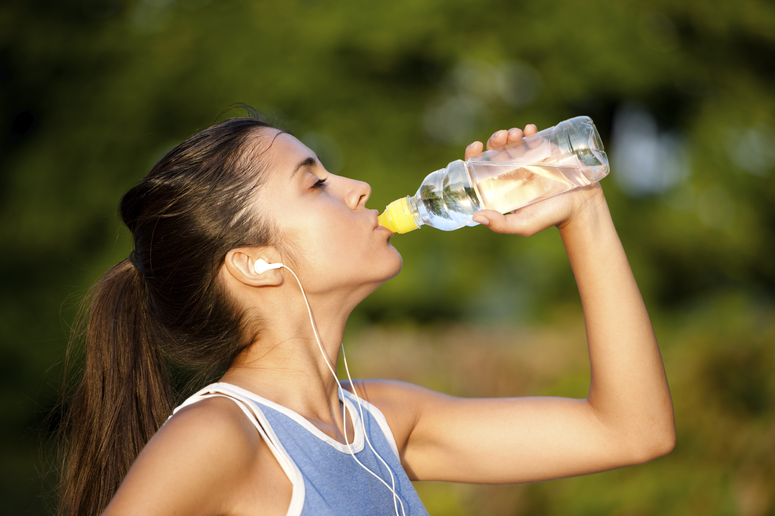
Don’t forget to move
Weekly exercise plan
Notes:
Don’t forget to move! What can/will you do this week to move your body?

Slide 12
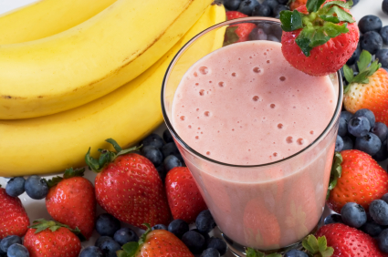
Conclusion
You just need – basic equipment and food in the pantry to create a smoothie
Notes:
You don’t need a state of the art kitchen, a degree from culinary school, or tons of time. You just need some basic equipment and food in the pantry to create a delicious smoothie that your family will want to come home to!

