Slide 1
Create a Skillet Meal
Food $ense

Slide 2
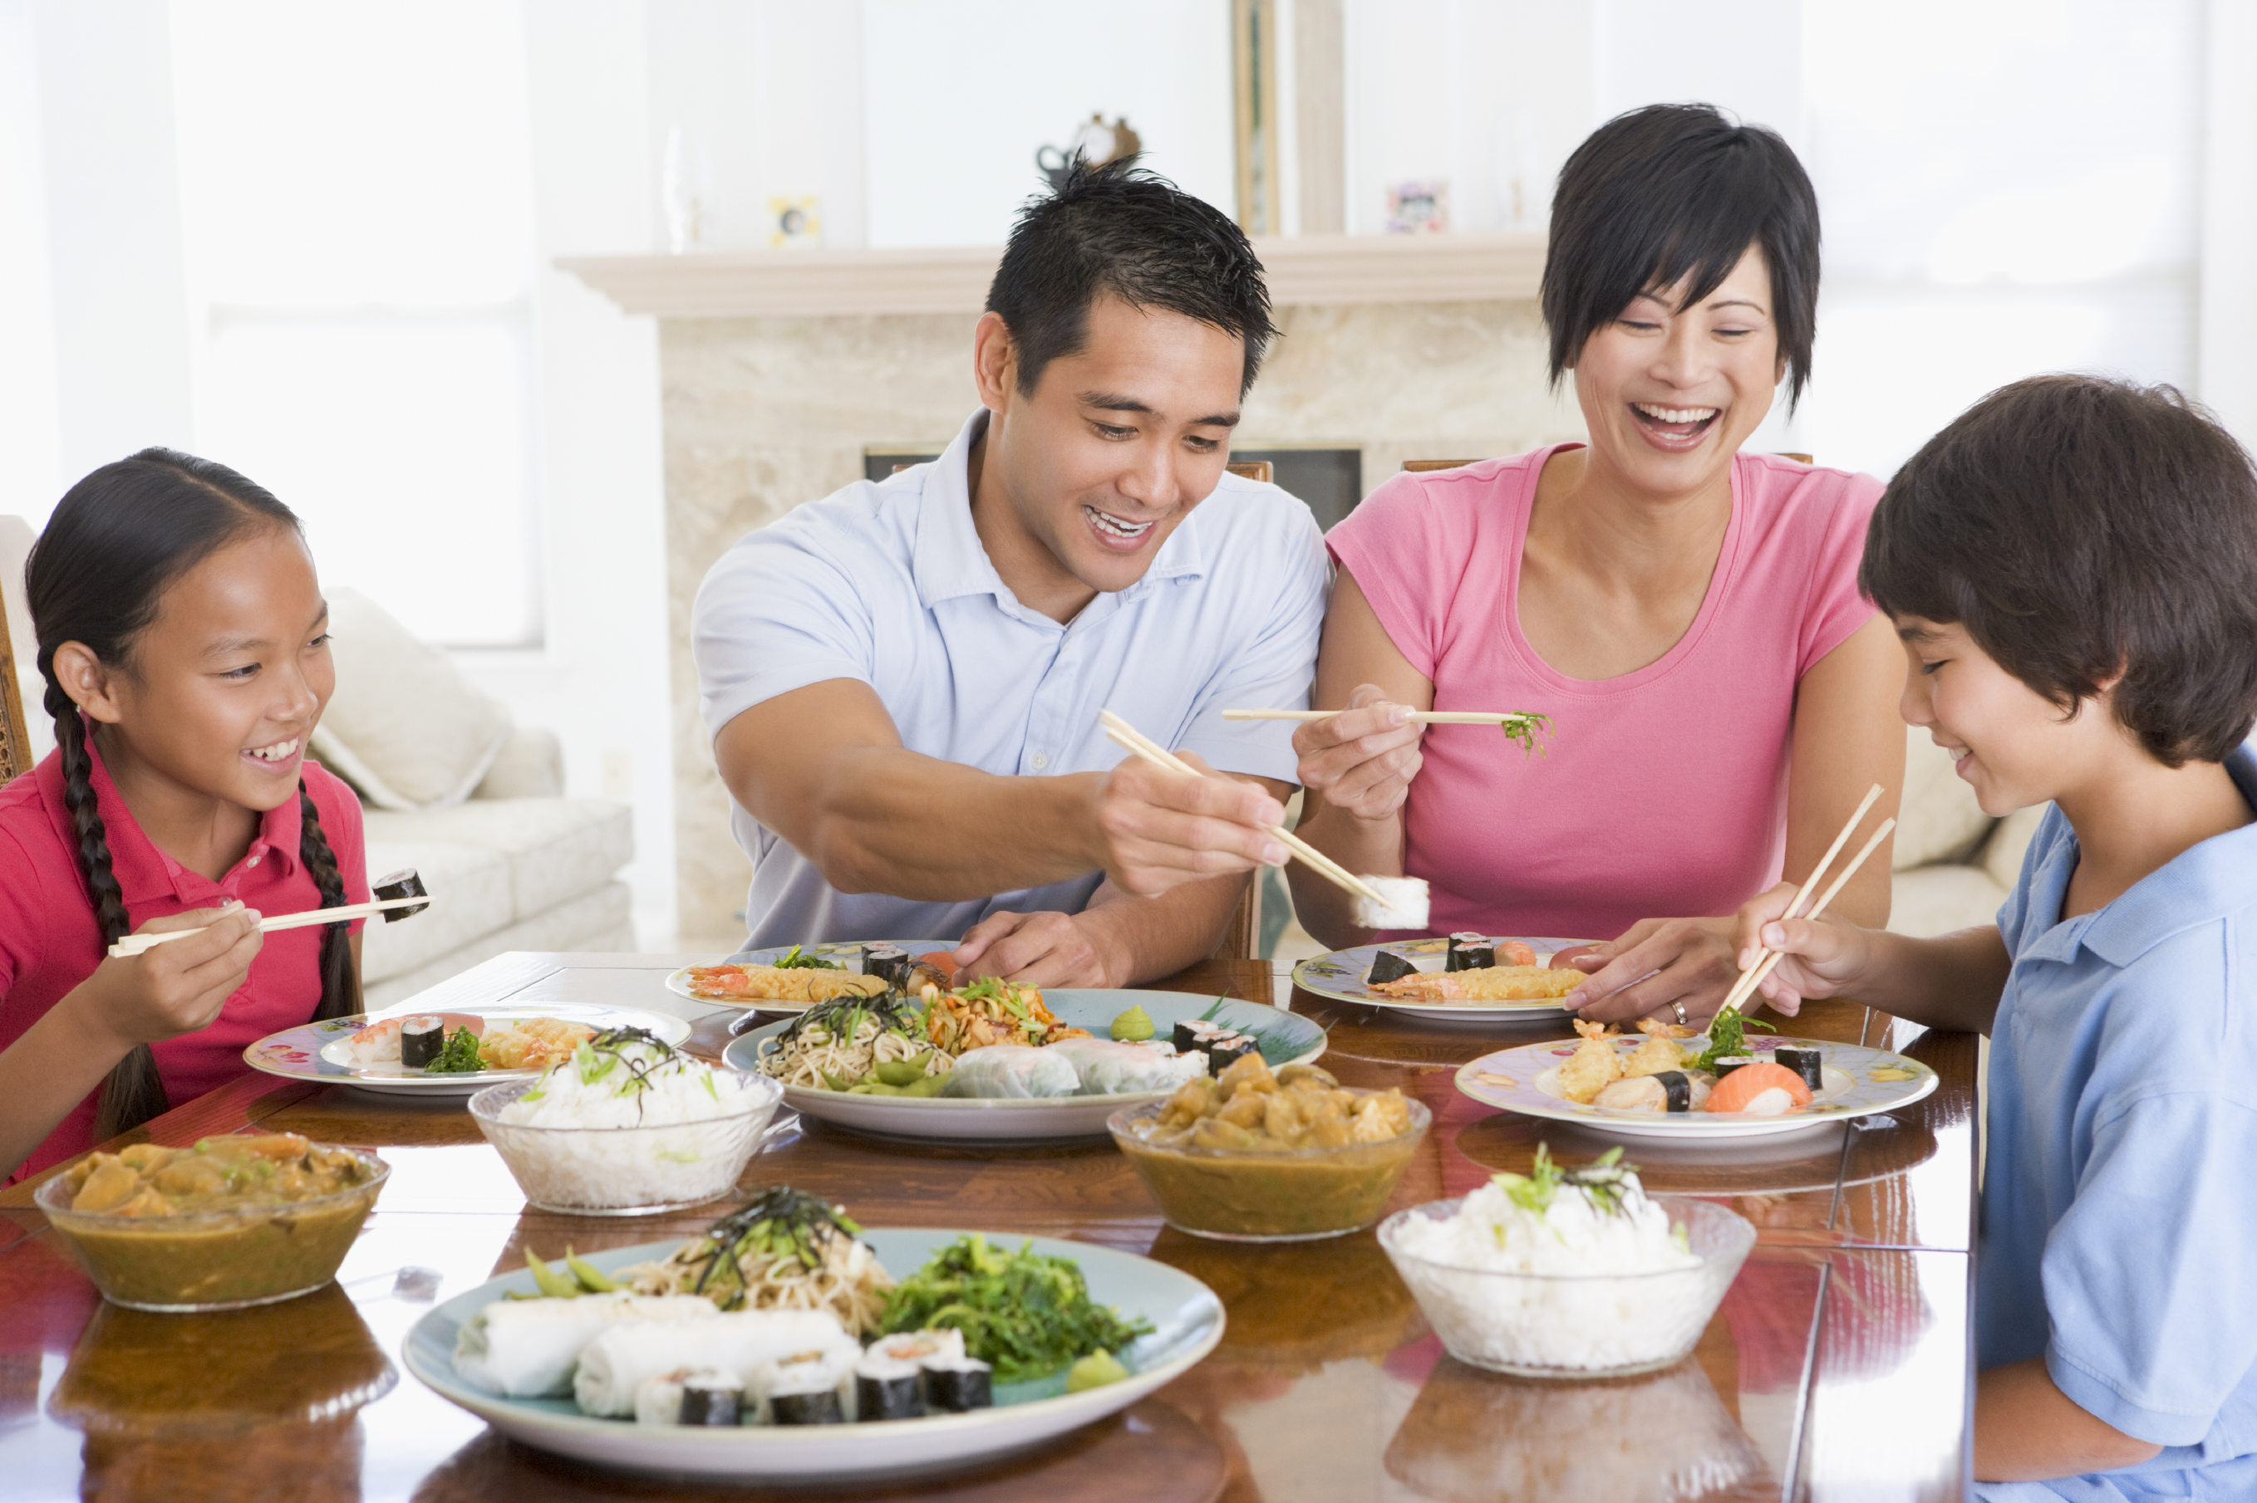
Importance of Family Mealtime
Family Bonding
Better Nutrition
Better Grades and Behavior
Notes:
Discuss why family mealtime is important.
Ask for opinions/ input on importance.
Include examples:
Family Bonding
Better nutrition with less chance of eating disorders
Better grades and behavior with less chance of drugs, alcohol, and sexual activity

Slide 3
Importance of whole food diets
What are whole food diets?
Whole Food Diets: As close to original source as possible
¾ MyPlate is plant based
What do diets lead to?
Benefits of whole plant foods
Notes:
Define a whole food diet and discuss why it is important.
* Whole Food Definition: as close to original source as possible with minimal processing and refining ( potatoes vs. potato chips)
* Ask participants on what they believe a whole food diet could include.
Discuss how ¾ of MyPlate is plant based
Benefits of Whole Plant Foods
* A diet rich in whole plant food is related to less chronic disease and obesity
* A diet rich in refined foods with added fats, sugar, and salt is related to increased chronic disease and obesity
* Whole plant foods full of fiber and water leave you feeling satisfied and full on less calories

Slide 4
Having a Well-Stocked Pantry
Food Availability Type = Food Decision
  Healthy vs. Unhealthy
No Need for a Recipe!
Buy Whole Foods
Ad/Sales
Shop Perimeter of Stores
Notes:
Discuss the necessity of a well-stocked pantry and how to make that happen:
*Temptation to eat out or make unhealthy choices is greatly increased if healthy, easy, and fast options are not available. The food readily available affects our food decisions
You don’t have to have a recipe or even a plan( although both are good) as long as your pantry has good food in it and you understand the techniques of how to put food together
Buy whole foods that are minimally processed or refined
Shop ads/sales
Shop perimeter of the store to avoid buying processed foods

Slide 5
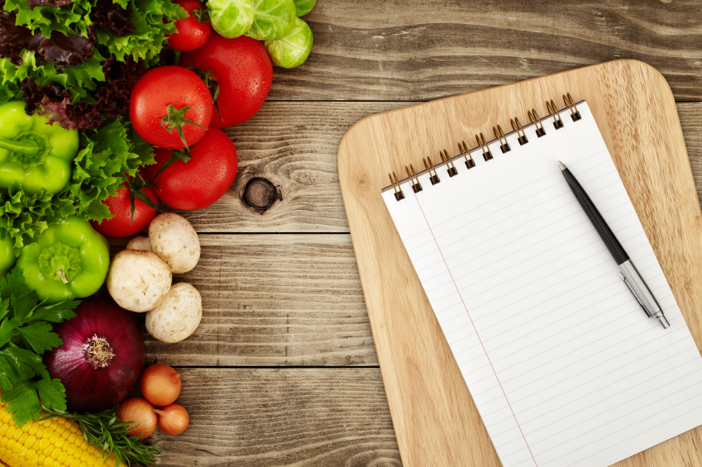
Discussion: Meal Plans
Create a menu
Theme nights
Notes:
Discuss meal plans and how they save time and money
Step to create a menu:
Look at ingredients already in pantry or fridge
Look through recipes/ come up with combinations to use food
Put together a menu for each meal
Extra Tips
Consider having theme nights: Monday is Mexican food, Tuesday is Italian, etc)

Slide 6
Create a Skillet Meal
Preparation:
  Whole Foods!!
  Equipment needed
Notes:
Preparation for creating a skillet meal:
Choose mostly whole foods and reduce highly refined processed foods
Show and explain equipment needed and how to use it: sharp knife, cutting board, vegetable peeler, vegetable grater, mixing cups and spoons, saucepan, skillet with lid

Slide 7
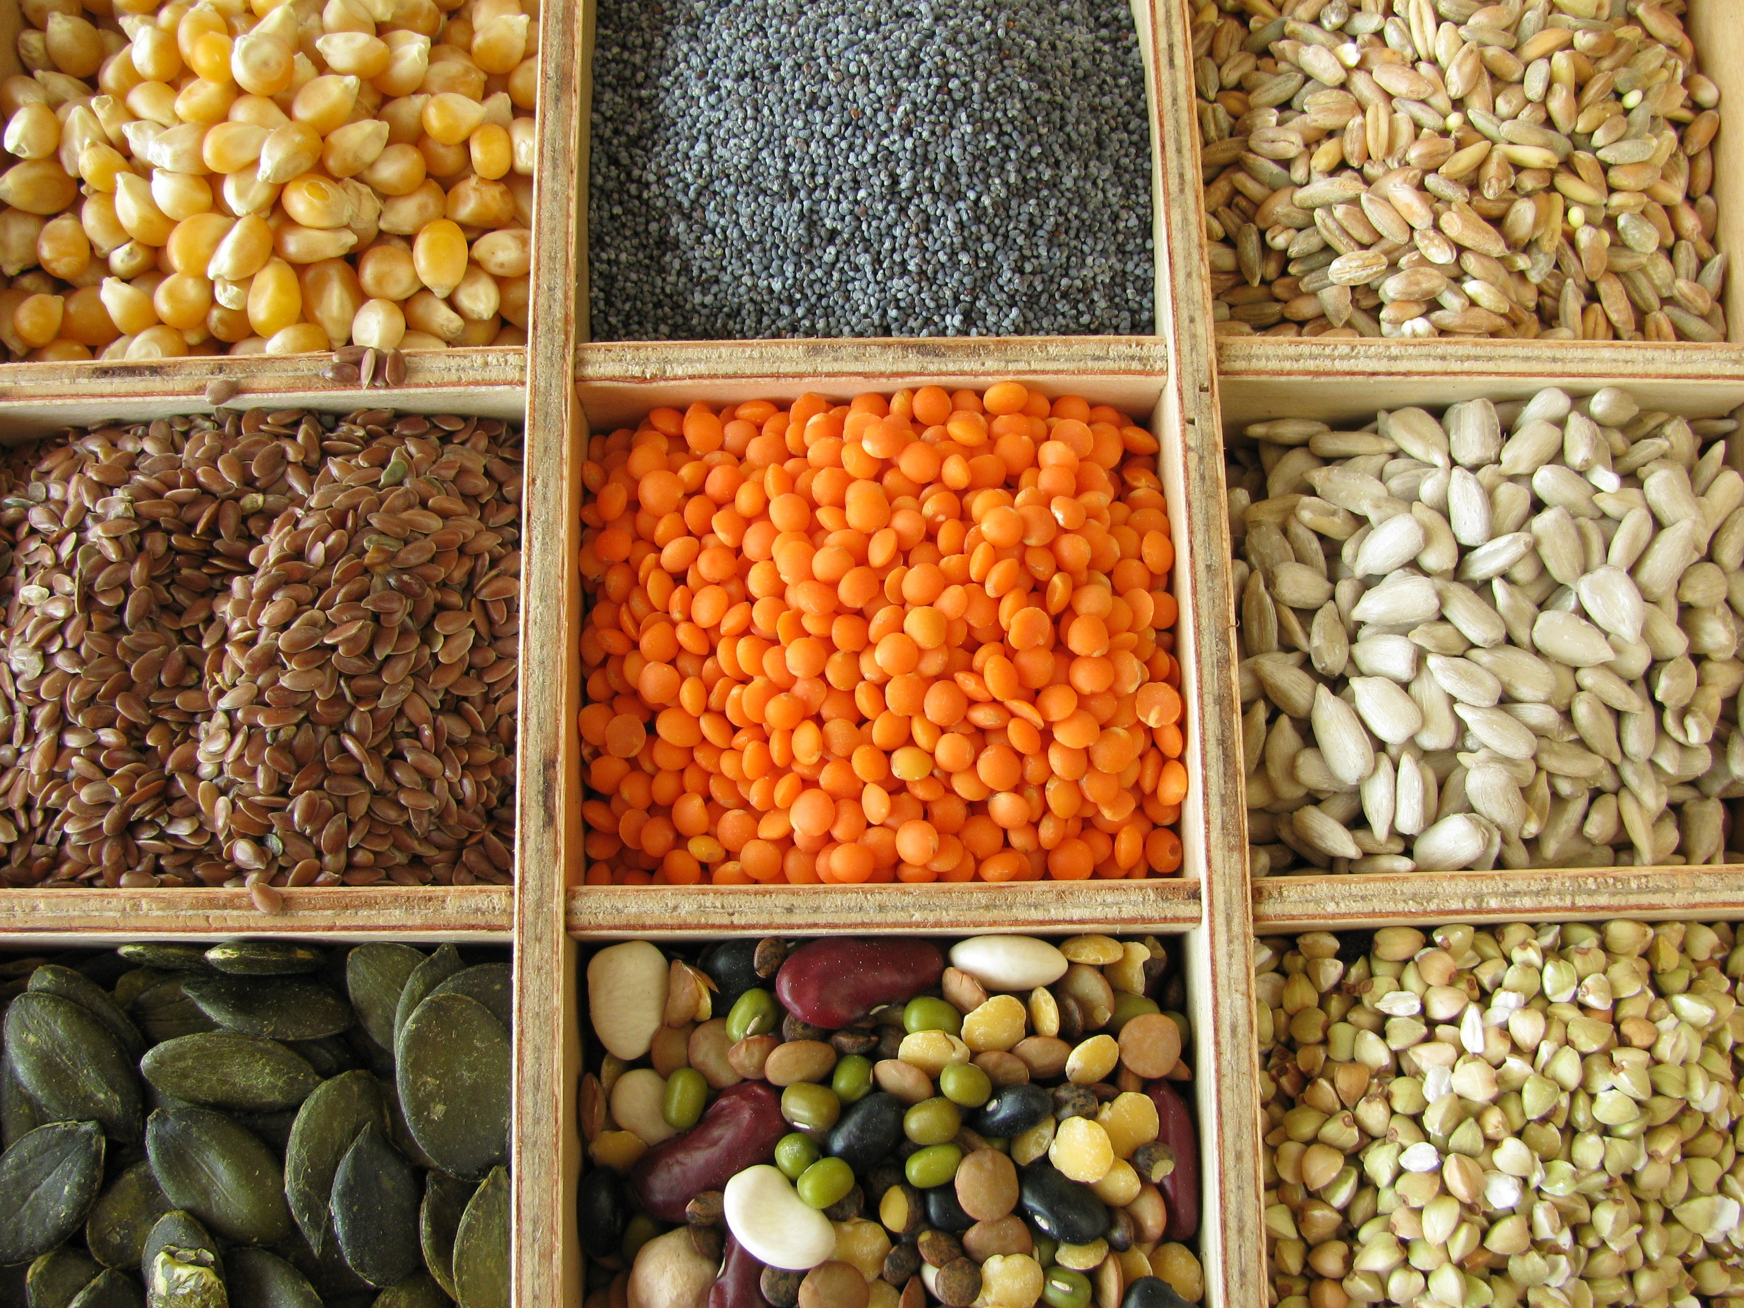
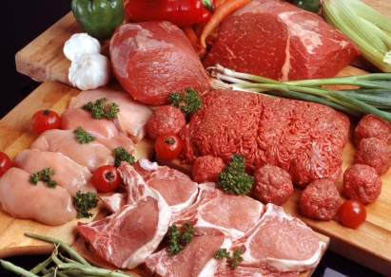
Create a Skillet Meal
Step 1: Protein
  Options: Meat vs. Plant
  Food Safety
Notes:
Steps: Protein
Discuss options- both meat and plant based
Discuss food safety- when to worry about cross contamination, proper hygiene, acceptable temperatures, and safe storage

Slide 8
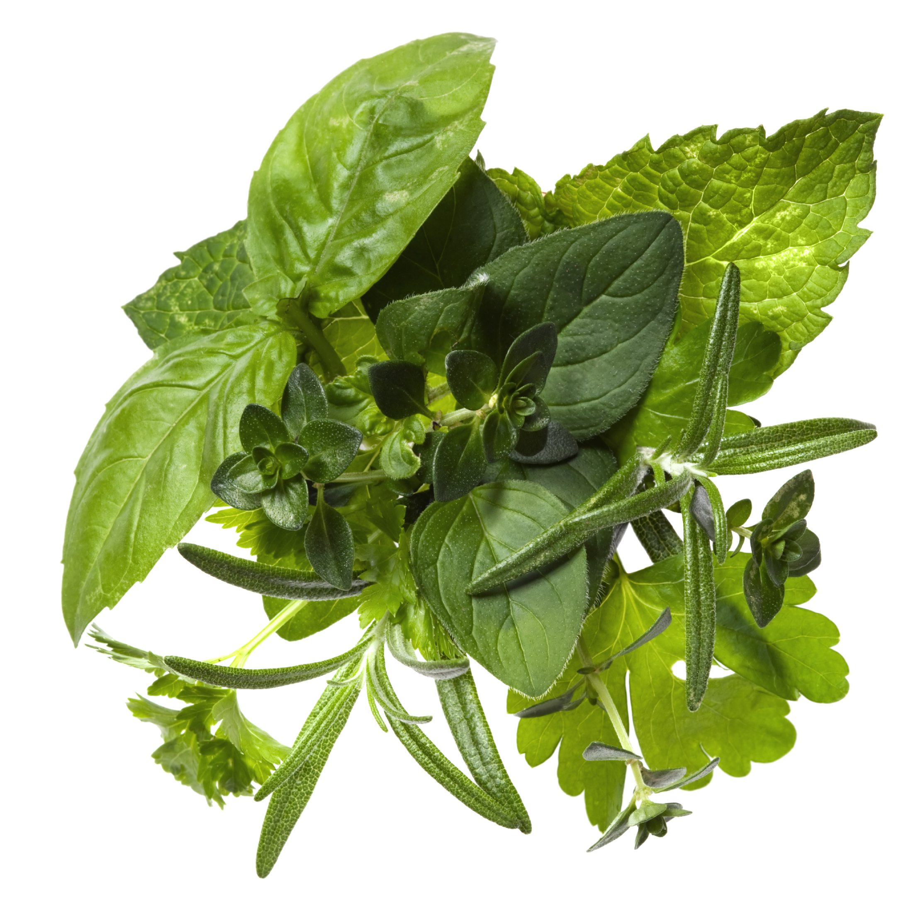
Create a Skillet Meal
Step 2: Flavors
  Onion and Garlic
  Spices/Herbs
    Example: Mexican vs. Italian Spices
Notes:
Steps: Flavors
Onion and garlic: sauté in small amount of oil, water, or broth
Choose spices/herbs according to other ingredients:
* example: use Mexican spices if the recipe has black beans, onion, garlic, tomatoes, and use Italian spices if skillet has pasta, tomatoes, zucchini, etc.
i. Mexican: cumin, oregano, chili powder, cilantro, garlic
ii. Italian: basil, oregano, parsley, garlic
iii. Asian: soy sauce, ginger, garlic, chilies, turmeric
iv: Savor/Thanksgiving: rosemary, sage, thyme, parsley

Slide 9
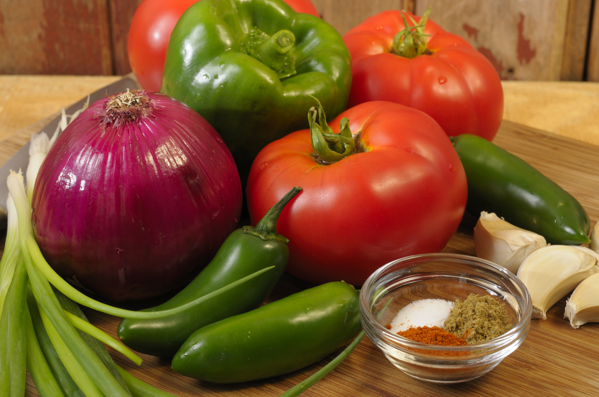
Create a Skillet Meal
Step 3: Veggies
  Options: common vs. uncommon
  Nutrition of Vegetables
  Vegetables give volume instead of calories
  Knife skills needed
Notes:
Steps: Veggies
Discuss options- What are some common veggies and not so common
Discuss how veggies are naturally rick in vitamins, minerals, antioxidants, and phytochemicals
Veggies will give the dish more volume but not calories
Demonstrate knife skills as you cut up veggies

Slide 10
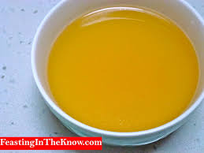
Create a Skillet Meal
Step 4: Liquid
  Necessary to cook starch such as uncooked rice or raw potatoes
  Adds Flavor
Notes:
Steps: Liquid
Liquid is optional depending on whether starch is precooked or not
Necessary to cook starch such as uncooked rice or raw potatoes
Gives added flavor if something other than water is used. What are some options?

Slide 11
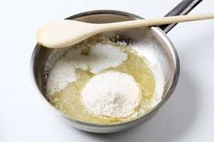
Create a Skillet Meal
Step 5: Sauce (optional)
  Not from a can
    Sauce made from a slurry
    SOS
Notes:
Step 5: Sauce
Sauce is an optional ingredient
Make a sauce that doesn’t come from a can so that there is less fat, sodium, preservatives, and decreases cost
Examples:
Sauce made from a slurry: add flour or cornstarch to water. No fat/ additional calories needed
SOS- define and explain, demo if time and circumstances permit

Slide 12
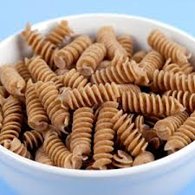
Create a Skillet Meal
Step 6: Starch
  Options
  Whole vs. Refined Grains
  Timing
Notes:
Step 6: Starch
Discuss options- what do participants usually use, what better choices could they make?
Discuss whole versus refined grains
Discuss how starch in skillet meals are usually cooked at the same time as other ingredients. However, sometimes it may be more convenient to cook starch separately (using left over rice, etc.) Reduce or eliminate amount of liquid used if this is the case

Slide 13
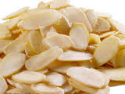
Create a Skillet Meal
Step 7: Toppings
  Options
  Watch out for added fats
Notes:
Step 7: Toppings
Ask what participants use
Discuss healthy options for toppings: Crushed almonds, breadcrumbs, salsa, etc.
Watch out for added fats: Example of using plain Greek yogurt vs. sour cream

Slide 14
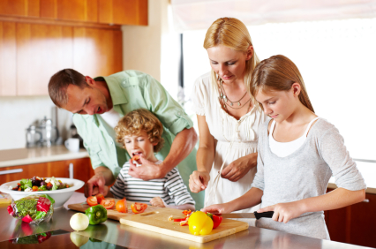
PRACTICE, PRACTICE, PRACTICE
Notes:
Bring pantry items from home and have class members come up with as many ideas for skillet meals as possible from those foods
Have class members think about their own pantry and create a list of meals using the ingredients they already have

Slide 15
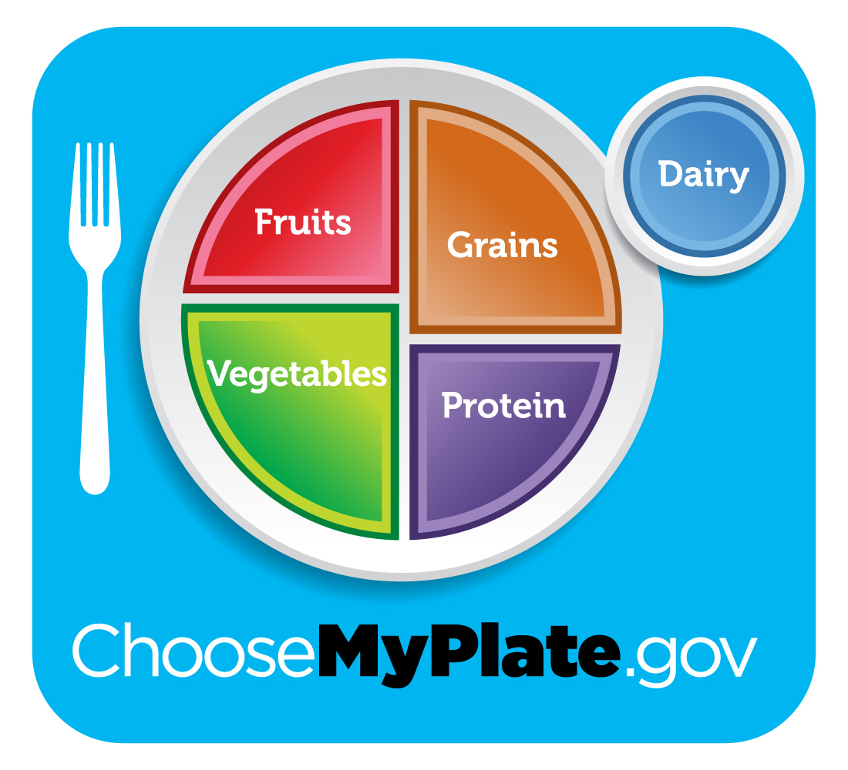
Incorporating MyPlate
What components of MyPlate does a skillet meal creation already have?
What can we add to our plate to round out the meal?
Notes:
Discussion Questions:
What components of MyPlate does a skillet meal creation already have?
What can we add to our plate to round out the meal?

Slide 16

Don’t Forget to Move!
What will you do this week to move your body?
Notes:
Being active is another important part of being healthy. What are some ways you will move around and be active this week?

Slide 17
Conclusion
You don’t need:
  a state of the art kitchen
  a degree from culinary school
  Or tons of time
All you need is:
  Basic equipment
  Food in the Pantry
Notes:
You don’t need a start of the art kitchen, a degree from culinary school, or tons of time. You just need some basic equipment and food in the pantry to create a healthy and warm skillet meal that your family will want to come home to!

