Slide 1
Create a salad
Food $ense
Notes:
This lesson teaches the basic techniques to create a wholesome and nutritious main dish salad from ingredients you already have. After this lesson, the goal is to be able to demonstrate the skills needed to stock your pantry with nutritious foods and to use those foods to create a tasty main dish salads using a whole foods approach that follows MyPlate meal plans.

Slide 2
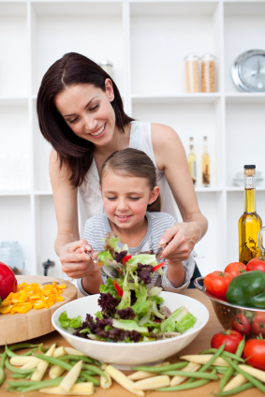
Introduction
Family Mealtime Important
Notes:
Discuss why family mealtime is important.
Ask for opinions/ input on importance.
Include examples:
Family Bonding
Better nutrition with less chance of eating disorders
Better grades and behavior with less chance of drugs, alcohol, and sexual activity

Slide 3
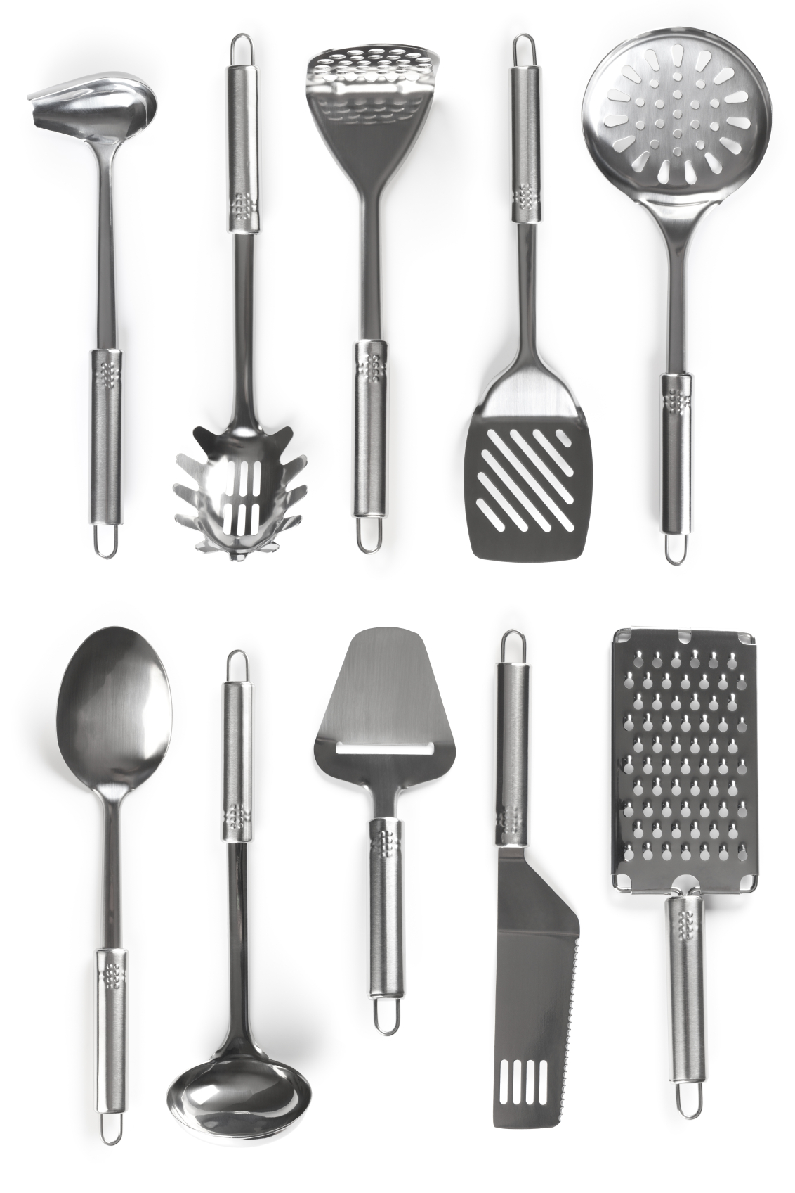
Introduction
Questions:
What basic kitchen equipment is
needed to make a salad?
Identify food safety concerns
when preparing a salad.
Notes:
Ask the questions above to increase participation in the class.

Slide 4
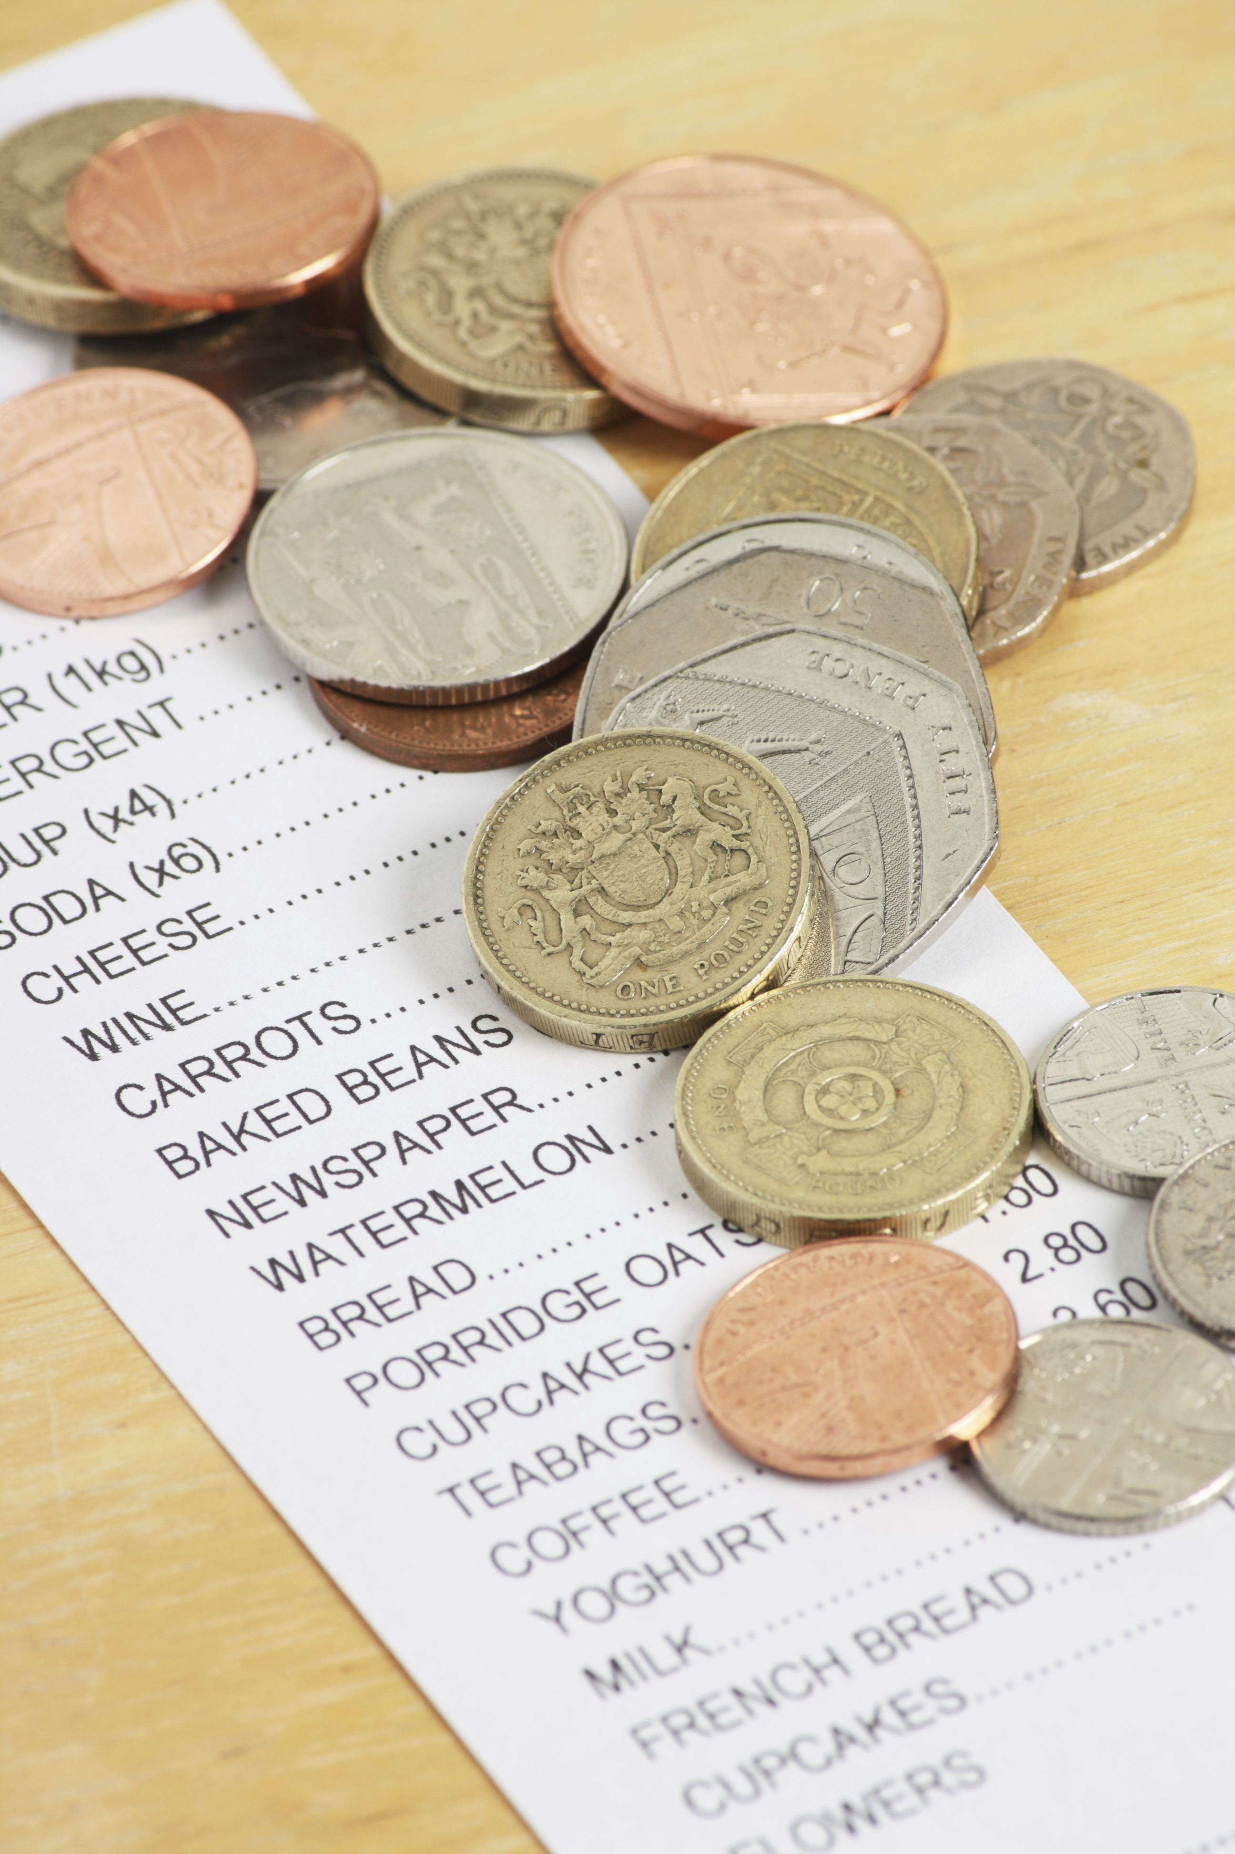
Introduction
Meal Planning
Save time and money
Steps/tips
Notes:
Discuss meal plans and how they save time and money
Step to create a menu:
Look at ingredients already in pantry or fridge
Look through recipes/ come up with combinations to use food
Put together a menu for each meal
Extra Tips
Consider having theme nights: Monday is Mexican food, Tuesday is Italian, etc)

Slide 5
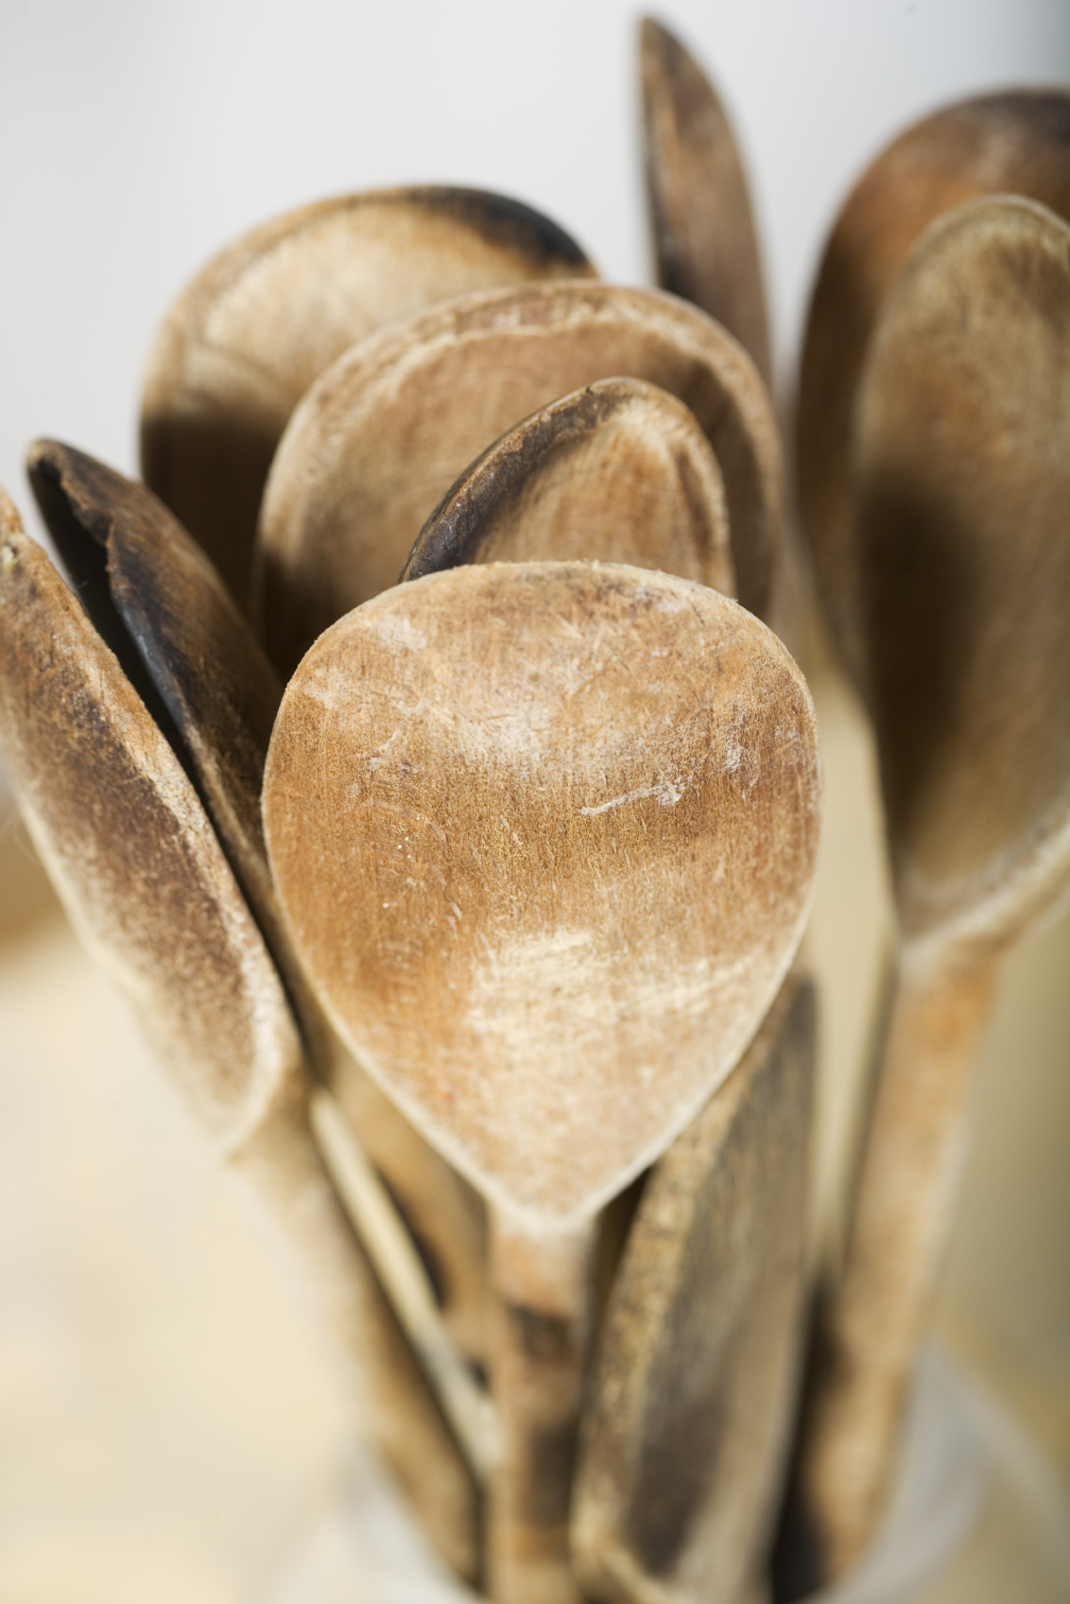
CREATE a Salad
Before Starting:
Choose Whole Foods
Equipment Needed
Notes:
Preparation for creating a salad:
Choose mostly whole foods and reduce highly refined processed foods
Show and explain equipment needed and how to use it: Sharp knife, cutting board, vegetable peeler, vegetable grater, large mixing bowl, spoons, measuring cups and spoons, saucepan, large salad bowl, etc.

Slide 6
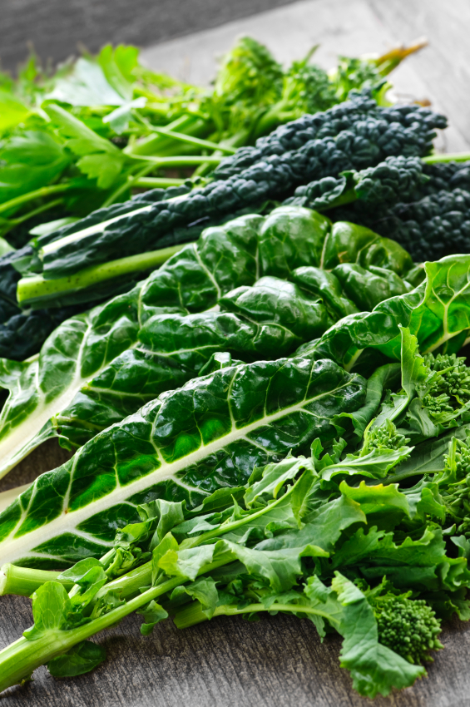
Create a Salad
Step 1: Base
Greens
Whole Grain Pasta
Whole Grains
Potatoes
Whole Grain Bread
Notes:
Steps: Base
Options: Discuss options, what do participants typically use, what better choices they could make
Discuss whole versus refined grains, pasta, & rice

Slide 7
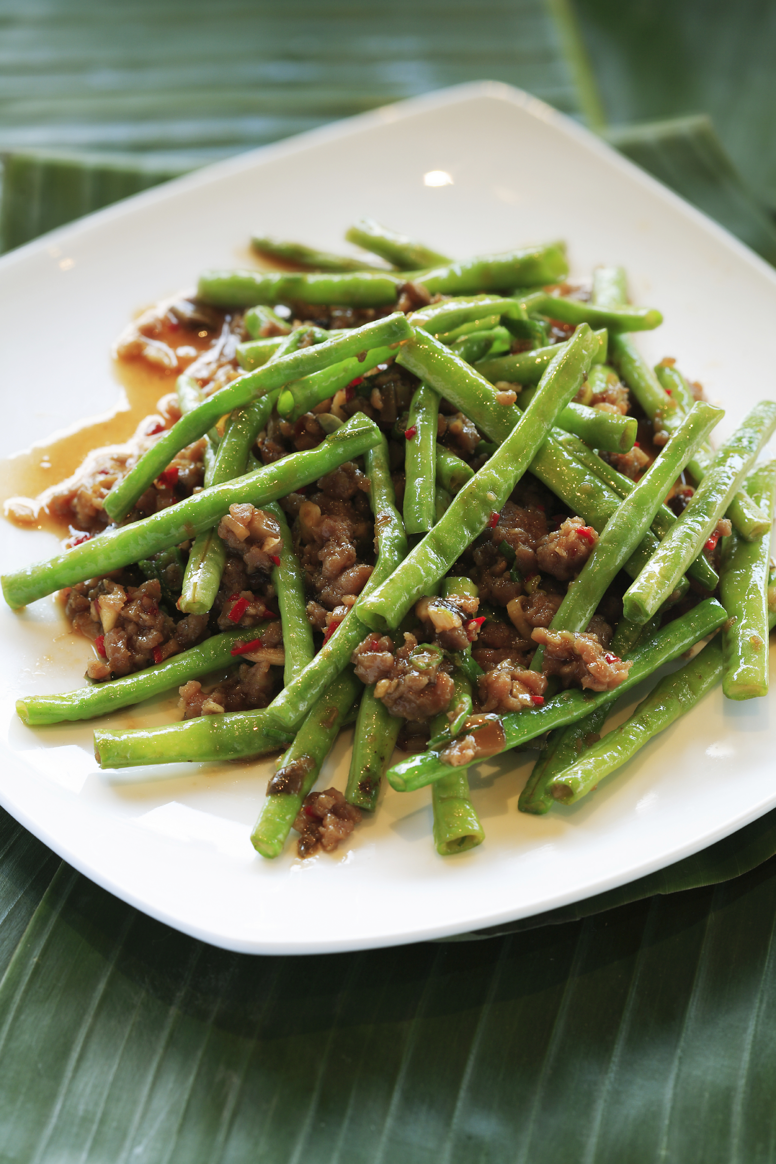
Create a Salad
Step 2: Protein
Meat and Plant-Based
Food Safety
Notes:
Steps: Protein
Discuss food safety- when to worry about cross contamination, proper hygiene, temperature, and storage
Discuss options-both meat and plant-based

Slide 8
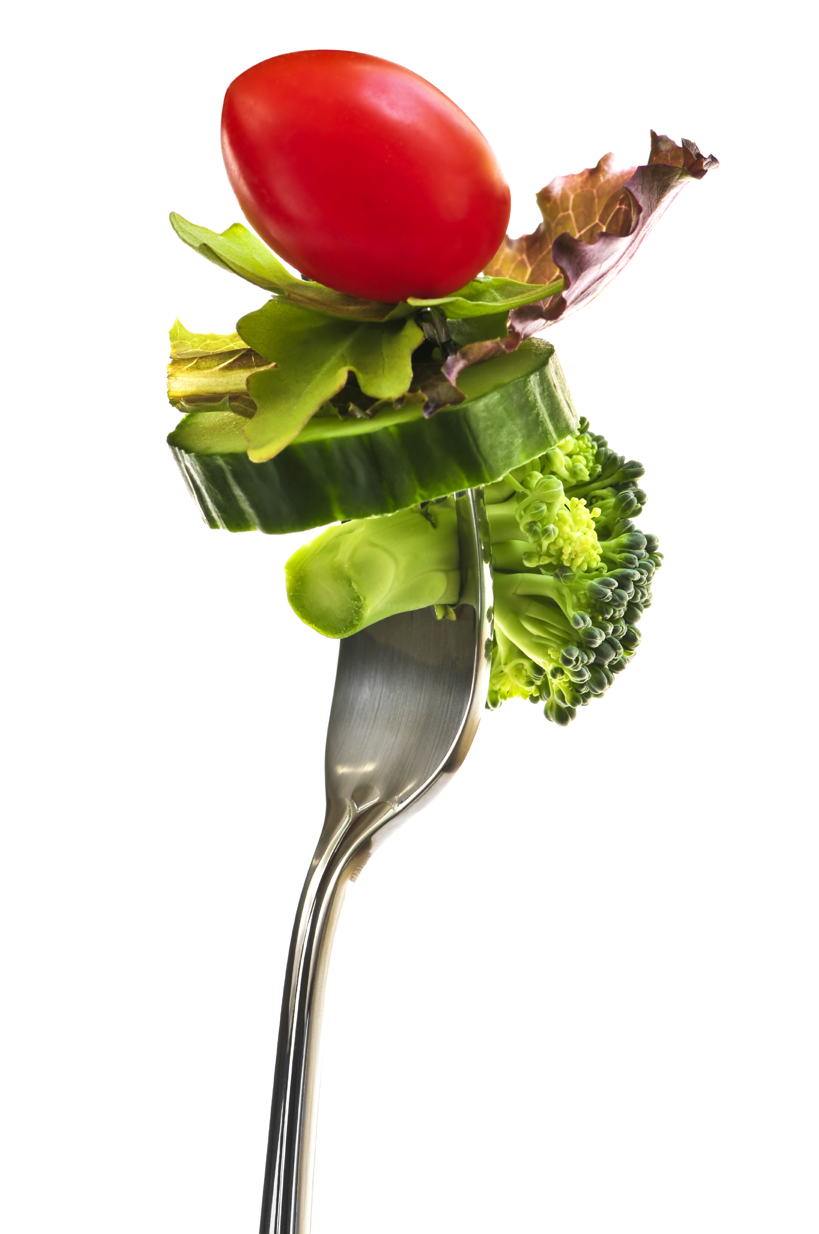
Create a Salad
Step 3: Veggies
Options
Vitamins, Minerals, etc.
Volume but not calories
Knife skills
Notes:
Steps: Veggies
Discuss options-most common and not so common
Discuss how veggies are naturally rich in vitamins, minerals, antioxidants, and phytochemicals
Veggies will give the salad more volume but not calories
Demonstrate knife skills as you cut up veggies

Slide 9
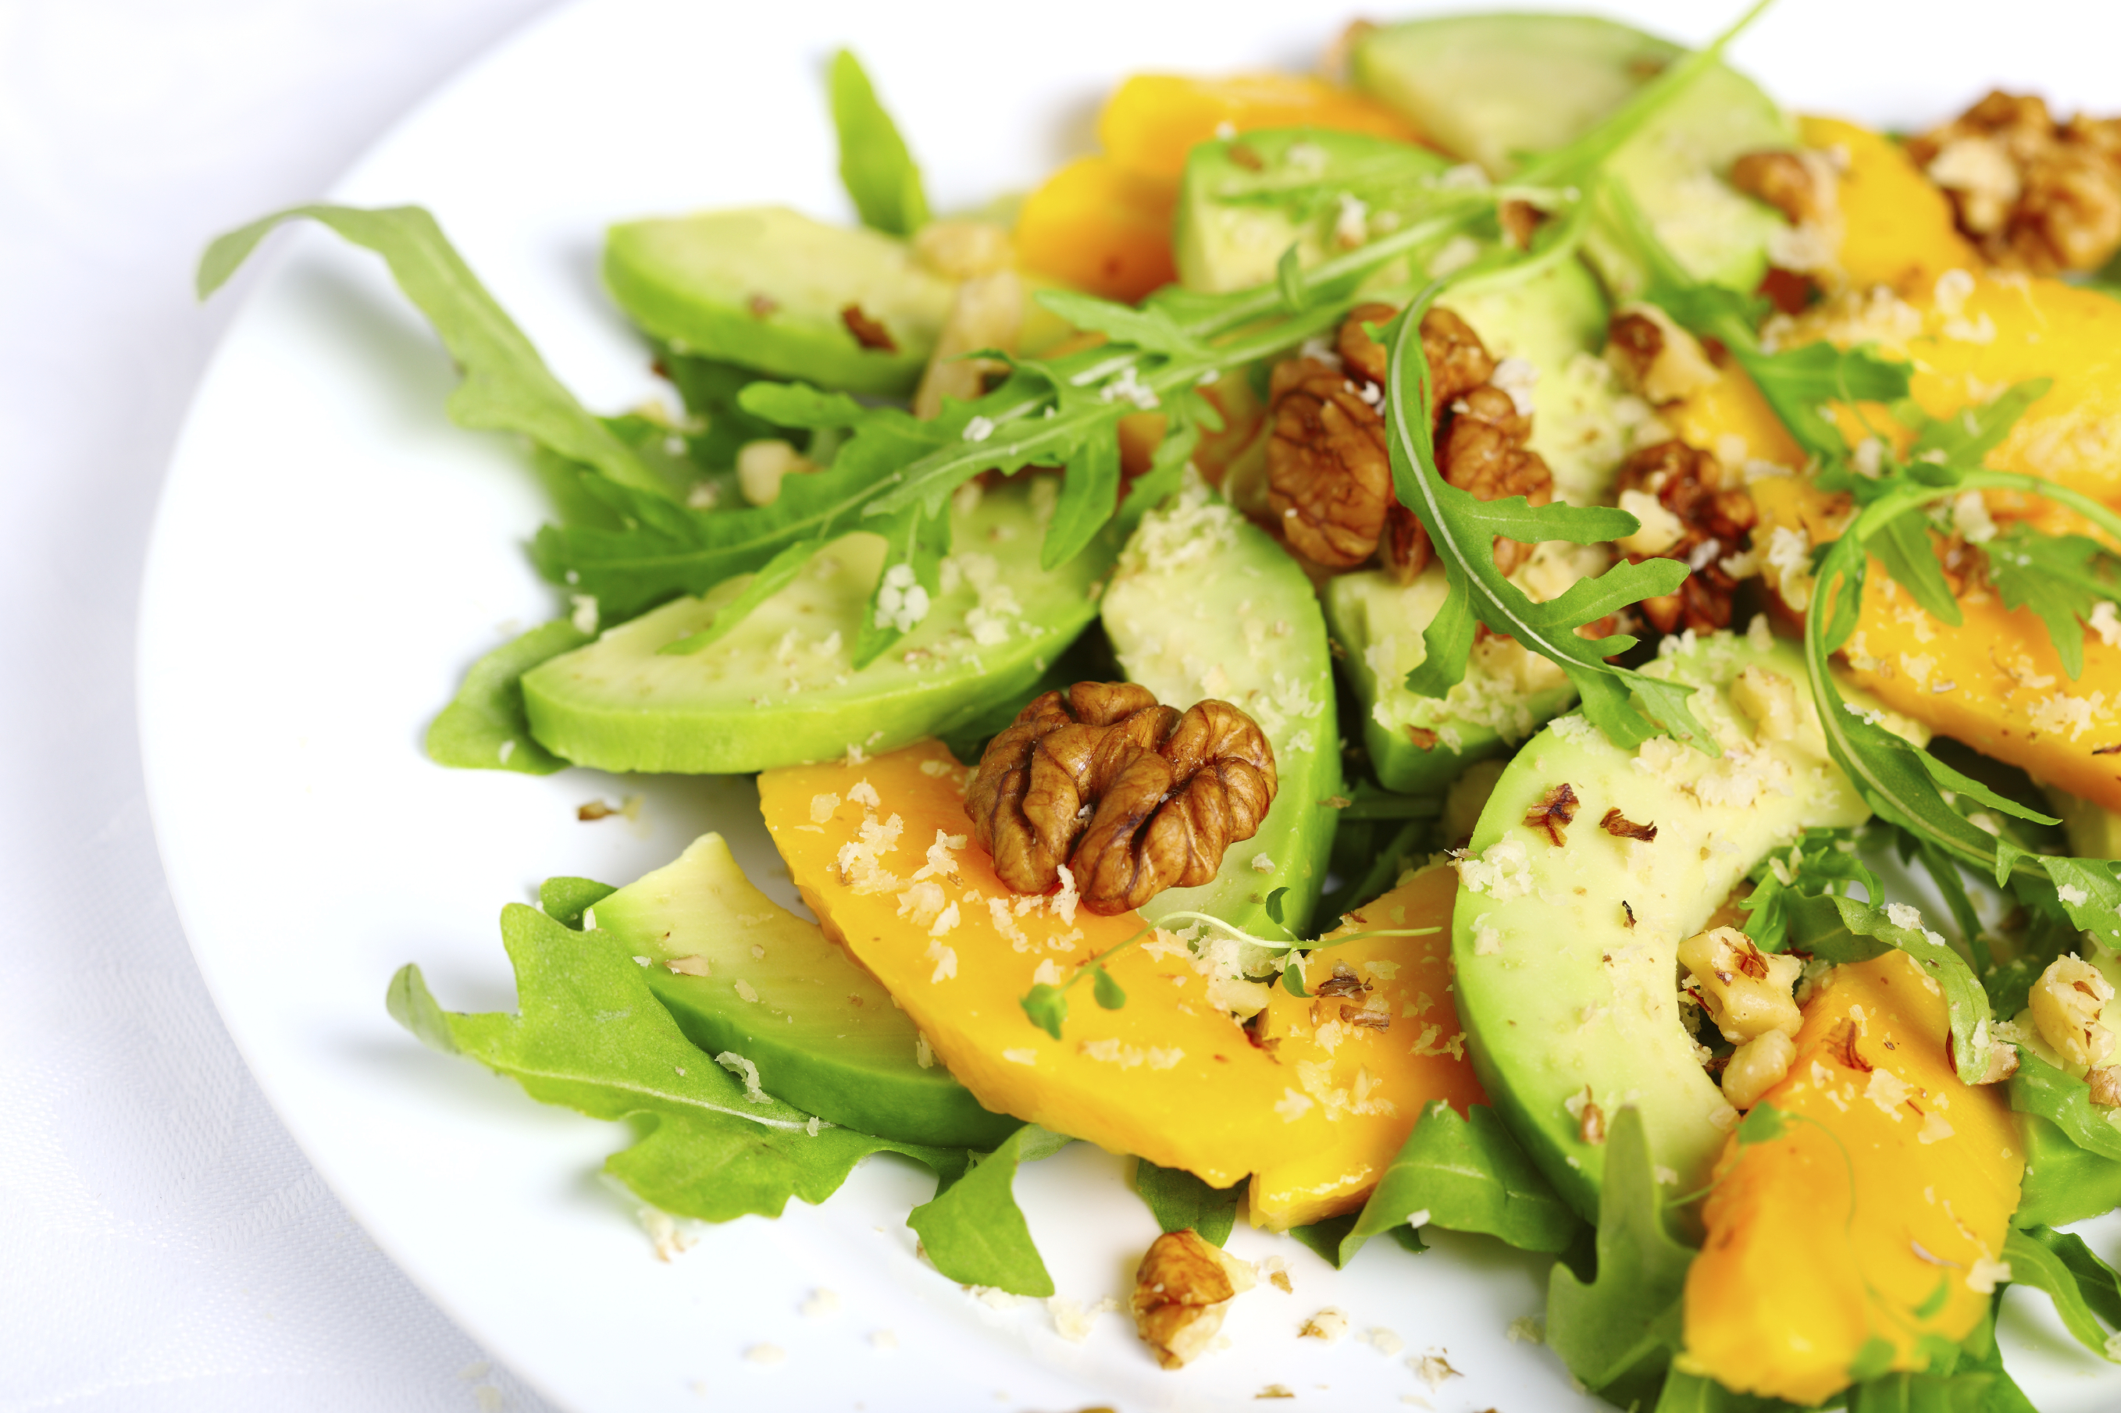
Create a Salad
Step 4: Flavors
Onion and Garlic
Spices or Herbs
Notes:
Steps: Flavors
Onion and Garlic – can be raw or cooked
Choose spices/herbs according to other ingredients
Example: use Mexican spices if salad has black beans, onion, garlic, tomatoes, and corn; use italian spices if salad ha pasta, tomatoes, zucchini; etc
Mexican: cumin, oregano, chili powder, cilantro, garlic
Italian: basil, oregano, parsley, garlic
Asian: soy sauce, ginger, garlic, chilies, turmeric
Savory/Thanksgiving: rosemary, sage, thyme, parsley

Slide 10
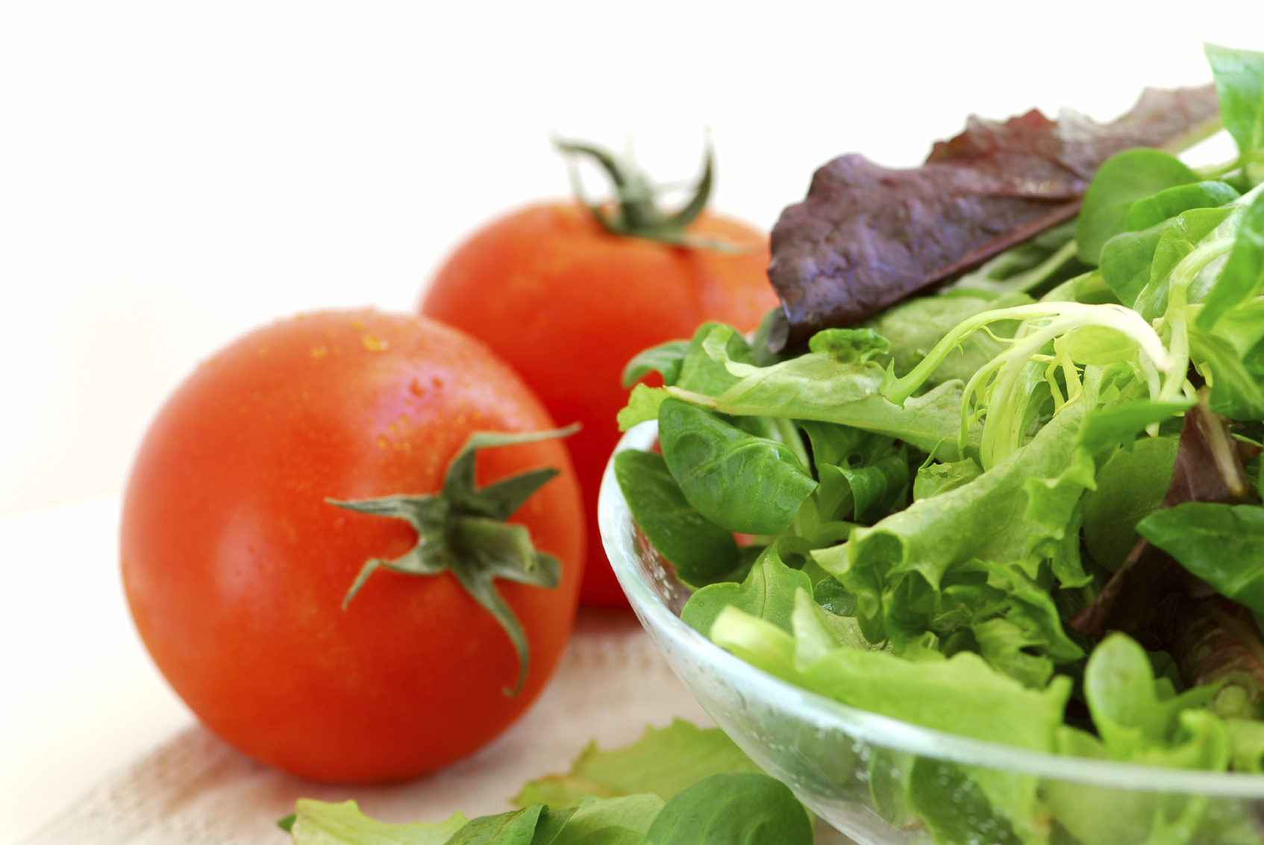
Create a Salad
Step 5: Dressing
Homemade Dressings
Notes:
Steps: Dressing
Homemade dressings – less fat, sodium, preservatives, cost (pennies versus dollars)

Slide 11
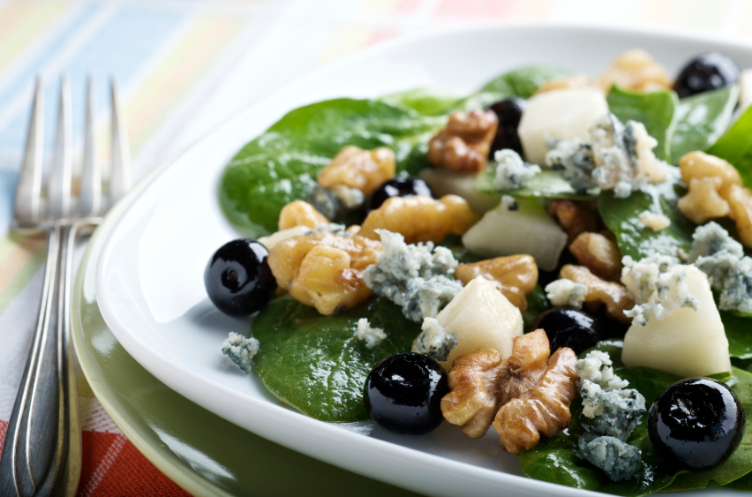
Create a Salad
Step 6: Toppings
Options
Added Fats
Notes:
Steps: Toppings
Discuss options
Watch out for added fats

Slide 12
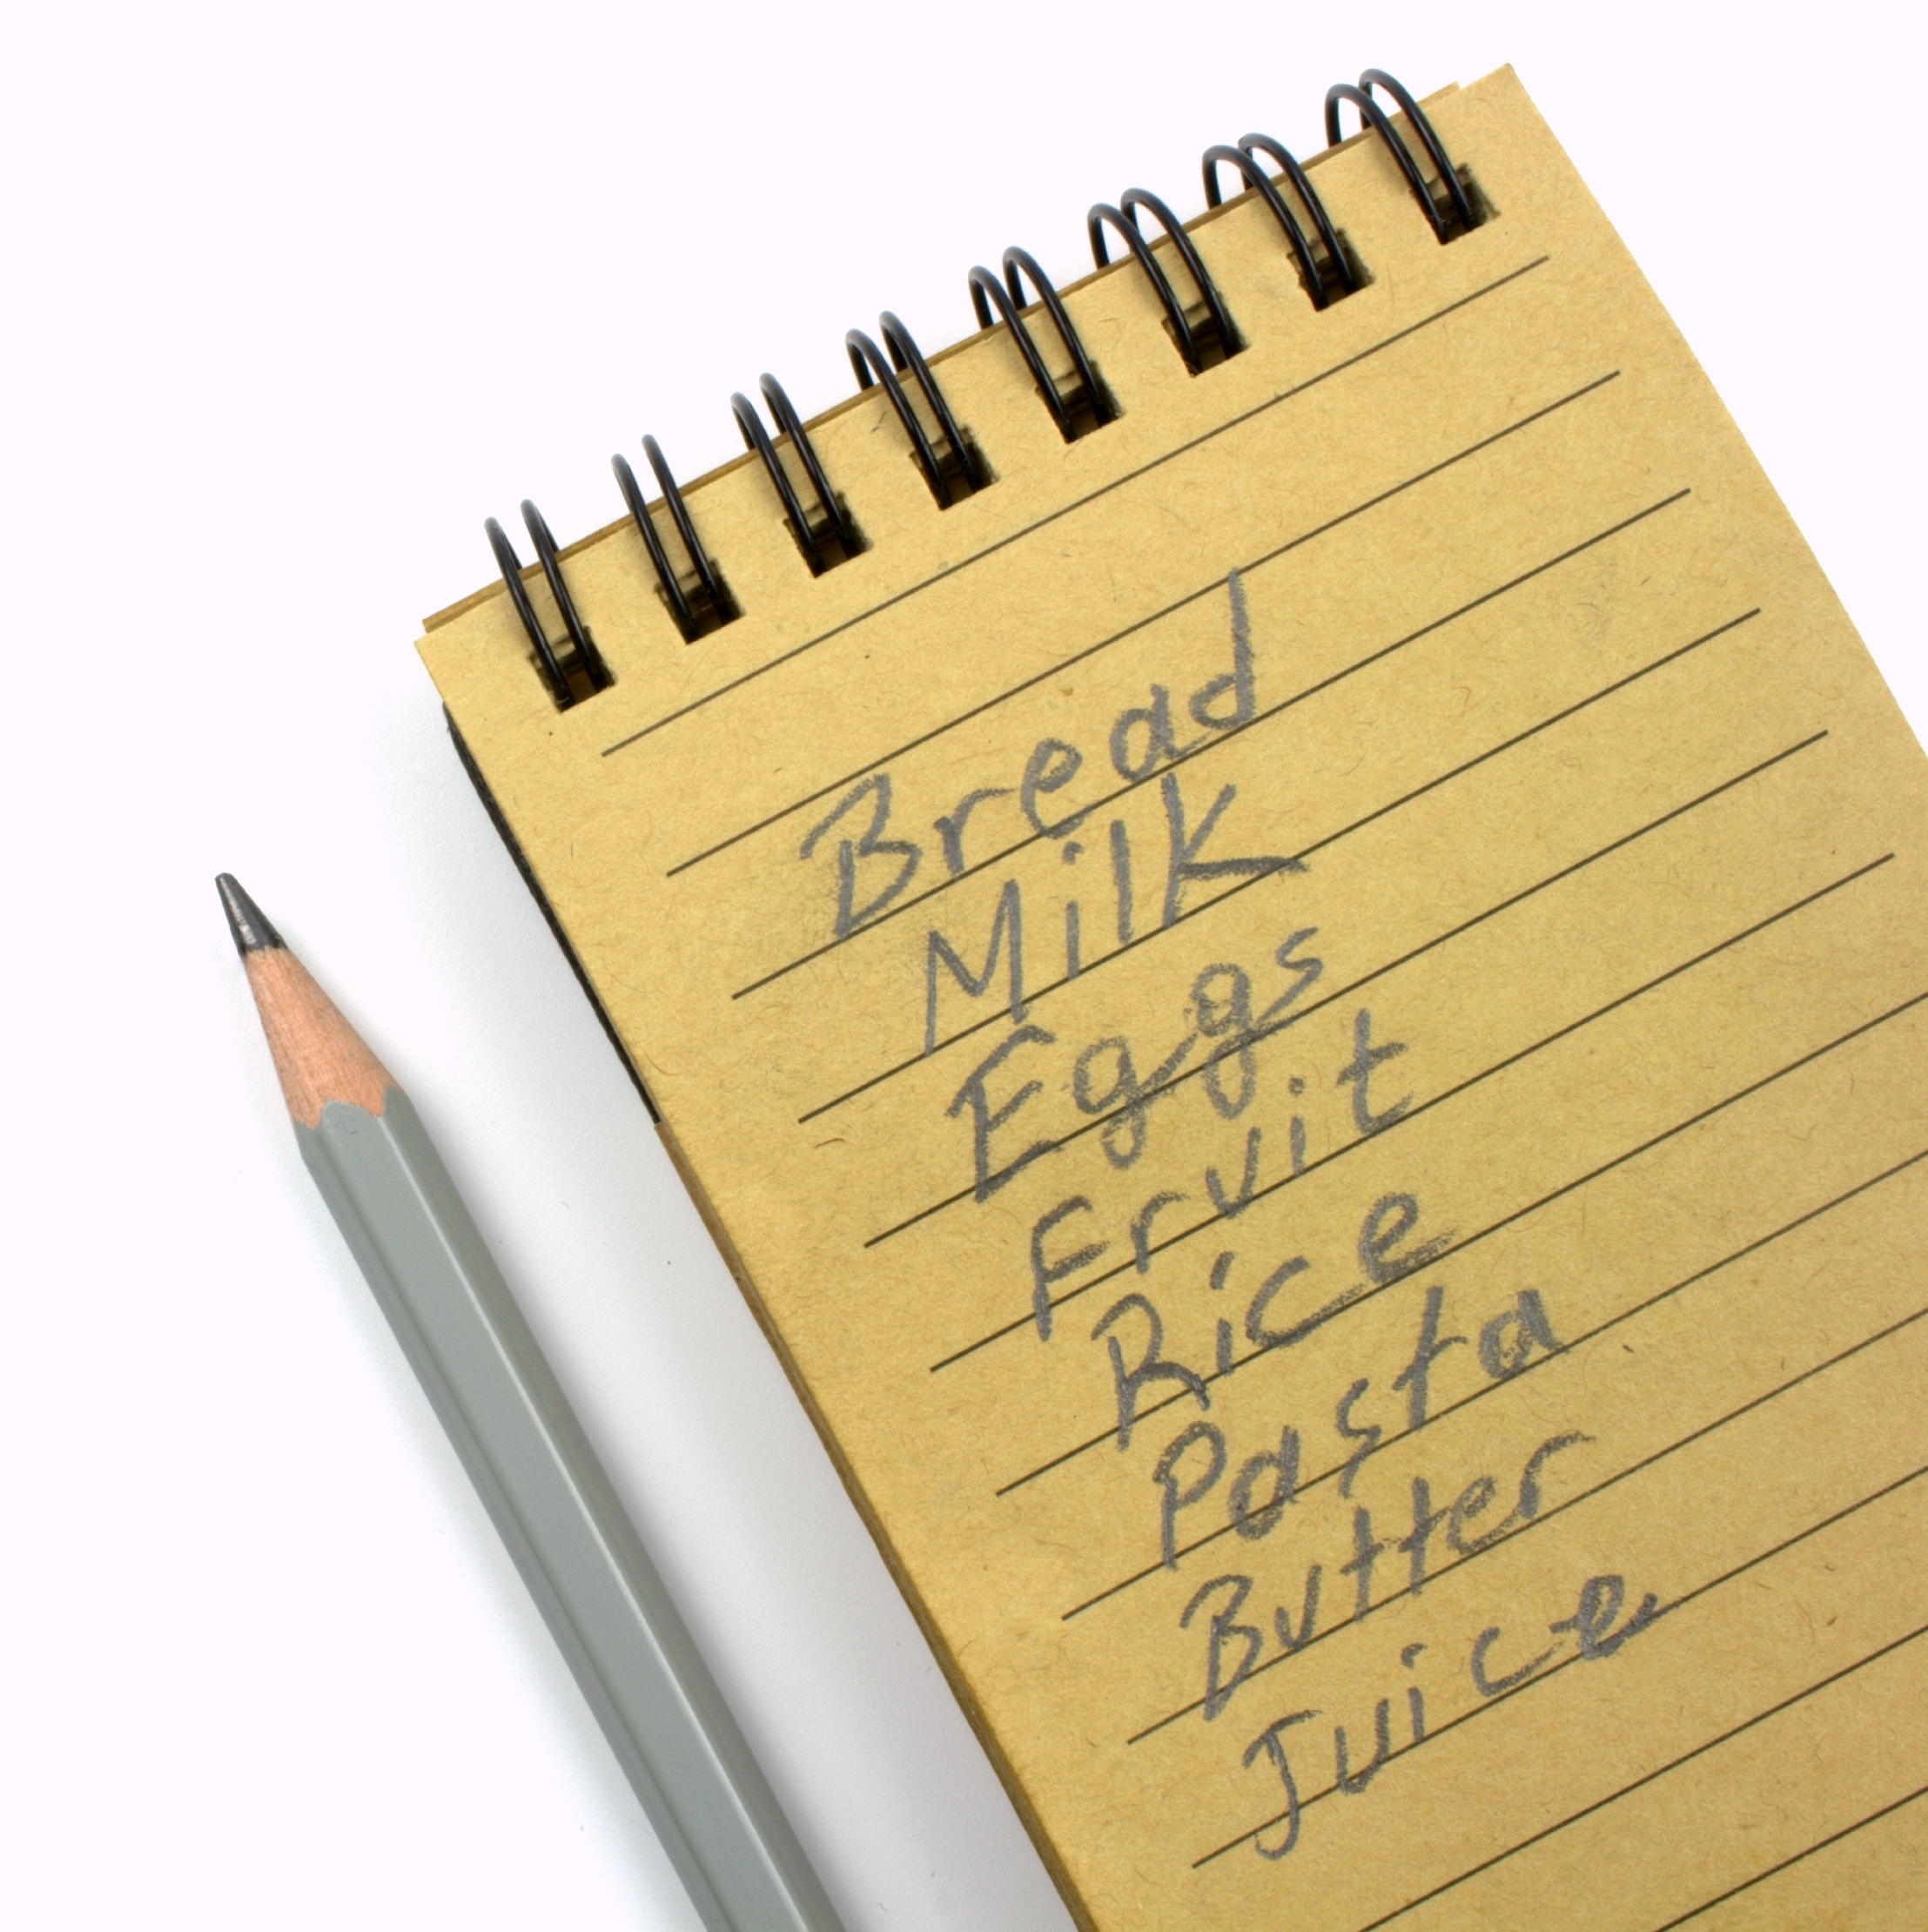
Practice Time!
Bring pantry items from home
Possible quick bread options from pantry ingredients
Notes:
Bring pantry items from home and have class members come up with as many ideas for salads as possible from those foods
Have class members think about their own pantry and create as many salad options as possible from what they already have

Slide 13
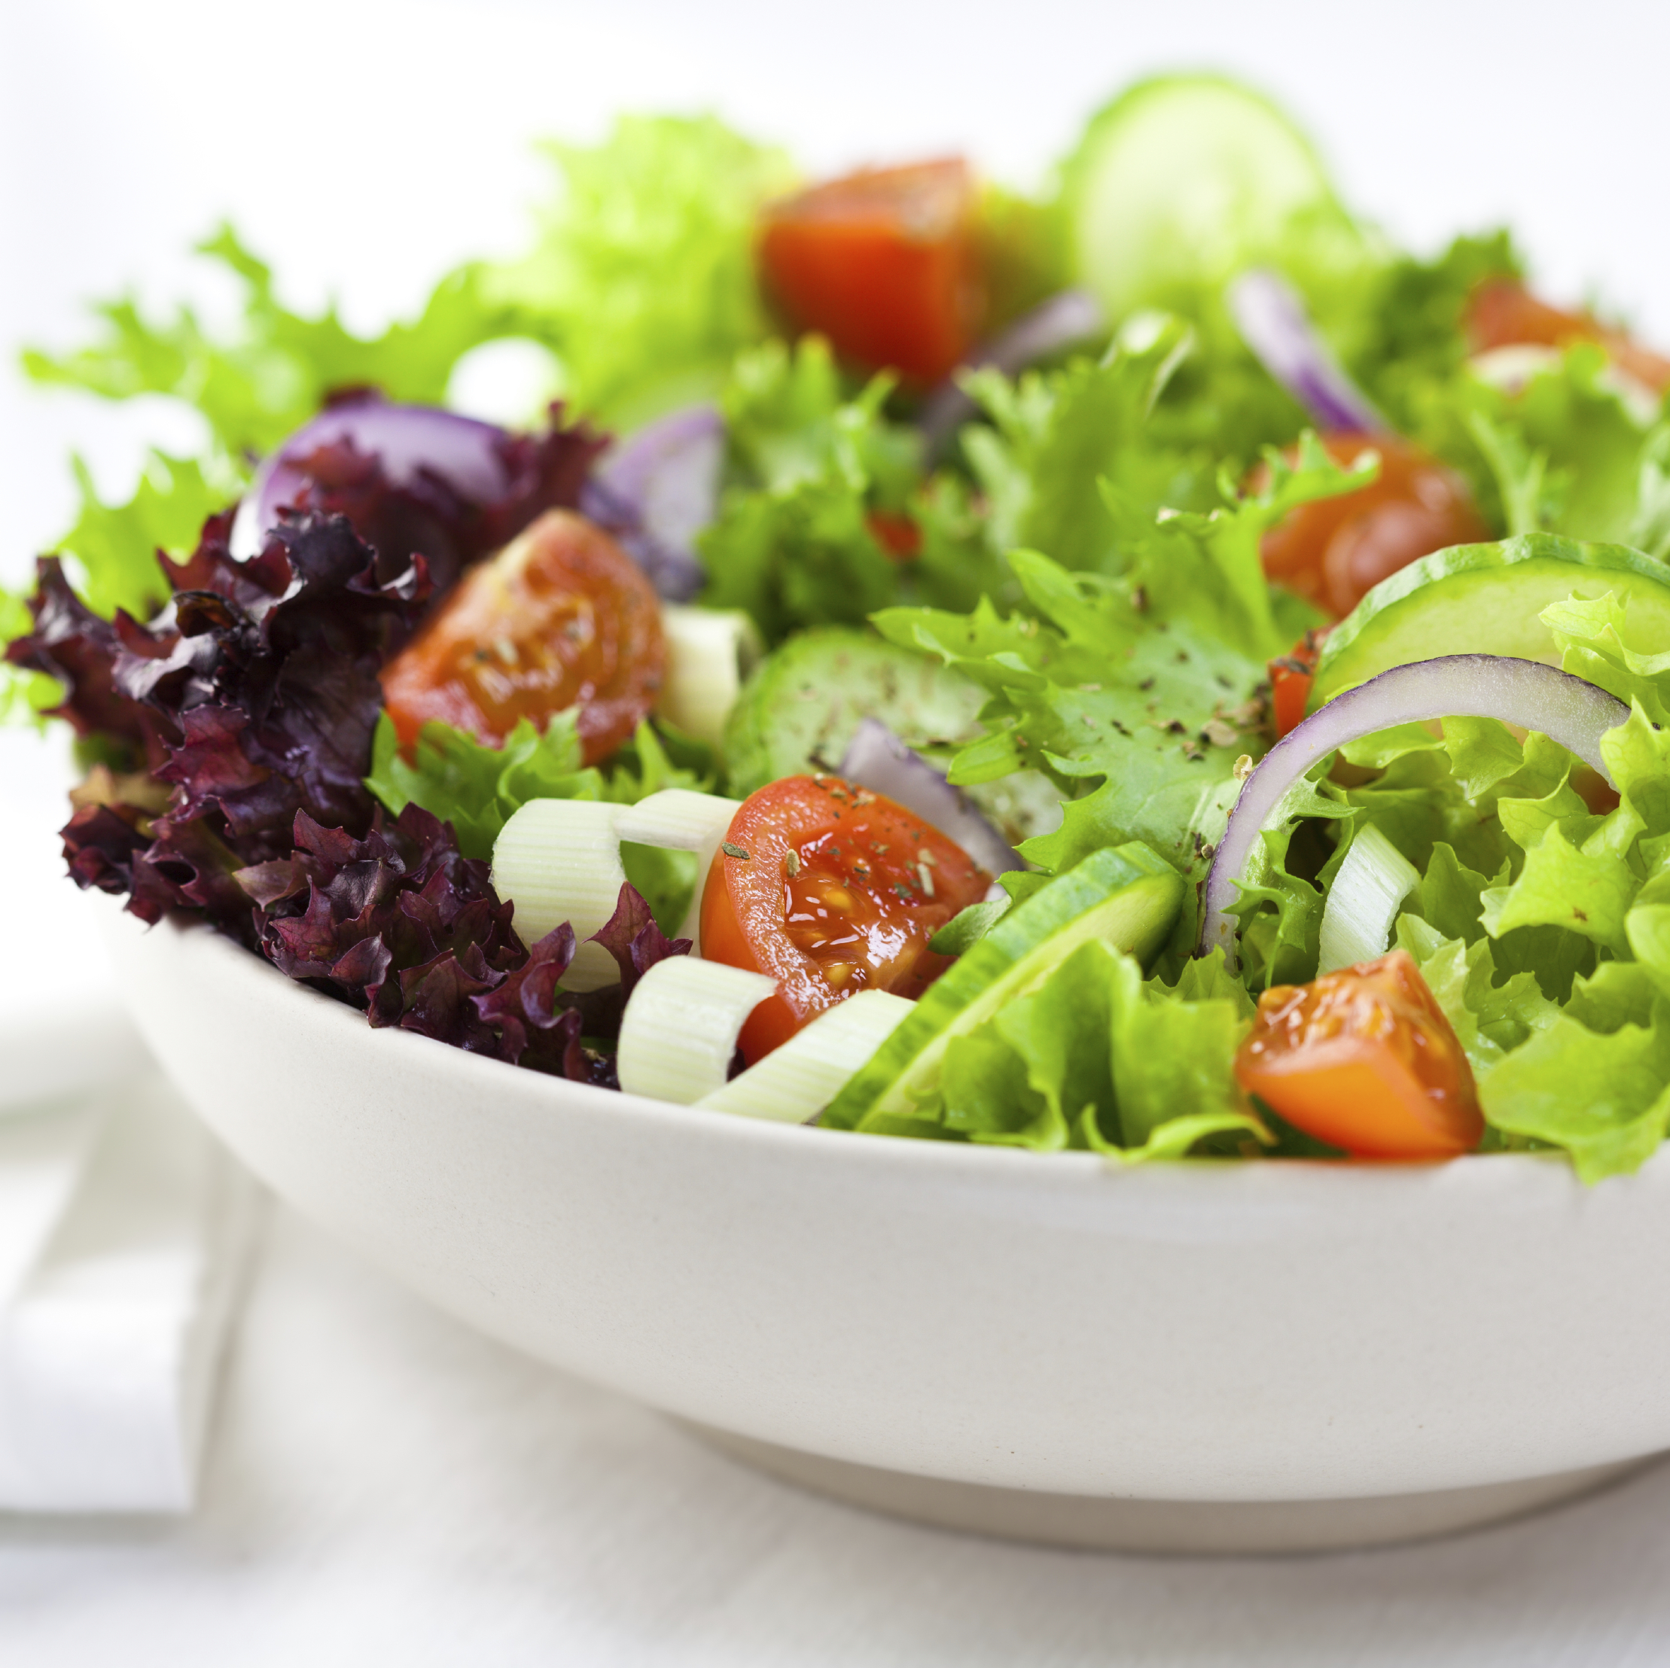
Incorporating MyPlate
What components of MyPlate does the salad dish already have?
What can be added to round out the meal?
Notes:
Discussion Questions:
What components of MyPlate does salad already have?
What can we add to our plate to round out the meal?

Slide 14
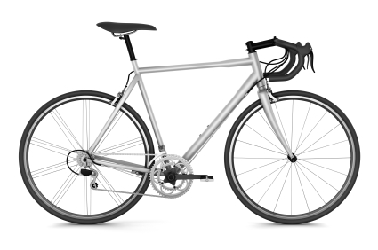
Don’t Forget to Move!
Weekly exercise plan
Notes:
Being active is another important part of being healthy. What are some ways you will move around and be active this week?

Slide 15
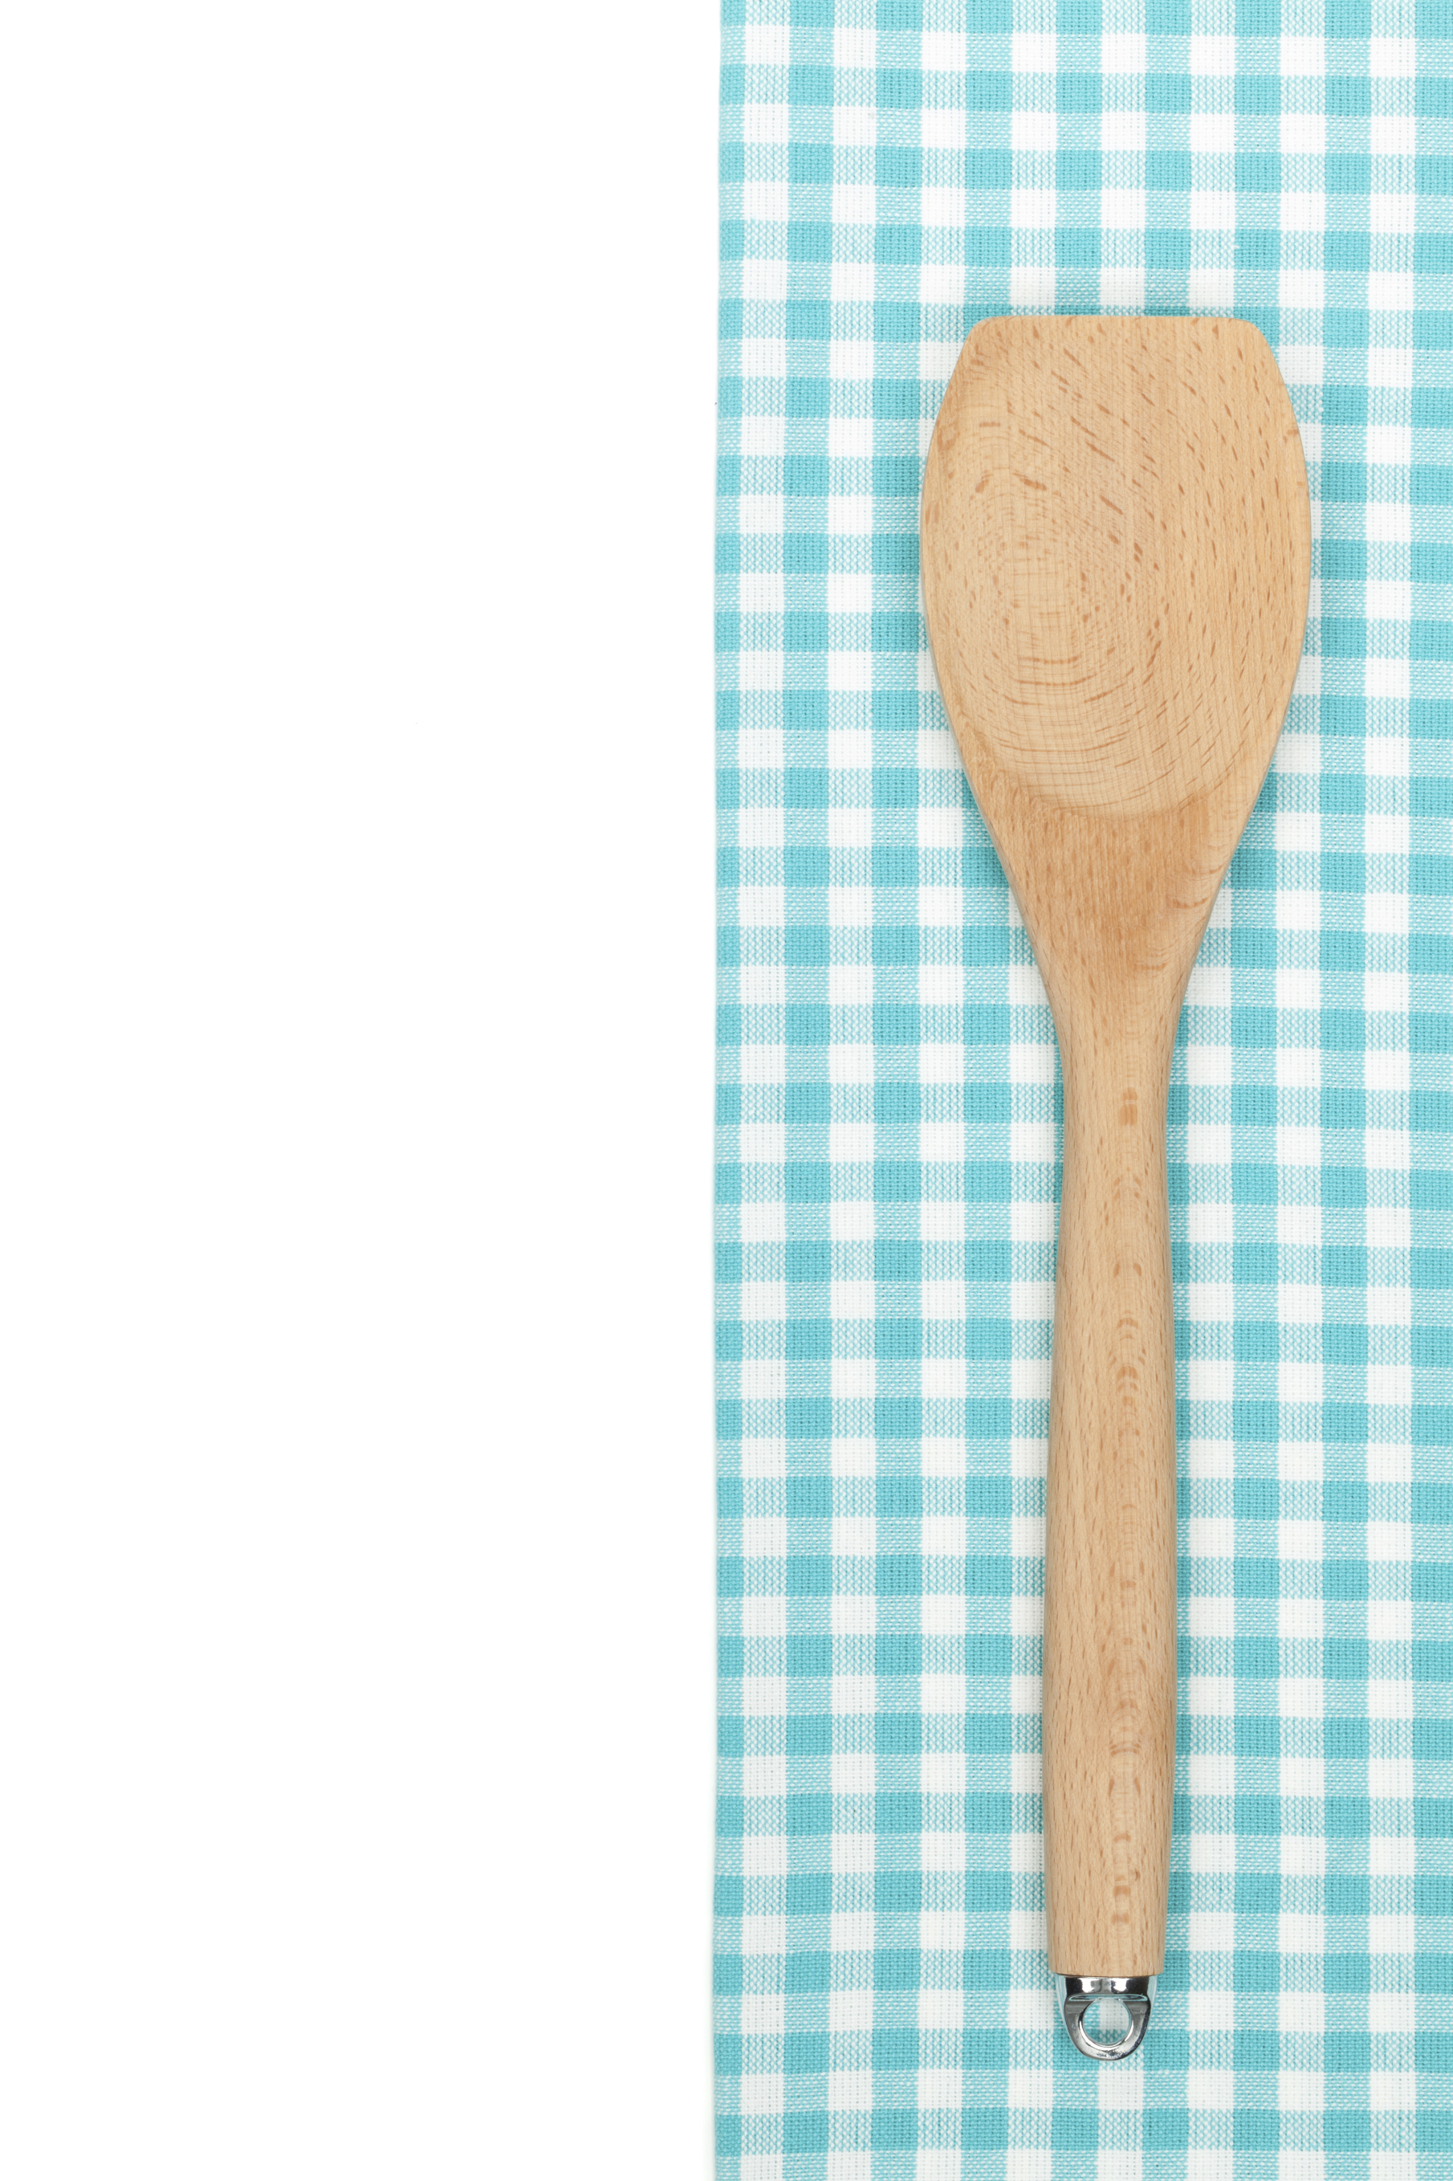
Conclusion
Just need – basic equipment and food in the pantry to CREATE a Salad
Notes:
You don’t need a start of the art kitchen, a degree from culinary school, or tons of time. You just need some basic equipment and food in the pantry to create a delicious salad that your family will want to come home to!
-Questions??
-Remind of next class!

