Slide 1
CREATE a QUICK BREAD
Food $ense

Slide 2

Introduction
Family Mealtime Important
Notes:
Discuss why family mealtime is important.
Ask for opinions/ input on importance.
Include examples:
Family Bonding
Better nutrition with less chance of eating disorders
Better grades and behavior with less chance of drugs, alcohol, and sexual activity

Slide 3

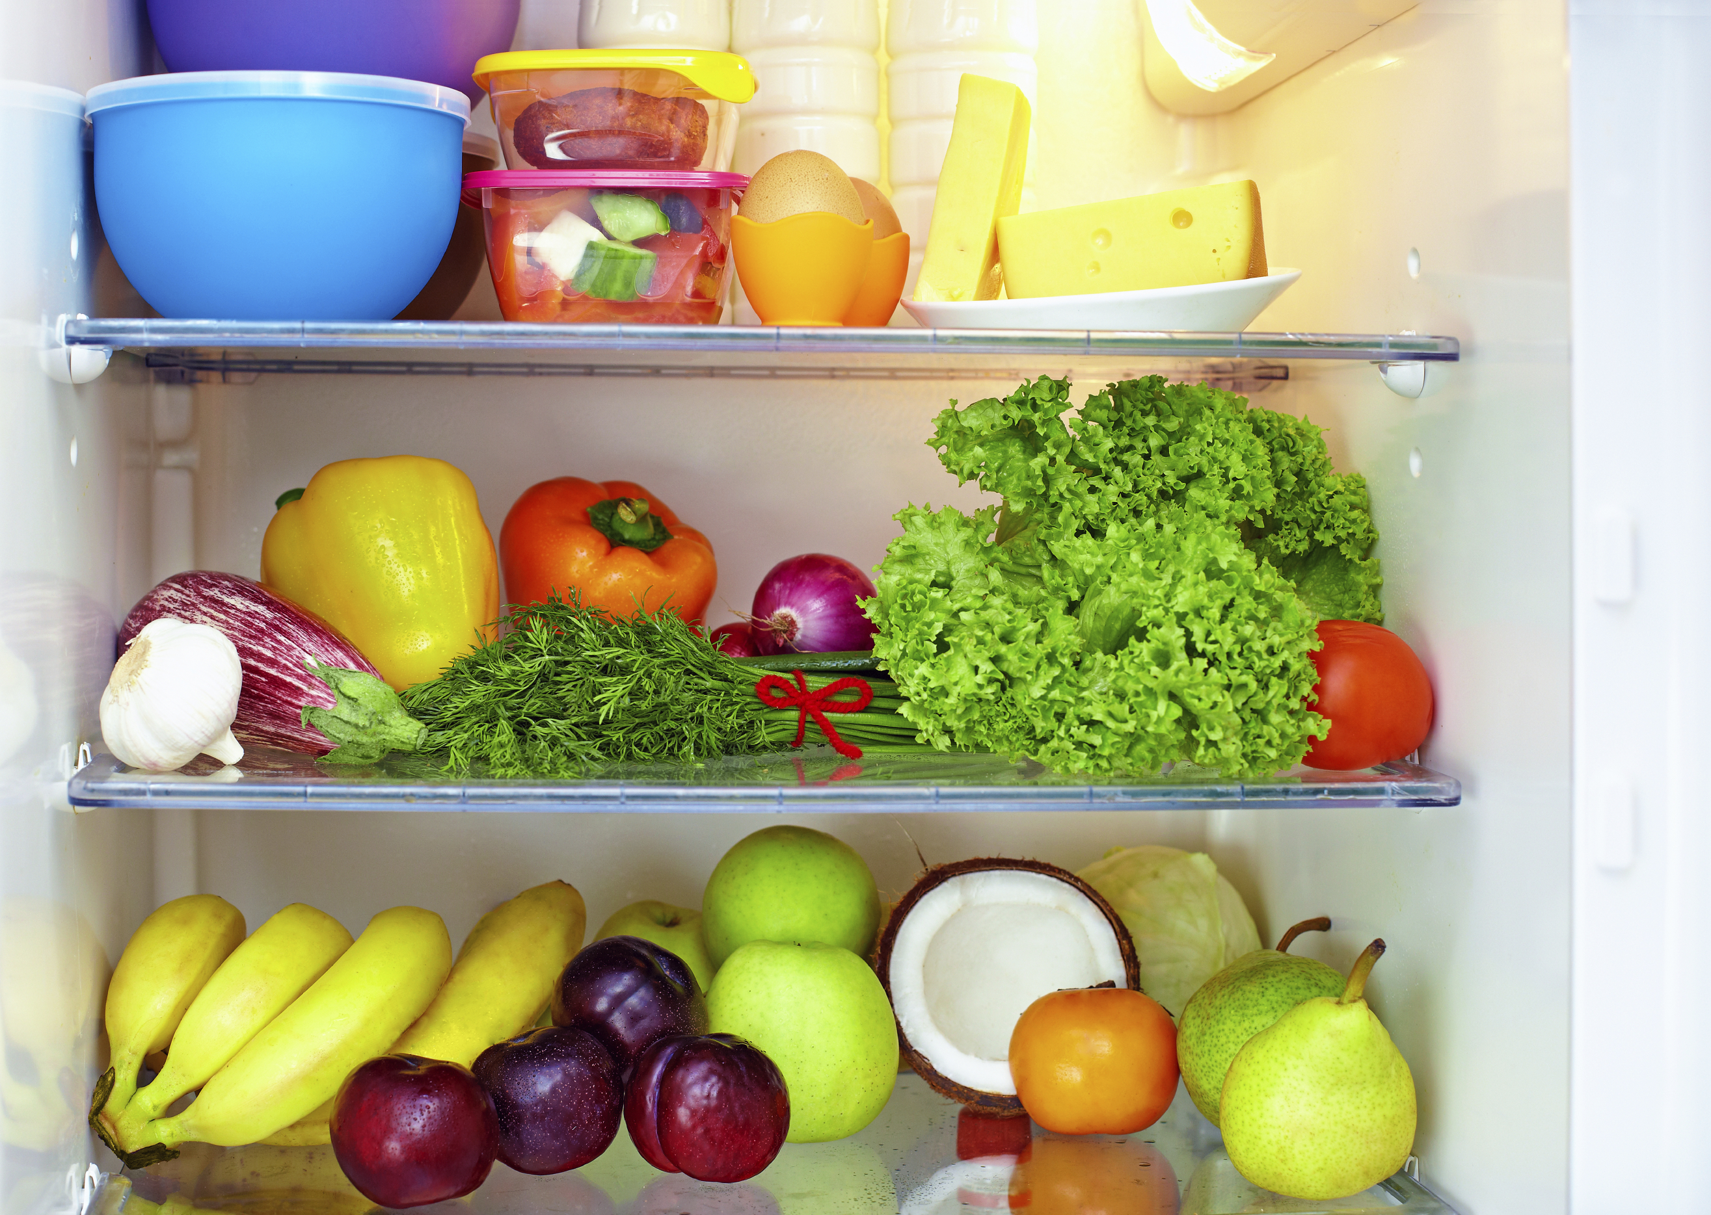
Introduction
Questions:
What is a whole food diet?
Why is a well-stocked pantry important?
Notes:
Ask the questions above to increase participation in the class.

Slide 4

Introduction
Meal Planning
  Save time and money
  Steps/tips
Notes:
Discuss meal plans and how they save time and money
Step to create a menu:
Look at ingredients already in pantry or fridge
Look through recipes/ come up with combinations to use food
Put together a menu for each meal
Extra Tips
Consider having theme nights: Monday is Mexican food, Tuesday is Italian, etc)

Slide 5
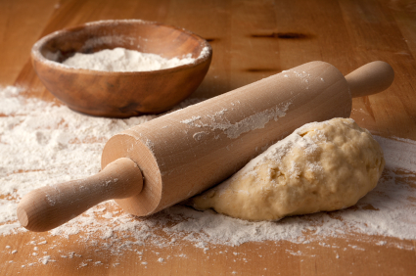
CREATE a Quick Bread
Before Starting:
Choose whole foods
Make sure to have needed equipment
Notes:
Preparation for creating a fruity dessert:
Choose mostly whole foods and reduce highly refined processed foods
-Example: discuss difference between a fruity crumble made with canned filling and a topping mix versus one made with fresh fruit and a topping made with oats and whole-wheat flour
-Show and explain equipment needed and how to use it: Sharp knife, cutting board, vegetable peeler, large mixing bowl, mixing spoons, saucepan, baking pan, casserole/oven-proof dish, etc.

Slide 6

CREATE a Quick Bread
Step 1: Add acid to milk
    Discuss options
Notes:
What are some options that you have used? Some options might be adding ¾ cup buttermilk or ¾ cups of yogurt.

Slide 7

CREATE a Quick Bread
Step 2: Egg/substitute
    Options
    Food Safety
Notes:
Have you ever used egg substitutes? What sort of food safety issues should we be worried about when storing eggs? We need to be careful not to expose eggs to any sort of cross contamination. We also must practice proper hygiene and store them in safe storage at acceptable temperatures.

Slide 8

CREATE a Quick Bread
Step 3: Flavors
    Options
    Spices/herbs
Notes:
What are some options for flavoring bread? Rosemary, thyme bread? What are some other not so common options? Make sure to choose the spices that you use only after considering the other ingredients you are using.

Slide 9
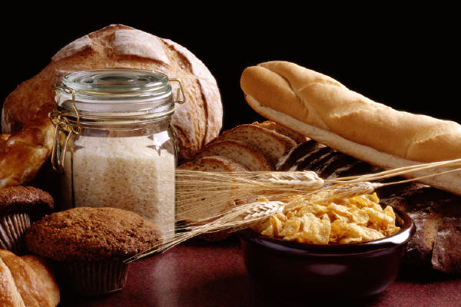
CREATE a Quick Bread
Step 4: Dry Ingredients
    Whole vs Refined grains
Notes:
Refined grains is essentially a wheat kernel that has had the outer layering removed. This removed a lot of key nutrients that our bodies need such as Vitamin B12 and iron. By choosing whole grains that have not had the outer layering removed, we can provide our bodies with these much needed nutrients. Try to make at least half of your grains in your diet whole grains.

Slide 10

CREATE a Quick Bread
Step 5: Extras
    End product
    Fruits and veggies rich in nutrients
    Hidden fats
Notes:
Consider the end product and how you want it to taste and what it will be served with. Discuss how fruits and veggies are naturally rich in vitamins, minerals, antioxidants, and phytochemicals. Watch out for hidden fats. Consider making a cranberry bread, or zucchini bread to add in these extras.

Slide 11

Practice
Bring pantry items from home
Possible quick bread options from pantry ingredients
Notes:
Bring pantry items from home and have class members come up with as many ideas for quick breads as possible from those foods. Have class members think about their own pantry and create as many quick bread options as possible from what they already have.

Slide 12

Incorporating MyPlate
What components of MyPlate does quick bread have?
What can be added?
Notes:
What components of MyPlate does quick bread already have? What can we add to our plate to round out the meal?

Slide 13


Don’t Forget to Move
Weekly exercise plan
Notes:
Being active is another important part of being healthy. What are some ways you will move around and be active this week?

Slide 14
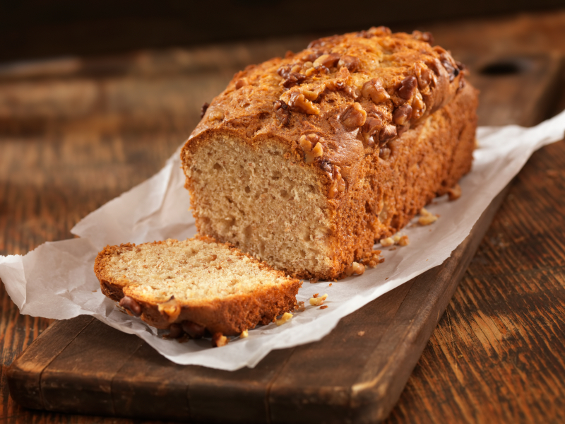
Conclusion
Just need - basic equipment and food in the pantry to create quick bread
Notes:
You don’t need a start of the art kitchen, a degree from culinary school, or tons of time. You just need some basic equipment and food in the pantry to create delicious quick breads that your family will want to come home to!
-Questions??
-Remind of next class!

