Slide 1
Create a pizza
Food $ense
Notes:
This lesson teaches how quick and easy it is to put together a delicious homemade pizza from ingredients you already have.

Slide 2
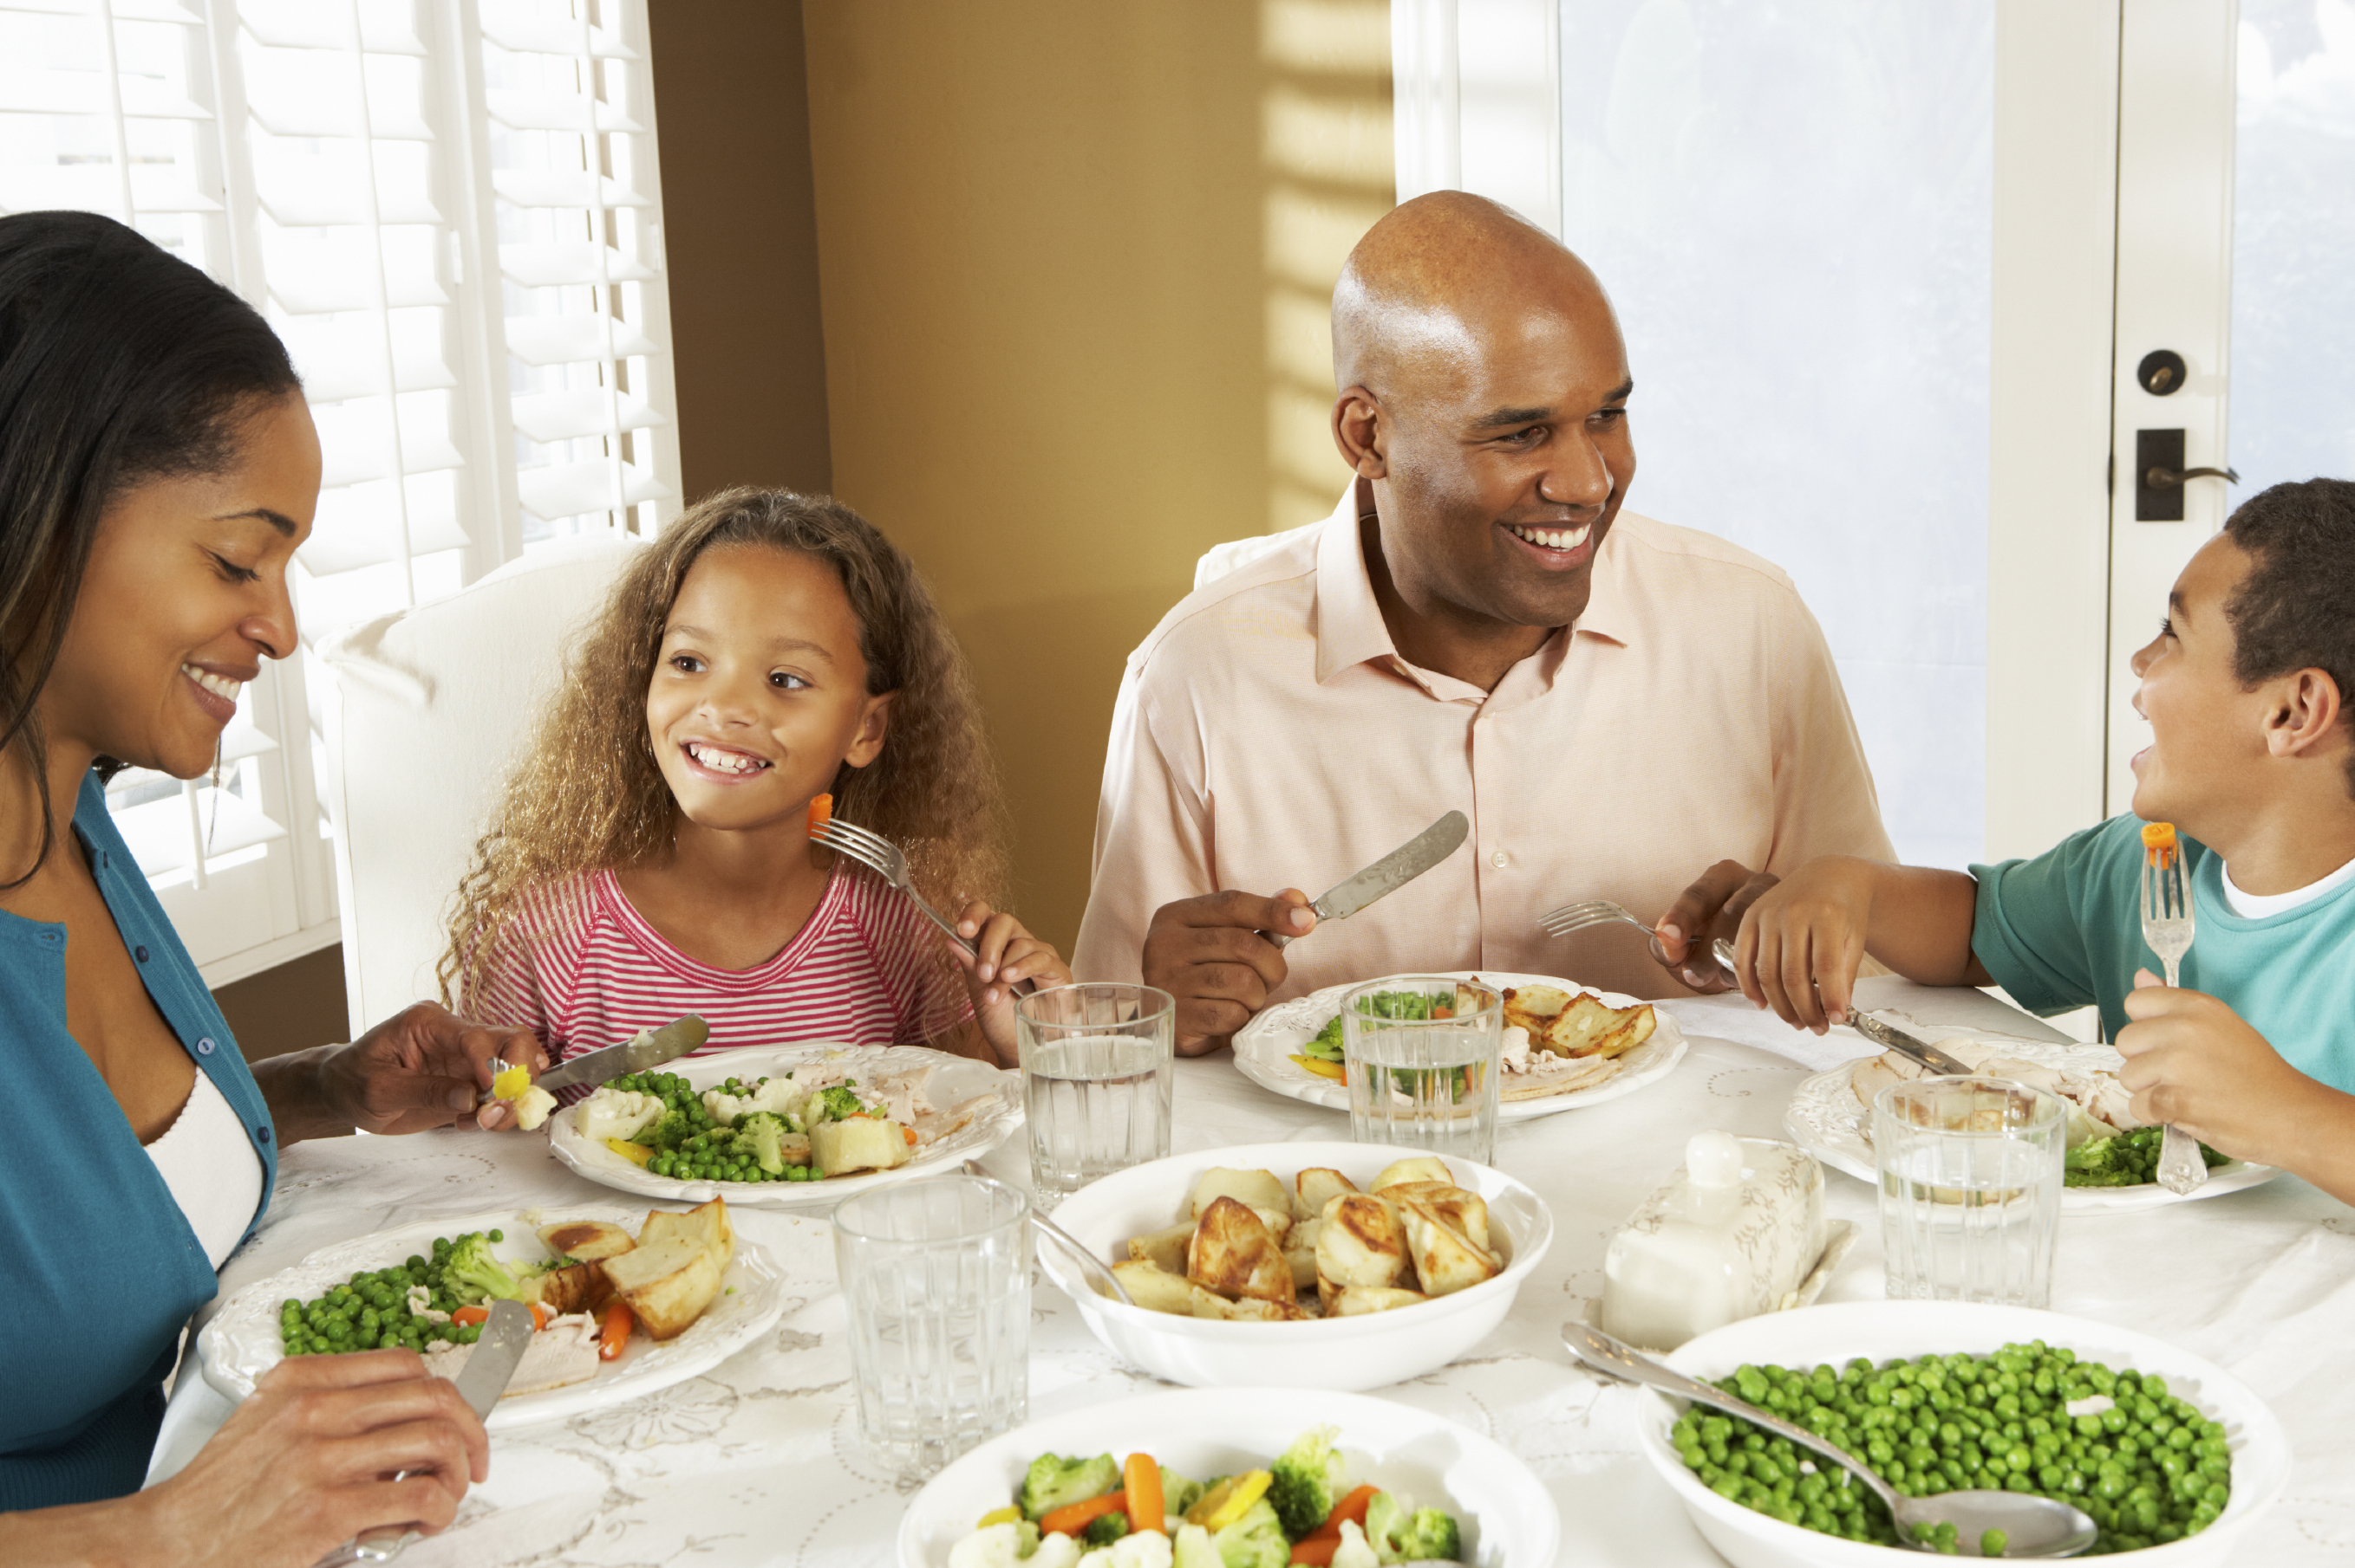
Introduction
Family Mealtime is important
Notes:
Family mealtime is important because it promotes family bonding. Families that eat together also generally have better nutrition and thus have less of a chance of developing eating disorders. And lastly, studies have shown that when a family eats together, it can increase grades and behavior in children while diminishing the chances of becoming involved in drugs, alcohol and sexual activity.

Slide 3

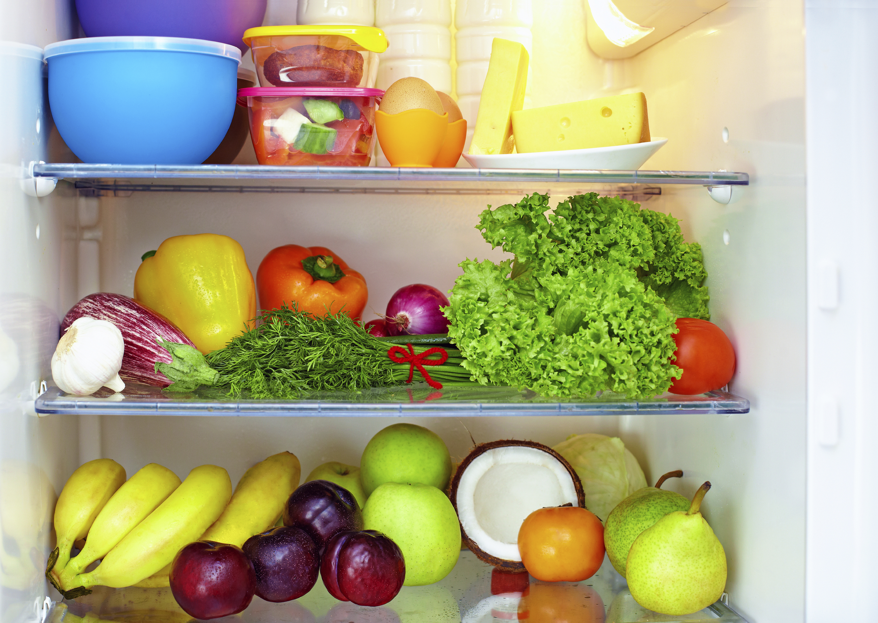
Introduction
Questions:
What is a whole food
diet?
Why is a well-stocked
pantry important?
Notes:
So what is whole food? A whole food is as close to the original source as possible meaning minimal processing and refining of foods. An example might be a potato vs. a potato chip. Remember that ¾ of MyPlate is plant based and that a diet rich in whole plant foods is related to less chronic disease and obesity. On the other hand, a diet high in refined foods with added fats, sugar and salt is related to increased chronic disease and obesity. Because Whole foods are generally full of fiber and water, it leaves you feeling satisfied and full on less calories.
A well stocked pantry reduces the temptation to eat out or make unhealthy choices because you already have food available. You don’t even need a recipe or a plan so long as your pantry has good food in it and you understand the techniques of how to put food together. Focus on buying whole foods that are minimally processed. Shop for ads, sales or with coupons and make sure to shop the entire perimeter of the store.

Slide 4
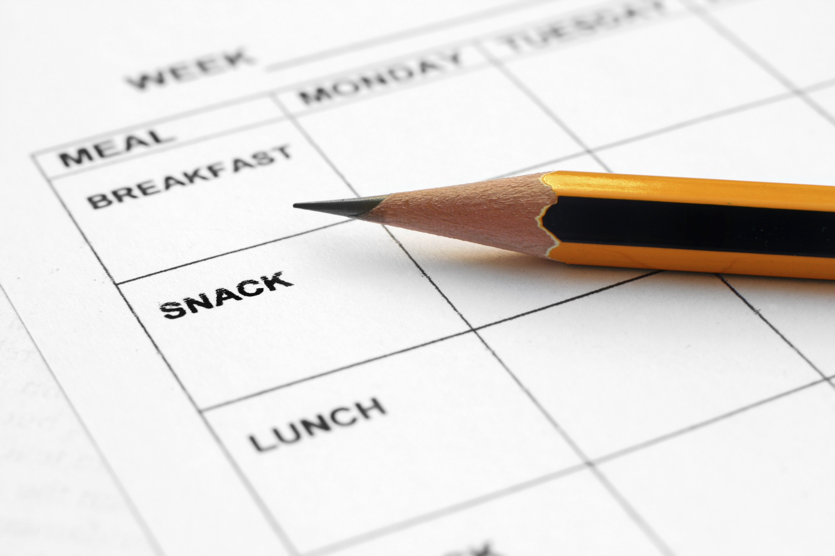
Introduction
Meal Planning
  Save time and
  money
  Steps/tips
Notes:
When it comes to meal planning, this might intimidate some people, but if you practice enough, you will find it just becomes second nature. Consider making meals you will look forward to such as a themed night. You could have Taco Tuesdays, or Italian food on Wednesdays.

Slide 5
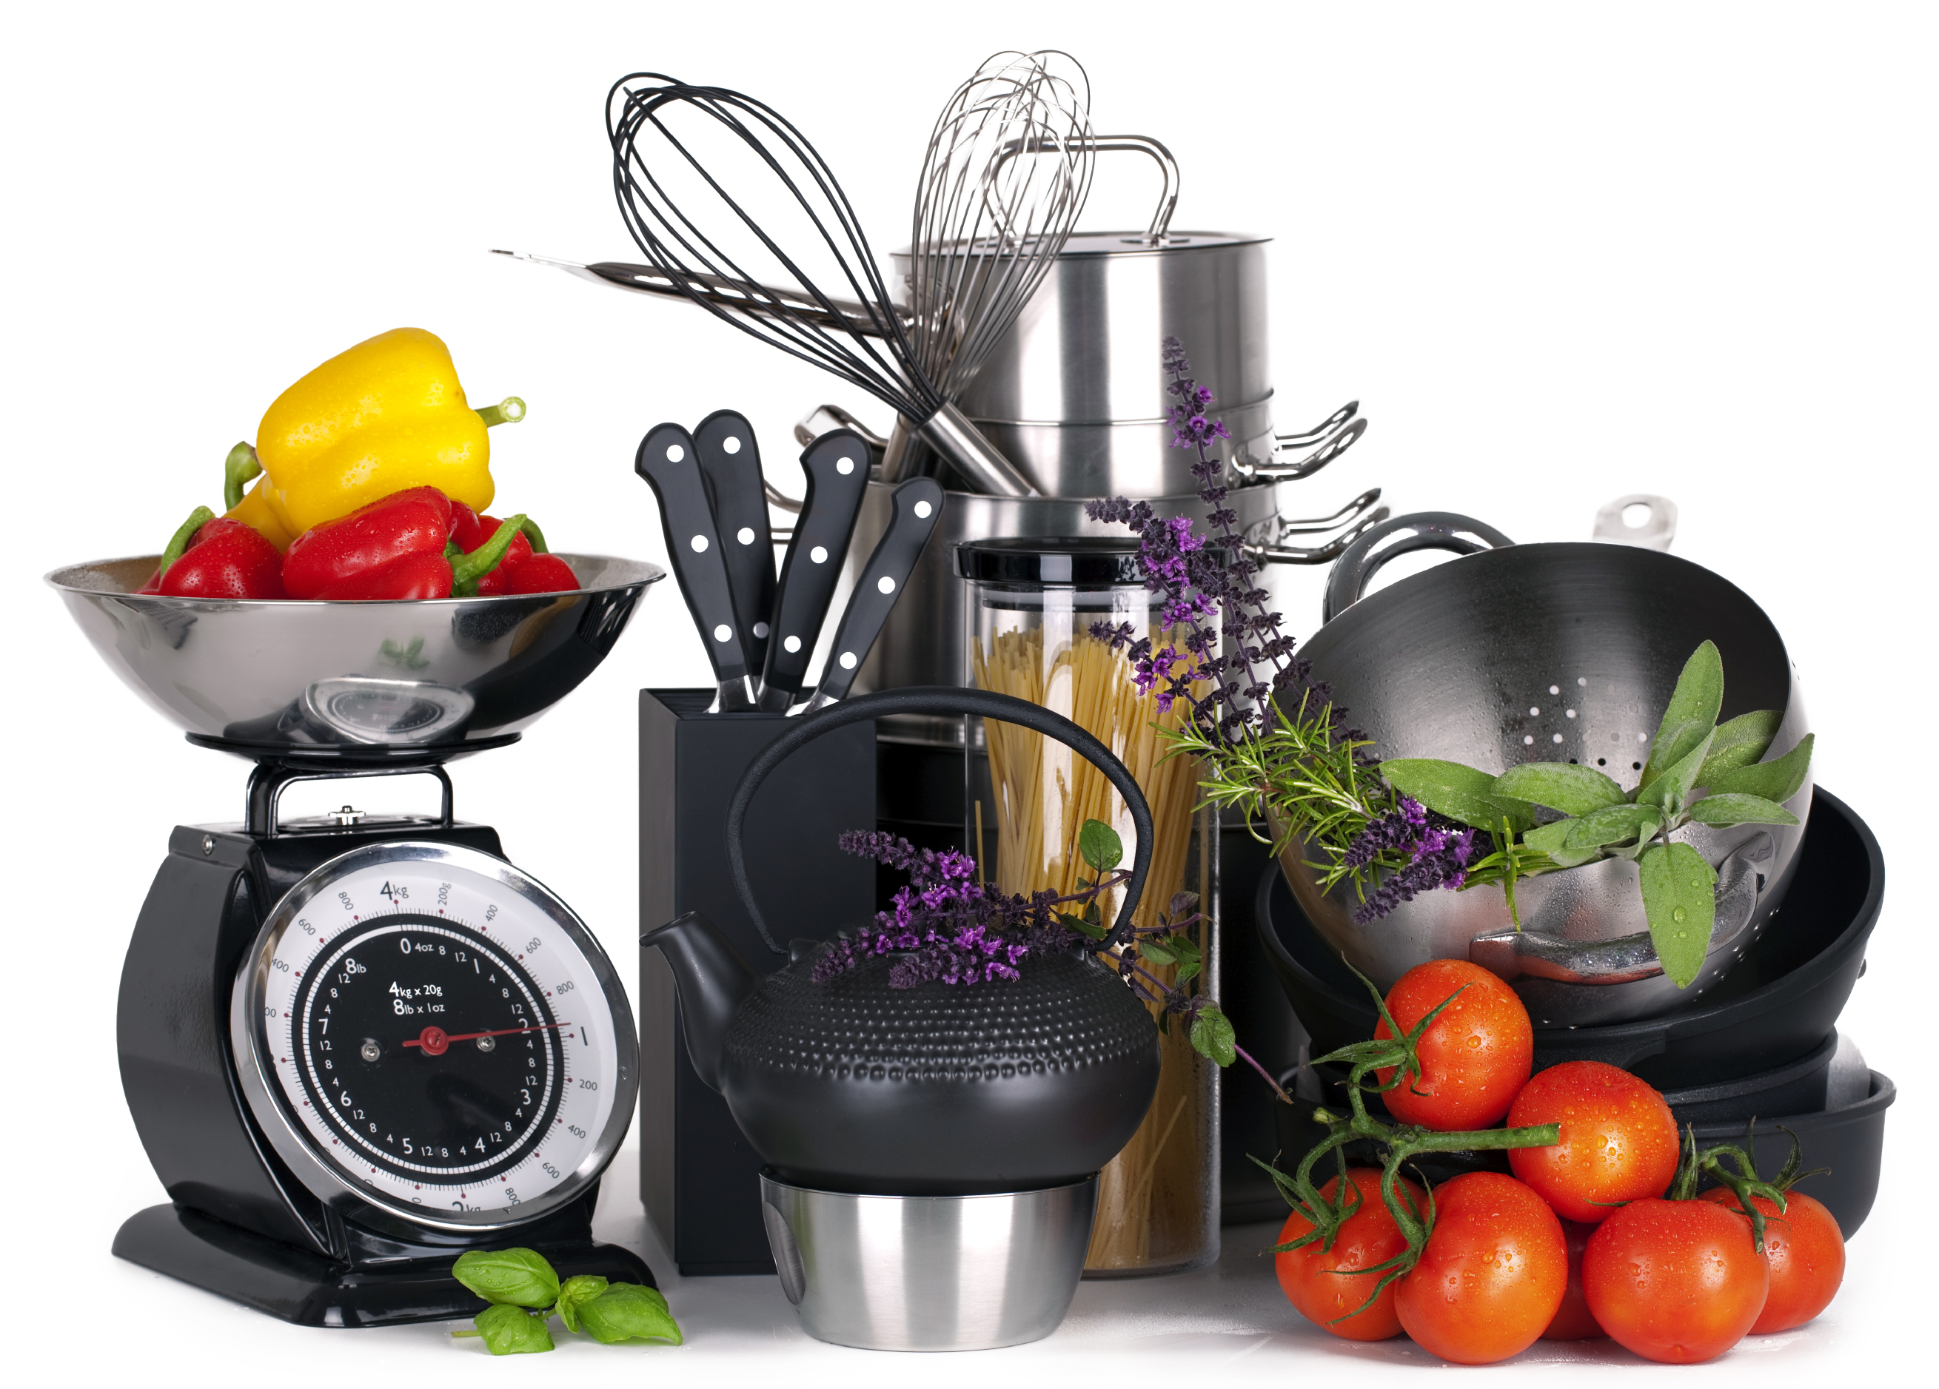
CREATE a Pizza
Before Starting:
Choose whole foods
Make sure to have
needed equipment
Notes:
What are the benefits of choosing certain ingredients on your pizza such as fresh herbs, and vegetables as opposed to processed meats and a ton of cheese?
For pizza your equipment could include any of the following depending on your pizza: rolling pin, cutting board, sharp knife, vegetable peeler, large mixing bowl mixing spoon, and pizza pan/baking sheet.

Slide 6
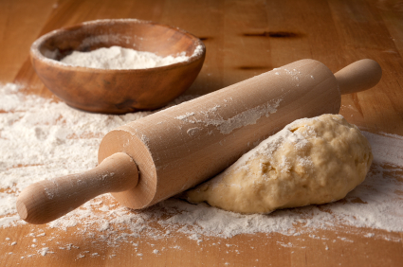
CREATE a Pizza
Step 1: Prepare Crust
Options?
Whole vs. refined grains
Homemade, whole grain
Notes:
What do each of you use for your crusts?
What other choices could we make?
Lets talk about the difference between whole and refined grains. Whole grains means it contain the entire grain, the bran, germ and endosperm. A refined grain has been processed to remove the bran and germ, this is done for finer texture and improves the shelf life, but it removes dietary fiber, iron and lots of B vitamins which are very beneficial to our health.

Slide 7
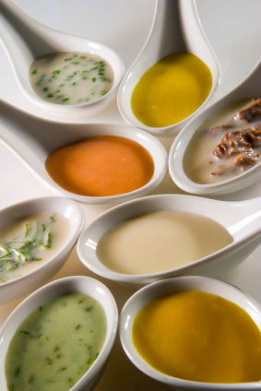
CREATE a Pizza
Step 2: Prepare Sauce
Options?
Spices according to flavors
Try limiting cheese
Notes:
What are some different flavors of sauces that you could use on your pizza?
Some spices that you could use for certain pizzas are: Mexican spices if your pizza has black beans onion, garlic, tomatoes and corn, or you could use Italian spices if your pizza has tomatoes olives, zucchini ect. Here are just a few of the spices included in each type of food.
Mexican: cumin, oregano, chili powder, cilantro, and garlic
Italian: basil, oregano, parsley, and garlic
Asian: soy sauce, ginger, garlic, chilies, and turmeric
Savory/Thanksgiving: rosemary, sage, thyme, and parsley
Try limiting cheese as much as possible while still allowing your pizza to taste good, think of it as a condiment rather than the main topping to control excess fat and calories.

Slide 8
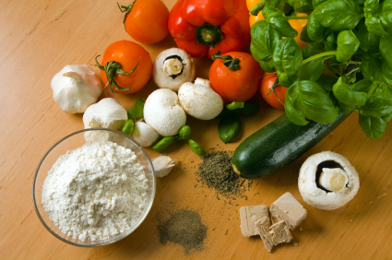
CREATE a Pizza
Step 3: Prepare toppings
Common vs. not options
Try veggies
(vitamins/minerals)
Knife skills w/veggies
Less of higher fat options
Food Safety
Notes:
What are some maybe not so common toppings that you guys like to use on your pizzas? Vegetables on your pizza are a great way to provide your family with vitamins, minerals, antioxidants and phytochemicals while adding lots of volume to your pizza without all the calories. Use foods with higher fat content to add flavor, not as the main topping. Practice safe chopping skills when chopping up veggies. Also, make sure to watch that no raw food that could contaminate other foods (raw chicken, other meats) don’t come into contact with any ready to eat foods. Also make sure that all of your refrigerated food was at the proper temperature before using and be sure to use proper hygiene.

Slide 9
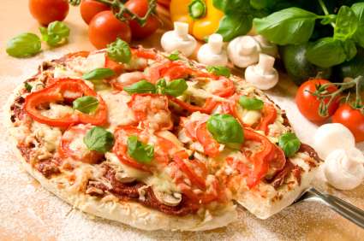
CREATE a Pizza
Step 4: Prepare pizza
Place crust on pie plate
Cover with sauce
Cover with toppings
Bake
Notes:
Here are the main steps put together.

Slide 10
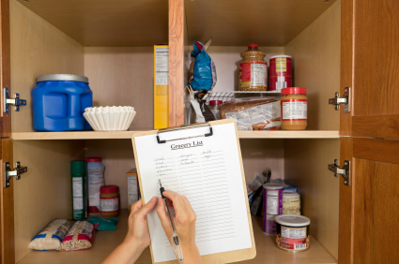
Practice
Pantry items from home
Possible pizza options from pantry ingredients
Notes:
Here are some pantry items from my own pantry. What could we make from what we see here?
Now lets make a list of what items you have in your pantry right now. How many different ideas for pizzas we can come up with based off of this list of foods?

Slide 11
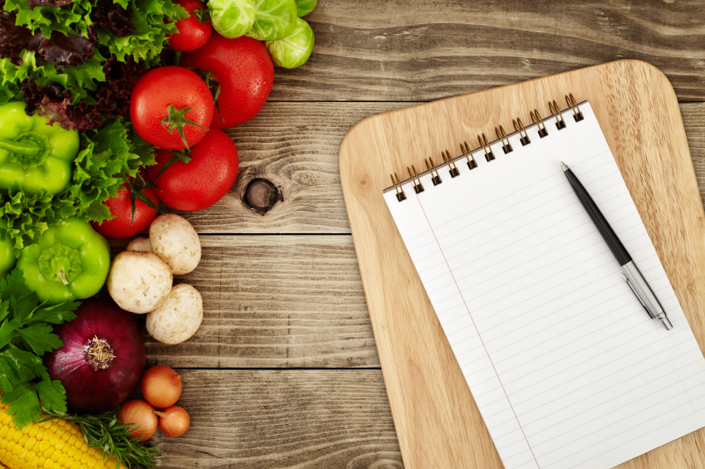
Incorporating MyPlate
What components does pizza have?
What can be added?
Notes:
What components of MyPlate does pizza already have?
What can we add to our plate to round out the meal?

Slide 12


Don’t Forget To Move
Weekly exercise plan
Notes:
Don’t forget to move! What can/ will you do this week to move your body?

Slide 13
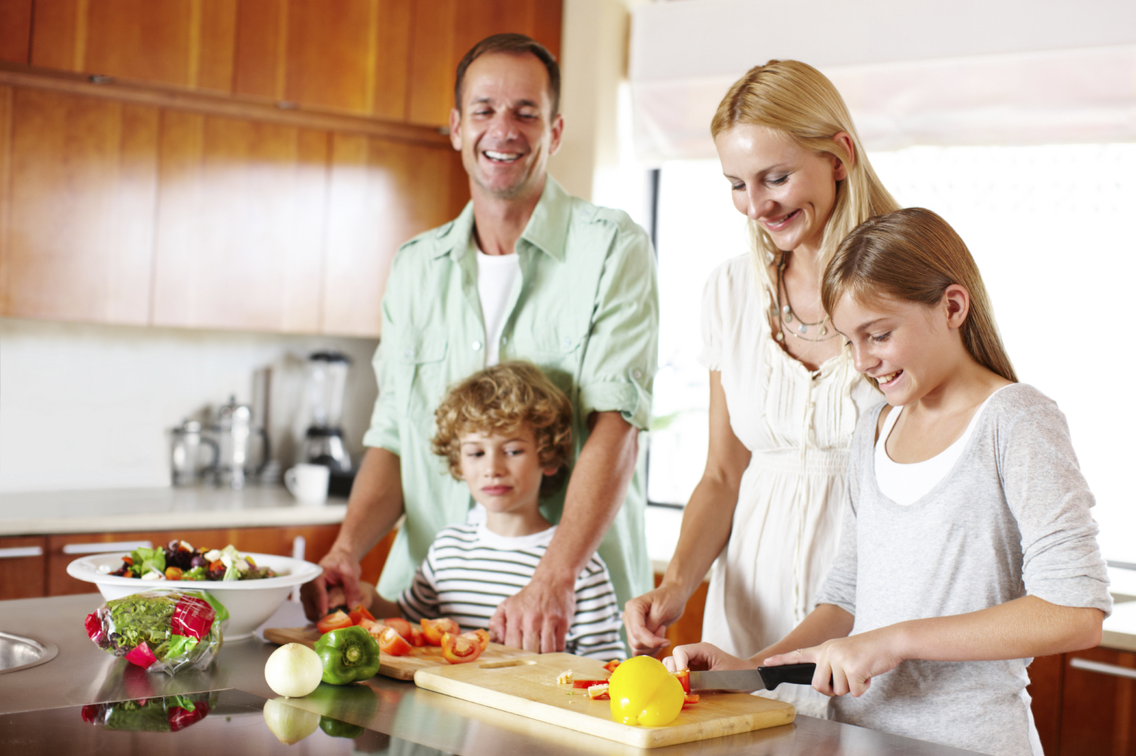
Conclusion
All you need – basic equipment and food from pantry
Notes:
You don’t need a state of the art kitchen, a degree from culinary school, or tons of time. You just need some basic equipment and food in the pantry to create a delicious pizza that your family will want to come home to!

