Slide 1
CreatE a casserole
Food $ense

Slide 2
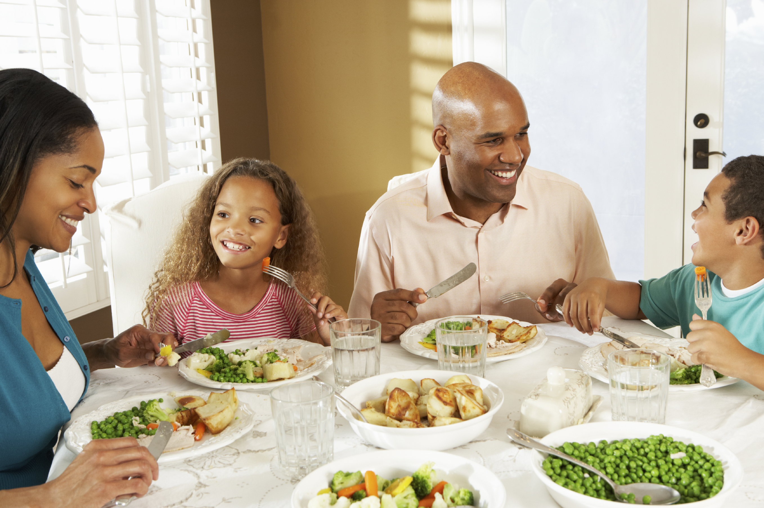
Introduction
Family Mealtime is important
Notes:
Family mealtime is important because it promotes family bonding. Families that eat together also generally have better nutrition and thus have less of a chance of developing eating disorders. And lastly, studies have shown that when a family eats together, it can increase grades and behavior in children while diminishing the chances of becoming involved in drugs, alcohol and sexual activity.

Slide 3

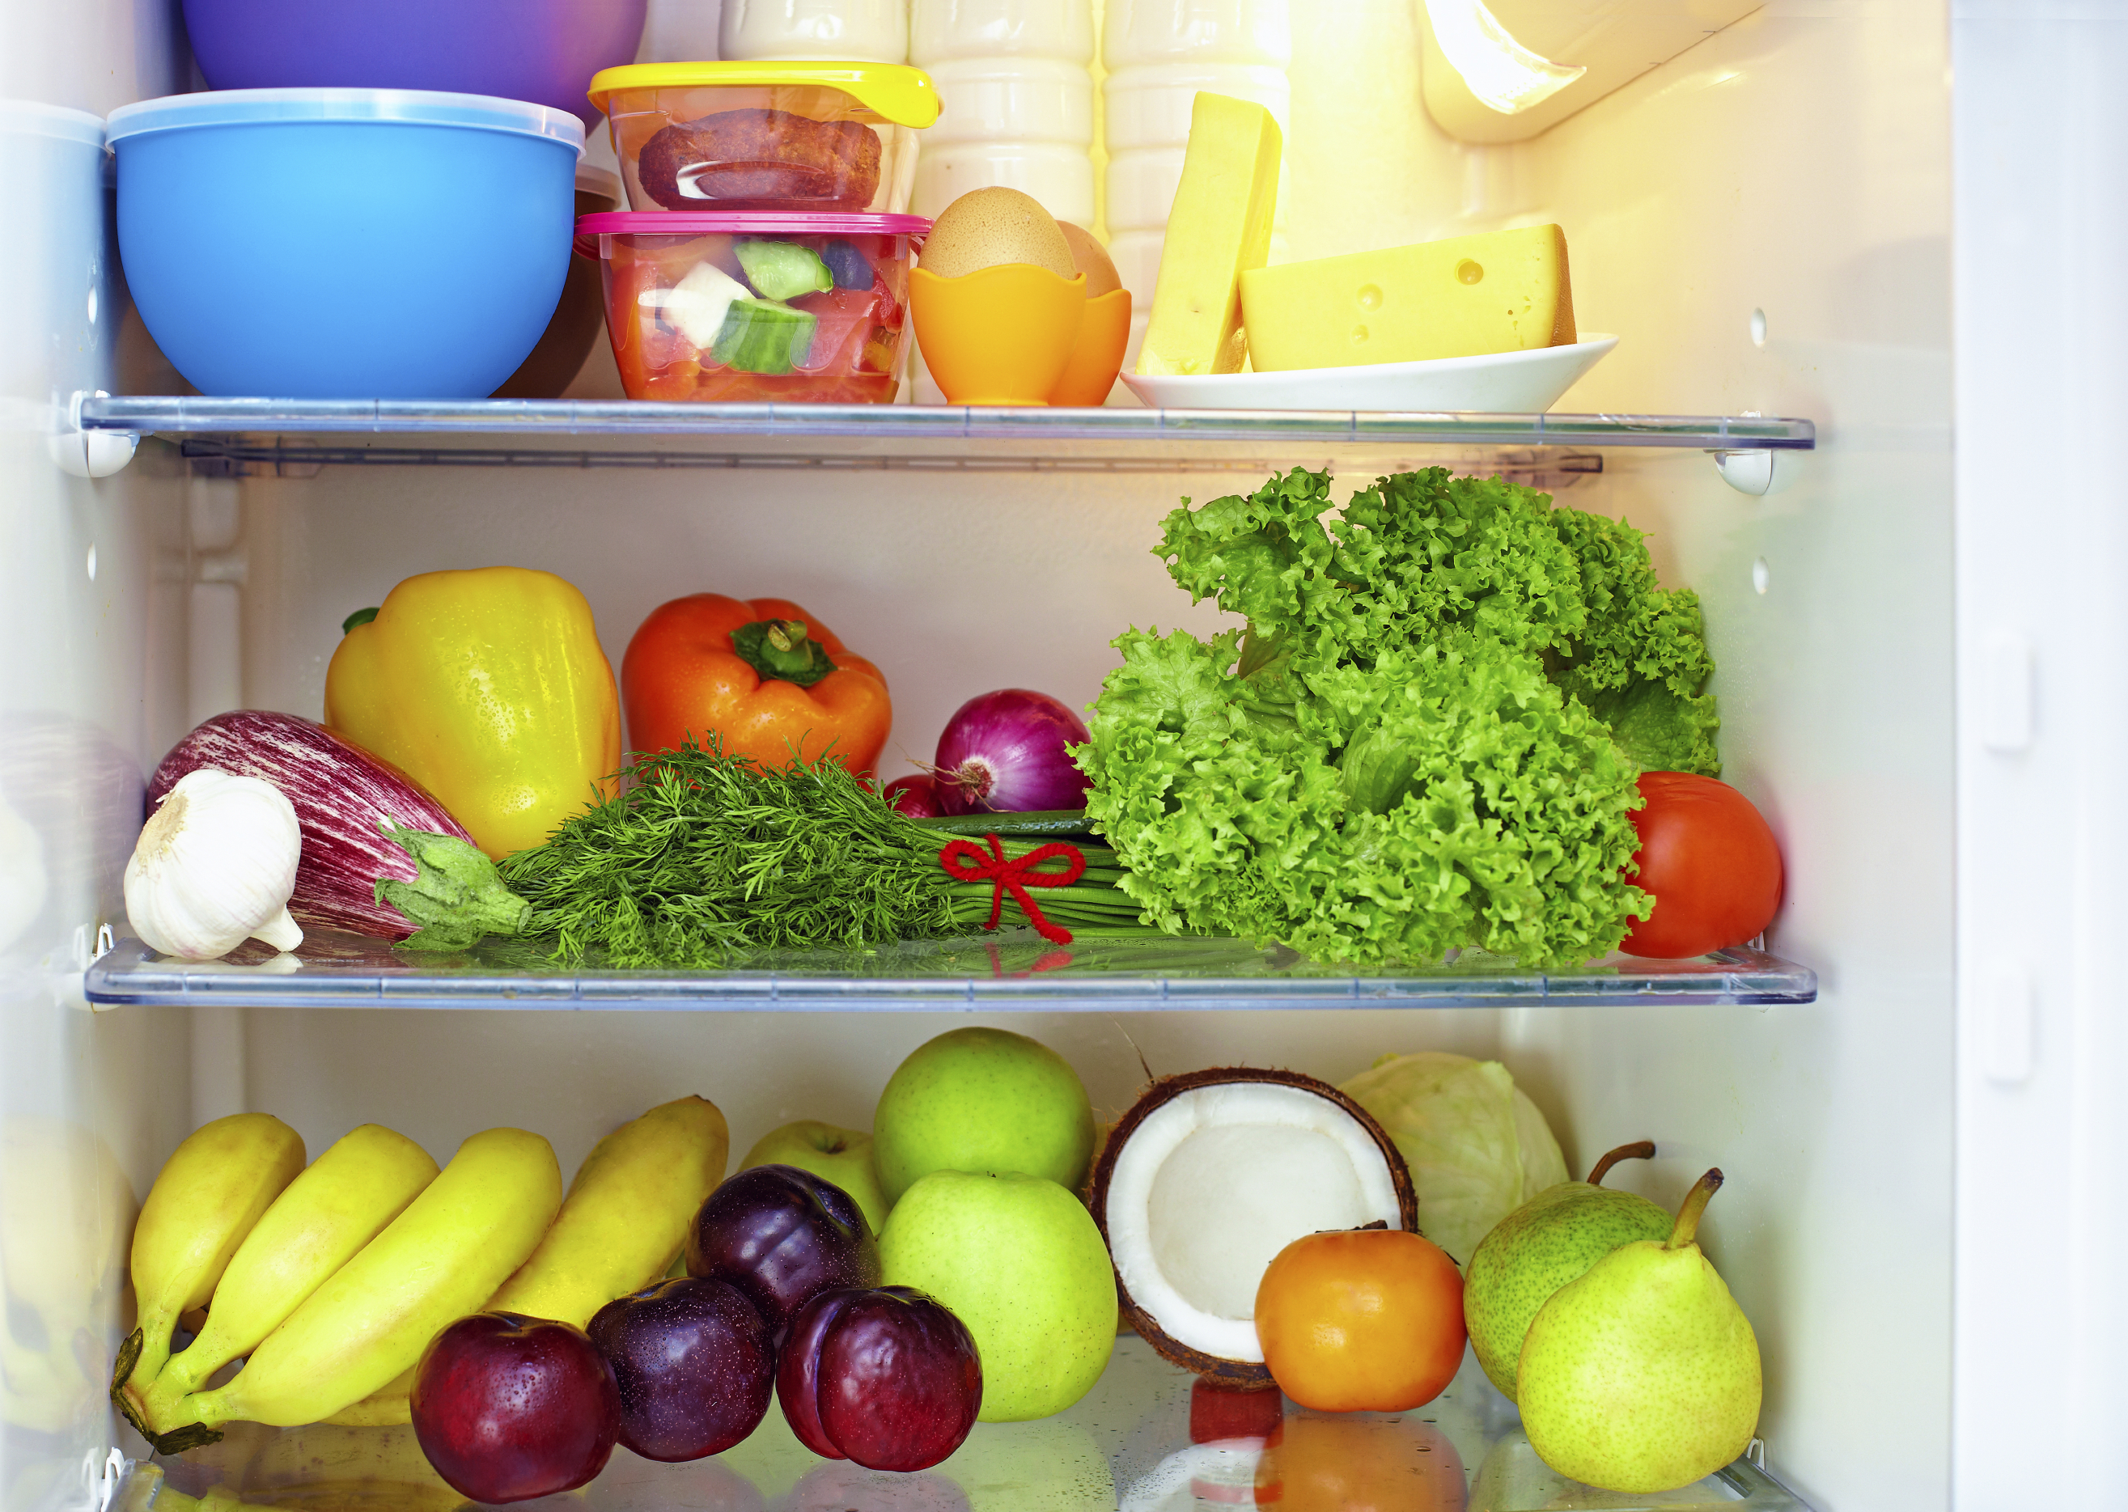
Introduction
Questions:
What is a whole food diet?
Why is a well-stocked pantry important?
Notes:
So what is whole food? A whole food is as close to the original source as possible meaning minimal processing and refining of foods. An example might be a potato vs. a potato chip. Remember that ¾ of MyPlate is plant based and that a diet rich in whole plant foods is related to less chronic disease and obesity. On the other hand, a diet high in refined foods with added fats, sugar and salt is related to increased chronic disease and obesity. Because Whole foods are generally full of fiber and water, it leaves you feeling satisfied and full on less calories.
A well stocked pantry reduces the temptation to eat out or make unhealthy choices because you already have food available. You don’t even need a recipe or a plan so long as your pantry has good food in it and you understand the techniques of how to put food together. Focus on buying whole foods that are minimally processed. Shop for ads, sales or with coupons and make sure to shop the entire perimeter of the store.

Slide 4
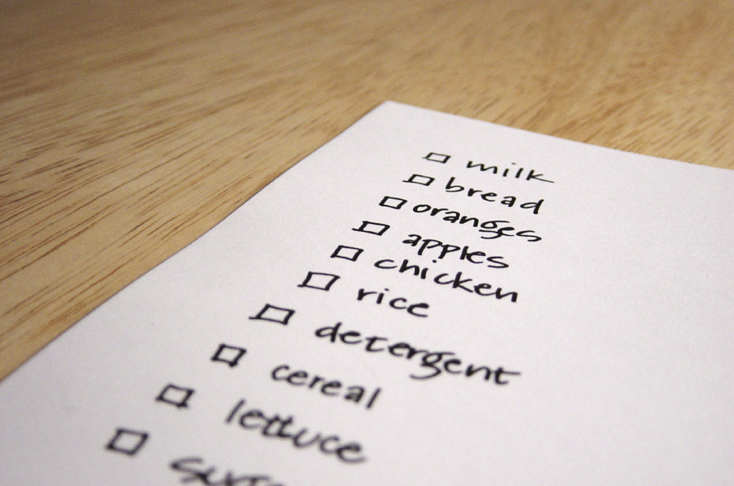
Meal Planning
Steps to creating a meal
Theme nights
Notes:
When it comes to meal planning, this might intimidate some people, but if you practice enough, you will find it becomes second nature. Consider making meals you will look forward to such as a themed night. You could have Taco Tuesdays, or Italian food on Wednesdays.

Slide 5
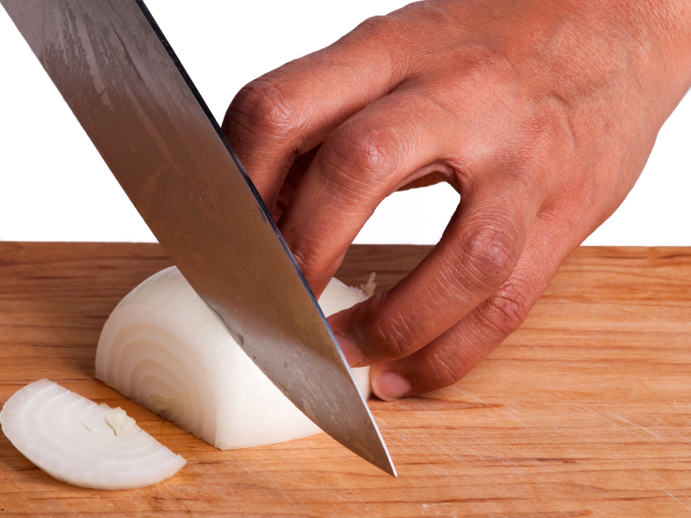
CREATE a Casserole
Before starting:
Choose whole foods
Make sure to have
needed equipment
Notes:
Before you start, it’s important to choose whole foods whenever possible. Lets talk about the differences between a casserole made with tater tots, cream of whatever soup and French fried onions as opposed to one with boiled potatoes, a homemade sauce and breadcrumbs. Can anyone explain why one is better than the other? Next we need to make sure we have the appropriate equipment to prepare the casserole. What items might you need? Several are a sharp knife, cutting board, vegetable peeler, vegetable grater, large mixing bowl, mixing spoons, saucepan and a casserole/oven proof dish.

Slide 6
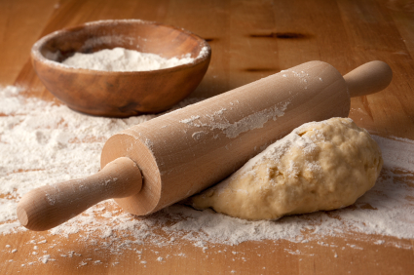
CREATE a Casserole
Step 1: choose a Starch
Options?
Whole vs. refined grains
Homemade, whole grain
Notes:
What are some different types of starch that you use? What are some alternative starch options that might be a bit more healthy? There is a large difference between whole and refined grains. Refined grains have a lot of nutrients such as Iron and B12 removed from them while whole grain still have these nutrients. Because of this, it is vital that we try to consume most of our grains in the form of whole grains. (discuss and demonstrate how to cook grains, rice and pasta)

Slide 7
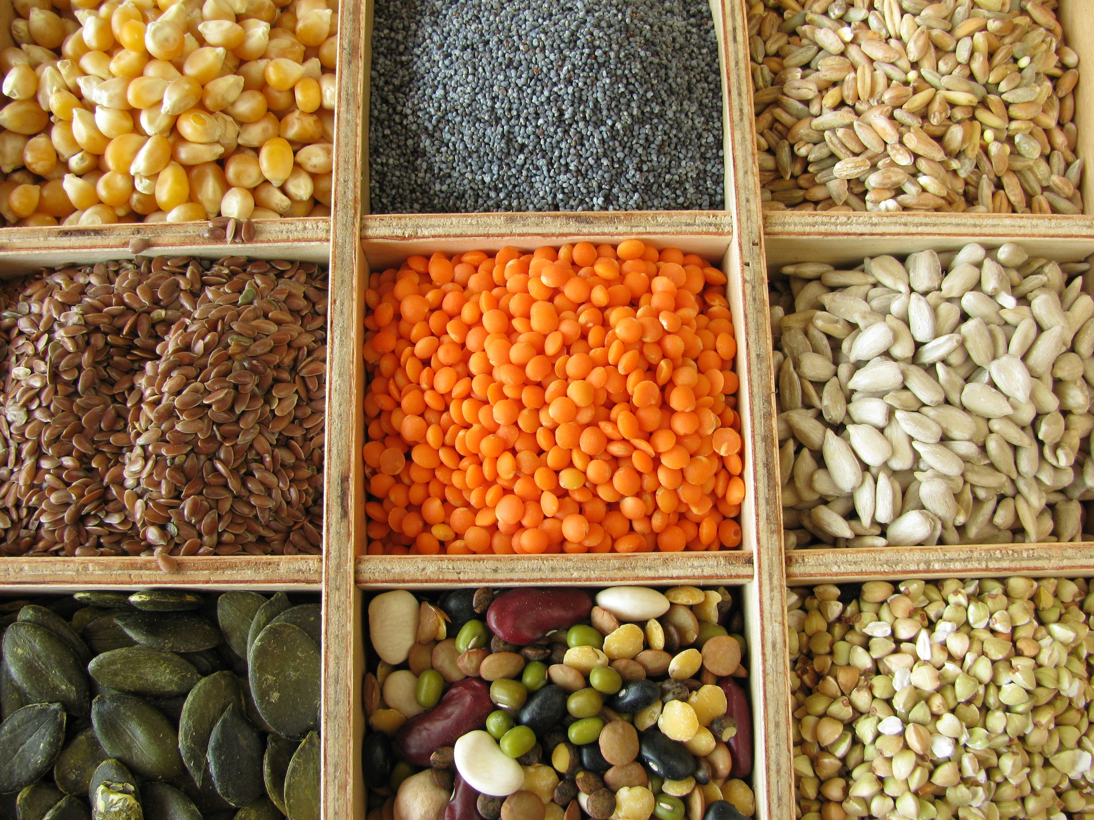
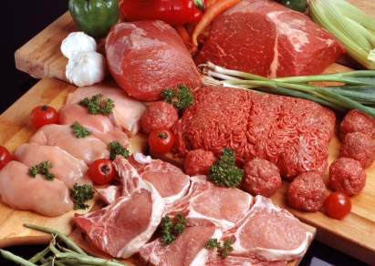
CREATE a Casserole
Step 2: Choose a protein
Either meat or plant based
Discuss food safety
Notes:
What are some options for both meat and plant based proteins? There is a lot of food safety issues that can come with meat so it is vital that when we are preparing meat we take into consideration cross contamination, proper hygiene, acceptable temperatures, and safe storage.

Slide 8
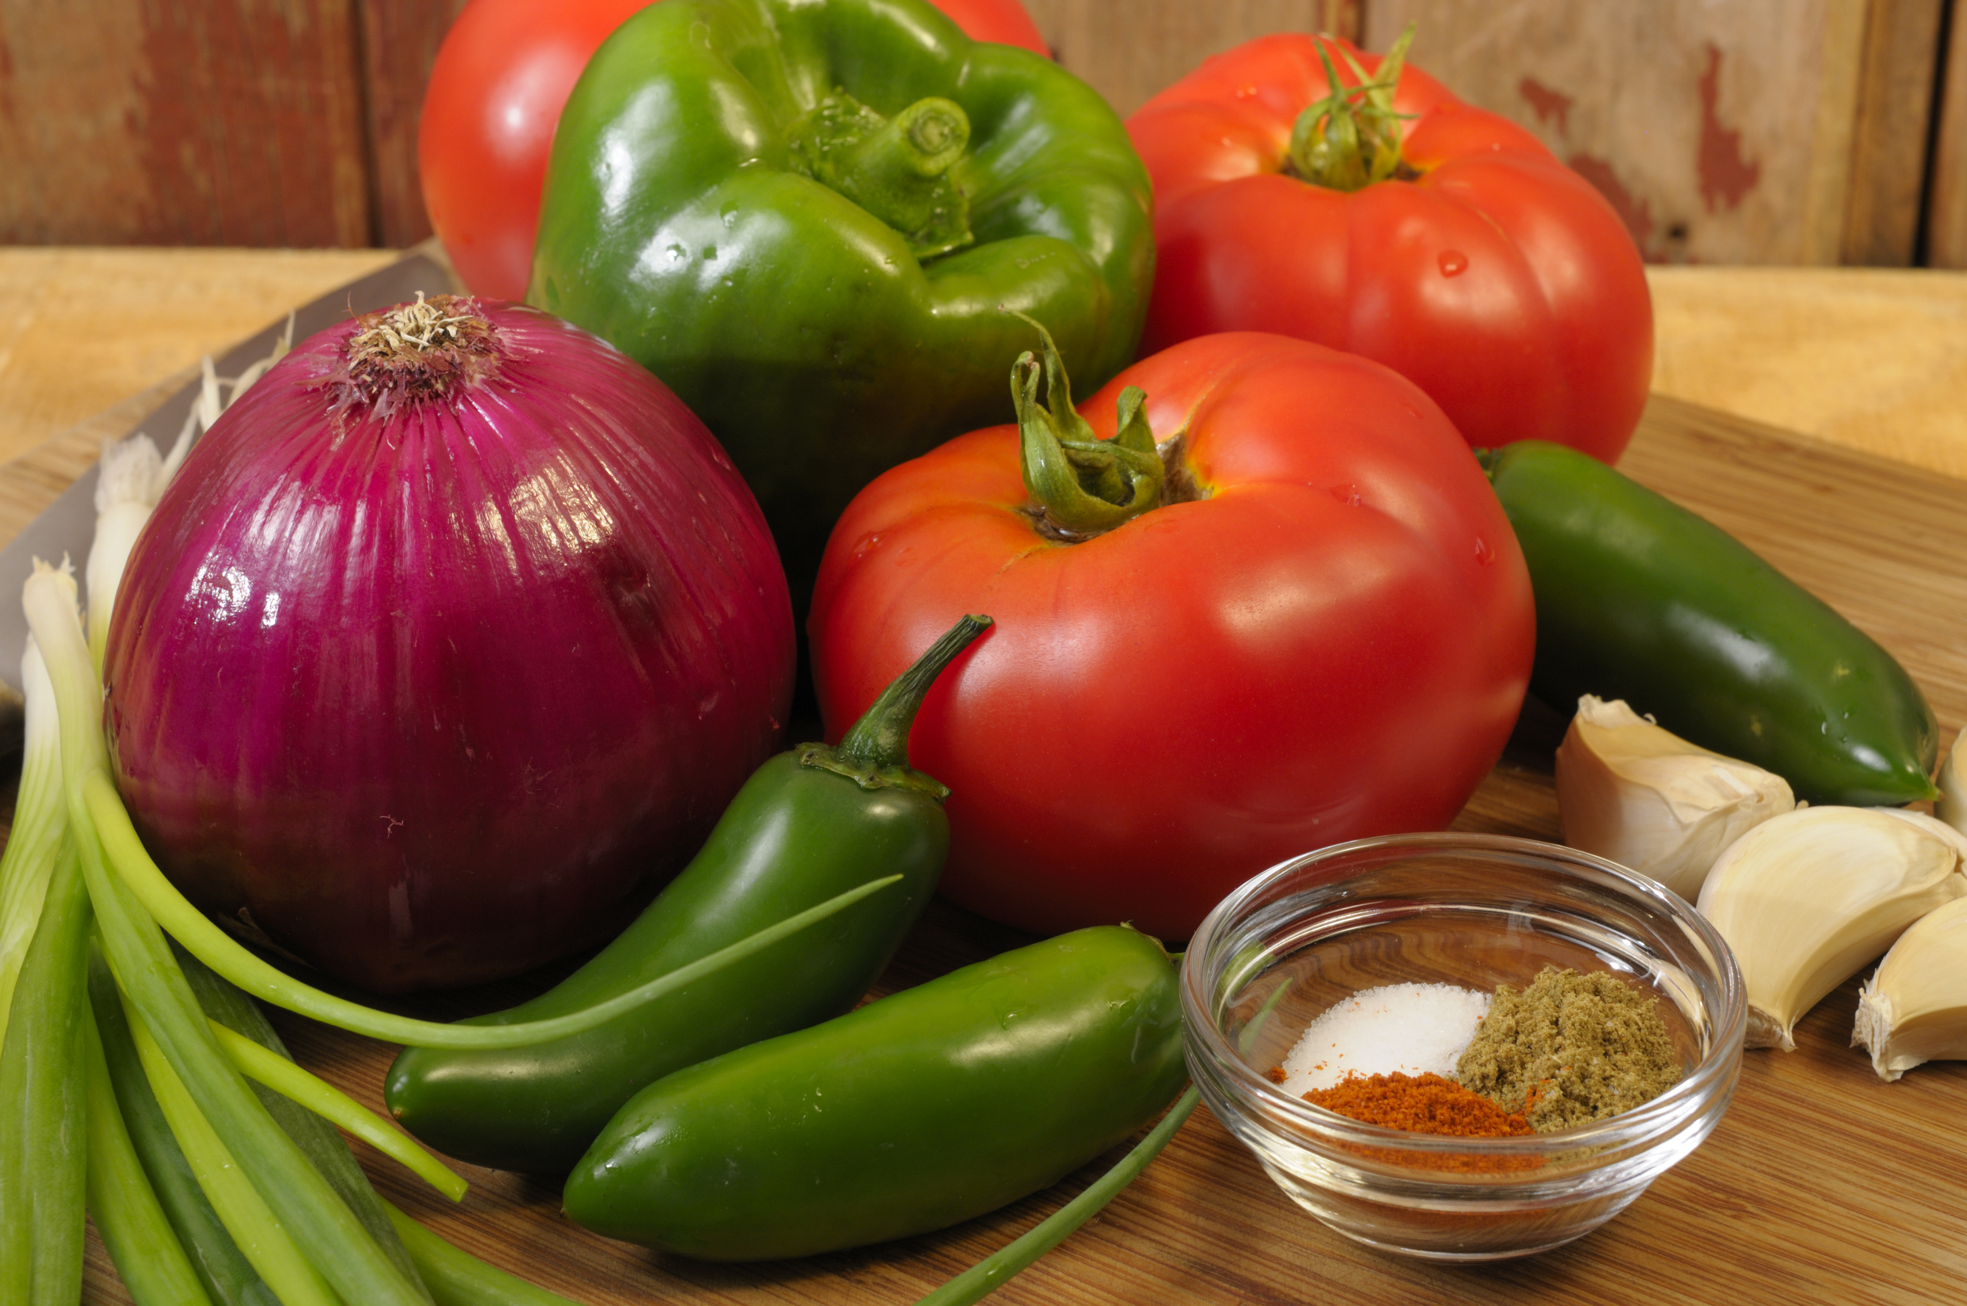
CREATE a Casserole
Step 3: Pick A Vegetable
Common vegetable options
Vitamins, minerals, antioxidants
Volume vs. calories
Proper knife skills
Notes:
What are some common vegetables that you choose and some other options that might be new to consider? Vegetables are naturally rich in vitamins, minerals, antioxidants and phytochemicals. Vegetables are beneficial to add because they can add more volume without adding a ton of calories. It is important to use proper knife skills when cutting vegetables (demonstrate how to cut vegetables properly)

Slide 9
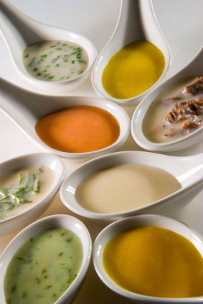
CREATE a Casserole
Step 4: pick a sauce
Make your own (roux, slurry)
Spices according to flavors
Notes:
It is much healthier to make your own sauce that doesn’t come from a can. Some benefits would be less fat, sodium, preservatives and a redued cost. You can make a white sauce from a roux and/or slurry. A roux uses a fat and flour with water added. A slurry adds flour to water, with no fat or additional calories needed. (SOS – define it and explain; demo if there is time and circumstances permit)

Slide 10
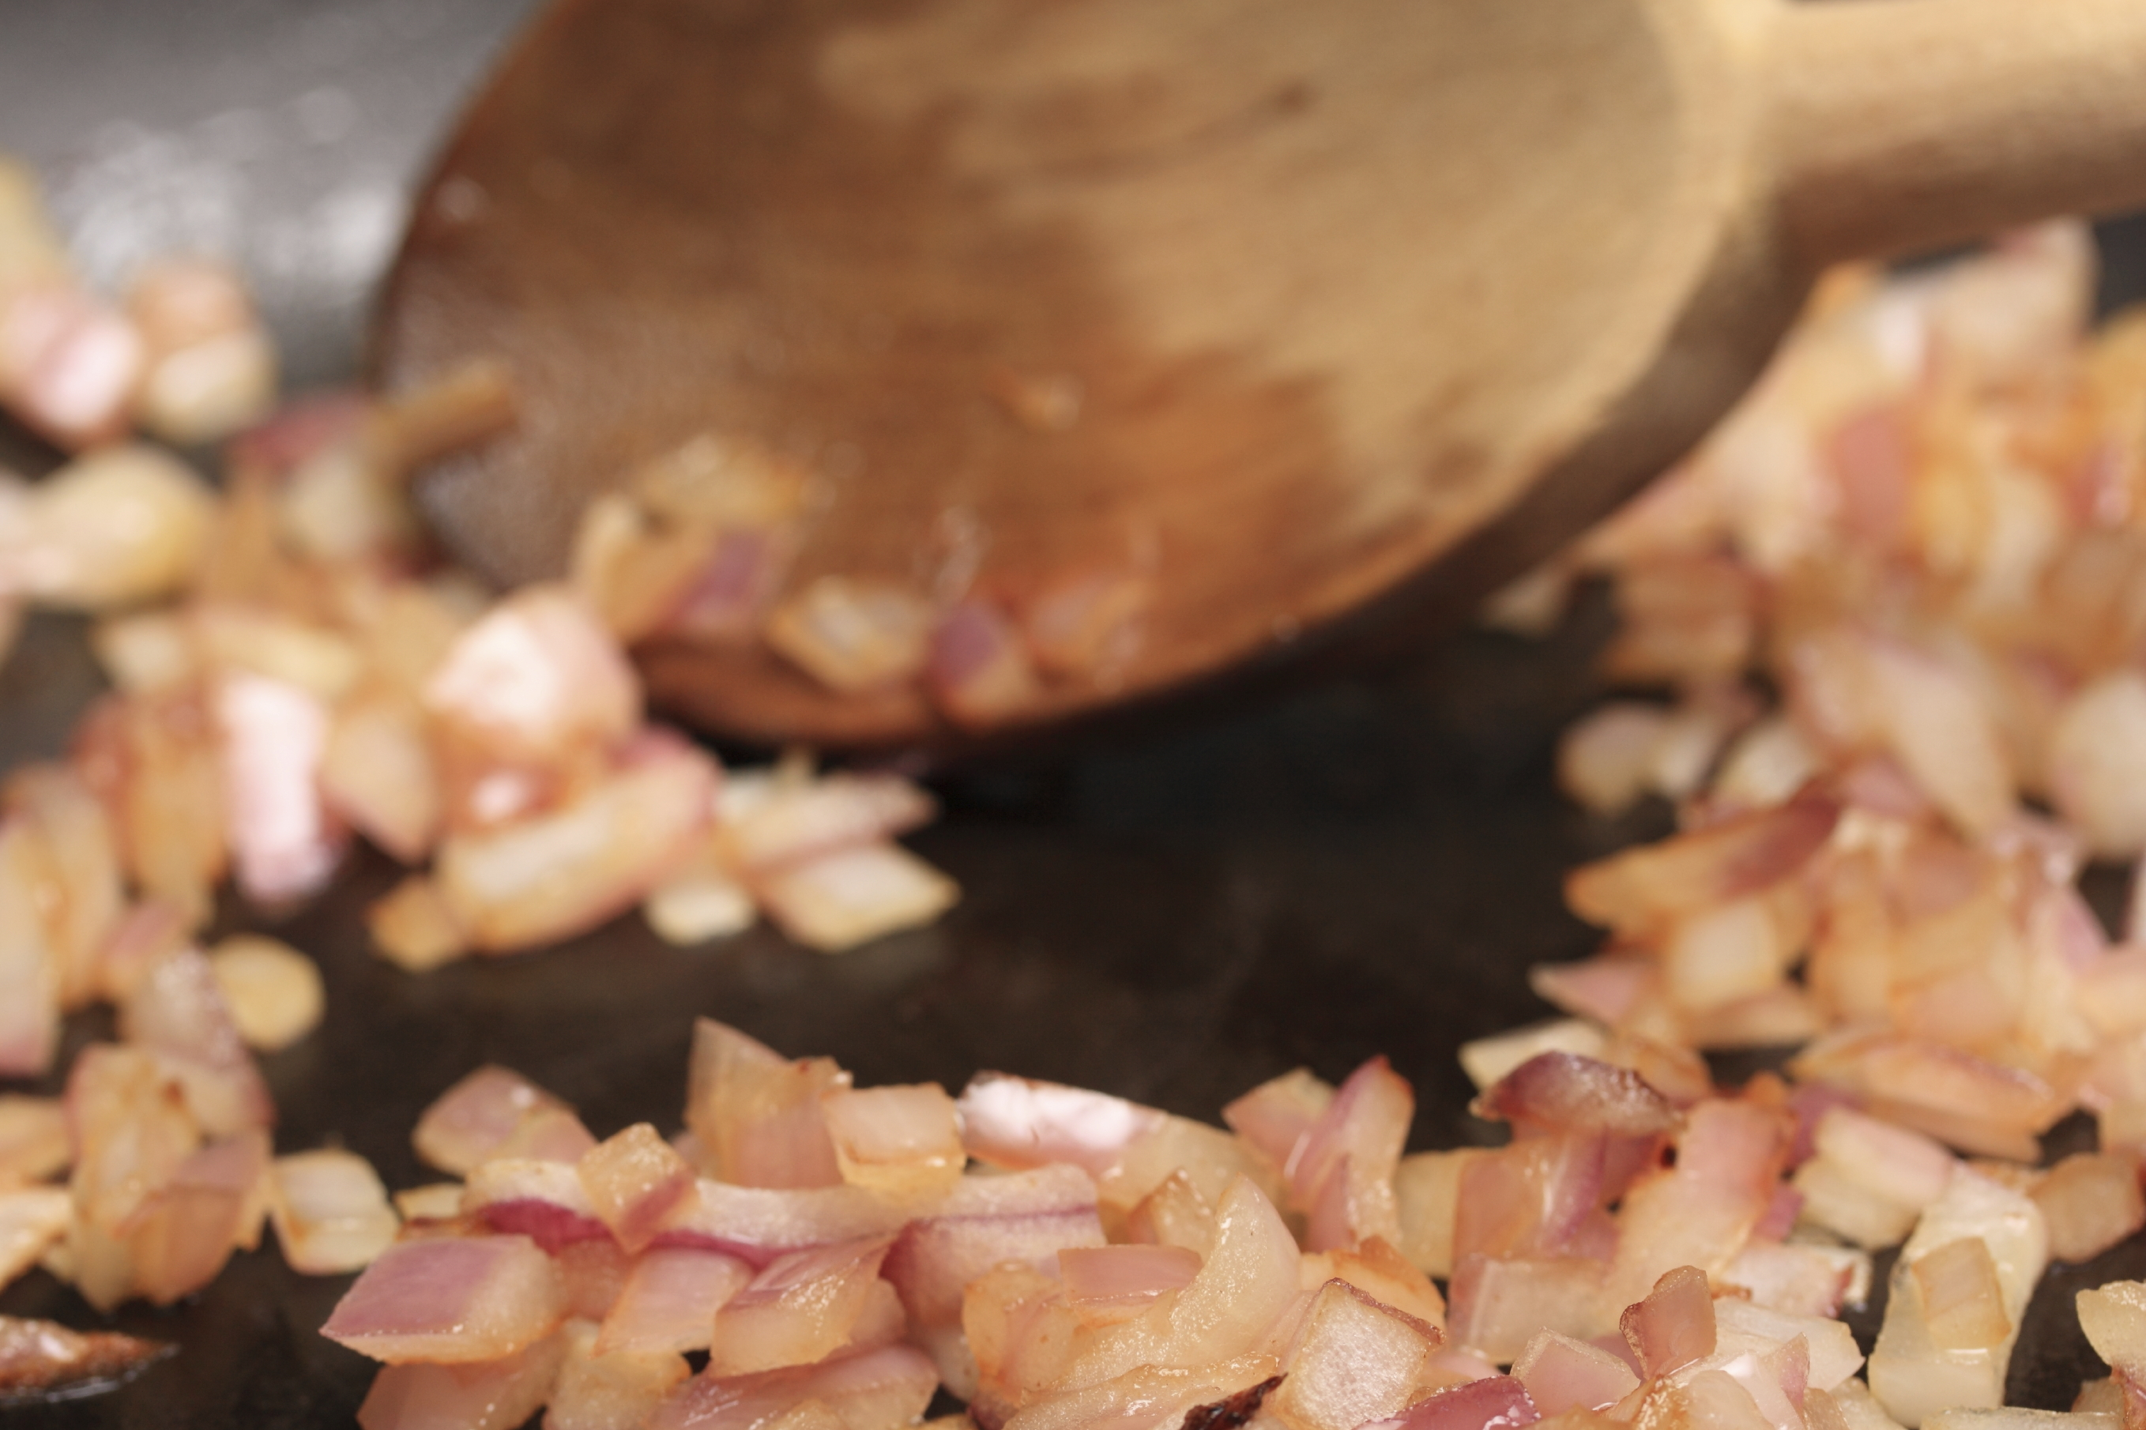
CREATE a Casserole
Step 5: Add Flavor
Onion/garlic sautéed
Choose spices
Notes:
Onions and garlic can be used for flavor. Sautéing onion and garlic sautéed in very small amounts of oil or water/broth can greatly increase the flavor of your casserole dish. Choose spices and herbs according to the other ingredients you have used. Here are some examples of what to use: for a Mexican dish, use cumin, oregano, chili powder, cilantro and garlic. For a Italian dish, basil, oregano, chili powder, cilantro, and garlic would be beneficial. An Asian dish would benefit from soy sauce, ginger, garlic, chilies and turmeric.

Slide 11
CREATE a Casserole
Step 6: Toppings
Discuss healthier options
Watch out for hidden fats
Notes:
What are some options for a topping you would put on your casserole? It is important to watch out for hidden fats.

Slide 12
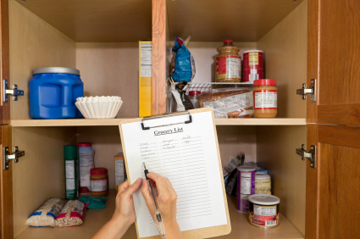
Practice
Pantry items from home
Possible casserole options from pantry ingredients
Notes:
(Show pantry items brought from home and ask participants what foods could be used in the casserole) What foods do you already have in your pantry that you could use to make a casserole right now?

Slide 13
Incorporating MyPlate
What components does a casserole have?
What can be added?
Notes:
What components of MyPlate does our casserole already have? What can we add to our plate to round out the meal?

Slide 14


Don’t Forget to Move
Weekly exercise plan
Notes:
Don’t forget to move! What can/will you do this week to move your body?

Slide 15
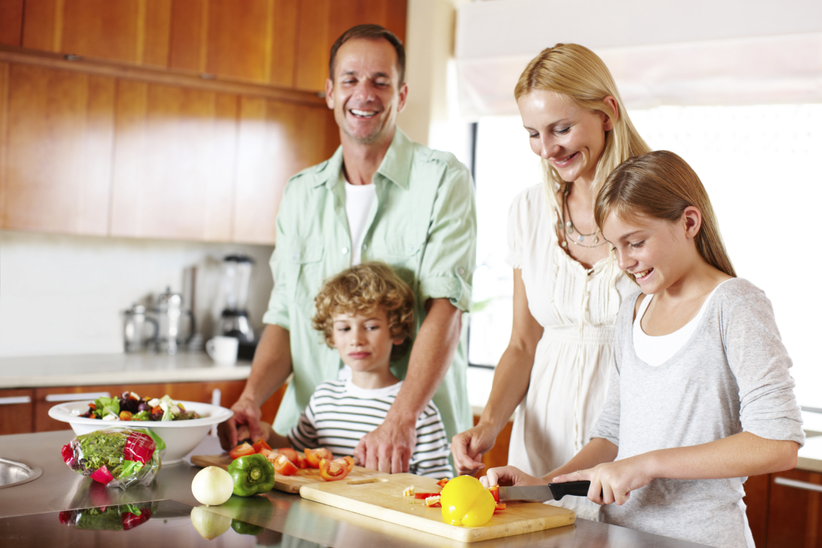
Conclusion
All you need – basic equipment and food from pantry
Notes:
You don’t need a state-of-the-art kitchen, a degree from culinary school, or tons of time. You just need some basic equipment and food in the pantry to create a delicious casserole that your family will want to come home to!

