Slide 1
Create Amazing Veggies
Food $ense

Slide 2
Goal
Nutritious Pantries
Use Food to Create Flavorful Vegetables
Understand and use a Whole Foods approach following the MyPlate meal Plan
Notes:
This lesson teaches how quick and easy it is to prepare and cook vegetables from ingredients you already have. After this lesson, the goal is to be able to have everyone demonstrate the skills needed to stock their pantries with nutritious foods and to use those foods to create flavorful vegetables. They should also be able to understand and use a whole food approach that follows the MyPlate meal plan

Slide 3
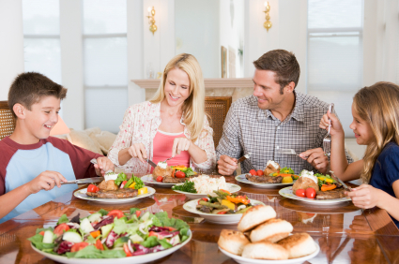
Importance of Family Mealtime
Family Bonding
Better Nutrition
Better Grades and Behavior
Notes:
Discuss why family mealtime is important:
Family Bonding: How does mealtime affect family bonding?
Better Nutrition, with less of a chance of eating disorder: How can family mealtime prevent eating disorders in children and parents?
Better Grades and Behavior with less of a chance of drugs, alcohol, and sexual activity

Slide 4
Importance of whole food diets
What are whole food diets?
Whole Food Diets: As close to original source as possible
¾ MyPlate is plant based
What diets lead to?
Benefits of whole plant foods
Notes:
Define a whole food diet and discuss why it is important.
* Whole Food Definition: as close to original source as possible with minimal processing and refining ( potatoes vs. potato chips)
* Ask participants on what they believe a whole food diet could include.
Discuss how ¾ of MyPlate is plant based
Benefits of Whole Plant Foods
* A diet rich in whole plant food is related to less chronic disease and obesity
* A diet rich in refined foods with added fats, sugar, and salt is related to increased chronic disease and obesity
* Whole plant foods full of fiber and water leave you feeling satisfied and full on less calories

Slide 5
Having a Well-Stocked Pantry
Food Availability Type = Food Decision
  Healthy vs. Unhealthy
No Need for a Recipe!
Buy Whole Foods
Ad/Sales
Shop Perimeter of Stores
Notes:
Discuss the necessity of a well-stocked pantry and how to make that happen:
*Temptation to eat out or make unhealthy choices is greatly increased if healthy, easy, and fast options are not available. The food readily available affects our food decisions
You don’t have to have a recipe or even a plan( although both are good) as long as your pantry has good food in it and you understand the techniques of how to put food together
Buy whole foods that are minimally processed or refined
Shop ads/sales
Shop perimeter of the store to avoid buying processed foods

Slide 6
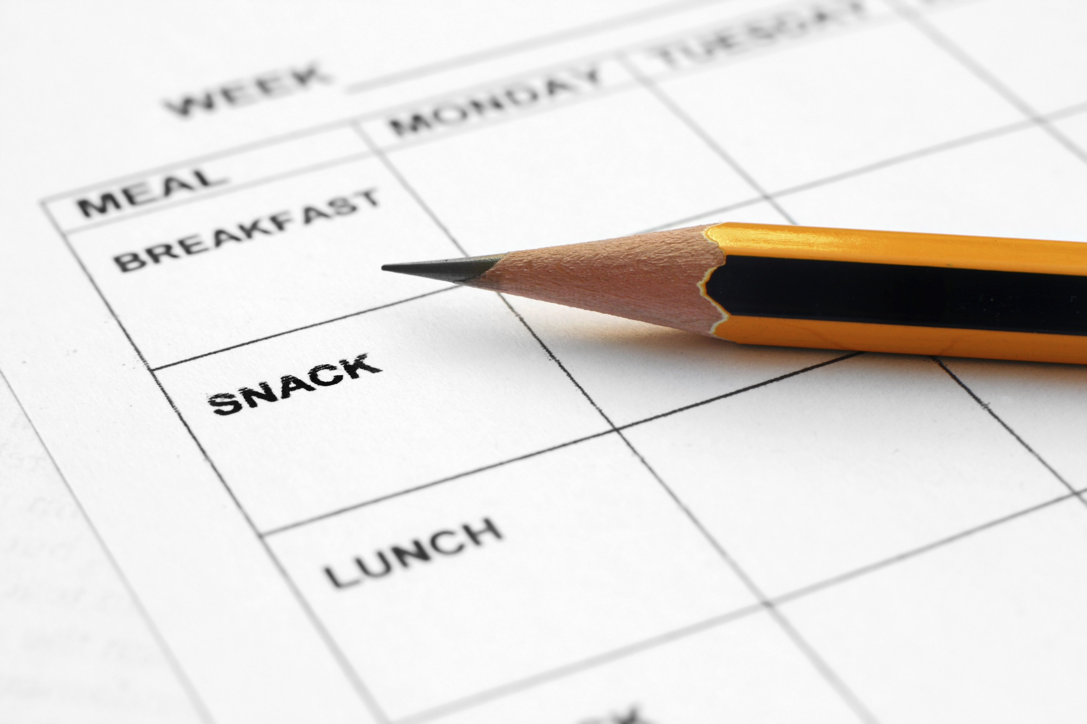
Discussion: Meal Plans
Create a menu
Theme nights
Notes:
Discuss meal plans and how they save time and money
Step to create a menu:
Look at ingredients already in pantry or fridge
Look through recipes/ come up with combinations to use food
Put together a menu for each meal
Extra Tips
Consider having theme nights: Monday is Mexican food, Tuesday is Italian, etc)

Slide 7
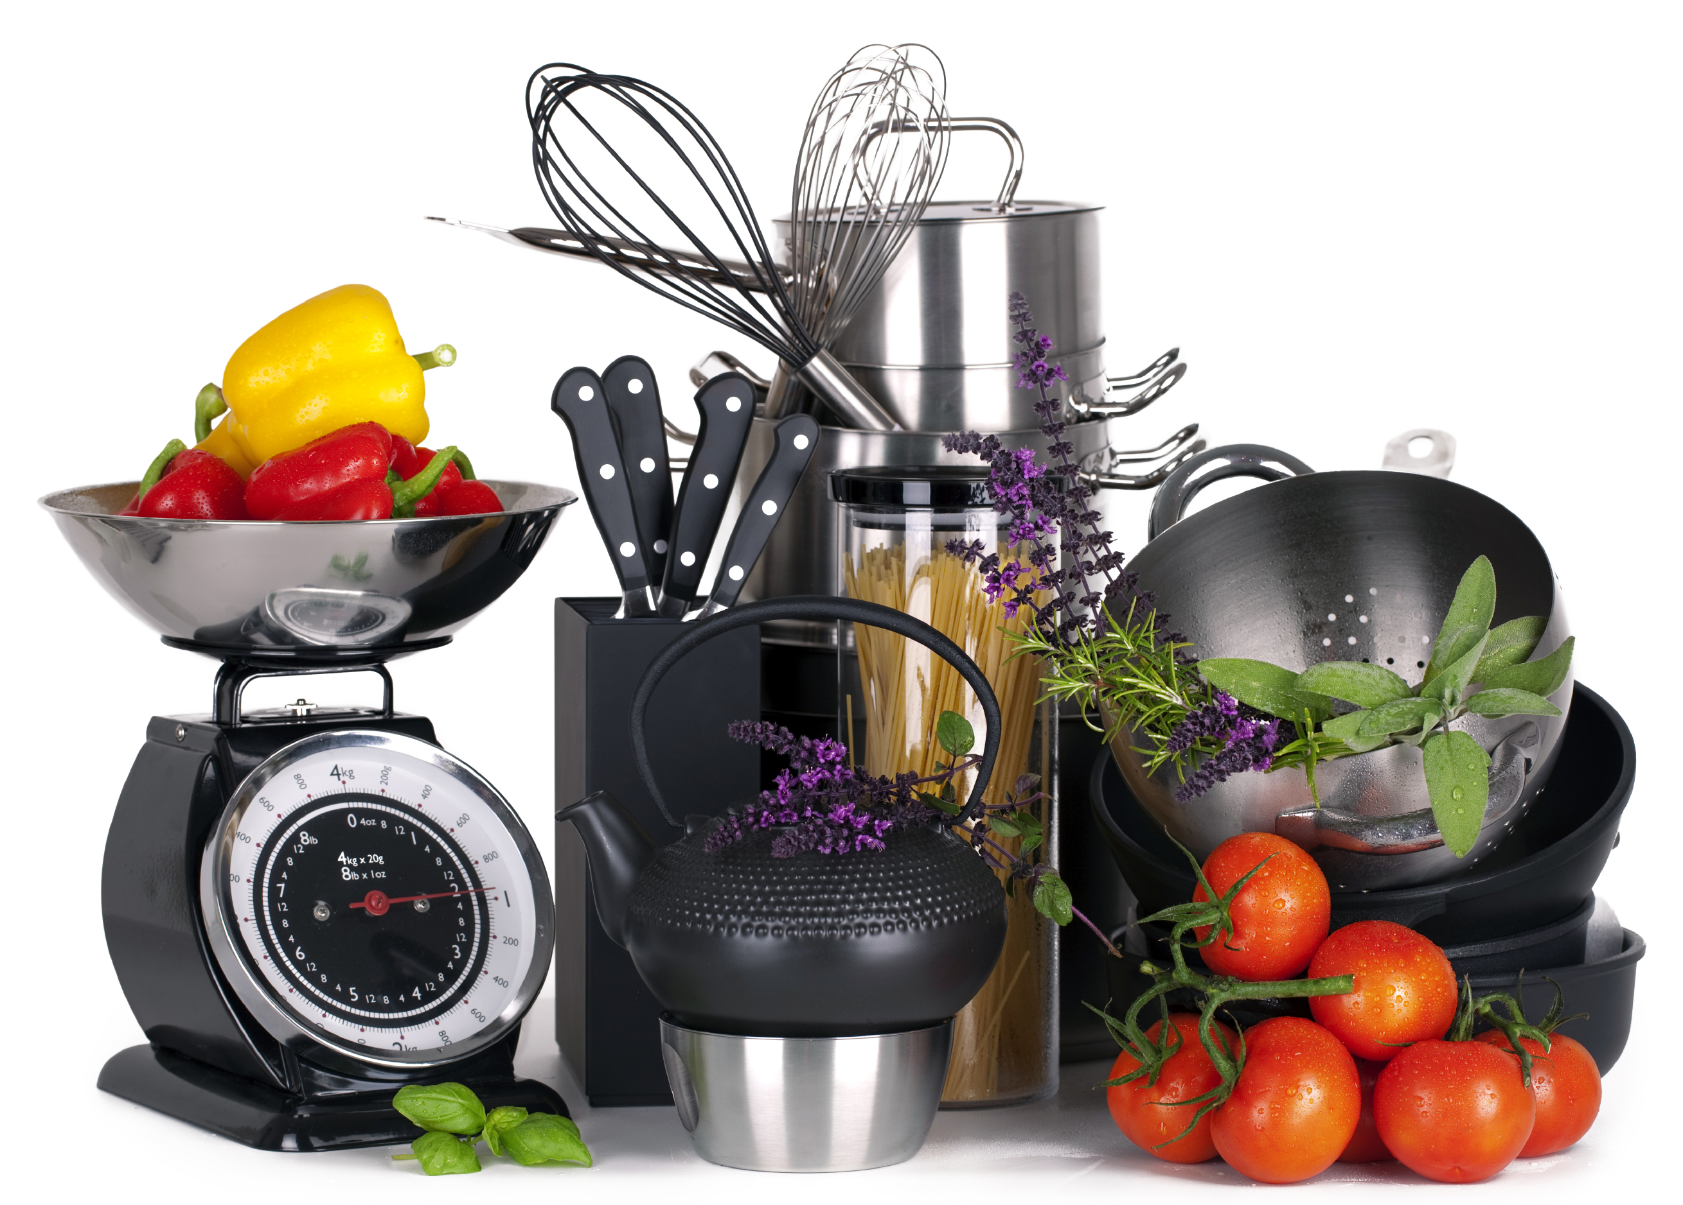
Create Amazing Veggies
Preparation:
  Whole Foods
  Equipment needed
Notes:
Choose whole foods whenever possible: example- discuss difference between vegetable dish made with French fried onions and fresh onions
Equipment Needed: Show and explain equipment needed: sharp knife, cutting board, vegetable peeler, vegetable grater, large mixing bowl, mixing spoons, saucepan, baking pan, casserole/oven-proof dish, etc.

Slide 8
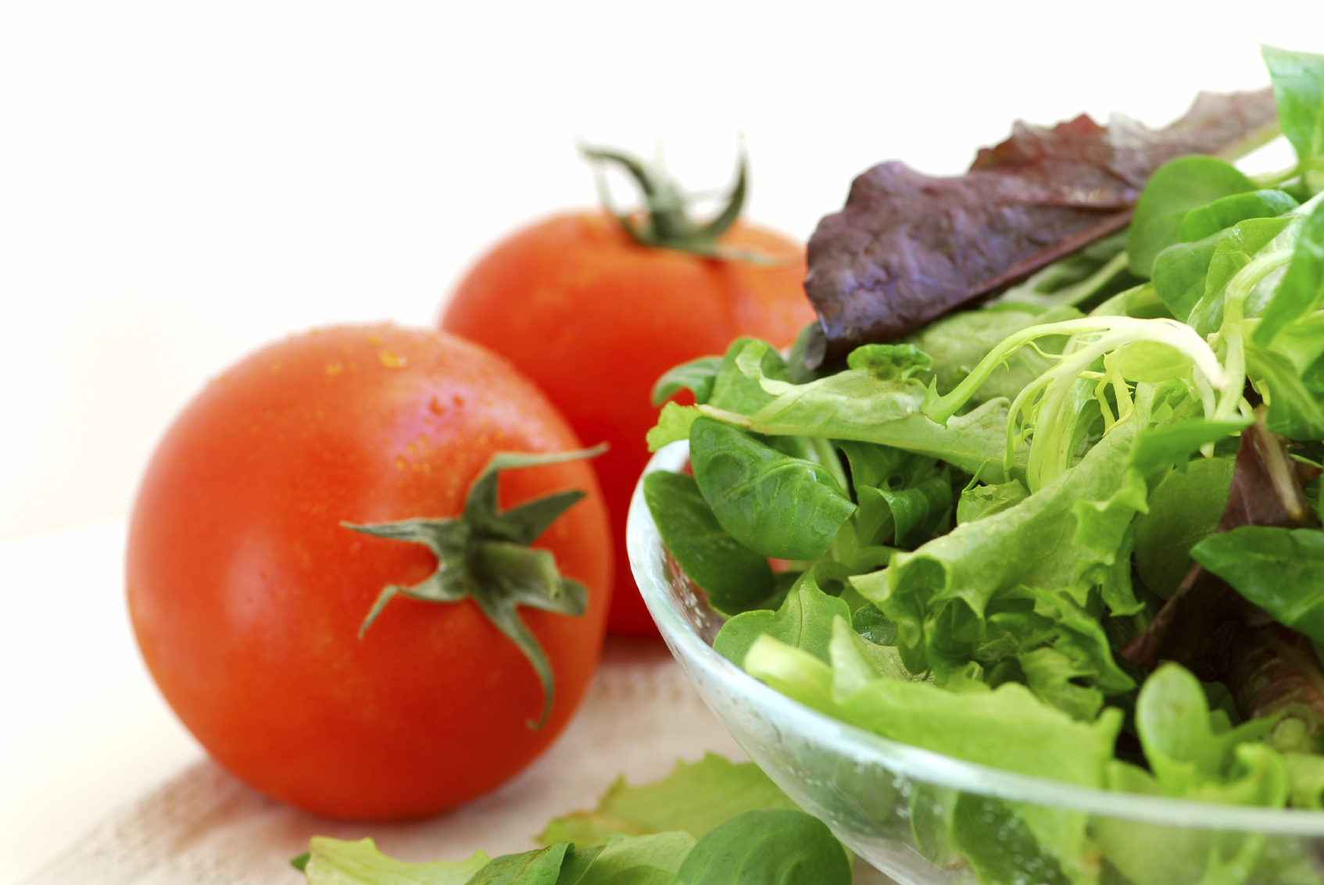
Create Amazing Veggies
Step 3: Veggies
  Options: common vs. uncommon
  Nutrition of Vegetables
  Volume vs. Calories
  Knife skills needed
Notes:
Steps: Veggies
Discuss Options- What do participants usually use, what other choices could they make?
Nutrition of Vegetables- Discuss how veggies are naturally rich in vitamins, minerals, antioxidants, and phytochemicals
Volume vs. Calories- Explain that veggies will give the dish more volume but not calories
Knife Skills- Demonstrate knife skills as you cut up veggies

Slide 9
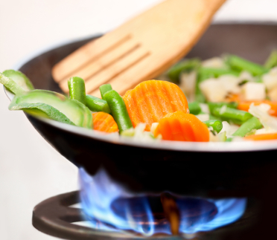
Create Amazing Veggies
Step 2: Cooking Methods
  Best Options for
  Veggies on hand
  Food Safety
Notes:
Steps: Cooking Methods
Options: Discuss best options for veggies on hand
Food Safety: Discuss when to worry about cross contaminiation, proper hygiene, acceptable temperatures, and safe storage

Slide 10
Create Amazing Veggies
Step 3: Flavors
  Options: common vs. uncommon
  Onion and Garlic
  Spices/Herbs
    Example: Mexican vs. Italian Spices
Notes:
Step: Flavors
Options: Discuss options for flavors, common and not so common
Onion and Garlic: sautéed in very small amount of oil or in water/broth
Spice/ Herbs: Choose spices/herbs according to other ingredients
Example: use Mexican spices if dish has black beans, onion, garlic, tomatoes, and corn; use Italian spices if dish has pasta, tomatoes, zucchini, etc.
i. Mexican: cumin, oregano, chili powder, cilantro, garlic
ii. Italian: basil, oregano, parsley, garlic
iii. Asian: soy sauce, ginger, garlic, chilies, turmeric
iv. Savory/ Thanksgiving: rosemary, sage, thyme, parsley

Slide 11
Create Amazing Veggies
Step 4: Extras
  Discuss options
  Watch for hidden fats
Notes:
Steps: Extras
Options: Discuss options, what can you add to your veggie dish? watch out for hidden fats

Slide 12
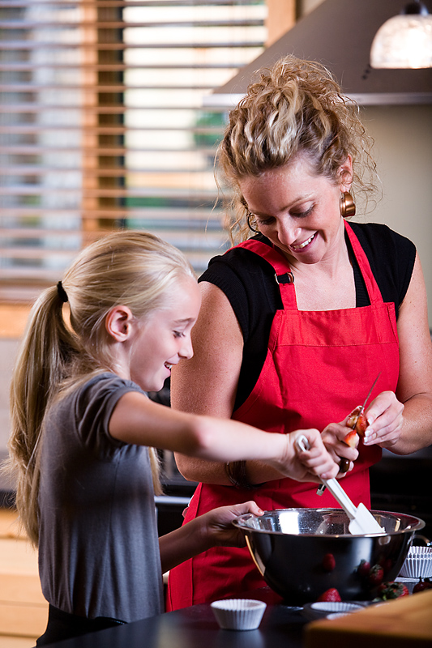
Practice, Practice, Practice
Notes:
Bring pantry items from home and have class members come up with as many ideas for skillet meals as possible from those foods
Have class members think about their own pantry and create a list of meals using the ingredients they already have

Slide 13
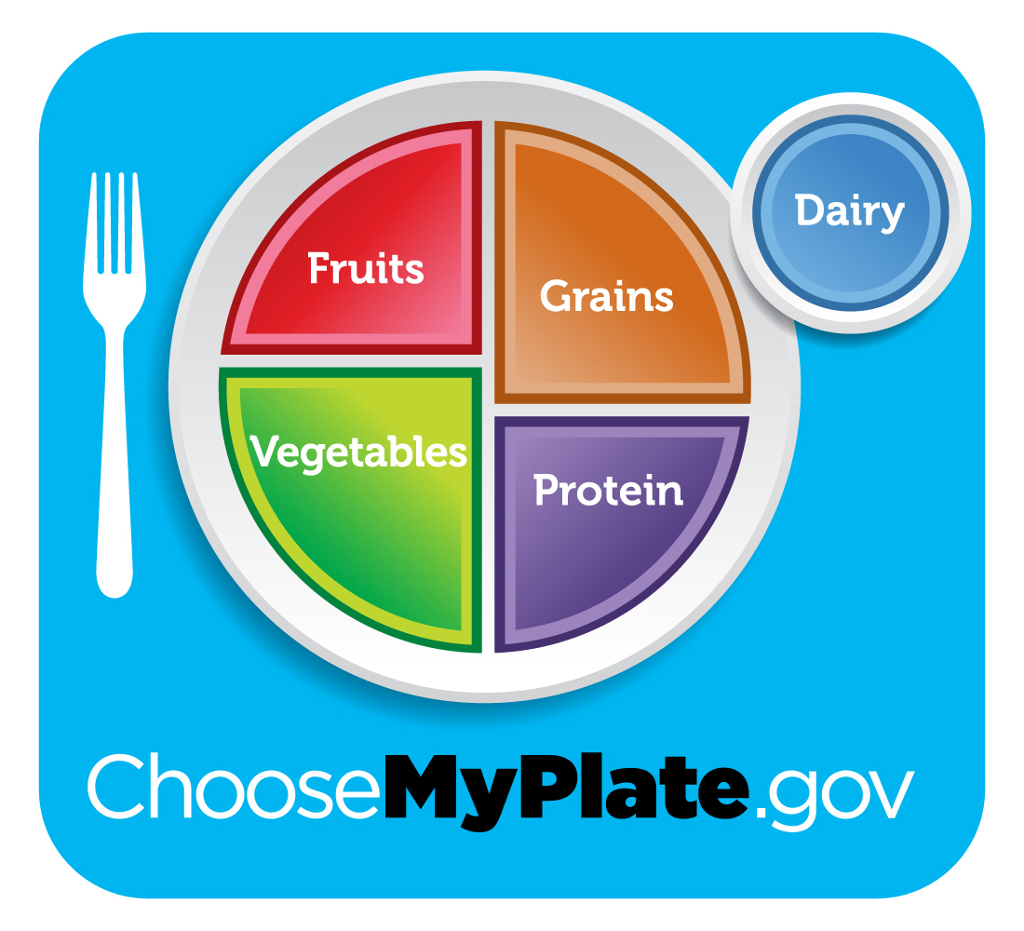
Incorporating MyPlate
What components of MyPlate does the vegetable dish already?
What can we add to our plate to round out the meal?
Notes:
Discussion Questions:
What components of MyPlate does a skillet meal creation already have?
What can we add to our plate to round out the meal?

Slide 14

Don’t Forget to Move!
What will you do this week to move your body?
Notes:
Being active is another important part of being healthy. What are some ways you will move around and be active this week?

Slide 15
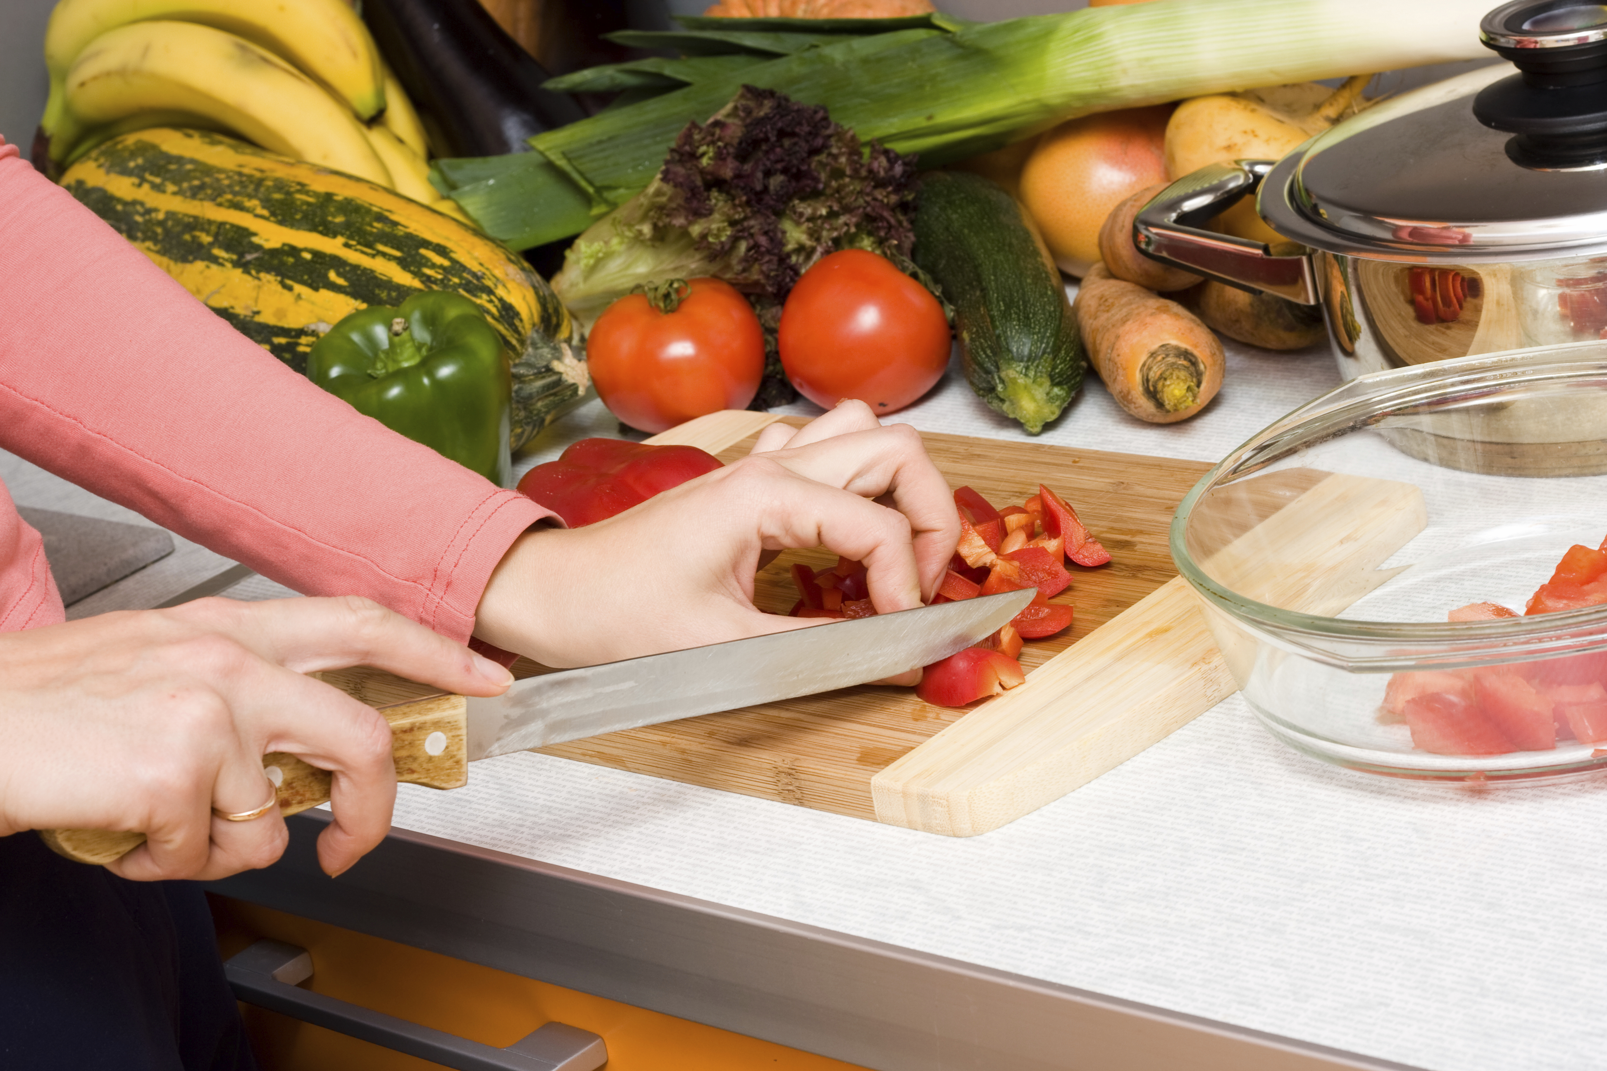
Conclusion
Notes:
You don’t need a start of the art kitchen, a degree from culinary school, or tons of time. You just need some basic equipment and food in the pantry to create a healthy veggie meal that your family will want to come home to!

