Slide 1
Create a fruity dessert
Food $ense
Notes:
This lesson teaches the basic techniques to create fruity desserts from ingredients you already have. We discuss meal planning and grocery shopping strategies that ensure always having good foods on hand. We discuss the difference between whole foods and refined foods, and why whole is a better choice.

Slide 2

Introduction
Family Mealtime is Important
Notes:
Discuss why family mealtime is important.
Ask for opinions/ input on importance.
Include examples:
Family Bonding
Better nutrition with less chance of eating disorders
Better grades and behavior with less chance of drugs, alcohol, and sexual activity

Slide 3
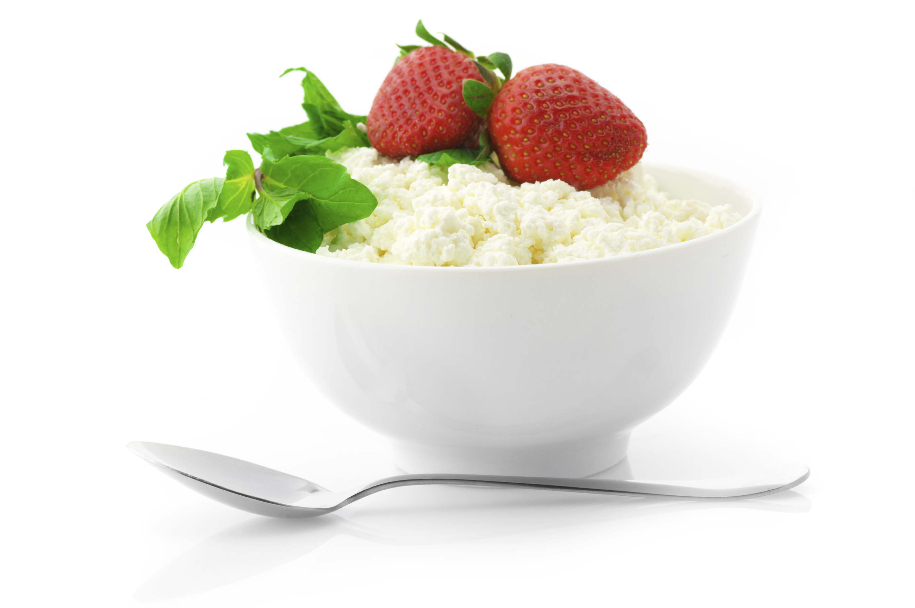
Introduction
Questions:
How does cooking at home improve nutrition? Save money? Save time?
What are various foods of a well-stocked kitchen?
Notes:
How does cooking at home improve nutrition while saving both time and money? What are some various foods of a well-stocked kitchen? What do you have in your kitchen right now?

Slide 4
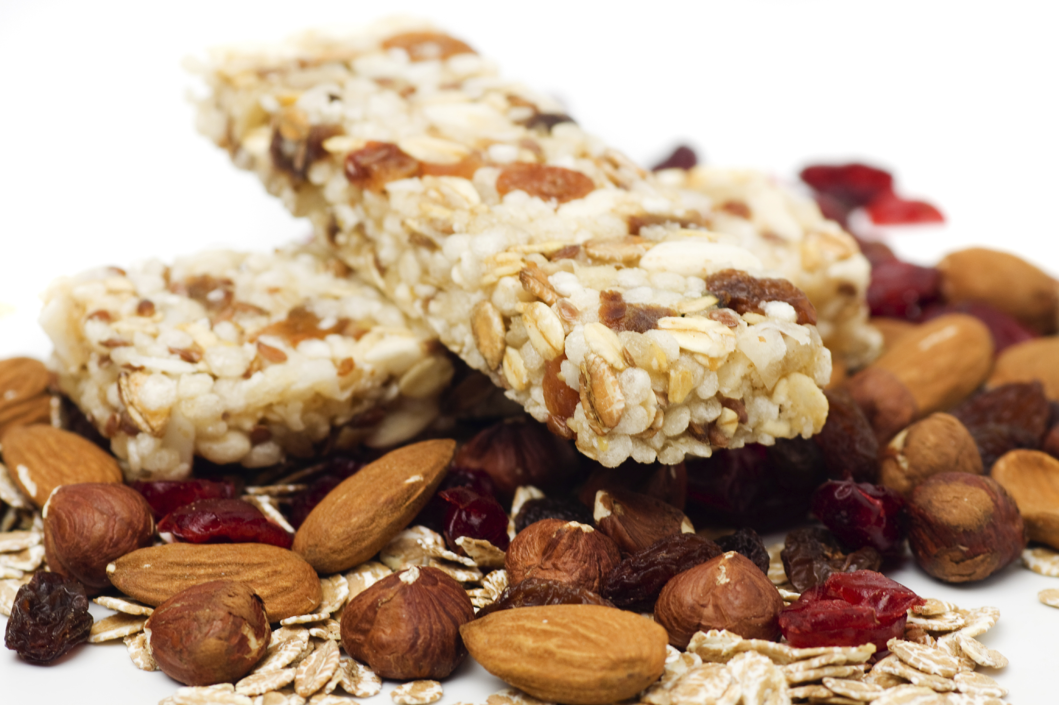
Introduction
Meal Planning
Save time and money
Steps/tips
Notes:
Discuss meal plans and how they save time and money
Step to create a menu:
Look at ingredients already in pantry or fridge
Look through recipes/ come up with combinations to use food
Put together a menu for each meal
Extra Tips
Consider having theme nights: Monday is Mexican food, Tuesday is Italian, etc)

Slide 5

CREATE a Fruity Dessert
Before Starting:
Choose whole foods
Make sure to have needed equipment
Notes:
Preparation for creating a fruity dessert:
Choose mostly whole foods and reduce highly refined processed foods
-Example: discuss difference between a fruity crumble made with canned filling and a topping mix versus one made with fresh fruit and a topping made with oats and whole-wheat flour
-Show and explain equipment needed and how to use it: Sharp knife, cutting board, vegetable peeler, large mixing bowl, mixing spoons, saucepan, baking pan, casserole/oven-proof dish, etc.

Slide 6

CREATE a Fruity Dessert
Step 1: Fruits
Discuss Options
Whole versus
refined food
Notes:
Steps: Fruits
Options: Discuss options, what do participants typically use, what better choices they could make
Discuss whole versus refined food

Slide 7
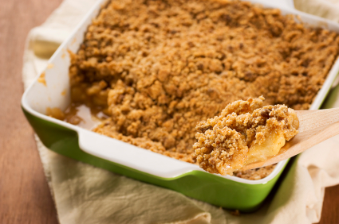
Create a Fruity Dessert
Step 2: Preparation Method
Options
Food Safety
Notes:
Steps: Preparation Method
Discuss options
Discuss food safety- when to worry about cross contamination, proper hygiene, temperature, and storage

Slide 8
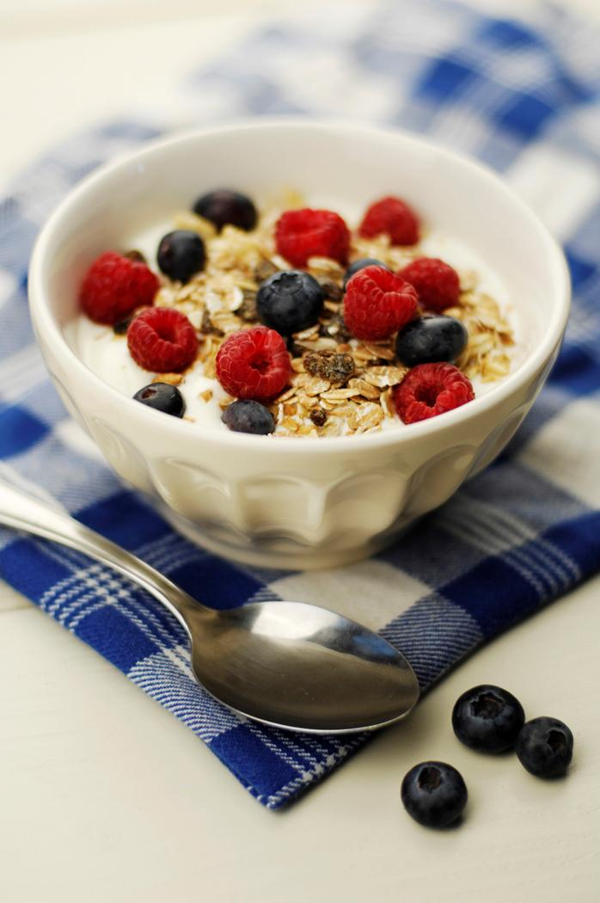
Create a Fruity Dessert
Step 3: Flavor
Options
Vitamins, Minerals, etc.
More volume but no calories
Knife Skills
Notes:
Steps: Flavor
Discuss options-most common and not so common
Discuss how fruits are naturally rich in vitamins, minerals, antioxidants, and phytochemicals
Fruits will give the dish more volume but not calories
Demonstrate knife skills as you cut up fruit

Slide 9

Create a Fruity Dessert
Step 4: Extras
Options
Hidden Fats
Notes:
Steps: Extras
Discuss options
Watch for hidden fats

Slide 10
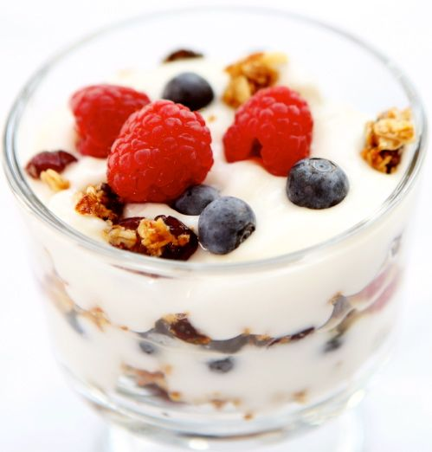
Practice Time!
Bring pantry items from home
Possible quick bread options from pantry ingredients
Notes:
Bring pantry items from home and have class members come up with as many ideas for fruit dishes as possible from those foods
Have class members think about their own pantry and create as many meal options as possible from what they already have

Slide 11
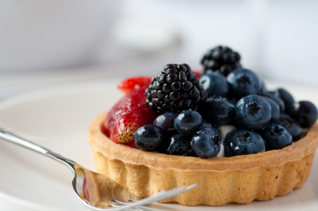
Incorporating MyPlate
What components of MyPlate does the fruit dish already have?
What can be added to round out the meal?
Notes:
Discussion Questions:
What components of MyPlate does the fruit dish already have?
What can we add to our plate to round out the meal?

Slide 12

Don’t Forget to Move!
Weekly exercise plan
Notes:
Being active is another important part of being healthy. What are some ways you will move around and be active this week?

Slide 13
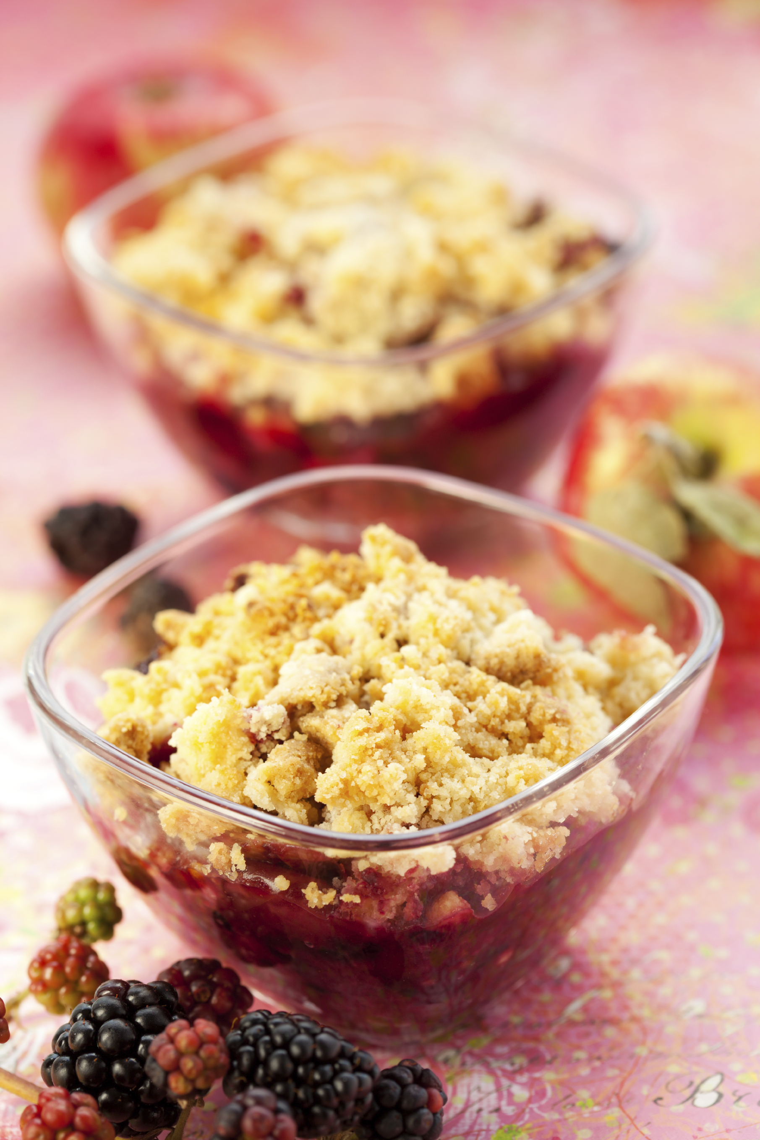
Conclusion
Just need - basic equipment
and food in the pantry to
CREATE a Fruity Dessert
Notes:
You don’t need a start of the art kitchen, a degree from culinary school, or tons of time. You just need some basic equipment and food in the pantry to create delicious meals that your family will want to come home to!
-Questions??
-Remind of next class!

