Slide 1
Notes:
Background info: The Smarter Lunchrooms Movement is dedicated to providing schools with the knowledge, motivation, and resources needed to build a lunchroom environment that makes healthy food choices the easy choice. Smarter Lunchrooms strategies are free or low-cost solutions that nudge students to voluntarily select the healthiest food in the lunchroom. Smarter Lunchrooms can see less waste, higher participation, more satisfied students, and increased consumption of important nutrient-rich foods.
In 2010, Drs. Just and Wansink established The Cornell Center for Behavioral Economics in Child Nutrition Programs (the B.E.N. Center) with funding from USDA FNS/ERS. The B.E.N. Center continues to conduct and support innovative research that applies principles of behavioral economics in order to discover strategies that improve children’s food choices in schools.

Slide 2
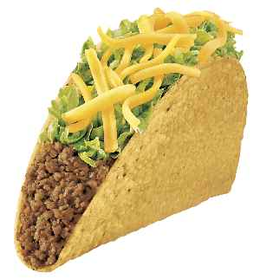
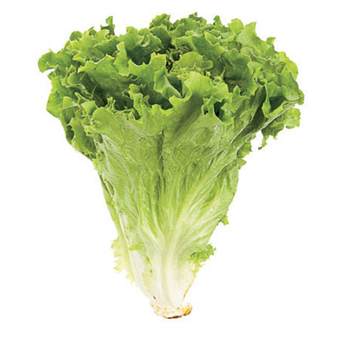
your favorite place to eat…
Notes:
Have participants close their eyes and think about their favorite place to eat. What does it smell like, sound like, look like. How is the food, the service, the overall atmosphere? Have participants share why its their favorite place. Then ask “Is your lunchroom the favorite place to be at your school? Does it have the same qualities as your favorite place?” After today you will learn some techniques and get ideas to use in your lunchroom to make it the best it can be!

Slide 3
6 Basic Principles to Consider
The following principles are based on research concerning various environmental cues that influence eating behavior. They are true in school lunchrooms as well as in restaurants, food courts and even in your kitchen!
Manage Portion
Sizes
Increase Convenience
Improve Visibility
Enhance Taste Expectations
Utilize Suggestive Selling
Set Smart Pricing Strategies
Notes:
The B.E.N lab has created 6 principles of behavioral economics in the lunchroom. They are above. Discuss each principle are give examples of how these could be used in the cafeteria.
Manage portion size: Schools have a federal portion size they must serve to students already. Schools could use smaller/harder to use utensils for unhealthy items on the salad bar (croutons, wontons, dressings) and big easy utensils for the more healthy options.
Increase convenience: Healthier items up front or first on the line. Easy to get to from all ages - down for younger grades, higher for older grades. Cut up fruit instead of whole fruit. Do you have any easy alternate serving styles? grab and go breakfast/lunch? pre-packaged salads/wraps/sandwich? How many serving lines?
Improve visibility: Fruit and vegetables in multiple locations. Menus before the lunch line. Menu boards with featured items and tomorrow's lunch where students can see. Sample trays at the beginning of line. Place pics of food on the lines for younger students.
Enhance taste expectations: Descriptive names of food (there is a food naming activity in the resources that you could complete). Have a contest and let the students name the menu items. Can you change the lunchroom atmosphere? move trash cans against the wall, is it clean, colorful, inviting? can you play music? Can you enhance the smell? Complete a taste test: a full blown taste test for new menu items- sample size items placed at beginning of line. Does your food taste good? Do you sample your food before you serve it? Food Fundamentals worksheet in resource packet. How does the food look in the serving pans/lines and how does it look on the tray?
Utilizing suggestive selling: Staff attitude- kitchen staff, janitorial staff, teachers, administration. Can you find a lunchroom champion to help talk about and market your program? PEERS!! get the kids involved. Student workers/ high school students in elementary. Social Media: school websites, hallways, newsletters, bathrooms, instagram, facebook.

Slide 4
Smarter Lunchroom Makeover
Notes:
Play video

Slide 5
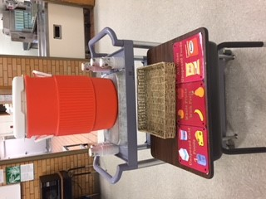
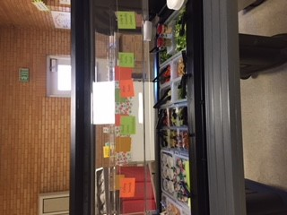
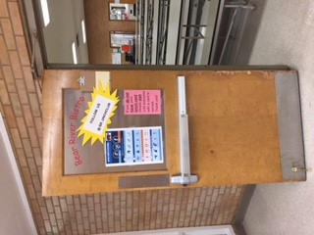
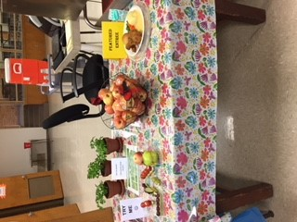
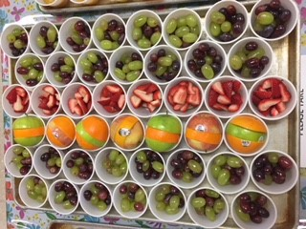
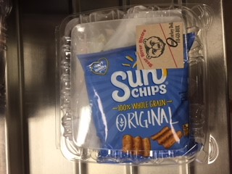
Notes:
Examples of (starting at top right): share table, naming salad bar, name of the lunchroom on the door, grab-n-go lunch with customized sticker, cupped fruit, entree of the day sample, fruit art for tasting.

Slide 6
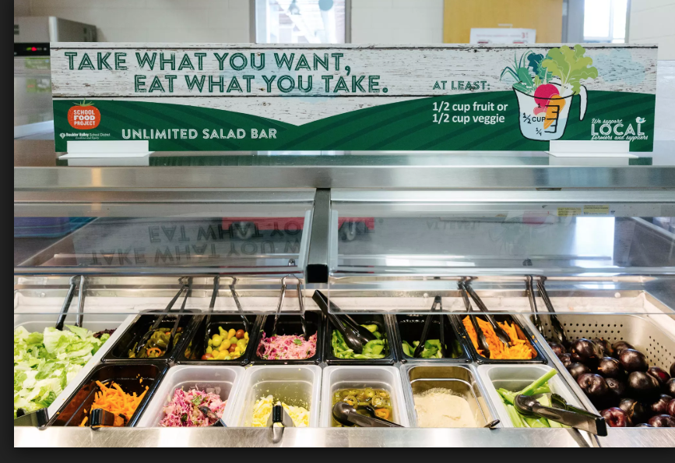
Notes:
Signage on a salad bar

Slide 7
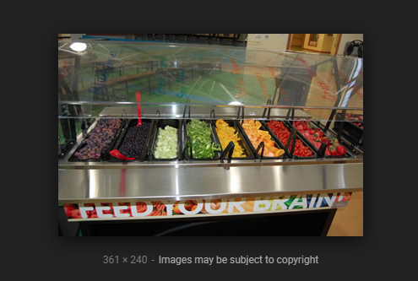
Notes:
more salad bar signage

Slide 8
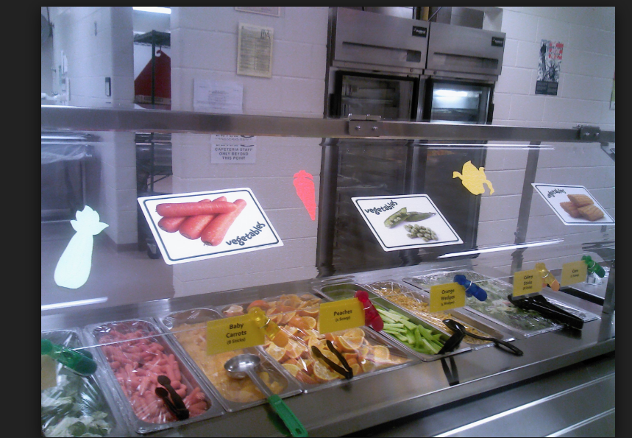
Name That Food
Notes:
pictures and names of the food being offered
Play “Name that Food” video

Slide 9
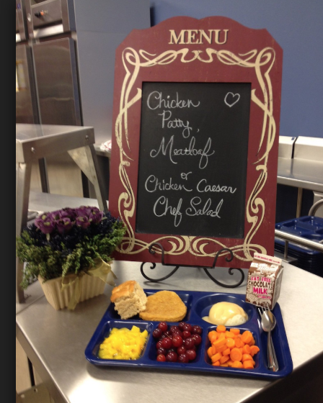
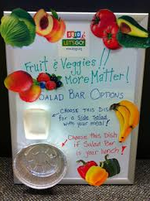
Notes:
Signage examples

Slide 10
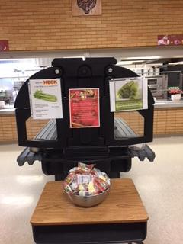
Making School Lunch Look Good
Notes:
Celery facts at end of salad bar along with fruit another fruit option.
Play “Making School Lunch Look Good” video

Slide 11
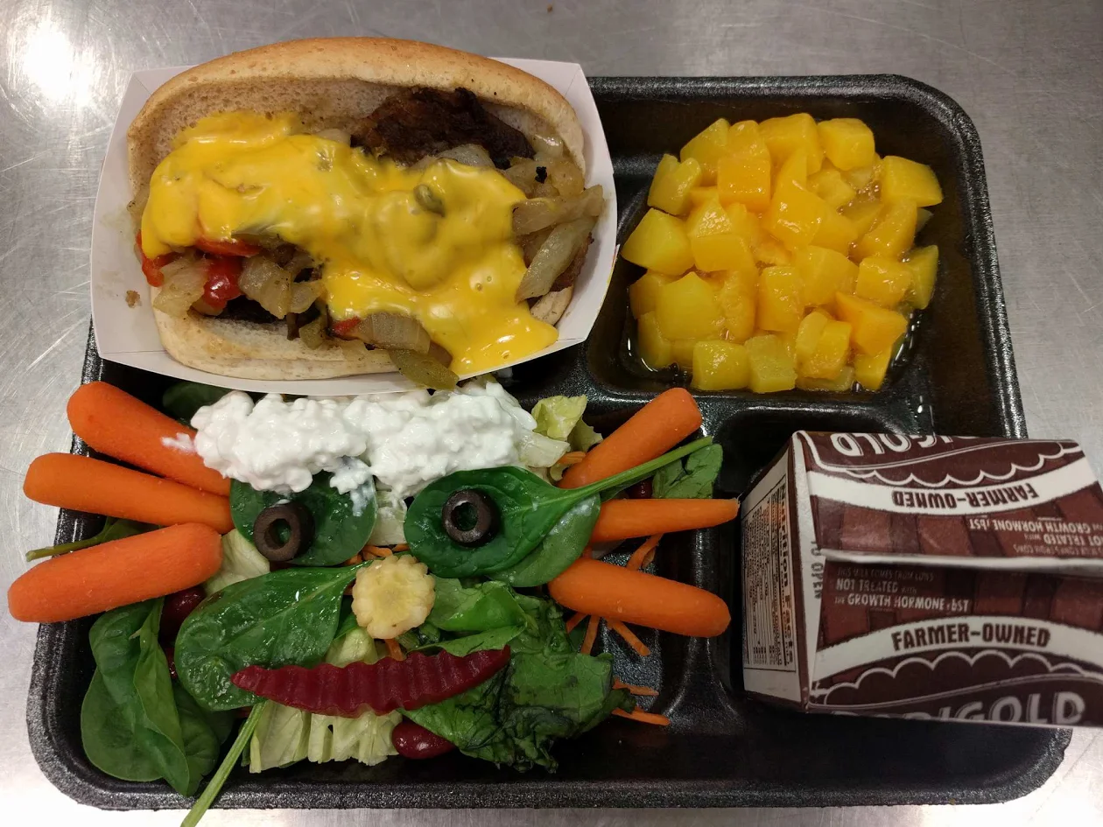
Notes:
Sample tray - this school has one staff dedicated to creating a sample tray everyday they put out for the children.

Slide 12
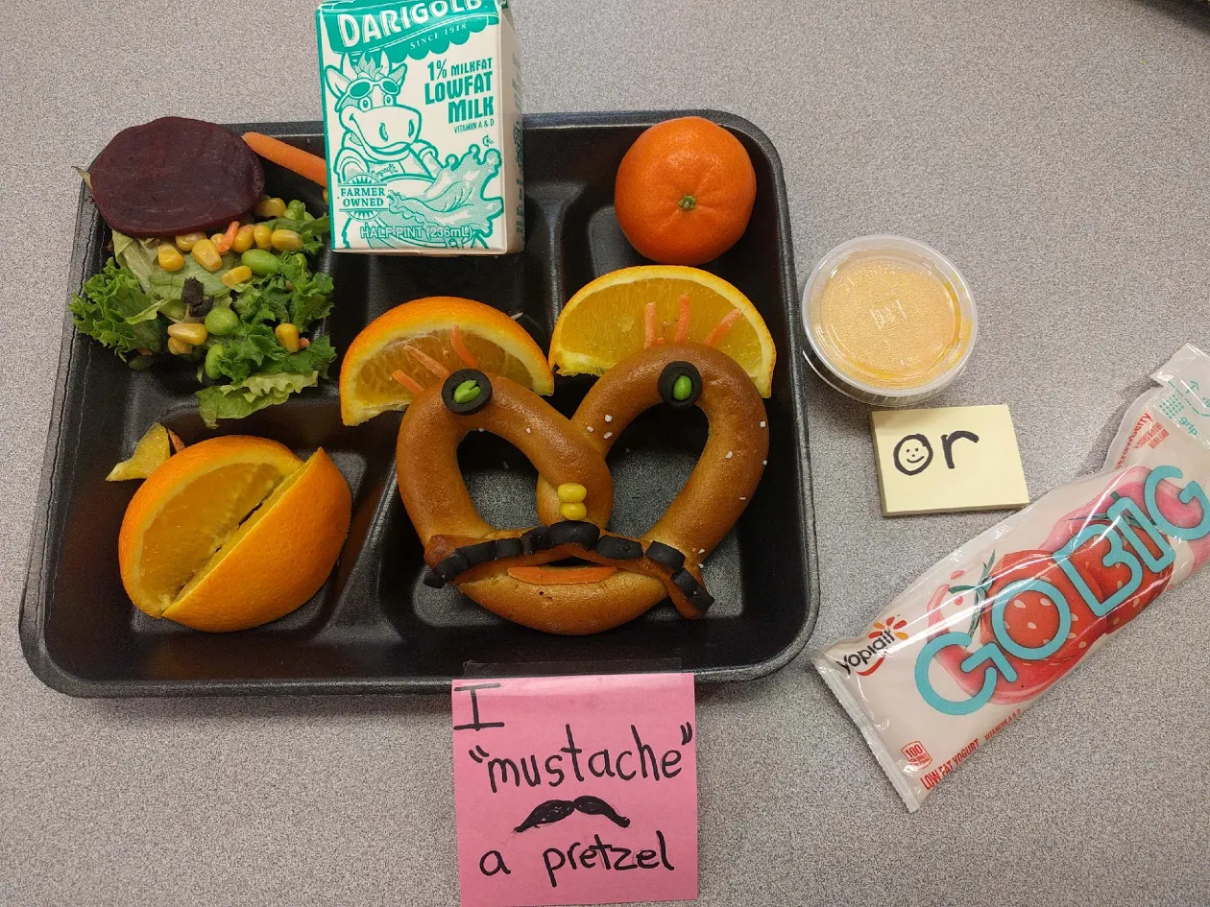
Notes:
Another sample tray from same school

Slide 13
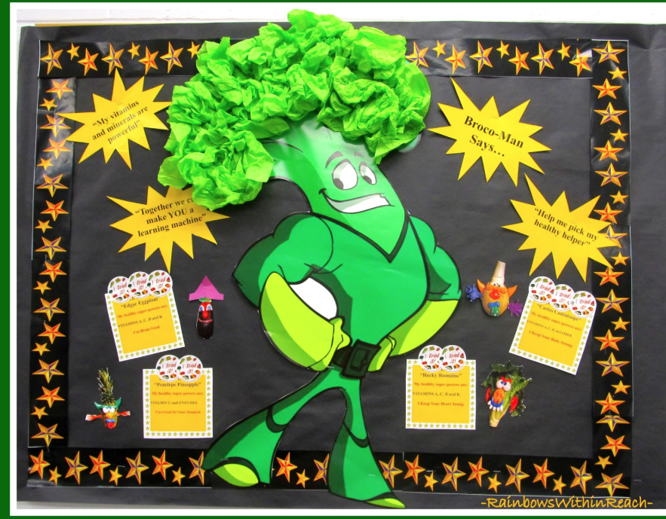
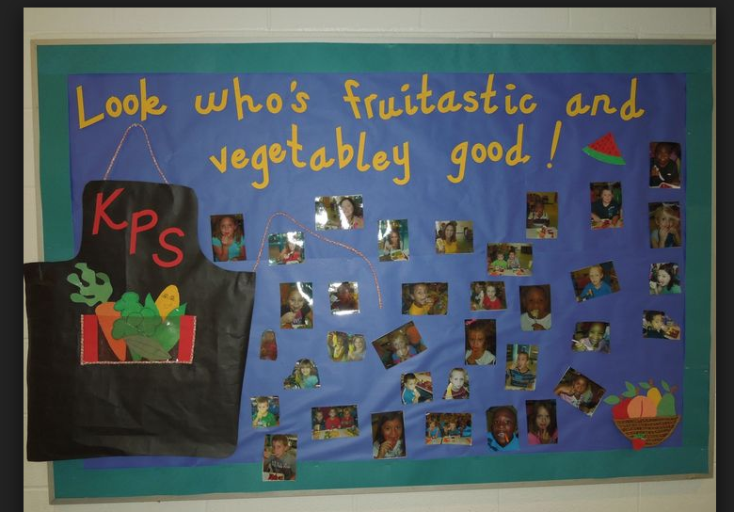
Notes:
Bulletin board examples

Slide 14
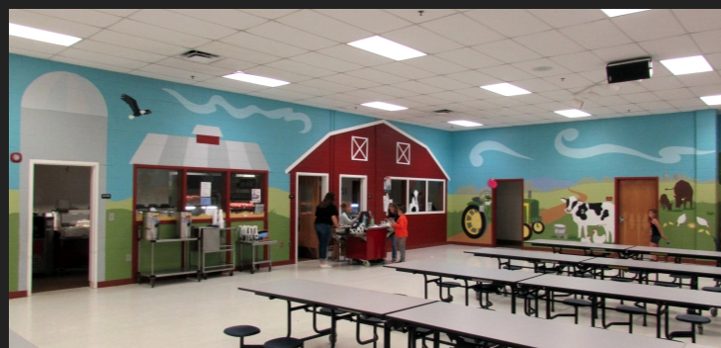
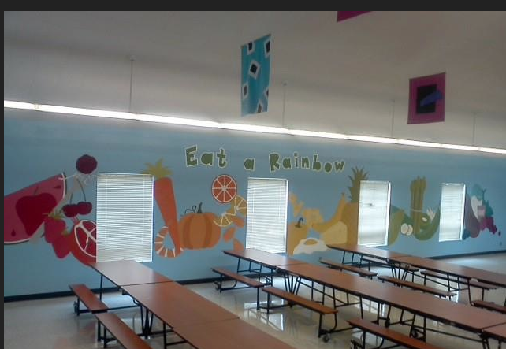
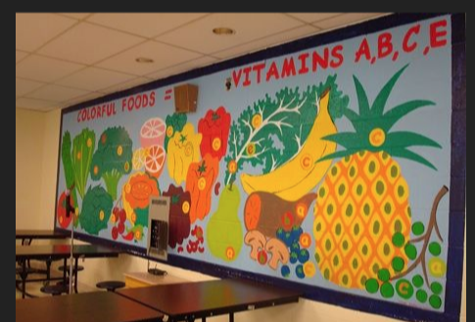
What Would McDonald’s Do?
Notes:
examples of cafeteria atmosphere- fun, bright and colorful - maybe art departments could help
We’re going to watch another short video about some other FREE things you can do to improve the environment in your cafeteria. Play “What Would McDonald’s Do?” video

Slide 15
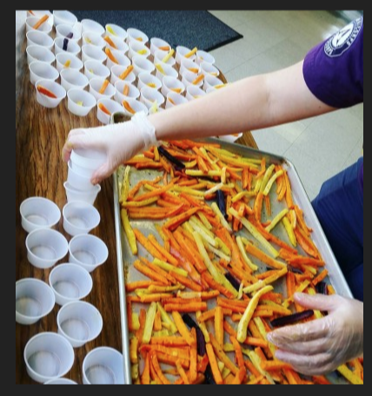
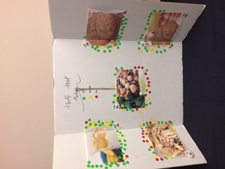
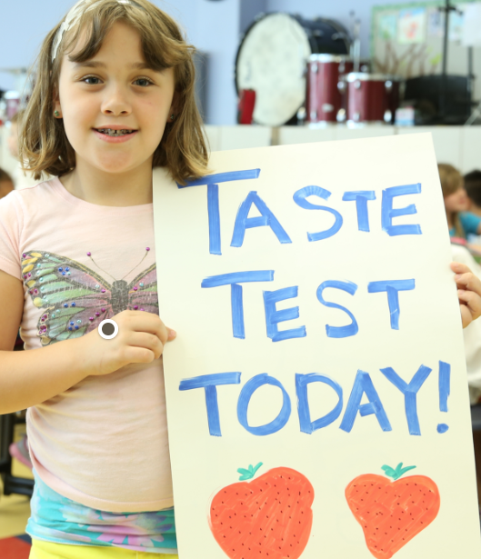
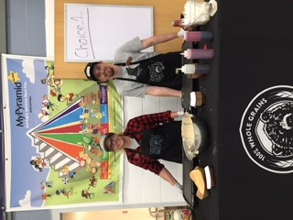
Notes:
examples of a taste test.

Slide 16
ssdfda
THREE PRIMARY PARTS TO THE SMARTER LUNCHROOM SCORECARD
The Scorecard
The Scorecard Summary
Frequently Asked Questions
Notes:
1. The Scorecard is completed to evaluate what is good and opportunities for improvement.
2. The Scorecard Summary is completed alongside the scorecard to provide a quick snapshot of the results.
3. Frequently Asked Questions about the Smarter Lunchrooms Scorecard: review this before you complete your first scorecard.
WHY?
Research-based strategies can help increase participation in school meals, reduce food waste, and increase consumption of healthy foods.
Snapshot of strategies that are currently in place and which ones to work on.
Used repeatedly to measure improvement over time.
WHO?
Nutrition Professionals - SNAP Educators, Local Health Department Health Educators, USBE CNP
TIME PERIOD
Arrive 20 minutes before the first meal service begins and plan to stay for at least one entire lunch period. Best practice is to stay for at least two lunch periods.
Mark an item if it is completely true.
Scorecard
Technical Advisors Instructions (google drive)
Quick and Inexpensive Lunchroom Makeover Ideas (google drive)
Anything else we want to introduce here?

Slide 17
ssdfda
SCORECARD (PDF)
Notes:
REVIEW THE SCORECARD
Two options to complete the scorecard: PDF or Online
Spanish Scorecard (PDF) available

Slide 18
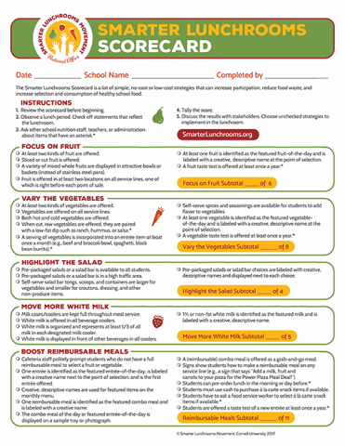
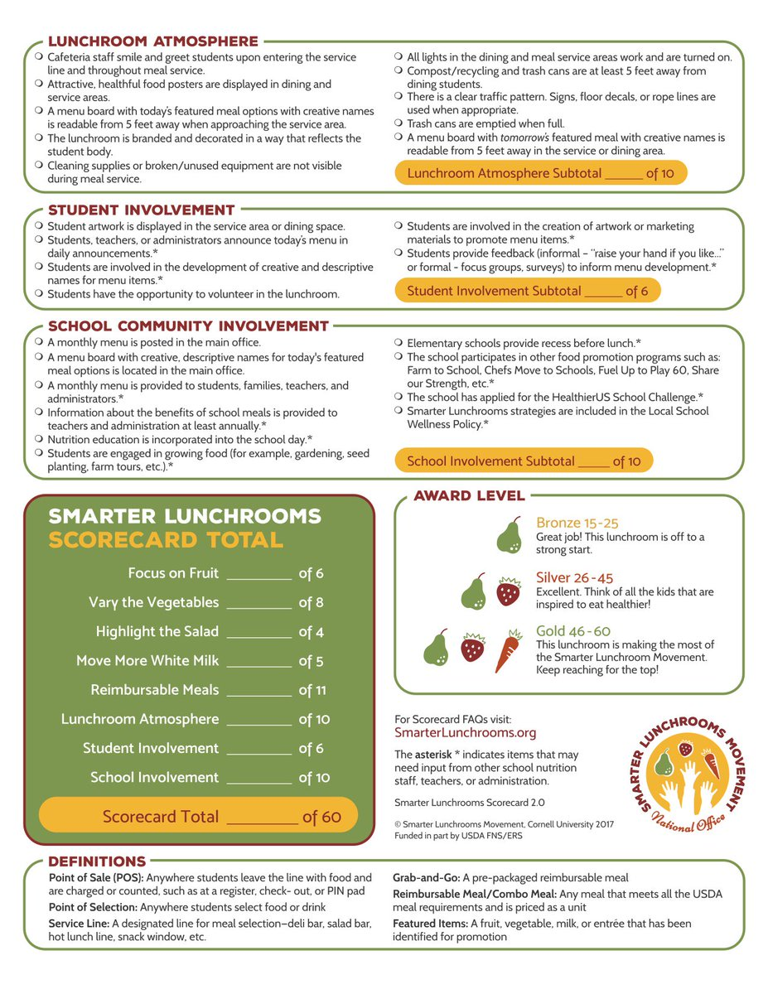
ssdfda
Notes:
THE SMARTER LUNCHROOM SCORECARD (PDF)
Contains 60 simple, no-cost or low-cost strategies that lunchrooms can use to increase participation, improve consumption of healthy food and reduce waste.
The more strategies that are being implemented, the more improvements in revenue, participation, and healthy eating you will see.
There are 8 categories
Focus on the Fruit
Vary the Vegetables
Highlight the Salad
Move More White Milk
Boost Reimbursable Meals
Lunchroom Atmosphere
Student Involvement
School Community Involvement
Research-based strategies that can increase participation in school meal programs, reduce food waste, and increase consumption of healthy foods.
It provides a snapshot of how many strategies are currently in place in a lunchroom and which ones the lunchroom can work toward.
The scorecard can be filled out repeatedly to measure improvement over time.
The scorecard is a valuable tool for school nutrition professionals to use in their own lunchroom(s). School nutrition professionals are encouraged to welcome stakeholders such as students, administrators, PTO members, and outside professionals to complete a scorecard to give diverse perspectives. Always ask permission before completing a scorecard in a lunchroom that is not your own and always provide results and feedback to the lunchroom leaders afterwards.
Each school is unique and may not be able to implement all the items - that’s OK!
If a strategy is only half-true do not mark it as complete.
Items with stars ★ indicates times that may need input from other school nutrition staff, teachers, or administration.
Plan on arriving 20 minutes before the first meal service begins and plan to stay for at least one entire lunch period. The best practice is to stay for at least two lunch periods.

Slide 19
ssdfda
SCORECARD (ONLINE)
Notes:
REVIEW THE SCORECARD
Review the Scorecard Online - Checking on Spanish Version online Scorecard TBA

Slide 20
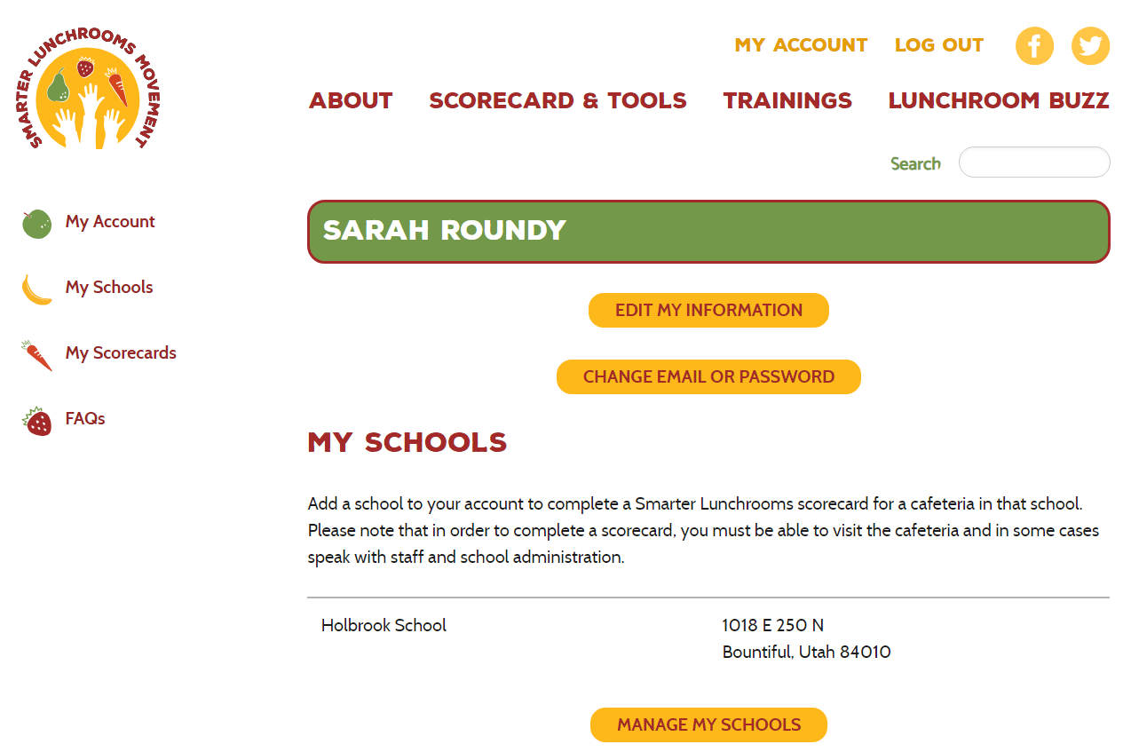
ssdfda
Notes:
THE SMARTER LUNCHROOM SCORECARD (ONLINE)
You can complete the score card anytime on any device. Once registered, simply log in anytime to enter, view, and download or print your completed Scorecard.
Key features include
Mobile friendly
Upload photos to accompany Scorecard strategies.
Save/Print a completed Scorecard with photos.
Save/Print a certificate indicating the cafeteria’s award level
One stop location for Scorecard record keeping.
How to login:
Create an account
Search for schools by name or zip code of the school.
Highlight the school name and add school to your list.
Click on the remove button to delete a school from your list.
Once all schools have been added click on Save.

Slide 21
ssdfda
Notes:
CREATE A SCORECARD
Select a school and create scorecard by answering all the questions.

Slide 22
ssdfda
Notes:
CREATE A SCORECARD (Continued)
Complete each category by selecting Yes or No.
Image restrictions:
Any number of files may be uploaded
5 MB
Allows: png, gif, jpg, jpeg

Slide 23
ssdfda
Notes:
CREATE A SCORECARD (Continued)
Complete each category by selecting Yes or No

Slide 24
ssdfda
Notes:
CREATE A SCORECARD (Continued)
Complete each category by selecting Yes or No

Slide 25
ssdfda
Notes:
CREATE A SCORECARD (Continued)
Complete each category by selecting Yes or No

Slide 26
ssdfda
Notes:
CREATE A SCORECARD (Continued)
Add any notes to the scorecard that is worth mentioning
Once you publish the scorecard it will not be able to be modified.
You can save the draft by clicking the “save as draft”

Slide 27
ssdfda
Notes:
SCORECARD RESULTS

Slide 28
ssdfda
2. SMARTER LUNCHROOMS SCORECARD SUMMARY
Notes:
SCORECARD SUMMARY
Review the Scorecard summary PDF

Slide 29
ssdfda
Notes:
SMARTER LUNCHROOMS SCORECARD SUMMARY
Complete this page alongside the scorecard to provide a quick snapshot of the results.
Four sections:
First impressions - When I walk into this lunchroom, the first thing I notice is...
Strengths - The lunchroom is doing a really good job at...
Opportunities - This lunchroom could be an even Smarter Lunchroom by...
Next Steps

Slide 30
ssdfda
3. FREQUENTLY ASKED QUESTIONS
Notes:
FREQUENTLY ASKED QUESTIONS
Review the frequently asked questions PDF

Slide 31
ssdfda
Notes:
FREQUENTLY ASKED QUESTIONS
Review the frequently asked questions PDF before you complete your first scorecard

Slide 32
For more information
Visit www.smarterlunchrooms.org
Or Contact
Your Info here:

