Slide 2
Family Mealtime Month
2014- Governor Herbert’s Declaration of Family Meals Month
2015-Food Marketing Institute’s Family Meal Month
2016- Food $ense Family Mealtime Campaign

Slide 3
Benefits
For Children
Decreased risky behavior
Increased self esteem
Better grades
Larger vocabulary
Healthier lifestyle
Lower soft drink consumption
Lower rates of eating disorders
Better relationships with parents
For Parents:
Save money
Better relationships with children
Able to role model healthy eating habits
Healthier lifestyles

Slide 4

Barriers
Time
Ability to cook
Tension
Cost

Slide 5

Barriers- Time
Always menu plan
Make Freezer Meals
Cook in bulk
Get everyone involved
Commit your schedule

Slide 6
Barrier- Lack of Cooking Skills
Start with the basics
Knife skills
Creates series
Use family mealtime as a way to try new types of cooking each week
Week 1: skillet cooking
Week 2: Baking
Week 3: Roasting
Create a menu and attach all the recipes
Ask friends and family for tips and recipes
Take advantage of social media!

Slide 7
Barriers- Tension
Remove pressure on eating
Discuss fun topics rather than tension topics
Get everyone involved in preparation
Teach etiquette
Theme Nights
Food Art

Slide 8
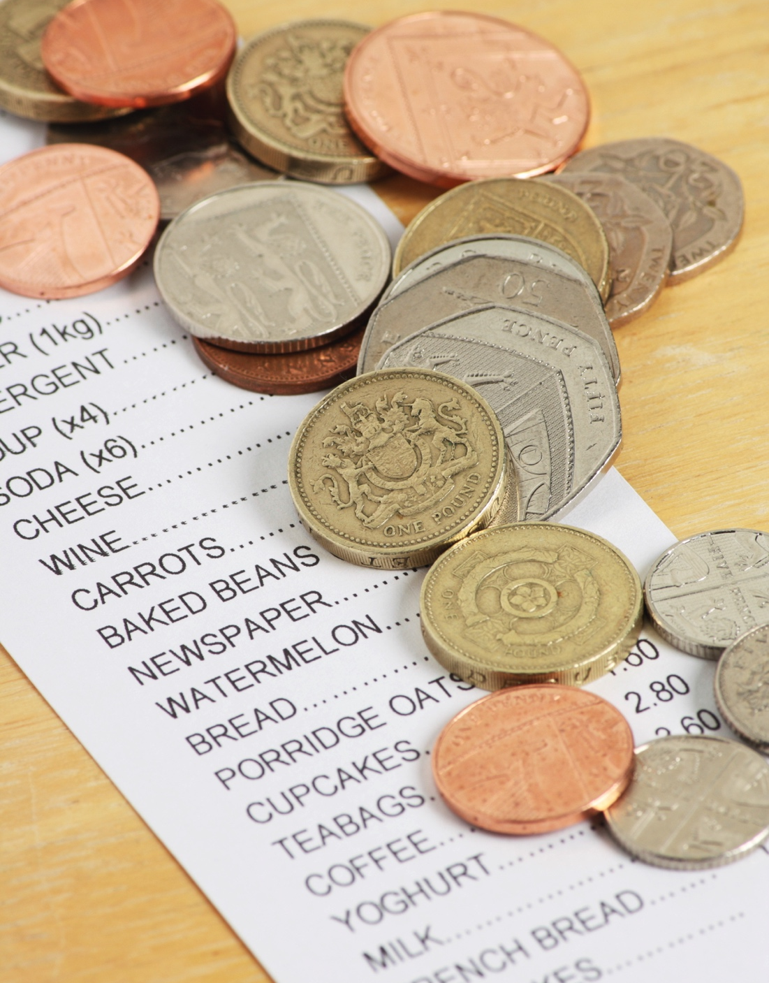
Barrier- Cost
Eat family meals at home
The average family saves $5-10 per meal/person
Use low cost recipes in the menu
Use a menu
Only grocery shop every other week
Buy in bulk
Buy produce that is in season

Slide 9
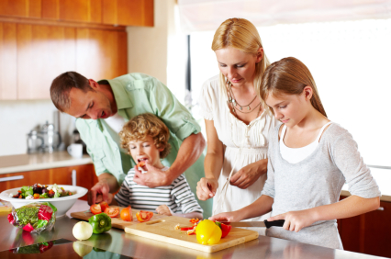
Getting Kids Involved

Slide 10
Benefits
Overcome food neophobia
Develop coordination and skills
Protection
Stronger family relationships
Healthy habits formed
Math/ literacy skills improved

Slide 11

Menu Planning with Kids
Ages 2-5
-Color coordinate fruits/ vegetables
-Circle foods they would like
-Help cut out coupons
Ages 6-10
-Help make a list of meals they like
-Look at MyPlate diagram and come up with one meal
-Come up with fruits and vegetables to have with each meal
Ages 11-18:
-Look up new recipes using social media
-Create a three day menu using MyPlate as a reference

Slide 12

Grocery Shopping with Kids
Ages 2-5
Name off fruits and vegetables during the grocery trip
Choose a fruit or vegetable as a ‘treat’
Ages 6-10
Read off the list and cross off items
Try to spot the items as they are passed
Ages 11-18
Take a portion of the list
Keep track of money spent and saved each week
If old enough to drive- do a small grocery trip on own

Slide 13
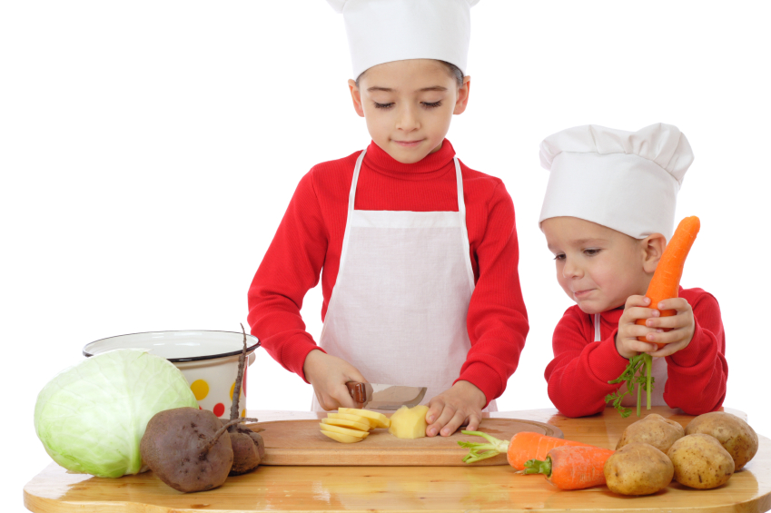
Cooking with Kids
Ages 2-5
Pour premeasured items into a bowl to mix
Tear up lettuce for a salad
Ages 6-10
Measure out ingredients
Toss a salad
Knead dough
Put together sandwiches
Ages 11-18
Make the sides or the main dish for the meal
Head chef for the day

Slide 14
If you were able to do something that would…
Strengthen your family
Help your kids stay healthy for the rest of their lives
Improve mental and social health
Build skills and self confidence for yourself and kids
Involve food
Would you do it?

Slide 15
Resources
Cooking with kids:
http://extension.psu.edu/youth/betterkidcare/news/2016/cooking-together
Other:
https://extension.usu.edu/fscreate/htm/family-mealtime-month/
Research Articles:
Utter J, Denny S, Robinson E, Fleming T, Ameratunga S, Grant S. Family meals and the well-being of adolescents. Journal of Paediatrics and Child Health. 2013;49(11):906-911. doi:10.1111/jpc.12428.
Neumark-Sztainer D, Hannan P, Story M, Croll J, Perry C. Family meal patterns: Associations with sociodemographic characteristics and improved dietary intake among adolescents. Journal of the American Dietetic Association. 2003;103(3):317-322. doi:10.1053/jada.2003.50048.
Neumark-Sztainer D. Family Mealtime While Growing Up: Associations With Symptoms of Bulimia Nervosa. Eating Disorders. 2001;9(3):239-249. doi:10.1080/10640260127551.

