Slide 1
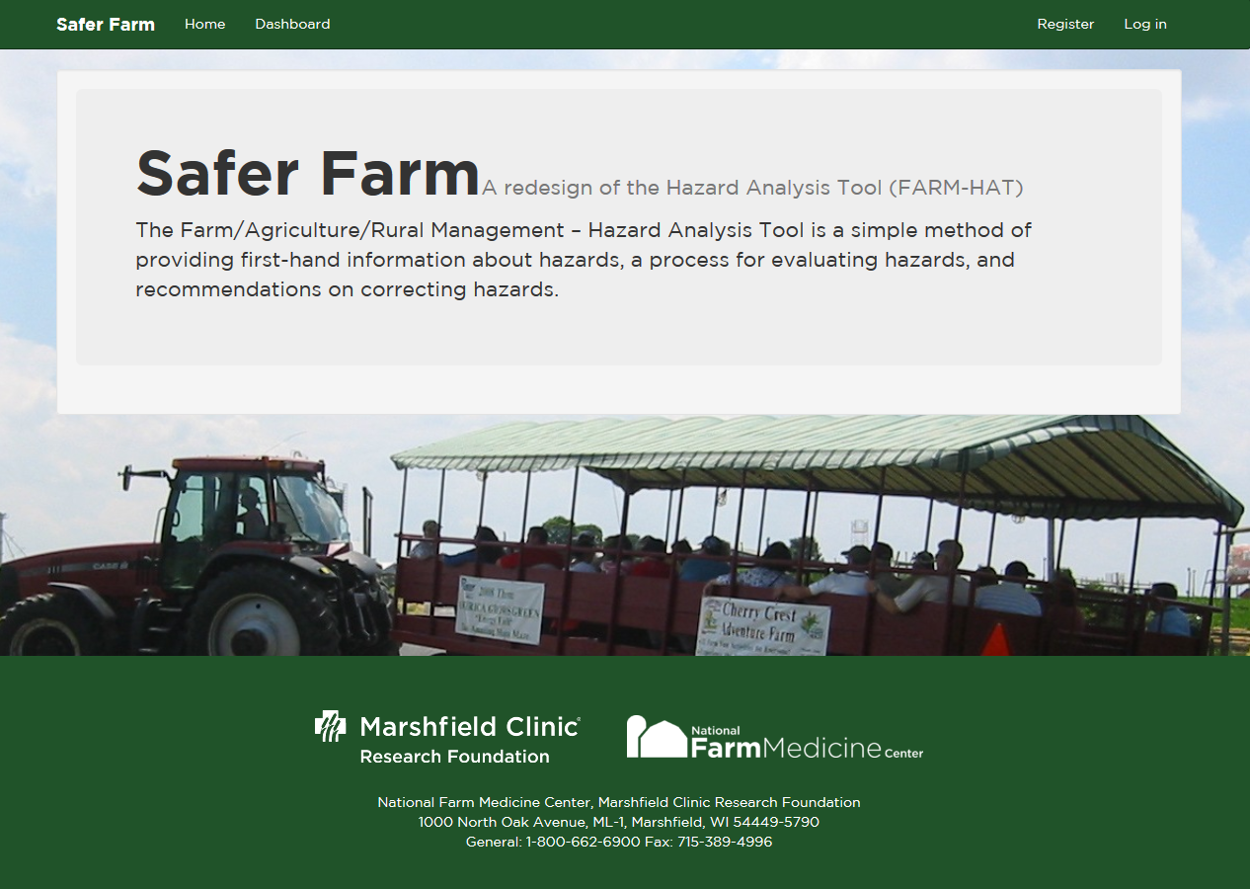
SaferFarm.org
Notes:
Thank you for your interest in this exciting project. We feel that people your age will be able to offer us some great comments on how useful this tool is to identify various hazards on the farm.
As we explained to you, we would like you to use this tool to evaluate various hazards on two tractors, two PTO powered machines and two different buildings. Once you register with Safer Farm, this is your technology. Use it as often as you like. Explore the many areas that we have assessments for. Let us know if you can suggest improvements and enhancements.
This lesson will show you how to use the tool for this project. If you have any questions or problems, please don’t hesitate to contact me. My contact information is given at the end.

Slide 2
What is SaferFarm?
Notes:
It is a farm hazard assessment tool that was created at Penn State University in 1990’s. This tool has been available to download from the PSU Ag Safety and Health website.
Safer Farm is a web-based initiative at the National Farm Medicine Center in Wisconsin. Penn State and National Farm Medicine Center are partnering to create this hazard assessment tool that you are about to use. A mobile friendly website is used so you don’t have to download the many documents that are used to create this tool onto your phone. You simply will login to the website where the data is being stored.

Slide 3
SaferFarm Site
Saferfarm.org
Register
Create username and password
Only you have access to this information
Login
Notes:
Before you can use the hazard assessment tool, you will need to create a user account at the SAFER FARM website. At this site you will create a username and password. Please make sure to write down this information for future reference. Your username and password are only known to you. Registration is instant. Once registered you can log in which will bring you to the home page.
Open your browser and type in Saferfarm.org
In the upper right corner, you will click on register.
Choose a username and password. Record this information because if you lose this, you will be unable to log in to your account later. We will not have access to this information.
Once you register successfully, you will receive a confirmation email.

Slide 4
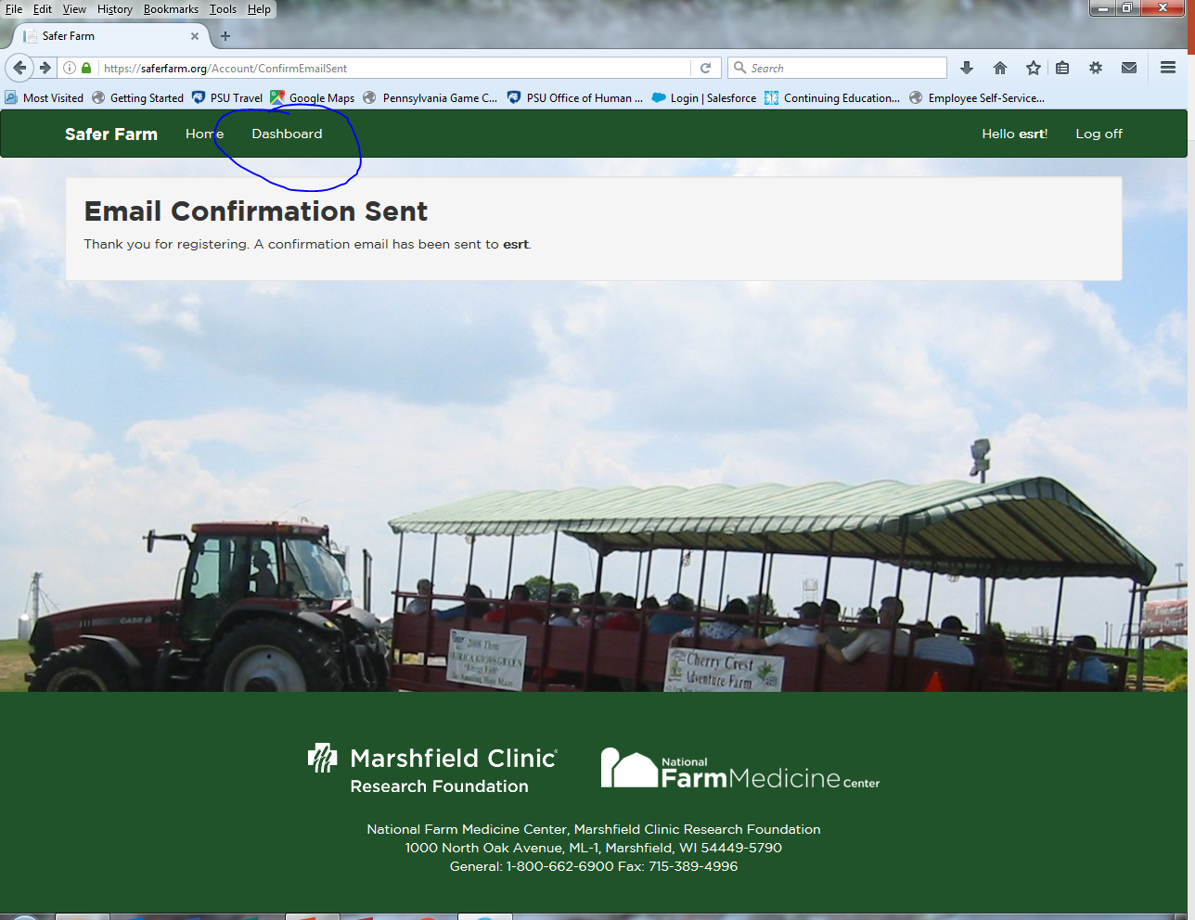
Dashboard
Notes:
After registering, you will receive an email confirmation.
Click on the Dashboard button at the top of the screen.

Slide 5
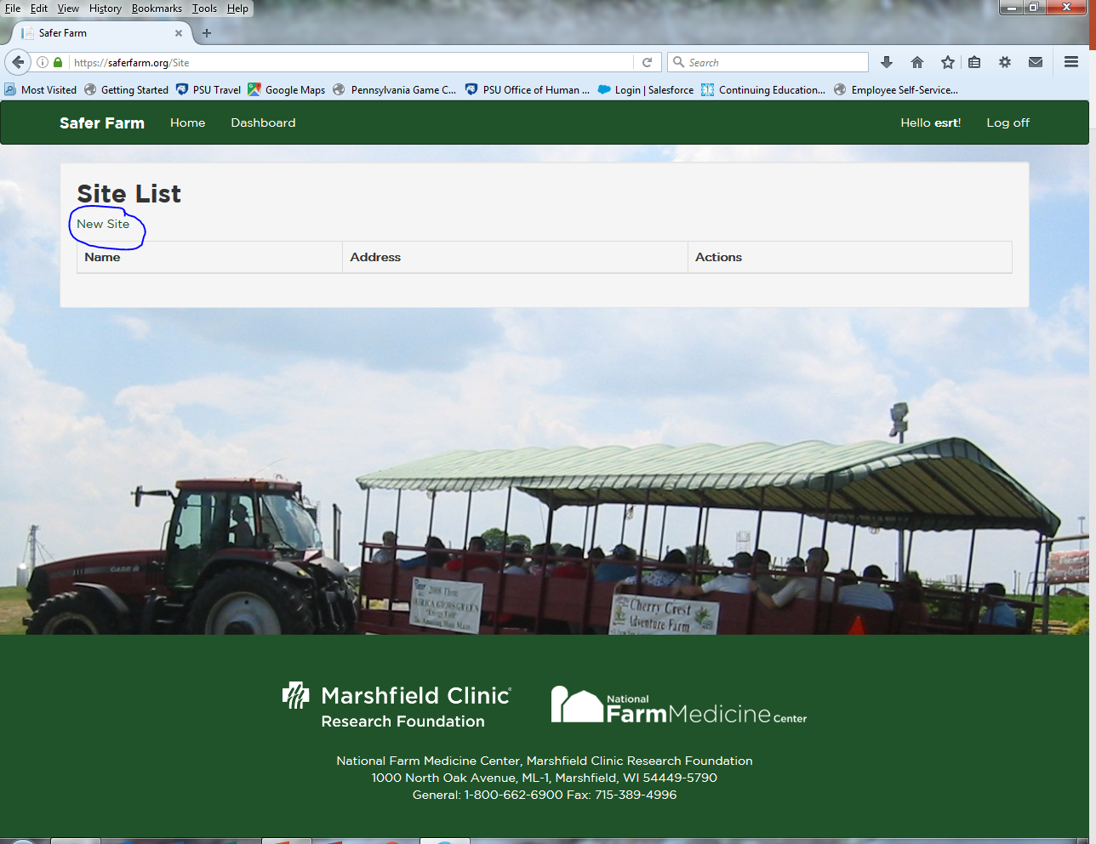
Dashboard-Site List
Notes:
The Dashboard button is where you will find all of your sites where you have done hazard inspections. Because this will be your first site, you will see none listed.
You should click on New Site.

Slide 6
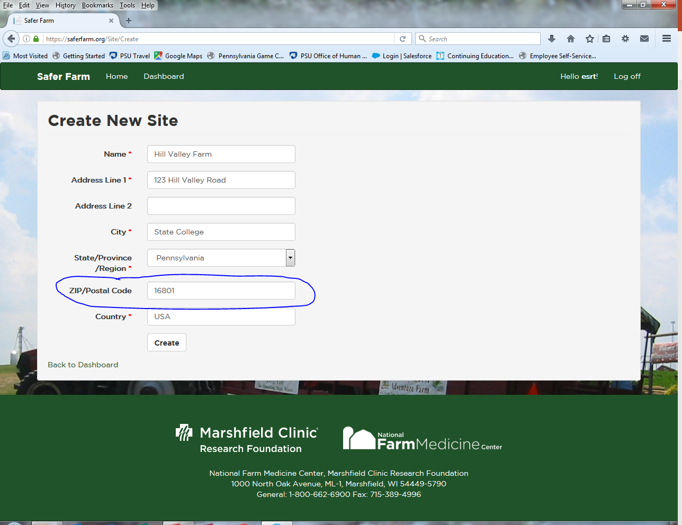
Create New Site
Notes:
Here you will fill in the appropriate information. The red asterisks signify the required information, however, I found out that even though Zip/Postal Code is not marked with an asterisk, this is required information.
Once you have the information entered, click on Create.

Slide 7
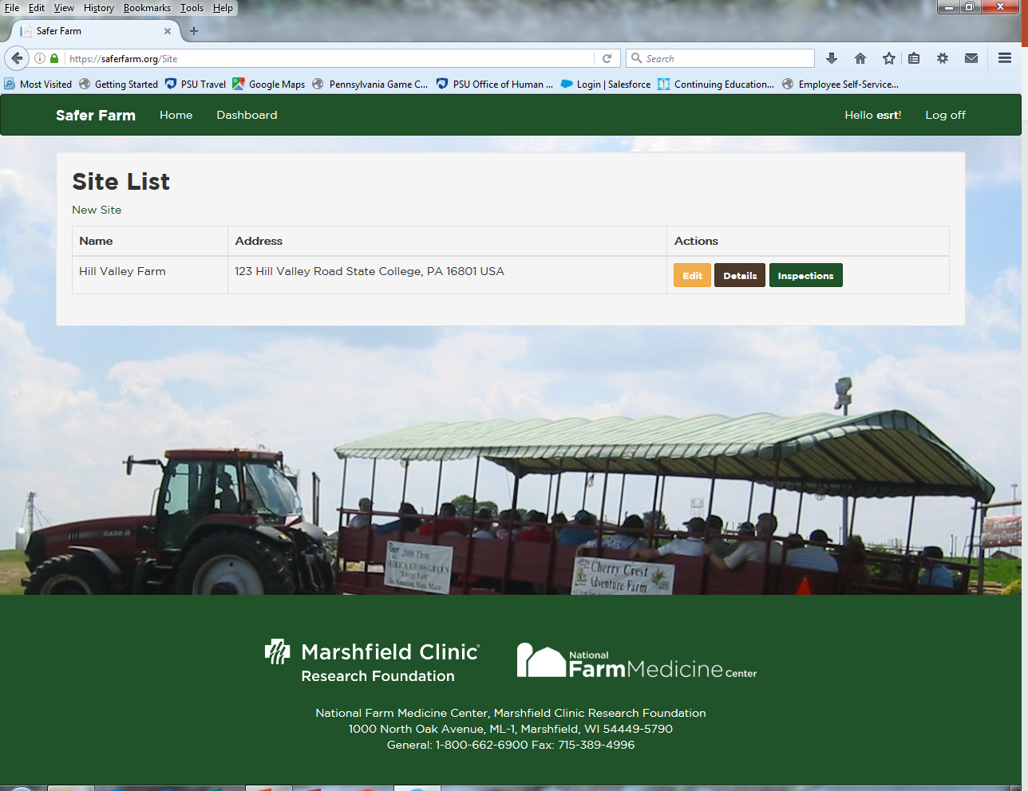
Site List
Notes:
You now have your first Site.
Edit will allow you to go back to the information you entered to create this site.
Details will show you this same information but will list the various inspections you have conducted at this site.
Click on the Inspections button. This will also list the inspections you have conducted. As you have no prior inspections, you will not see any.

Slide 8
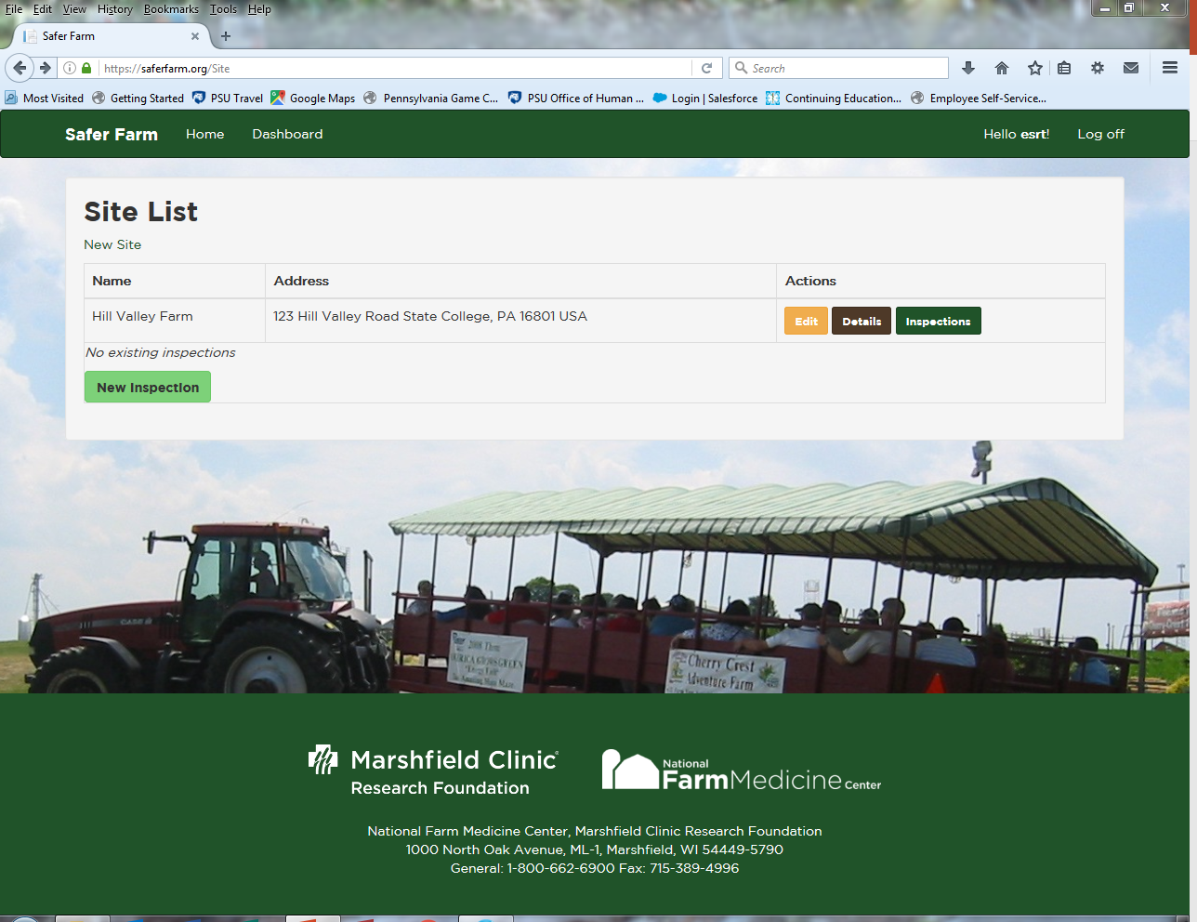
Inspections
Notes:
To start your inspection, now click on New Inspection.

Slide 9
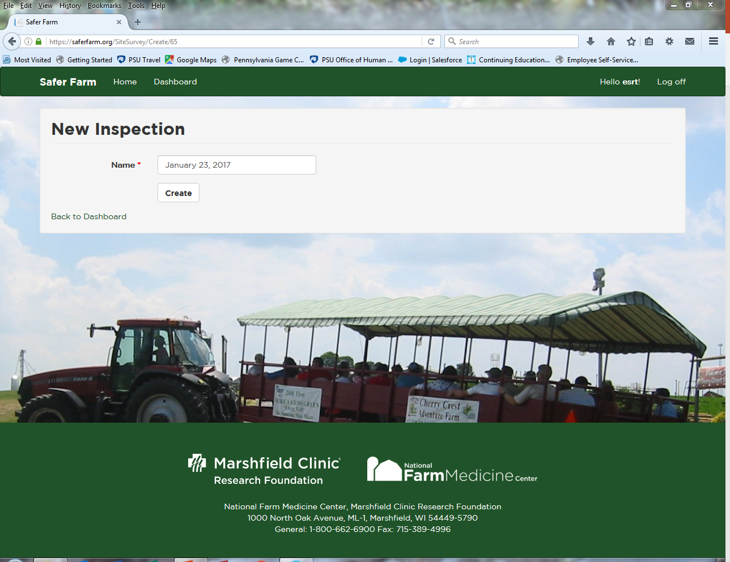
New inspection
Notes:
You need to name your inspection. We suggest that you name them by the date that you are doing them. That way, if you assess the same items at a later date, you can compare your average scores which can help document that you were able to change things to make them safer.
You can name your inspection anything that you want, as long as it makes sense to you.
Once you name it, click on Create.

Slide 10
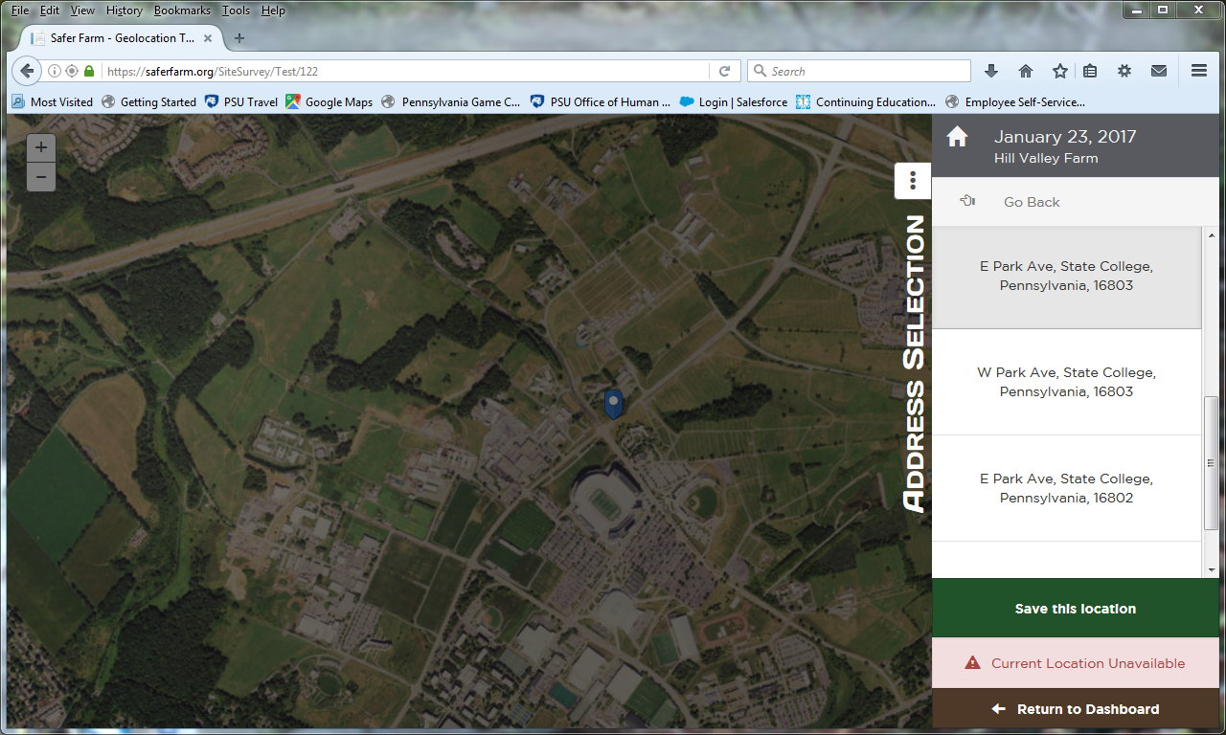
Create new inspection
Notes:
One of the neat functions of this program is to pinpoint your specific location. This may or may not be important to you and is not necessary for the assessment tool to work. Once you choose the correct address or find your location, this can be used to specify exact locations of the tractors, machines or buildings you are using.
You may be given several choices of locations. Once you find your specific location, click on Save this location.

Slide 11
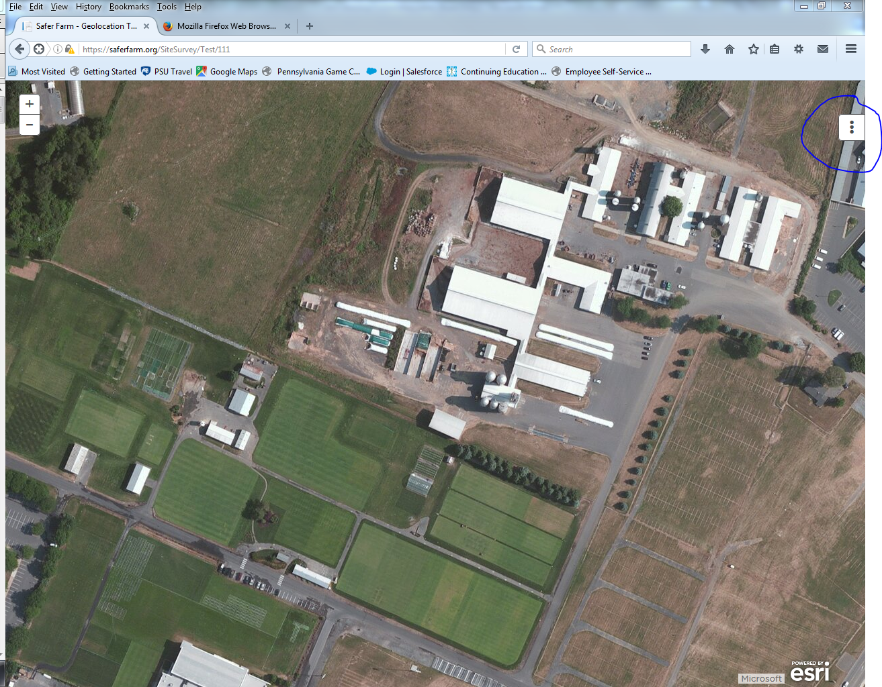
New inspection
Notes:
If you have sufficient internet connection at your location, you should see your location on an aerial picture. You MAY have to select an address on the right side of the photo. If prompted, click save this location. This will allow you to pin specific sites on this picture.
To start your inspection, click on the white box with three dots in the upper right side of the picture.

Slide 12
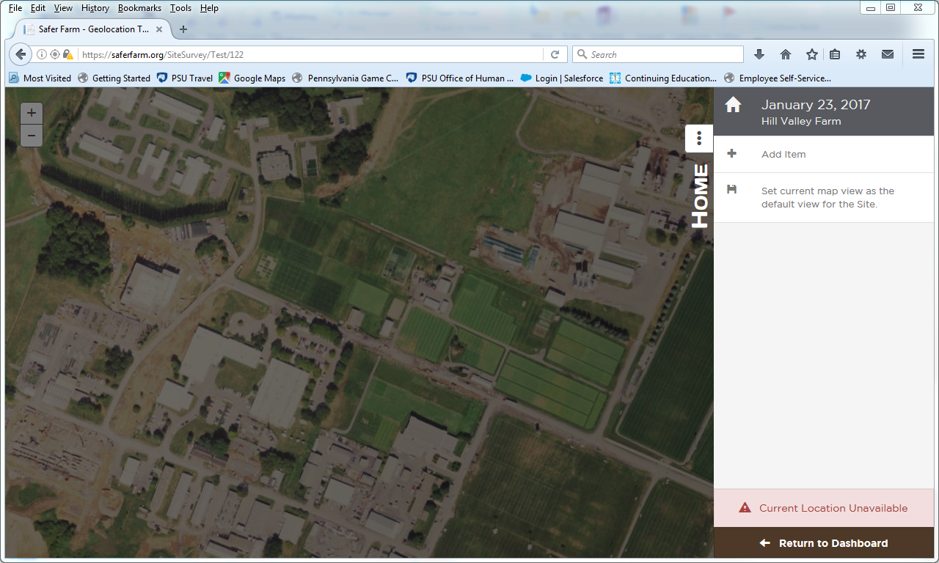
New inspection-Add item
Notes:
To begin assessing hazards on your tractor, you will need to select what items you will want to assess. When you click here, you will see what your options are.

Slide 13
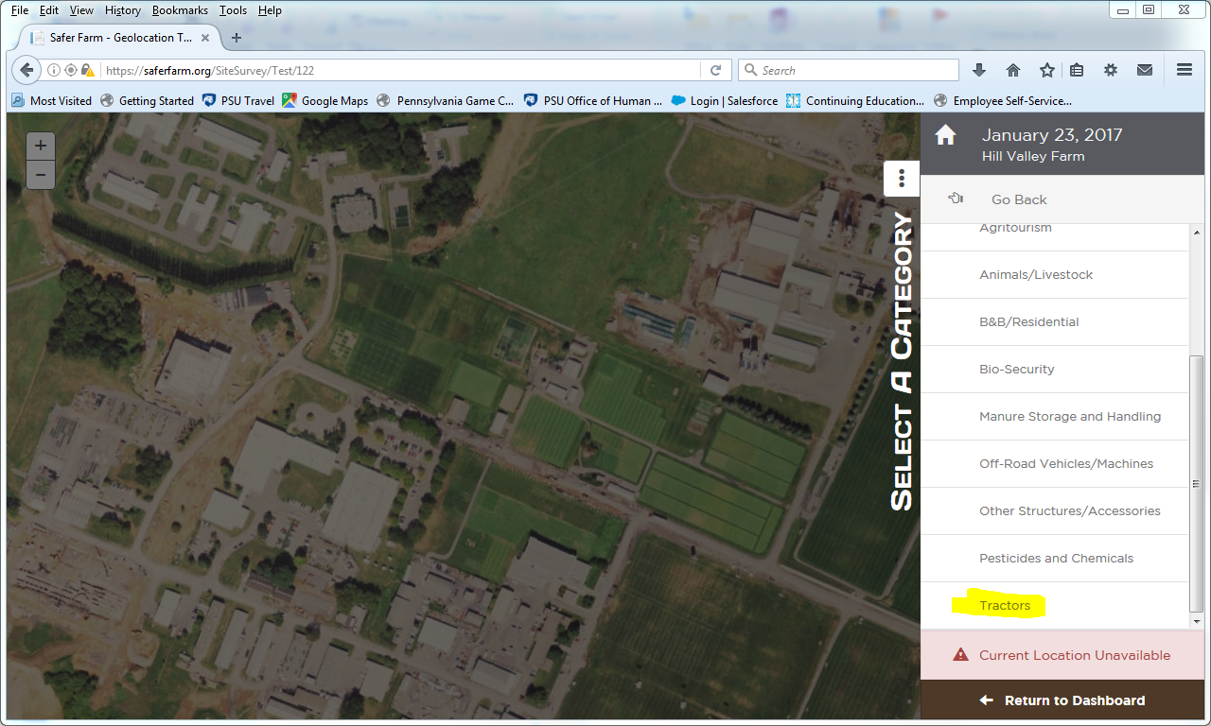
New inspection-Categories
Notes:
This will open up your possible categories. Take a moment to see what the available categories are.
Let’s start our inspection on a tractor, you will click on Tractors (highlighted here in yellow).

Slide 14
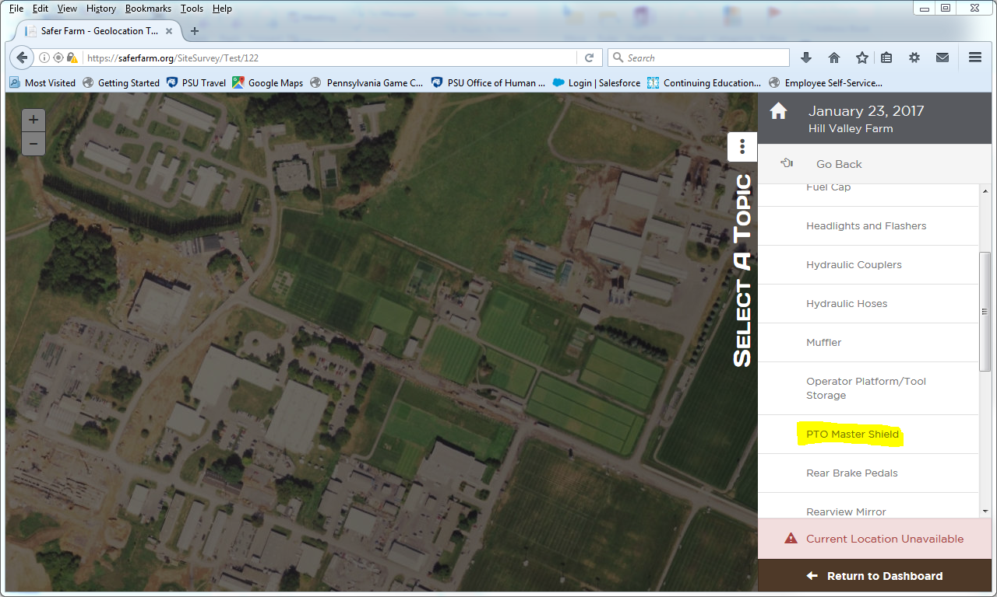
Categories and items
Notes:
Once you select tractor, you will see various Topics on tractors that can be assessed. For this project, we’d like you to select at least 3 separate topics to assess on each tractor. Let’s use the PTO Master Shield in this example.

Slide 15
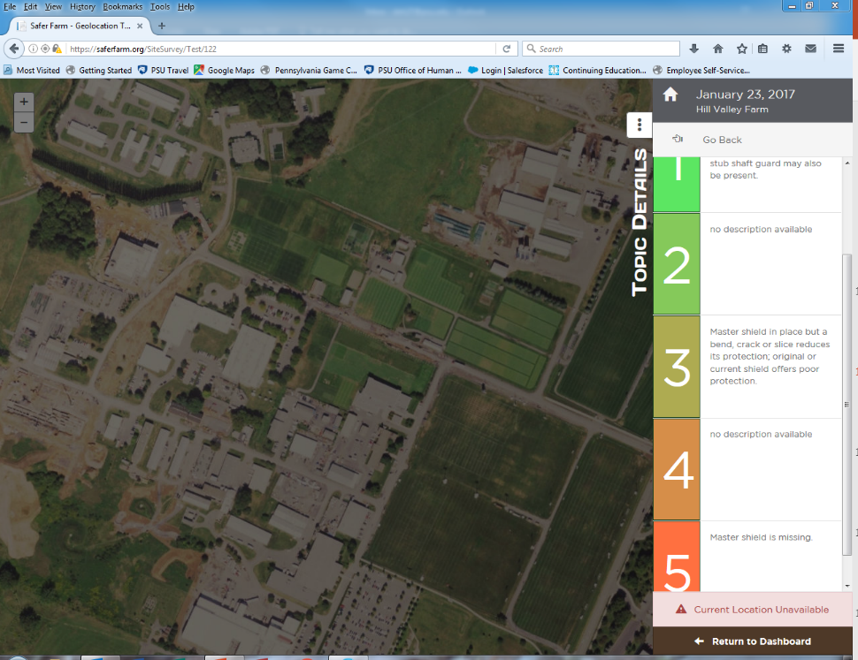
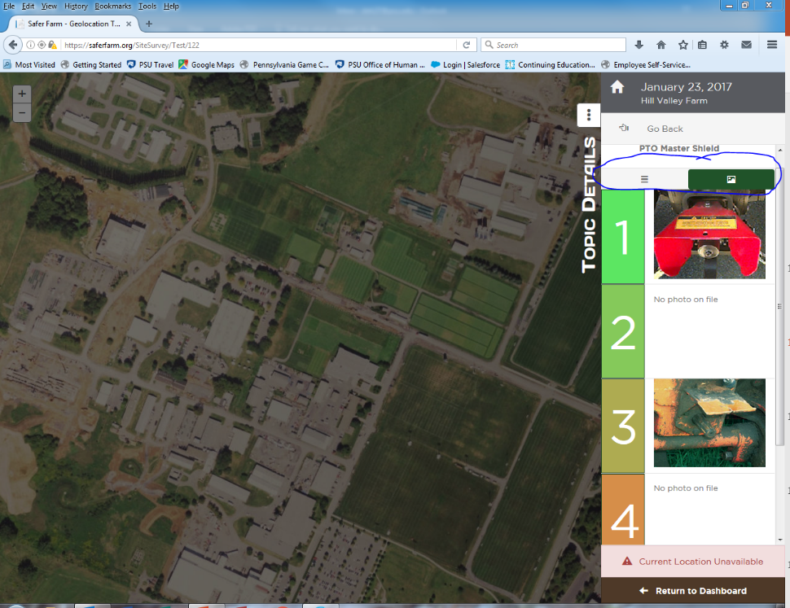
Assessment form
Notes:
Once you click on the item, you will see an assessment form open, with numbers (1-5) on the left with some written description next to numbers 1, 3, and 5. Occasionally you will see written description next to all numbers. It’s worth noting here that 1’s are the ideal and 5’s are the worst, most hazardous. 3’s are the middle of the road.
Sometimes the written descriptions are not enough to help you decide a particular score so we’ve included pictures of each item (1, 3, and 5 only). Click on the photo icon (circled in blue) and this will open pictures instead of the written description.
Click on the appropriate score for your item.

Slide 16
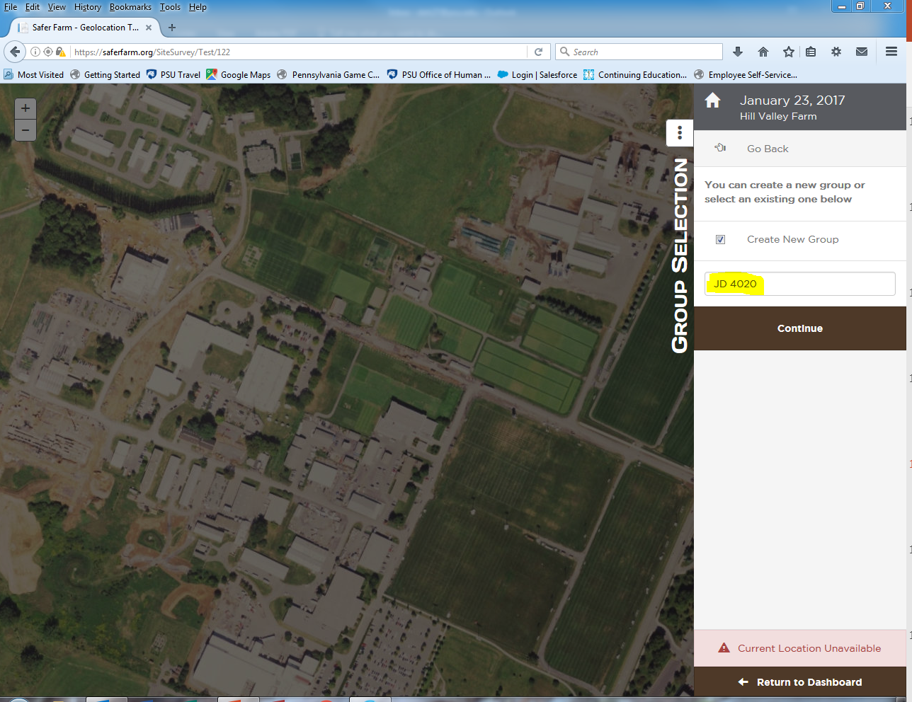
Group selection-Name
Notes:
Once you score your item, you will see this screen. This will allow you to name your category (tractor, machine or building) with a unique name. In my example here, I used my John Deere 4020 (JD 4020).
Once you name your group, click continue.

Slide 17
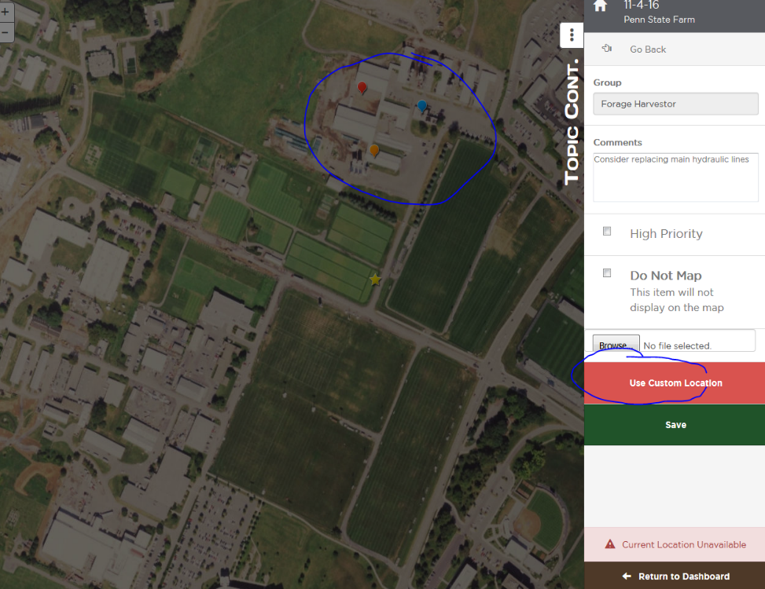
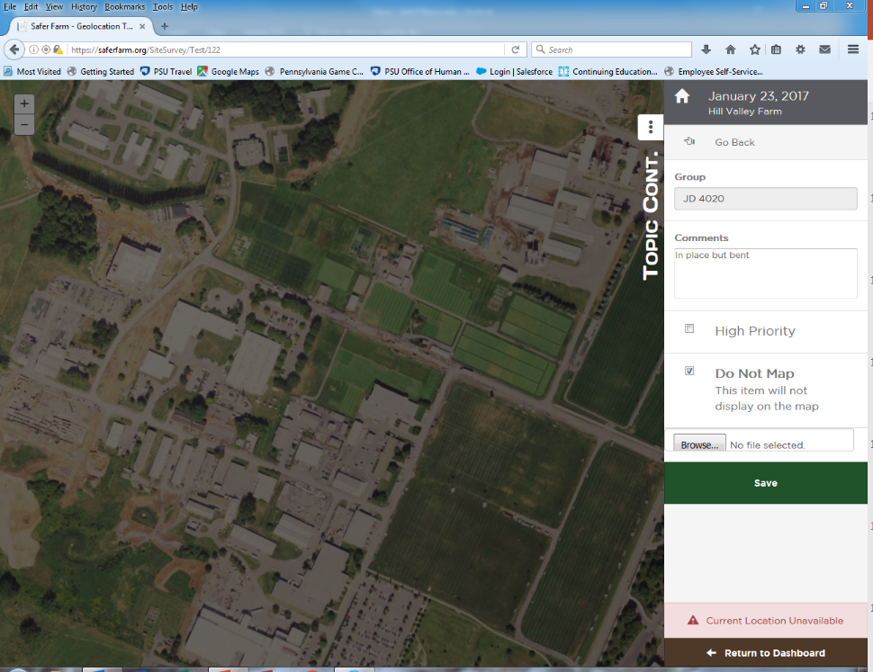
Custom location & Save
Notes:
When you are ready, click Use Custom Location Button and you will be able to click on the aerial map the specific location where this tractor is. OR
In my case, I will choose not to pin the map this specific location, I will click the Do Not Map button. Once you do this, you will see a Green Save Tab arrive.
The picture on the left shows how the pinning works. This may make more sense to you to identify specific buildings rather than machinery that is portable. Either way you choose to do this is fine.

Slide 18
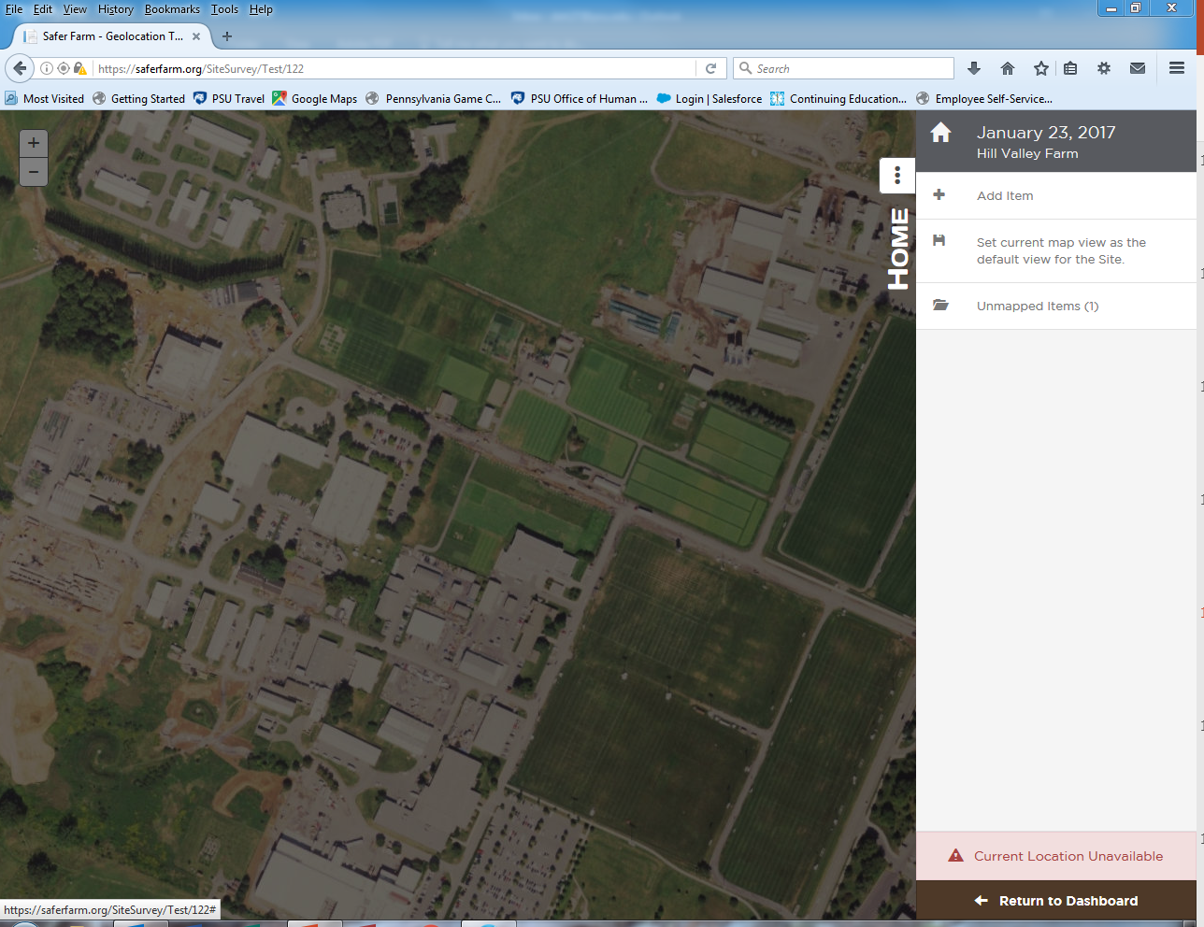
Save and Home Screen
Notes:
Once you hit save, you will be brought back to the home screen where you can select more items and topics Just like you did for the tractor PTO Master Shield, you would select Tractor, then select another topic that you want to assess on that tractor and conduct your assessment. This time, when you are completed with your assessment, instead of naming a new group, you would select the group (in my case my JD 4020) to save this assessment in.
You would repeat this process with your other tractor, then your machines and buildings.

Slide 19

Return to Dashboard
Notes:
Once you are completed with your assessment of your tractor, click on Return to Dashboard.

Slide 20
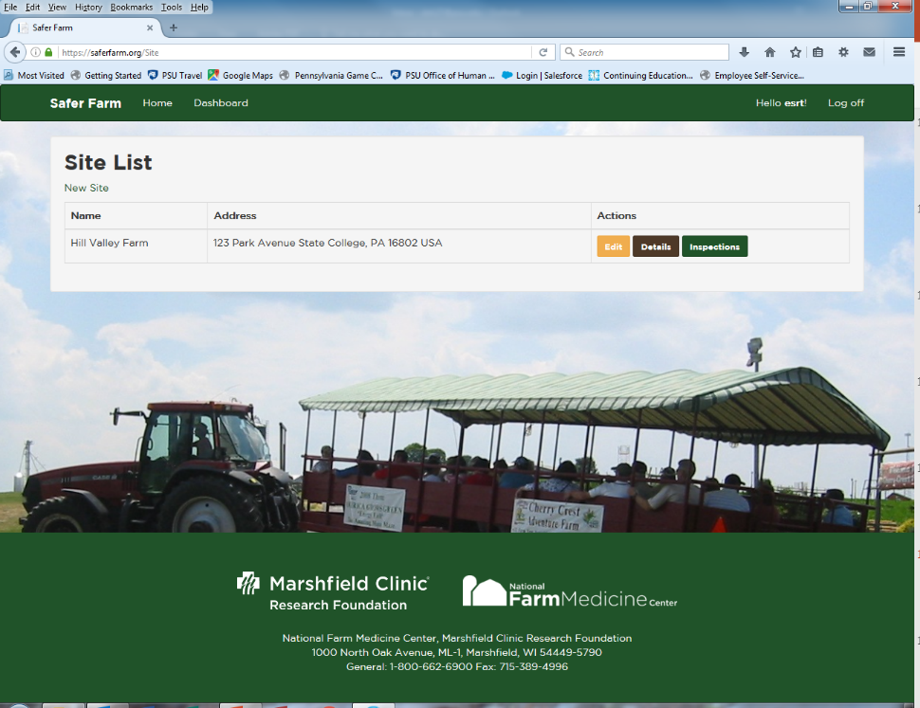
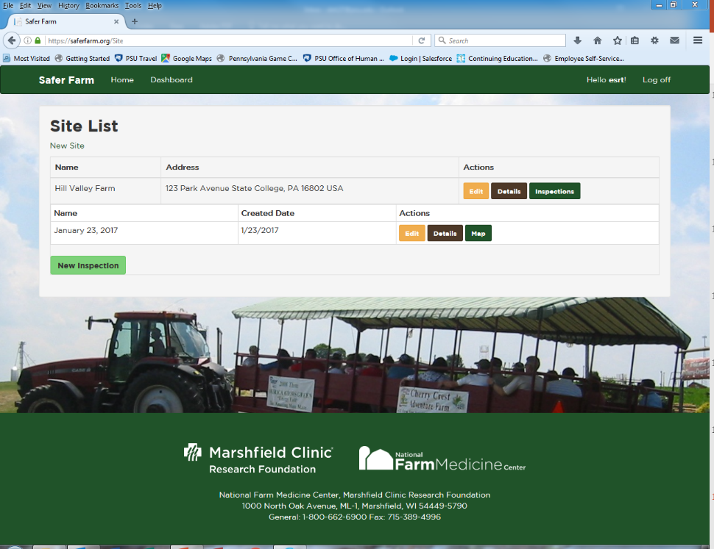
Dashboard-Site List
Notes:
If you go back to Dashboard, you will come to a screen that lists your sites. The one you just created will be the only one you will see. If you click on Inspections, you will see a screen that will show what inspections you have conducted.

Slide 21
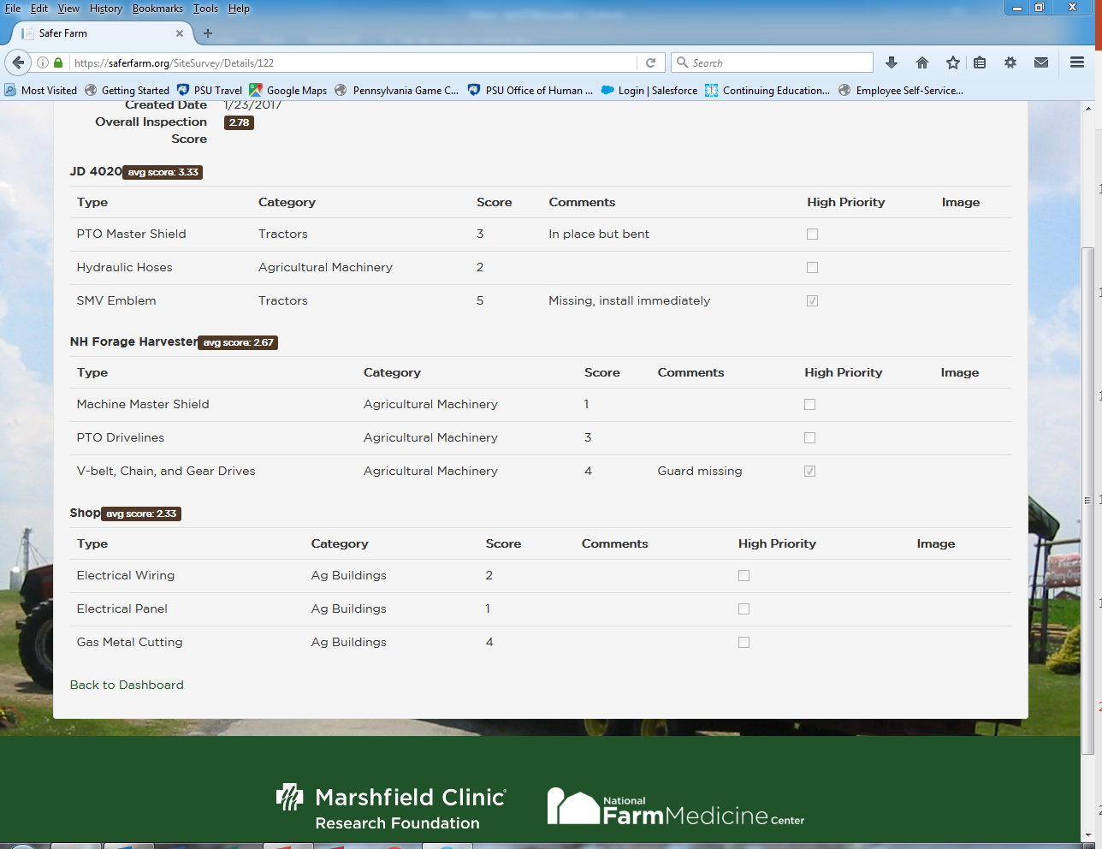
Inspection Details
Notes:
If you click on Details next to your inspection, you will have a listing of all of the categories that you inspected during this day.
You will notice that on this screen you will see an overall inspection score which averages all individual items that you inspected.

Slide 22
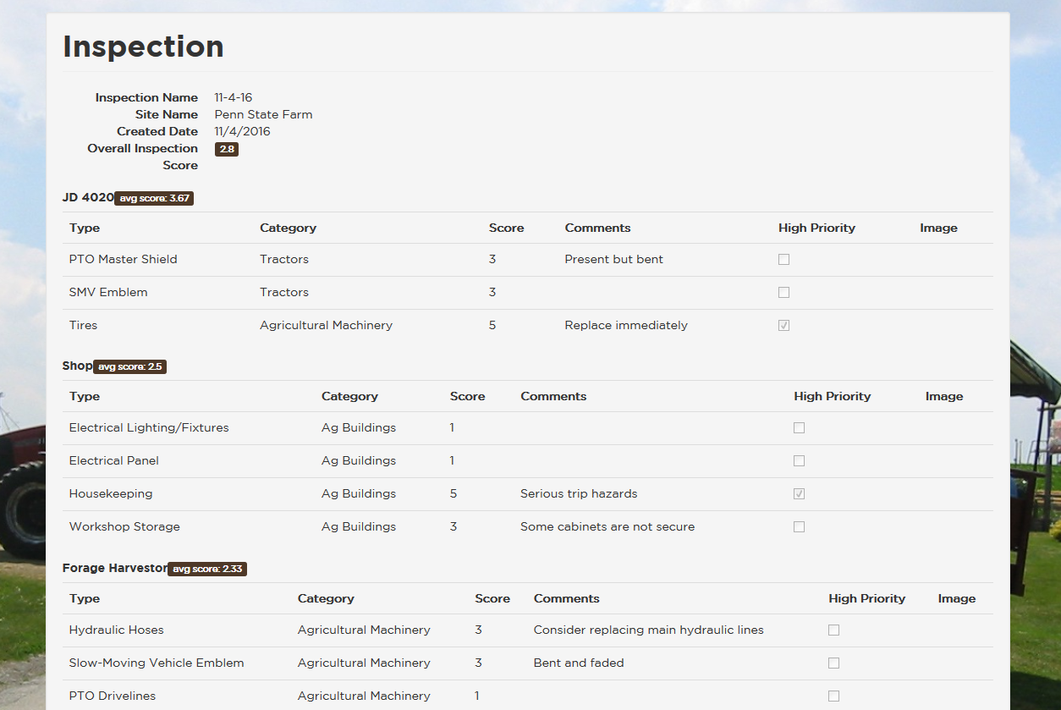
Inspection Details
Notes:
Clicking on details will show you the summary (details) of the specific inspection. In this screen shot, you will notice the overall score of 2.8 which combines the scores of my John Deere 4020, my farm shop and my forage harvester. You can also see the various comments that were made during the assessment and any high priorities.

