Slide 1

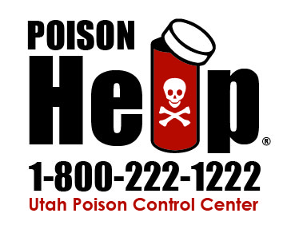
Utah Poison Control Center
WONDERFUL WORLD OF POISONS
Kelly Teemant, BS, MCHES®
Training & Communication Coordinator
Notes:
Intro-
Good afternoon thank you for having me, I’m Kelly Teemant from the Utah Poison Control Center. I’m here to talk with you about the “wonderful world of poisons.” I’ve been with Poison Control for over 10 years and can truly say I have a passion for poison and I don’t mean Bret Michaels rock band “POISON” although I do quite like their song Every Rose Has Its Thorn.
Lets get things started with a little audience participation to make sure you’re all still awake.
1. Easy question first. By raise of hands who know the phone number for poison control? Come of everyone should raise their hands it’s on screen.
2. But seriously let step it up a bit does anyone have it saved in their cell phone?
3. What is the worst or most dangerous poison? That’s a relative or tricky question and you could argue different reasons (like symptoms or the size of dose needed) for many substances like ricin, cyanide, arsenic, strychnine, tetrodotoxin (puffer fish), Botulinum Toxin, VX nerve agent and the list goes on but the truth is the worst poison is the one that causes death. Which is what we’d like to prevent. Since we’re not in a James bond move these exotic poisons are not the everyday poisons we general see, that’s not to say they don’t come up.
500 years ago Paracelsus the "father" of toxicology is reported to have said "What is there that is not poison? All things are poison and nothing is without poison. Solely the dose determines that a thing is not a poison,” And he had a point. Ultimately, we are surrounded by potentially dangerous substances – it’s the dose that makes it deadly.

Slide 2

Utah Poison Control Center
Established in 1954
Statewide program
Administratively in the University of Utah College of Pharmacy
Mission: to prevent and minimize adverse health effects from a poison exposure through education, service, and research
Notes:
The Utah Poison Control Center has a proud legacy as one of the first poison center’s established in the United States. It is a program of the University of Utah College of Pharmacy with a mission to prevent and minimize adverse health effects from a poison exposure through education, service and research.

Slide 3


Poison Center Services
24 hour resource for poison information, clinical toxicology consultation
POISON CENTER HELP IS FREE, EXPERT, AND CONFIDENTIAL
Poison prevention education
We help people of all ages – in all types of situations
Notes:
The UPCC manages an average of 118 calls per day from both the general public and health professionals, providing free consultations 24 hours a day, seven days a week, 365 days per year!
Before we get to far into this presentation I want you to think about the communities and people you serve and how the Utah Poison Control Center can be a resource for them and how can we help you?
We are here to help people of all ages – in all types of situations. I see that as something that fits inline with USU Extension goal of improving the lives of individuals, families and communities throughout Utah.

Slide 4

UPCC Expertise
Specialists in poison information (SPIs)
  Pharmacists and nurses
  Special training in clinical toxicology
  Nationally certified
  Staff around-the-clock
Poison info providers (PIPs)
Medical doctors and clinical toxicologists
Health educators
Notes:
When calling the Utah Poison Control Center 24-hour hotline you reach a specialist in poison information or for short SPI– these expert are pharmacists or nurse with additional training in clinical toxicology and are supported by other clinical and administrative staff.

Slide 5
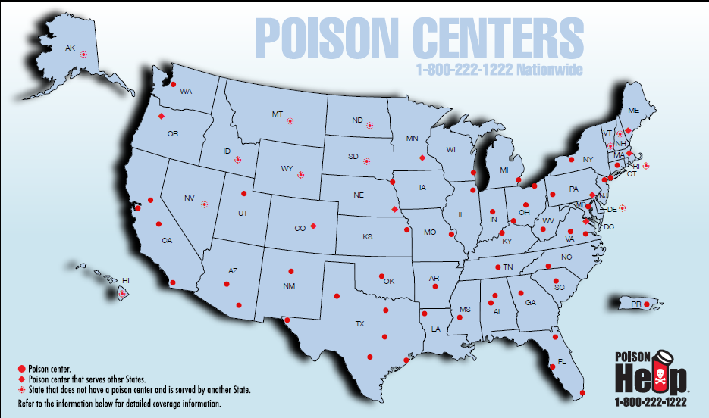
Notes:
There are 55 poison control centers to serve the entire United States and US territories. Not every state has its own poison control center. Some poison centers such as Colorado and Oregon serve more than one state, and some large states have more than one poison center like California or Texas.
Anywhere in the US you will have access to a regional poison control center – even if it is not physically located in your state.

Slide 6

National Poison Data System (NPDS)
Largest database on poison exposures in US
  Hospitalized and home management cases
  > 36 million poison exposures
  Computerized data collection at PCC
  Data uploaded in near real time (~ 7 min)
Annual report published www.aapcc.org
Public health and post-marketing surveillance
  New and emerging threats
  Evidence to support regulatory actions
  Education and research
Notes:
A medical record is created for each exposure reported to each poison center in the U.S. Collectively with the other 55 PCCs in the US there are over 2.4 million poison exposures reported annually – making the National Poisoning Data System or NPDS – the single largest database on poisoning exposures in the United States and the only database that includes exposures that are managed outside of the healthcare system. Giving a real picture of poisoning events throughout the United States.
Since the database was created there are over 36 million poison exposures this large number of poisoning exposures allows for evaluation of trends in poisoning.
Poison centers share info with health departments, FDA, CDC, and other health agencies.
This information helps us to identify the most common kinds of poison exposures.
Identification of new and emerging threats
Prompt new product/medicine formulations
Evidence to support regulatory actions/recalls
Development Education programs
Research

Slide 7
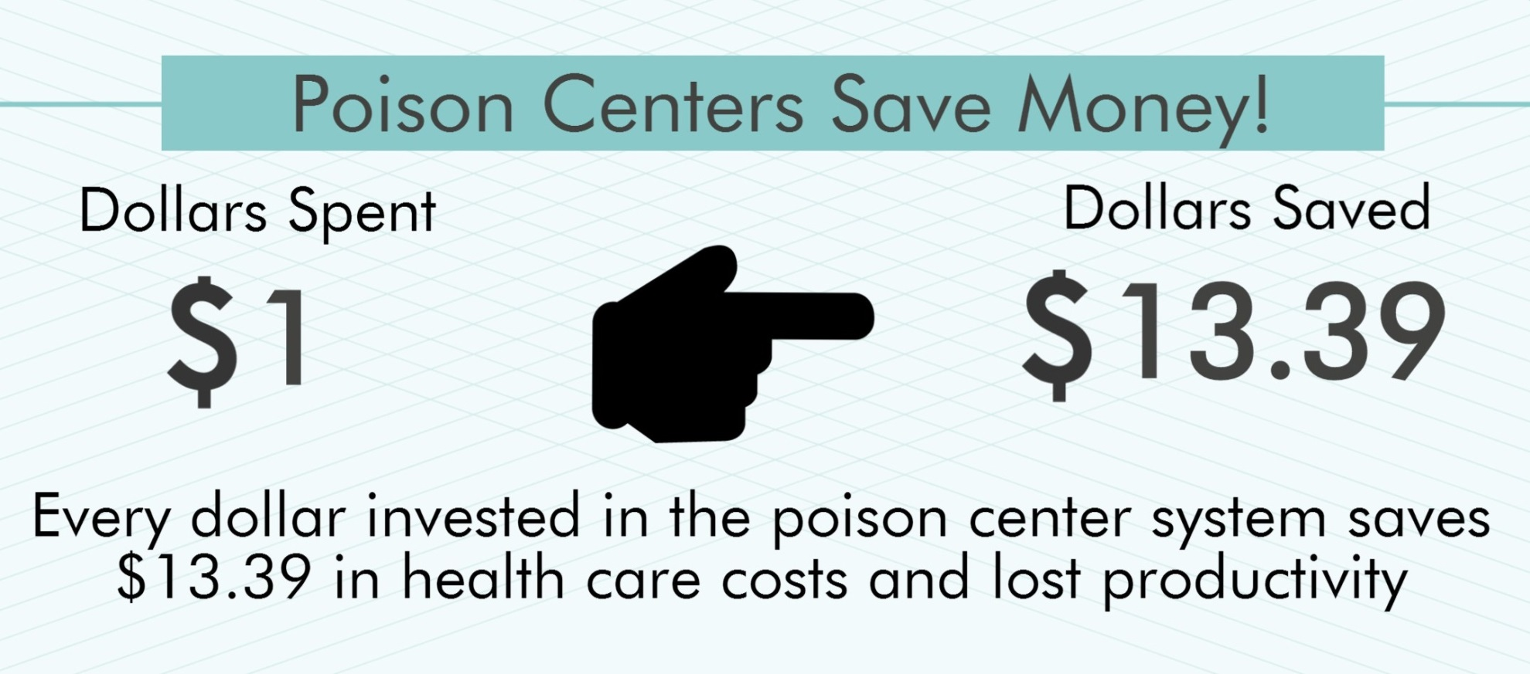
Best Health Care Deal Around
Notes:
Over the past 63 years, since 2017, the UPCC has provided more than 1.76 million consultations, reducing the burden on healthcare providers and saving countless lives in the process. And, since the majority of consultations can be managed over the phone, the poison center saves Utah families money and unnecessary visits to emergency departments. Every dollar invested in poison control saves $13.39 in health care costs and lost productivity.

Slide 8
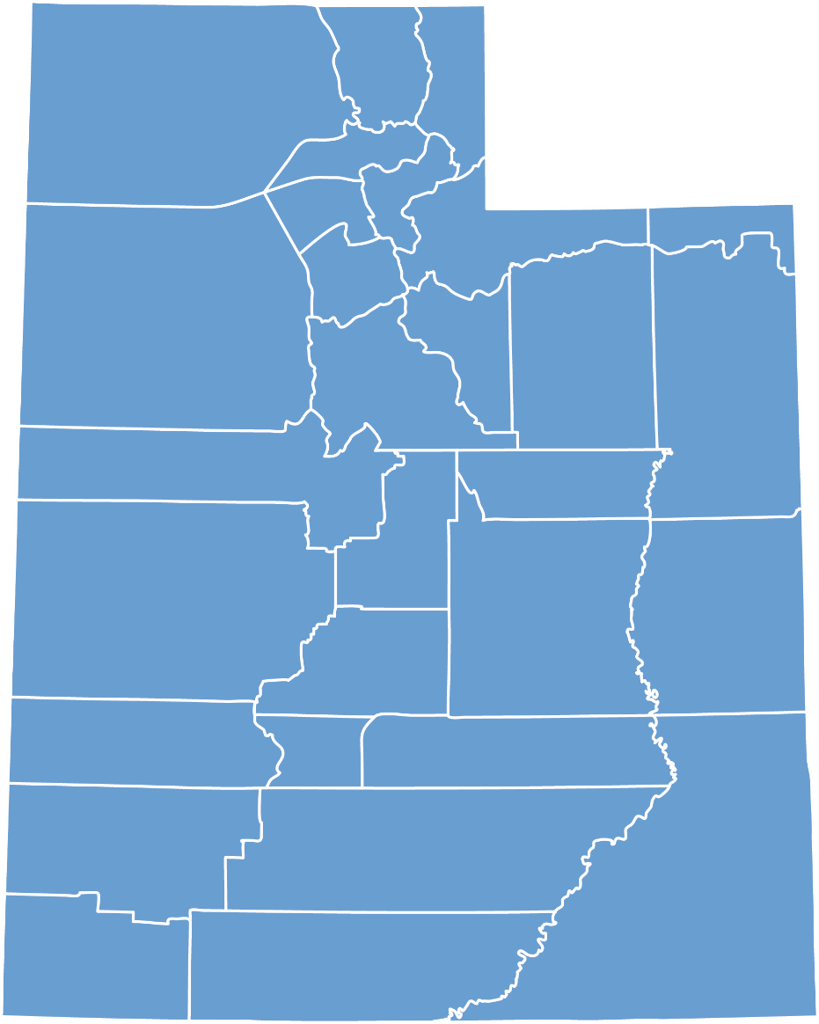
Utah’s Poison Problem
43,217 total cases
39,475 human poison exposures
58% involved children less than 6 years of age
93% occurred in the home
75% were managed on-site with telephone follow-up
Utah Poison Control Center, 2017
Notes:
There are over 40,000 total calls to the UPCC each year. More than ¾ of calls are handled without sending the patient to a health care facility. The overwhelming majority of poisonings occurred in the home.
I know some of you might be thinking Poison Control that just for one a kid gets into something they shouldn’t, and while your right with 58% of the calls in children less that 6 we get calls from all age groups.

Slide 9
Leading Causes of Unintentional Injury Deaths
United States, 2014
Poisoning | 38,851
Motor Vehicle Accidents | 35,369
Falls | 30,208
Choking | 4,864
Drowning | 3,391
Fires, flames, and smoke | 2,760
106 people die each day as a result of unintentional poisoning
Lifetime Odds of Death from Poisoning
1 in 109
National Safety Council, Injury Facts 2016
Notes:
This chart speaks for itself.
Poisoning remains the most common cause of unintentional injury death, well ahead of firearms deaths and motor vehicle crashes. Of the top three leading causes of preventable injury-related death – poisoning is the highest. This current trend is linked to a dramatic climb in poisoning deaths driven by the opioid epidemic.
Before I go to the next slide, what do you think is the most common poison exposure?

Slide 10
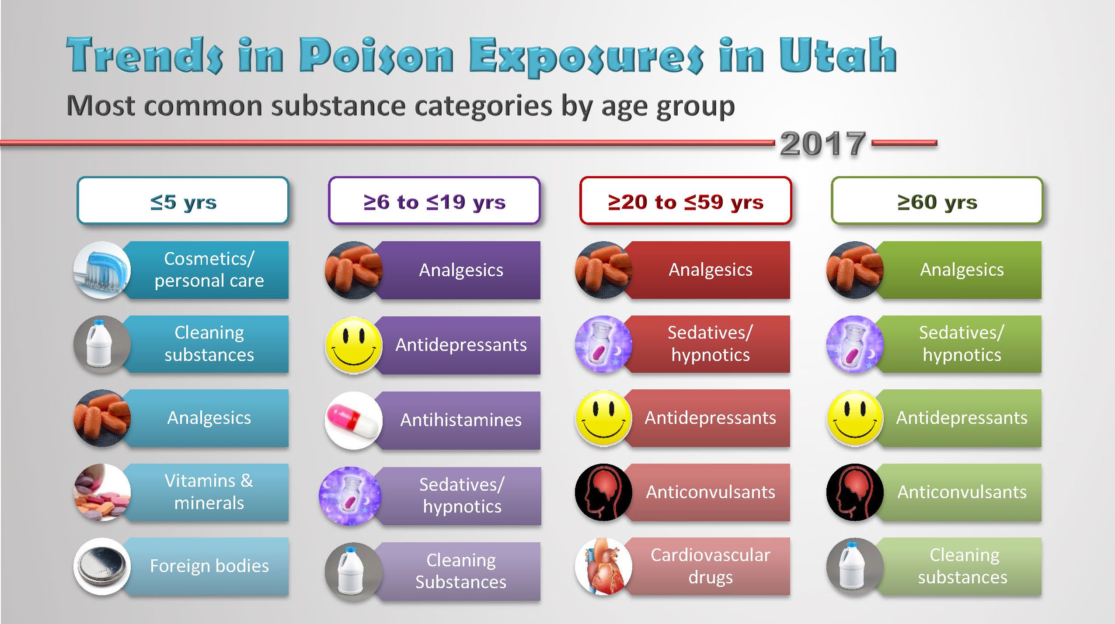
Notes:
This represents the most common categories of exposures by age reported to the Utah Poison Control Center. The chart shows the most common substances, not necessarily the most toxic substances. Common substances tend to reflect what substances are readily available in the home.
The majority of exposures reported to the poison center are unintentional in all age groups except those ages 13-19 years. Exposures in teens are more likely to be intentional in nature; either self-harm, intentional misuse or abuse.
Analgesics: Pain medicine (anti-inflammatories like acetaminophen and ibuprofen, as well as prescription pain medicine)
Sedatives: Valium, sleep medications, anxiety
Antipsychotics: mentally ill, Zyprexa, Seroquel, schizophrenia

Slide 11
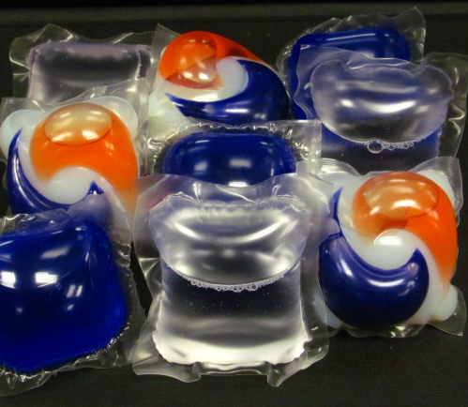
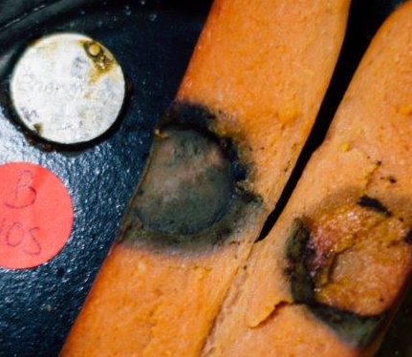
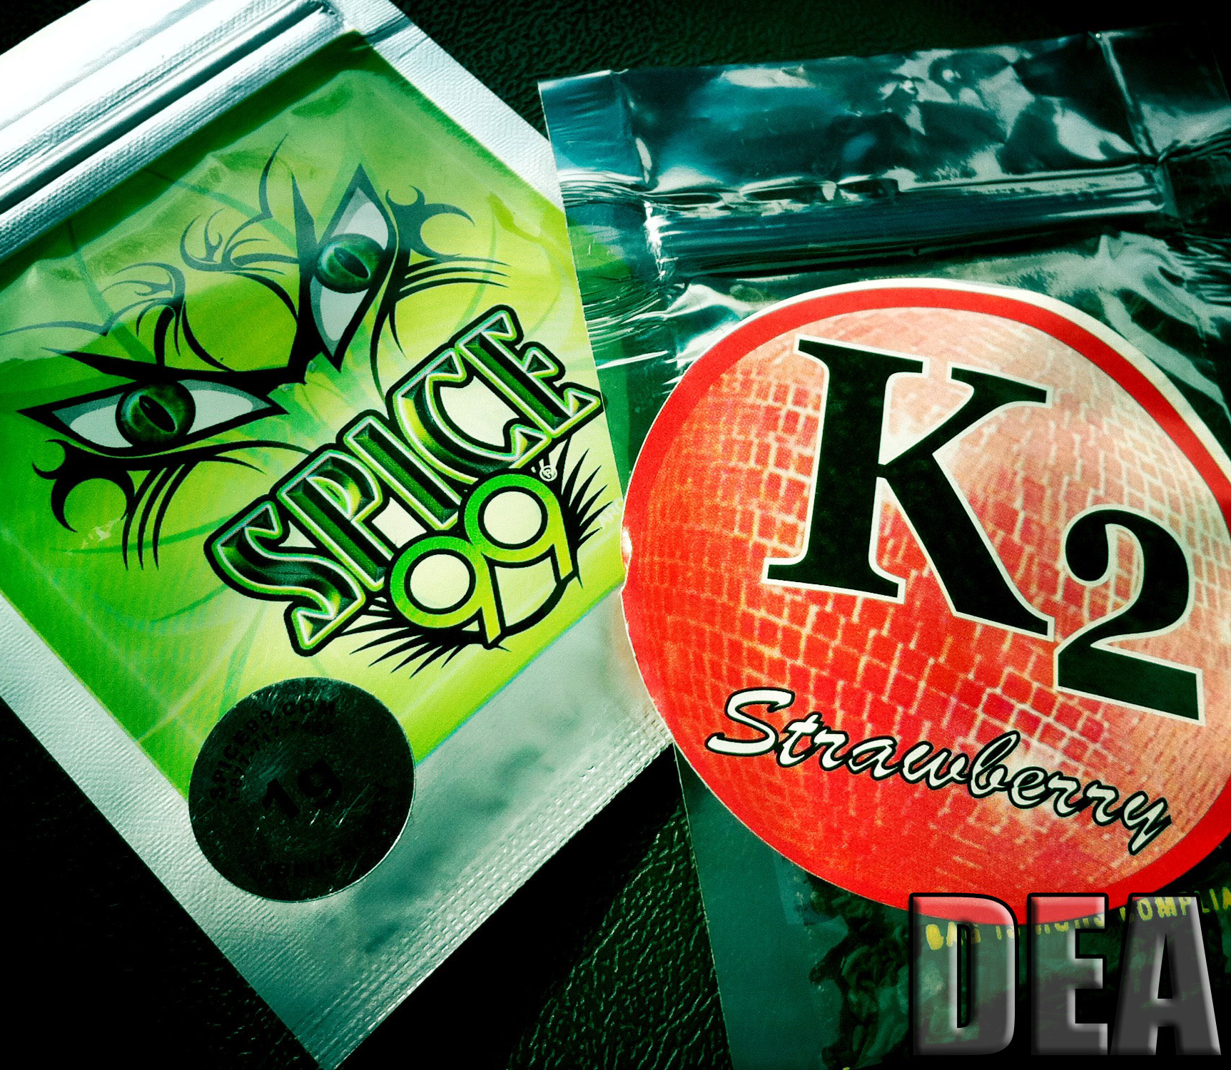
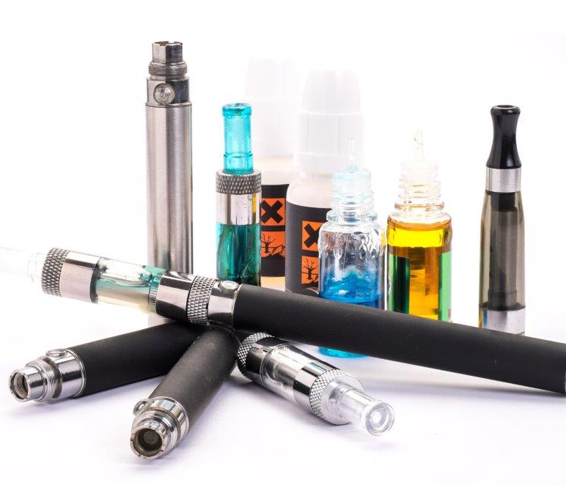
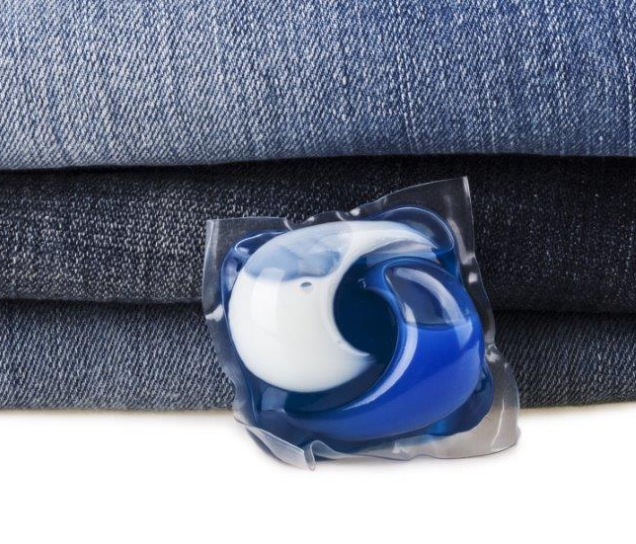
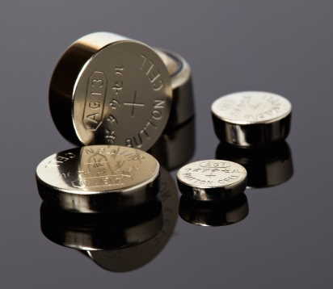
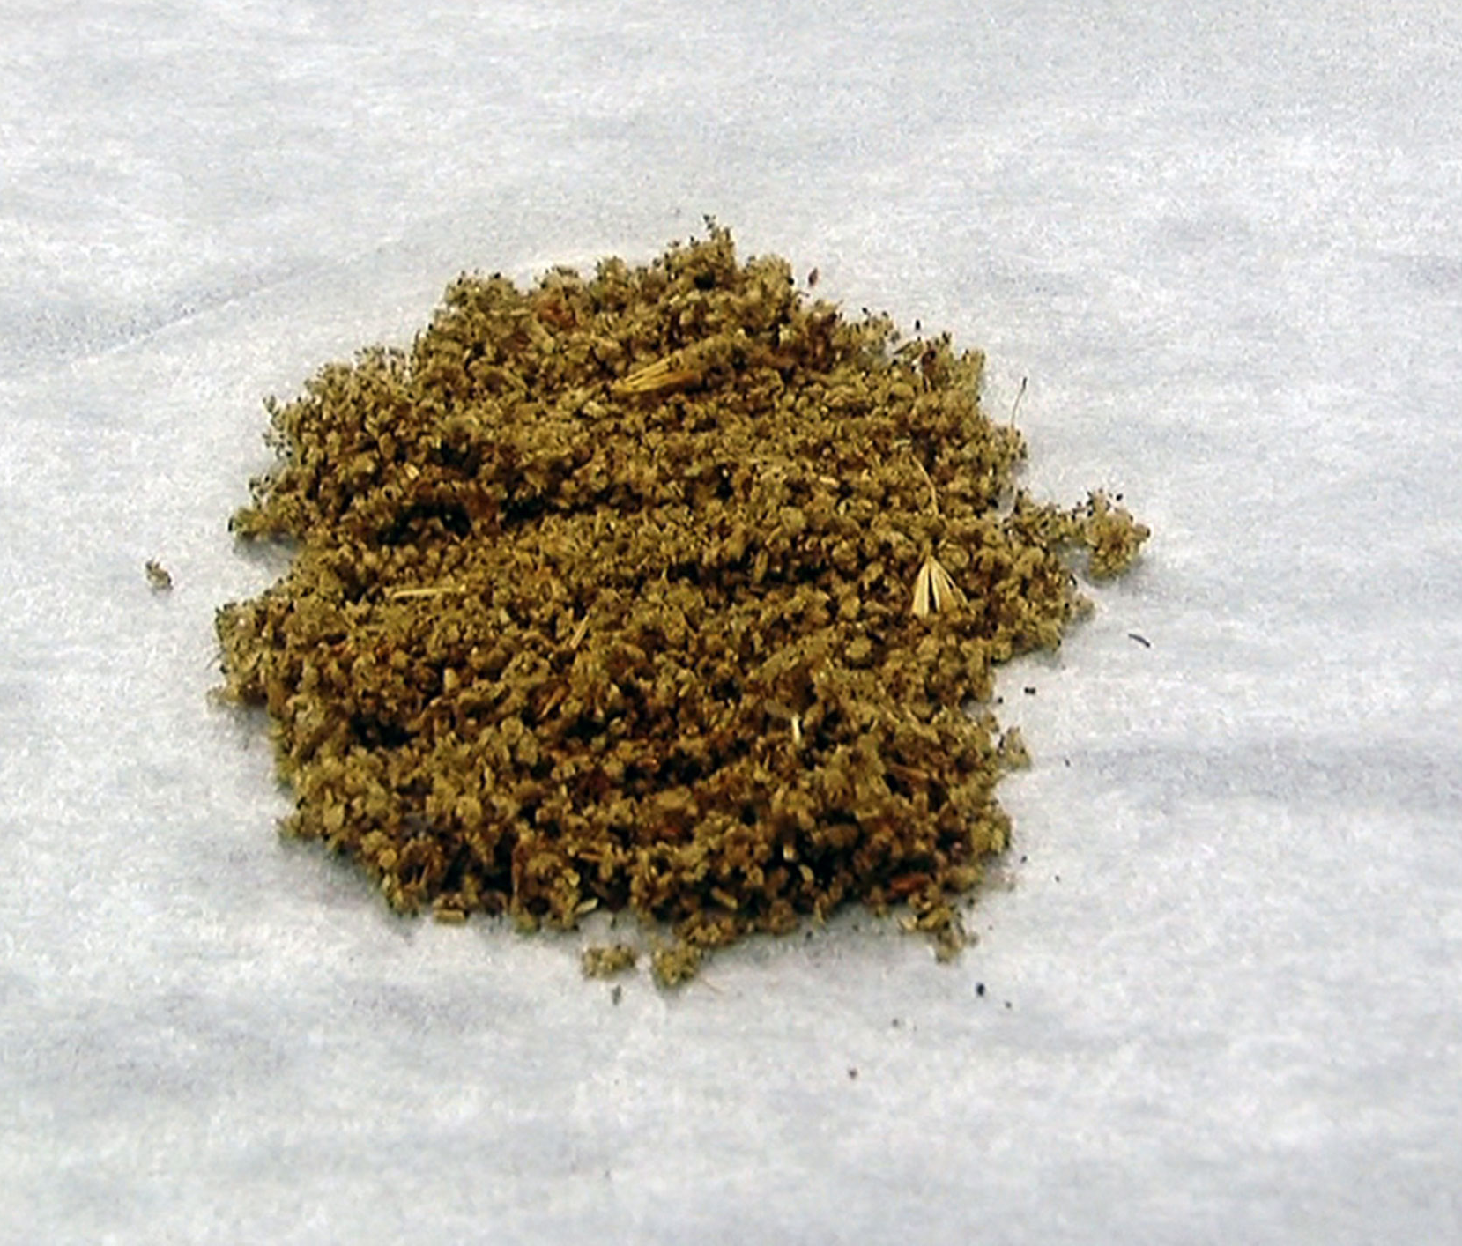
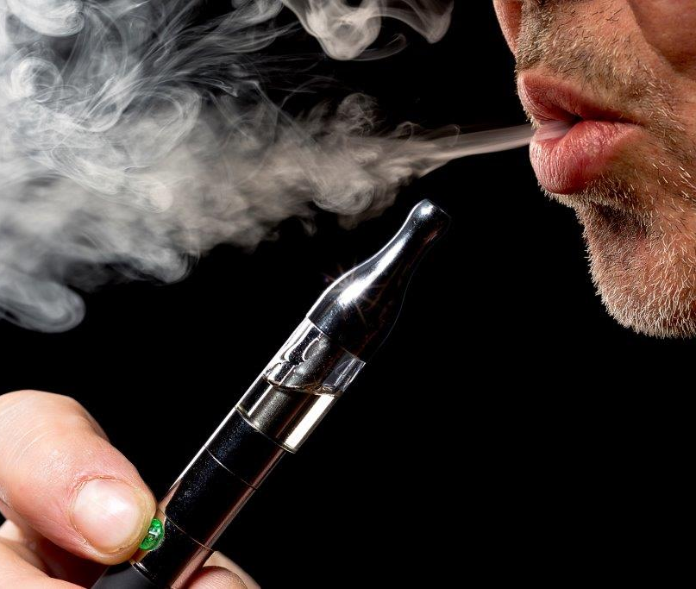
Trending topics
1
2
3
4
Notes:
1-Laundry detergent packets: Tide pod Challenge, young children or elderly adults may mistake the colorful pods for candy (look a likes).
2-Button batteries: A button battery can cause damage in three ways: First, it can create electrical current. Second, it can put pressure on sensitive tissues and third, it can leak harmful chemicals from the battery. And all of these can cause burns to the throat or the stomach. The burn can be so intense after only several hours of exposure that the voice box can be destroyed or internal bleeding can occur.
3- Spice is a synthetic cannabinoids, its man-made chemicals bind to the same receptor in the brain as marijuana, but are much more potent it can cause nausea and vomiting, rapid heart rate, suicidal thoughts, violent behavior, paranoia, and hallucination. In 2016, there were 2,695 calls to poison control centers across the nation for harmful exposure from these drugs.
4- E-cigarettes and liquid nicotine: As little as a teaspoon of e-cigarette liquid can be fatal to a child. We saw a huge increase in exposures starting in 2012 (16 cases) to the height in 2014 (133 cases), although the amount of exposures have tapered in 2017 we still have 89 exposures in Utah.
These are some of the products we have seen surges in recently, mostly due to the availability or popularity of the items.
Reference: https://www.drugabuse.gov/related-topics/trends-statistics/infographics/synthetic-cannabinoids-k2spice-unpredictable-danger

Slide 12

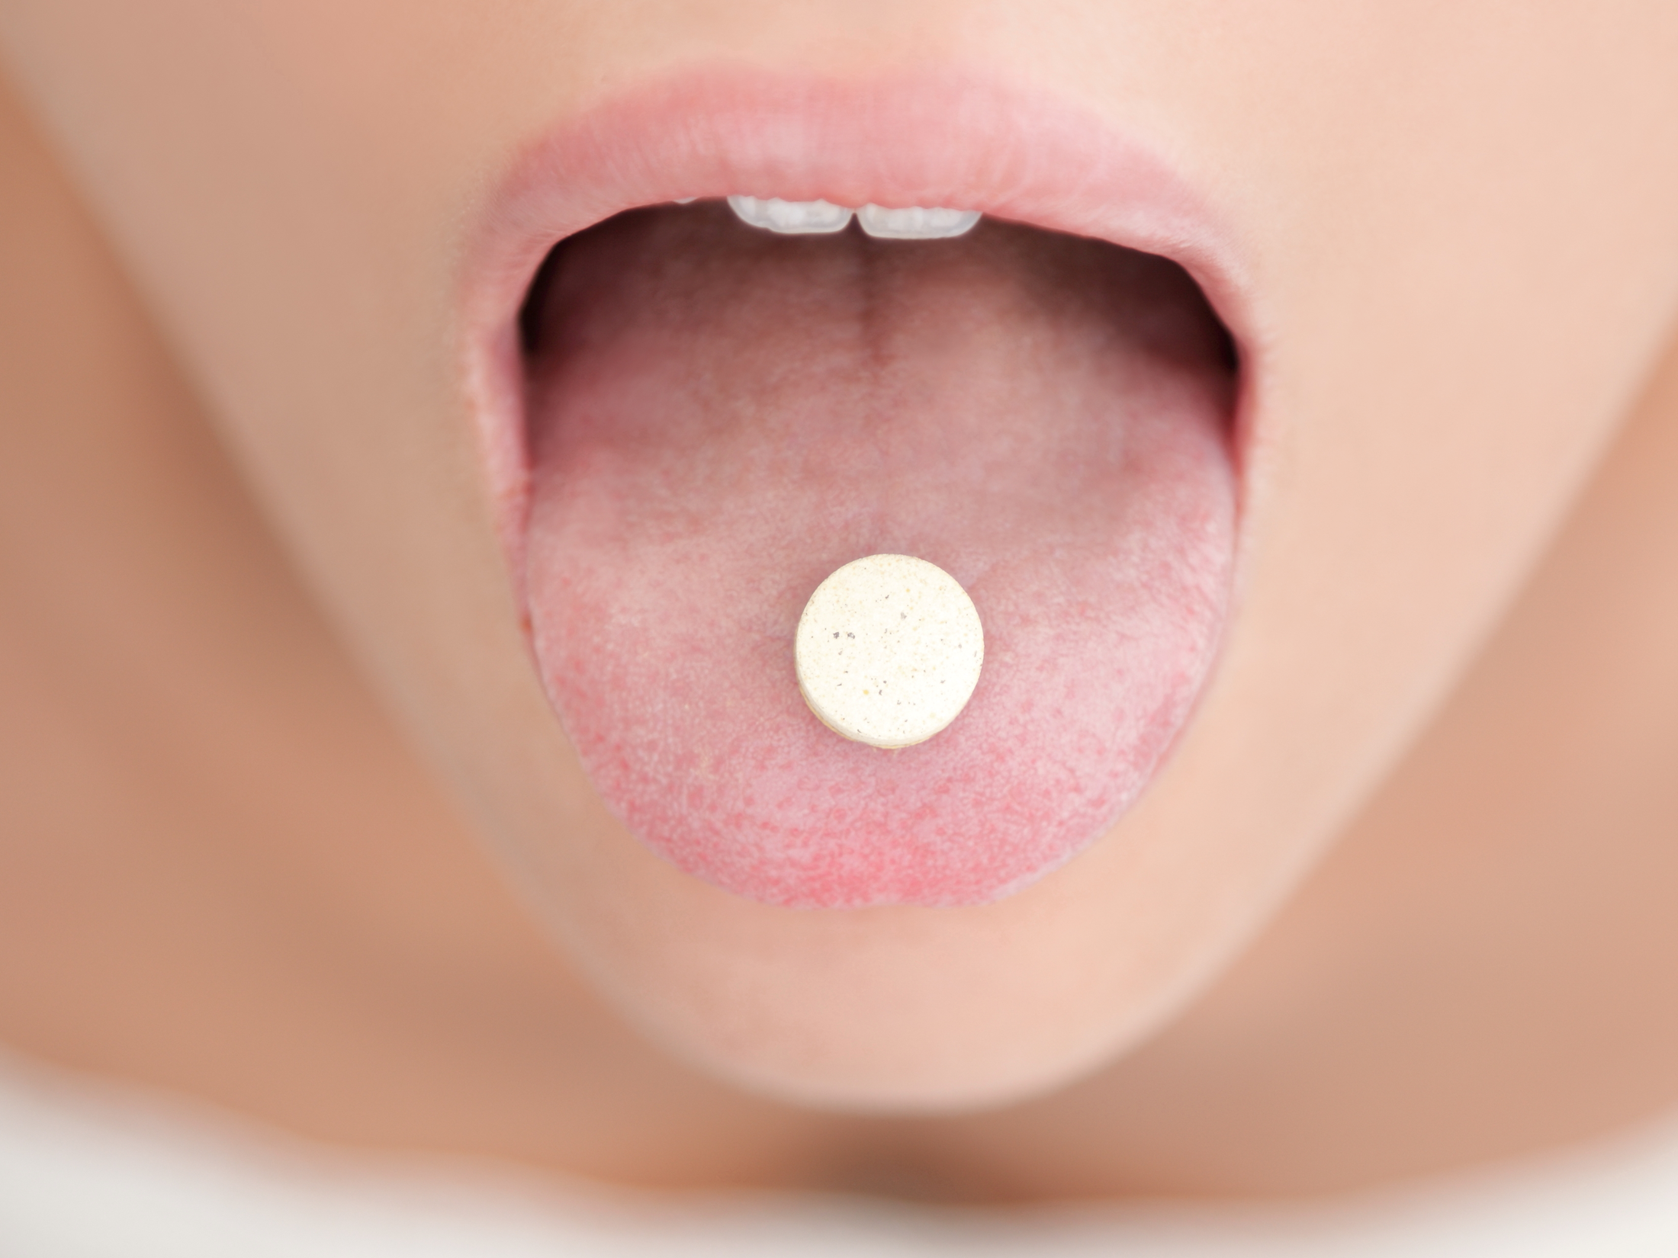


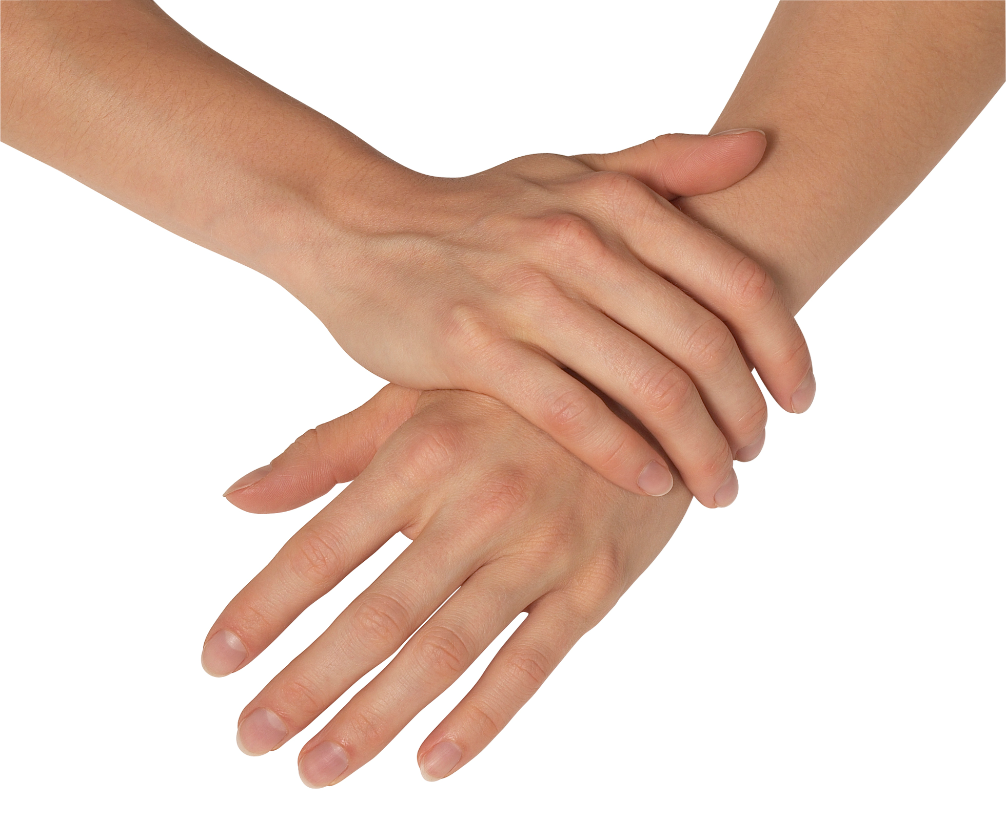


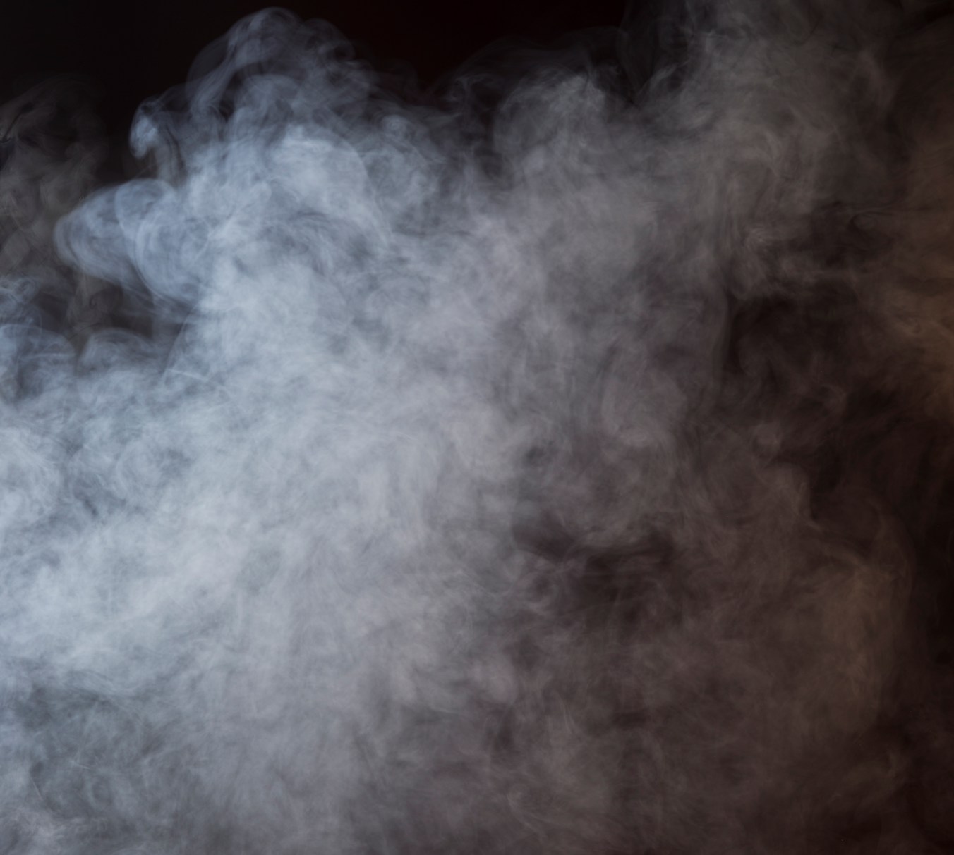
What Is A Poison?
Exposure
Forms
Notes:
A poison is anything someone eats, breathes, gets in the eyes or on the skin, that can cause sickness or death if it gets into or on the body.
Poisons come in different forms
Solid
Liquid
Gas or spray
Think of real life instead of the Hollywood version of poisoning. Does it make you think differently when I ask “who knows someone or has themselves been poisoned?” ( you don’t have to answer)
(Optional) "The dose makes the poison."

Slide 13
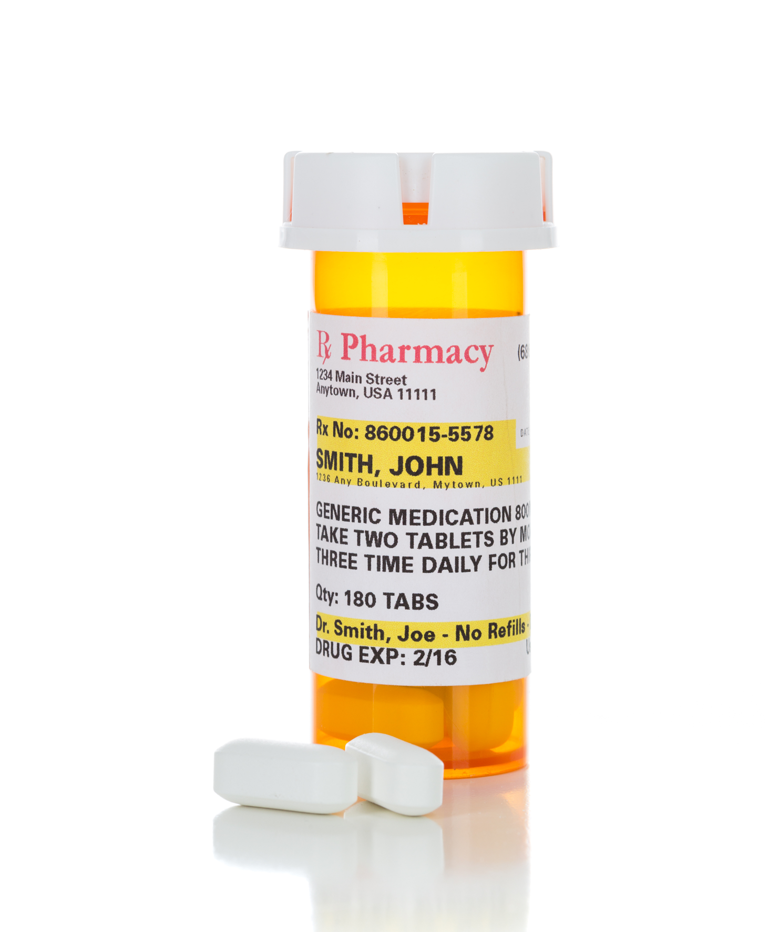
Types of Calls
Pediatric ingestions
Overdoses
Abuse
Adverse reactions
Therapeutic errors
Environmental
Occupational
Pesticides
Natural products
Plants
Envenomations
Bites and stings
Chronic exposures
Hazardous materials
Infectious diseases
Food poisoning
Disaster preparedness and response
And more
Notes:
Even though 60% of the our calls involve children under the age if 6 years, the poison center responses to many types of poisoning exposures. While overdoses and pediatric ingestions may be the most common calls, PCC fields calls about adverse reactions to medications and household products, therapeutic errors, environmental and occupational exposures as well as natural products – including plants and envenomations. We responds to many calls of public health significance including hazardous materials incidents , infectious disease, and food poisoning. While most exposures are acute poison control also consults on situations that are more chronic in nature and the list goes on. . . .
Other examples
Environmental/occupational concerns
Carbon monoxide
Cyanobacteria
Hazardous materials
Pesticides
Food/water contamination
Infectious diseases
Vector borne
Hanta virus
Rabies
Novel psychoactive substances

Slide 14



What happens on the phone
History and objective evidence
Risk assessment
Treatment recommendations
Management sites
Follow-up
Clinician consultation
Notes:
The role of the specialist is to gather a thorough objective history quickly then make a risk assessment, the circumstances of the exposure, the health status of the individual as well as the toxicology of the agent.
They rapidly assess whether the situation is safe to manage on-site or whether the patient requires transport to a health care facility.
The majority of call (75%) are managed on-site with telephone follow-up
Follow-up calls are often made to determine if the situation is resolving as anticipated or if there are any additional adverse consequences that need attention.
20% of exposure calls are from pre-hospital and hospital providers. If the call originates from a Clinician– they obtain that same history and provide recommendations to manage the patient. We are part of the health care team and will follow consult throughout a patients stay in the hospital.

Slide 15
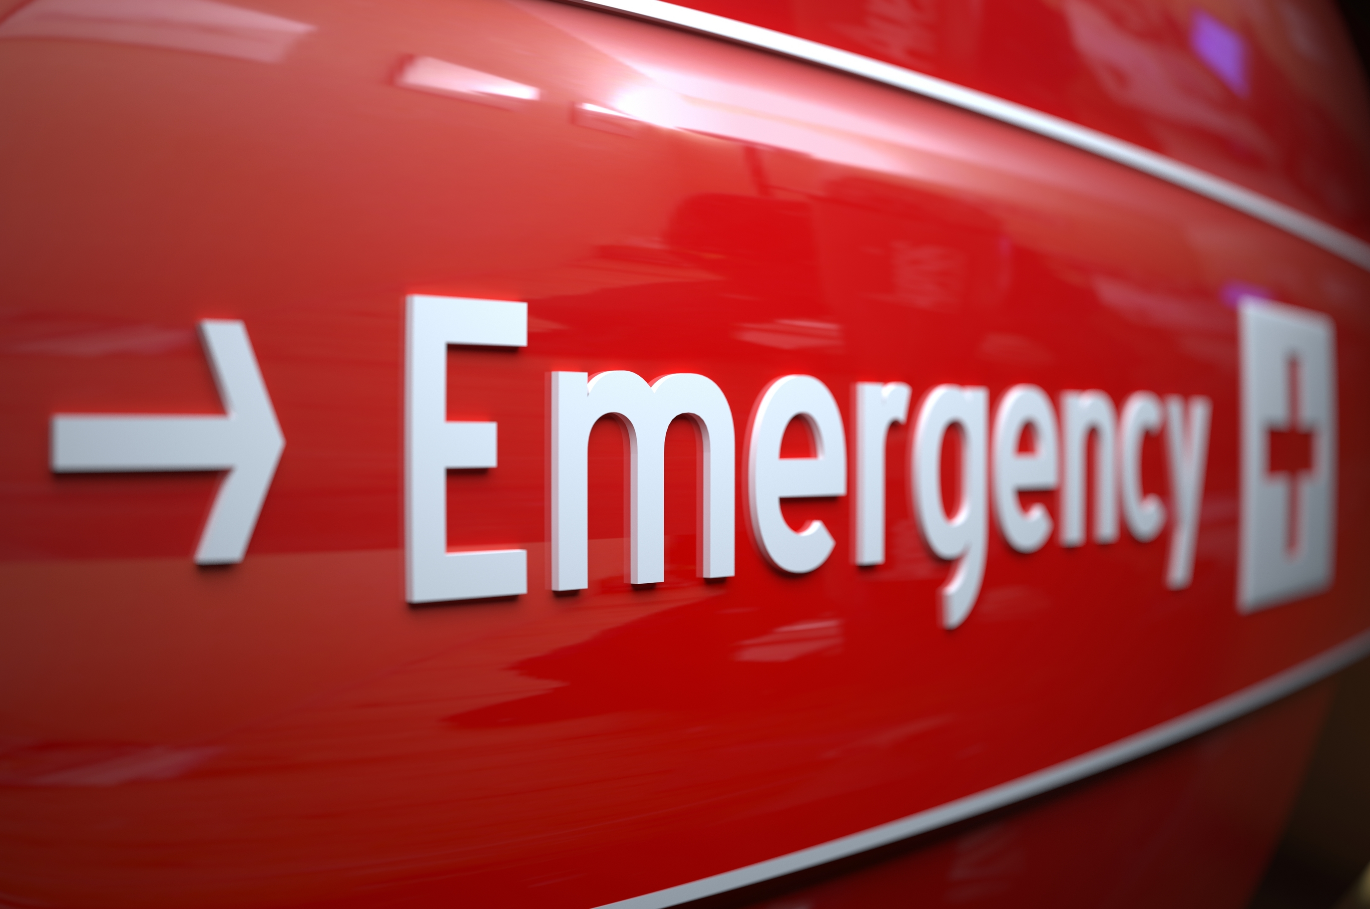
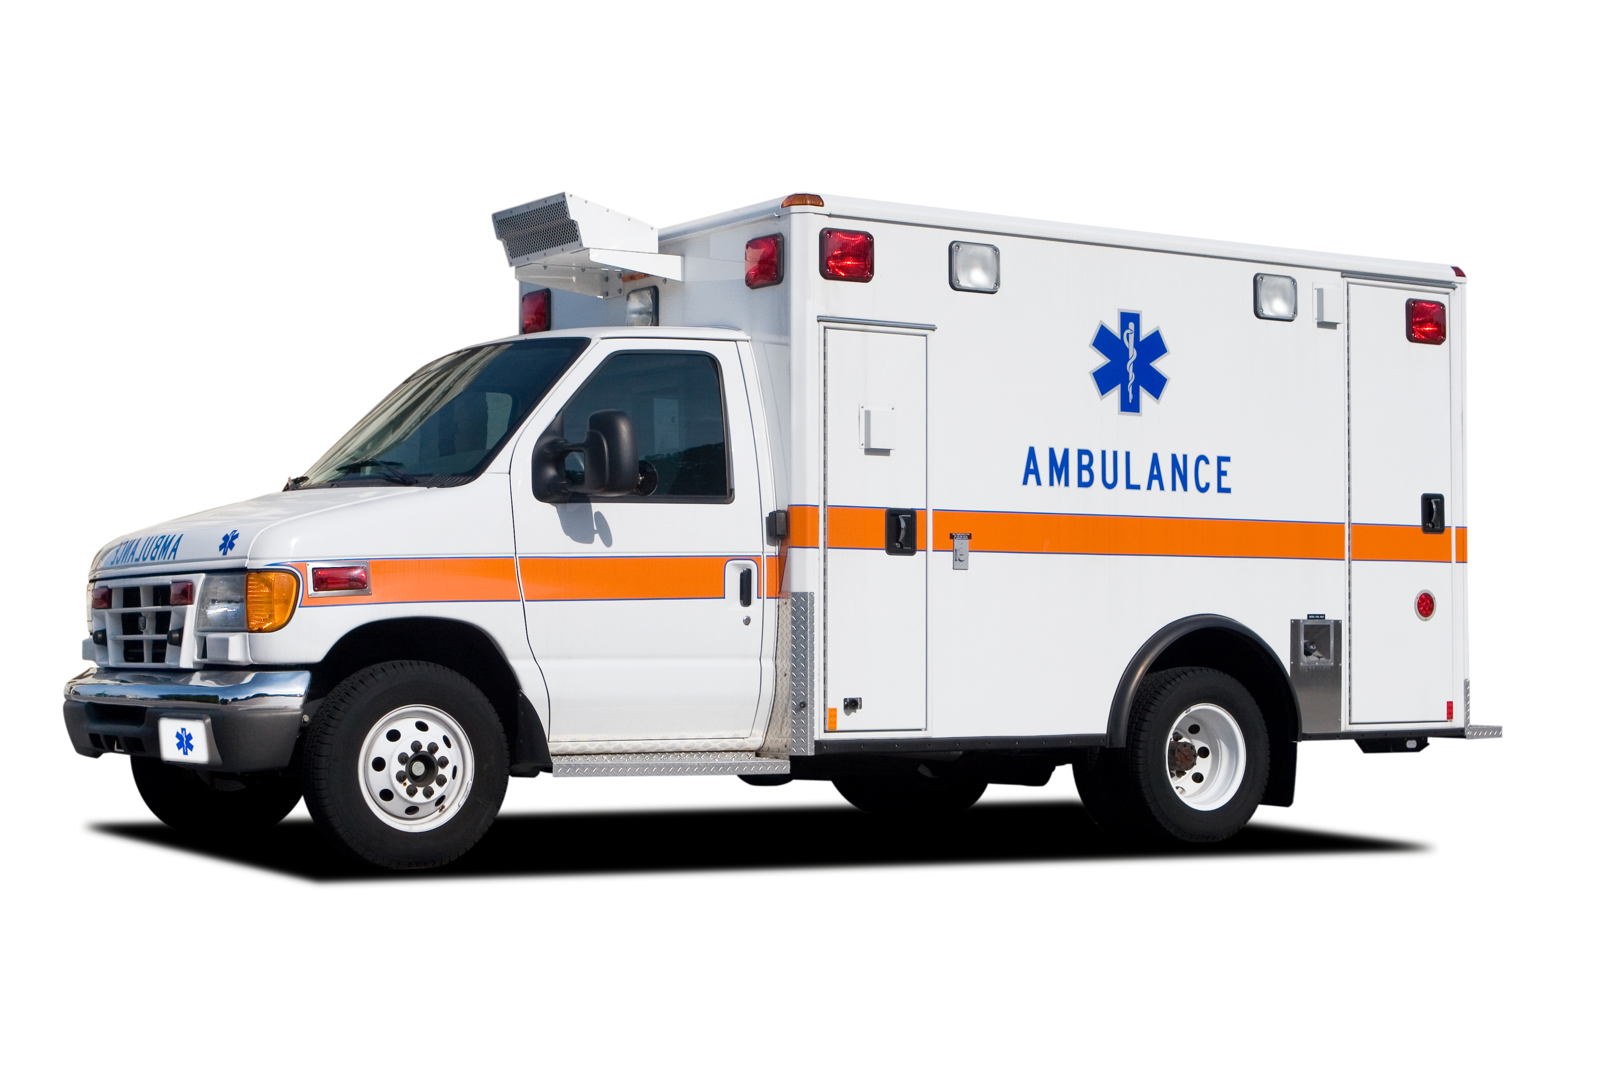
Benefits of Poison control
Rapid evaluation and assessment
Reduced Emergency Departments visits
Continuity of care
Assist in better utilization of care/ resources
Reassure worried well
Disease surveillance
Notes:
The benefits of the poison control starts with the way specialists assess, triage, manage, and continually monitors patients with a poison exposure. This helps decrease crowding in emergency departments, minimizes unnecessary EMS ambulance transport and frees critical emergency medical staff for true emergencies
The UPCC plays a critical role in disease surveillance, disaster readiness and response, and prescription drug epidemic response. Public health officials rely on poison control for its expertise and resources when responding to public safety issues, including hazardous chemical spills, contaminated water supplies, and product tampering.

Slide 16
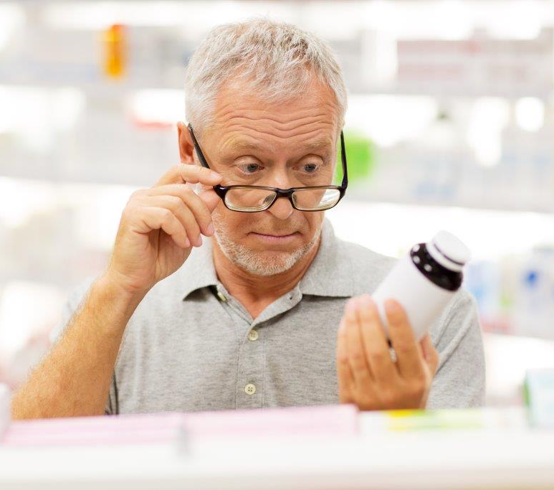
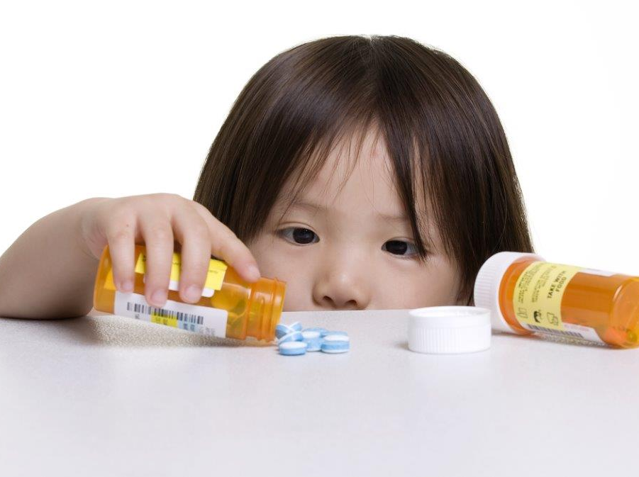
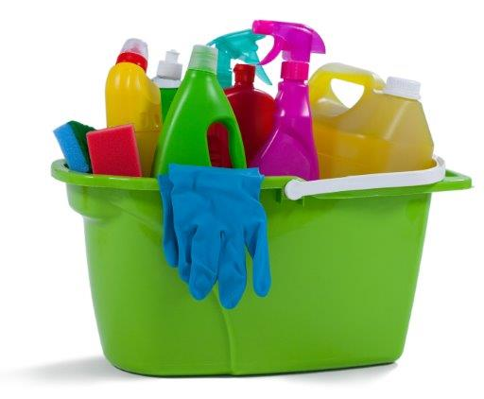
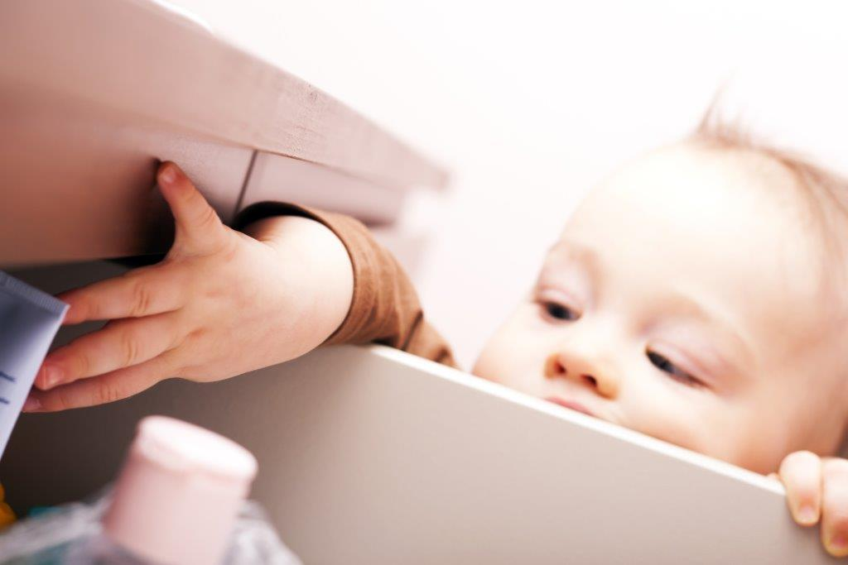
The Prevention Message
Keep up and away and out of reach
Use child-resistant caps (not child-proof)
Be aware of multiple ingredients in medicine
Safely dispose of medications
Do not refer to medicine as candy
Keep products in original container
Read labels and instructions before use
Do not mix cleaning products
Use cleaners in well ventilated area
Handle chemicals with caution (use protective gear)
Save/post poison control number 1-800-222-1222
Notes:
keeping poison out of sight and out of reach
use child resistant closures (CRC) but remember that aren’t child proof, but they can slow a child’s access to the product.
Be aware of multiple ingredients in medicine
Safely dispose of medications
Do not refer to medicine as candy
Keeping products, medicines and cleaners, in their original containers is not only key to poison prevention, but allows for quicker assessment of a poison exposure.
Be sure to read the labels on medicine so you don’t end up taking too much of one ingredient such as acetaminophen.
Do not mix cleaning products
Use cleaners in well ventilated area
Handle chemicals with caution (use protective gear)
Lastly don’t forget to post the poison control number near phone or in your cell phone.

Slide 17
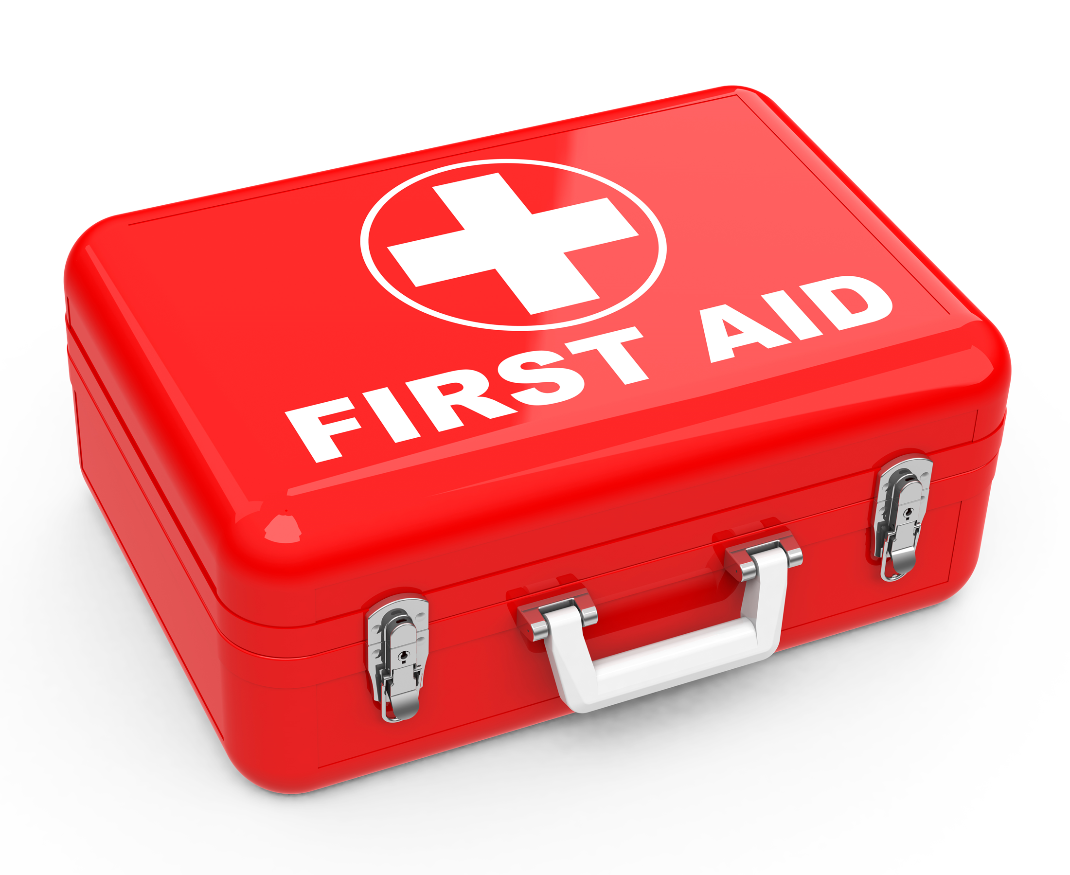
First Aid Tips
Swallowed poison: do not give anything, call the poison control center
Inhaled poison: get victim to fresh air, call poison control center
Poison on skin: remove contaminated clothing and rinse skin with water for 15 minutes, call the poison control center
Poison in eye: flush eye for 15 minutes using a large cup filled with lukewarm water held 2-4 inches from eye, call the poison control center
Notes:
If a poisoning does occur, following these first aid tips.

Slide 18

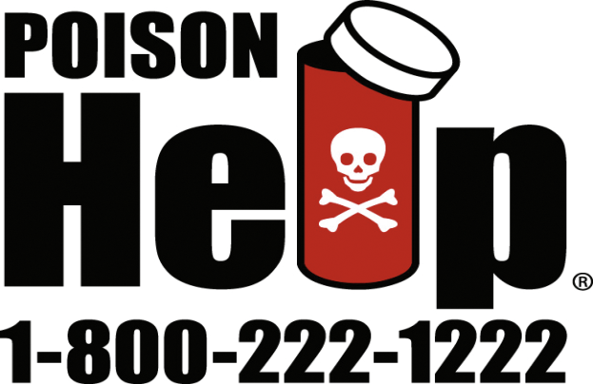
Emergency Action For Poisoning
Remain calm, but don’t wait for the person to look or feel sick; some exposures can have a delayed effect
If the person is unconscious, having convulsions, or difficulty breathing; call 911
Otherwise call the UPCC
Notes:
If you wait for the person to become sick, it may be too late to help them. Please call right away if a poisoning occurs. Don’t guess, be sure.

Slide 19
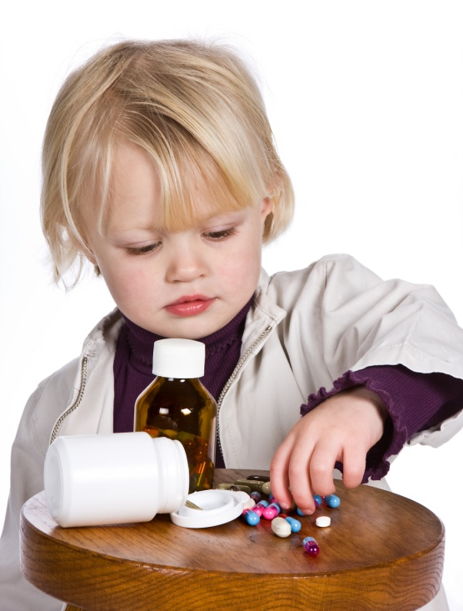
Education Goals
Decrease the frequency of poisoning
Decrease severity of poisoning
Enhance general awareness
1-800-222-1222
Notes:
A vital part of the UPCC’s mission is education and prevention. Outreach education efforts focus on ways to prevent poisoning as well as generate awareness to the poison center services. The UPCC constantly updates efforts to combat current poisoning trends, providing vital prevention information across the state.
There are 3 major goals that drive poison prevention education:
Decrease the frequency of poisoning
Encourage purchase and use of safe products
Endorse concept of child-resistant packaging
Appropriate storage and handling of products
Decrease severity of poisoning
Encourage posting of emergency numbers near telephone.
Educate on first aid
Enhance general awareness
Distribution of educational materials

Slide 20
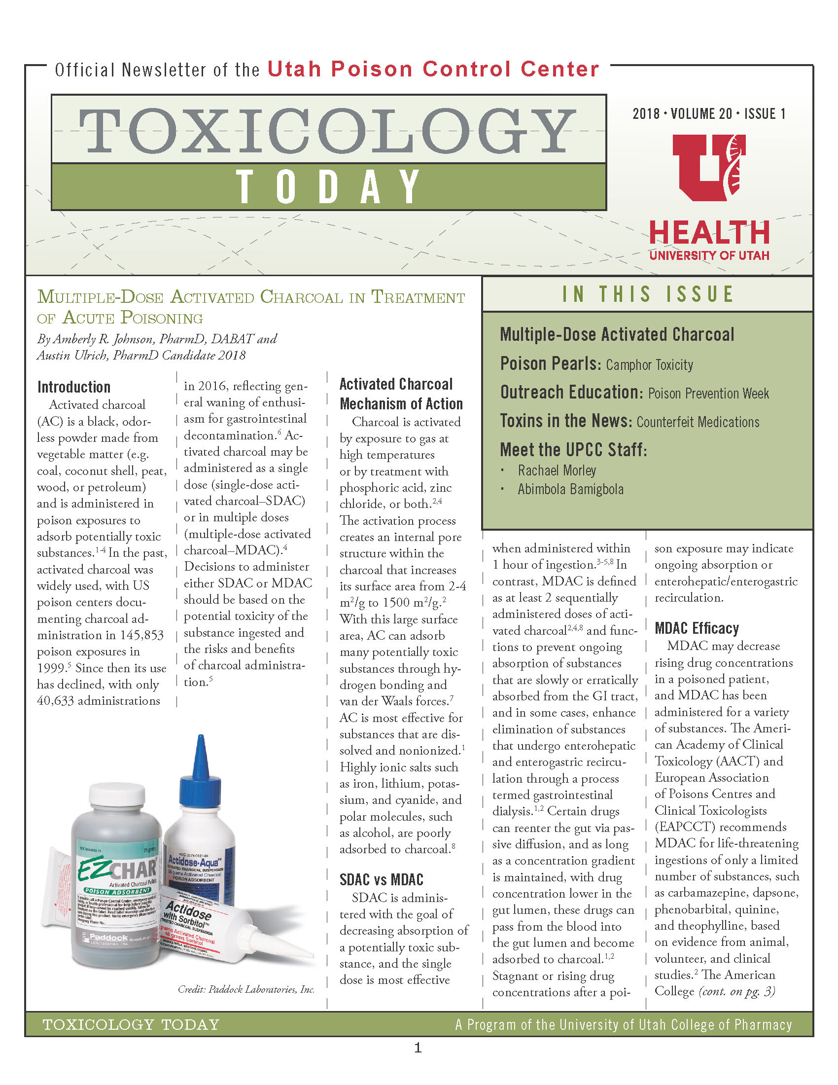
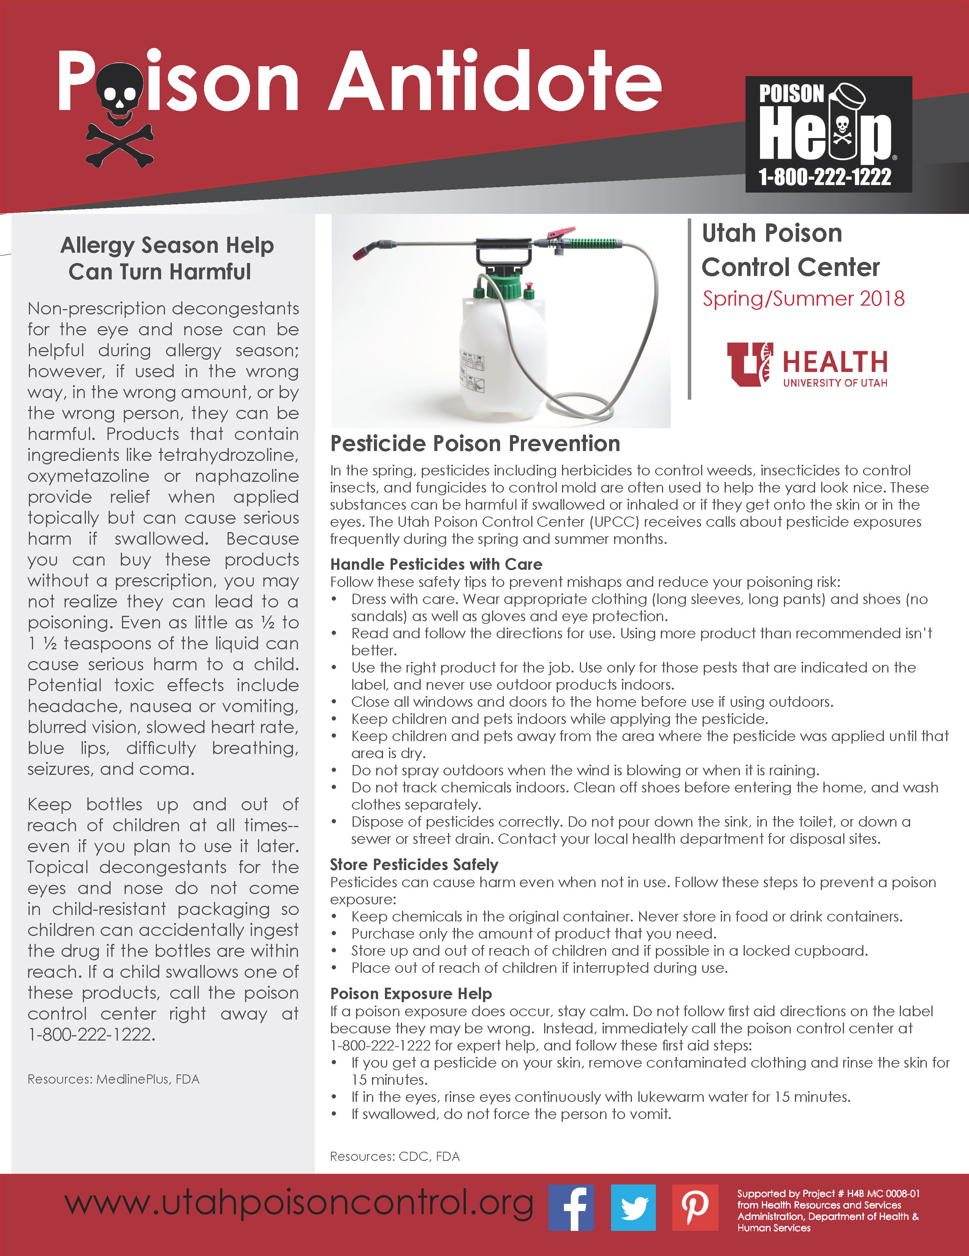
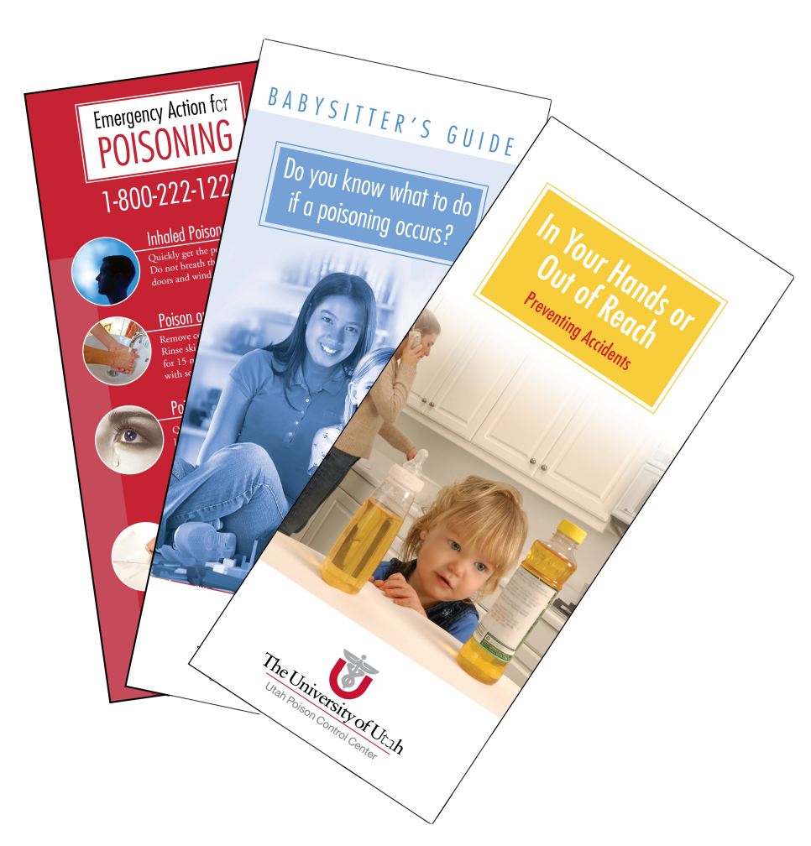
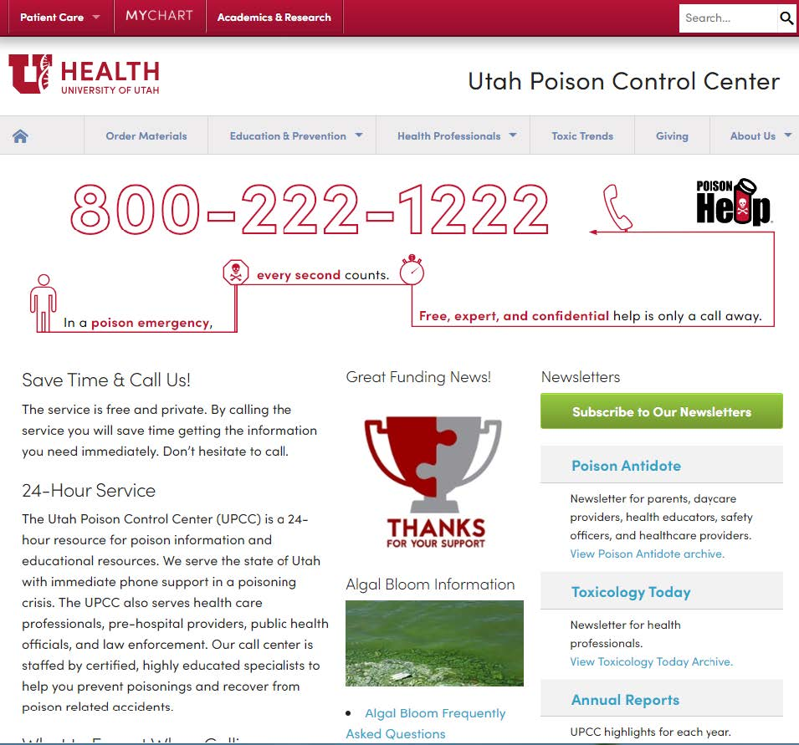
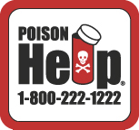



Poison education Resources
Website
Brochures and posters
Stickers and magnets
Lesson plans and
presentations
Social media
Newsletters
Plant database
:
www.utahpoisoncontrol.org
@utahpoison
Notes:
Take some time to visit our website it has a lot of resources we’d like to share. On the screen is sample of our educational materials. I’ve have brought some with me you can take today or your welcome to contact the UPCC to order materials for free. You can signup for our newsletters, check out the plant database find lesson plans and presentation like :
Poison safety lesson plans for children
Poison prevention lesson plans for adults
Young parent lesson plan
Babysitter's Guide to Poison Prevention Lesson Plan
Over-The-Counter (OTC) medicine Safety
Older adults medication safety
and so much more.

Slide 21

UPCC Projects
Naloxone Training
Safe Kids Utah projects
Education to Head Start families
UCO-OP (Utah coalition for opioid overdose prevention)
OAMS (older adult medication safety) program
Notes:
The UPCC is involved in an projects including:
Naloxone Training: Developing in partnership with the UDOH e-Learning modules for public safety officers and the lay public
Safe Kids Utah projects: Include medication safety and laundry packet safety
Education to Head Start families
UCO-OP (Utah coalition for opioid overdose prevention): Public awareness and naloxone workgroups
OAMS (older adult medication safety) program

Slide 22


UPCC Partnering with
Parenting
Harmful Algal Bloom
Bites and Stings
Food Safety
Pharmacy/STEM
Opioid Prevention and Harm Reduction
webPOISONCONTROL app
E-Learning Modules
Home Buyer Education: Radon and CO
Fertilizer/Pesticide Safety and Prevention
Research
Health Living
Veterinary Medicine: Animal or Human Exposure
Plant Poison Exposures
Medication Safety
Aging
4H Curriculum and Clubs
Train the Trainer
Notes:
Outreach education efforts to local health districts, schools, and communities are critical to reducing the poisoning trend. USU Extension has your finger on the pulse, you understand your communities and their needs. We know partnering with all of the amazing faculty and staff can bring a synergistic effect and make a difference in the life of Utahan.
We’ve has been lucky this year to meet with some of USU extension leadership where we brainstormed areas we can connect, I’ve listed some on the screen as highlights. Hopefully some of theses topics and the services we provide will resonate with you.

Slide 23


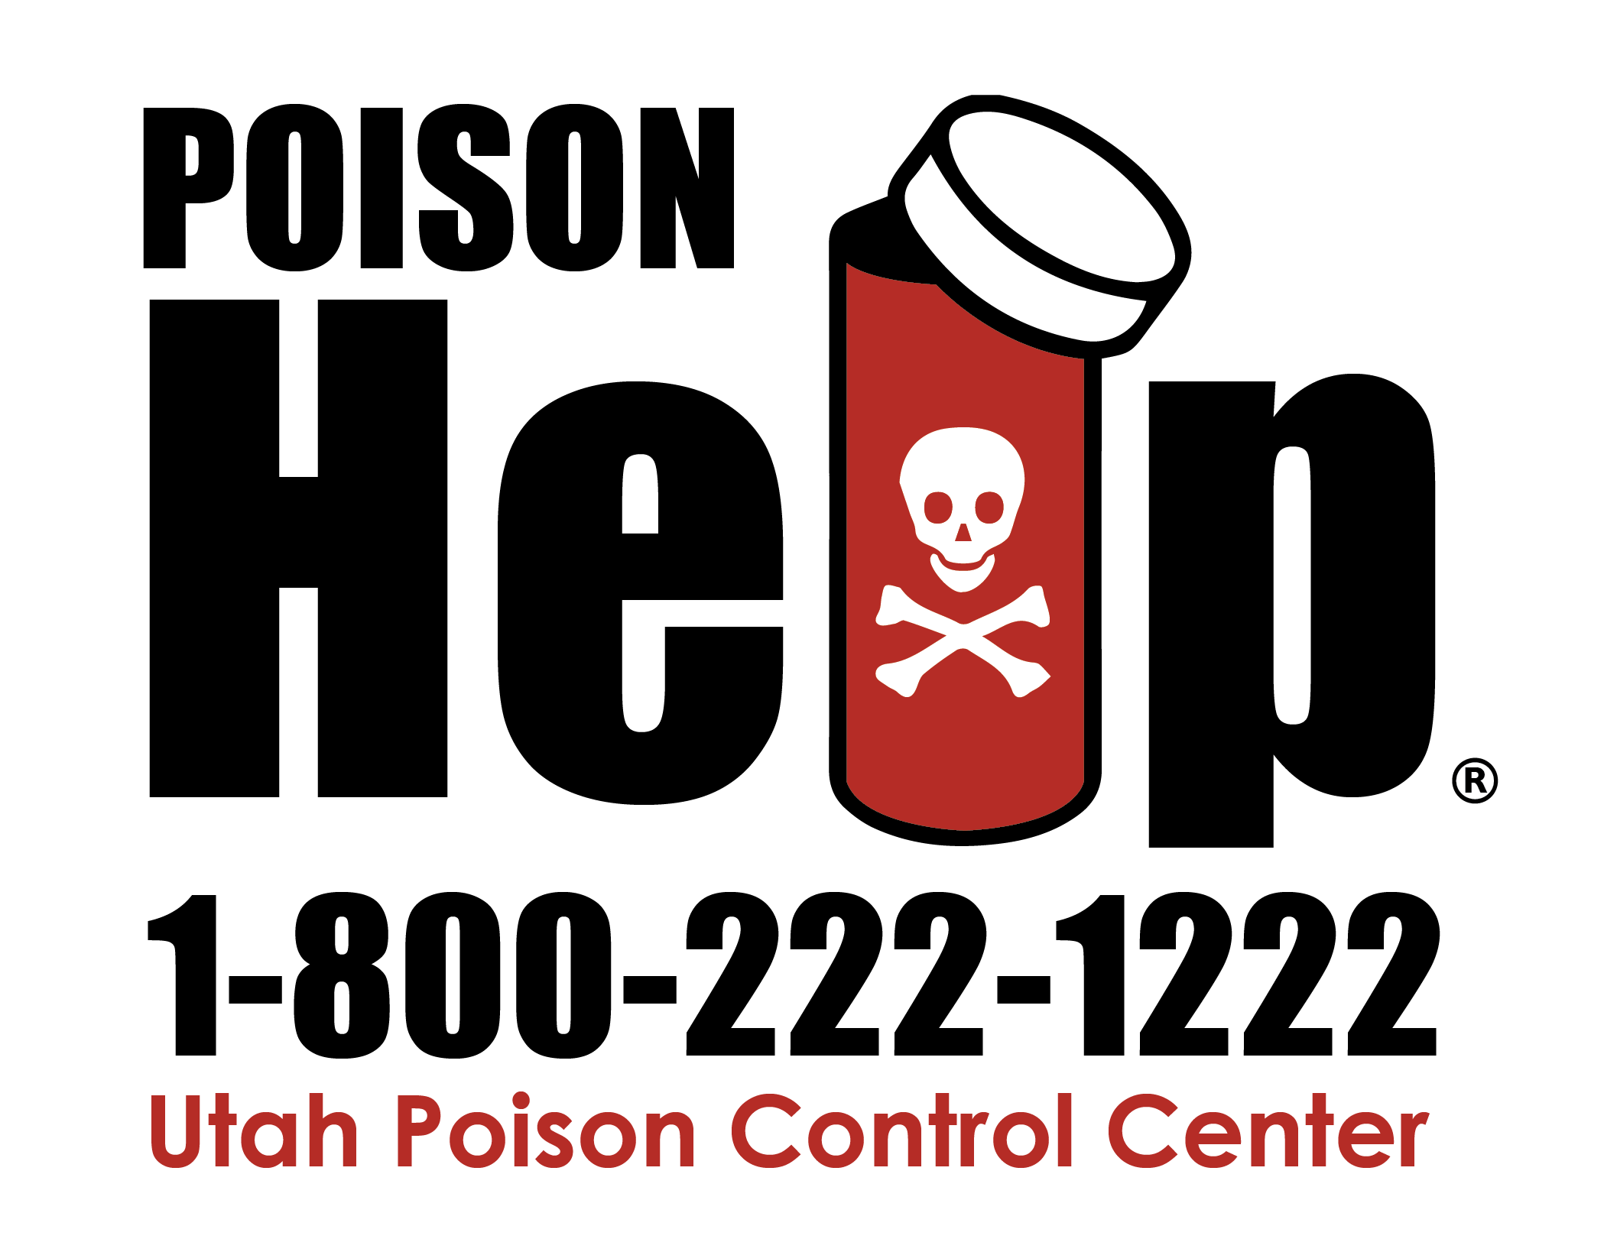
Kelly Teemant, BS, MCHES®
Kelly.Teemant@utah.edu
801.587.0624
Notes:
I want to say thank you for letting me be here and remember we hope to prevent poisonings, but if a poisoning happens, call the Utah Poison Control Center for help.
If you haven’t yet, save the number to your phone. One day it may save you back.
My contact info is on the screen please reach out to me or grab me during lunch.

