Slide 1



Notes:
When you add an image, you must sent it to back. Right Click on Image > Send to Back > Send to Back

Slide 2


A NEW FOCUS
HEALTH EXTENSION: Advocacy. Research. Teaching.
National Cooperative Extension (known for agriculture) has introduced health as an essential focus area
Utah State University Extension has implemented a cutting-edge four-year pilot initiative which emphasizes this focus area

Slide 3

HEALTH EXTENSION: Advocacy. Research. Teaching.
HEART Initiative
The Health Extension: Advocacy, Research, & Teaching (HEART) Initiative models how Extension can join community partners to better address the health and wellness needs in our state.
HEART brings unique academic resources into the community, partnering locally and nationally to address the opioid epidemic and other pressing public health issues.

Slide 4
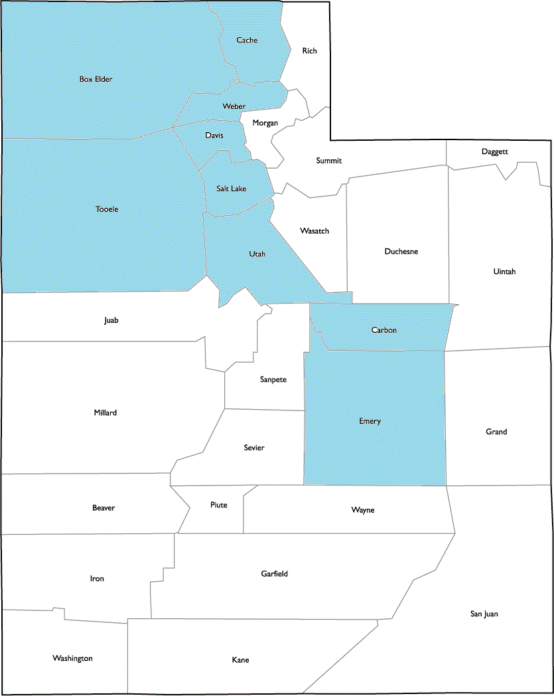
HEART serves 9 Utah counties where opioid use disorders have had some of the most devastating effects:
Carbon & Emery Counties
Davis & Weber Counties
Salt Lake County
Toole & Utah Counties
Box Elder & Cache Counties
HEART’s focus areas

Slide 5
The state of Utah has the 7th highest rate of opioid overdose in the nation
Carbon & Emery Counties have the highest rates of opioid overdose in the state
Tooele, Weber, & Salt Lake Counties have rates higher than the state and national rates
Utah, Box Elder, and Davis Counties have rates higher than the national average
State Rate 17.4
per 100,000 population
*National Rate: 10.76
per 100,000 population
HEART’s focus areas

Slide 6

2018
The Opioid Health and Wellness Summit in August 2018 was hosted by HEART to bring together national experts and partners to discuss collaborative ways to address the epidemic here in Utah
2019
Three summits serving Utah’s needs
The summit featured a listening session to hear the community and professional opinion of where help and attention is required and to develop a strategic plan.
2019 will feature a summit in Price, Utah to address rural needs and the 2020 summit will be located in Vernal, Utah with a tribal focus.
2020

Slide 7

HEART’s strategic plan
Youth Mentorship in partnership with 4-H
Education in schools in partnership with PROSPER
Evidence-based Fact Sheets
Healthcare provider and community resources for Pain Management
PREVENTION AND EDUCATION
Notes:
When add image, you must sent it to back! Right Click on Image -> Send to Back -> Send Back

Slide 8
HEART’s strategic plan
Master Health Volunteer Program to increase health based volunteerism in the community
Coalition partnerships
Service mapping to address gaps in service provision and community accessibility
Community Advisory Board to ensure the community voice guides all HEART outputs and projects
STRENGTHENING COMMUNITY TIES
Notes:
When add image, you must sent it to back! Right Click on Image -> Send to Back -> Send Back

Slide 9
HEART’s strategic plan
Amend registration procedures for opioids in the state
Establish Mental Health Parity
POLICY
Notes:
When add image, you must sent it to back! Right Click on Image -> Send to Back -> Send Back

Slide 10
HEART’s strategic plan
Storytelling and narratives from community members in the 9 Utah counties HEART serves focused on hope and recovery
Culturally responsive harm reduction education curriculum for substance abuse counselors in Utah
STIGMA REDUCTION
Notes:
When add image, you must sent it to back! Right Click on Image -> Send to Back -> Send Back

Slide 11
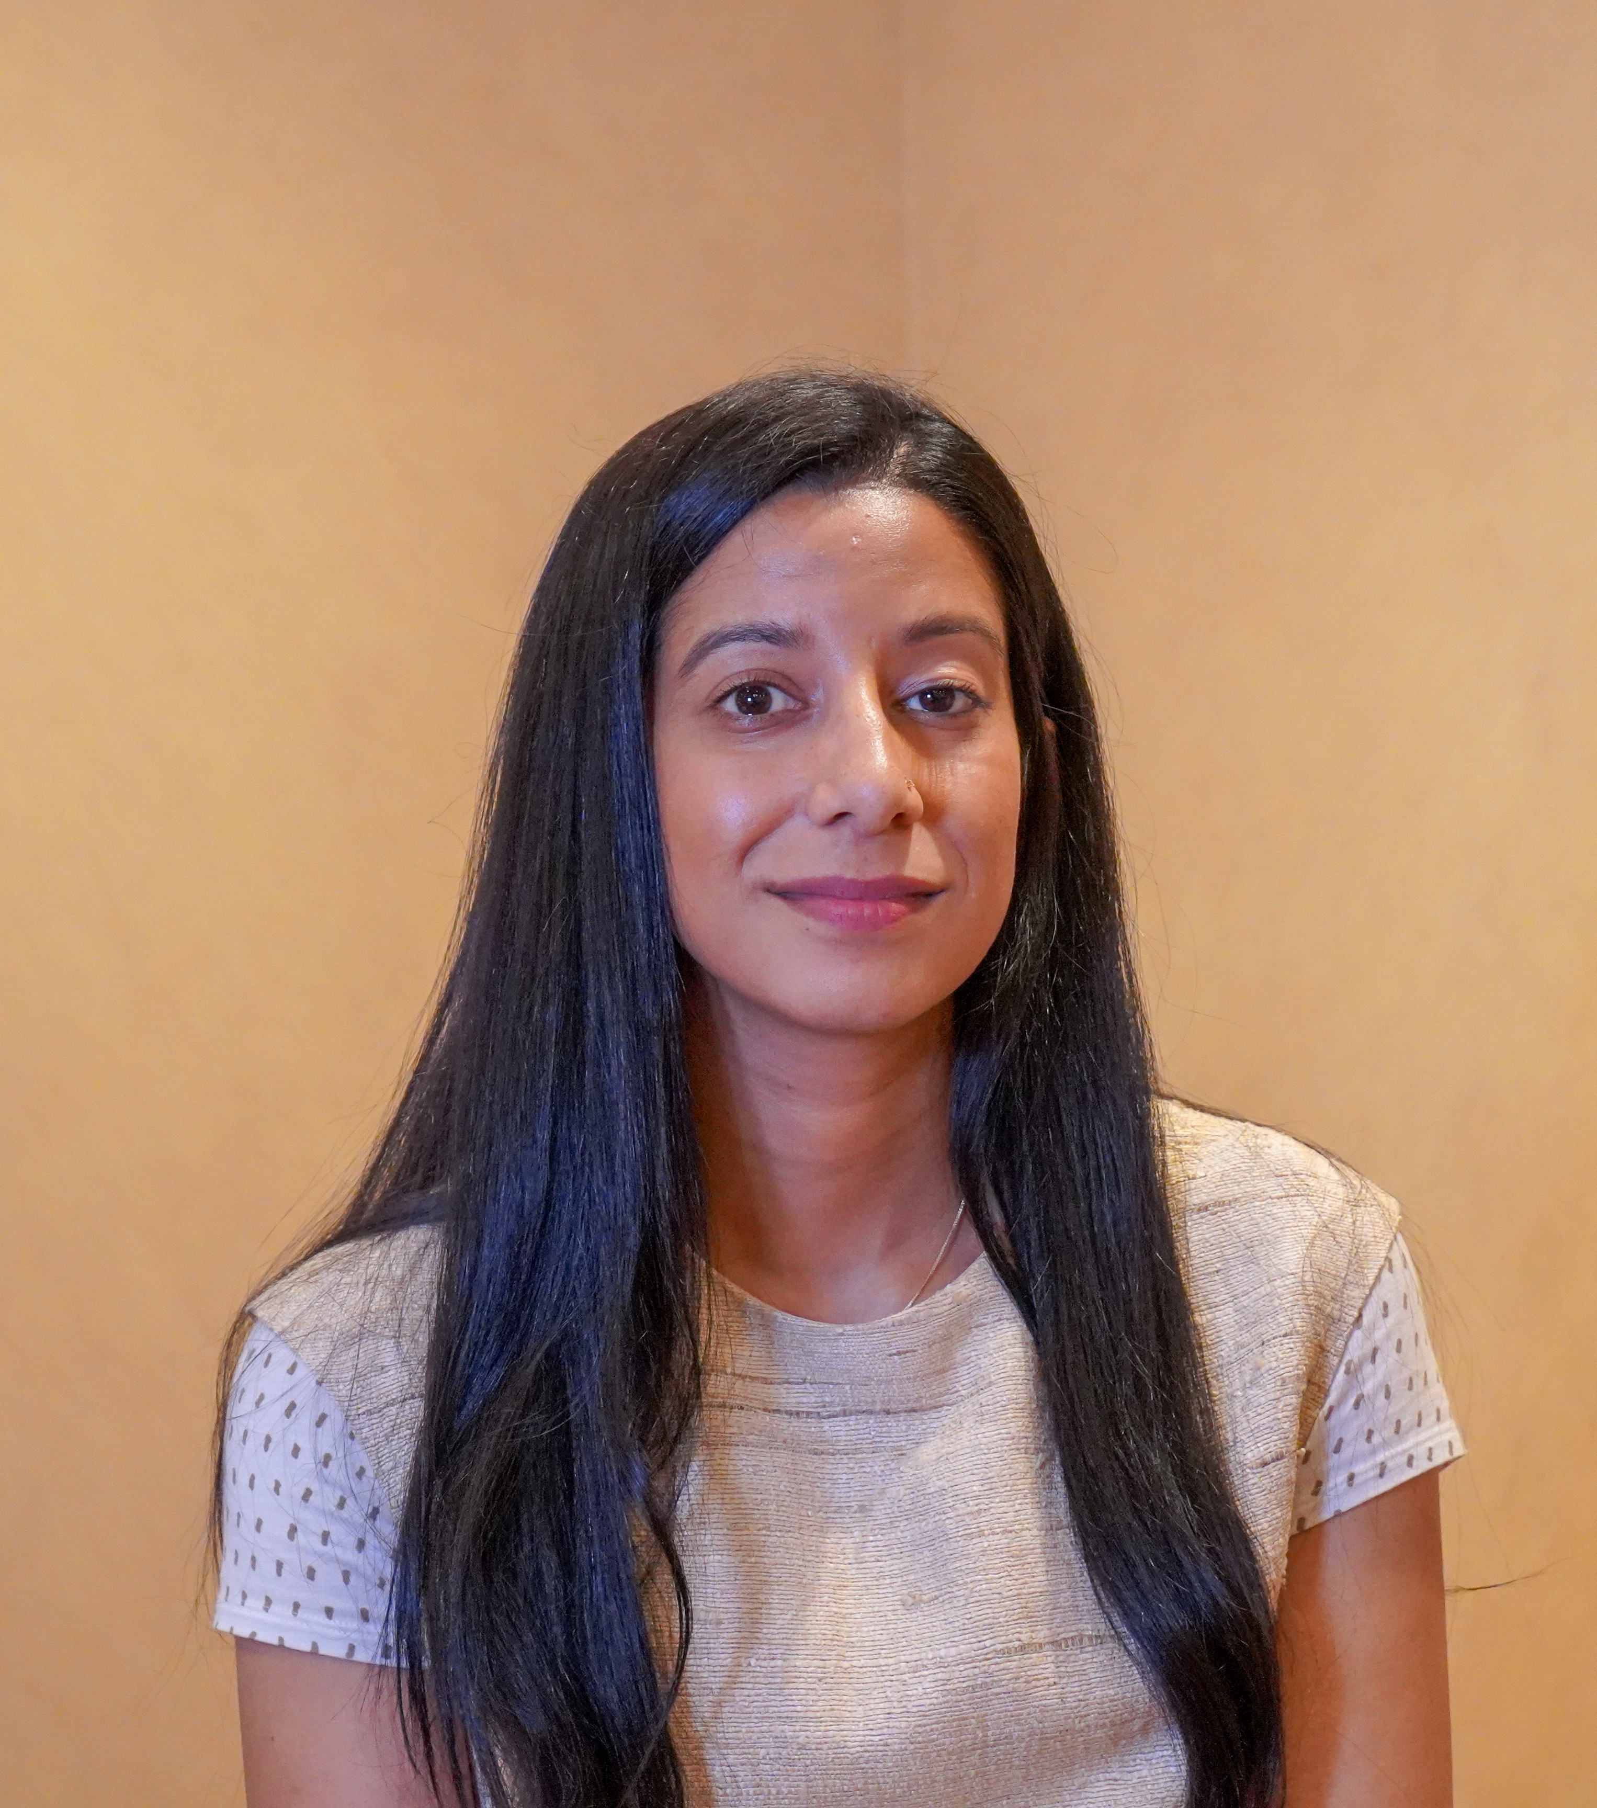


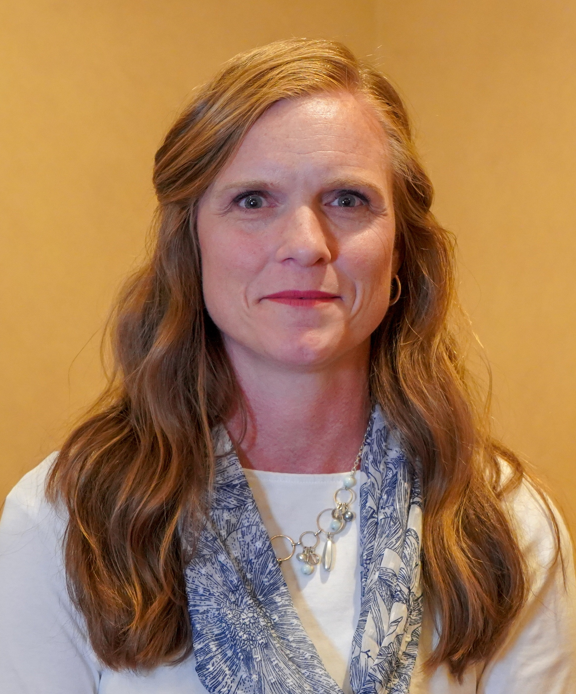
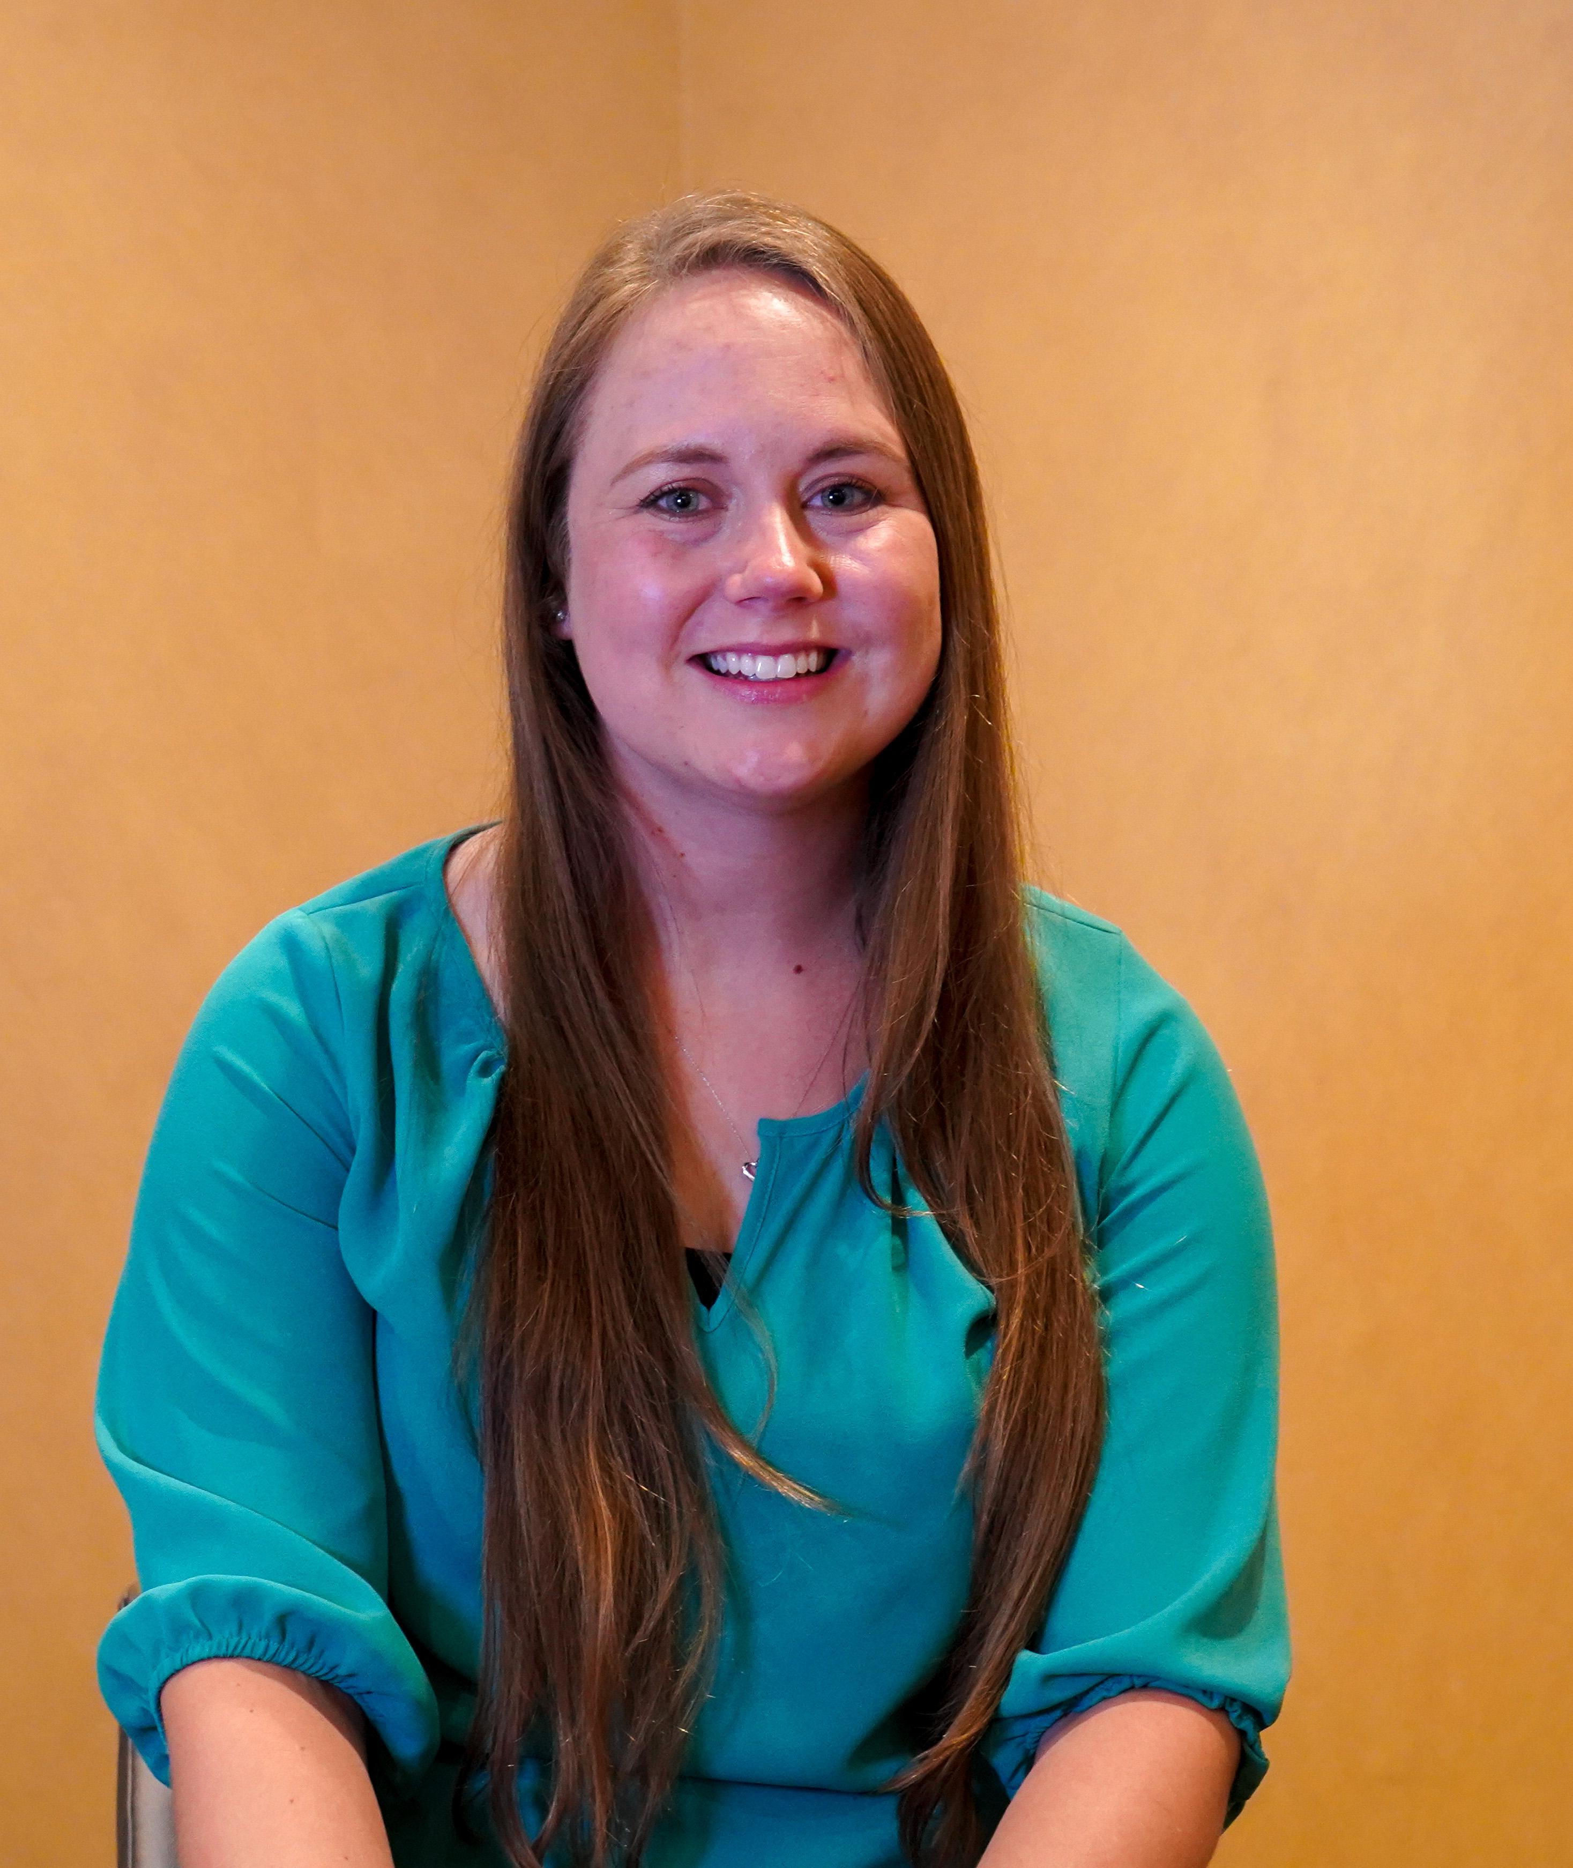
HEART TEAM
AVAILABLE AND EXCITED TO COLLABORATE WITH HEALTH AGENCIES ACROSS THE STATE TO PROMOTE UTAH’S OVERALL HEALTH AND WELLNESS!
Kandice Atismè
Davis & Weber Counties
Kandice.Atisme@usu.edu
(435) 919-1332
Maren Wright Voss
Toole & Utah Counties
Maren.voss@usu.edu
(801) 851-8464
Reshma Arrington
Salt Lake County
Reshma.arrington@usu.edu
(385) 468-4816
Tim Keady
Box Elder & Cache Counties
Tim.keady@usu.edu
(435) 752-6263
Ashley Yaugher
Carbon & Emery Counties, HEART Coordinator
Ashley.yaugher@usu.edu
(435) 636-3276

Slide 12

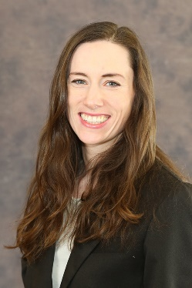

HEART TEAM MANAGEMENT
AVAILABLE AND EXCITED TO COLLABORATE WITH HEALTH AGENCIES ACROSS THE STATE TO PROMOTE UTAH’S OVERALL HEALTH AND WELLNESS!
Mateja
Savoie-Roskos
HEART Evaluator
Mateja.savoie@usu.edu
(435) 797-5777
Sandra
Sulzer
HEART Director
Sandra.sulzer@usu.edu
(435) 797-2925
Learn more on our website:
extension.usu.edu/healthwellness/heart

Slide 13
THANK YOU
HEALTH EXTENSION: Advocacy. Research. Teaching.
CITATIONS
Utah Department of Health (2018, August 16). Opioid Overdose by County Data
Images
http://www.aplu.org/members/commissions/food-environment-and-renewable-resources/board-on-agriculture-assembly/cooperative-extension-section/extension-directors-and-administrators/awards/index.html
https://www.worldatlas.com/webimage/countrys/namerica/usstates/counties/utcountymap.htm
https://www.pinterest.com/pin/366691594655768456/

