Slide 1


Slide 2
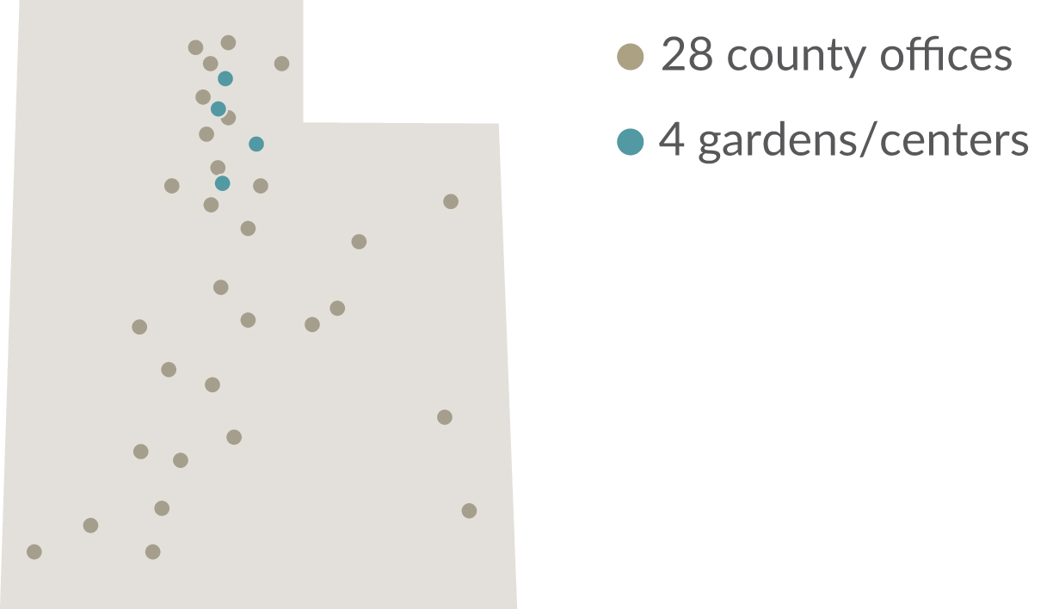
LOCATIONS THROUGHOUT UTAH

Slide 3
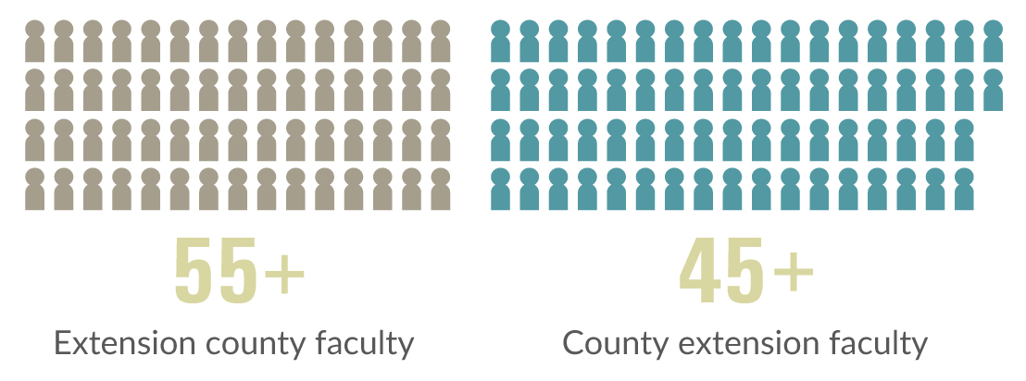
FACULTY & STAFF NUMBERS

Slide 4

PROGRAM AREAS

Slide 5
RESOURCES

Slide 6
OUR GOAL

Slide 7

FIND US ONLINE

