Slide 1
Digital Measures
Yes, we actually use the data you enter in Digital Measures and truly appreciate your reporting efforts

Slide 2
Some uses for Digital Measures
Annual Performance Review
Board of Regents Performance Measures
USDA-NIFA Accomplishments Report
USDA-NIFA Plan of Work
USDA-NIFA Multi-state and Integrated Research Report
Department Reports

Slide 3
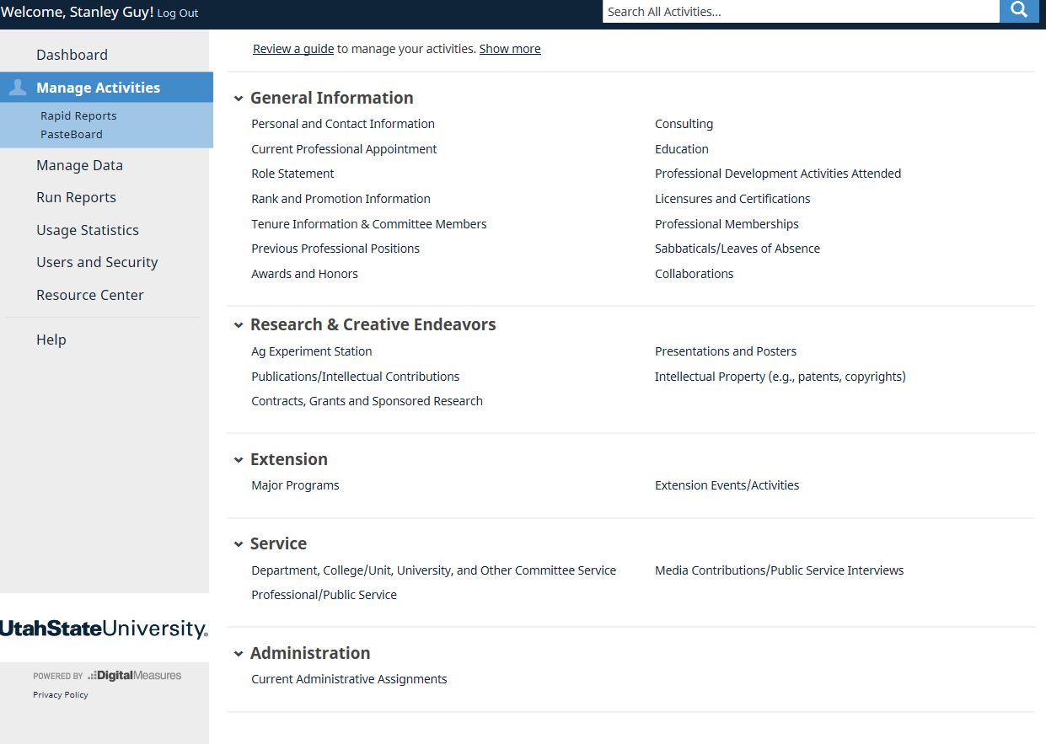

Slide 4
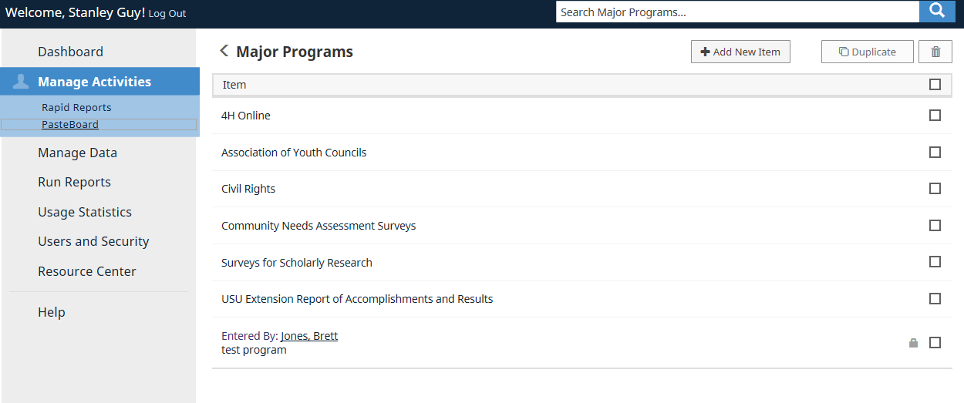

Slide 5
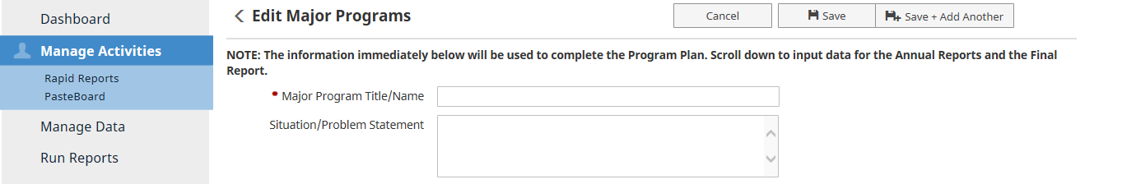
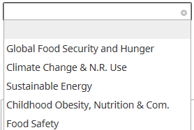
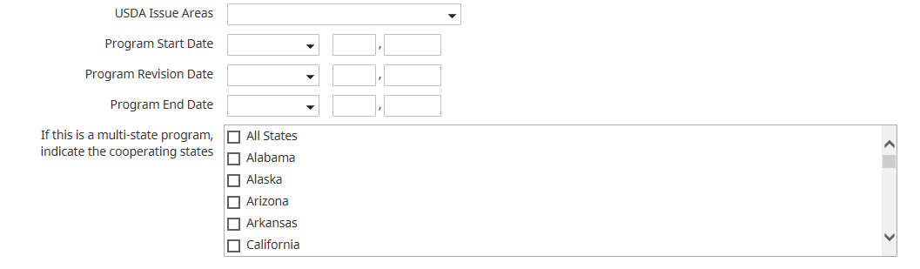
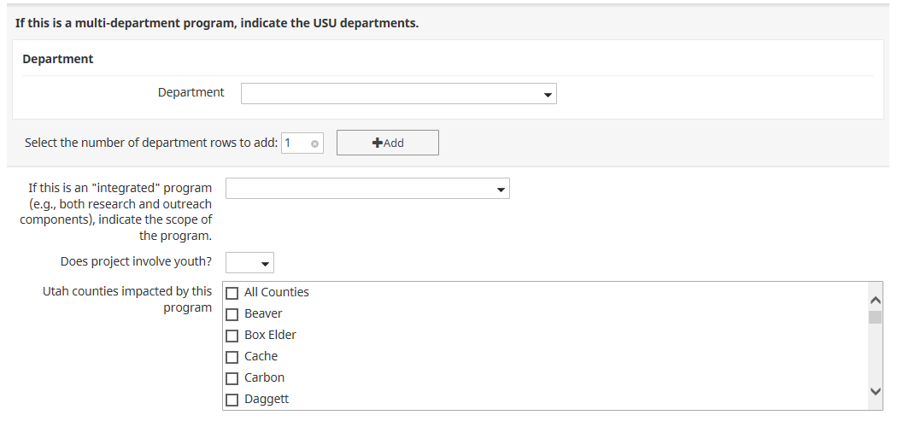
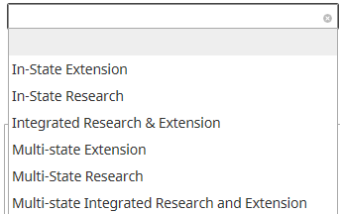
Master Key Reporting Field
Key Reporting Field
Key Reporting Field
Key Reporting Field

Slide 6
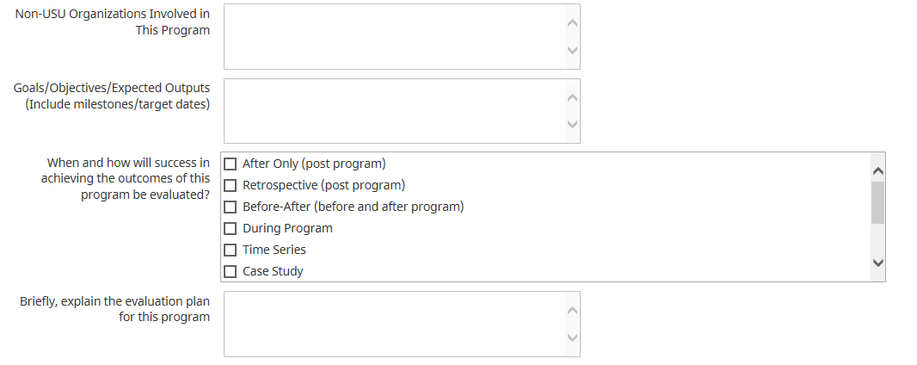
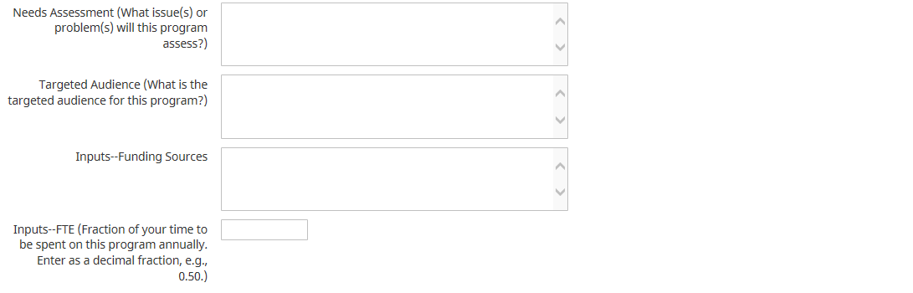

Make sure you enter as decimal 0.50 = 50% of your time

Slide 7
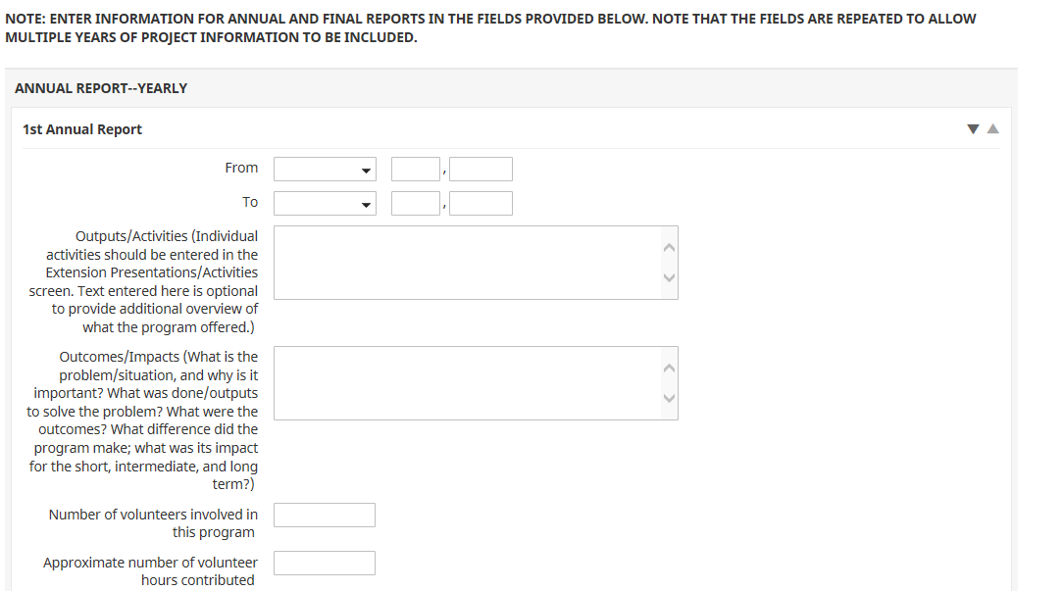

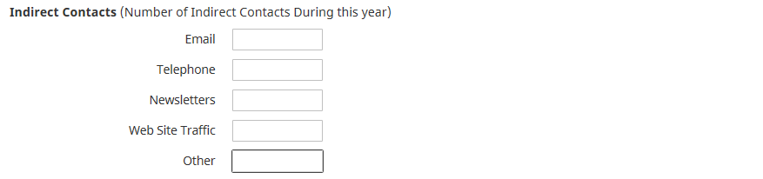

Be sure to enter from and to dates: From: January 1, 2017
To: December 31, 2017
Key Reporting Field
Key Reporting Fields

Slide 9
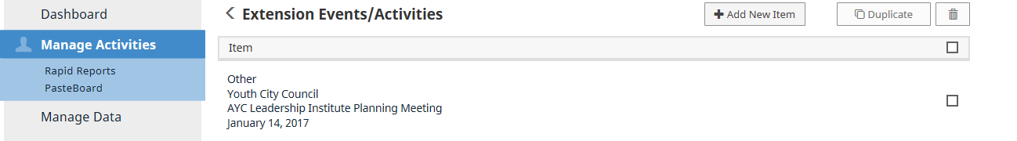
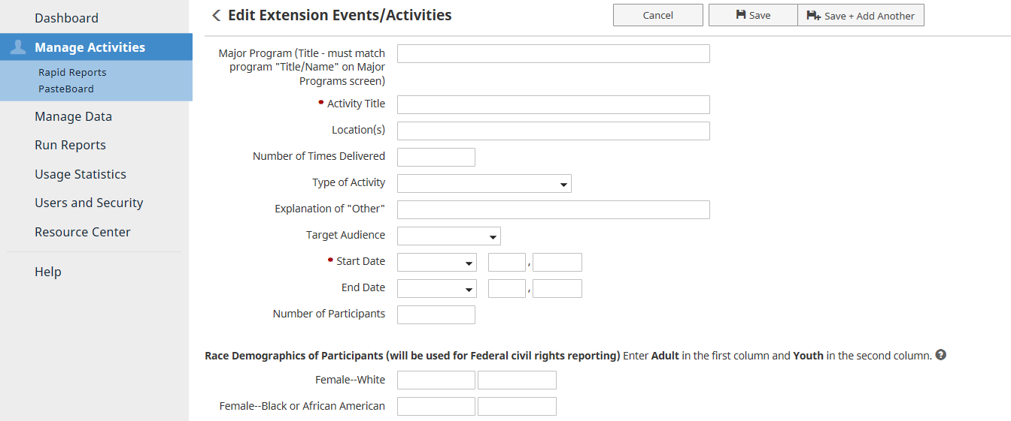
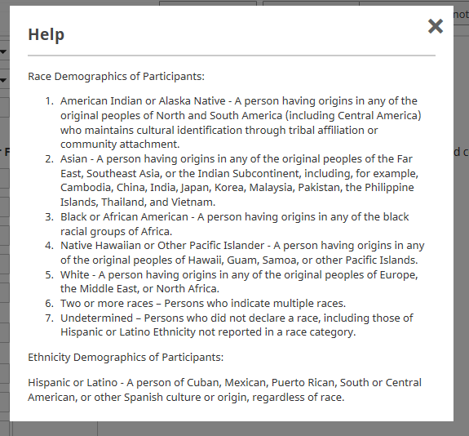
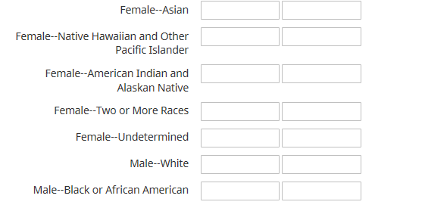
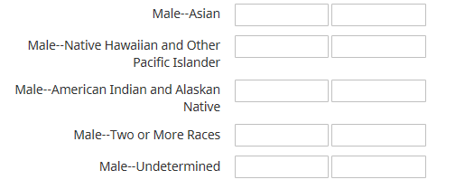
Master Key Reporting Field
Key Reporting Fields
Key Reporting Fields

Slide 10
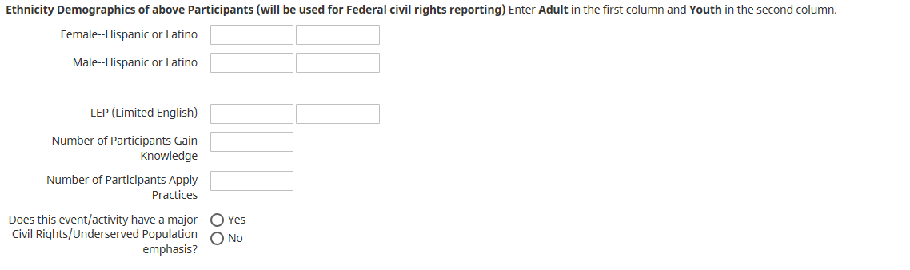
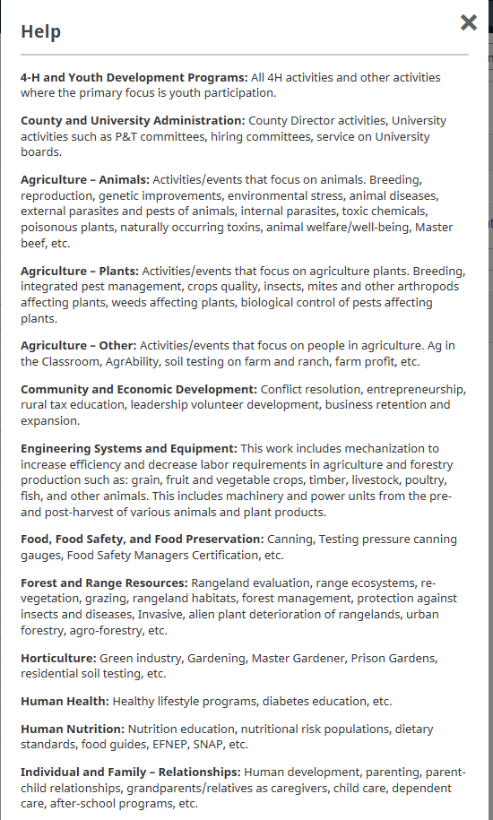
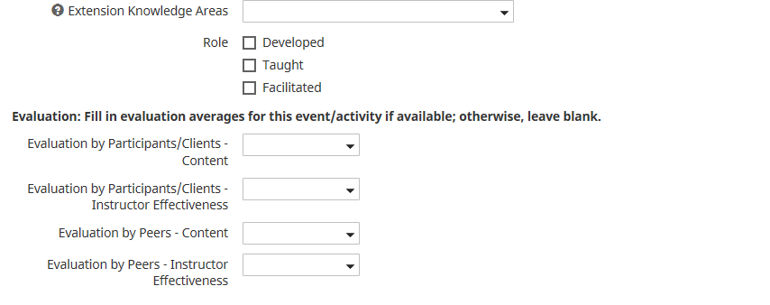
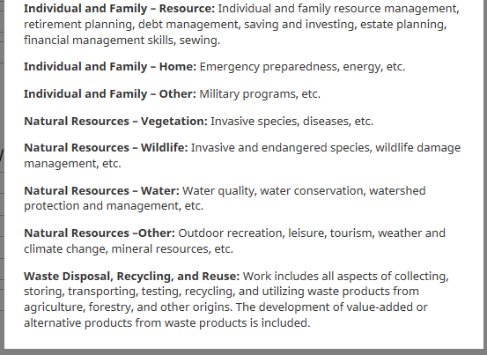
Key Reporting Fields
Key Reporting Fields

Slide 11
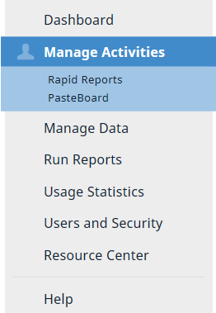
Run the NIFA Summary: Extension report to show by USDA Issue area your:
number of events/activities for each knowledge area
total direct contacts by race and ethnicity
the number of participants gained knowledge (Gained Knowledge)
and the number of participants apply practices (Gained Practice).

Slide 12
Contact Information:
Stan Guy
stanley.guy@usu.edu
(435) 797-3221

