Slide 1

Huntsman Cancer Institute
Cancer Prevention Education: Partners and programs
Jane Ostler, MS CHES and Jennyffer Morales M.Ed and M.Phil.
Notes:
Introduction of myself and Jennyffer Morales

Slide 2
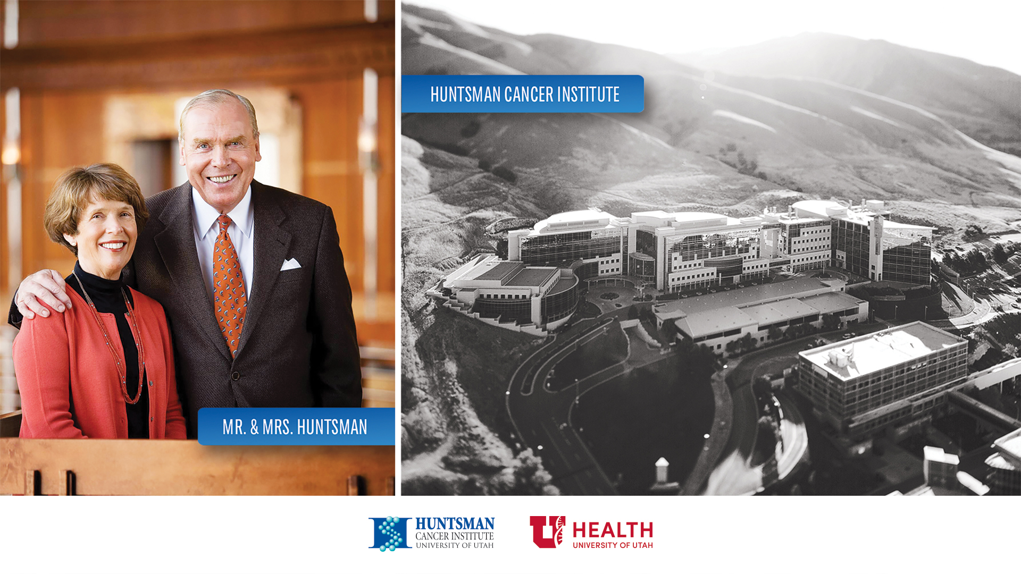
Notes:
Discuss Jon and Karen Huntsman and the Huntsman Cancer Institute

Slide 3


Understand cancer from its beginnings
Use that knowledge in the creation and improvement of cancer treatments
Relieve the suffering of cancer patients
Provide education about cancer risk, prevention, and care
Notes:
Discuss the mission of HCI

Slide 4
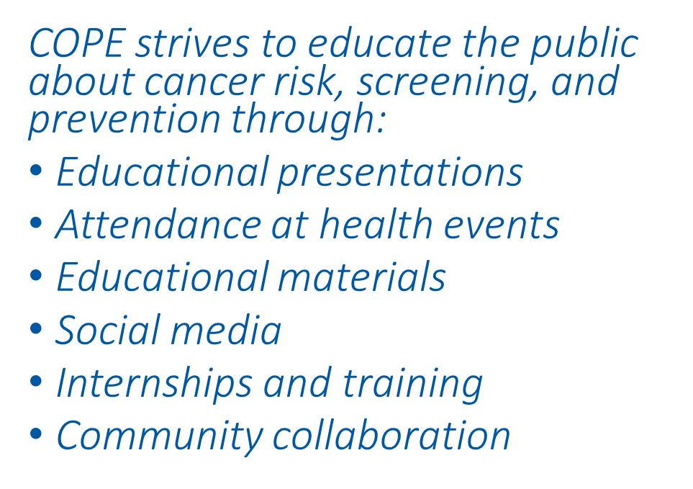
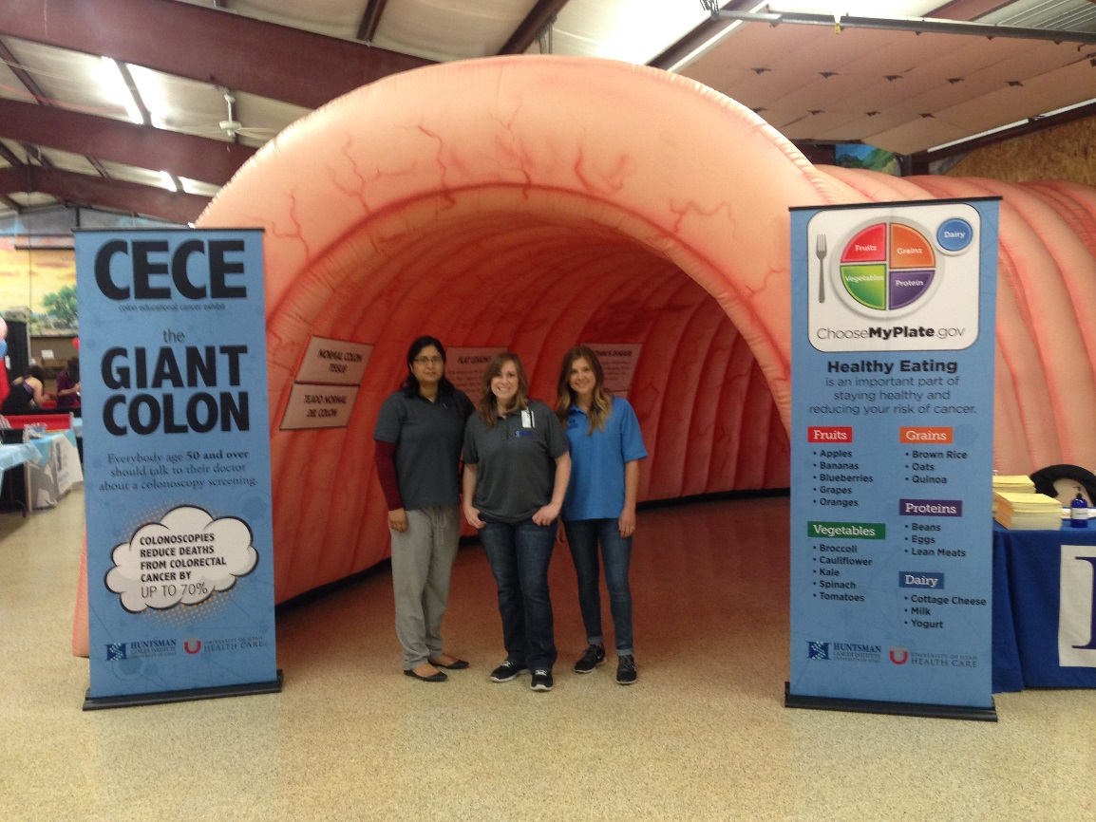
Community Outreach and
Prevention Education (COPE) Program
Notes:
Discuss examples for each bullet point
Worksites, religious groups, schools, non-profit, special populations like seniors, Hispanic/Latino, students, rural populations
Invitations to health events all over Utah and surrounding environs
Rack cards, exhibits (giant and mini colon, pig lungs, skin scopes, MyPlate activities, and other table top exercises
FB Live Events, Twitter chats, Youtube channel, Pinterest, Instagram, Circle of Hope Blog
8-10 interns a year, undergraduate and graduate students in a health field major to gain experience
Many community collaborations with various organizations

Slide 5
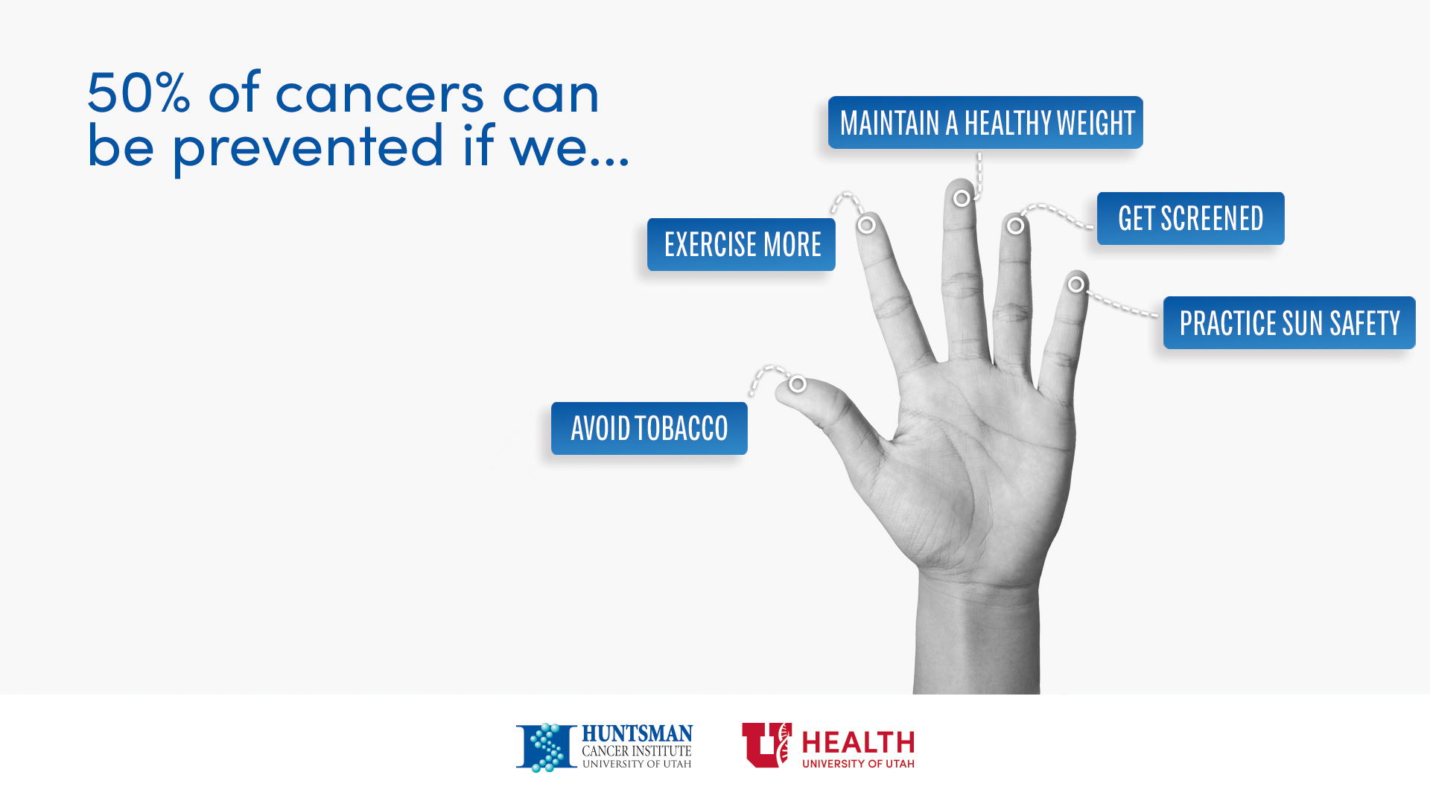
Notes:
Many of the topics that we promote are centered around 5 behaviors that reduce our risk for cancer by 50% (discuss)
Avoid tobacco
Exercise more
Maintain a healthy weight
Get screened
Practice sun safety
We also discucss other cancer prevention topics like testing for Radon, vaccination, and genetic testing.

Slide 6













































































































Outreach Audience
Notes:
Discuss collaborations with
NIMA
NCI
HARMON’s
Potential for USU Extension in agriculture programs for healthy food and sun safety, 4H, gardening, and other community programs where access to resources may be limited, but educational interventions are valuable

Slide 7
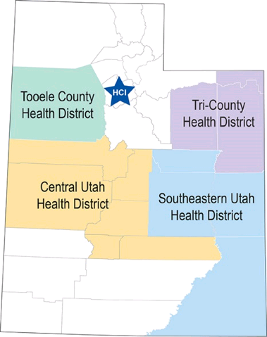
Community Health Education Grant
National Cancer Institute
Rural and frontier
GMaP
Collaborators
Notes:
Jenn discusses rural

Slide 8
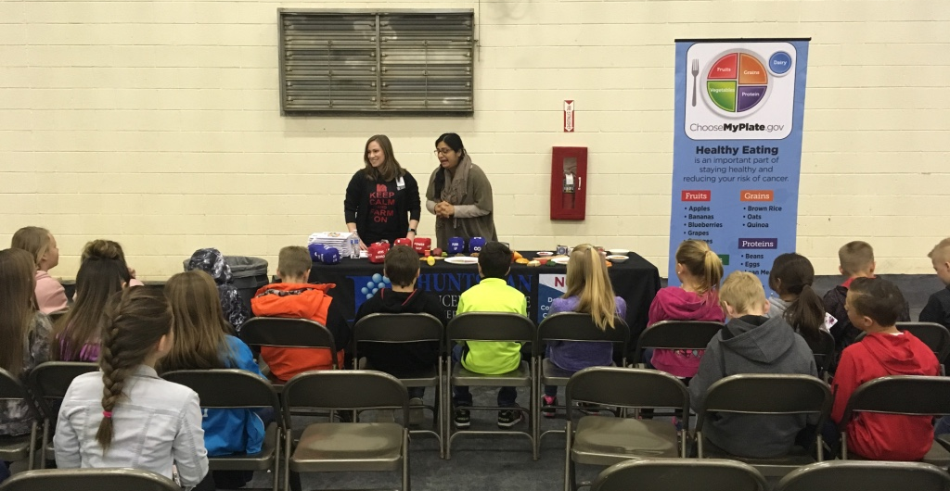
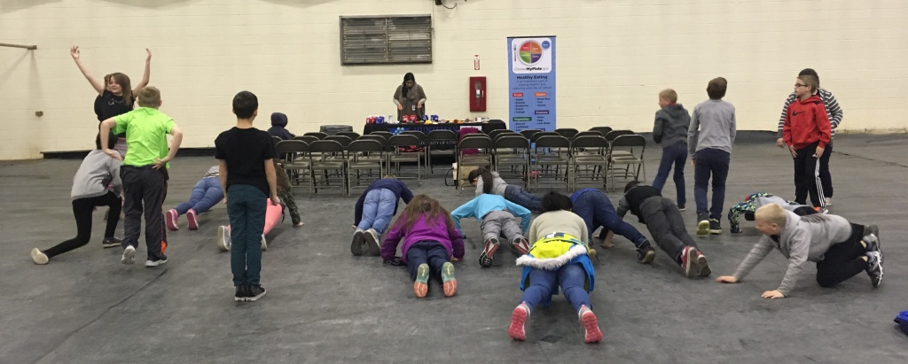
HCI and USU Collaborations
Farm Field Days, Vernal
Partners
  Cancer-Fighting Foods
    Where do they come from?
    Where can you get them?
  Exercise
    When can you do it?
    How can you do it?
Notes:
Jane discusses Stacey McArthur, Utah State Department of Agriculture, students, teachers, seeing other people like Susie that we collaborate with, etc.

Slide 9
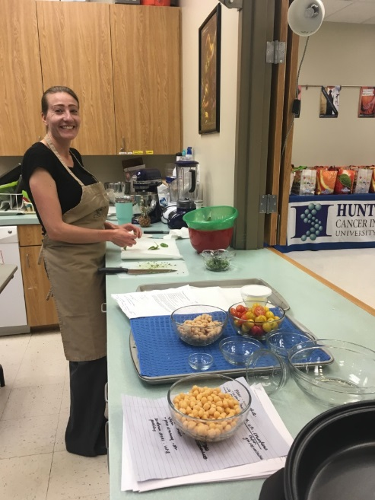
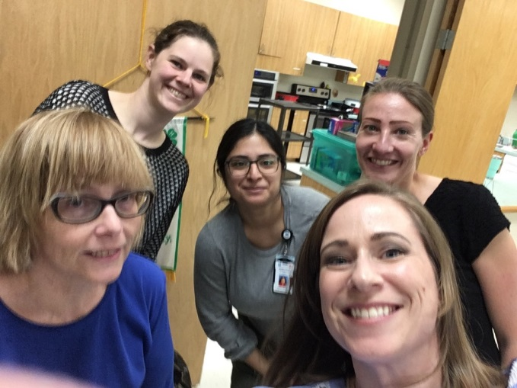
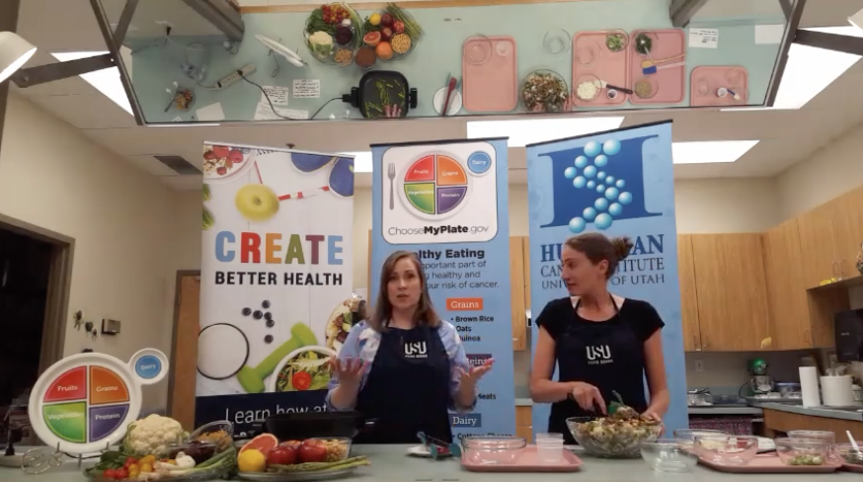
HCI and USU Collaborations
Food Demonstration, Tooele
Partners
  Cancer-Fighting Foods
    Skillet
    Salad
  Facebook Live Event
  https://www.facebook.com/HuntsmanCancerInstitute/videos/10155705671617830/
  Or recipes at extention.usu.edu/tooele
Notes:
Jenn discusses food demo, giveaways, live audience, views, recipes, Darlene, Brittany, and Jacqueline

Slide 10

HCI and USU Connections
Research
  Dr. Elizabeth Braungart Fauth
  Associate Professor, USU Department of Human Development and Family Studies
  Salt Lake County Aging
  Mountainland Association of Governments
  CCPS at HCI
Notes:
Jane discusses connecting SLCO Aging and MAoG with Research initiatives at USU
Jenn discusses our research teams

Slide 11
Future Directions
Think 5 (or more)
HPV
Radon
Notes:
Jane and Jenn: How else can we incorporate these and other cancer prevention topics into USU programs? How can we support USU programs? Agriculture, 4H, social media presence, etc.
Avoid tobacco
Exercise more
Maintain a healthy weight
Get screened
Practice sun safety
We also discuss other cancer prevention topics like testing for Radon, vaccination, and genetic testing.

Slide 12
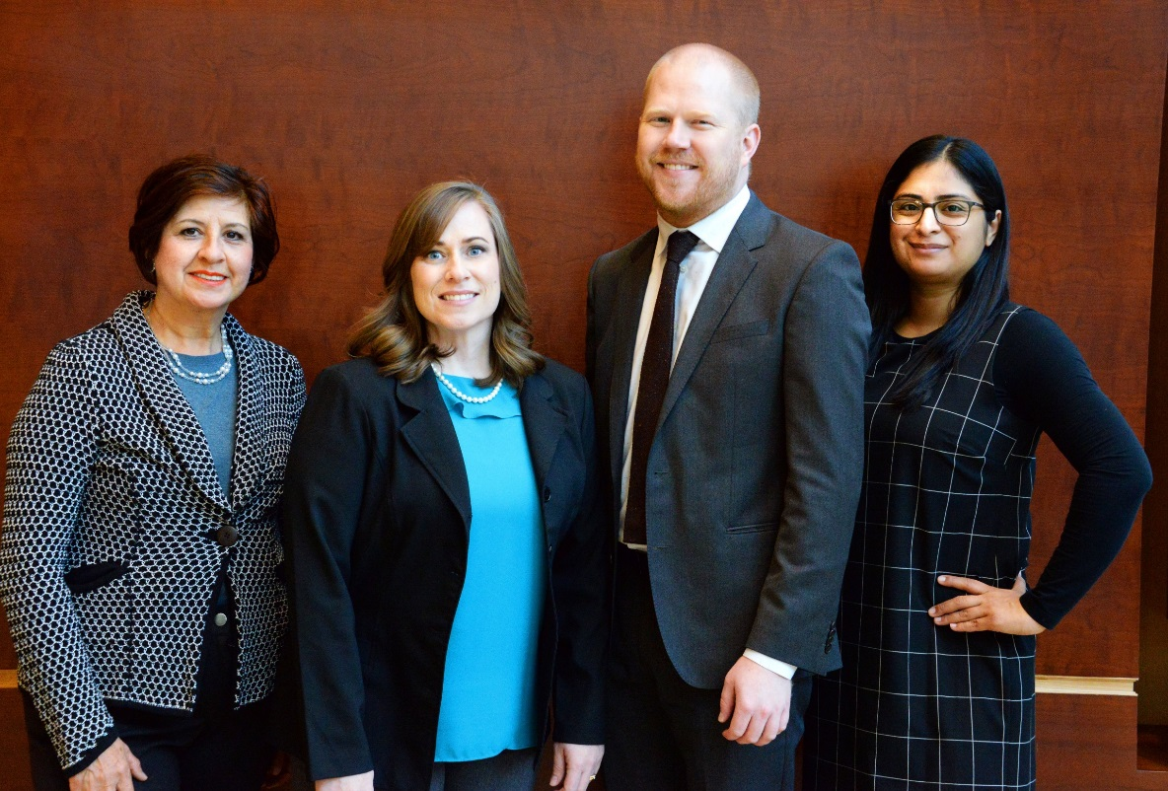
QUESTIONS ?
Garrett Harding, Manager, Community Outreach
O: 801-587-9976 | garrett.harding@hci.utah.edu
Jane Ostler, Community Health Educator
O: 801-585-0090 | jane.ostler@hci.utah.edu
Jennyffer Morales, Community Health Educator
O: 801-587-4607 | jennyffer.morales@hci.utah.edu
Guadalupe Tovar, Patient Navigation and Hispanic Outreach
O: 888-424-2100 | guadalupe.tovar@hci.utah.edu
Notes:
Our contact information.

Slide 13







stop by
1950 Circle of Hope
6th floor of HCI’s hospital
chat live
Click the “Ask a Question”
Button on any HCI webpage
call
1-888-424-2100 toll free
e-mail
cancerinfo@hci.utah.edu
text
“askhci” to 66746
visit
www.huntsmancancer.org/clc

Slide 14


