Slide 1
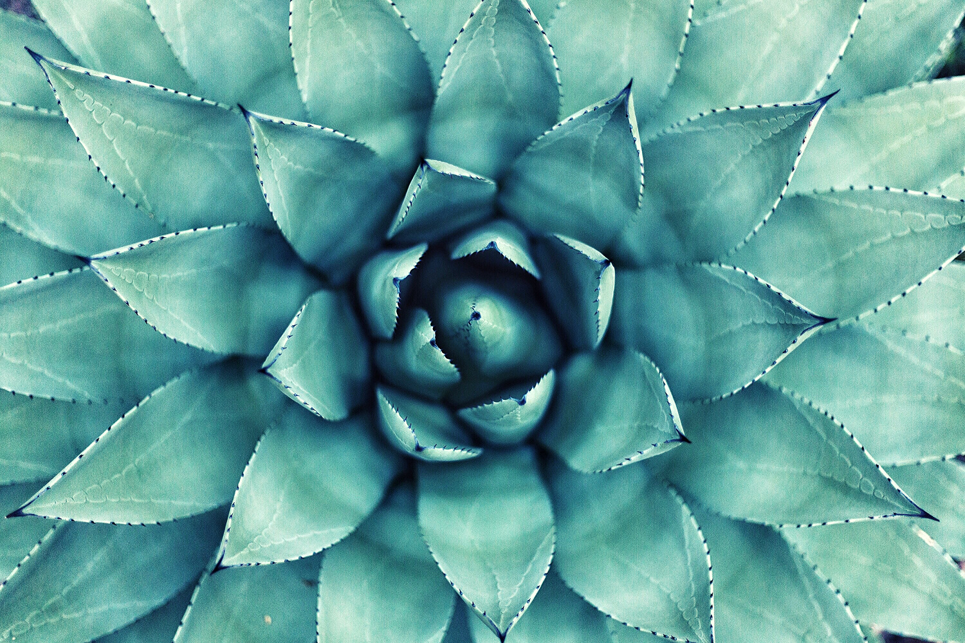

Online Gardening Course
PRESENTED BY CLARK KENT

Slide 2
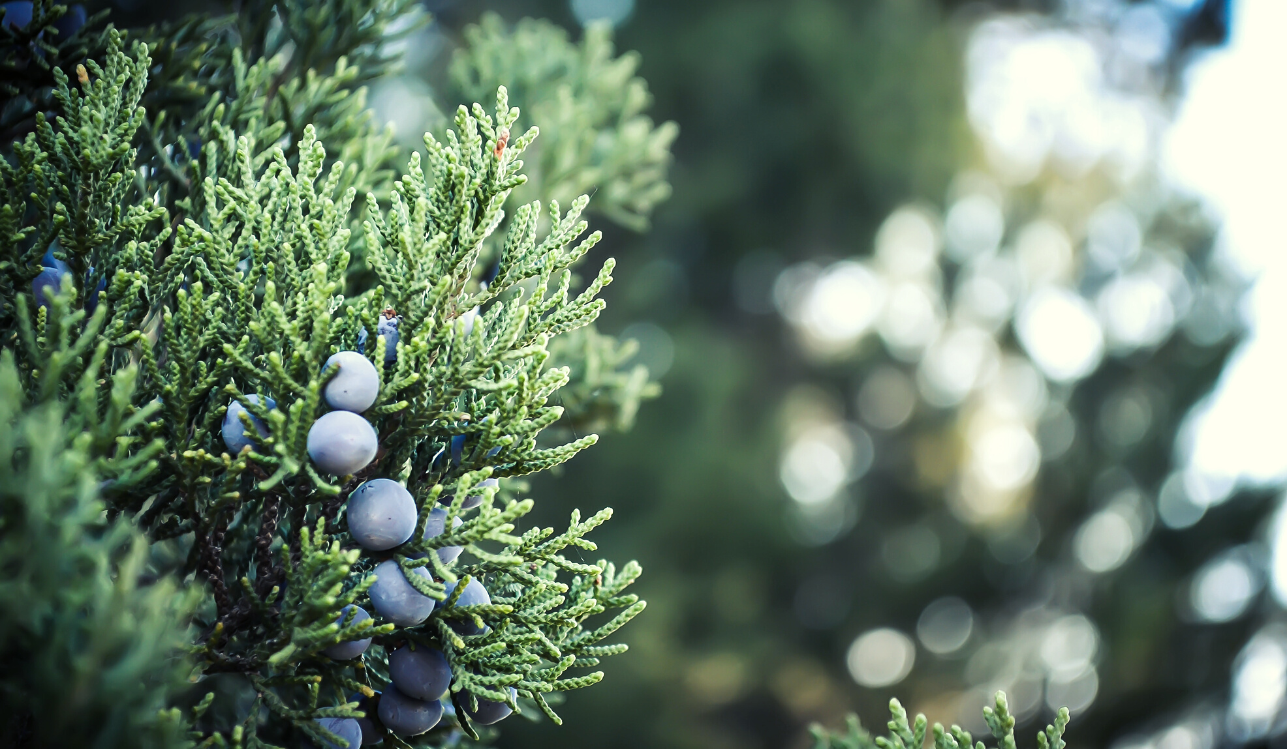
WELCOME TO THE COURSE!
Course introduction
What you’ll learn
Course promise

Slide 3
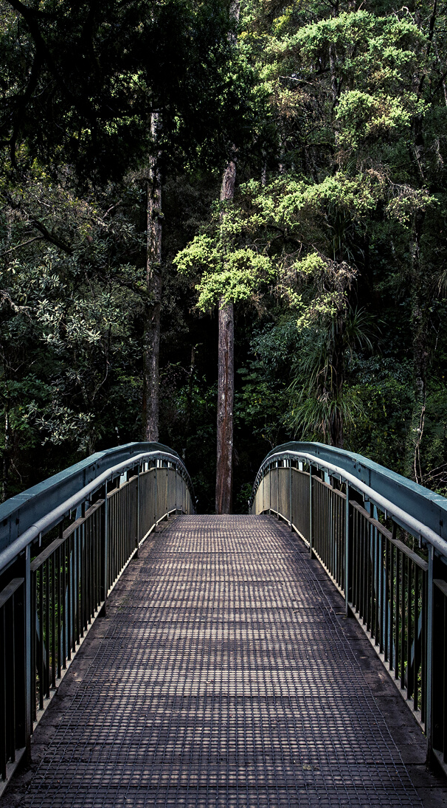
MEET
THE INSTRUCTOR
Bio and photo of instructor here
Share why you are qualified to teach the course.

Slide 4
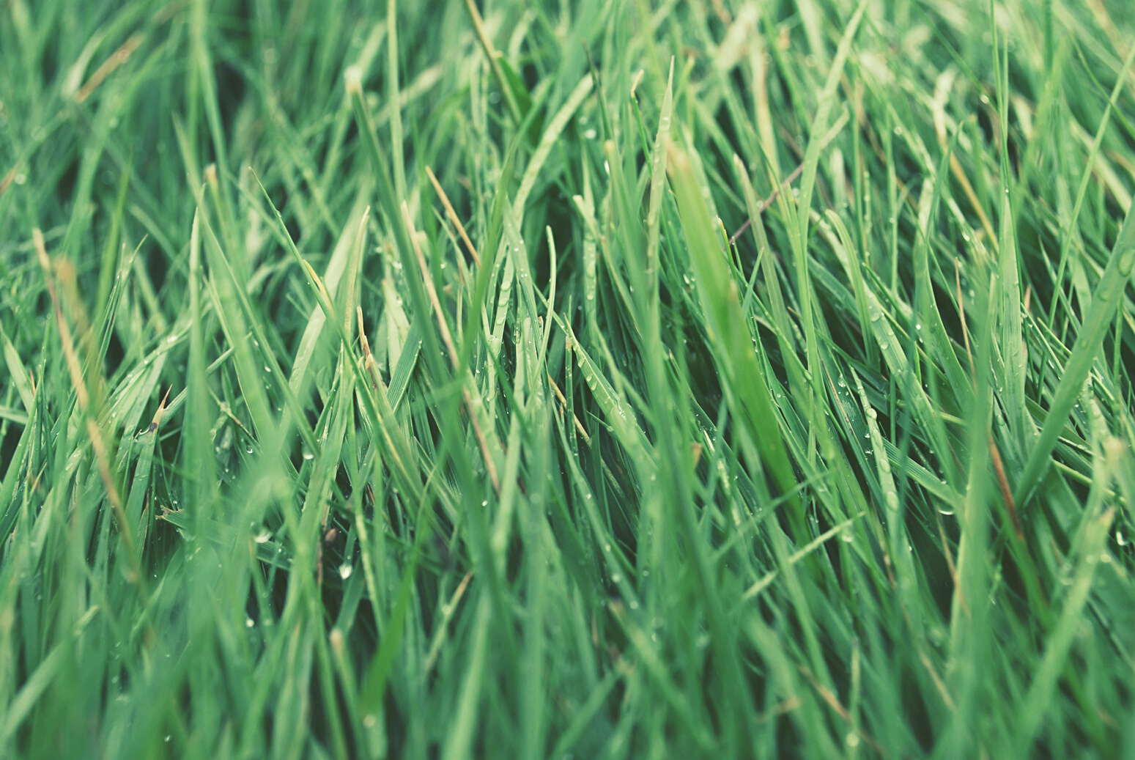
INSERT OBJECTIVE #1 HERE
Gardening is the activity of growing and maintaining the garden. This work is done by an amateur or professional gardener. A gardener might also work in a non-garden setting, such as a park, a roadside embankment, or other public space.

Slide 5
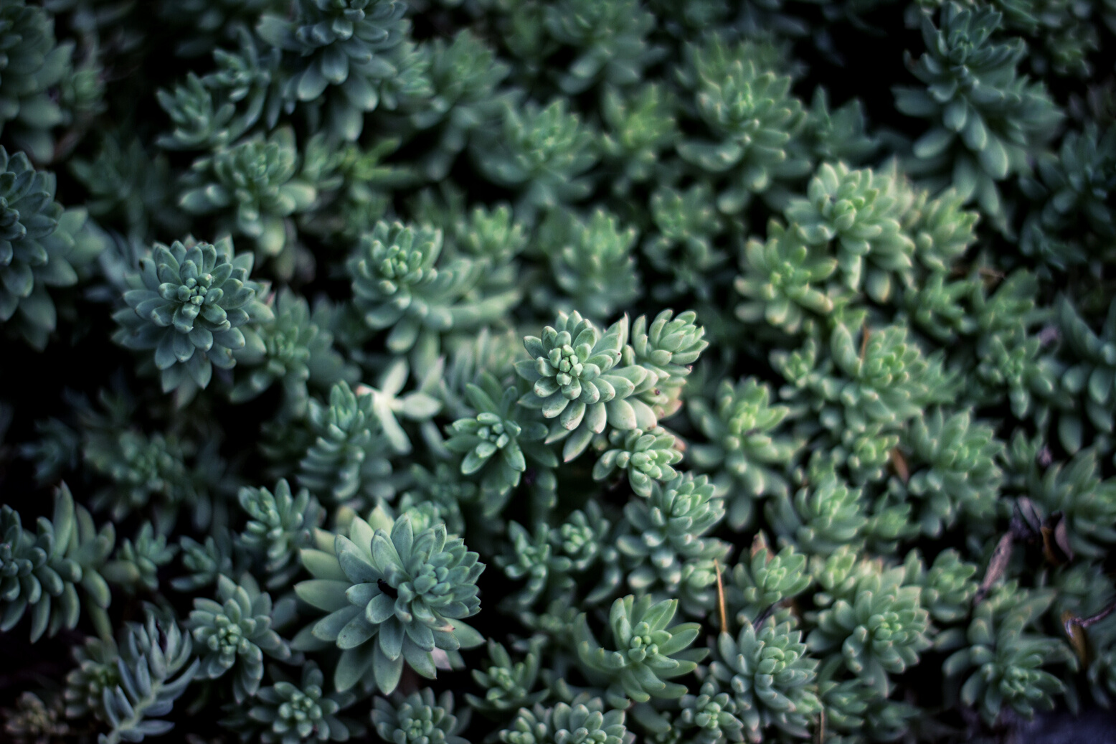
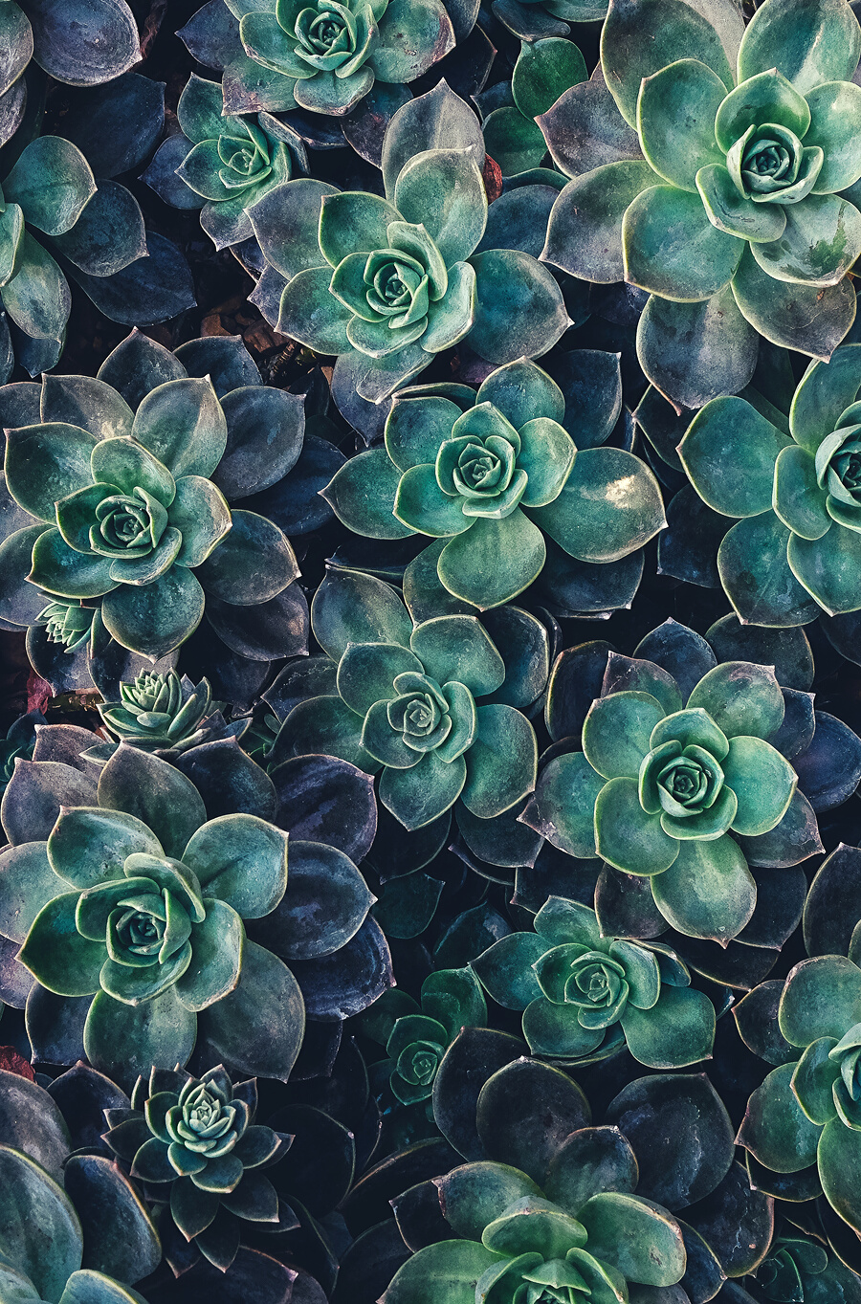
1.1 LECTURE MATERIALS
Insert course content here

Slide 6
QUOTE
"Why try to explain miracles to
your kids when you can just
have them plant a garden."
Robert Brault, Freelance Writer

Slide 7
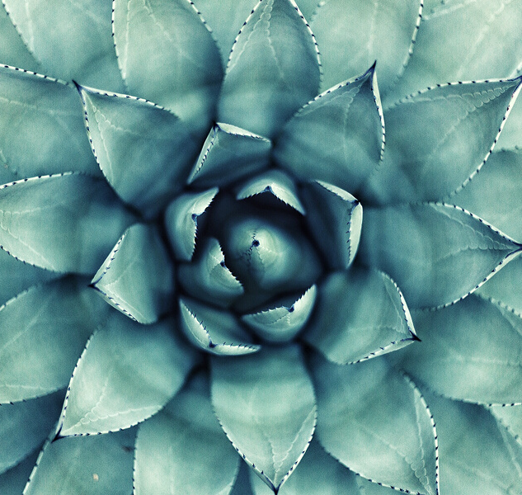
1.2 LECTURE MATERIALS
SEDUM
ECHEVERIA AGAVE
ECHEVERIA
GREEN PRINCE
The plants vary from annual and creeping herbs to shrubs.
They are drought-resistant, although they do better with regular deep watering and fertilizing.
They can be propagated easily by separating offsets, but also by leaf cuttings, and by seed.
$ 4.85
$ 4.55
$ 4.65

Slide 8
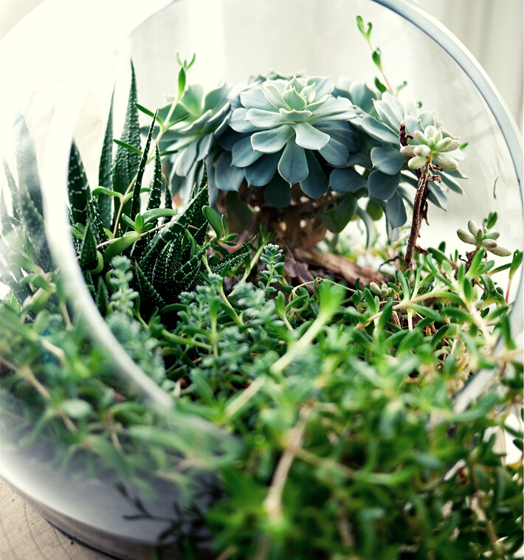
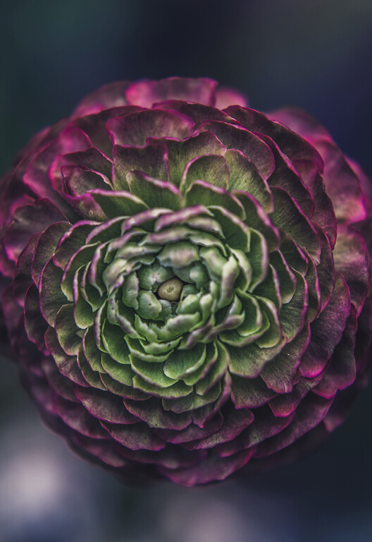
1.3 LECTURE MATERIALS
Insert course content here

Slide 9
1.4 LECTURE MATERIALS
Insert course content here

Slide 10
INSERT OBJECTIVE #2 HERE
Gardening is the activity of growing and maintaining the garden. This work is done by an amateur or professional gardener. A gardener might also work in a non-garden setting, such as a park, a roadside embankment, or other public space.

Slide 11
INSERT OBJECTIVE #3 HERE
Gardening is the activity of growing and maintaining the garden. This work is done by an amateur or professional gardener. A gardener might also work in a non-garden setting, such as a park, a roadside embankment, or other public space.

Slide 12
THANK YOU!
FOR MORE INFO, VISIT: GARDEN.USU.EDU

