Slide 1
Direct Market Sales Considerations

Slide 2
Direct Market Alternatives
Farmers’ Markets
Roadside Farm Stands
Pick-Your-Own
Farm Stores/Shops
Community Supported Agriculture Programs (CSAs)
Restaurants

Slide 3
Why direct market?
Opportunity for increased returns…..
Reduce marketing costs (trans, retail, packaging) – capture profits of middleman
Consumer willingness to purchase and pay a premium for fresh, high quality produce – improved pricing
Large consumer demand now for local foods due to food safety, environmental, energy usage, ag land preservation concerns
Provide quantities (smaller) and/or quality differing from commercial markets

Slide 4
Farmers’ Markets
Advantages/challenges
Travel time and transportation to market
Labor for market
Interaction with customers/use of existing customer base
Advertising/promotion by market
Set day/time
Sales/pricing uncertain
Need variety of products

Slide 5
Farmers’ Markets – Consumer Advantages
Freshness, variety, and quality
Local products
Minimize “food miles,” energy usage
Support local agriculture
Socialization/community event
Primary customer types
Organic and Health Enthusiasts
Homegrown Enthusiasts

Slide 6
Customer Types – Organic/Health
Willing to pay premium / less concerned with pricing
Eat 70% of meals at home
Healthy lifestyle – diet & exercise
Concerned with food safety
Higher education levels

Slide 7
Target Organic & Health Enthusiasts
Clear labeling for certified & non-certified organics
Information
Recipes
Storage
Nutritional / safety benefits
Wine parings / meal planning

Slide 8
Customer Types – Homegrown
Less willing to pay premium / somewhat concerned with pricing
Eat 90% of meals at home
Supporters of local agriculture & ag open space
More children in household
Home gardeners
Canning & storage

Slide 9
Target Homegrown Enthusiasts
Clearly label product origins – state & region
Tell “farm story” with poster pictures & in brochures
Family appeal of booth
Information
Gardening / arid region suggestions
Canning / preserving
Recipes / preparation / pairing

Slide 10
Farmers’ Market Suggestions
Present an attractive booth
Use effective signage
Employ well-trained staff
Create Brand Identity
Sell quality products

Slide 11
Present an Attractive Booth
Clean, tidy, organized
Colorful, abundant, appealing
Appropriate for your product
Signs, pricing, identity
Be creative

Slide 12
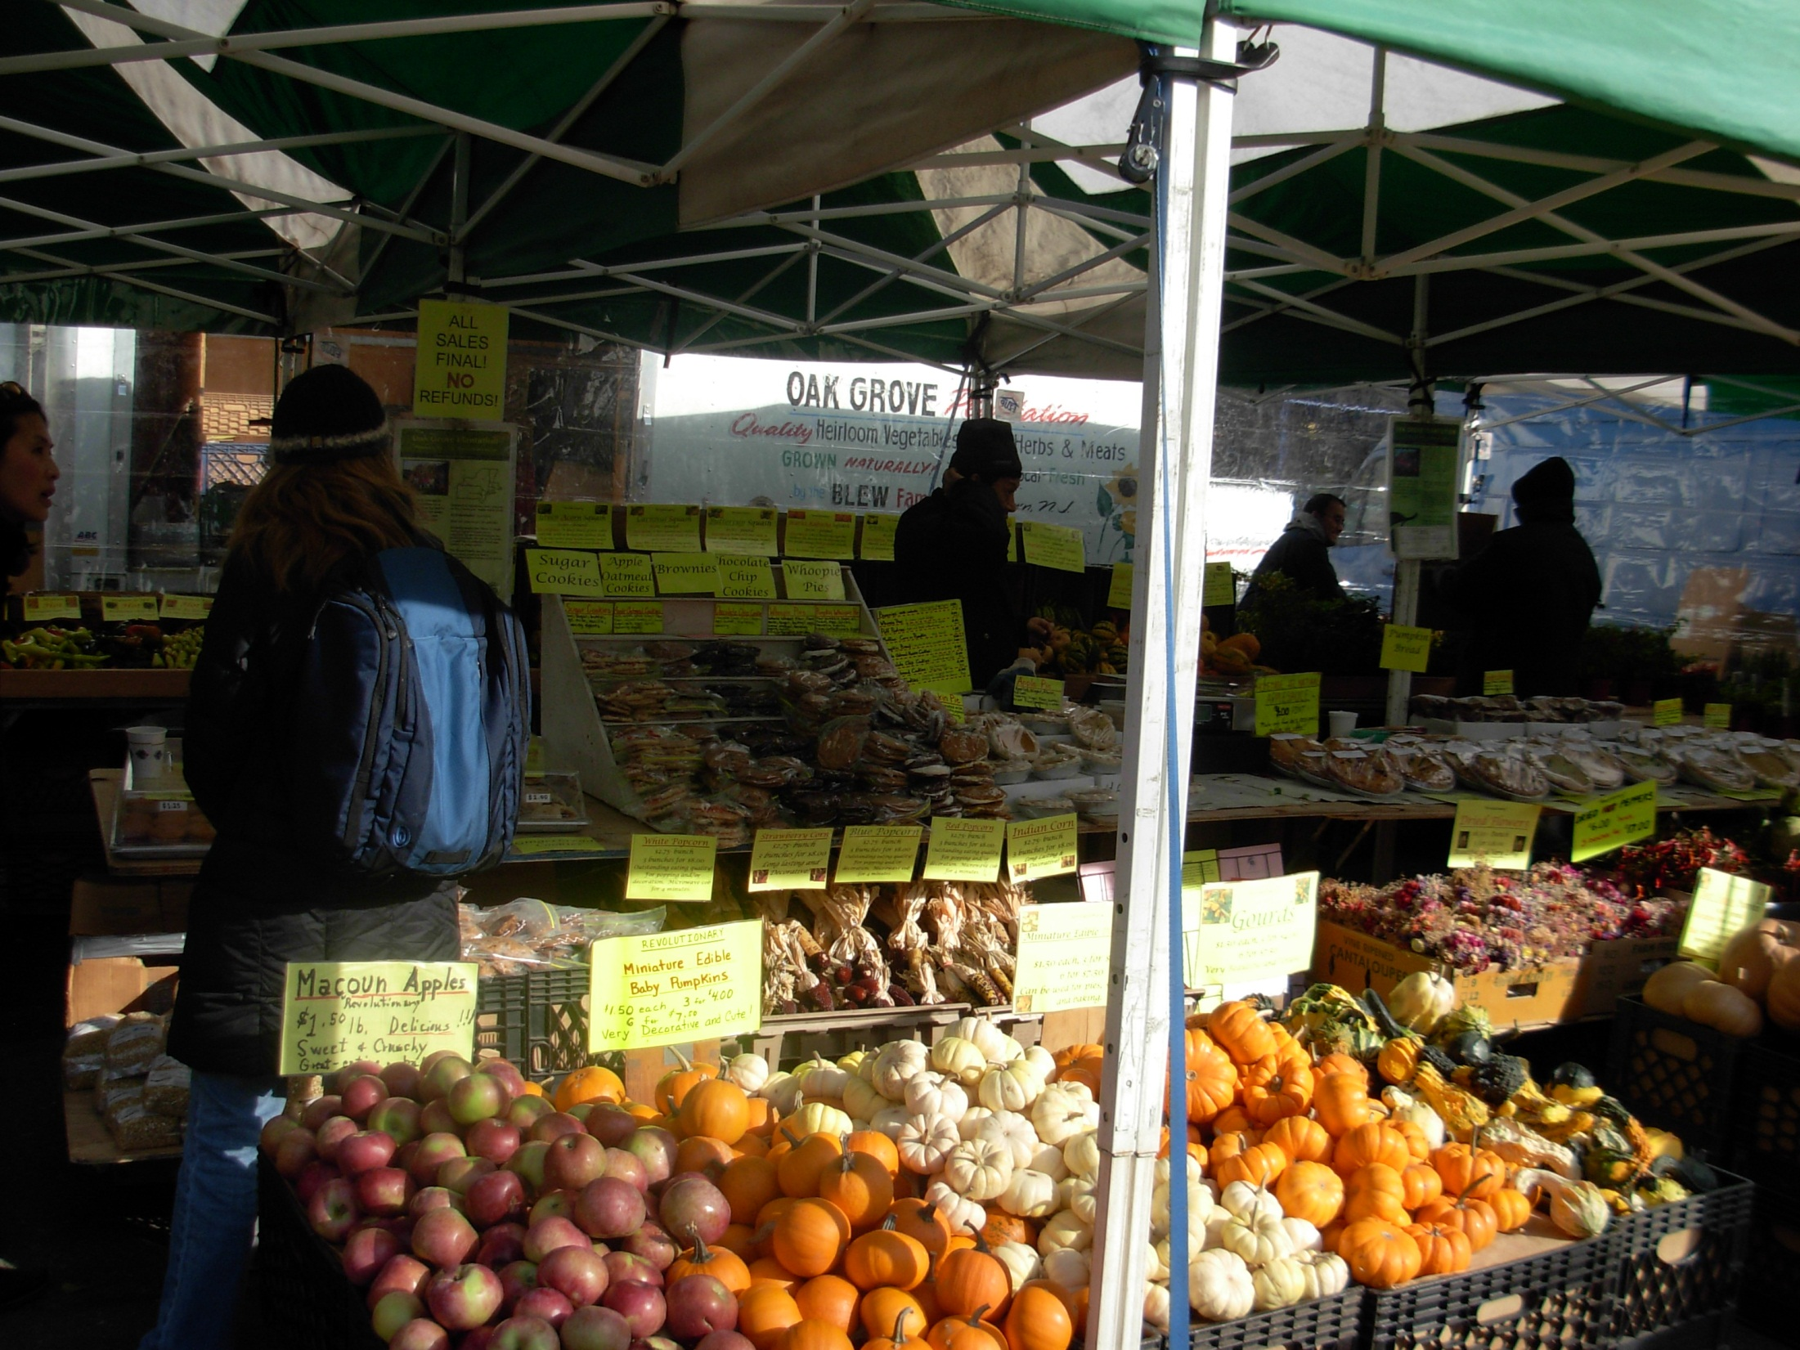

Slide 13
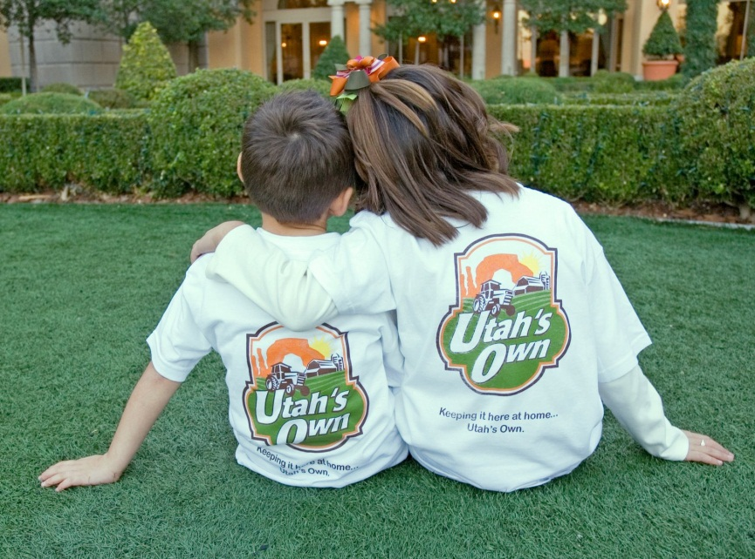

Signage
Easy to read, simply stated
Show pricing
Be creative
Tell your story
Banners – Utah’s Own

Slide 14
Staff –Represent Your Business
Staff should know the rules of each market and how to direct customers
Staff should be able to describe your farm, growing practices, upcoming crops, retail outlets
Train staff to always acknowledge waiting customers
Talk about setting up sales for next week
Hire friendly faces
Consider name tags or uniforms

Slide 15

Create Brand Identity/Tell Your Story
Who are you? Why are you special? Where are you from?
Consistency from market to market and week to week
Learn to say direct from “your name”
Use your name on signs, name tags, handouts, etc…

Slide 16
Build Return Customers
Successful vendors build relationships with their customers
Repeat customers are key to success
Sell quality products at fair market prices
Deliver consistent, friendly service
Get to know your regular customers by name

Slide 17
Techniques for Repeat Sales
Recipes, bags, tips
Solicit feedback
Collect email addresses to advertise upcoming crops and specials
Distribute handouts (recipes, tips)
Say “see you next week”
Sell reusable containers, offer a discount if they are returned

Slide 18
Community Supported Agriculture (CSA) Programs
Farmer/group of farmers offer shares to the public
A share is a box of vegetables/fruit and other farm products (bread, jam, etc.)
Consumer purchase a share - subscription
Consumer receives the share - box of vegetables/fruit each week during the growing season
Shared risk between farmers and consumers
Share in the good (great yields) and the bad (weather, pest or other crop damage)

Slide 19
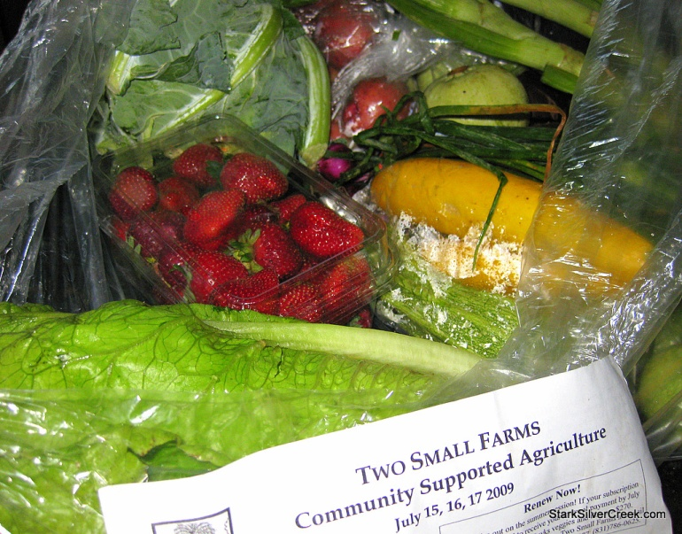
CSAs –Advantages
Marketing occurs before growing season - predefined market
Share payments are made in advance - provides cash flow
Develop relationship with customer – needs, feedback
Usually also do farmers’ markets and on farm stand in addition to CSA membership

Slide 20
CSAs –Challenges
Production complexity – 30 or more crops
Shareholder administration and communication – CSA manager
Turnover in share holders from year to year
Need to provide high quality diverse products
Consumer desire for variety – may need to have several farms working together
Cleaning and packaging requirements
Consumer education – seasonality, weather issues, cooking/recipes - newsletters
Provide several drop-off locations – volunteer management

Slide 21
CSAs – Consumer Advantages
Availability of super fresh, healthy food
Exposure to new veggies and varieties, new cooking ideas
Exposure to farms and growing process
Develop relationship with farmer - freshness, safety, support local business

Slide 22
CSA Consumer Overview
Highly educated
More fully employed (vs. FM shoppers)
Female and primary shopper
Complete more home food prep (vs. FM shoppers)
Food quality important
Supporting local farmers important
High incidence of vegetarians
Variety and appearance less important (vs. FM shoppers)
Organic less important

Slide 23
CSA Suggestions
Provide recipes with share baskets
Hold cooking demonstrations
Provide educational information on food preserving and gardening
Allow own share packaging, or half shares
Include weekly newsletter addressing seasonality and current weather issues
Provide home delivery service

Slide 24
Restaurants
Target high-end or fine dining category
Use of locally-produced , in-season, and specialty produce popular
Why?
Perceived higher quality and freshness
Establish relationship with local grower, orders, quality, etc…
Restaurant customer requests for local products
Availability of unique or specialty varieties - heirlooms

Slide 25
Restaurants - Advantages
Higher return, product pricing
Reliable customer base
Build relationship with customer/local business
Opportunity to grow special varieties

Slide 26

Restaurants - Challenges
Distribution – delivery, availability, variety
Limited seasonal availability
Low volume frequent sales
High turnover – chefs move, restaurant closing
Product packaging, labeling, processing to meet food safety regs may be costly

Slide 27
Approaching Restaurants/Chefs
Contact the chef or person in charge of food buying – never contact during meal service
Research the menu, clientele, food philosophy
Understand the key personnel – chefs, owners, managers
Find out how they wish to be contacted and when (day/time)
Invite the chef or buyer to your farm
Bring samples of produce to share with the chef/buyer
Schedule a winter visit for crop planning

Slide 28
Approaching Restaurants/Chefs
Prepare a “story” for your farm
Provide overview of your products, volume, packaging, availability (season)
Update chefs on availability regularly
Grow unique items, select the best product for chefs
Make weekly contact at agreed time, provide deliveries on time
Immediately notify chef of potential shortages and/or change in delivery

Slide 29
Resources
Direct Marketing Guide for Fruit and Vegetable Producers at http://www.utextension.utk.edu/publications/pbfiles/PB1711.pdf
CSA information for farmers at http://www.nal.usda.gov/afsic/pubs/csa/csafarmer.shtml
Local Harvest at http://www.localharvest.org/csa/
Utah’s Own at http://utahsown.utah.gov/
University Cooperative Extension Publications - http://www.unce.unr.edu/ and http://extension.usu.edu/
Chefs Collaborative at http://chefscollaborative.org/
ATTRA at http://attra.ncat.org/

Slide 30
Thank You
This material is based upon work supported by USDA/NIFA under Award Number 2015-49200-24225.

