Slide 1
Marketing: Target Customers & Promotional Strategies

Slide 2
Overview
Target marketing defined
Customer value proposition
Three Cs of marketing
  Customers, costs, and competition
Four Ps of marketing
  Product, price, place, and promotion
Food tourism and tourist types
Western food tourists
Tourism promotion options and resources

Slide 3
Marketing Defined
Marketing is anticipating the needs and wants of targeted customers and managing the process through which these needs and wants are satisfied ... profitably
Notes:
Key Words . . .
• anticipating….looking at external conditions and the future to be forward looking
• needs and wants….what qualities and assurances they value
• targeted customers….those most inclined to be motivated by your enterprises’ values and mission
• management process….tactical decisions to carry through on strategic choices
• customer satisfaction….loyalty, repeat customers, word of mouth
• profitability
Good Marketers know
what a customers needs are
before the customer Knows

Slide 4
Mass vs. Target Marketing
Mass Marketing
  Commodities
  Low cost due to economies of scale
  Low contribution ➔ high volume
Target Marketing
  Customer segments
  Increase value for small segment
Notes:
Contributions are what this sale will mean to your whole enterprises’ financials…..commodities provided little returns, but volumes of sales aggregated these small returns quickly
With target markets, you chooses customers that allow you to charge prices that may return more to the firm, and make up for smaller scale

Slide 5
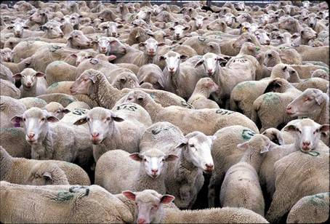
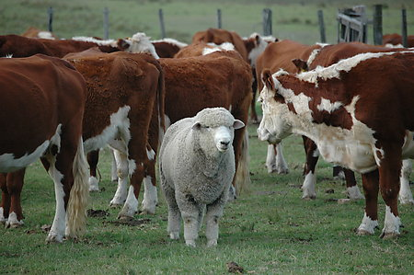
Commercial or Specialized?
The market place can
be crowded …
can you stand out in a crowd?
Notes:
While the commercial market channels can seem crowded, local marketing can be also. You may not be the only seller of fresh veggie's, honey or grass-fed lamb…
SO… the $64 question is how to standout or make what you have differ from the competition?

Slide 6
Types of Marketing
Strategic Marketing
  Encompasses the entire firm strategy
  Deals with the broader issue of determining firm’s strategic position in the market and how to create value from that position
Product Marketing/Pricing
  Deals with the tactical side of selling a product
  Similar to a set of standard operating procedures for marketing a particular product
Notes:
You will use both, but strategic sets the tone for more tactical and operational decisions and tasks, so they should be tackled first
Good Marketers know
what a customers needs are
before the customer Knows

Slide 7
Marketing Overview
Analyze strengths, weaknesses, opportunities and threats (SWOT)
  Use internal and external information
Research customers, costs and competition (3 Cs)
Develop the marketing mix using product, price, place and promotion (4 Ps)
Notes:
These 3 concepts represent how the principles of strategic marketing will be organized and discussed in this lesson

Slide 8
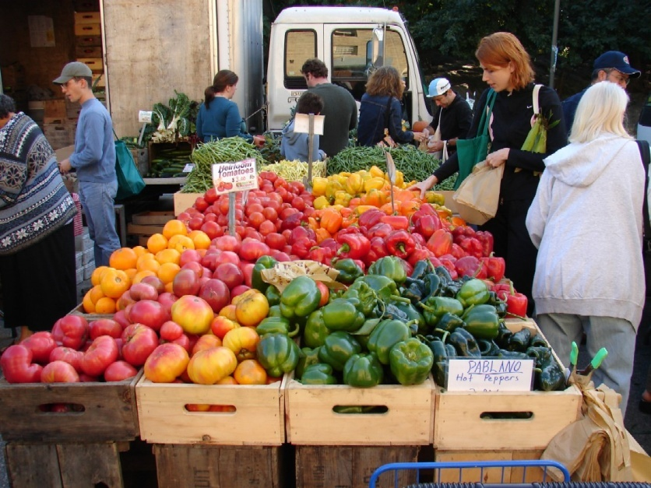
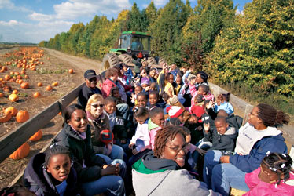
The 3 Cs of Marketing
1. Customer
2. Costs
3. Competition

Slide 9
1. Customers
Who are you selling to?
What is important to targeted customers?
Make sure you are distinctively different from competition in areas of importance to target customers
  Competitive analysis
  Reallocation of resources if necessary
  Positioning
  Market intelligence
Notes:
WHO'S RESPONSIBILITY IS MARKETING?
EVERYONE IMPACTS MARKETING EFFECTIVENESS
BUT SOMETHING THAT IS EVERYONE'S RESPONSIBILITY, ENDS UP BEING NO ONE'S RESPONSIBILITY
These should be developed in initial planning stages, but revisited here since marketing is so fundamental to mission…and the mission may define what markets and customer segments are most relevant

Slide 10
Customer Segments
Loyal are return customers … less worried about costs, want a relationship
Value segment are hardest to keep happy, but do recognize and value quality
Convenience segment are those you can get to make impulse buys … less price sensitive
Price segment is not too attractive unless you compete entirely on price
Notes:
A business may not target just one, but should have a primary focus, and then another segment they can market effectively to
The instructor may want to brainstorm effective marketing strategies for each type at this point…..

Slide 11
Target Customers
For each target segment define
  Demographics
    Age, location, education, etc.
  Psychographics
    Health, food safety, nutrition, environmental, support local growers, etc.
  Needs/Preferences
    Product characteristics, variety, delivery location, etc.
Notes:
At some point, you should really describe who you believe is seeking your type of product, and one of the provided worksheets provides a way to organize your thoughts and define these segments.
Describe them, estimate how many there are…and what marketing strategies will work with them…..and seek our research on customers wherever possible

Slide 12
Target Customers
For each target segment estimate
  Potential number of customers
    Ex. Number of households within 50 miles
  Volume of sales per customer
    Project volume through consumption stats of USDA, local records, own surveys, etc.
  Potential total sales volume

Slide 13
2. Your Costs
(and their $$ Spending)
Know variable costs of producing your product
Realize there are fixed costs that must be paid, whether you produce your product or not
Use variable and fixed costs to calculate the break-even point where costs are covered
  Covered in more detail in upcoming financial lessons
Compare break-even with industry standards
Notes:
If these terms are new to you, you may need to wait until you have put enough cost records and financials together to do this well….
If you know these costs, it is important to price relative to variable costs, but if small scale, also know prices will need to be high since there are fewer units to cover “big costs” (whereas larger producers may be spreading those costs across thousands or millions of units)

Slide 14
Product Benefits and Costs
Tangible – Product benefits (costs) that are easy to measure, “features”
  Packaging, taste, size….
Intangible – Product benefits that are not easily measured
  Local, organic, humanely raised
  Benefits and costs harder to determine
    Promotion will often be used to communicate intangible values
Notes:
Both tangibles and intangibles provide benefits to the customer.
Tangible can be cultivar, size, blemish-free, sweet or freshly harvested
Intangible is harder to understand, but the fact sheet shares some research done by CSU on these less “experential” elements, like local, organic and purchased directly…that are more values-driven
But, it is important that the agribusiness firm knows the value that its tangible and intangible features provide, and that this value is clearly communicated to the customer.

Slide 15
Know Costs to Control Costs
To survive in a competitive market-based economic system,
  You must be a low cost producer
  Or market to a specialized segment
Always know and control your costs
  You control only what you can quantify and measure
  You measure costs through accounting and budgeting
Notes:
Instructor: Divide students into groups and assign a product and category (producer or consumer). Participants can write their stories on the Proposed Enterprise Development Activity Sheet.
For example, you might select carrots, huckleberry jam and chocolate rum cake, or you might include the example of asparagus production by bringing in a jar of pickled asparagus. Why would someone want to buy the specific product, from the viewpoints of both producer and consumer? Whenever possible, provide samples of actual products to stimulate ideas.
Alternatively, you can allow students to self-identify a product or use the asparagus example. Allow more time for this style of activity.

Slide 16
3. The Competition
…and Other Challenges
From SWOT analysis, assess your business’ strengths and weaknesses compared to your competitor’s
Competition can be other operations, regions, product or service types
Responses to risks and barriers in the market

Slide 17
Competitor Analysis & Strategic Value Creation
Make sure you are distinctively different
from your competition
in areas of importance
to your customers
Competitive analysis
Reallocation of resources if necessary
Positioning

Slide 18
Competitive Analysis
You are concerned with their product position, brand strength and prices
Emulating their good ideas may be a key to success…
  Look online, food-oriented publications
  Read or watch shows you might not otherwise

Slide 19
The Marketing Mix (4 Ps):
Implementation
Price
Product
Promotion
Place
Notes:
We now transition to the next stage….after assessing our environment with 3 Cs, we make decisions on how to operationalize our marketing strategies

Slide 20
The Marketing Mix
The 4 Ps of Marketing
  Understanding important Product Claims
  What Place will Consumer Find You?
  How will you Promote Cost Effectively?
  What are Effective Pricing Strategies?

Slide 21
1. Product (& Services)
Goods that satisfy the needs of a target market should have the following characteristics:
Physical features (design and packaging)
Branding and image/personality
Degree of customer service: products and services
Consistent quality, supply or experience
Notes:
Branding is how you will develop a unique identity in the marketplace with customers, like Horizon Dairy did in the dairy industry
Degree of customer service is how “accessible” the producers are to customers…but it will impact labor costs, so there are likely price implications

Slide 22
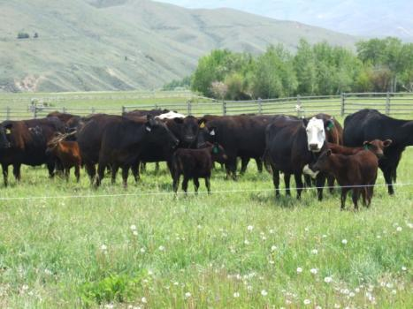
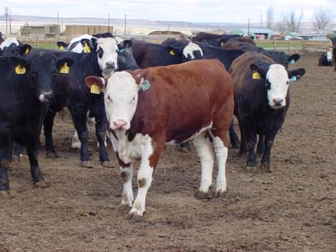
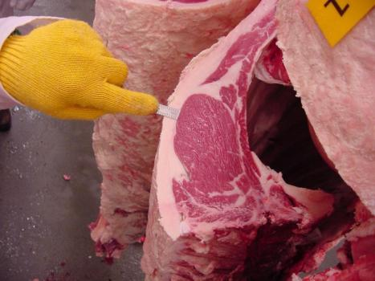
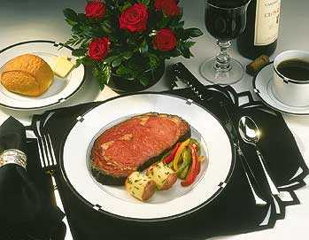
What Product Are
You Marketing?
Grass or
Livestock ?
Meat or an
Experience?
Notes:
There are many products that can be produced on small-acreage properties. Below is a partial list of possible enterprises:
Crops
Livestock – small and large ruminants, exotics
Service
Recreation
Tourism
Value-added products – food and nonfood agricultural products (soaps, candles, botanical body products, etc.)
One or more of the above
Now is not the time to limit your thinking! Consider a broad range of possibilities that match your interests and local opportunities.
Instructor: Remember that the increased use of the Internet opens another realm of market possibilities for farm-based ventures. “Local” doesn’t necessarily have to restrict a venture to a single physical location.

Slide 23
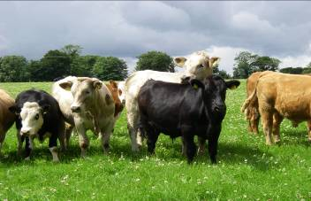
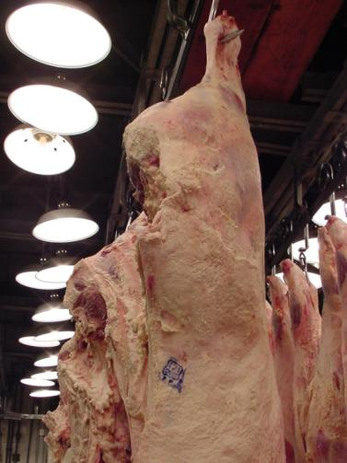
Knowing Your Product
Begin with the end in mind
  What attributes are important to your
  market segment?
Do your products meet those specifications?
Value-added characteristics
  Traceability, treatments, welfare, certification, local”
Notes:
Before you can develop a business plan, you need to know what you plan to sell. On the Proposed Enterprise Development Activity Sheet, write down three enterprises you think might be a good match for you, your property and your local area. The proposed enterprises can be taken from the Testing Possibilities Activity Sheet you did earlier in class.
Instructor: This activity can be done in groups or individually. We have provided a completed sample activity sheet for enterprises including free-range chickens, asparagus and parsnips. The lesson plan also includes sample mission statements juxtaposed with slogans that represent a starting point for many participants.

Slide 24
2. Price
Set prices based on:
  Value-based pricing – Match price to perceived value by customer, brand loyalty, customer oriented price
  Competition-based pricing – Match prices to similar products of your competition)
  Cost-based pricing – Set price dependent upon production costs)
Use discounts or incentives to boost sales but with a specific goal in mind

Slide 25
Supply & Demand Set Price
Price
Niche
Markets
P_{n}
Specialized
Markets
P_{s}
P_{c}
Commercial
Markets
Demand
Q_{n}
Q_{s}
Q_{c}
Quantity
Notes:
Demand curves slope down to the right. As price decreases quantitiy demanded would increase.
Supply curves slope up to the right. As price increases amount supplied would increase.
A “flat” or more horizontal curve is more elastic –more sensitive to price changes.
A more vertical curve is less elastic or less sensitive to price changes
Price and quantity are constantly seeking an equilibrium which is reached when a quantity clears the market at a given price.
Using beef as an example, a commercial market might be represented by a large retailer selling volume (unbranded) product at a lower price
A specialized market might be one like Certified Angus Beef (CAB) where an association has created more value by controls on quality and by market awareness campaigns
A niche market might be a local producer selling grass-fed or organic beef to customers in a limited geographic area.
Moving from commercial to specialized to niche the price increases, customers who seek out a particular “type” of product are typically willing to pay more for the perceived benefits, and more willing to buy regardless of other factors so demand is more inelastic, but the market segment is smaller.

Slide 26
Pricing Strategies by Segments
Loyal and Convenience consumers can be highest revenue potential…skimming
  Artisanal, foodies or ready-to-eat products
First time buyers may be attracted through penetration
  Sampling in new market with coupons
  Volume discounts, CSAs
Good pricing strategies can help increase revenues from those less price sensitive
  High-end meat cuts, heirloom produce, early season crops
Notes:
Can anyone recall the segments we discussed in the marketing principles?? How they may relate to these new price/value segments?

Slide 27
3. Place – Distribution Channel
Strategic elements of location
    Do customers translate where you sell into part of your identity?
Where does your target market shop?
  Channels include:
    Direct sales and internet sales
    Intermediate sales - broker or distributor
    Restaurants and grocery
Notes:
Idaho PTV show Local Foods http://idahoptv.org/dialogue/diaShowPage.cfm?versionID=214860

Slide 28
4. Promotional Objectives
Stimulate sales
Differentiate product offerings in varying markets
Share information
Accentuate value of product
Stabilize seasonal demand
Source: Lou Pelton, David Strutton, & James Lumpkin. 1997.
Marketing Channels: A Relationship Management Approach, pp 99-109.

Slide 29
Promotional Methods
Advertising
  Newspaper, television, magazine, radio, Internet, billboard
  How does Internet change your strategy?
Public relations
  Community service or events
Sales promotions
  Point-of-purchase displays, trade shows, and demonstrations (free samples)
Word of mouth
  Includes social media (Facebook, Twitter)
Source: Lou Pelton, David Strutton, & James Lumpkin. 1997.
Marketing Channels: A Relationship Management Approach. Pages 99-109.

Slide 30
Target Marketing
3 Cs allows you to complete an external assessment of where you fit in the market
4 Ps are strategic choices about how to gain competitive advantage
  More on positioning and promotion in the Direct Marketing section

Slide 31
Food Tourism Market

Slide 32
Food Tourist Types
Some tourists treat food consumption as part of the travel experience
Some tourists use food as a basis for their activities
Some tourists use food to select the destination itself
Food choices can be motivated by…
  Cultural experience
  Interpersonal relations
  Excitement
  Sensory appeal
  Health concerns

Slide 33
Foodies & Food Tourism
A foodie is a person with “a long-standing passion for eating and learning about food, but are not food professionals”
May choose to travel specifically to experience new foods
Well educated on food, but often just an interest and enthusiasm for learning about food
Often have high standards for food quality, but may not require expensive or gourmet foods
Frequent food related festivals and events
  Motivation to visit, stay at accommodations, and eat at local restaurants

Slide 34
Barr & Levy’s Foodie Types
Foodie Type | Description
Whole-Foodier Than Thou | Uses only organic methods growing their own produce and flowers, slaughters their own meat, uses simple ingredients in their cooking.
Squalor Scholar Cook | Does their research and knows the history of their favorite foods and recipes, sticks to traditional recipes, has the academic and historical knowledge of food to set them apart from others.
Made in Paris | Starts off learning basic cooking techniques in small restaurants and manages to move themselves up the ranks through their connections to make a living cooking in Paris, a foodie mecca.
Paris C’est un Dump | Ultimate upscale foodie that spends much of their time in expensive restaurants, subscribes to important food magazines, and is extremely picky.
Gorgeous East in Me | Drawn to ethnic and foreign foods, constantly wants to try new things and experience new cultures through food.
Foodies on Ice | Regards food as artistic material, aims to impress by creating ice sculptures, elaborately decorated cakes, or butter statues.
All-American | Small-town foodie that searches out local food and ingredients that deserve attention, constantly attempts to improve their crops and create new dishes.

Slide 35
Western Food Tourism
Colorado Agritourism Study
  895 survey responses 2005-2006
  Age - 46 years on average
  Income - 37% earned incomes over $75,000 per year
  Marital status - 73% of travelers were married
  Family composition -
    28% were young couples, no children
    42% were families with children
  90% identified themselves as White
Grouped respondents into five “tourist types”

Slide 36
Colorado Agritourism Study
Group 1: The Loyal Colorado Enthusiasts - 13% of travelers
  Parents of older children and couples who return often based on their previous agritourism experiences
  Largest share of participants in outdoor recreation on farms and ranches during the summer
  Likely to camp and stay within a few hundred miles of home
  Participate in a diverse set of agritourism activities
Group 2: Family Ag Adventurers - 17% of travelers
  Most promising agritourism visitors
  Plans their travels around specific agritourism outings and participates in unplanned activities several times per year
  Middle-income, often traveling with children in bigger parties
  Willing to visit local enterprises and travel long distances to reach a variety of agritourism destinations
  Travel primarily in summer and fall

Slide 37
Colorado Agritourism Study
Group 3: In-State Explorers - 30% of travelers
  Coloradans who explore the state by car on short jaunts
  Don’t travel with agritourism activities in mind, but participate in unplanned activities
  Travel frequently and are from upper-middle income households
  Many planned to travel in the subsequent year and participate in some agritourism
  The culinary events in which they currently participate may be the best means to extend their visitation and spending into other agritourism experiences
Group 4: The Out-of-State Activity Seekers - 4% of travelers
  No plans to visits the following year
  More likely to spend longer trips in hotels, resorts, second-homes or bed and breakfast accommodations
  Primarily mid- to upper-middle class individuals, traveling in smaller parties (even though they are parents)
  More likely to engage in agritourism as a secondary or unplanned activity
  Enjoy participating in numerous outdoor activities, and report some of the highest interest across all agritourism activity groups
  Travel is spread more evenly across all four seasons, relative to others

Slide 38
Colorado Agritourism Study
Group 5: The Accidental Tourists - 36% of travelers
  Coming for non-recreational business, educational, or convention activities
  Not seeking agritourism activities

Slide 39
Colorado Study Results
Larger groups participating in agritourism are more likely to plan their trip itinerary (and include agritourism activities) prior to travel)
Groups used local and business websites (not national websites) to plan their holiday
Tourists attracted to an area by its natural amenities tend to participate in agritourism activities in these areas
Need to link marketing for agritourism enterprises to natural parks, forests and recreation areas, such as representing them in park brochures and at visitor centers
Private enterprises should describe the natural aspects of their operations in their marketing materials

Slide 40
Western Food Tourism
Utah Tourism Study
  In-person survey of tourists in Utah (coming from/going to ID, NV, CO, MT), Summer 2013/Winter 2014
  Random sampling technique, 700 surveys completed
  12 sites at gateways, national parks, airports, ski areas, convention and visitor centers
Create a profile of tourist types
  What types of people visit (demographics, attitudes, interests, etc.)
  What is the reason for their visit and who travels with them?
  What types of experiences and activities do they seek?
    How important are food related experiences?
  How do they research and plan their travel?
  How long do they stay and where do they stay?

Slide 41
Sample Demographics
68% married
52% male
College degree 31%, graduate degree 40%
49% full time employed, 29% retired
84% White, 5% Asian, 4% Hispanic
Average income in 2012 $103,000
Average age 50 years
Length of stay average of 10.6 days
Average party size of 2.9 adults and 1.6 children

Slide 42
Travel Specifics
Research/booking resource
  Internet/website 41%
  Brochure/booklet 10%
  Recommendation from family/friend 3%
  Tradition 32%
  Other 14%
Travel reason
  Business travel 14%
  Visiting family/friends 5%
  Visiting national parks 8%
  Outdoor activities 37%
  Visiting cultural/heritage sites 21%
  Special events/festivals 2%
  Agritourism activities 8%

Slide 43
Food Interests
Organization membership (18%)
  Slow Food = 10%
  Dining Club = 11%
  Coop Grocer = 22%
  Wine/Beer Club = 27%
  Cooking Club = 8%
  CSA = 15%
  Other = 7%
Dietary restrictions
  Yes 15%

Slide 44
Activities At Home & While Traveling
At Home
While Traveling
Buy locally sourced food: Shop at farmer's markets: Participate in a CSA: Buy organic certified produce: Visit local farms: Cook at home: Try new food items or recipes: Buy food you don't recognize: Eat ethnic foods: Attend beer/wine festivals: Food canning: Beer/wine making: Home gardening: Composting: Recycling: Other: | 3.52(1.16) 3.08(1.14) 1.73(1.11) 2.79(1.19) 2.05(1.14) 4.29(0.80) 3.86(0.91) 2.93(1.19) 3.57(1.05) 2.39(1.27) 1.80(1.11) 1.35(0.88) 2.62(1.50) 2.14(1.49) 4.35(1.07) 3.75(1.89)
Buy locally sourced food: Shop at farmer's markets: Visit local farms: Spend the night at local farms: Participate in agritourism: Cook at accommodations: Try new food items or recipes: Try local recipes: Buy food items as souvenirs or gifts: Seek out local sourcing restaurants: Attend beer/wine festivals: | 2.80(1.19) 2.46(1.16) 1.77(0.95) 1.28(0.65) 1.60(0.88) 2.82(1.31) 3.48(1.06) 3.12(1.19) 2.72(1.13) 2.97(1.23) 2.22(1.28) 3.67(1.33) 2.38(1.77)
Rating scale of 1-5 (Never to Always)

Slide 45
At Home Activities/Interests

Slide 46
While Traveling Activities/Interests

Slide 47
Primary Tourist Groups
Family Vacation - 50% of sample
  Younger (mid 40s), less educated (in comparison) adults, with children, less likely married. Spend fewer days on vacation and are primarily involved in outdoor recreation on an annual trip. Use multiple sources for trip information and tend to do more cooking, but seek local foods and spend a lot on food.
Utah Pilgrimage - 8% of sample
  Older (mid 50s), married individuals traveling with older child, staying for a month and spending little on food, but seeking some food experiences and involved in food clubs. Visiting heritage sites and family primarily. Information from internet and past experience used in trip planning.

Slide 48
Primary Tourist Groups
Couples Vacation - 11% of sample
  Married, highly educated, middle-aged couples (upper 40s), seeking food and drink experiences with high food spending. Traditional annual two week trip, use internet for secondary information, visiting heritage sites and outdoor recreation. More heavily involved in food related activities while traveling and at home.
Random Vacation - 25% of sample
  Older (mid 50s), married, more likely male on a 7 day vacation. Traveling with older child in various activities (outdoor recreation, heritage sites, agritourism). Primarily use the internet for trip information. Food spending lower and not all that involved in food related activities while traveling. They just need to eat!

Slide 49
Utah Study Results
Overall highly educated, married, seeking outdoor recreation, cultural/heritage sites, and agritourism activities
Good potential (20% of sample)
  Couples Vacation (Foodies with funds)
  Utah Pilgrimage (Cultural/local foods)
  Family Vacation – should not be overlooked
Internet-based promotional programs most useful
Quality experience essential – repeat visits
Link marketing for food tourism to outdoor recreation destinations
  Promote in park and resort brochures, visitor centers, etc.
  Describe “proximity” to primary destinations in all materials
  Heritage trail and food tourism linkages needed

Slide 50
Tourism Promotion Options
Brochures, flyers, etc.
  Leave with hotels, visitor centers, parks, resorts
Business website
Memberships
  Chambers of commerce, visitor/convention bureaus, local food organizations, etc.
Tourist Information Centers (TIC) can help you to reach customers
  Know how tourists arrive (major hubs/airports) and what activities they seek
Other publications
  Websites
    State/regional tourism, local food, trip/vacation booking
  Tourism publications
    Local, national, international
  Heritage/scenic trail maps
  Attraction publications
    Parks, resorts, etc.

Slide 51
Promotional Resources
State | Organization | Type | Contact
Montana | Montana Office of Tourism | Tourism | tourism.mt.gov/
 | Made In Montana | Local Food | madeinmontanausa.com/
Wyoming | Wyoming Office of Tourism | Tourism | www.wyomingofficeoftourism.gov/
 | Made in Wyoming | Local Food | www.wyomingbusiness.org/wyomingfirst
Nevada | Nevada Grown | Local Food | nevadagrown.com
 | Nevada Tourism Department | Tourism | www.travelnevada.com
Utah | Utah’s Own | Local Food | utahsown.com
 | Local First Utah | Local Food | localfirst.org
 | Utah Tourism Department | Tourism | www.utah.com
National | Slow Food | Local Food | slowfoodutah.com
 | Brand USA | Tourism | www.thebrandusa.com
 | Discover America | Tourism | www.discoveramerica.com

Slide 52
Recommendations
New customers can’t find you IF they can’t find you
  Establish a website
  Create a Facebook profile
  Register with many related directories
Let someone else work for you
  Invest in your local business and/or agriculture alliance
Collaborate with similar businesses
Establish and maintain a continual conversation with current customers
Notes:
I would talk about how you need to continually interact with your customers and potential customers to keep on top of what they are looking for. This can include blogging, intercept surveys or even informal conversations with customers at your place of business (so both electronic and in-person).

Slide 53
Thank you!

