Slide 1
Extended Season Market & Product Alternatives

Slide 2
Overview
Expanding consumer demand for local foods
Tourism market opportunities
Extended season benefits
Out-of-season pricing premiums
Extended season market choices
Out-of-season product and service options

Slide 3
Expanding “Buy Local” Movement
185% increase in farmers’ markets from 2000 to 2014
275% increase in CSA programs from 2004 to 2014 (6,000)
288% increase in food hubs from 2007-2014 (302)
The National Grocery Association 2012 Consumer Panel
The availability of local foods was a major influence on grocery shopping decisions as 87.8% of respondents rated local food availability as “very or somewhat important,” with 45.9% indicating “very important”
The need for “more locally grown foods” was the second most desired improvement among surveyed grocery shoppers at 36.6%, just under “price/cost savings”
In 2012, 164K farmers (7.8% of US farms) sold $6.1 billion in local foods

Slide 4
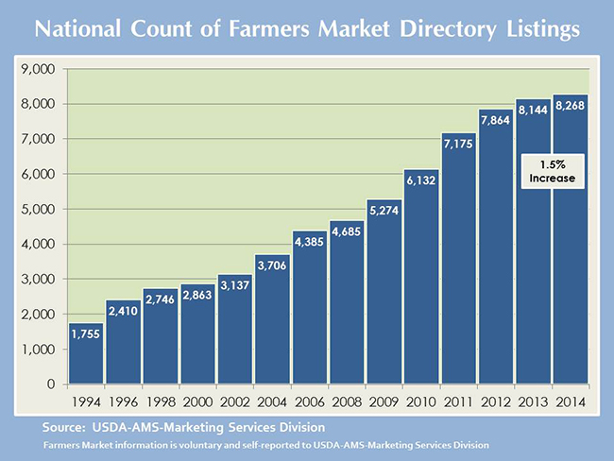
Farmers’ Markets in US

Slide 5
Tourist Demand for Local Foods
The National Restaurant Association's 2013 Restaurant Industry Forecast reported that 7 of 10 consumers were more likely to visit a restaurant offering locally sourced items
The National Restaurant Association’s 2014 “Top Ten Trends across the Nation,” included locally sourced meats/seafood and locally grown produce as the top 2 trends

Slide 6
Food Tourism Growth
The US travel Association reports that 17% of American leisure travelers, engaged in culinary or wine-related activities while traveling within the past three years
2011 Napa Valley wine tourism expenditures of $1.05 billion
2014 Oregon Brewers Festival generated $32.6 million in additional spending
Food/Drink Tourism
Tourism focused on exploratory eating, eating unfamiliar items or participating in new customs to encounter, learn, or understand new places and cultures
Tourists seek food/drink experiences based on local identity and culture, authenticity
Tourists travel to those destinations that have established a reputation as a place to try/experiment with quality local products

Slide 7
Food Tourism Market
Eating/drinking is a major component of the tourist experience
30-40% of tourism expenditures are on food/drink
Tourists tend to be less sensitive to food/drink prices
Food/drink is considered “vital” to the perceived quality of a tourism experience

Slide 8
Tourism Market in Intermountain West
Popular tourism destination, prime area for tourism development
20+ national and state parks
Nevada 2014 tourism indicators
53.8 million total visitors
27 million state/national park visits
Total travel spending: $62.2 billion
Utah 2013 tourism indicators
23.5 million total visitors
4.2 million skier visits
Total travel spending: $7.5 billion
Montana 2014 tourism indicators
10.9 million total visitors
53K jobs supported
Total travel spending: $3.9 billion
Wyoming 2014 tourism indicators
10.1 million total visitors
31K jobs supported
Total travel spending: $3.38 billion

Slide 9
Extended Season Opportunities
Increased sales to current residents
Demand for local foods year-round
Growing market opportunity
Regional tourism in all seasons
Tourists interested in outdoor activities are often food tourists

Slide 10
Extended Season Impacts
Small growers rely heavily on direct sales outlets
Farmers’ markets, CSAs, farm stands, etc.
Extending the sales season (FM Example)
$448 additional revenue per week
$2,681 additional revenue/month per additional outlet
Producer revenue increases three-fold when FMs operate 7 months or longer as compared to 5 months or less
Current literature finds that the success of small farms may be enhanced by…
Expansion of direct market outlets
Diversification into agritourism, and
Value-added products

Slide 11
Extended Season Impacts
Diversify into value-added processed products
Premiums for local processed products as well
Use summer extras, culls, etc. for processing
Cottage food production laws now in Western states
Ability to earn revenues year-round
Produce prices low in the normal season, especially in the West
Premiums likely for local products in the off season

Slide 12
Out-of-Season Pricing Premiums
Study in which produce prices at farmers’ markets were recorded
May to November 2011
Four markets in Utah, 14 markets in Colorado
Eight fresh produce items
Tomatoes, cucumbers, summer squash, potatoes, greens, herbs, green peppers, carrots
Results of predicted product pricing models pre and post season
Pre season premiums for tomatoes ($3.50/lb), greens ($1.50/package), and cucumbers ($1.50/each)
Post season premiums for potatoes ($.50/lb) and summer squash ($.14/each)
Also for carrots and herbs, but product size, bundle size, and variety changed through out the year
Strawberries
$6.00 out-of-season local direct market outlet price per pound (Maughen et al., 2014) vs. $2.36 per pound retail price (ERS, US Average 2013)

Slide 13
Extended Season Market Choices
Winter farmers’ markets and farm stands
Off-season CSA programs
Specialty stores and tourist destinations/stores
Farm stores/shops
Local-sourcing restaurants
Farm-to-school programs
Traditional grocery stores

Slide 14
Winter Farmers’ Markets & Farm Stands
Value-added processed products
Honey, cheese, vinegar, salsa, etc.
Stored products
Onions, carrots, garlic, potatoes, etc.
Frozen meats
Eggs and dairy
Baked goods
Hoop house greens, vegetables, etc.

Slide 15
Off Season CSAs
Meat, egg, and cheese shares
Soup and bread shares
Fall, winter, and spring shares
Stored and processed (frozen, canned, etc.) products
Hoop house greens and vegetables

Slide 16
Specialty Stores/Tourist Destinations
Food souvenirs
High quality lunches and snacks
Value-added products
Honey, jams, salsa, jerky, etc.
Local bagged nuts and dried fruits
Specialty local products
Coffee, chocolate, cheese, baked goods, etc.

Slide 17
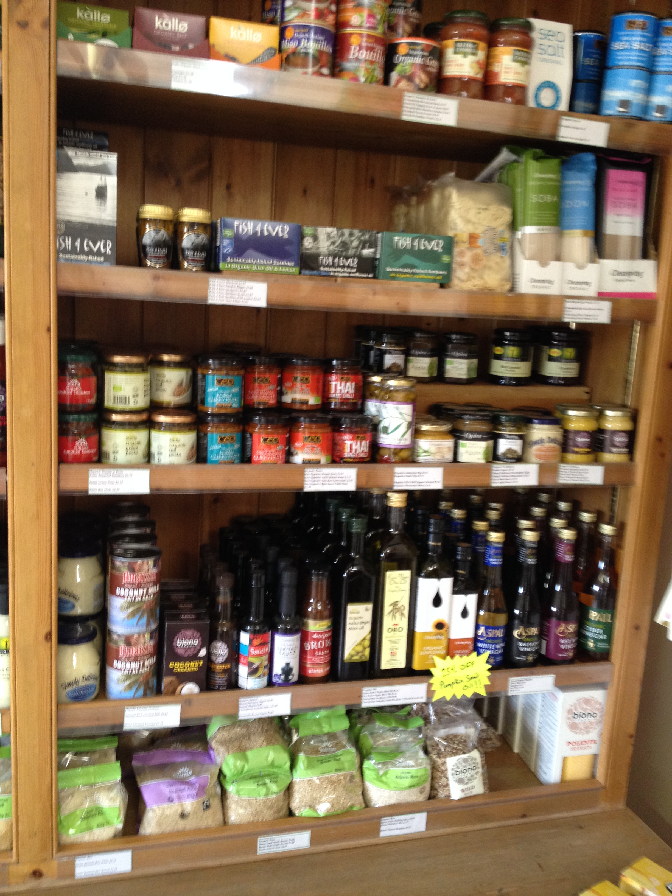
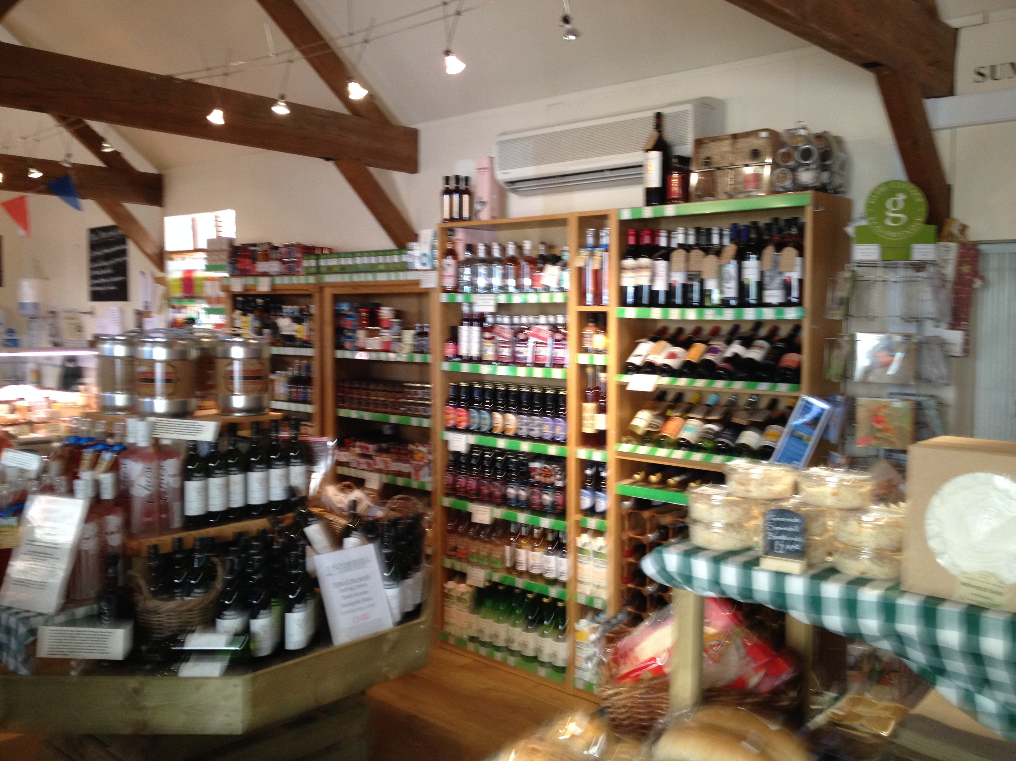
Value-Added

Slide 18
What is a Farm Shop?
A farm shop/store, also called a roadside farm market, is a permanent or semi-permanent structure where farm products, both fresh and processed are offered for direct sale to consumers
Shops are normally open to the pubic year-round and often provide snacks or a lunch counter/cafe
Shops can be located on or near farms or in nearby towns/cities

Slide 19
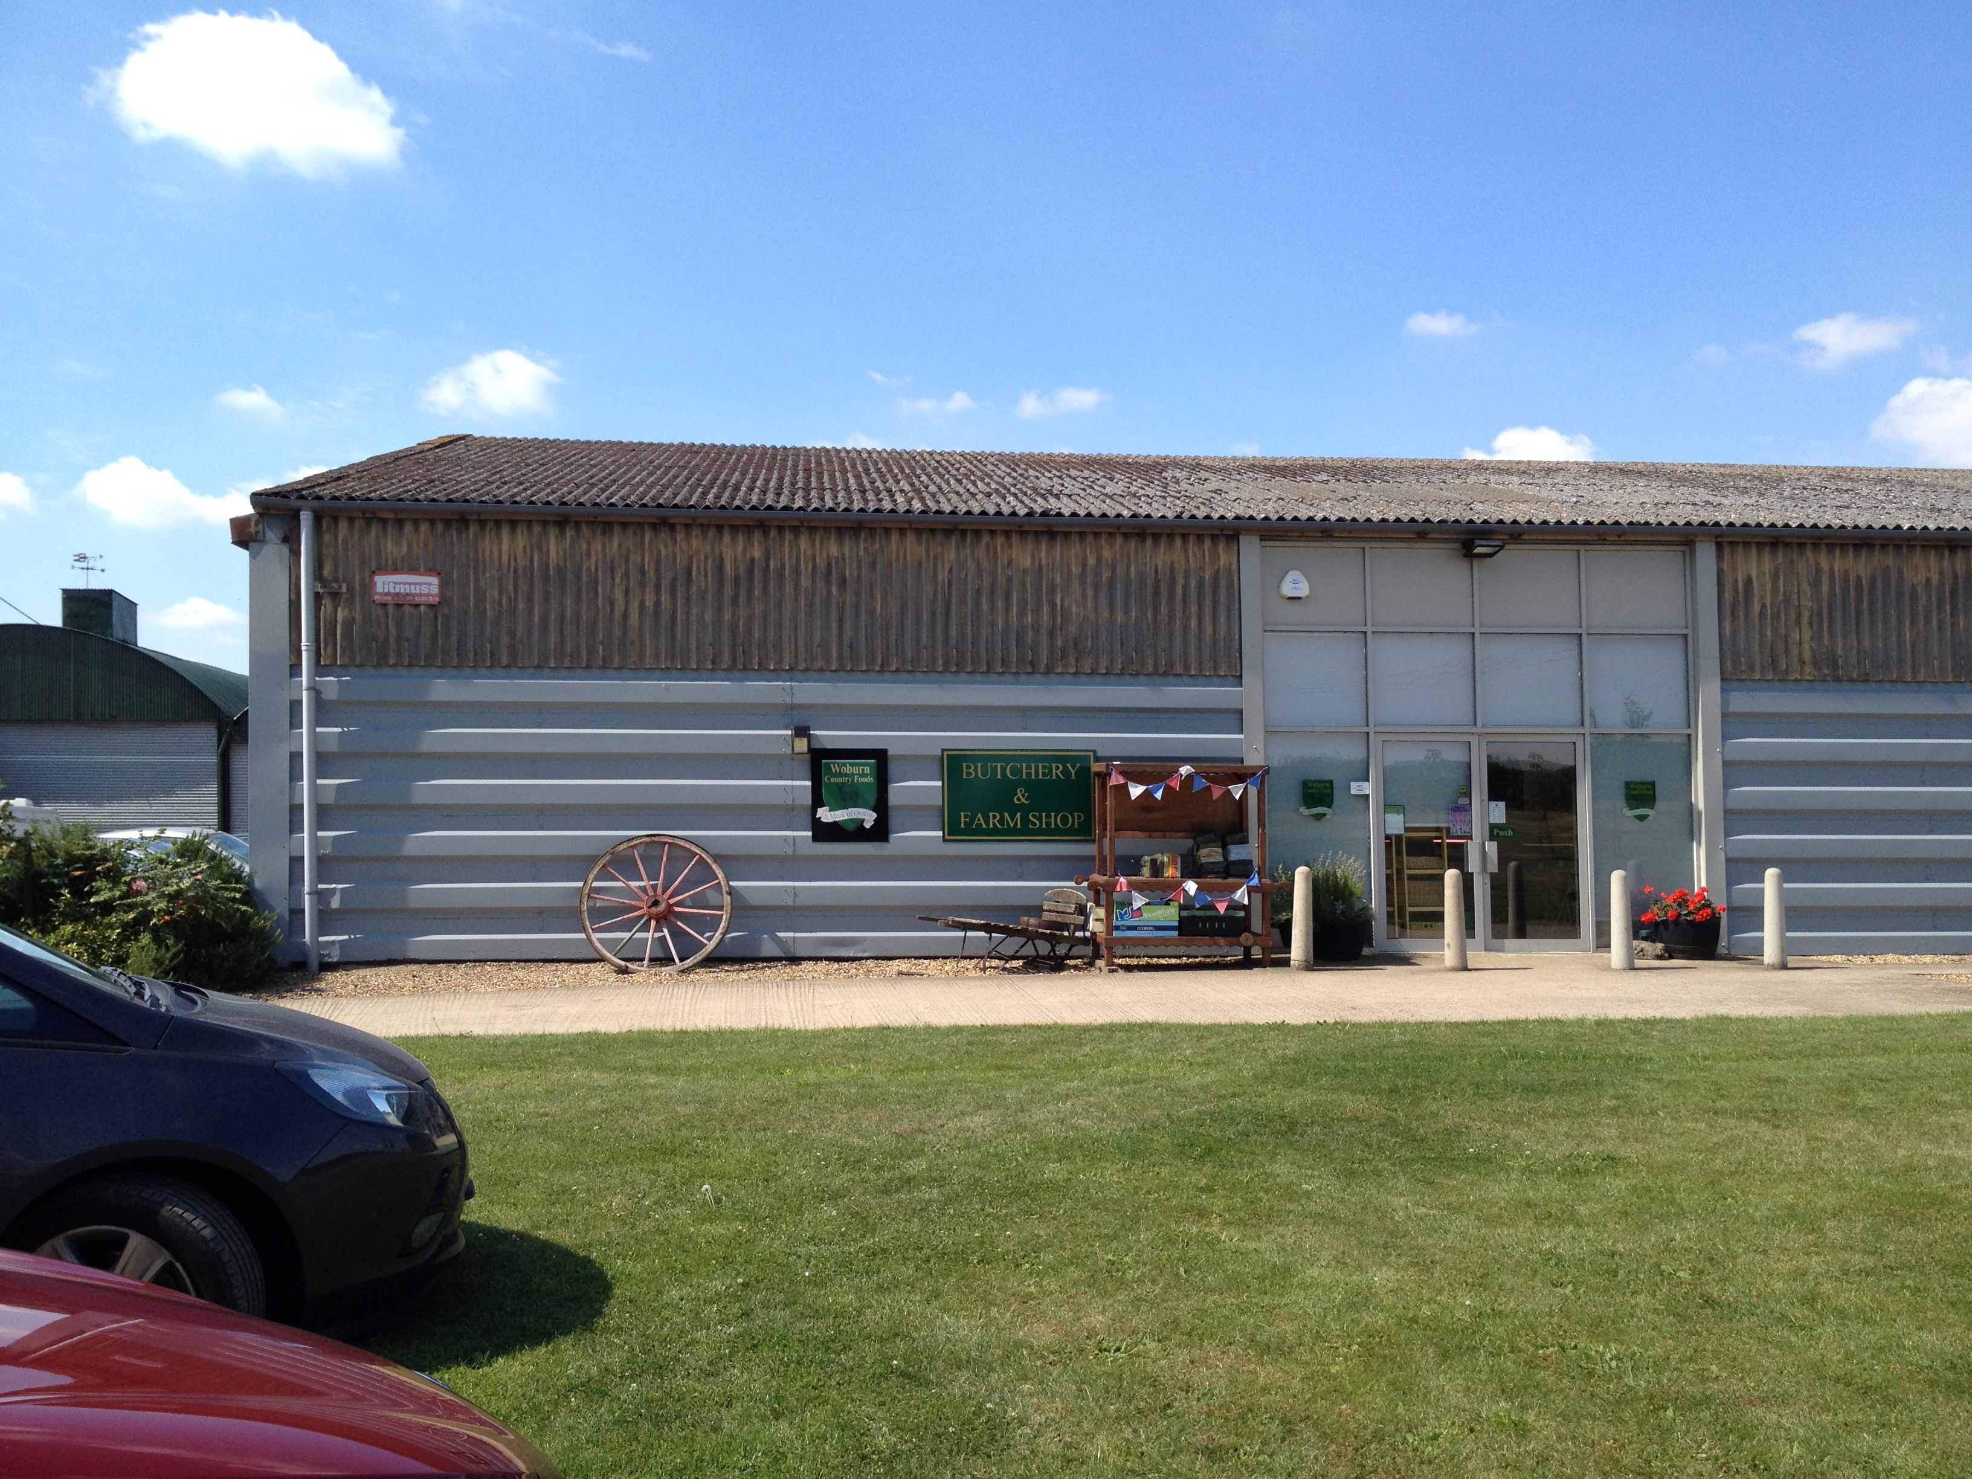
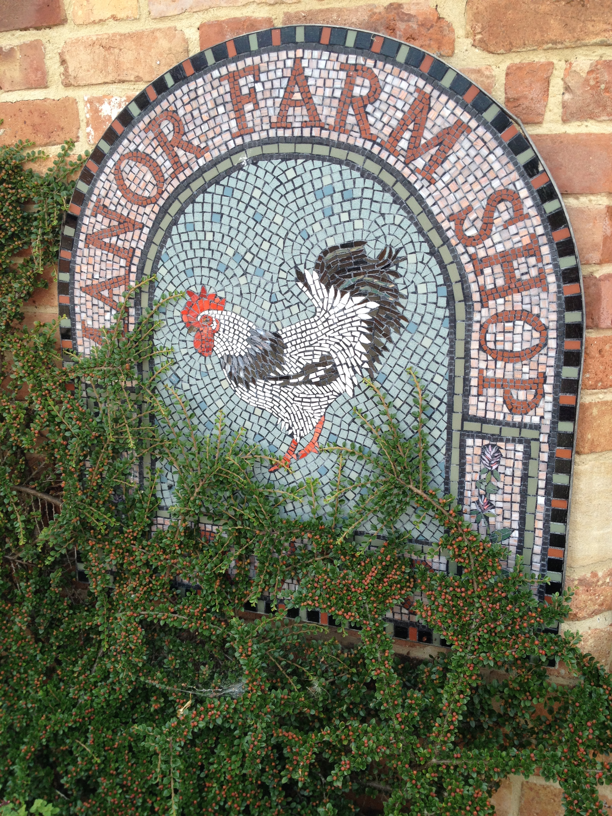
Farm Shops

Slide 20
Farm Shop Benefits
Additional market outlet for current products
Reduced transportation/marketing costs
Year-round sales (additional sales)
Outlet for value-added products
Income/employment for family members

Slide 21
Typical Farm Shop Products & Services
Value-added products
Fresh produce
Frozen foods
Specialty meats & cheeses
Ready to eat foods
Café or restaurant
Bakery
Butcher
Herbs, plants & starts
Animal petting zoos
Events (weddings, parties, etc.)

Slide 22
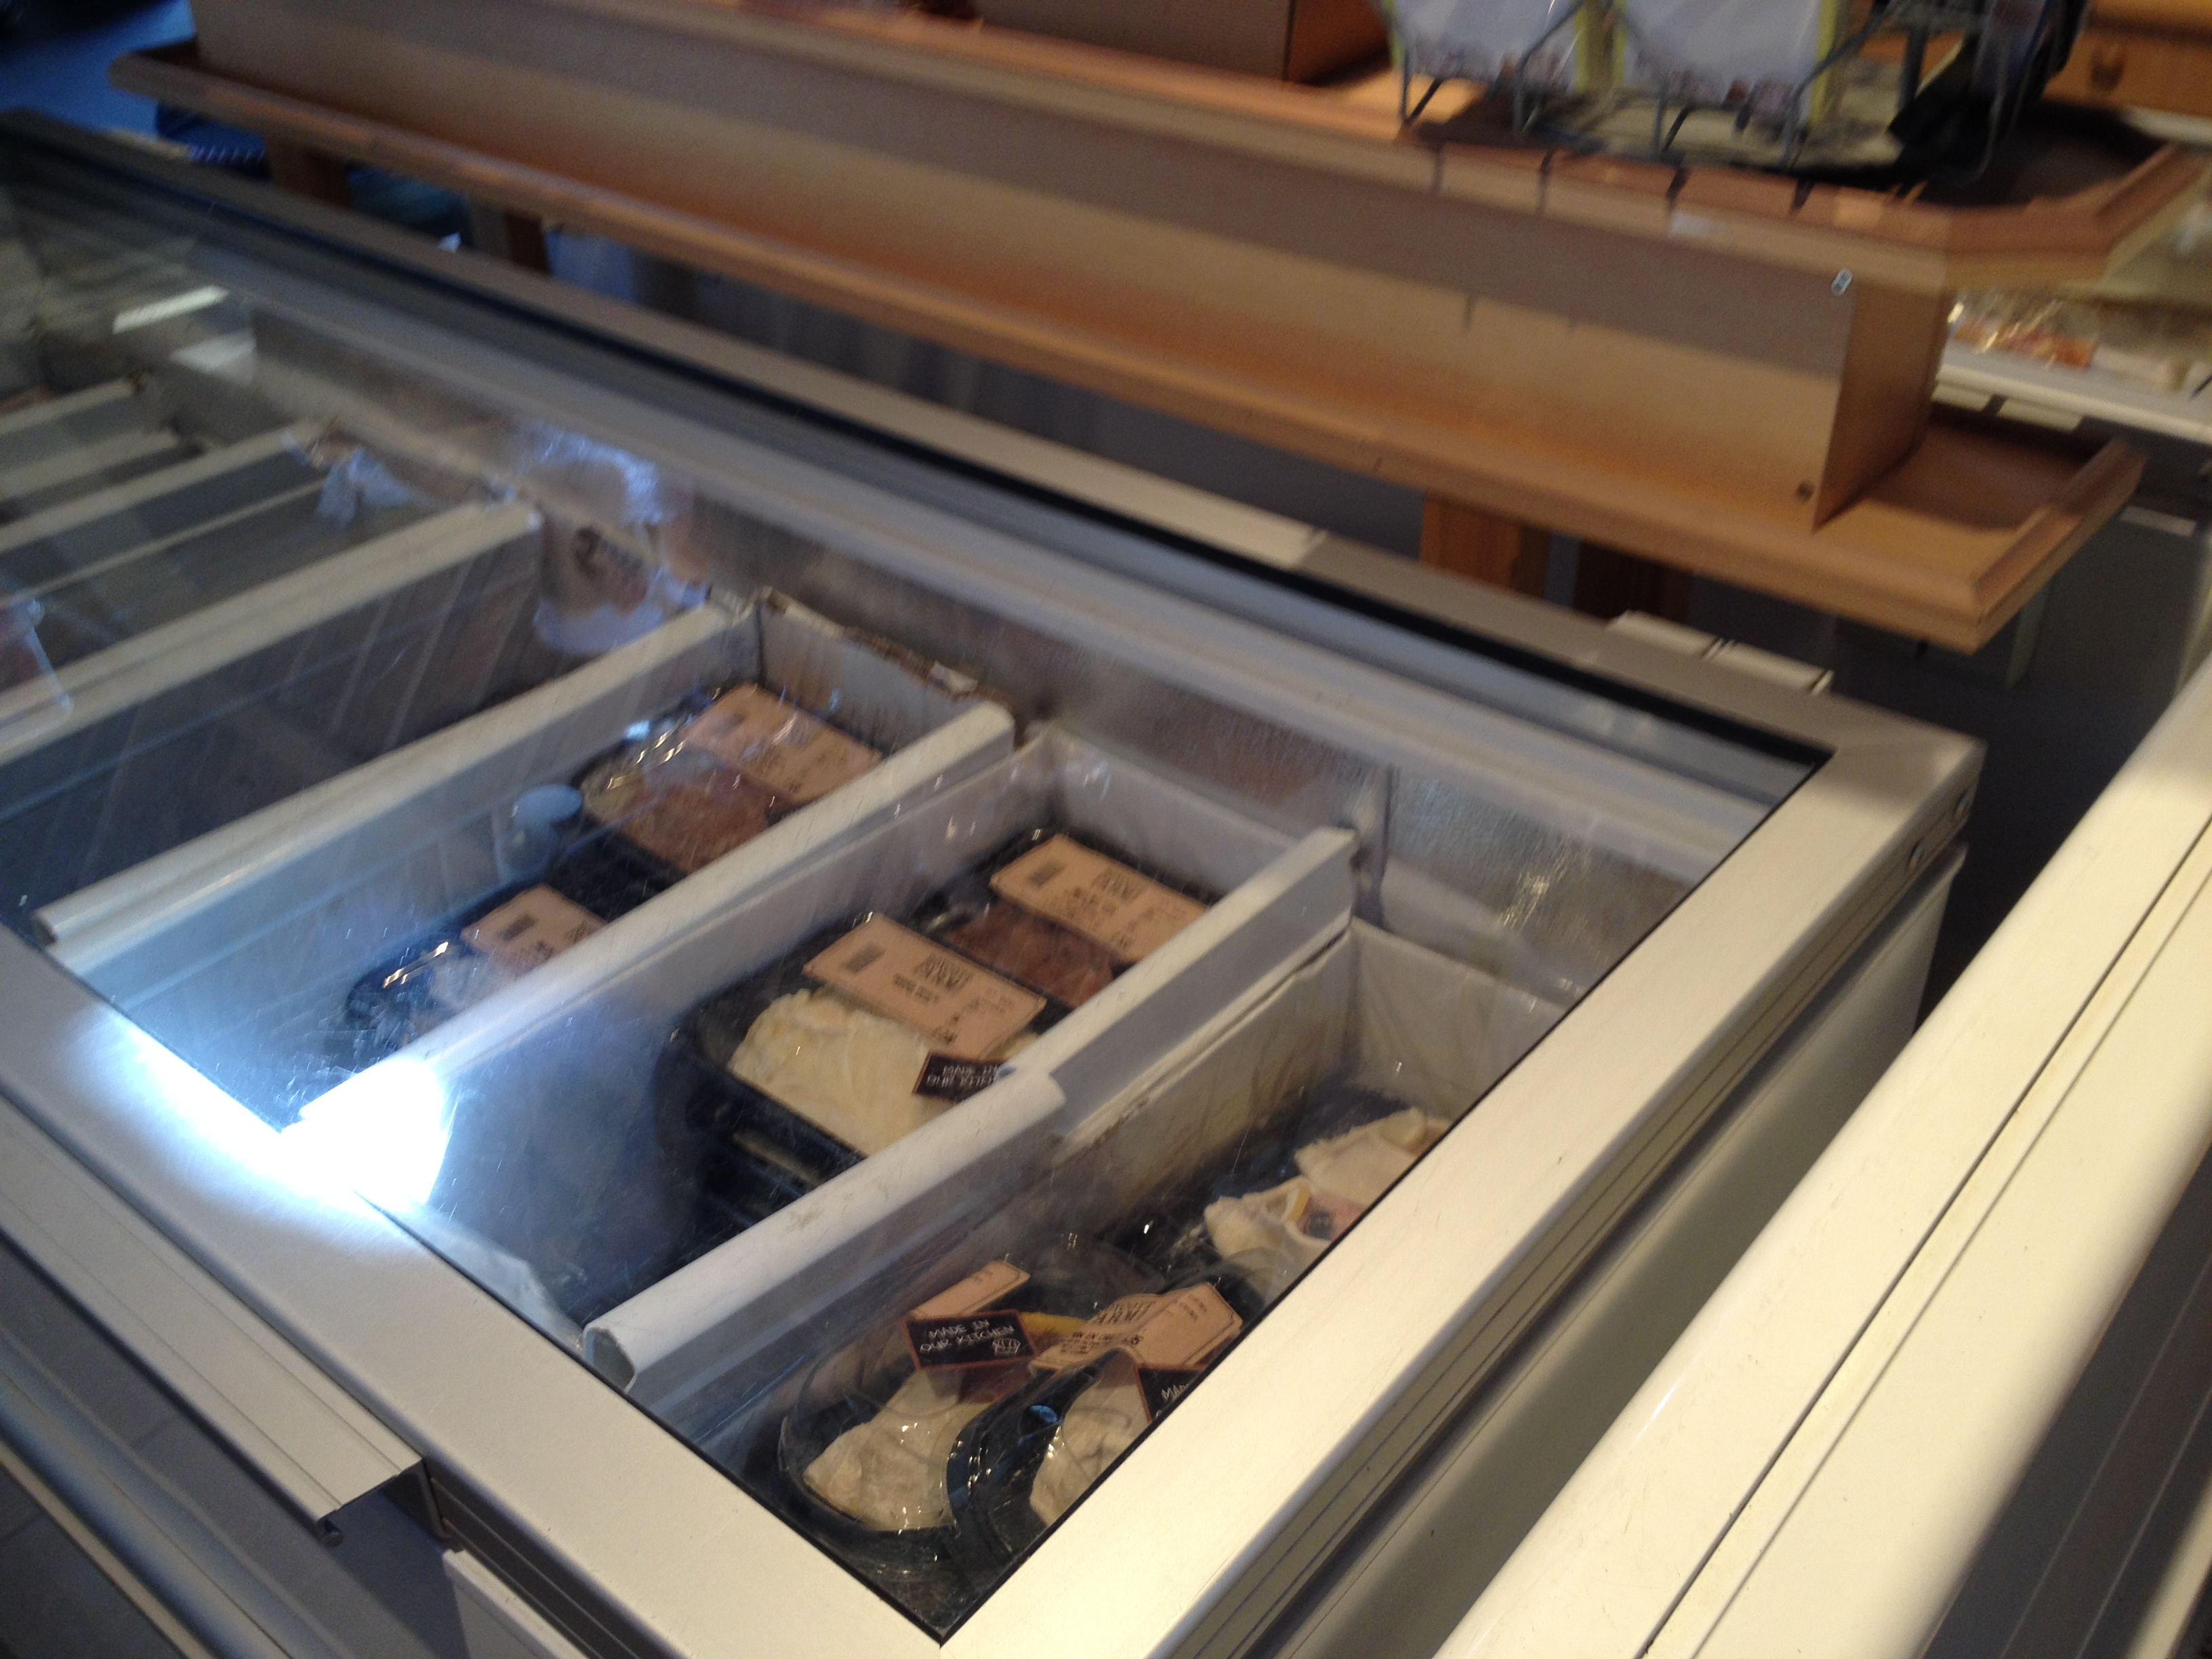
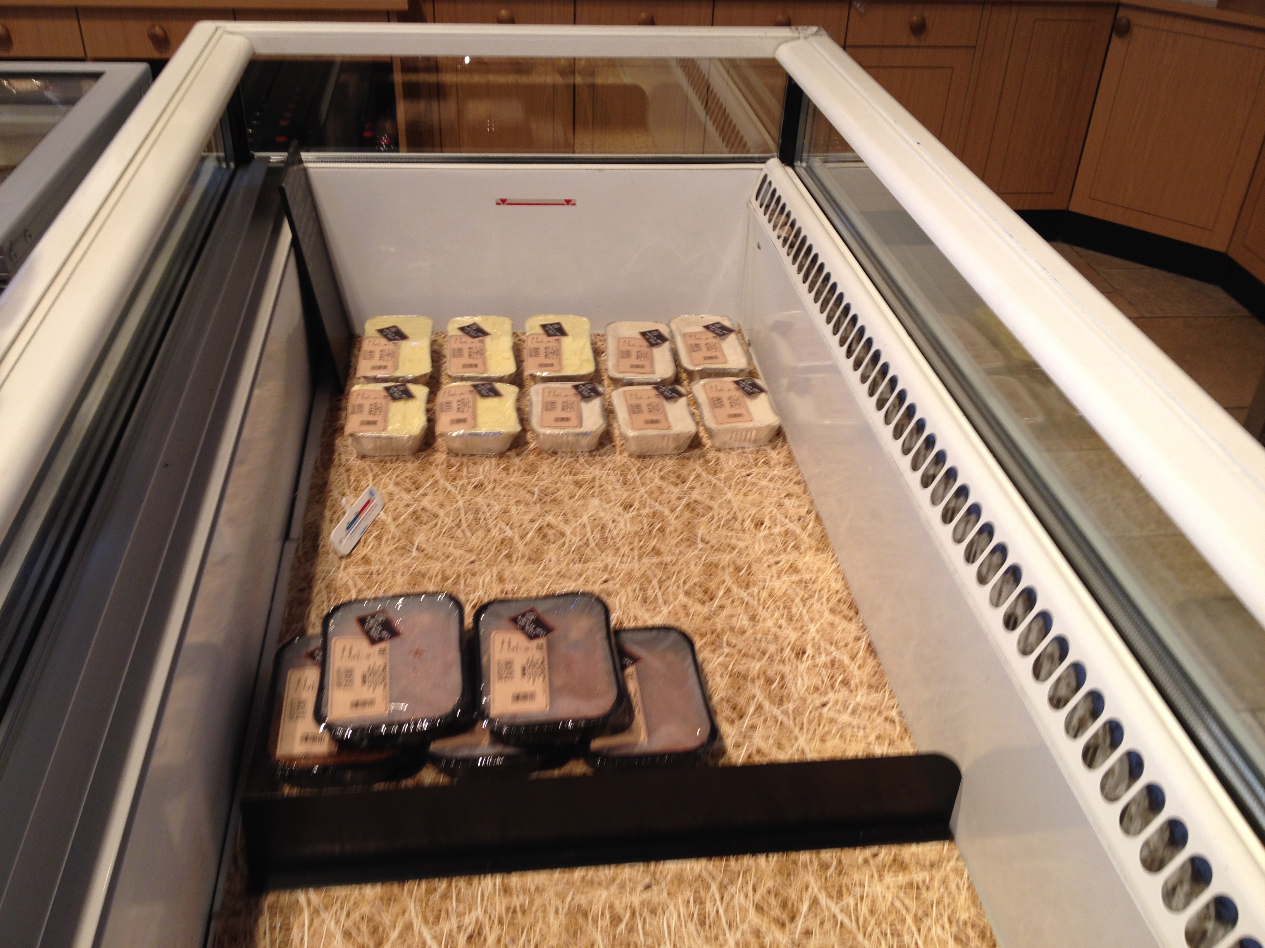
Ready to Eat

Slide 23
Utah Farm Shops/Local Sourcing Specialty Stores
Off/on-farm shops
Liberty Heights Fresh – Salt Lake
Urban Farm and Feed – Murray
Heber Valley Cheese – Park City
Rowley’s Red Barn – Santaquin
Cox Honeyland – Logan
Copper Moose – Park City
Rosehill Dairy – Richmond
Specialty grocery
Real Foods – 3 locations (sell all own farm products)
Tony Caputo’s – 3 locations

Slide 24
Thank you!

