Slide 1
Market and Pricing Strategies

Slide 2
Market Assessment Process
Define target market(s) for the product or service
  Consumers who have a need for the product or service and are willing to pay a profitable price for it
Market assessment steps
  Estimate market size
    Available customer base and purchase amounts
  Estimate a feasible range of prices
    To cover production costs
  Assess consumer sensitivity to pricing
Notes:
These are the general steps and process. A few examples of marketing to local tourists versus destination tourists are used to demonstrate the market assessment steps. You may pick a couple of target groups and the assess the potential market. After going through the examples, various methods to do market research are covered.​

Slide 3

Define your target market
Detailed picture of your target market allows you to:
  Implement effective and targeted promotion
  Cater to most valuable customers
  Design of new products which serve customer needs
  Select appropriate outlets for your products(s)
  Provide services and support your market needs/demands

Slide 4
How is a target market defined?
Demographics
  Age, location (state, county, etc.), gender, education level, income, children, martial status, etc.
Psychographics
  Interests, hobbies, or concerns regarding health, food safety, environmental, etc.
Product/Service needs or preferences
  Product or product characteristics (options, variety, location, package size, etc.) they require

Slide 5
Consumer Data Collection Methods
Survey existing or potential customers
General market assessment surveys
Conduct product/pricing trials
Ask fellow providers (competitors)
Use secondary data resources
  USDA, marketing firms, Extension, other online resources

Slide 6
Existing Customers
Past transactions, orders, and communications
Online orders
  Name and contact info is provided, spending habits, user preferences, etc.
Surveys
  At purchase, online, at events…
Customer appreciation events, “disguised focus groups”
  Conduct surveys, provide samples for feedback, make observations
Competitions
  “To win” must provide contact info and a few other details may be demographic or interests…

Slide 7

What customer data to collect?
Name and contact information
Transaction history
Record of communication and responses
Demographic profile (age, gender, profession, etc.)
  Birthdays and anniversaries
Psychographic profile (hobbies, interests, etc.)
Spending habits

Slide 8

Name & contact information
Market directly to the customer
Customize/personalize communications
Communicate about upcoming sales, new products, new flavors/varieties, etc.
Communicate about late or out of stock items

Slide 9
Transaction history
Basic preferences, which products they purchase and when/how
  What products are most important to them
  Where do they shop or purchase the product
  Amount of the product (size, frequency, etc.)
Amount they spend with your company on an annual, monthly, weekly, basis
  How valuable are they
  What specials or customer appreciation items/events you should offer to them

Slide 10
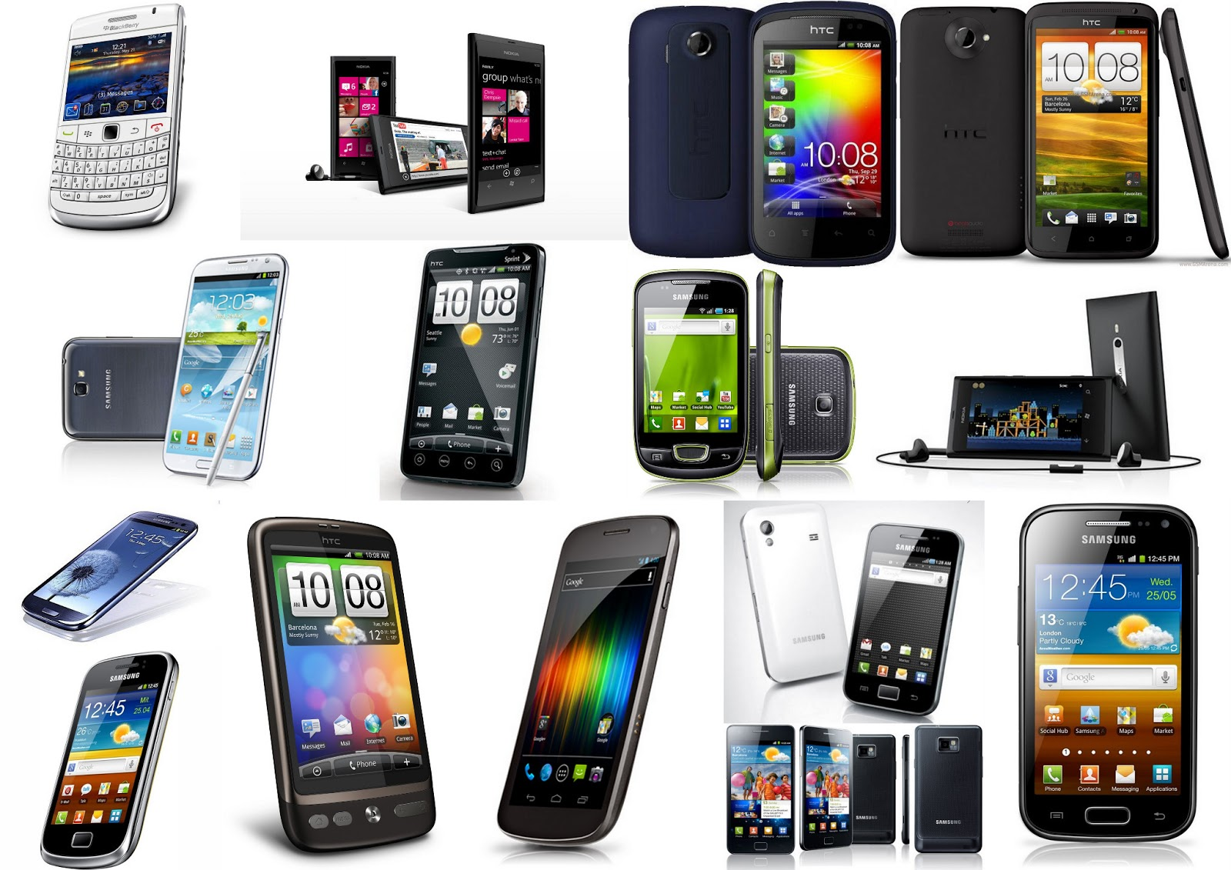
Record of communication & responses
Effectiveness of different types of communication
  One method may encourage sales more than others
Customer preferred communication style/type
  Email, phone, etc.
Track communications so that spaced appropriately
  Not overwhelming, or too many

Slide 11
Demographic profile
Age, location (state, county, etc.), gender, education level, income, children, martial status, etc.
  Birthdays and anniversaries
    Email/send birthday/anniversary card with promotion (% discount, coupon, etc.)
    Personal touch and customer feels valued, reminds them of your company/products
Harder to obtain
Provides an improved description of your target market
  Type of customer you should cater to, expand market

Slide 12
Psychographic profile
Interests, hobbies, etc.
Concerns regarding health, food safety, environment, etc.
Difficult to obtain
Use to select effective promotional channels
  Magazines or publications of interest, social media, etc.
Use to inform special labeling, packaging, certification
  Organic, recyclable, low whatever….
Use to inform corporate responsibility initiatives
  Concerns of interests of customers
    Sustainability, fair trade, worker health, etc.

Slide 13
Spending Habits
How do your customers shop?
  Thoughtful purchasing, impulse buys, or comparison (price) shopping
Display products and structure pricing around habits
  Grocery stores place candy and magazines near checkout for impulse buys
Difficult to assess
  Structured surveys, try different strategies to see which work, professional assistance from marketing agency

Slide 14
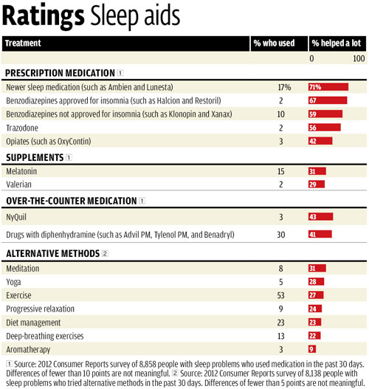
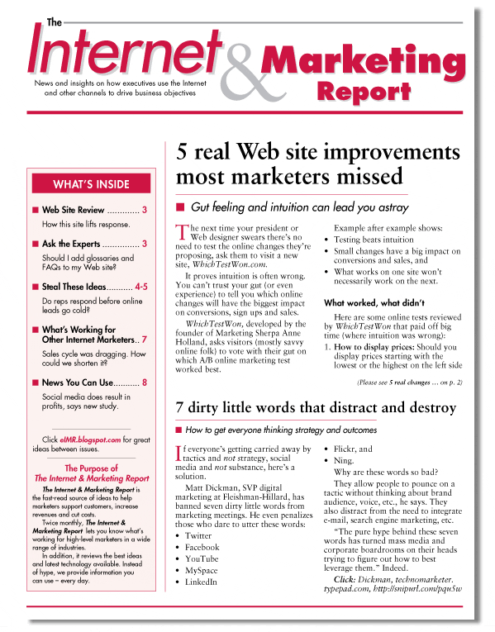
Outside Data
Existing research and statistics
  Government stats and reports
  Expenditures, investments, consumption
Published reports
  Trade associations, banks, government
Market research organizations
  Consumer panels, retail audits

Slide 15
Data examples - Government
Demographics from the most recent U.S. Census can be searched online by state and by zip code http://factfinder.census.gov/faces/nav/jsf/pages/index.xhtml
  Ages, household and family size, income, ethnicity, etc.
  All of which can provide information as to the characteristics of potential customers in the surrounding area
Average annual consumption levels for hundreds of foods in the US can be found on USDA’s Economic Research Service (USDA-ERS) website http://www.ers.usda.gov/data-products/food-availability-(per-capita)-data-system/.aspx
  ERS data is for standard, conventional products only

Slide 16

Customer or Market Assessment Surveys
Surveys are the most popular method for collecting data
Variety of methods including
  Telephone survey
  Face-to-face (in-person) survey
  Internet survey
  Dot survey
  Observation
  Informal interview

Slide 17
Telephone surveys
Telephone surveys are conducted by calling individuals and having them answer questions over the phone
Advantages of telephone surveys
  Interviewer can encourage respondent to answer all the questions
  Responses can be analyzed immediately
Disadvantages of telephone surveys
  Expensive to pay telephone interviewers
  As with mail surveys, random sampling is best, but call list can be put together from phone book if necessary
  Many residents now only have cell numbers, unlisted numbers

Slide 18
In-Person Interviews
An in-person interview is a survey administered face-to-face
Advantages of in-person interviews
  Interviewer can encourage respondents to fully complete survey
  Results can be analyzed immediately
  Specific populations can be targeted
    Farmers’ markets, grocery stores, etc.
Disadvantages of in-person interviews
  Costly to pay interviewers
  Some respondents may not be unwilling to reveal information about themselves to a stranger
  Must have permission to conduct these interviews in a public place

Slide 19
Internet Survey
An web-based survey is conducted via software online
  A letter, post card, or email is sent out inviting respondents to take the survey
Advantages of internet surveys
  May be completed faster than other survey types
  May be less expensive to conduct than other survey types
  Some software ensures that respondents have to answer all the questions
  Results can be analyzed immediately
  Some online survey providers can supply email listings of target audience

Slide 20

Internet Survey, cont.
Disadvantages of Internet surveys
  Population of interest must have Internet access
    Contacting the population of interest may be more difficult than with other methods
  Some individuals may be uncomfortable providing sensitive information (such as household income) over the Internet

Slide 21
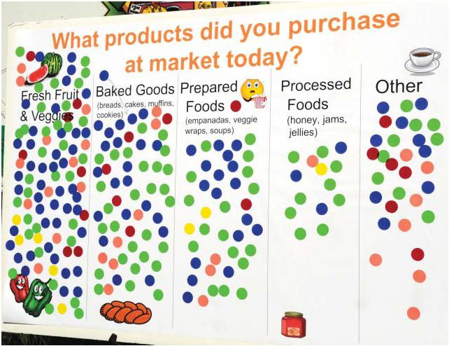
Dot Survey
Dot surveys or posters are used to focus on just a few important questions
Technique involves usually no more than four questions displayed on an easel
Response categories are listed as well
Respondents place stickers or “dots” in the proper category to indicate their response

Slide 22
Dot Survey, cont.
Advantages of dot surveys
  Offer an alternative to written and oral surveys
  Simple to complete-has been found to increase response rates over other survey types
Disadvantages of dot surveys
  Can only ask a few questions
  Respondents can see responses from other respondents-may be swayed by what they see
    Argument that this effect is similar to real-world activity, such as fad items and impulse buying

Slide 23
Interviews & Observation
Used to understand behavior, evaluate reactions
  Focuses on image, product usage, and associations with name
May be focus groups in which a group of target customers is asked a lengthy set of questions
Informal interviews consist of asking the same simple, but specific questions of many people
Observation consists of observing consumers and taking note of their behavior, perhaps reaction to trying a new product or flavor
Providing samples, comment cards, recording impressions/behaviors at sales venues, customer appreciation events, etc.

Slide 24
Estimating Market Size

Slide 25
Estimating Market Size –
Farm Tourism Examples
Local Tourists
  Local customers traveling for a day or weekend outing, such as in-state or less than 100 miles away
  U-pick strawberry operation example
Destination Tourists
  Visitors on a long vacation to specific destinations
    National and state parks, heritage sites, etc.
  Farm tourism venture example
Notes:
These are two different potential target customers. While both are tourists, they are very different. This module goes through the steps to assess the market size for each group.​

Slide 26
Local Tourists
If selling items directly from farm/ranch
  Consider how far you can expect customers to travel
The USDA Forest Service's National Survey on Recreation found the average distance traveled to visit a farm in 2000 was 80 miles
Western operators find their consumers travel over 75 miles to participate in U-picks, farm festivals, and related farm activities
  No alternatives exist in their metro area
Notes:
Customers are not going to travel 75 miles if more local options exist. What are some reasons why tourists would travel to your operation? Where would they come from?

Slide 27
Local Tourists
Potential number of customers
  Demographics and population size in the area are important for estimating demand
    Demographics from the most recent U.S. Census can be searched online by state and ZIP code - http://factfinder.census.gov/faces/nav/jsf/pages/index.xhtml
      Ages, household and family size, income, ethnicity, etc.
      All of which can provide information as to the characteristics of potential customers in the surrounding area
Potential purchase size
  Examining current and historical consumption patterns can be helpful
    Average annual consumption levels for hundreds of foods can be found on the USDA’s Economic Research Service (USDA-ERS) website - http://www.ers.usda.gov/data-products/food-availability-(per-capita)-data-system/.aspx
    ERS data is for standard, conventional products only
Notes:
These are sources of data for estimating market size. The next slides use a U-pick example to demonstrate using them. You may want to go to a website showing the demographics of your area. Many counties, cities, and state’s have web pages that provide some population and demographic estimates. You can also gather census data from census.gov.​

Slide 28
U-Pick Example
A strawberry producer is considering turning one acre of the operation into a U-pick
Estimates that each acre will yield 10,000 pounds
The average annual consumption of strawberries per person is 8 pounds (ERS, 2014)
Use the following equation to determine the appropriate market size when selling one week’s consumption of strawberries
The producer will need a market size of 64,935 consumers/visits annually to sell all output
Notes:
Some yield information can be found from your individual state’s extension budgets You can also google yield estimates. The 8 pounds of strawberries was found using the link on the previous slide.​
​
Although a person consumes 8 pounds per year, that amount is divided by 52 to get the amount they will consume per week (or on a visit). In this case it is only .154 pounds. While this might seem low, remember that this is an average. Some customers might buy more, and others may buy nothing.​
​
Over the strawberry season, the operation will need 64,935 customers or visits. ​

Slide 29
U-Pick Example
For the U-pick strawberry operation, the producer may be interested in targeting families.
  Helpful to know if nearby communities have enough families to make up a portion of the 65,000 consumers needed to make the U-pick operation feasible.
Bend/Redmond, OR (less than 75 miles from Warm Springs Indian Reservation)
  26,073 families, average of 3.5 persons (2010 Census)
  91,255 potential customers
Notes:
Once you know how many customers you need, you can begin looking to see how many exist. ​

Slide 30
U-Pick Example
What percentage might visit the u-pick?
  If 40%, then 36,502 customers
    Almost 30% of the U.S. population visited farms one or more times (2000)
      But, agritourism has been growing at a rate of 6% annually
If customers purchase 16 pounds annually for freezing/canning
  Only need 32,467 customers/visits annually
Notes:
The previous slide showed how to find the total number of potential customers. However, not all will be actual customers. You can estimate the percentage that you think might be actual customers. Multiply that percentage by the total number. You can also vary other assumptions. For example, if customers purchase 16 pounds annually then you only need 32,000 customers. There may be reasons that customers coming to the U-pick will have a higher level of consumption than the average. These may be customers that really like fresh strawberries. ​
​
For a product like milk, they may not consume more than average. Part of the estimation is finding the data and part is using your own reasoning. ​
​
Try to be as realistic as possible.​

Slide 31
Destination Tourists
Many rural areas in the West are located between a major urban center and national/state parks, ski resorts, etc.
  Vacation destinations for many foreign and out-of-state visitors
Estimating the potential size of these markets requires information on
  Where visitors are coming from
  Where visitors are returning to
Notes:
Tourists coming from or returning to local destinations may be passing by your area. The portion passing by could be potential customers.​

Slide 32
Grand Canyon National Park Example
Consider Grand Canyon National Park (GCNP)
  Attracts around 4.4 million visitors annually
    GCNP Statistics at http://www.nps.gov/grca/learn/management/statistics.htm
Seasonal visitation is another important item to consider
  Annual visits to the GCNP by season
    Winter: 11% of total visits
    Spring: 27% of total visits
    Summer: 39% of total visits
    Fall: 23% of total visits
  Visitation by month at https://irma.nps.gov/Stats/Reports/Park/GRCA
Notes:
The Grand Canyon is used as an example here. Data on other parks are available on the websites listed.​

Slide 33
Grand Canyon National Park Example
Where visitors to Grand Canyon National Park stayed before and after visiting the park
Notes:
This shows that Flagstaff, or an operation on the road between the Grand Canyon and Flagstaff, will have a lot more potential customers than Albuquerque, New Mexico. However, there may be additional parks that attract visitors to your areas.​

Slide 34
Grand Canyon National Park Example
Consider a business located between Page, AZ, and GCNP
    3.4% of visitors stayed in Page prior to visiting GCNP
    4.0% of visitors stayed in Page after visiting GCNP
The average number of visitors who would pass by this business location can be found with the following equation:
The number of GCNP visitors that would pass by the business location each month averages 13,567
    With a low of around 5,970 visitors during the winter months (11% of total)
    And a high of 21,164 visitors during the summer months (39% of total)
Notes:
Because we are starting with a very large number of visitors, even a small percentage provides a lot of potential customers.​

Slide 35
Grand Canyon National Park Example
The Page, AZ, business is a farm tourism venture (hay rides, farm stays, etc.)
  Assume venture needs to earn an average of $10,000 in sales monthly to be viable
  Expects average purchase of $25/person
Calculate the percentage of total visitors to GCNP the venture needs to attract
Notes:
Only a small percentage are needed to reach this goal, partly because we are starting with such a large number to begin with. ​

Slide 36
Grand Canyon National Park Example
The venture would need to attract 2.9%, on average, of the monthly GCNP visitors
  6.7% of winter visits
  1.9% of summer visits
This is a fairly high percentage of total visitors
For the business plan to work, the venture may try
  Starting the venture on a smaller scale
  Attracting more of the heavy summer traffic
Notes:
While 2.9% seems small, this is still a large number. When you start really small, you can find out exactly why customers are stopping and what they want. You can also being to build reviews and social media.​
​
Its also good to ask yourself how you will get that number to stop each day? What can you do to let the tourists know you exist?​
​

Slide 37
Product Pricing

Slide 38
Estimating Product Price
Major pricing approaches
  Cost-based
  Demand-oriented
  Competition-oriented
    Not normally used independently
Notes:
By understanding the various approaches to estimating product price you are able to make better assumptions.

Slide 39
Cost-Based Pricing
Cost-plus pricing
  Price equals total costs divided by number of units
  Shortcomings
    Not tied to consumer demand
    No incentive to reduce costs
    Adjustments for rising costs poor
Mark-up pricing
  Add a percentage to the cost of product (mark-up)
  Very popular for retailers and wholesales
    Easy, too many products to estimate demand
  Shortcomings
    Not tied to demand
    Profit biased by pricing

Slide 40
Retail Distribution Example
Plan to sell product retail (local tourist shop)
Set pricing at retail level and then evaluate demand
  Ask wholesales and retailers what margin they require
Example
  $5.00 cost of production
    Multiply by 1.25 for wholesale price (Average 20-30%)
  $6.25 wholesale
    Multiply by 1.40 for retail price (Average 30-50%)
  $8.75 retail
Will consumers pay $8.75?
Need to use this price at all outlets
Notes:
Sometimes its easy to look at a retail price and say, “I could make it for that.” However, you have to factor in all the markups along the way. In this case, a product that you sell for $5 would need to retail for $8.75. If you eventually want to go into retail, you need to consider this price in all your marketing endeavors.​
​
For example, assume that you are selling bottles of pickles. You start selling them at the farmers’ market for $6 a jar. Customers are now used to paying $6. The season is ending and they ask whether they can purchase your pickles in a store. With the markups required, the store would need to sell each bottle for $8.75. Why would the store want to carry your product when they know that customers could go to the farmers market and get it for $6? ​
​
So even when starting, think about where you want to end up. It may be that by the time you start selling to a retail outlet, your costs will have gone down, but you should think about all the outlets you might use to sell your product and how the prices would need to work to be consistent.​

Slide 41
Demand-Oriented Pricing
Price at customer value (willingness to pay)
Price skimming
  Charge high price at first to pick up consumers willing to pay more
  Gradually reduce price to pick up consumers who are more price sensitive
Penetration pricing
  Initial low price to capture market share
  Discourages competition
  Price is increased later when consumers are hooked
  Common in new food products
Notes:
Sometimes penetration pricing can have lasting effects. Customers may begin to think the original price is the price an item should be. Rather than having lower prices, doing some type of sale or coupon may help customers see the lower price as temporary rather than establishing the cost of an item.​

Slide 42
Competition-Oriented Pricing
Simple form of pricing
Ideal when similar products exist
Penetration pricing
  Lower than competition price
  Creates demand
Parity pricing
  Equal to competition price
Premium pricing
  Higher than competition price
  Signals higher quality
Notes:
This pricing is setting your price to signal what type of product you have (a value item, something similar to others, or a premium product worth a higher price).​

Slide 43
Competitive Analysis
How many competitors operate in the market?
Are competitors large or small? Near or far?
What types and numbers of products do they sell?
What pricing methods do they use?
Notes:
A competitive market may mean that it will be harder to get customers and that prices are lower. Sometimes having unique characteristics can help shield you from competition.​

Slide 44
Consider External Factors In Pricing
Distribution
  Wholesale and retail margins
  Transportation and packaging costs
Environmental factors
  Taxes, weather events, fad diets, energy policy
Legal/regulatory factors
  Labeling, certification, permits, safety
Notes:
All of these could affect the price. For example, environmental factors could cause prices to fluctuate. For example, if lettuce freezes, the price of lettuce could increase drastically for a few weeks until an new crop is ready to harvest. A fad may temporarily increase demand for a product and increase the price. ​

Slide 45
Pomegranate Juice Pricing Example
Produce and sell juice at specialty/health stores
Cost of production is $0.80 per 8 oz. juice
  $0.80 cost of production (multiply by 1.20)
  $0.96 cost with profit (multiply by 1.25)
  $1.20 wholesale price (multiply by 1.40)
  $1.68 minimum retail price required
$1.47 per 8 oz. retail price (ERS, 2013)
  Pricing data is U.S. average, specialty retail price may be much higher
  Target market may be willing to pay more (health benefits, families with children, seniors, etc.)
  What packaging, labeling, etc. may differentiate the product?
Notes:
Here is one example of pricing. ​

Slide 46
U-Pick Pricing Example
Strawberry U-pick operation
  10,000 pounds per acre
  $23,600 in revenue per acre
    $2.36 per pound retail price (ERS, U.S. average 2013)
  $18.88 in revenue per person
    Average consumption is 8 pounds/year (ERS, 2014)
Need to know the cost of production (including visitor services, permits, etc.)

Slide 47
U-Pick Pricing Example
Considerations
Visitors may purchase much more than 8 pounds annually (processing, events, etc.)
Visitors may be willing to pay more or less than retail depending on…
  Experience
    Family outings, may pay much more per pound for the farm experience
  Amount purchased
    Bulk purchases for canning, freezing, etc., may pay less per pound
  Specialty item
    For organic, and other specialty labels or designations may pay more per pound
    $3.48 organic wholesale price per pound (ERS, San Fran 2013)

Slide 48
Food Product Pricing Resources
Fresh and processed fruits and vegetables
  http://www.ers.usda.gov/data-products/fruit-and-vegetable-prices.aspx
Meats and poultry
  http://www.ers.usda.gov/data-products/meat-price-spreads.aspx
Organic foods
  http://www.ers.usda.gov/data-products/organic-prices.aspx
Drinks and meals away from home
  http://www.ers.usda.gov/data-products/quarterly-food-away-from-home-prices.aspx

Slide 49
Assessing Consumer Sensitivity to Pricing
Nine primary effects influence consumer price sensitivity
  Perceived substitute effect
    How many substitutes exist? If many, consumers will be more price sensitive
  Unique value effect
    Consumers less price sensitive if the product is “unique”
    Increase market share through differentiation
  Switching cost effect
    Cost of changing from one product to another
    People are reluctant to change and seek out new information
    Consumers less price sensitive given large switching costs
Notes:
This would be a good place to stop and ask the participants about how these would affect their products. Would customers be more price sensitive or less for their products?

Slide 50
Assessing Consumer Sensitivity to Pricing
Difficult comparison effect
  If products/services are hard to compare, consumers are less price sensitive
Price-quality effect
  Often associate a higher price with higher quality
Expenditure effect
  More sensitive to price changes on large, expensive items than small, inexpensive ones
    Price changes on meat compared to salt

Slide 51
Assessing Consumer Sensitivity to Pricing
Fairness effect
  Impacted by what they consider fair (sense of value-added)
Inventory effect
  Seasonality affects price sensitivity
    Higher demand for steak in summer due to outdoor grilling
End-benefit effect
  Some consumers willing to pay more for products that protect the environment, preserve open space, support family farms, etc.

Slide 52
Market Assessment Process
Define target market(s) for the product or service
  Consumers who have a need for the product or service and are willing to pay a profitable price for it
Market assessment steps
  Estimate market size
    Available customer base and purchase amounts
  Estimate a feasible range of prices
    To cover production costs
  Assess consumer sensitivity to pricing

Slide 53
Additional Resources
U.S. Census demographic data - http://factfinder.census.gov/faces/nav/jsf/pages/index.xhtml
USDA’s Economic Research Service (USDA-ERS) consumption data - http://www.ers.usda.gov/data-products/food-availability-(per-capita)-data-system/.aspx
Target marketing tools and guides from the Western Extension Marketing Committee - http://valueaddedag.org/
Agritourism and food tourism product development and marketing - http://diverseag.org/htm/farm-and-food-tourism
Cooperative Extension Service, available in each state – Utah State University (https://extension.usu.edu/), University of Nevada, Reno (https://www.unce.unr.edu/), University of Arizona (https://extension.arizona.edu/), and Oregon State University (http://extension.oregonstate.edu/)
Small Business Development Centers (SBDC), available in each state - https://www.sba.gov/tools/local-assistance/sbdc
National Sustainable Agriculture Assistance Program (ATTRA) - https://attra.ncat.org/index.php
AgPlan - https://agplan.umn.edu/

Slide 54
Worksheets
The following worksheets may be used to develop your marketing plan
  Product/service description
  Target market(s) description
  Sales volume estimation
  Competition overview
  Pricing strategies
  Promotion plan

Slide 55
Thank You
This material is based upon work supported by USDA/NIFA under Award Number 2015-49200-24225.

