Slide 1

Module 1: Why Farm and Food Tourism?

Slide 2
Overview
Understand the growing market for farm and food tourism
Understand the specific enterprise and product opportunities within farm and food tourism
Evaluate the role foods play in creating a tourism destination image
Recognize farm/food tourism impacts to rural communities
Understand the potential benefits of implementing farm/food tourism operations and products

Slide 3
Food Tourism & Economic Development
Agricultural producers face numerous challenges and look to diversify product offerings, access new markets, and expand market periods and pricing
Tourism providers struggle to find the regional distinctiveness necessary to differentiate themselves from other tourism destinations
As a result of the growing local foods movement, farm and food tourism may provide a solution

Slide 4
Food Tourism & Economic Development
Food tourism has been shown to……..
Enhance a destination’s tourism offering
Generate additional economic opportunities for local growers and processors, especially in close proximity to prime tourism destinations
Provide a venue to promote and distribute local agricultural goods and value-added products
Provide tourists with the cultural experiences they seek

Slide 5
Buy Local Movement
185% increase in farmers’ markets from 2000 to 2014
275% increase in CSA programs from 2004 to 2014 (6,000)
288% increase in food hubs from 2007-2014 (302)
The National Grocery Association 2012 Consumer Panel
The availability of local foods was a major influence on grocery shopping decisions as 87.8% of respondents rated local food availability as “very or somewhat important,” with 45.9% indicating “very important”
The need for “more locally grown foods” was the second most desired improvement among surveyed grocery shoppers at 36.6%, just under “price/cost savings”
In 2012, 164K farmers (7.8% of US farms) sold $6.1 billion in local foods

Slide 6
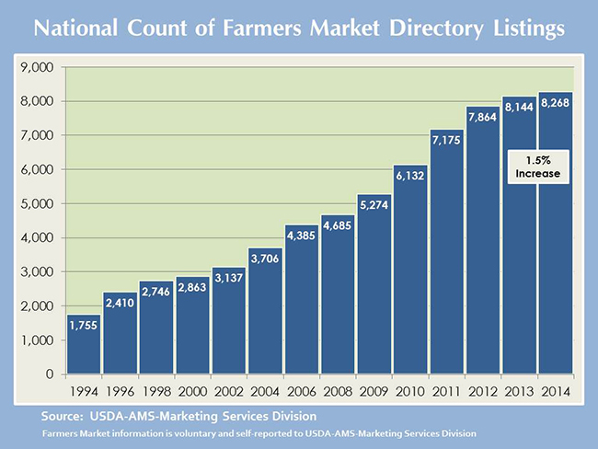
Farmers’ Markets in US

Slide 7
Local Food While Traveling
The National Restaurant Association's 2013 Restaurant Industry Forecast reported that 7 of 10 consumers were more likely to visit a restaurant offering locally sourced items
The National Restaurant Association’s 2014 “Top Ten Trends across the Nation,” included locally sourced meats/seafood and locally grown produce as the top 2 trends
The US travel Association reports that 27 million travelers, or 17% of American leisure travelers, engaged in culinary or wine-related activities while traveling within the past three years

Slide 8
International Trend
Local food demand not just a US phenomenon
Denmark, Switzerland, and Austria report the highest per capita consumption of farmers’ market produce
The European Union has required origin labeling for all fresh food since 2011
The UNWTO reports that 88.2% of member countries consider gastronomy a crucial element in the brand and image of their destination and 68% of the countries consulted carry out marketing activities or promotion based on food tourism (US included)

Slide 9

Brand USA
Destination marking organization for the United States, established in 2011

Slide 10
What is Food Tourism?
The desire to experience a particular type of food or the products of a specific region…
A form of regional development that helps strengthen local food and beverage production through backward linkages in tourism supply-chain partnerships
Provides new opportunities to promote and distribute local products while providing an enhanced visitor experience through the expression of community identity and cultural distinctiveness

Slide 11
What is Food Tourism?
An expression of culture
A form of regional heritage
Supports the enhancement of the tourist experience
Creates backward linkages in the food supply chain
Supports socio-economic growth in rural regions

Slide 12
What is Agritourism/Farm Tourism?
Agritourism is a subsector of food tourism that specializes in the incorporation of visits to farms for the purposes of on-site retail purchases, enjoyment, and education
Pick your own
Farm-stays
Corn mazes
Farm tours
Farm shops

Slide 13
Farm Tourism Examples
Farm/ranch vacations
Garden/nursery tours
Fee fishing
Fee hunting
Horseback riding
Petting zoo
Camping/picnicking
Wagon rides
Bed and breakfast
Agricultural exhibits
Skeet shooting
Exotic farm animals
School tours
U-pick operations
Game preserve
Christmas tree farms
Wagon rides
Pony rides
Pumpkin patch
Farm shops/stands
Bird watching
Corn maze

Slide 14

What is Culinary Tourism?
The practice of exploratory eating, especially those instances in which eating unfamiliar food or participating in new food customs as a way of encountering, learning, or understanding other places and cultures
Food/wine trails
Cooking schools
Farm shop visits
Restaurant experiences

Slide 15
Culinary Tourism
Occurs when visitors seek to experience cuisine and culture together
Focus on authentic and unique experiences that take advantage of the unique heritage, charm, hospitality, and sense of place that already exists in the community
Wine tourism in California
Cheese sampling in Wisconsin
Maple syrup tasting in Vermont
Cajun food experiences in Louisiana

Slide 16

Food-Based Attractions
Include special events surrounding food and drink
Food festivals
Farmers’ markets
Wine festivals
Beer festivals

Slide 17
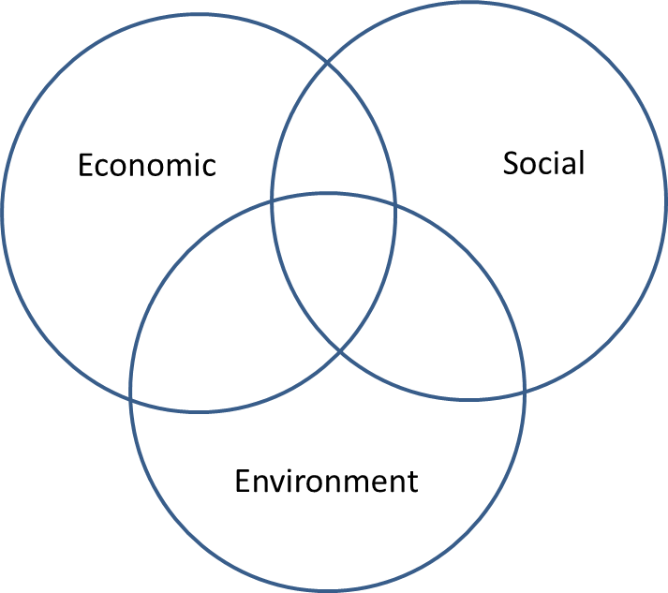
Food Tourism & Rural Communities
Enhancing the economic opportunities, environment, and social fabric of a region

Slide 18
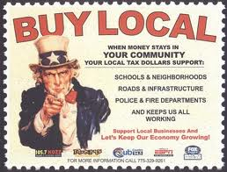
Food Tourism
Economic Impacts
Increases employment in rural areas
Decreases rural-to-urban migration
Reduces economic leakages
Promotes fair trade

Slide 19
Food Tourism
Environmental Impacts
Preservation of open-space/agricultural areas
Respects the carrying capacities of natural ecosystems
Reduction in waste, which is often recycled into the farm’s production process
Supports alternative or specialized production systems (free-range or pasture-grazing, organic, eco-friendly, etc.)

Slide 20
Food Tourism
Social Impacts
Food is an expression of culture
Flavors develop throughout history based on the local environment, historic trade routes, and settlement
Food is an important component of local religious practices and celebrations

Slide 21
Where Food Tourism Originates
Government policy – top down
Tour operators – demand driven
Individuals – innovative business ideas
Individuals – passionate people

Slide 22
The Players
The agriculture sector
Agricultural producers seek to diversify their offerings and distribution networks in an attempt to secure a viable future
The tourism sector
Tourism is facing increased competition and struggles to find the regional distinctiveness necessary to differentiate themselves against the sheer number of tourism destinations, both locally and internationally

Slide 23
Connecting Local Producers &Tourism Sector
Many local producers are micro-businesses that do not want to grow and/or farmers are reluctant to diversify
Producers often do not see the value-added in entering the tourism sector
Producers lack knowledge and/or available knowledge is confusing about tourists and the tourism industry
It is difficult to reach producers as they are widely spread geographically
There are differing needs between small and large producers

Slide 24
Common Challenges in Food Tourism
Encouraging wider use and better promotion of locally produced food
Identifying and accessing tourism markets
Gaining knowledge about tourism markets as tourism data is fragmented and not well maintained
Building a destination brand based on local food production or food service establishments
Collaboration and creating a better network between regions and groups (food producers and hospitality businesses)
Accessing best-practice knowledge from around the country

Slide 25
Food Tourism Development
The tourism industry has led the charge in innovation due to its elevated importance in rural growth policies
Emphasis has shifted away from sectorally-based towards territorial-based development
The unification of food and tourism requires the cooperation of distinctly different industries with varying needs and challenges

Slide 26
Why Consider Food Tourism?
Food is one of the major tourism activities
One-third of tourism expenditures are on food/drink
Tourists tend to be less sensitive to food prices
Food is considered a “vital” component in the quality of a tourism experience
The product is the basis of food tourism

Slide 27
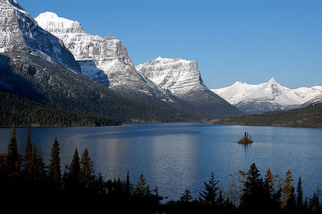
Tourism Market in the West
Western US a popular tourism destination, prime area for tourism development
20+ national and state parks
Idaho 2013 tourism indicators
30.2 million total visitors
Total travel spending: $1.4 billion
Nevada 2013 tourism indicators
52.2 million total visitors
24.6 million state/national park visits
Total travel spending: $58.1 billion
Utah’s 2013 tourism indicators
23.5 million total visitors
4.2 million skier visits
10.4 million state/national park visits
Total travel spending: $7.5 billion

Slide 28
Why Consider Food Tourism
Additional market for current products
Diversification into new enterprises/products
Reduced transportation/marketing costs
Year-round sales (additional sales)
Outlet for value-added products
Income/employment for family members
Cottage food production now option in Nevada/Utah/Wyoming/Colorado

Slide 29
Why Consider Food Tourism?
On-farm activities, the visitor comes to you
Eliminates the need for transportation
Ability to work in a familiar environment
More flexibility in scheduling activities
Display “show off” products
Educate others about local foods
Interact with people from around the globe

Slide 30
Activity
Worksheet 1.1: The Role of Food in Tourism
Think about a recent trip/vacation…..
What role did food play in your travels?
Did you have a memorable food experience?
Did you try any local/ethnic foods?
Did you visit any food attractions?
Did you purchase any food souvenirs?
Did you notice restaurants sourcing local food? If so, how was it promoted?
What type of food experience would have enhanced your trip?

Slide 31
Activity
Worksheet 1.2: Enterprise/Product Description
What unique products/services can your operation offer tourists?
What partners do you have that can assist?
How, specifically, can they help?

Slide 32
Thank you!

