Slide 1
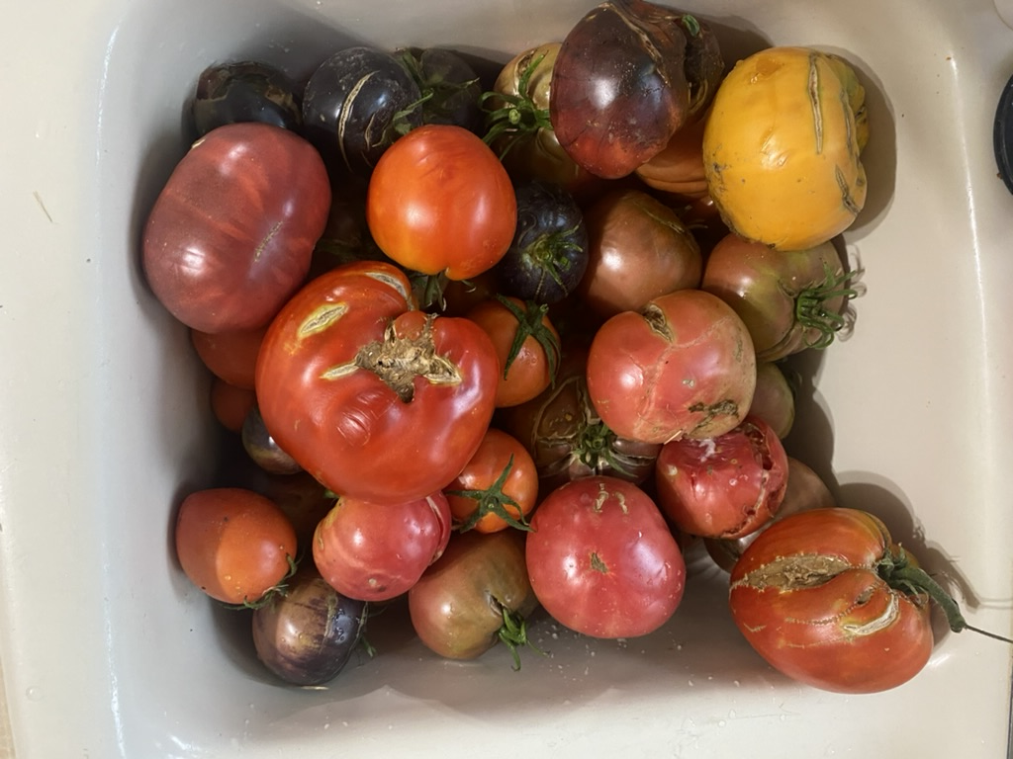
Utah Veggie Reviews
Early 2026 Update
Wesley Crump
Cody Zesiger
USU Extension Horticulture

Slide 2
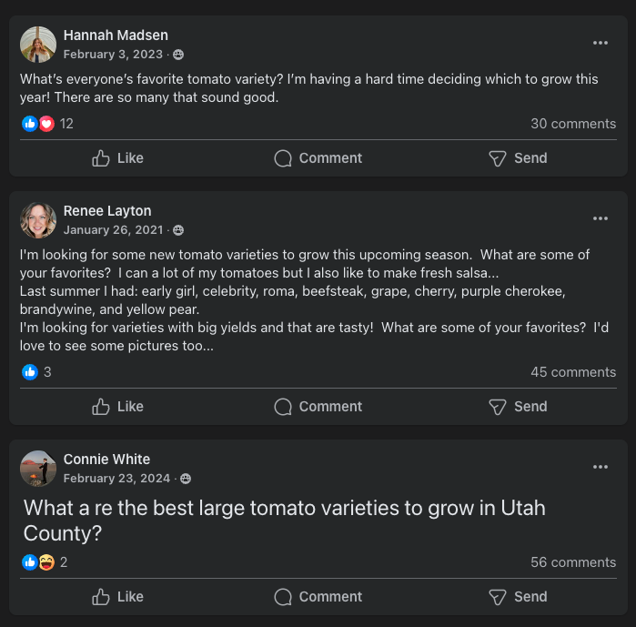
Background
How to share knowledge about vegetable varieties with community?
How to do this in a living and lasting way?
Notes:
Not only in a living way (for which social media is very useful—always something new and changing), but also in a lasting way—a reliable way that you’ll be able to refer to again and again in the future.

Slide 3
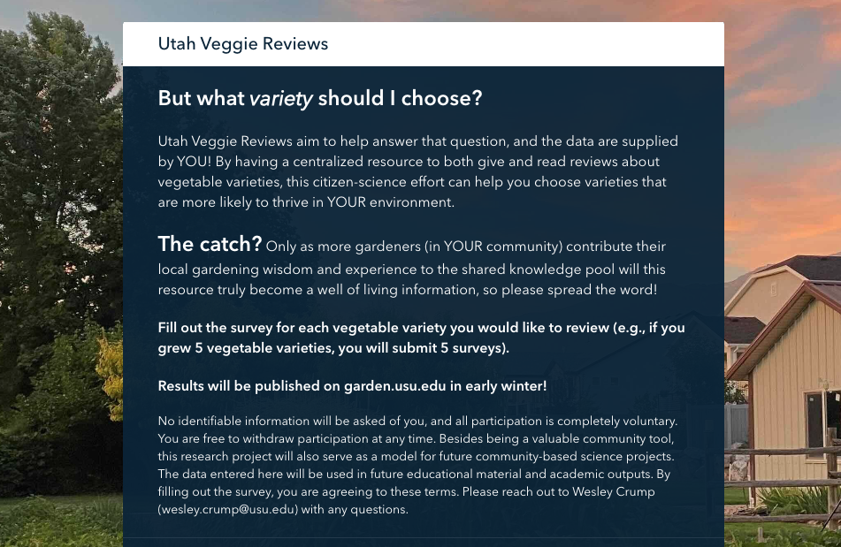
Utah Veggie Reviews
Introduced last year (2025) at this conference
Posted a few times on the Utah’s Gardening Experts Facebook page
Just shy of 250 reviews to date!
https://survey123.arcgis.com/share/77dc36f886ca4effa0a42875988a81bc

Slide 4

2025 Reviews
Who is reviewing?
  16 counties involved
    Cache – 71
    Salt Lake – 37
    Davis – 29
    Utah – 27
    Box Elder - 24

Slide 5
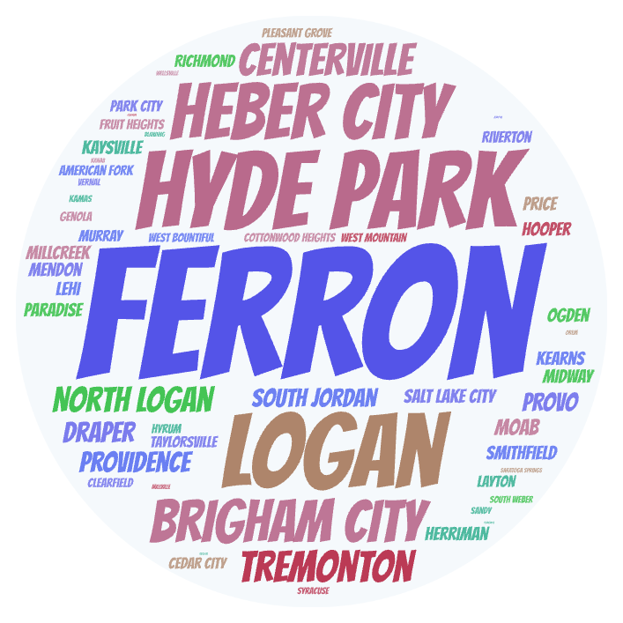
2025 Reviews
Who is reviewing?
  16 counties involved
    Cache – 71
    Salt Lake – 37
    Davis – 29
    Utah – 27
    Box Elder - 24
  57 cities involved
    Ferron – 18
    Hyde Park – 17
    Logan – 16
    Heber City – 15
    Brigham City - 13

Slide 6
2025 Reviews
What crops were reviewed?
  44 crops
    Tomato (74)
    Cucumber (19)
    Pepper (17)
    Beans (15)
    Summer Squash (13)

Slide 7
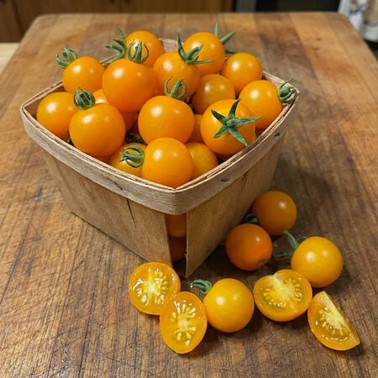
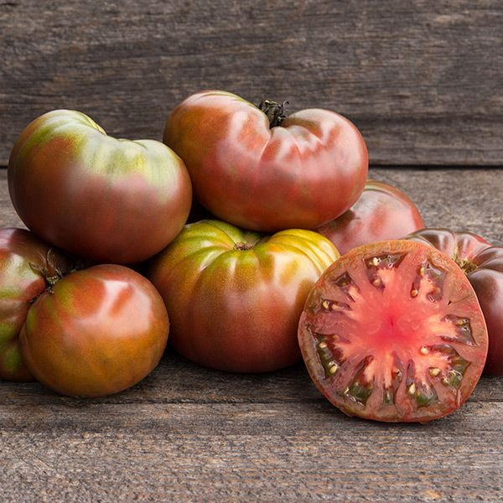
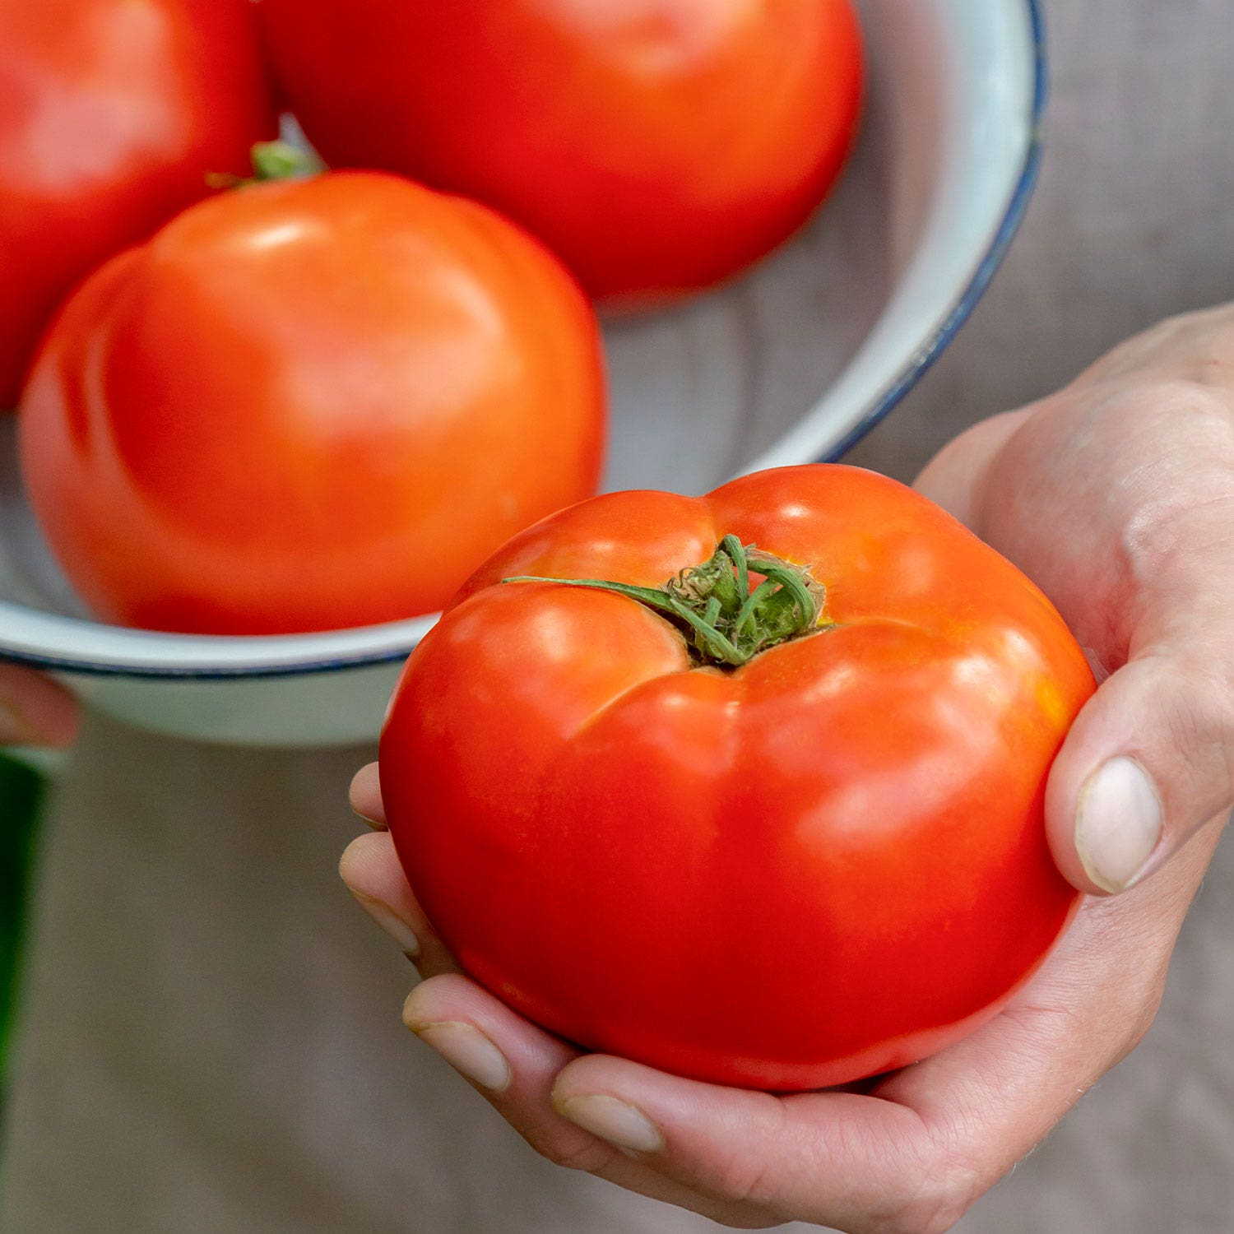
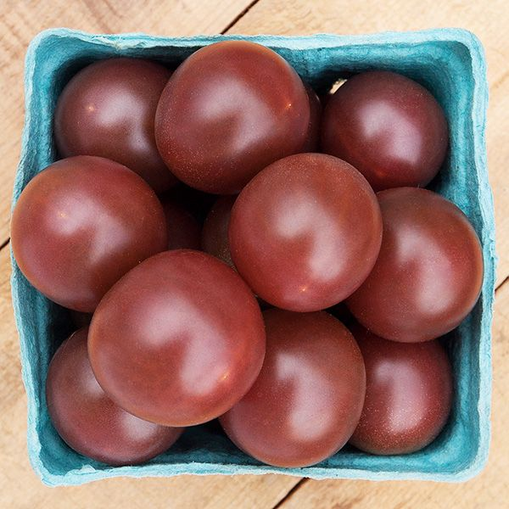
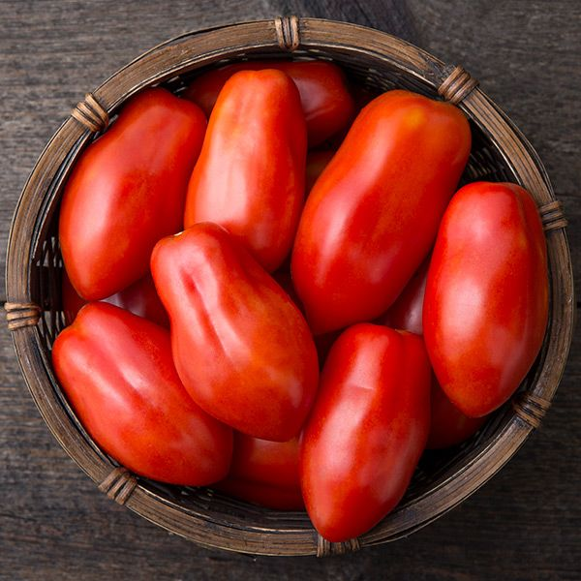
Sun Sugar
Cherokee Purple
2025 Reviews
Tomatoes
  47 cultivars reviewed
    Sun Sugar – 7
    Cherokee Purple – 4
    Celebrity – 4
    Black Cherry – 4
    San Marzano - 3
https://www.ufseeds.com/
https://www.highmowingseeds.com/
Sun Sugar
San Marzano
Celebrity
Black Cherry
“An extremely high yielding orange cherry tomato that is larger and more crack resistant than Sun Gold. Has a sweet, almost fruity flavor. A favorite of visitors to my garden.”
https://www.burpee.com/
https://www.highmowingseeds.com/
https://www.highmowingseeds.com/

Slide 8
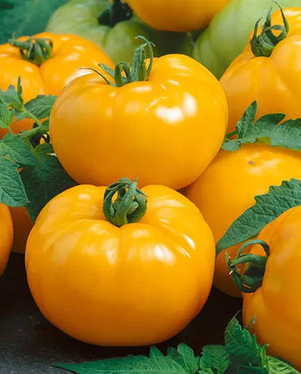
2025 Reviews
From review of:
  Azoychka Tomato
“I know this isn't a popular variety but I think it's because people are unaware of this treasure. It's a Russian yellow variety that takes off early in the colder May weather. It will produce as early as an early girl, but has a tangy sweet almost citrus flavor. Yields continue until the late fall making this a great producer.”
I’M TRYING THIS ONE IN 2026
https://victoryseeds.com/products/azoychka-tomato

Slide 9
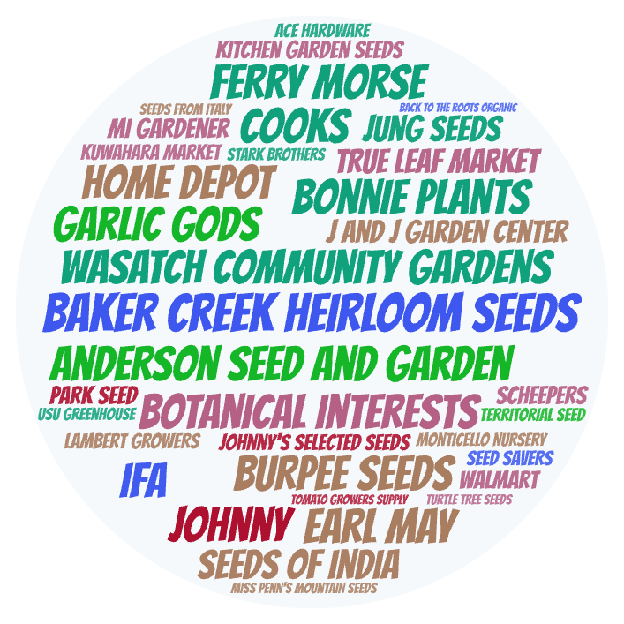
2025 Reviews
Seed vendors
  35 vendors listed

Slide 10
‘Blue Venture’ Cabbage
2025 Reviews
“Absolutely the longest holding cabbage I have grown. Very long harvest window. Has a good, sweet flavor, and heads just grow larger and larger without splitting.”
‘Georgia Jet’ Sweet Potato
Seed vendors
  35 vendors listed
Extended reviews
  169 out of 247
  68%
“The best of several sweet potatoes I have tried. Produces smooth, attractive sweet potatoes that look like store bought. Some will be very large. Need lots of heat and as much growing season as you can give them.”
‘Gernika’ Pepper
“Heirloom basque pepper, very similar to shishito but not at all spicy. Can be fried and eaten green, or I have saved many and let ripen to deep red. when ripe can be dried and ground into paprika!”

Slide 11
2025 Reviews
Seed vendors
  35 vendors listed
Extended reviews
  169 out of 247
  68%
Nutrient Management
  ”Organic” = 109
  “Conventional” = 110
  “Both” = 28

Slide 12
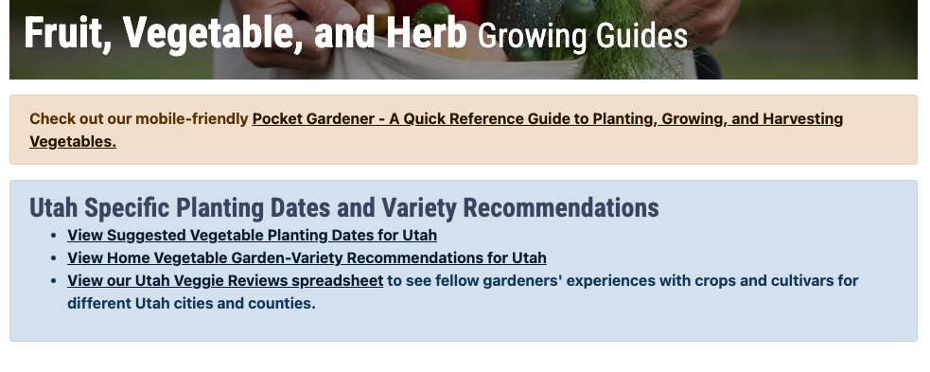
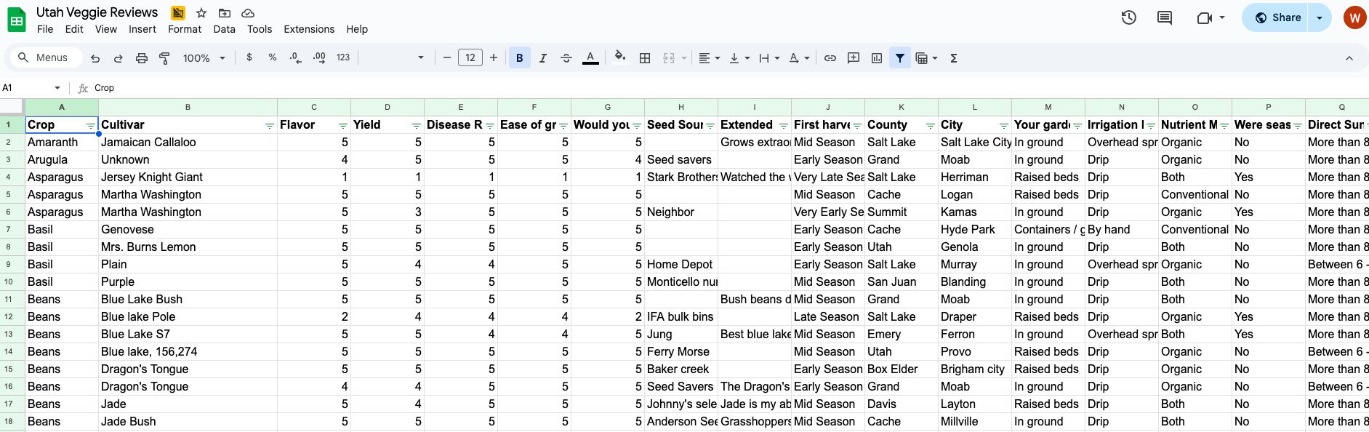
Shortcomings of current format
Currently just a google sheet linked on garden.usu.edu
  Fruit, Vegetable, and Herb Growing Guides
Survey and outputs are separate
No real-time updates
Data entry can be cumbersome
WHAT ARE YOUR THOUGHTS?
  Link at end of slides

Slide 13
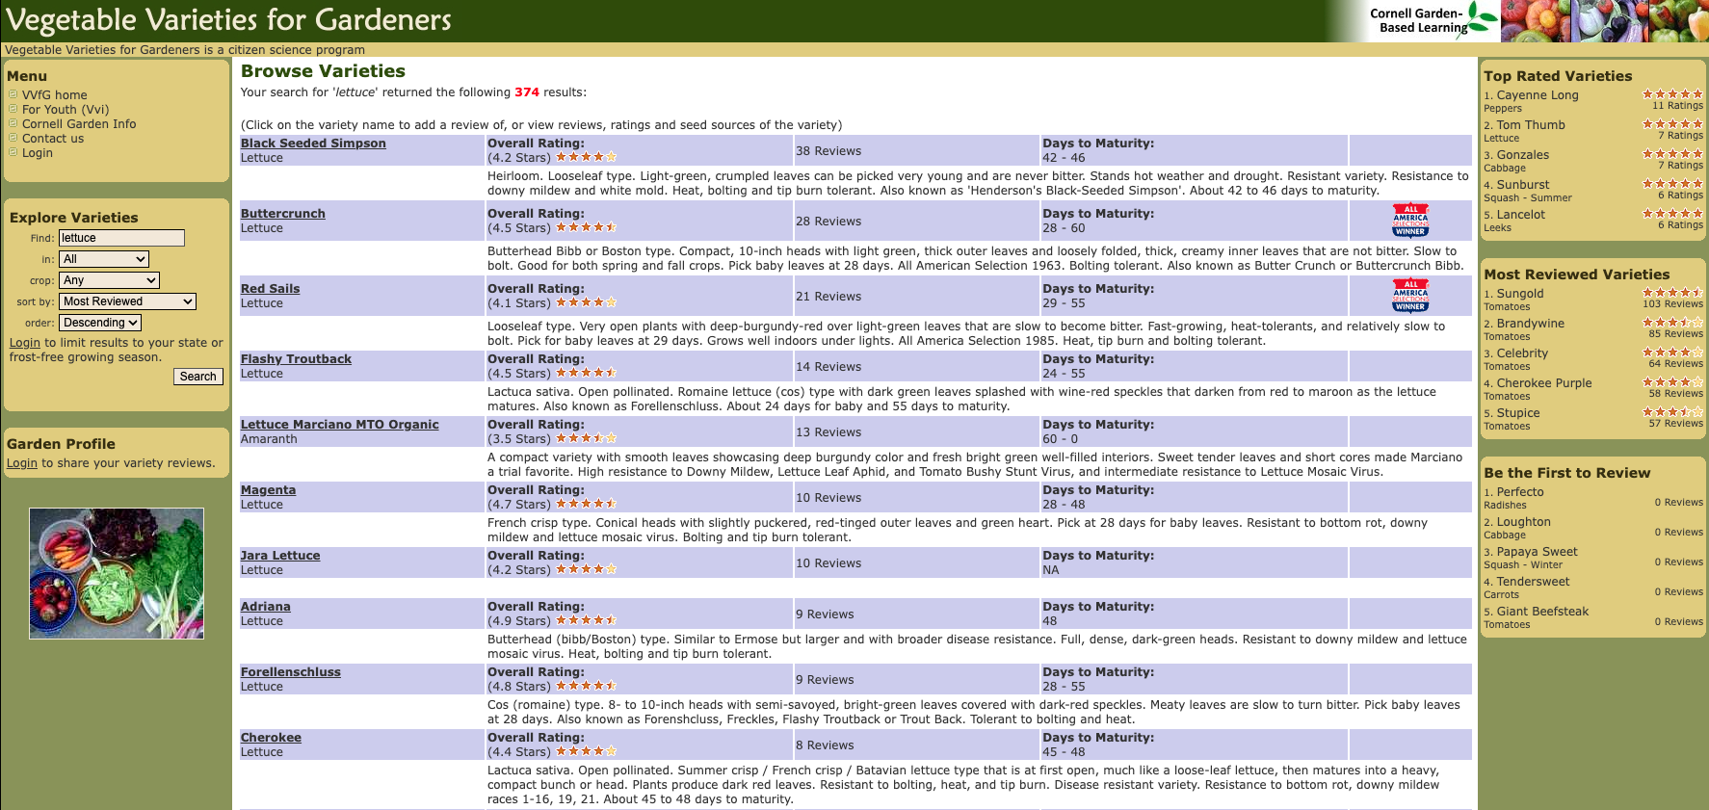
Future format (hopefully)
Standalone website interface
Mobile app
Create user profile
  Eliminates needs to answer contextual questions for each review
Photo submission option
Increased uniformity for cultivar names
Visually easy to digest, intuitive
Summary statistics and graphs
Applying for grant to help with development
  Send us a letter of support!
Notes:
If you think this could be a useful tool, either for home use or for your small business, please consider writing a short letter of support and emailing that to Wesley.crump@usu.edu

Slide 14
Homegrown Tomato Trials
Companion program to the Utah Veggie Reviews
Focused trialing of three cultivars of tomato
Model can be expanded to include other crops
Five counties involved in 2025
  Cache
  Davis
  Iron
  Wasatch
  Summit
Master Gardener volunteers grew out tomatoes and reported

Slide 15
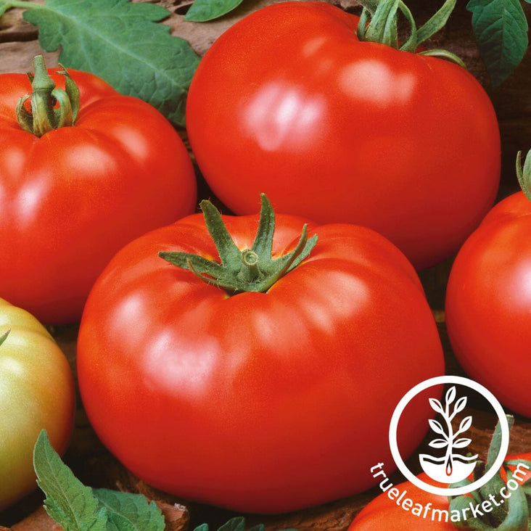
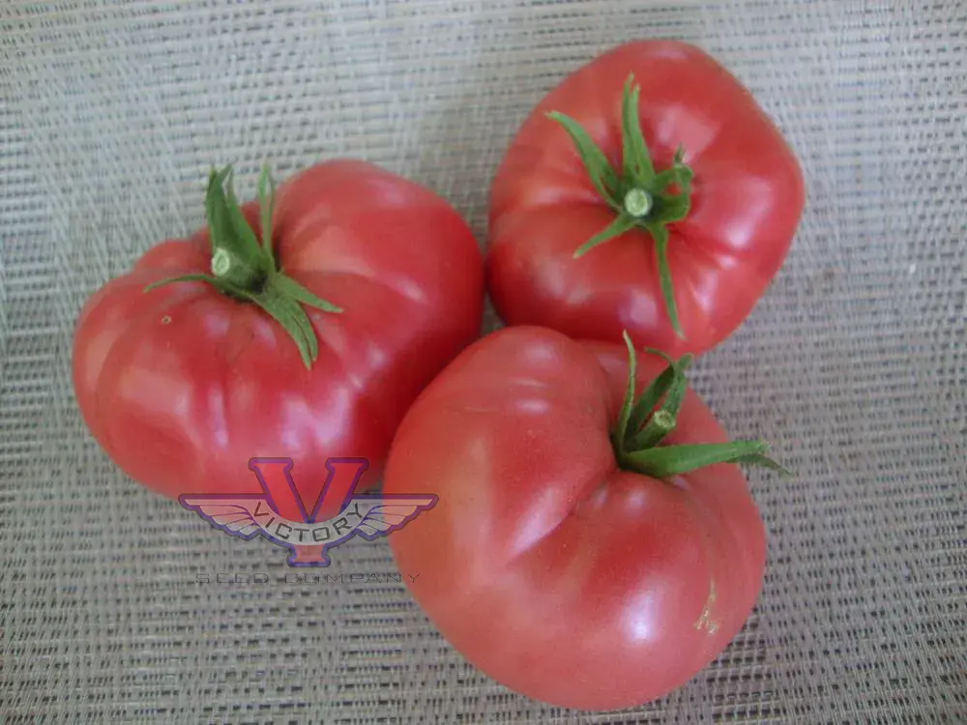
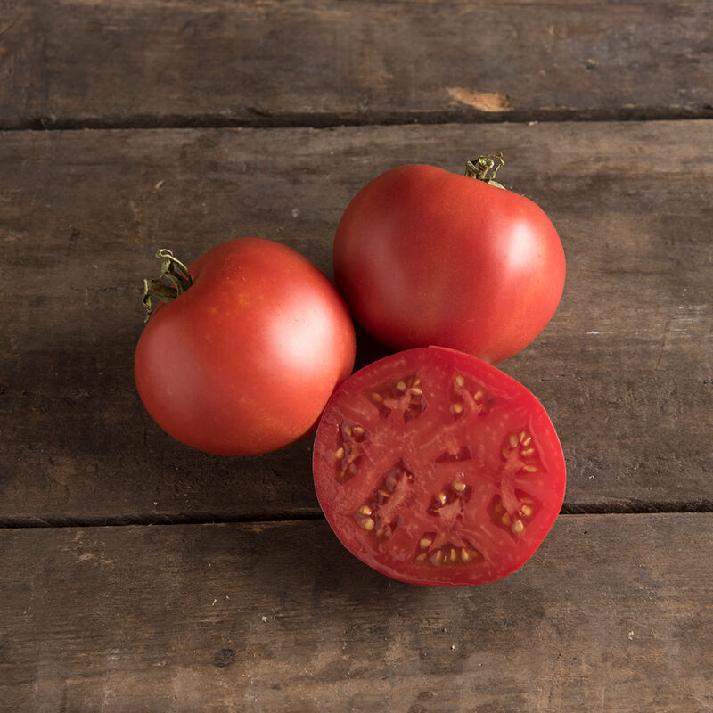
Brandywine
Mortgage Lifter
Moskvich
Homegrown Tomato Trials
Tomatoes trialed
  Brandywine Red
  Mortgage Lifter
  Moskvich
“80-100 Days to maturity (from transplant). Solanum lycopersicum. Brandywine Red Tomato Seeds. Non-GMO, warm season annual, open-pollinated, heirloom, potato leaf, indeterminate, slicing tomato…If you are looking for a trusted red beefsteak-style tomato with that classic old-time flavor, this is it. Open pollinated ”
- True Leaf Market
“85 days, indeterminate - …It has been a popular variety in the Logan, West Virginia area since it was introduced in the 1940s^{[2]} and got international attention when its seed was introduced to gardeners in the mid-1980s. The regular leaf vines produce fruit that are large, some reaching over a pound each, pink in color, and one of the best flavored beefsteaks available. Open pollinated”
- Victory Seed Company
“One of the most appealing extra-early tomatoes [60 days].
Fruits are early, deep red, and cold tolerant. Rich flavor. Smooth and globe-shaped. 4-6 oz. with a small stem scar. Indeterminate. Open pollinated.”
- Johnny’s Selected Seeds

Slide 16
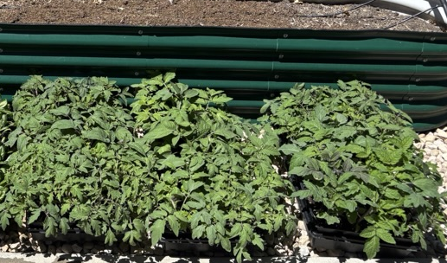
Homegrown Tomato Trials
Participants received plants (3 plants per cultivar) at appropriate time for transplanting outside in their area
Planted and grew plants as they would normally
Noted when first harvested
Post-harvest survey (rated 1-5)
  Harvest amount/size
  Continuous production
  Cracking resistance
  Blossom end rot resistance
  Taste
  Grow again?
Notes:
Describing the trialing process

Slide 17
DAYS TO MATURITY
Homegrown Tomato Trials
Brandywine: n = 16
  Wasatch/Summit: n=8
  Cache: n=4
  Davis: n=4
Mortgage Lifter: n=11
  Wasatch/Summit: n=3
  Cache: n=5
  Davis: n=3
Moskvich: n=20
  Wasatch/Summit: n=8
  Cache: n=4
  Davis: n=8
Brandywine
Mortgage Lifter
Moskvich
True Leaf Market
Victory Seed Company
Johnny’s Selected Seeds
Notes:
THERE WERE SOME CRAZY SHORT NUMBERS IN WASATCH COUNTY…MAKING MORTGAGE LIFTER WAY LOWER…

Slide 18
CONTINUOUS BEARING
Homegrown Tomato Trials
Brandywine: n = 16
  Wasatch/Summit: n=8
  Cache: n=4
  Davis: n=4
Mortgage Lifter: n=11
  Wasatch/Summit: n=3
  Cache: n=5
  Davis: n=3
Moskvich: n=20
  Wasatch/Summit: n=8
  Cache: n=4
  Davis: n=8
Brandywine
Mortgage Lifter
Moskvich
True Leaf Market
Victory Seed Company
Johnny’s Selected Seeds

Slide 19
CRACKING RESISTANCE
Homegrown Tomato Trials
Brandywine: n = 16
  Wasatch/Summit: n=8
  Cache: n=4
  Davis: n=4
Mortgage Lifter: n=11
  Wasatch/Summit: n=3
  Cache: n=5
  Davis: n=3
Moskvich: n=20
  Wasatch/Summit: n=8
  Cache: n=4
  Davis: n=8
Brandywine
Mortgage Lifter
Moskvich
True Leaf Market
Victory Seed Company
Johnny’s Selected Seeds

Slide 20
B.E.R RESISTANCE
Homegrown Tomato Trials
Brandywine: n = 16
  Wasatch/Summit: n=8
  Cache: n=4
  Davis: n=4
Mortgage Lifter: n=11
  Wasatch/Summit: n=3
  Cache: n=5
  Davis: n=3
Moskvich: n=20
  Wasatch/Summit: n=8
  Cache: n=4
  Davis: n=8
Brandywine
Mortgage Lifter
Moskvich
True Leaf Market
Victory Seed Company
Johnny’s Selected Seeds

Slide 21
TASTE
Homegrown Tomato Trials
Brandywine: n = 16
  Wasatch/Summit: n=8
  Cache: n=4
  Davis: n=4
Mortgage Lifter: n=11
  Wasatch/Summit: n=3
  Cache: n=5
  Davis: n=3
Moskvich: n=20
  Wasatch/Summit: n=8
  Cache: n=4
  Davis: n=8
Brandywine
Mortgage Lifter
Moskvich
True Leaf Market
Victory Seed Company
Johnny’s Selected Seeds

Slide 22
GROW AGAIN?
Homegrown Tomato Trials
Brandywine: n = 16
  Wasatch/Summit: n=8
  Cache: n=4
  Davis: n=4
Mortgage Lifter: n=11
  Wasatch/Summit: n=3
  Cache: n=5
  Davis: n=3
Moskvich: n=20
  Wasatch/Summit: n=8
  Cache: n=4
  Davis: n=8
Brandywine
Mortgage Lifter
Moskvich
True Leaf Market
Victory Seed Company
Johnny’s Selected Seeds

Slide 23
GROW AGAIN?
Homegrown Tomato Trials
Brandywine: n = 16
  Wasatch/Summit: n=8
  Cache: n=4
  Davis: n=4
Mortgage Lifter: n=11
  Wasatch/Summit: n=3
  Cache: n=5
  Davis: n=3
Moskvich: n=20
  Wasatch/Summit: n=8
  Cache: n=4
  Davis: n=8
Brandywine
Mortgage Lifter
Moskvich
True Leaf Market
Victory Seed Company
Johnny’s Selected Seeds

Slide 24
Homegrown Tomato Trials
GETTING PEOPLE TO REPORT!!!!
Challenges
    ¼ reported

Slide 25
Homegrown Tomato Trials
Looking to the future…
Hoping to continue/expand
INTERESTED IN PARTICIPATING?

Slide 26
Links & Resources
Suggestions on Utah Veggie Review formatting
  https://usu.co1.qualtrics.com/jfe/form/SV_0PdmZ5BX3pjC8lw
Letters of support for Utah Veggie Review Website/App development
  Wesley.crump@usu.edu
Utah Veggie Review Survey
  https://arcg.is/0brujG1
Utah Veggie Review 2025 results
  asdf

