Slide 1
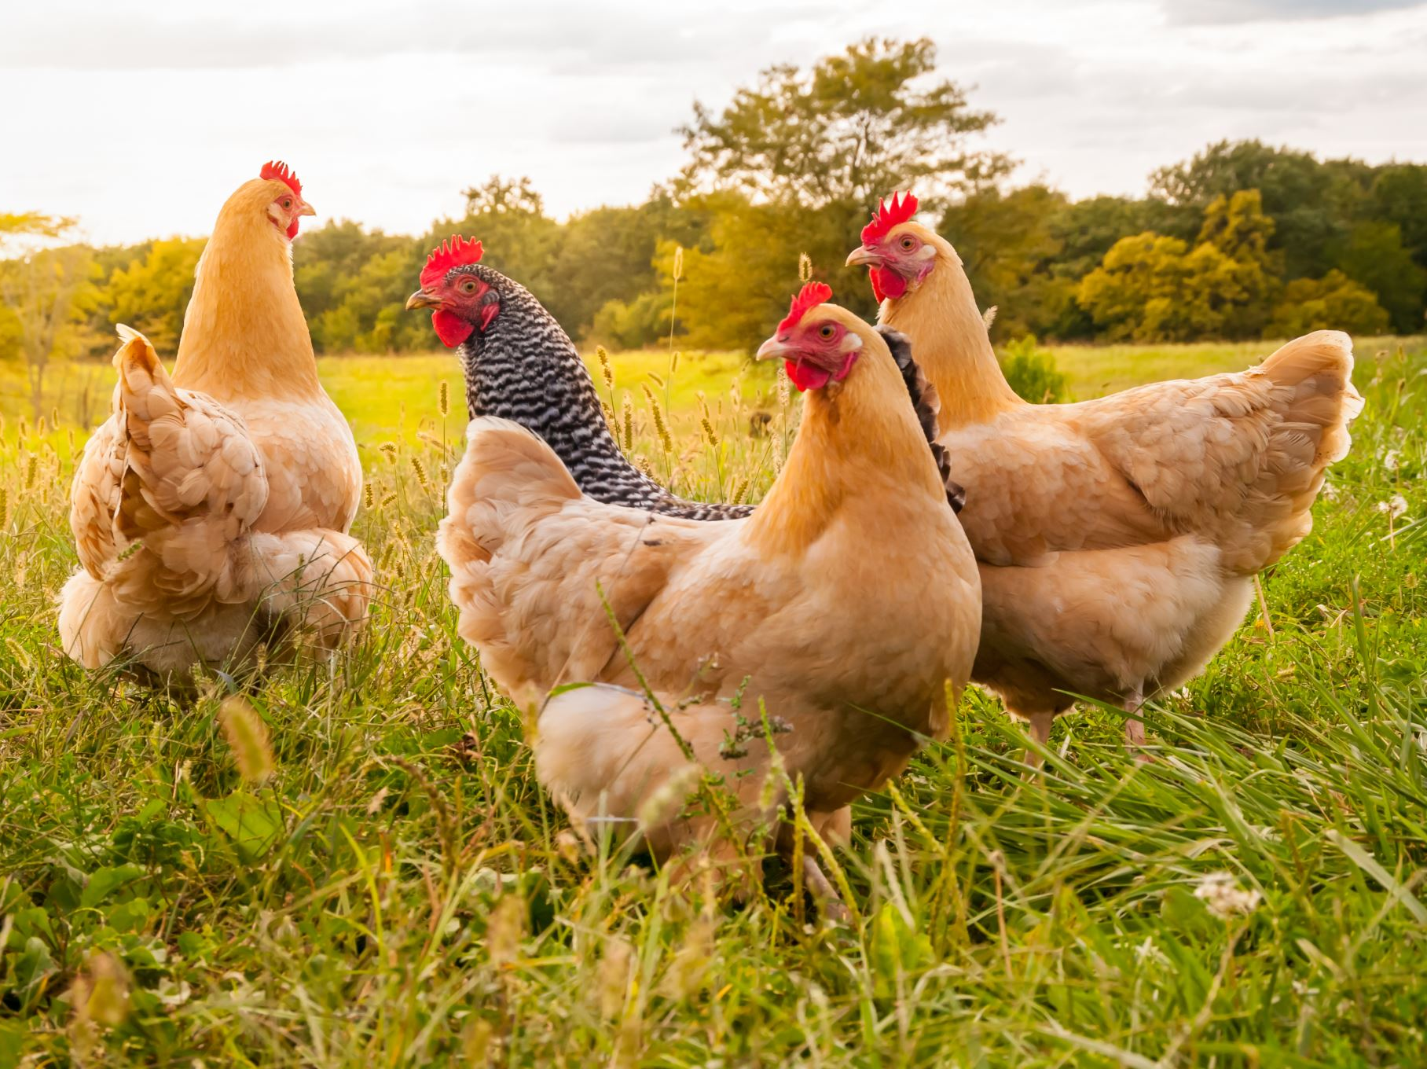
Practical Poultry Biosecurity:
Preventing Disease Before It Starts
Farmer-Focused Training Presentation

Slide 2
What is Biosecurity?
A set of practical steps to prevent disease entry and spread:
Keeping diseases OUT of your farm
Stopping diseases from spreading BETWEEN birds

Slide 3
Common Poultry Diseases Prevented by Biosecurity
  Newcastle Disease
  Infectious Bronchitis
  Coccidiosis
  Salmonella
  Avian Influenza

Slide 4
Newcastle Disease
Cause: Virus
Spread:
Direct contact with infected bird/ Movement of infected birds between farms
Respiratory secretions and dropping
Contaminated feed, water, equipment, clothing, or vehicles
Prevention
1. Vaccination (Most Important)
2. Biosecurity Measures
Restrict farm access
Disinfect equipment, footwear, and vehicles
Isolate new or sick birds/ Avoid mixing birds of different ages
Control wild birds and rodents
3. Good Management Practices

Slide 5
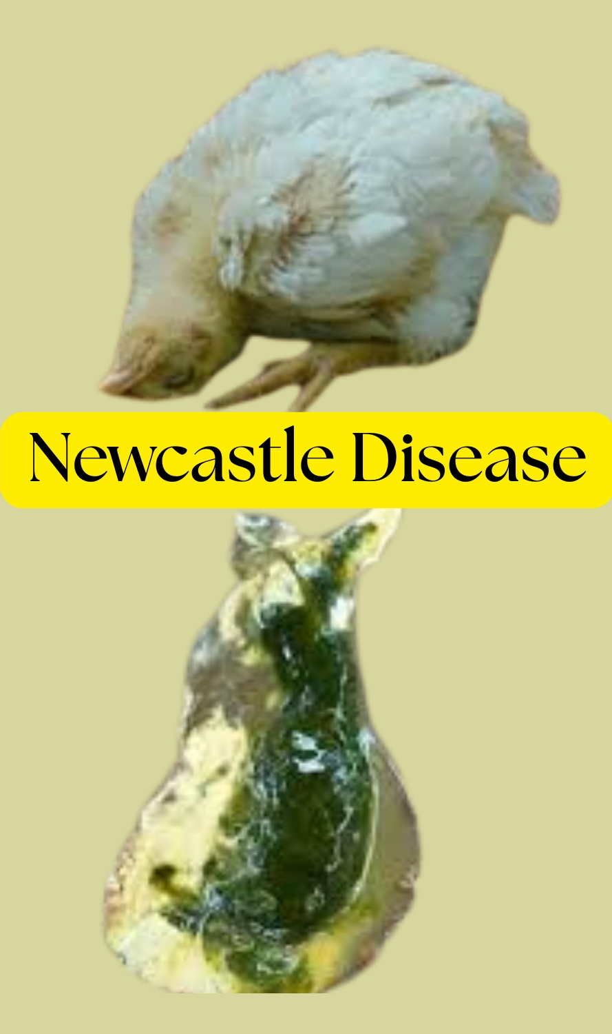
Newcastle
Source; Poultryvetcare.com

Slide 6
Infectious Bronchitis (IB)
Cause: Virus
Spread:
Airborne respiratory droplets (very rapid spread)
Direct contact with infected birds
Contaminated equipment, feed, water, clothing, and crates
Movement of people between poultry houses
Prevention:
1. Vaccination (Key Control Method)
2. Biosecurity
3. Good Management

Slide 7
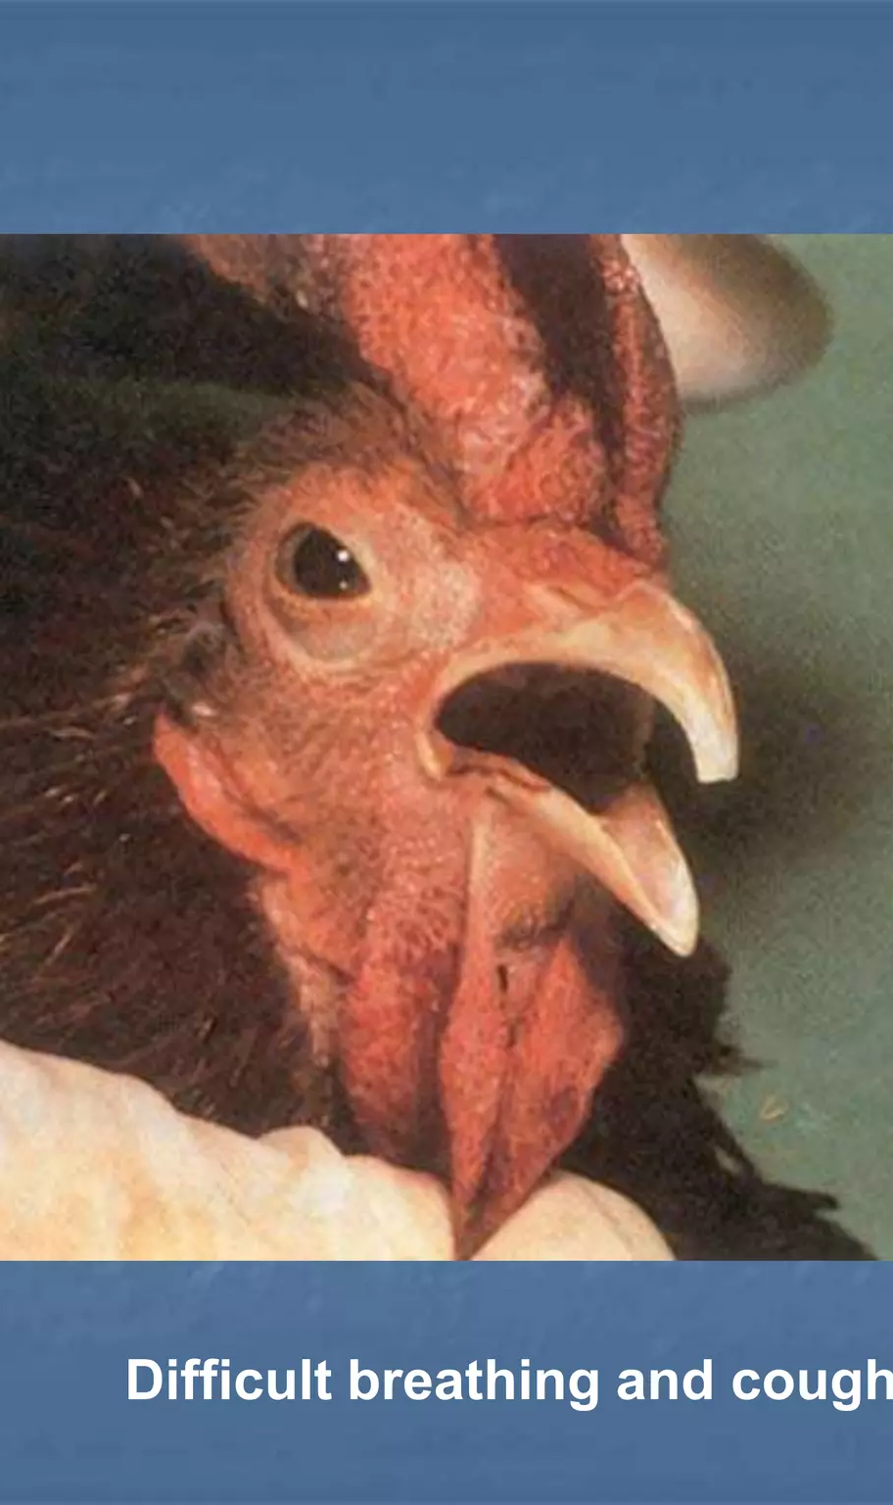
Infectious Bronchitis (IB)
Source: Slideshare.net

Slide 8
Coccidiosis
Cause: Protozoan parasites
Spread:
Contaminated litter, feed, or water
Wet and dirty litter
Overcrowding
Poor sanitation
The parasite multiplies in the intestine and damages the gut lining.
Prevention
1. Anticoccidial Medications-
a. Ionophores- Monensin, Salinomycin, Lasalocid, Narasin, Maduramicin, Semduramicin
b. Chemical (Synthetic) Anticoccidials- Amprolium, Nicarbazin, Diclazuril, Decoquinate, Clopidol, Robenidine, Zoalene (Zoalene®/3-Nitro), Sulfaquinoxaline, Sulfadimethoxine, Sulfamethazine
Generally, NOT Recommended in Laying Hens (During Active Egg Production)
a. Ionophores- Monensin, Salinomycin, Lasalocid, Narasin, Maduramicin, Semduramicin
b. Chemical Anticoccidials, Nicarbazin (can severely affect egg quality and hatchability), Clopidol, Robenidine, Zoalene (3-Nitro), Sulfaquinoxaline, Sulfadimethoxine, Sulfamethazine
2. Vaccination
3. Good Litter Management
4. Biosecurity and Hygiene

Slide 9
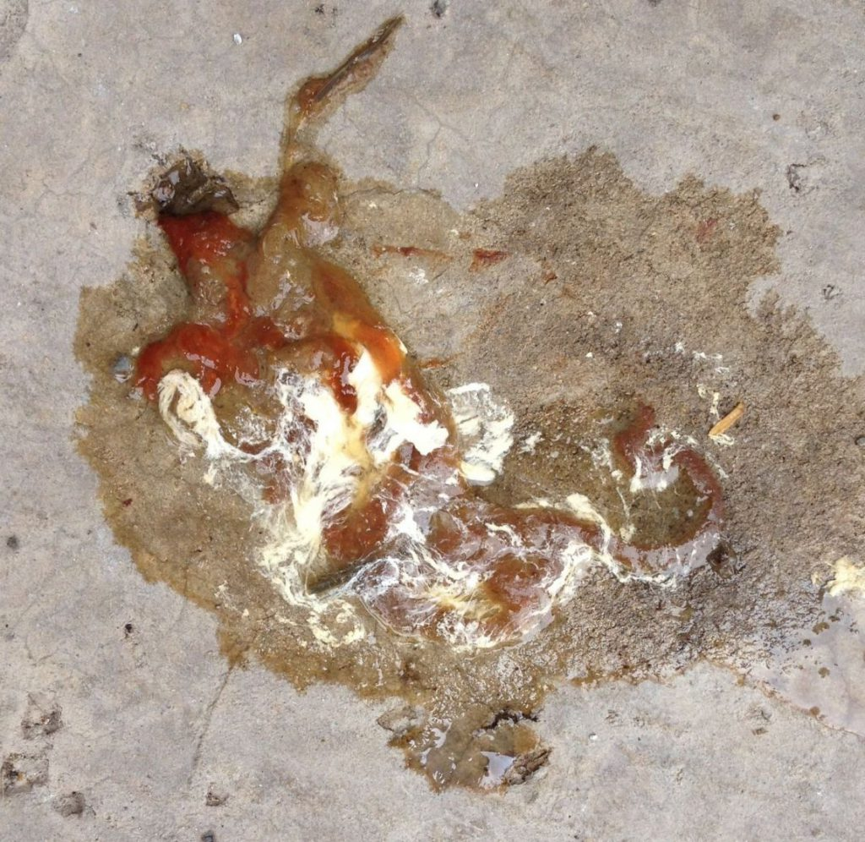
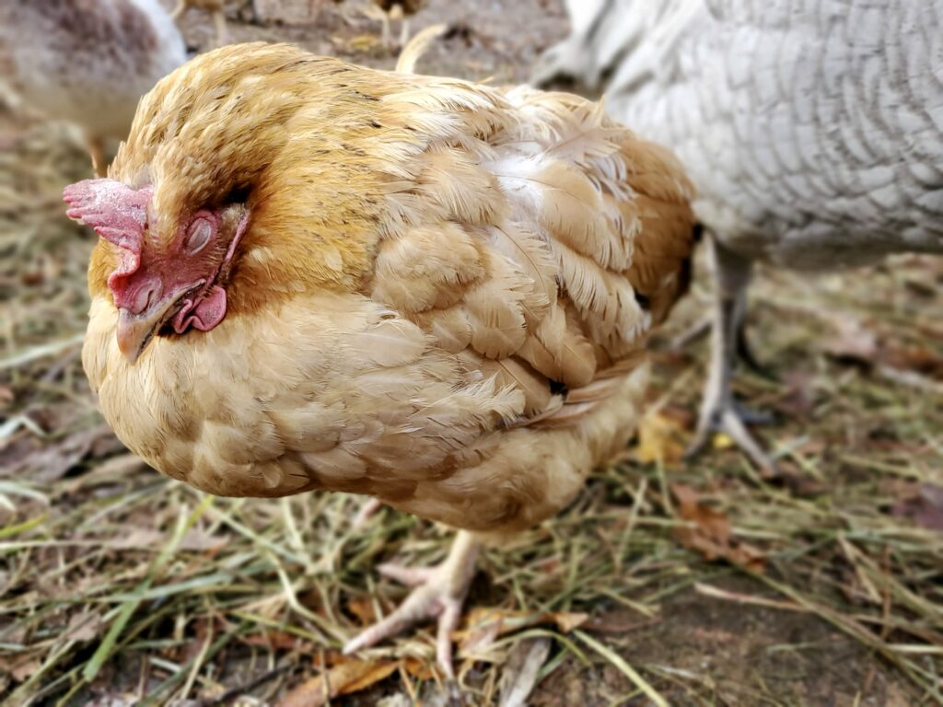
Coccidiosis

Slide 10
Salmonellosis (Salmonella Infection)
Cause: Bacteria of the genus Salmonella.
Types in poultry:
Salmonella Pullorum (Pullorum disease)
Salmonella Gallinarum (Fowl typhoid)
Salmonella Enteritidis and Salmonella Typhimurium (food safety concern)
Spreads:
Contaminated feed and water, equipment /Fecal contamination/ Infected eggs (vertical transmission)
Rodents, wild birds, insects/poor hygiene
Prevention
1. Strict Biosecurity
2. Hatchery and Breeder Control
3. Good Farm Management
4. Monitoring and Testing
5. Vaccination (Where Available)

Slide 11
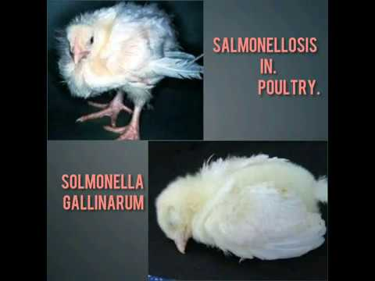
Salmonella Infection
Source: Vet and wildlife rescuer

Slide 12
Avian Influenza
Cause: Virus:
Low Pathogenic Avian Influenza (LPAI) – causes mild disease
Highly Pathogenic Avian Influenza (HPAI) – causes severe disease with high mortality
Spreads:
Direct contact with infected birds
Respiratory secretions and feces
Contaminated feed, water, equipment, clothing, and vehicles
Live bird markets
Migratory wild birds (natural reservoirs)
Prevention
1. Strict Biosecurity (Most Important)
2. Surveillance and Early Detection
3. Vaccination (Where Approved)
4. Proper Disposal

Slide 13
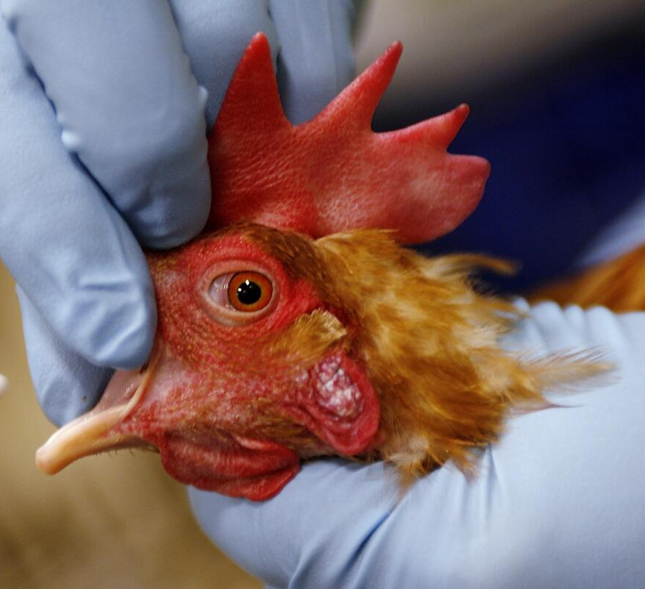
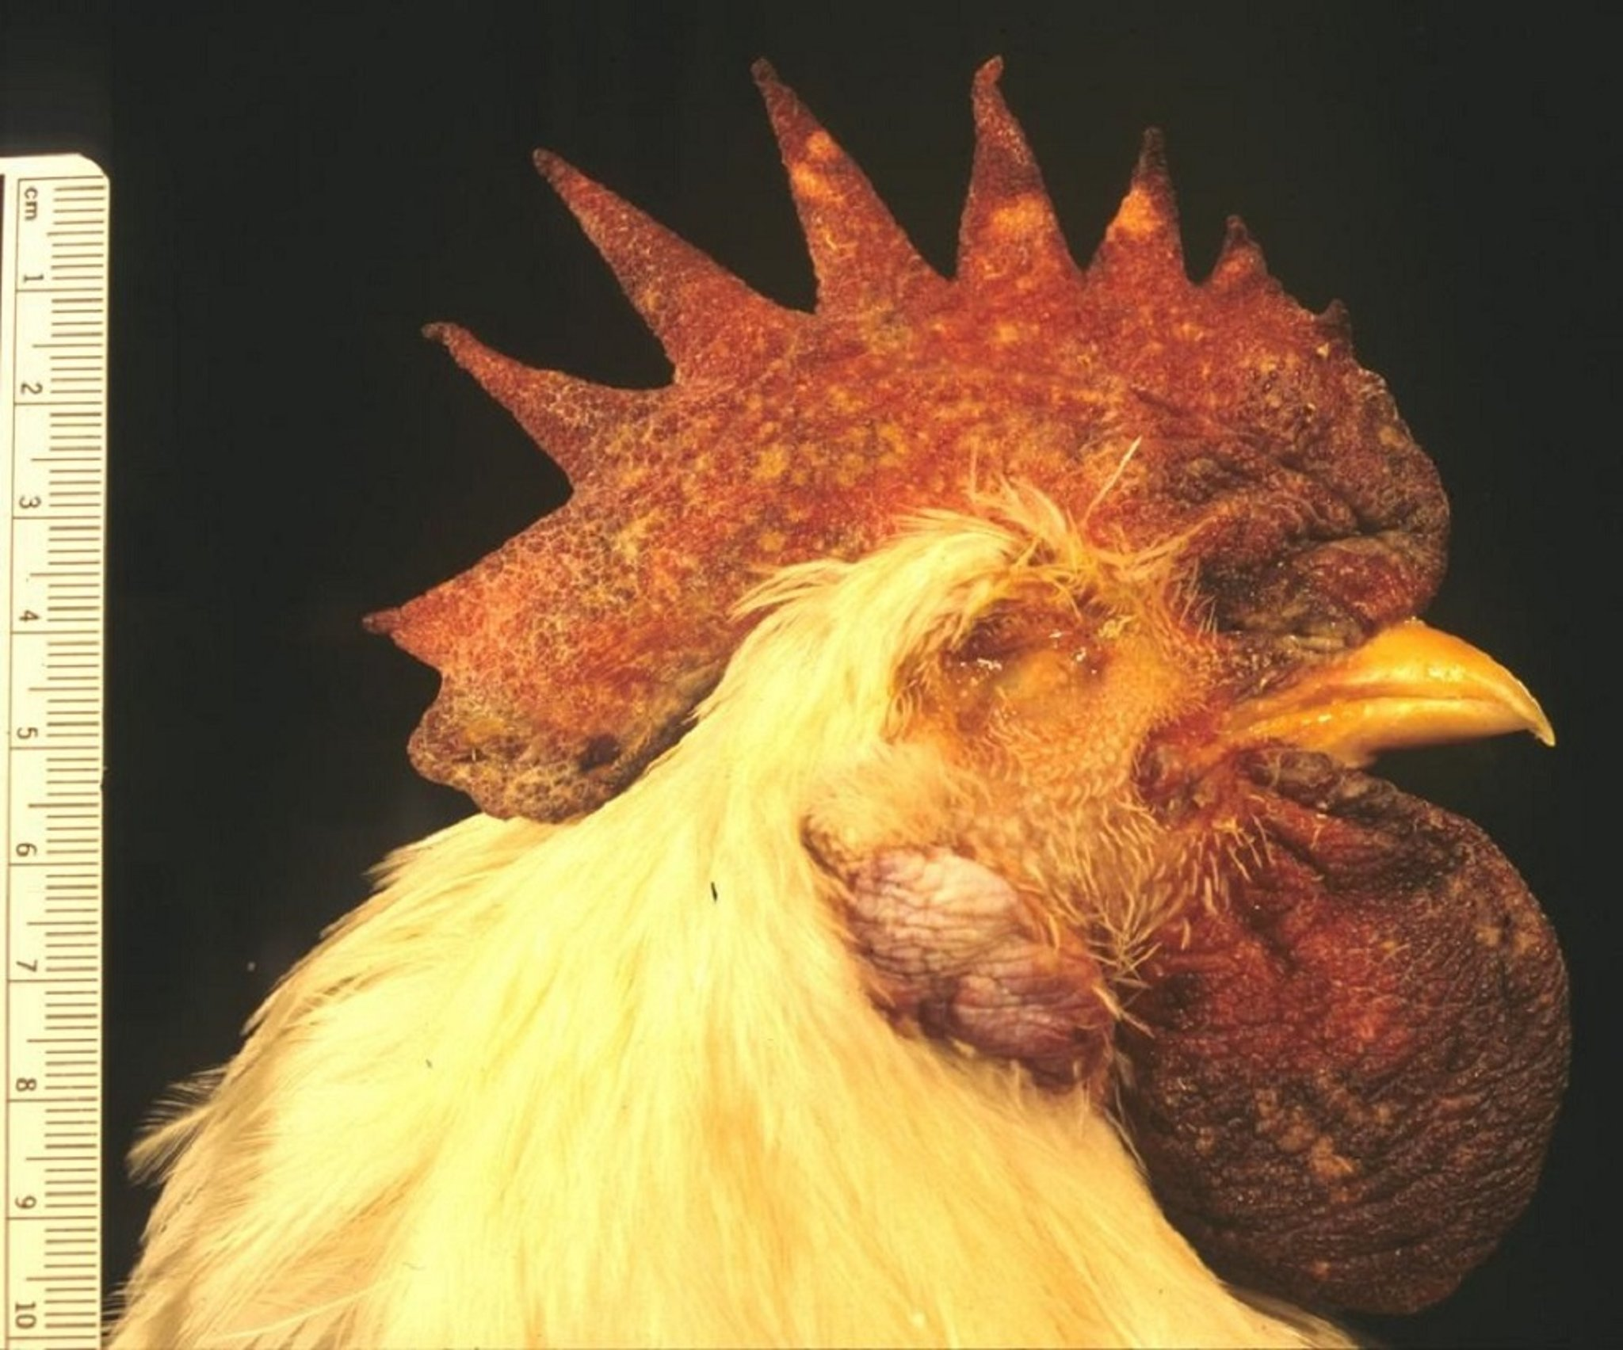
Avian Influenza:
Photos- Latimes.com / msdvetmanual.com

Slide 14
Common diseases of poultry
Disease | Causative Agent | Key Symptoms | Mortality | Zoonotic Risk
Newcastle Disease | Newcastle Disease Virus | Coughing, sneezing, nasal discharge, greenish diarrhea, twisted neck, paralysis, drop in egg production | Moderate to very high (depends on strain) | No
Avian Influenza | Influenza A virus (H5, H7 subtypes) | Sudden death, swelling of head/comb, purple discoloration of comb/wattles, respiratory distress, diarrhea, drop in egg production | High in HPAI | Yes (some strains)
Infectious Bronchitis | Infectious Bronchitis Virus (Coronavirus) | Coughing, sneezing, watery eyes, nasal discharge, poor egg quality (thin shells), reduced egg production, kidney problems (wet droppings) | Low to moderate | No
Coccidiosis | Eimeria spp. (protozoa) | Bloody diarrhea, weight loss, ruffled feathers, weakness, poor growth, reduced feed efficiency | Moderate (if untreated) | No
Salmonellosis | Salmonella spp. (bacteria) | Diarrhea, weakness, poor growth, decreased egg production, high chick mortality (Pullorum), swollen joints (sometimes) | Low to moderate (high in chicks) | Yes
 |  | Note: Respiratory signs prominent: Newcastle, Avian Influenza, Infectious Bronchitis Bloody diarrhea: Coccidiosis Public health concern: Avian Influenza (some strains), Salmonella Nervous signs (twisted neck): Newcastle disease

Slide 15
Poultry Vaccination Schedule (With Age & Benefits)
Disease | Vaccine Type | Age of Administration | Method | Applicability | Purpose / Benefits
Newcastle Disease (ND) | Live (B1) | Day 1–7 | Eye drop / Spray | Broilers, Layers, Breeders | Early protection; stimulates local respiratory immunity
 | Live (LaSota booster) | Day 14–21 | Drinking water / Spray | Broilers, Layers, Breeders | Strengthens immunity; reduces virus circulation
 | Inactivated (killed) | 8–12 weeks (56–84 days) | Injection | Layers, Breeders | Long-lasting immunity; protects egg production
 | Booster (live/killed) | During lay (every 3–4 months if needed) | Water / Injection | Layers, Breeders | Maintains high antibody levels during production
Infectious Bronchitis (IB) | Live (Mass type) | Day 1 | Spray / Eye drop | Broilers, Layers, Breeders | Early respiratory protection
 | Live booster | Day 14–21 | Drinking water / Spray | Broilers, Layers, Breeders | Enhances protection; improves flock uniformity
 | Inactivated | 8–12 weeks (before lay) | Injection | Layers, Breeders | Long-term protection; improves egg quality and shell strength
Coccidiosis | Live oocyst vaccine | Day 1 (hatchery) | Spray / Gel droplets | Broilers (some), Layers, Breeders | Develops natural intestinal immunity; reduces drug resistance
 | Booster | Usually not required | — | — | Immunity develops through controlled cycling
Salmonellosis | Live attenuated | Day 1–7 | Drinking water | Layers, Breeders | Reduces intestinal colonization and shedding
 | Booster (live) | 6–8 weeks (42–56 days) | Drinking water | Layers, Breeders | Strengthens immunity before maturity
 | Inactivated | 10–16 weeks (before lay) | Injection | Layers, Breeders | Reduces egg contamination; longer antibody protection
Avian Influenza (where permitted) | Inactivated (H5/H7 specific) | 1–3 weeks (7–21 days) | Injection | Layers, Breeders (high-risk areas) | Reduces mortality and virus shedding
 | Booster | 10–16 weeks (before lay) | Injection | Layers, Breeders | Maintains protection during laying period

Slide 16
Why Biosecurity Matters
Prevention is cheaper than treatment
Reduces mortality and production losses
Protects your investment
Maintains market access and consumer trust

Slide 17
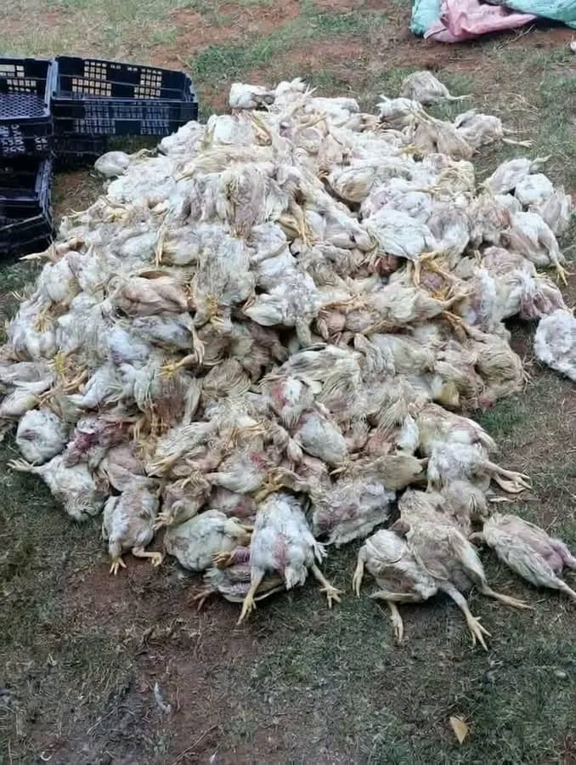
The little stuff we brush off today can come back and hit us hard tomorrow.

Slide 18
Real Utah Cases — What Happened & Why It Matters
Utah has commercial, small-scale, and backyard flocks
Migratory bird flyways increase Avian Influenza risk
Outbreaks can restrict interstate poultry movement
Prevention protects Utah’s poultry reputation

Slide 19
Case 1: 2025 Poultry HPAI Utah Detections
Date Confirmed | County | Facility Type | Number of Birds Affected | Quarantined/Released
9/26/2025 | Sanpete | Commercial Turkey | 34,798 | Released
9/28/2025 | Sanpete | Commercial Turkey | 8,744 | Released
10/4/2025 | Sanpete | Commercial Turkey | 12,985 | Released
10/5/2025 | Sanpete | Commercial Turkey | 30,936 | Released

Slide 20
Case 2: Large Chicken Flock Loss — Cache County (2024)
HPAI outbreak, northern Cache County, fall 2024:
Culling of an estimated 1.6–1.8 million chickens at a commercial poultry farm.
Largest poultry losses Utah has seen in recent years.
Demonstrates how quickly disease can spread once introduced.

Slide 21
Case 3: Backyard & Commercial Cases Across Utah (2024)
In November 2024, additional HPAI cases were confirmed.
Three turkey farms in Piute County
Small backyard flock in Salt Lake County.
Between November 10 to 19, 2024,
Three turkey farms in Piute County
Totaling 107,800 turkeys depopulated
One backyard flock of 253 birds being depopulated in Salt Lake County
Backyard flocks often serve as sentinel indicators of disease spread in a region.

Slide 22
Case 4: Wild Birds: Real Disease Pressure in Utah
As of Feb. 10, 2025, 122 wild birds
One mountain lion,
Some skunks and,
three red foxes in Utah tested positive for avian flu- 2022.
The counties currently seeing positive avian flu cases in wild birds since November include:
Box Elder, Cache, Carbon, Davis, Emery, Millard, Salt Lake, San Juan, Tooele and Weber

Slide 23
How Diseases Enter our Farm
Visitors and workers
New birds introduced to flock
Wild birds and rodents
Contaminated equipment
Feed and water contamination

Slide 24
Practical Poultry Biosecurity: Preventing Disease Before It Starts
Control Farm Access/Footbath Best Practices
Clean and Disinfect Equipment/ Isolate New Birds
Control Rodents and Wild Birds/Water and Feed Safety
Daily Health Monitoring/Sick Bird Management
Proper Disposal of Dead Birds/Worker Hygiene
Farm Layout Planning
Vaccination and Veterinary Support/ Emergency Response Plan

Slide 25
Control Farm Access
Limit visitors:
  Keep a visitor logbook
  Provide farm-specific boots and coveralls

Slide 26
Footbath Best Practices
Place at every poultry house entrance
  Use recommended disinfectant
  Change solution regularly
  Remove dirt before stepping in
  Have a permanent footwear used only in your poultry house

Slide 27
Worker Hygiene
Wash hands before and after handling birds
Use dedicated farm clothing
Avoid visiting other poultry farms
Shower in/shower out if possible

Slide 28
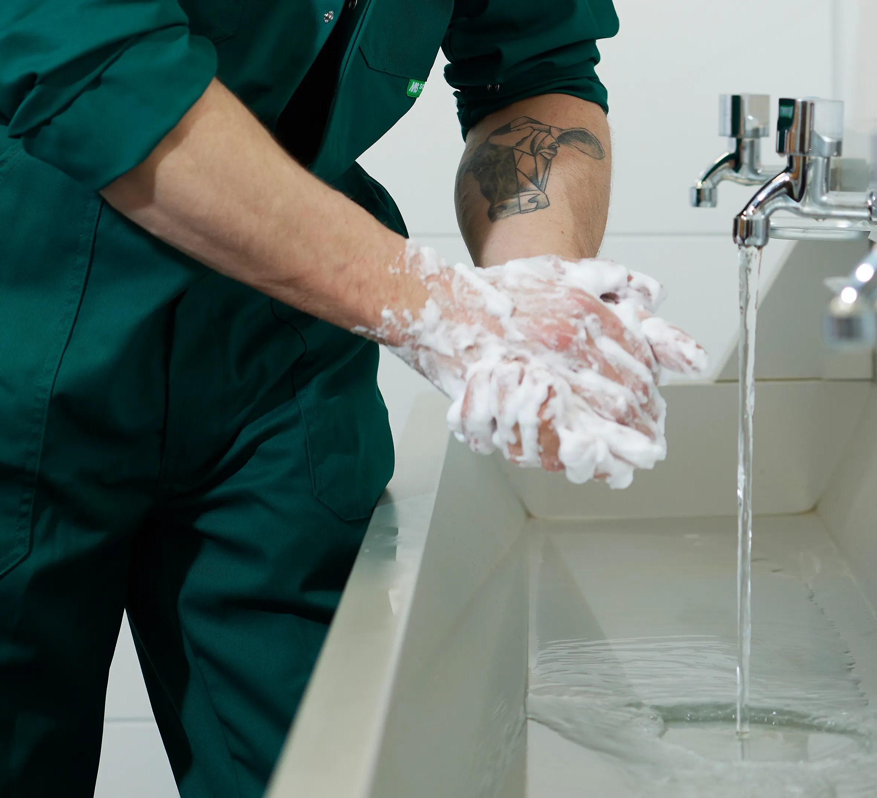
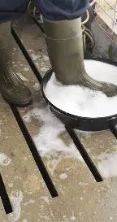
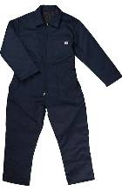
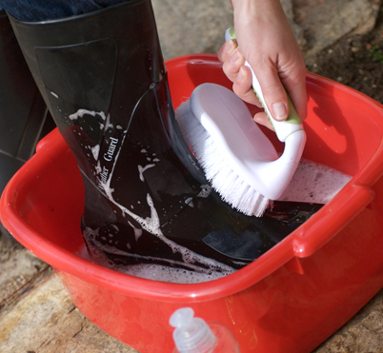
Boot / Handwashing/Foot Dip/coverall

Slide 29
Clean and Disinfect Equipment
Clean before disinfecting (remove organic matter)
Use approved disinfectants
Avoid sharing equipment between farms
Disinfect vehicles entering farm

Slide 30
Poultry Disinfectant Dilution & Contact Time Guide
Disinfectant Type | Common Dilution Range | Minimum Contact Time | Best Use Areas | Important Notes
Sodium Hypochlorite (Bleach 5–6%) | 1:32 (½ cup per gallon) for general disinfection | 10 minutes | Floors, equipment, footbaths | Clean surfaces first; inactivated by organic matter; corrosive to metals
Quaternary Ammonium Compounds (Quats) e.g. Alkyl dimethyl benzyl ammonium chloride | 1:200 to 1:400 (per label) | 10 minutes | Equipment, walls, boot dips | Less effective in heavy organic matter; good for routine sanitation
Phenolic Disinfectants | 1:64 to 1:256 | 10–20 minutes | Floors, walls, vehicles | Works better in presence of some organic material
Accelerated Hydrogen Peroxide (AHP) (e.g., Virkon-type products, Virkon®-S, Accel®/SaniDate® products) | 1% solution (10 g per liter or per label) | 10 minutes | Housing, equipment, footbaths | Effective against viruses (AI, ND); relatively low residue
Peracetic Acid / Peroxygen Blends e.g. Peracetic acid + hydrogen peroxide products | 0.2–0.5% (per label) | 5–10 minutes | Equipment, waterlines, fogging | Strong oxidizer; good cold-weather performance
Iodophors | 1:100 to 1:200 | 10 minutes | Footbaths, water sanitation | Stains surfaces; reduce concentration for drinking water use
Formaldehyde (Formalin) | 2–5% solution or fumigation per protocol | 6–24 hours (fumigation) | Terminal disinfection (empty house)

Slide 31
Isolate New Birds
Quarantine new birds for 2 - 4 weeks
Monitor for signs of disease
Do not mix immediately with main flock

Slide 32
Control Rodents and Wild Birds
Seal holes in houses
Use rodent traps and bait stations
Keep feed stored securely
Use netting to prevent wild bird access
Eliminate standing water that attracts waterfowl
Prevent wild bird nesting near poultry housing

Slide 33
Water and Feed Safety
Provide clean drinking water
Clean drinkers regularly
Store feed in dry, rodent-proof containers
Discard moldy feed immediately

Slide 34
Daily Health Monitoring
Check birds twice daily
Watch for coughing, sneezing, diarrhea
Look for drop in feed or water intake
Record mortalities

Slide 35
Sick Bird Management
Isolate sick birds immediately
Consult veterinarian early
Dispose of dead birds properly
Never sell sick birds

Slide 36
Proper Disposal of Dead Birds
Burial (where permitted)
Composting
Rendering (if available)
Follow local regulations

Slide 37
Farm Layout Planning
Separate clean and dirty areas
Designate loading zones away from poultry houses
Maintain perimeter fencing

Slide 38
Vaccination and Veterinary Support
Follow recommended vaccination schedule
Keep vaccination records
Build relationship with local veterinarian

Slide 39
Emergency Response Plan
Report unusual deaths immediately
  Restrict movement on farm
  Contact veterinary authorities
  Follow official guidance
Contact Utah Department of Agriculture & Food (UDAF)
  Work with Utah State University Extension
  Any local veterinary unit in your area

Slide 40
Economic Benefits of Biosecurity
Higher productivity
Lower treatment costs
Better flock performance
Sustainable poultry business

Slide 41
Key Take-Home Message
Biosecurity is everyone’s responsibility
Small daily actions prevent big losses
Healthy birds = Profitable farm

