Slide 1

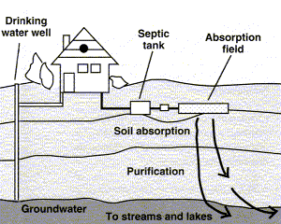
Utah On-Site Wastewater Treatment Training Program
Utah Water Research Laboratory
USU, Logan
Judy Sims Email: judith.sims@usu.edu

Slide 2


Owning a Septic System: What You Need to Know
When a centralized wastewater treatment system is not available to treat your wastewater, then it is YOUR RESPONSIBILITY to OPERATE AND MAINTAIN your own “mini-treatment” plant
Proper handling of your wastewater will protect you and your community from wastewater contamination
That is, protection from contamination by disease-causing organisms and a condition referred to as blue-baby syndrome

Slide 3
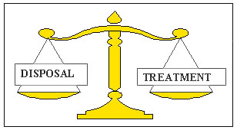
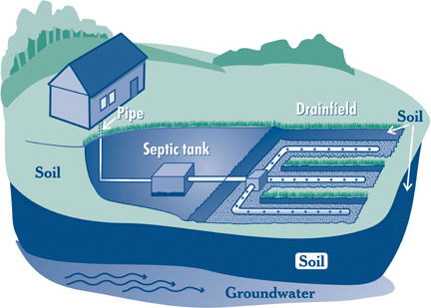
On-Site Wastewater Treatment and Disposal System
Suitable Soil:
Not too Fast,
Not too Slow

Slide 4

On-Site Wastewater Treatment Systems
On-site systems can experience two types of failure
Operational Failure
A system after installation not usually checked or monitored until----
System does not remove the wastewater from the home or yard (disposal)
Often is an emergency situation and affects homeowner directly
Is usually (hopefully?) corrected promptly

Slide 5
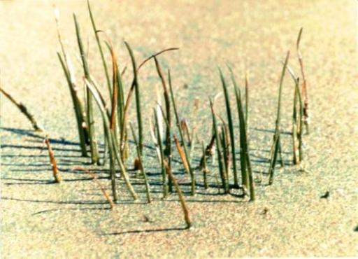
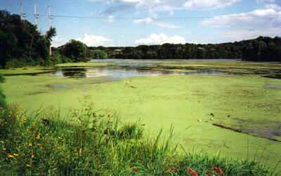
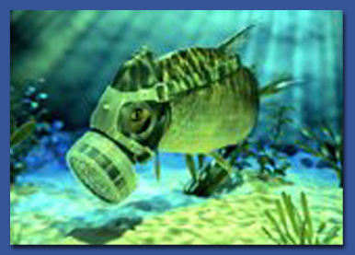
On-Site Wastewater Treatment Systems
Functional failure
System continues to remove wastewater but does not properly treat the wastewater prior to discharge into the environment (treatment)
Often does not directly impact the homeowner but can affect the community through degraded water quality and potential public health problems
Homeowners often don’t know when a functional failure has occurred
Even if do, may be reluctant to acknowledge the failure and repair the system

Slide 6
First Septic System Problem
Hydraulic overloading of system
That is, adding more water per day than the system is designed for
Size of the septic tank is based on the daily flow
Size of the drain field is based on the MAXIMUM amount of wastewater the system can handle on a daily basis (includes a safety factor for times of high flow)

Slide 7
Example: Three Bedroom Home with Five People
For a three-bedroom home, maximum daily flow is 450 gallons per day, and the minimum size of the septic tank is 1000 gallons (Utah Regulations)
Average flow per person is about 45 – 60 gallons per day
Therefore, the daily wastewater flow for 5 people is 225 - 300 gallons per day
But leaky toilets and faucets(can add up to 200 gallons per day!), long or lots of showers, and/or several loads of laundry
Can result in exceeding the maximum allowable daily flow rate of 450 gallons per day, leading to system failure, both functional and operational

Slide 8
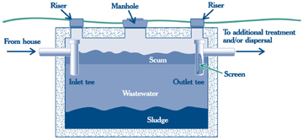
Septic Tank
Wastewater flows into the tank as you use it in the home:
The heavier solid materials sink to the bottom (forming the sludge layer)
The lighter materials float to the top (oils and greases, soap scum, TP)
The tank’s primary purpose is to hold these solids and also to start biological treatment
There should be about 3 to 5 years of storage capacity for solids before the tank needs to be pumped out and
solids removed

Slide 9
What Happens to the Solids in the Tank?
It takes about 2 days for the solids to separate out and for anaerobic biodegradation of the solids by microorganisms (removes about 50% of the solids)
We need to be careful about how we treat those helpful microorganisms (both in the tank and in the drain field)

Slide 10
Taking Care of Your Septic Tank
Conserve water
Avoid or minimize use of garbage disposal
Compost food wastes to decrease volume of solids entering tank
Avoid excess use of antibacterial cleaning products
Only flush toilet paper and human wastes
Pump tank periodically
Every three to five years pumped or inspected (to see if pumping is necessary)

Slide 11
Second Problem: Disposing Inappropriate Materials in Your Septic System
Do not dispose of non-biodegradable solids (e.g., coffee grounds, dental floss, disposable diapers, sanitary products, kitty litter, bandages, non-flushable wipes, paper towels and tissues, cigarette butts, condoms)
Do not pour grease or oil down drains
Do not dispose of pesticides, paint thinners, paints, solvents, antifreeze, disinfectants, unused medications, and poisons into septic tank systems

Slide 12
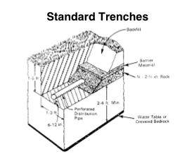
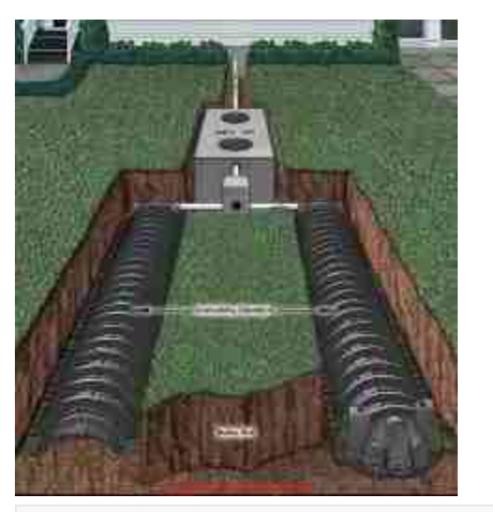
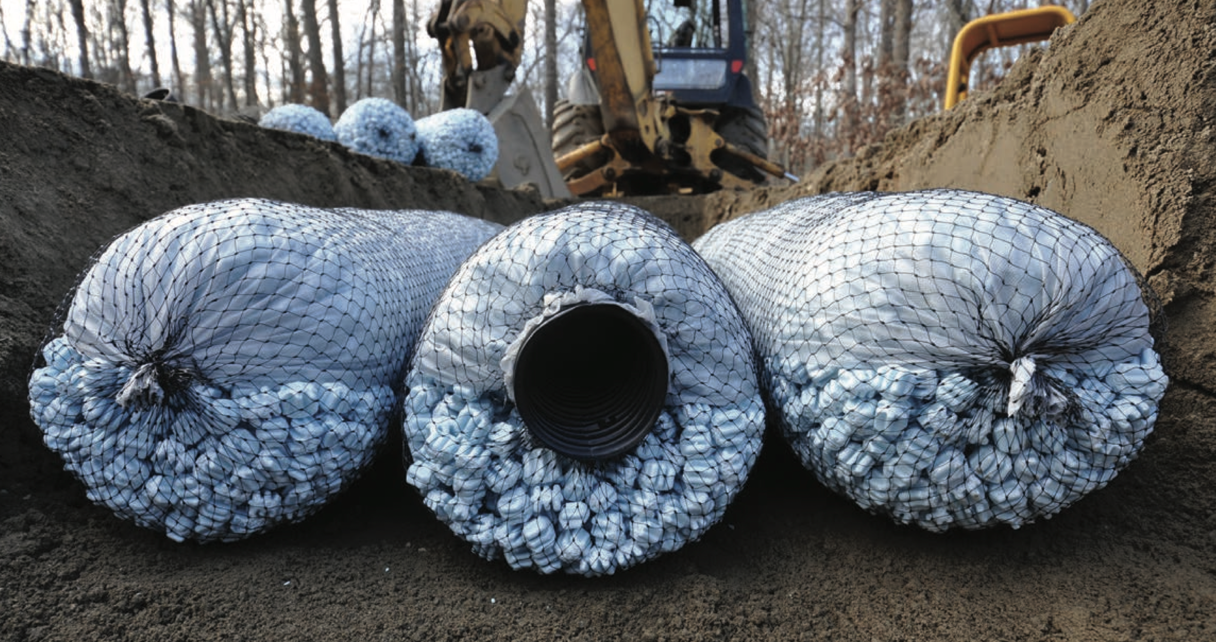
The Drain Field

Slide 13
Taking Care of Your Drain Field
Do not:
Drive over the drain field or compact it in any way
Build a structure on top of it
Cover it with concrete or asphalt
Do not over-irrigate (may leach contaminants)
Do:
Plant grass on the drain field to minimize soil erosion
Roots of trees and shrubbery can get into the lines and plug them
Divert surface runoff water from roofs, patios, driveways, and other areas away from the absorption field

Slide 14
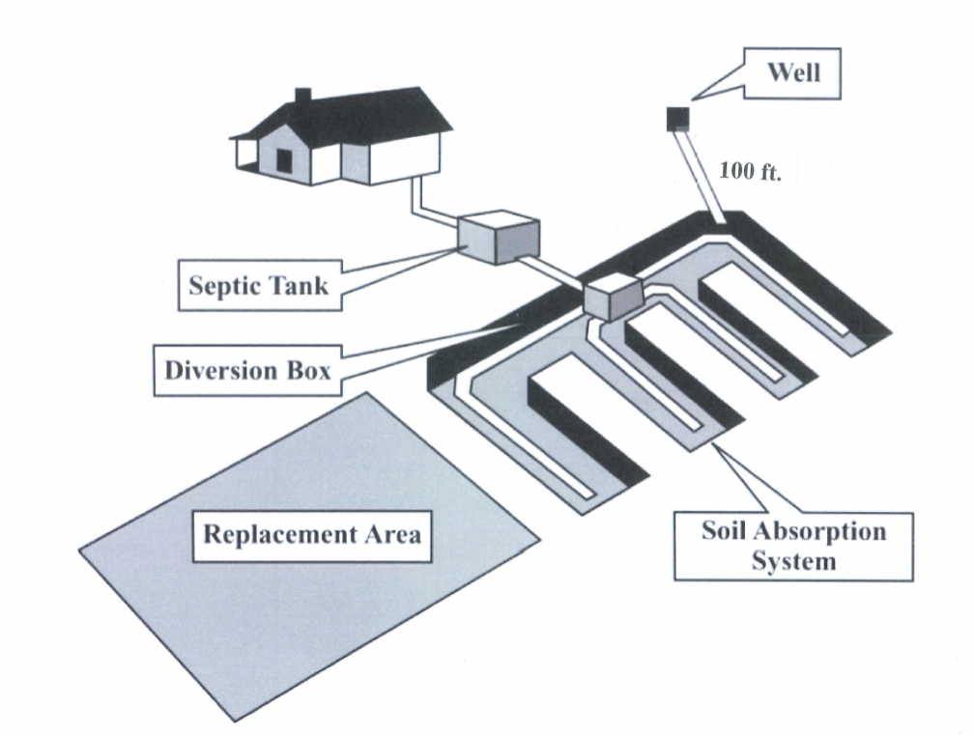
If Drainfield Fails…
"Replacement area" means that sufficient land with suitable soil, excluding streets, roads, and permanent structures is available and is intended for 100% replacement of the drain field

Slide 15
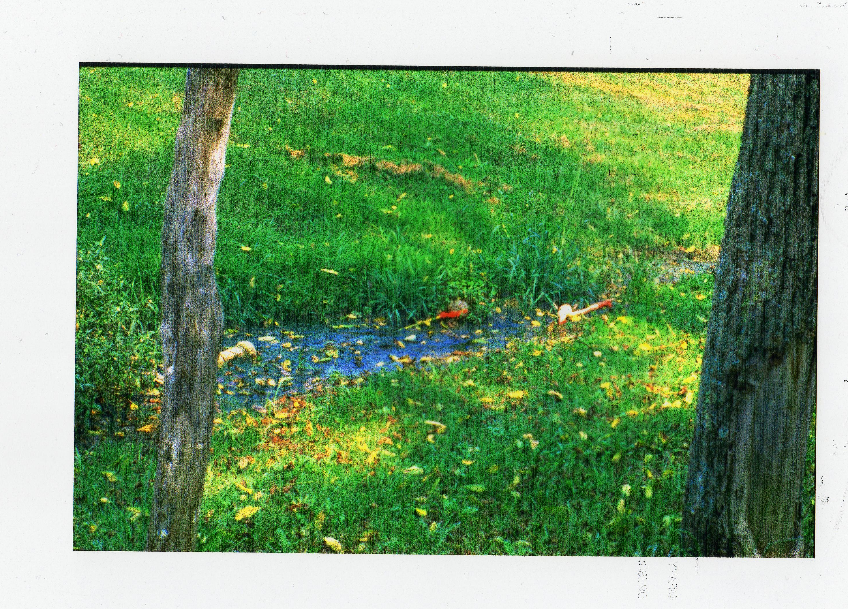

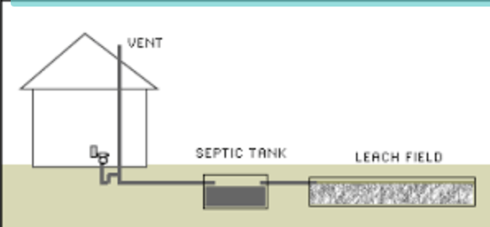
Warning Signs of Failure
Tests showing presence of fecal coliform bacteria or high levels of nitrate in well water
Surfacing wastewater or wet spots in the drain field
Plumbing backups
Slow-draining fixtures
Wastewater odors in the house or yard
It’s normal, however, for the house plumbing vent on the roof to emit wastewater odors

Slide 16
Alternative Systems
If your site has limitations such as:
Inadequate separation distance to ground water or bedrock
Not enough separation distance from water bodies, slope, property lines, etc.
Soil too fast or too slow
You may have a more complex treatment system that requires periodic inspection and maintenance by a certified professional

Slide 17
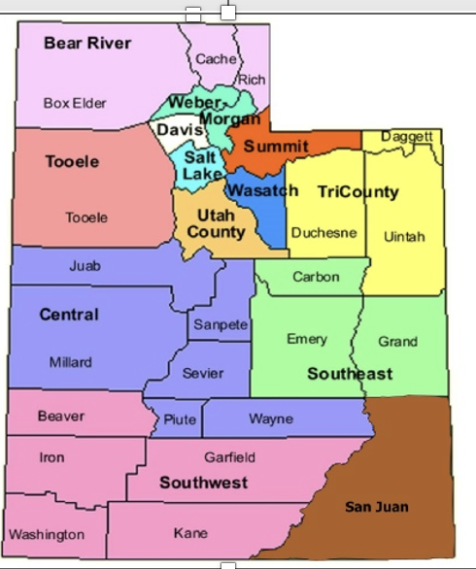
Help!! Advice from Local Health Department (Funds May Be Available for Repairs and Replacement of Failing Systems)
Also may seek assistance from a certified on-site wastewater professional (See Website for Utah Division of Water Quality Onsite Program)

