Slide 1

Welcome to Farm and Food Business Resources Urban and Small Farms Conference
Please use the Q&A to ask your questions (not the chat)
Presenters will answer questions at the END of the presentation
PLEASE fill out the surveys between presenters. It helps us better serve you!
These presentations will be recorded and made available on www.diverseag.org after the conference (it will take a few weeks)
Closed captioning can be turned off on your personal computer using the controls at the bottom of your screen

Slide 2

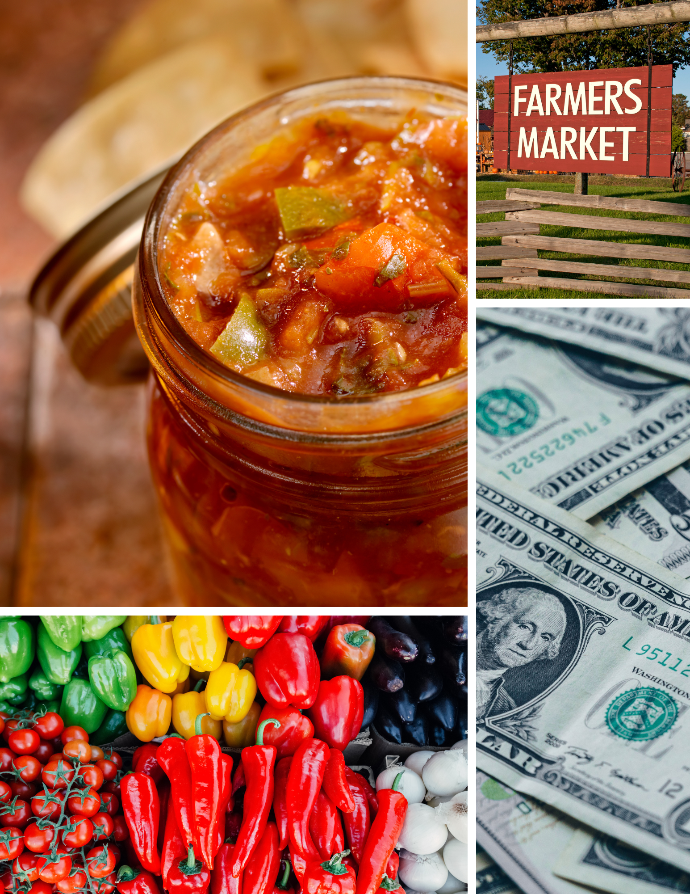
Utah Farm & Food Business Program Updates and Introductions

Slide 3
USDA Regional Food Business Centers
The USDA Regional Food Business Centers will support a more resilient, diverse, and competitive food system
Support producers by providing localized assistance
Provide technical assistance needed to access new markets and resources
Assist small- and mid-sized producers in overcoming barriers to market access

Slide 4
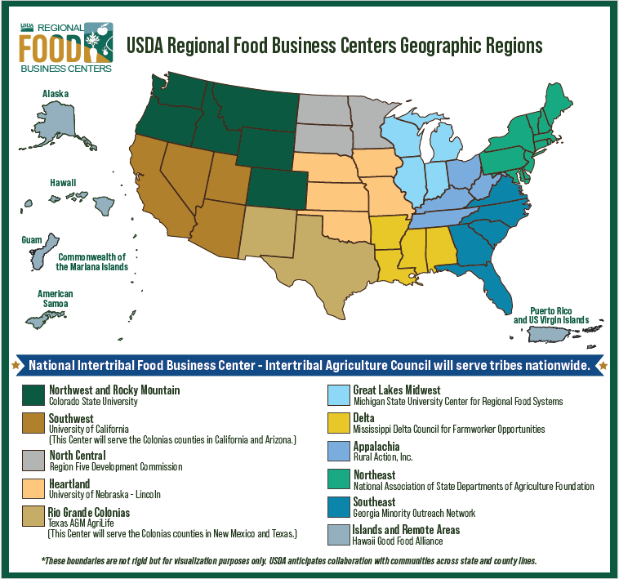
Twelve Centers
Utah is part of the Southwest Regional Center based at the University of California
Resources created through one center will be shared with all

Slide 5
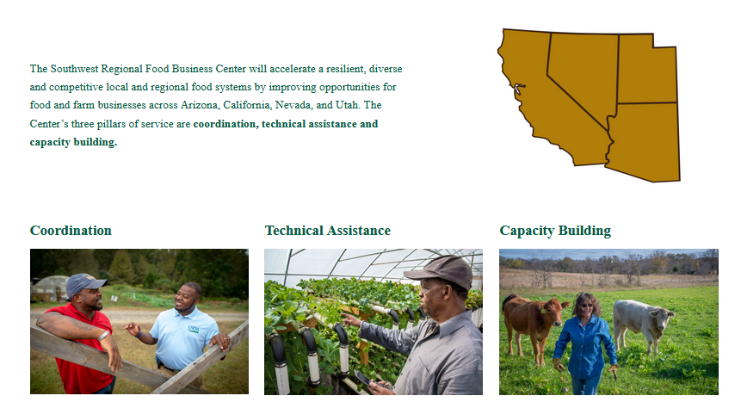
Southwest Regional Food Business Center

Slide 6
Utah Project Team – SWRFBC
Karin Allen
USU Lead
Kaylan Burns
Project Coordinator
Tyson Lloyd
NE Utah Business Consultant
Brance Hammons
NW Utah Business Consultant
Kynda Curtis
Ruby Ward
Co-PIs
Tim Chamberlain
Southern Utah Business Consultant
Caroline Hargraves
UDAF Lead
Allison Ross
Grants Specialist
New Hire
Regulatory Navigation Specialist

Slide 7
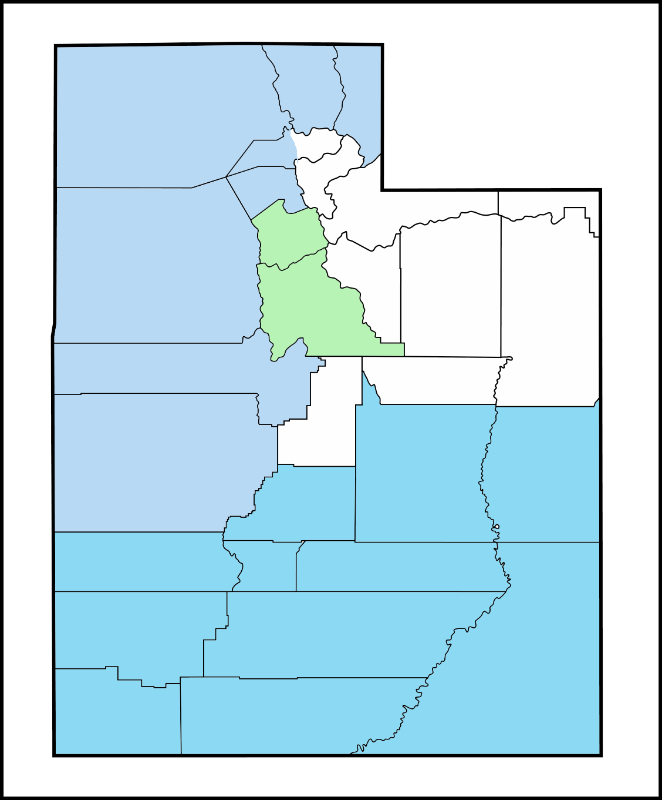

Introductions – Kaylan Burns
Utah Food and Farm Business Program Coordinator
Born and raised in Houston, TX
BS in Business Management from BYU-Idaho
Very passionate about our food system!

Slide 8
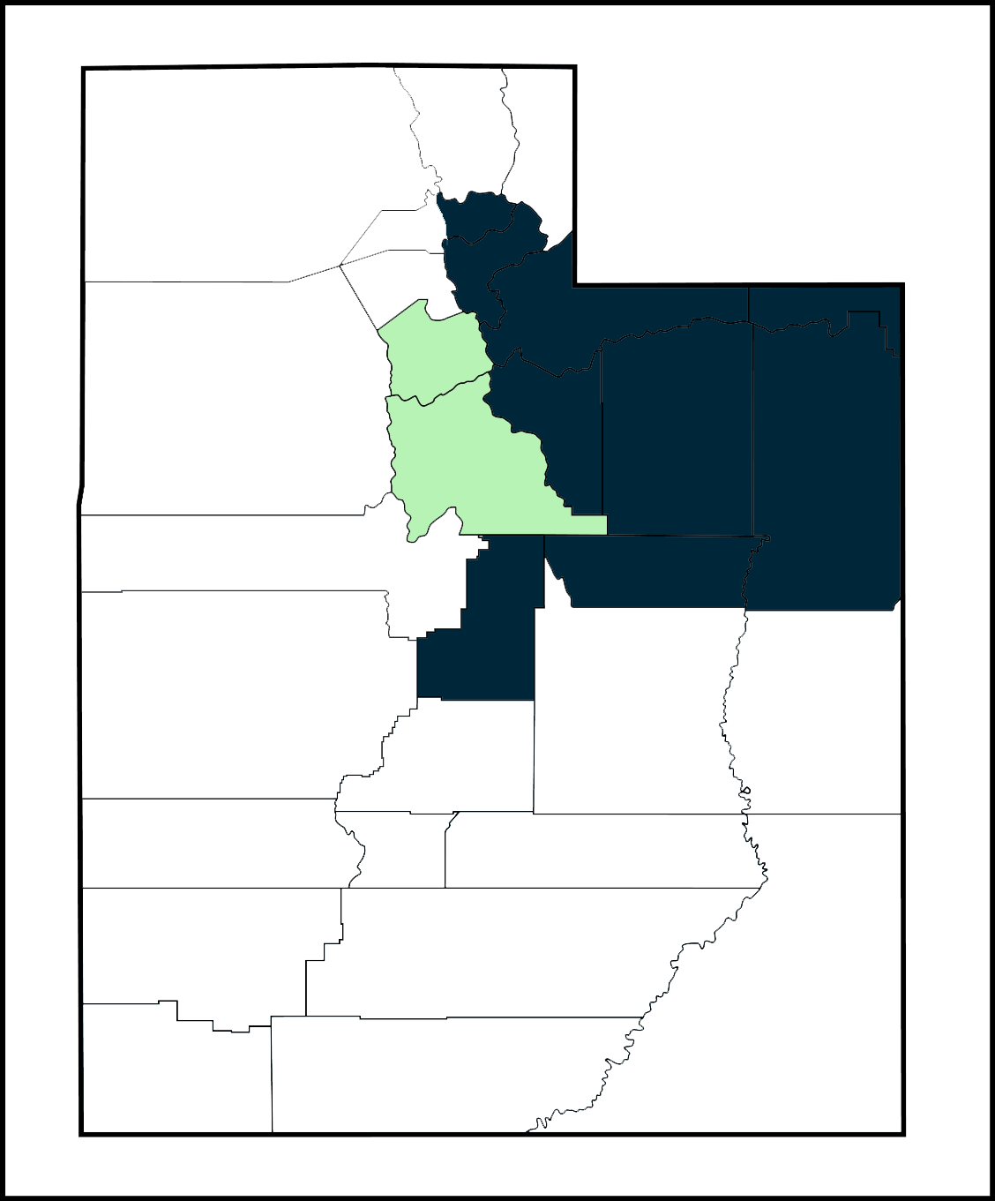
Introductions – Tyson Lloyd
Northeastern Utah Food Business Consultant
7 years experience with organic vegetable farming
Expertise in grants, market development, and social media strategies
Passionate about supporting Utah farmers

Slide 9
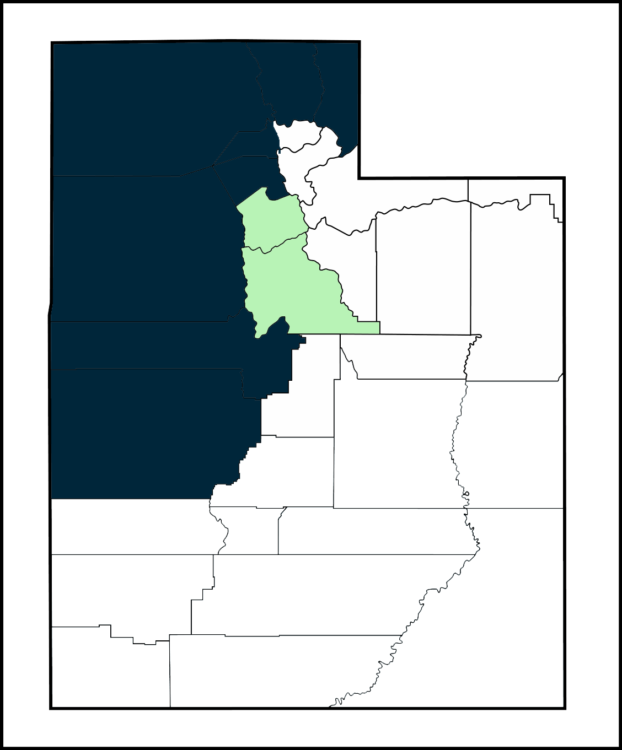
Introductions – Brance Hammons
Northwestern Utah Food Business Consultant
Lifelong involvement in agriculture
Cattle and sheep production
Background in agricultural and commercial lending
Enjoys working with ag producers to help them be financially successful

Slide 10
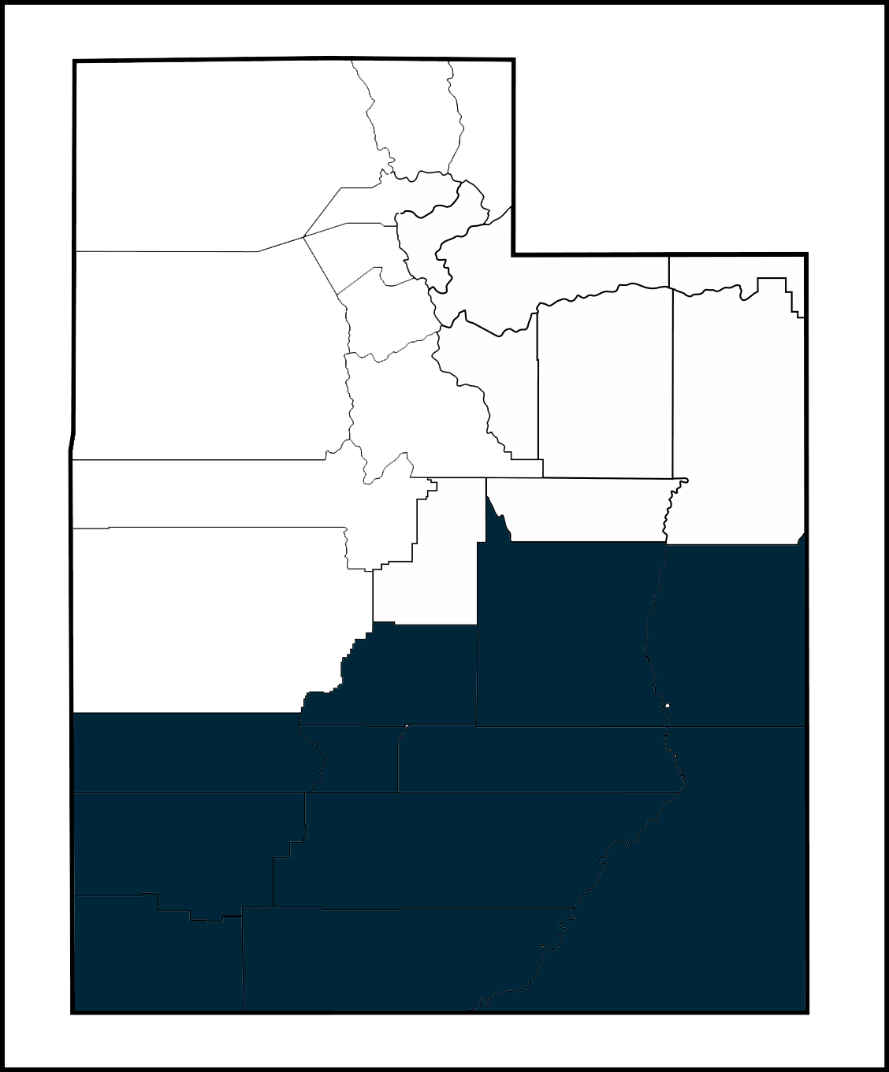
Introductions – Tim Chamberlain
Southern Utah Food Business Consultant
11 years with Utah SBDC
USU Blanding and Snow College
Certified Gallup Strengths Finder coach
MHR from USU
40 years raising farm animals in rural Utah

Slide 11


Utah Food & Farm Business Program Resources
Business Builder RFA open through Feb 26
Get your application in early in case there are problems!
FoodBiz website (extension.usu.edu/foodbiz)
Food Business Basics online Extension course
FRAME guidebooks
Resources for Micro Entrepreneurs link on Diversified Agriculture site

Slide 12


For Future Updates and Events
Sign up to be added to the Foodbiz listserv
Regional events on SWRFBC site, sign up to be added to newsletter (swfoodbiz.org)
National updates on USDA RFBC site (www.ams.usda.gov/services/local-regional/rfbcp)

Slide 13
Questions?

