Slide 1




Module 1: Business Plan

Slide 2
Module 1: Business Plan
Part 1: Pre-business planning
Part 2: Business plan - production considerations
Part 3: Business plan - marketing and finance

Slide 3
Module 1 Part 1: Pre-business planning

Slide 4
Hobby vs. Business
You WANT to run a business for FUN
Profit is not main concern
Other reasons:
Teach skills to children or community members
Produce food in a certain way
Fun
You WANT to make a PROFIT
Profit is the main concern
How can I effectively run a business to provide income?
Notes:
If you really want to run a business for fun to teach your kids. Check into your States cottage food laws and run it out of your home. You could do it for a summer through that route. If in Utah, the optional module 6 will cover the home food options in Utah and some of the home food safety issues. You could still use all of these, but the point if for a successful business.

Slide 5
Pre-Business Checklist
Family and business are intertwined.
Before you can build your financial future, make sure your personal and financial standing are stable right now.
Personal life
Finance

Slide 6
Personal Life
Do I have any life-changing events?
Do I have commitments that require large amounts of time or money?
Do I have a good credit score?
Is my personal debt manageable?
Am I healthy and physically able?
Do I have a good support system? Does my family support this business idea?

Slide 7
Finance
Do I have personal assets such as a home or savings I am willing to risk?
Can I start this business without borrowing money?
Do I have family or partners willing to finance me?
Do I have a great relationship with my banker?
In 2020, payday loan companies in Utah charged 652% APR, or $12 for a $100 every 7 days.
The highest rate charged was 1,669% APR, or $32 on a $100 loan for 7 days.
Notes:
Utah’s payday loan rates are 2nd highest in America. Only Texas is higher. (sltrib.com)

Slide 8
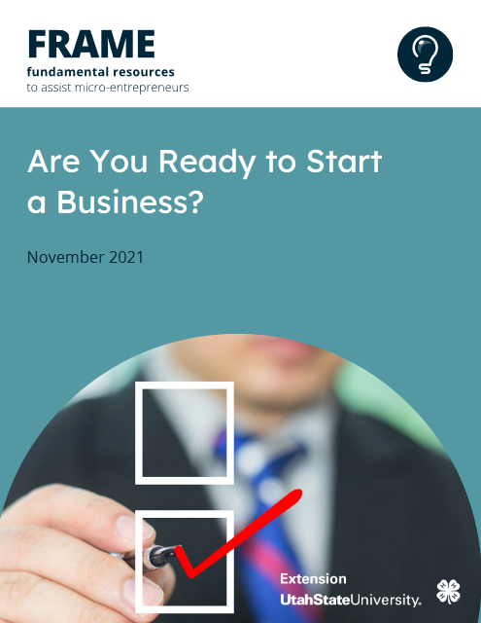
Exercise
Pre-business checklist.

Slide 9
Module 1 Part 2: Business plan – production considerations

Slide 10
What is Your Idea of Success?
What do you want your business to look like down the road?
Can you feasibly make that vision a reality?
What does the financial aspect of that vision look like?

Slide 11
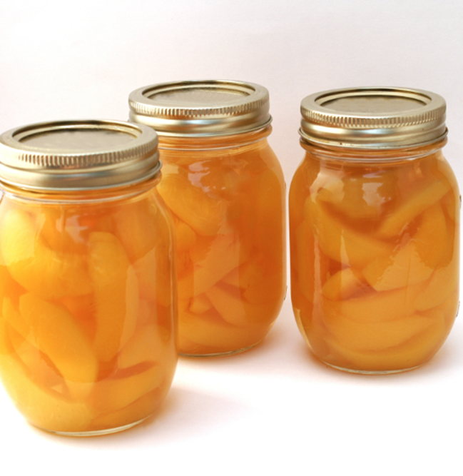
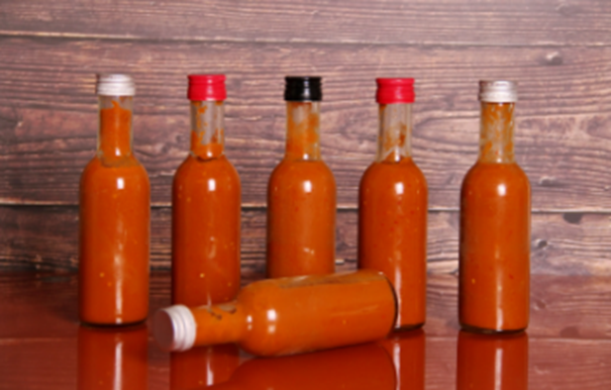
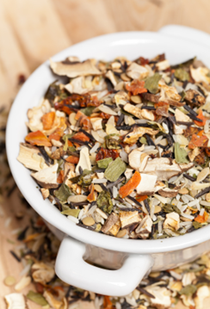
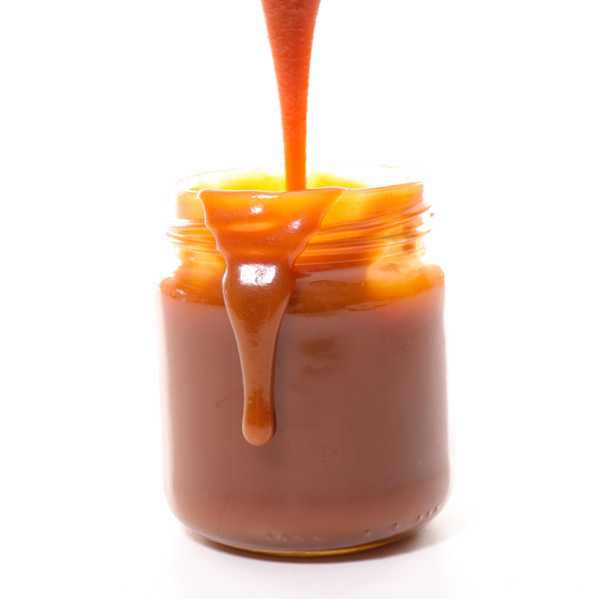
Basic Questions for Starting a Food Business
Be prepared
Plan for and picture success
What the business looks like?
Will it make money?
Notes:
Will it make money – hobby vs business
Pictures need to be redone to look like a puzzle that fits together (rather than 4 unconnected pictures). Is there a template already for this in Canva?

Slide 12
What is Your Food Business Idea?
What is your food product?
Where will you make your product?
How will you package your product?
For each question:
State specifically
Refine your idea
Notes:
We will examine these questions and others in the upcoming slides.

Slide 13
What is Your Food Product?
What is your recipe?
Convert your recipe from volume (cups) to weight (ounces or pounds)
Will your recipe work on a large scale?
Is it too time-consuming or difficult?
Are the ingredients expensive or hard to find?
There may be restrictions on the type of product and where you can sell it based upon regulations. This will be covered in Module 2.
Notes:
The labor and time will make the product more expensive. If ingredients are hard to find it will be difficult to have a consistent product.

Slide 14
What Certifications, Trainings, and Licenses are Needed?
Business license - usually a requirement, check into your local state and area.
Most states have specific requirements for food processors.
What food safety trainings are required?
This can vary depending on the type of food products you are making.
It could take 6 to 8 weeks to obtain licenses or longer. Plan ahead!

Slide 15
Where Will You Make Your Product?
What type of space is available?
Restaurant kitchen
Incubator kitchen
Food processing facility
Do you need specialized processing equipment that is not available?
Where will you store your ingredients?
Is this space provided as part of a kitchen rental?
Notes:
We’re focusing on commercial production, but Some states allow food products to be made in home kitchens – the options for Utah are covered in optional Module 6.

Slide 16
How Will You Package Your Product?
Look of the packaging- specialty shapes or lids
Specialty packaging comes with higher costs
Label for the product
Functional (will not fade or fall off)
What must be listed? (Module 4)
Durability of the packaging
Is it breakable?
Does it help extend shelf-life?

Slide 17
Where Will You Sell Your Product?
Wholesale – This includes sales through grocery store chains, to restaurants, etc.
Retail – This includes direct-to-consumer sales
Sales from your private property
Farmer’s Market/Craft Fair
Website
Notes:
For farmers market/craft fare - Pay to be there
Be there or pay someone else to be there
Own property - Convenient but may violate city ordinances for traffic/parking in neighborhood

Slide 18
How Will You Store, Transport, and/or Ship Your Product
Where will you store your product?
Is space included in a kitchen rental fee?
Transportation/Shipping
Weight costs
Cost associated with case packaging and bulk packaging

Slide 19
Module 1 Part 3: Business plan – marketing and finance

Slide 20
Do You Know Your Competition?
How many other options are there for customers to buy instead of yours?
How much do similar products sell for at grocery stores or farmer’s markets?
What are the characteristics of the competing products and how does yours stand out?
There are always competitors!

Slide 21
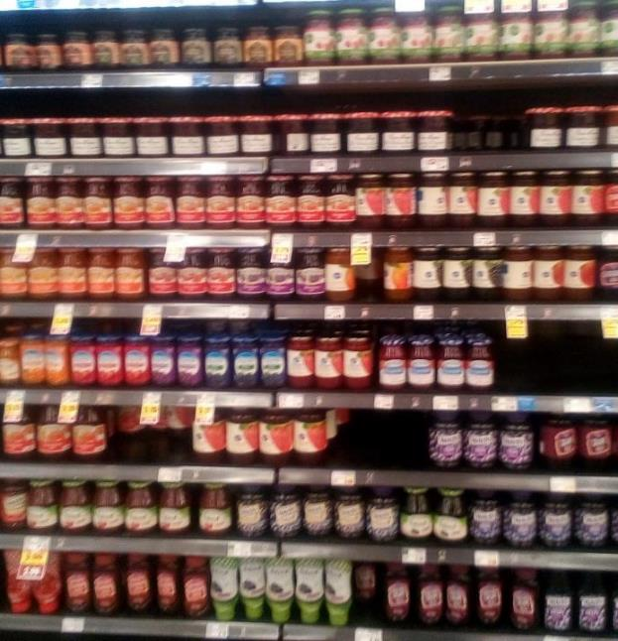
Who Are Your Customers and Why Will They Buy From You?
Who is going to buy your product?
Why from you and not someone else?
How will you customers find you?
How will you get their attention?
How is your product special?
Do you have a story to help sell your product?

Slide 22
What Will You Need to Buy to Get Started?
Think through what will be required to make your product
If you are making larger quantities, do you need bigger equipment?
Think through what will be required to sell your product
Do you have what you need to set up your sales area or for transportation?
You may need to collect sales tax. Check with the state department of commerce, city and county for specifics for your area.
Price each item you need to start up the business
Utah has a state sales tax requirements and many cities have additional sales tax requirements.

Slide 23
What Supplies Will You Need For Production and Where Can You Get Them?
Do you know a source that consistently carries your ingredients?
Is it easy to access?
How long will it take for you to get supplies each time you need them?
Are spoilage or waste likely?
Allow for this in estimating the amount needed.
Buying in bulk is not better if your ingredients have a short shelf-life.

Slide 24
What Other Expenses Might There Be?
Do you need a compatible or secondary device to use with a mobile card reader?
Liability Insurance may be required by some sales locations and vendors.
Are you giving out samples?

Slide 25
Where Will You Get Your Money to Start?
How much money will you need to get this idea to the point where you can start selling?
Do you have personal savings?
Will you borrow from friend or other source?
If you borrow, you have to pay it back.
Can your relationship handle the risk?
Are there other programs that you can access?
Small Business Administration loans
Producer/processor grants

Slide 26
Think About Your Risk?
Liability insurance shifts financial risk to the insurance company
Extra time before you can sell or slower production
Learning curve
Reserves insulates you from risk
Financial
Out of stock

Slide 27
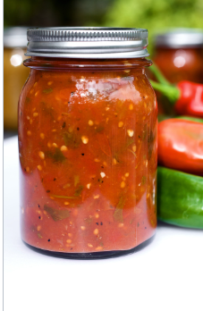
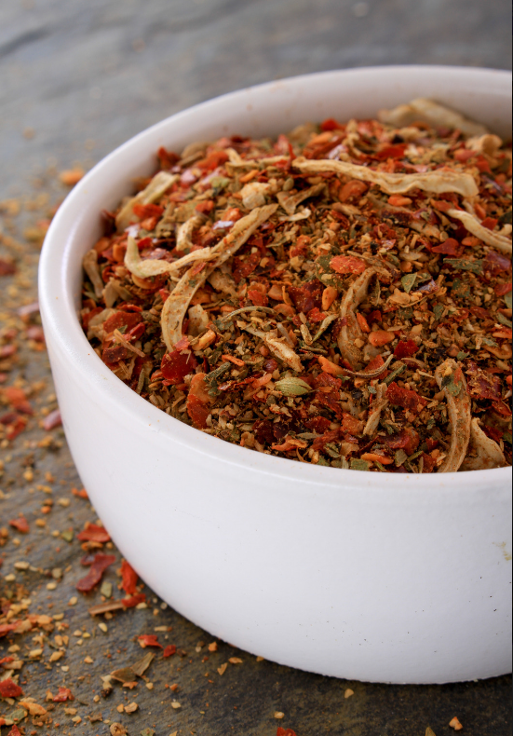
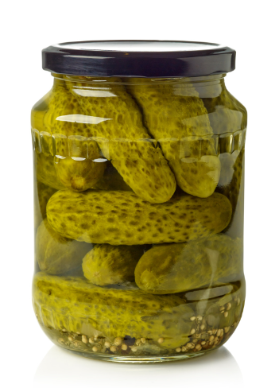
Potential Next Steps
Work on more complete answers for each question. Refine and add detail.
For each question create a list of additional information you need.
Outline the steps to get your plan done.
Revisit you plan and goals. See if they still align or if you need to revise.

