Slide 1

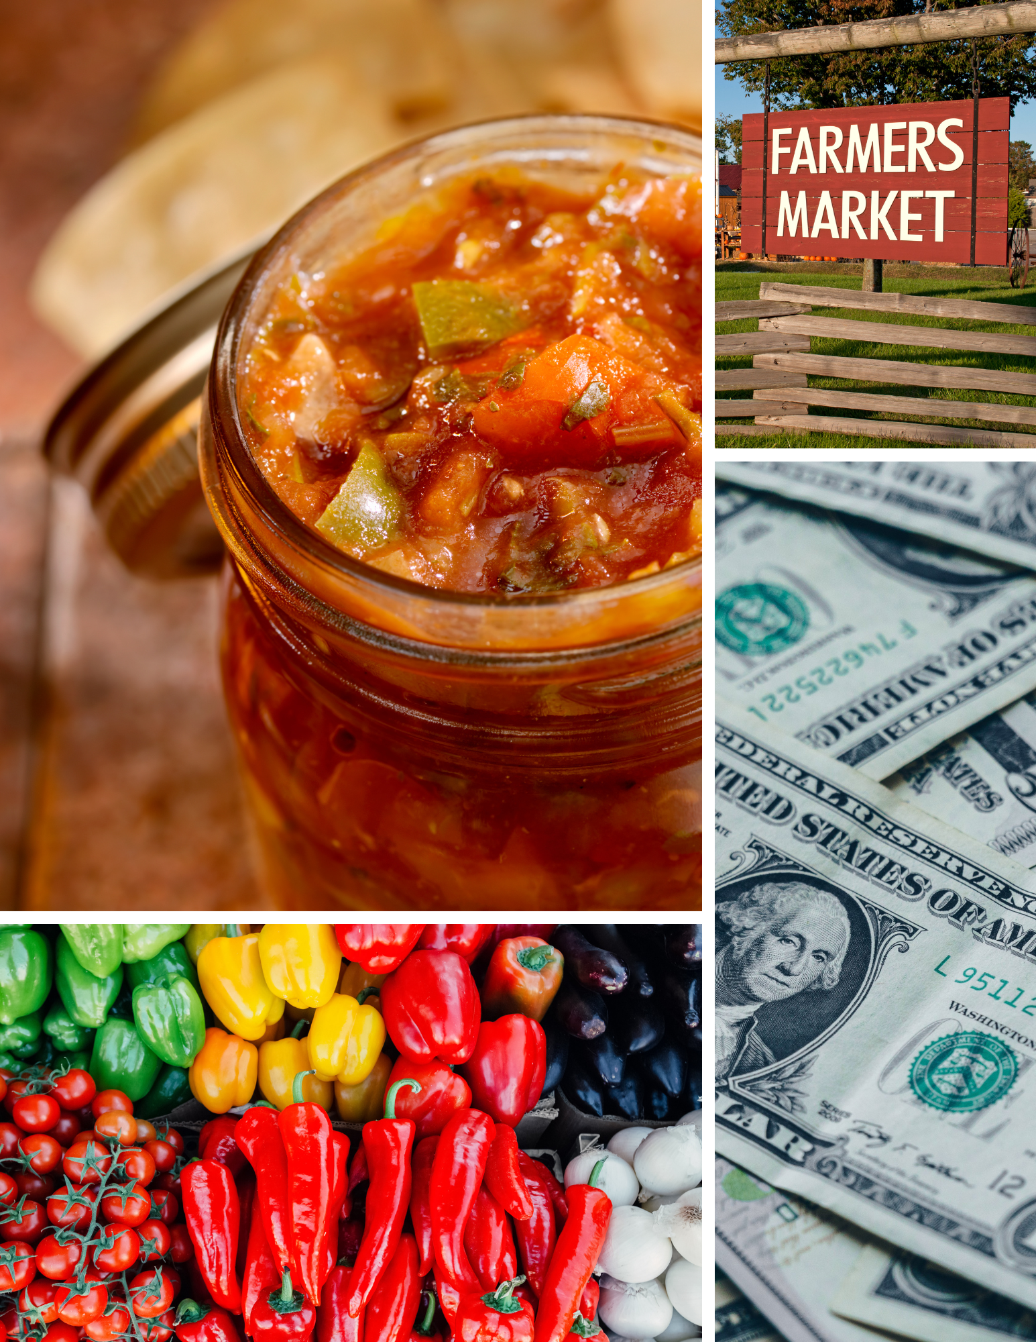


Food Business Basics

Slide 2
How to use this series
This course will provide basic information for starting a packaged/processed food business
Have something to take notes
Things to remember
Questions that you have
Information that you need to check on or find
You can start, stop and rewatch portions as needed
Not all of your questions will be answered!

Slide 3

Realities of food business
Highly regulated
Complex requirements
Multiple agencies may be involved
They are not easy businesses to run
They can be very successful

Slide 4
Food Business Basics – Course layout
Module 1 – Business Plans
Module 2 – Food Regulations
Module 3 – Profit and Budget
Module 4 – Labels
Module 5 – Bringing it all together
Some extra time spent planning and gathering information can save more time and money later.

