Slide 1
Importance of a Balanced Hoof
Karl Hoopes, DVM

Slide 2
Definition of Hoof Balance
Hoof balance should be considered a concept, as it has no universal definition
  Each hoof is an individual and should be treated as such
Goals of a Balanced Hoof
    Should not cause undue stresses to any part of the limb above it
    The foot should contact the ground and load evenly
    All the internal structures of the foot can function correctly

Slide 3
Balanced Hoof
Geometric balance – How the hoof looks, is it symmetrical when not in motion.
Dynamic balance – How the hoof functions in movement

Slide 4
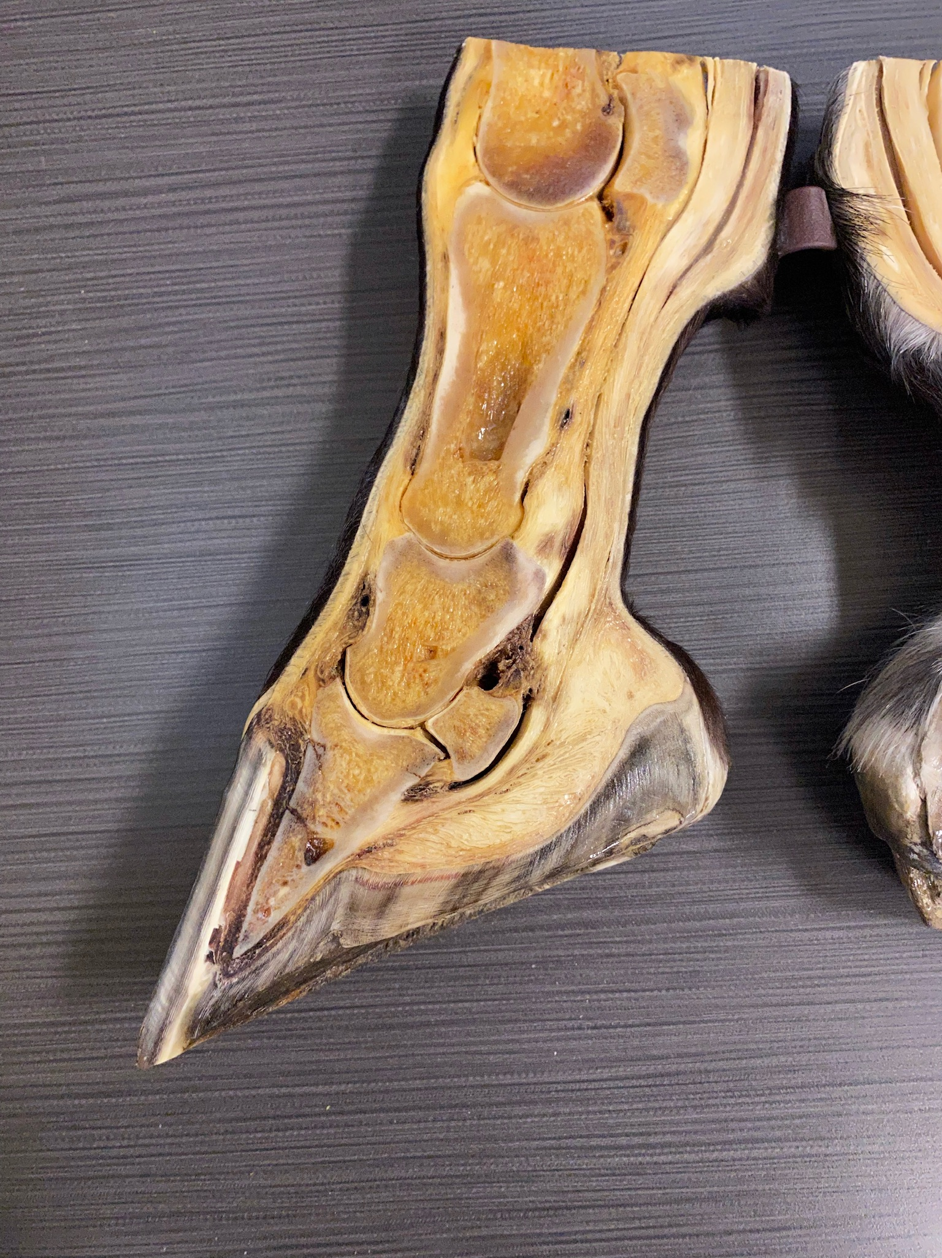
Hoof Anatomy
Cannon Bone
Long Pastern
Short Paster
Coffin Bone
Digital Cushion
Hoof Wall
Hoof Sole

Slide 5
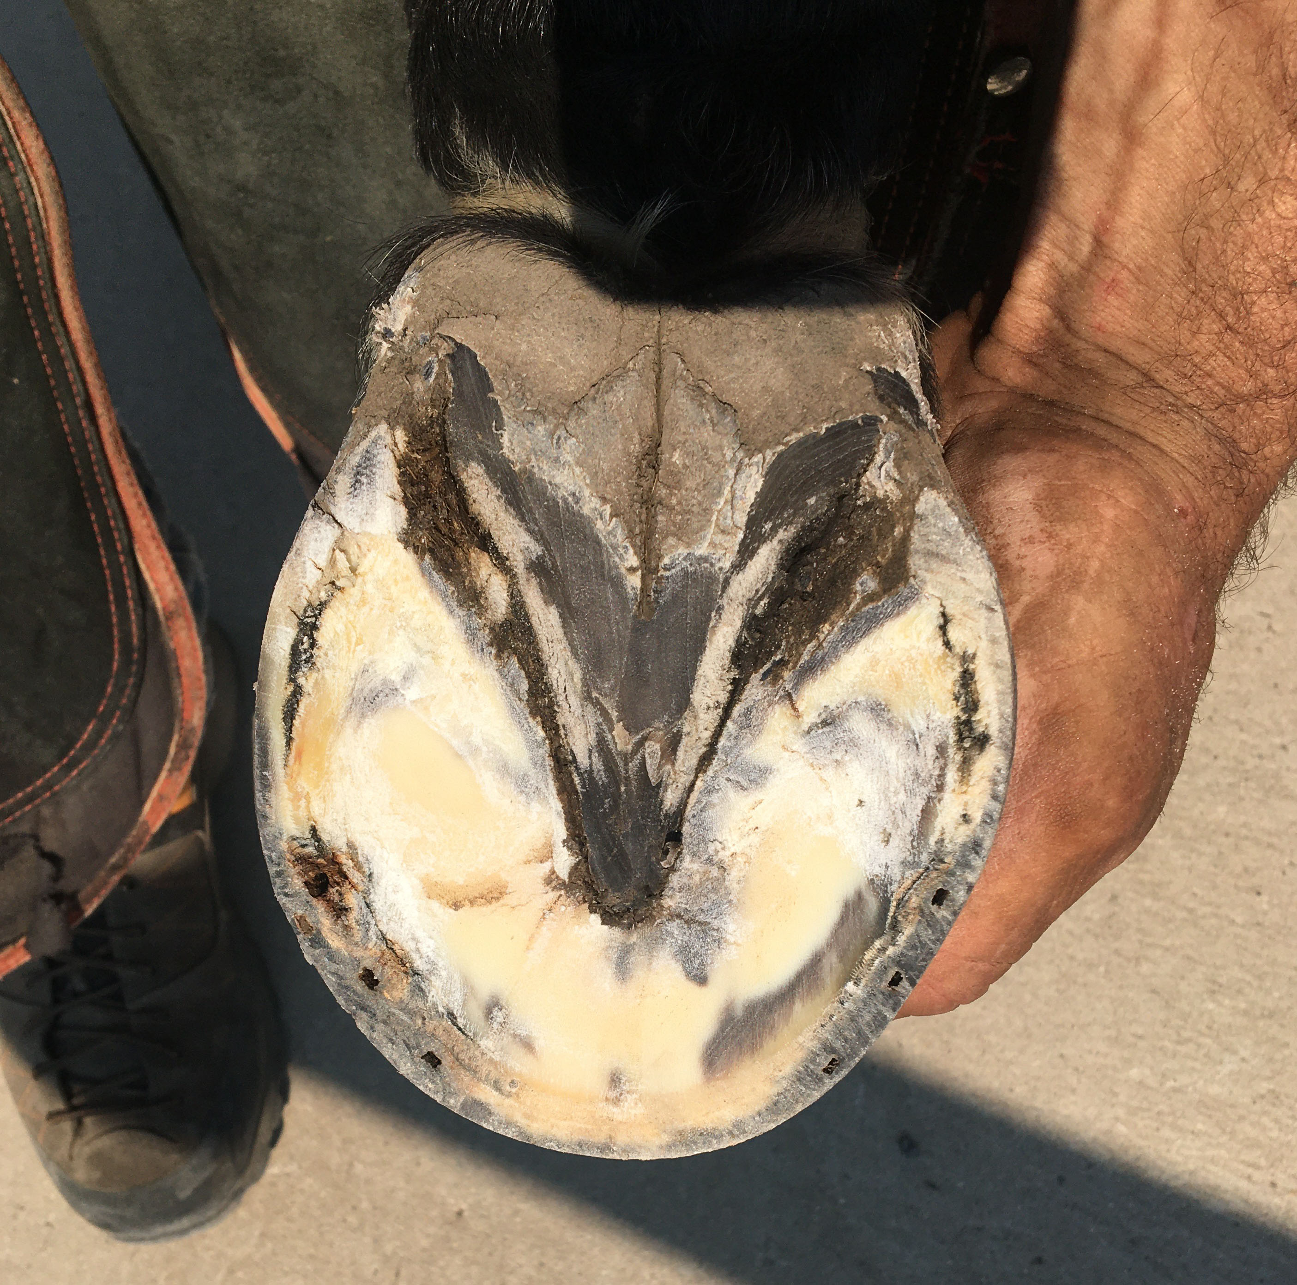
Hoof Anatomy
Heel
Frog
Sole
Toe

Slide 6
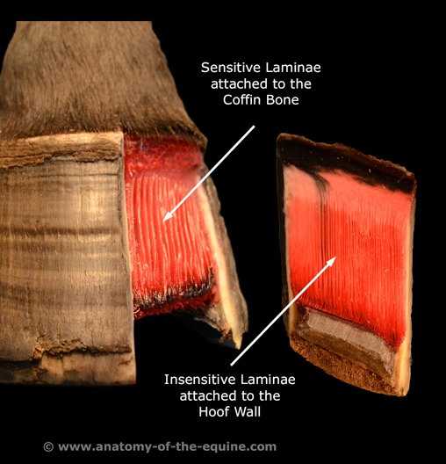
Lamina
Interdigitating epithelial tissue connecting the bone structures to the hoof wall and sole

Slide 7
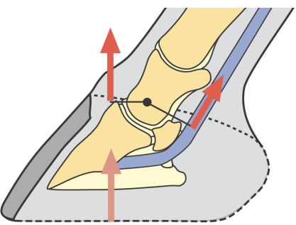
Biomechanics of Horse Hoof
Dr. Steven O’Grady
Force of weight bearing
Center of Rotation
Extension Force
Flexion Force
Ground pushing up

Slide 8
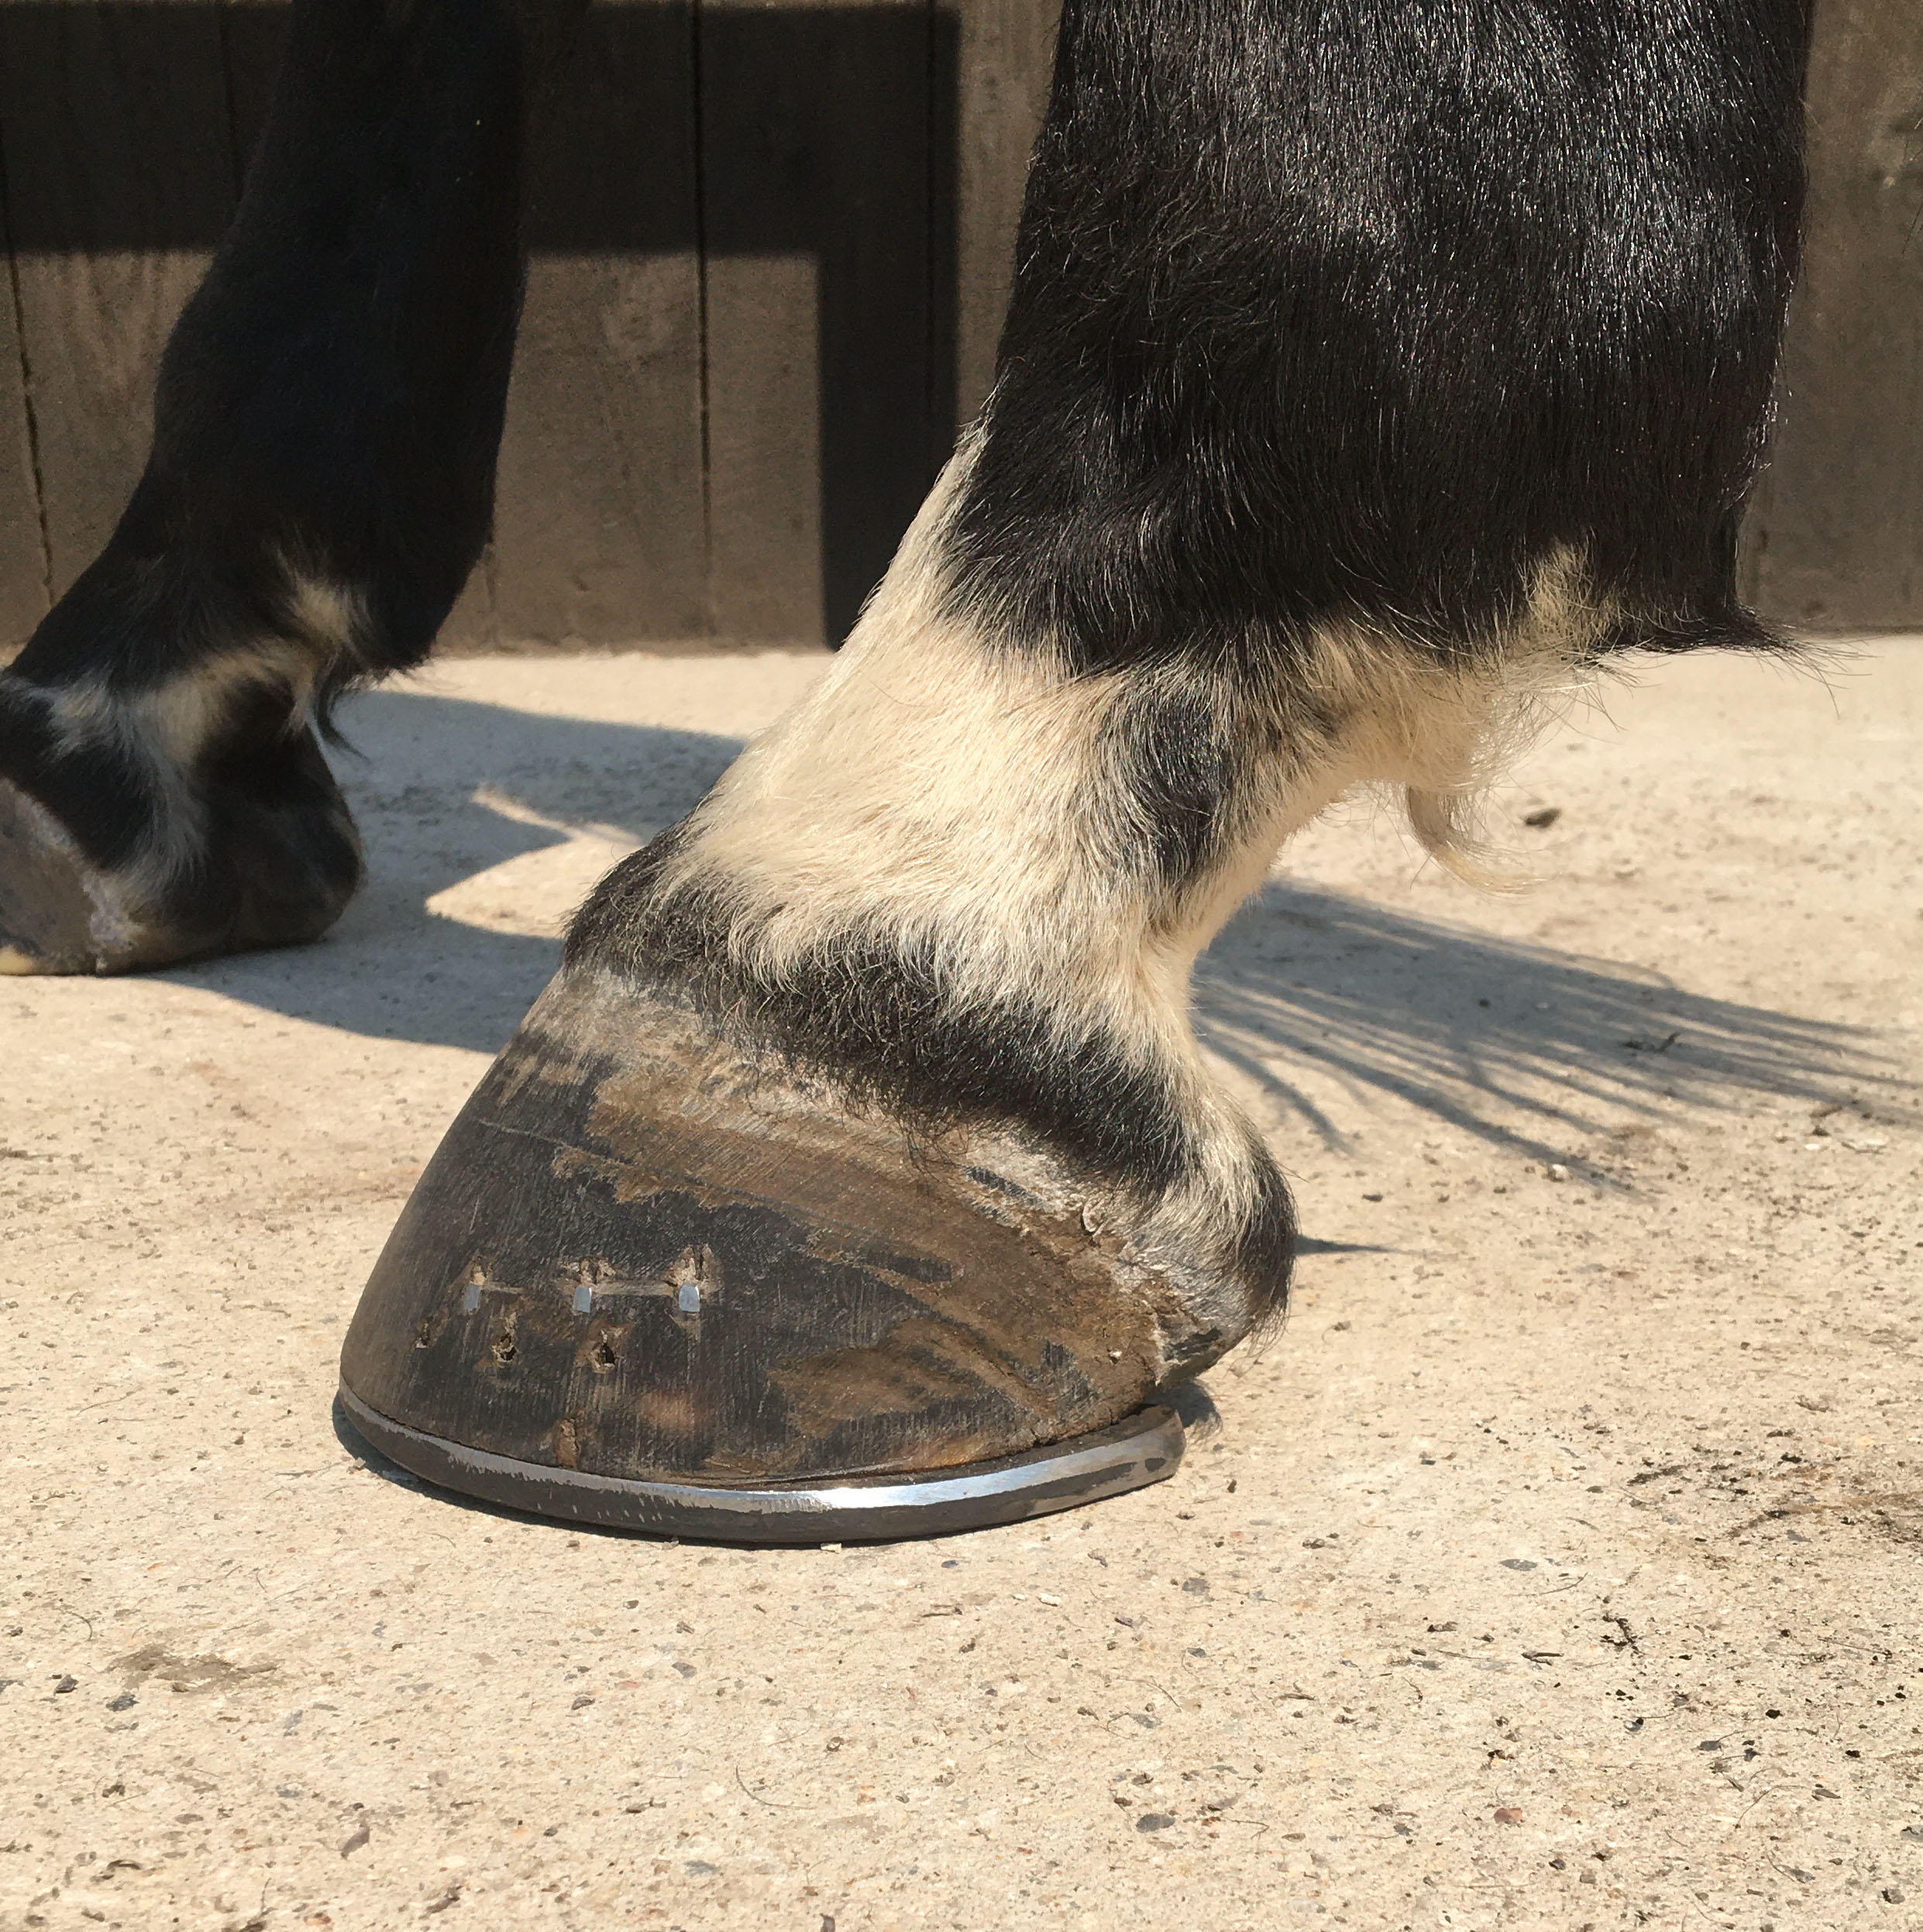
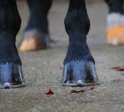
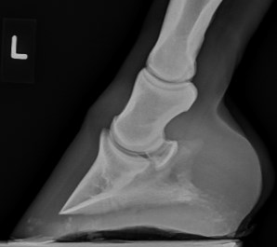
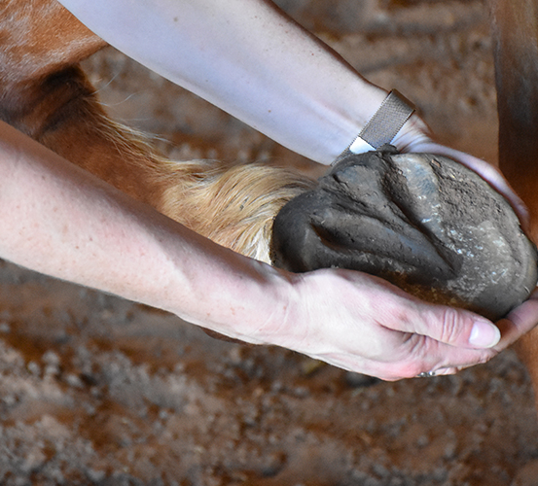
Hoof Balance
How can we determine that a foot is balanced?
    Looking at the outside of the foot
      Must evaluate front view, side view, bottom, and in motion.
    Looking on the inside - x-ray
      Not always available
      Necessary to know for sure what is going on inside

Slide 9
Things to consider for a Balanced Hoof*
Center of Rotation
Hoof Pastern Axis
Hoof Wall Distortion
Breakover
*no particular order of importance
Sole Depth
Palmar Angle
Heel Support
Mediolateral Symmetry

Slide 10
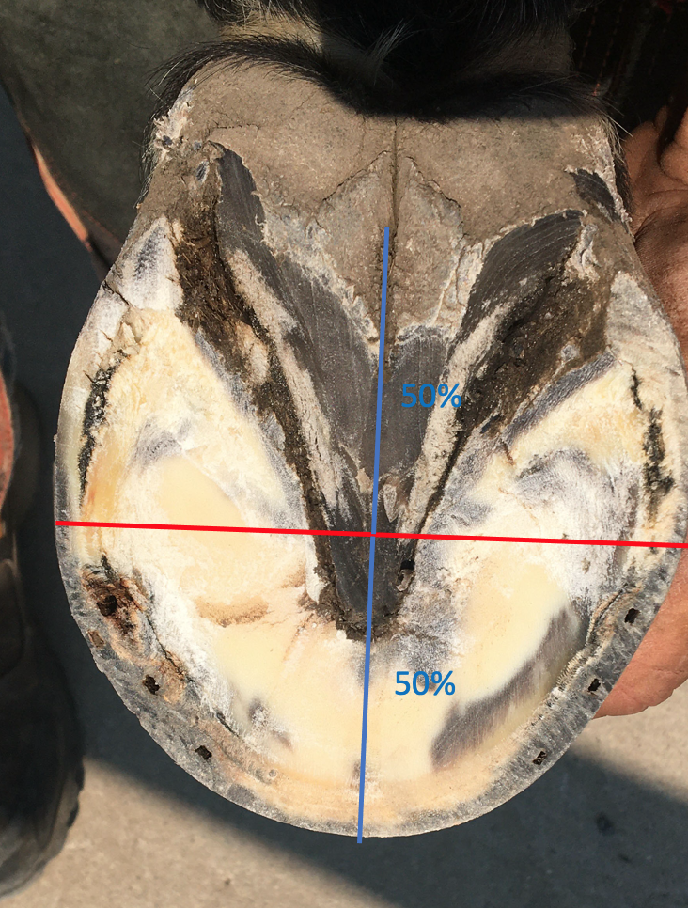
Center of Rotation
Correlates to the widest part of the foot
50% rule
  The distance between breakover (the forwardmost point of the shoe's ground contact) and the Bridge should equal the distance from the Bridge to the heel end of shoe

Slide 11
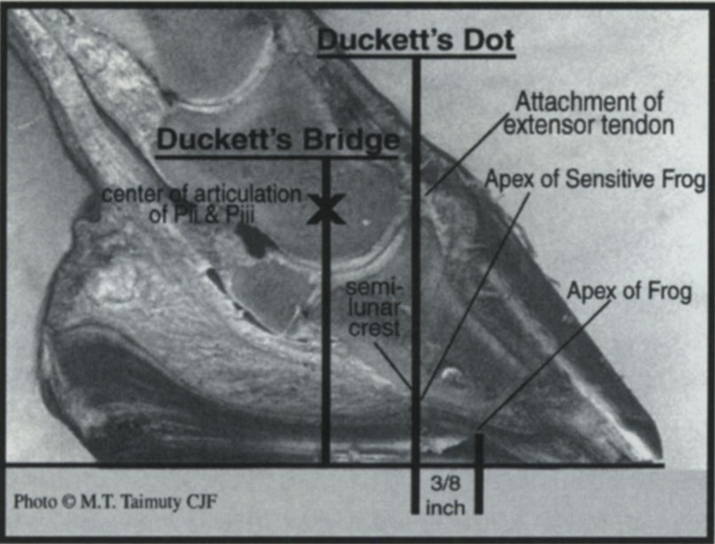
Duckett’s Dot and Duckett’s Bridge

Slide 12
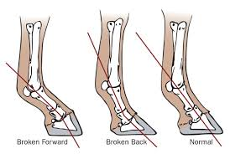
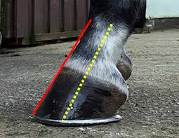
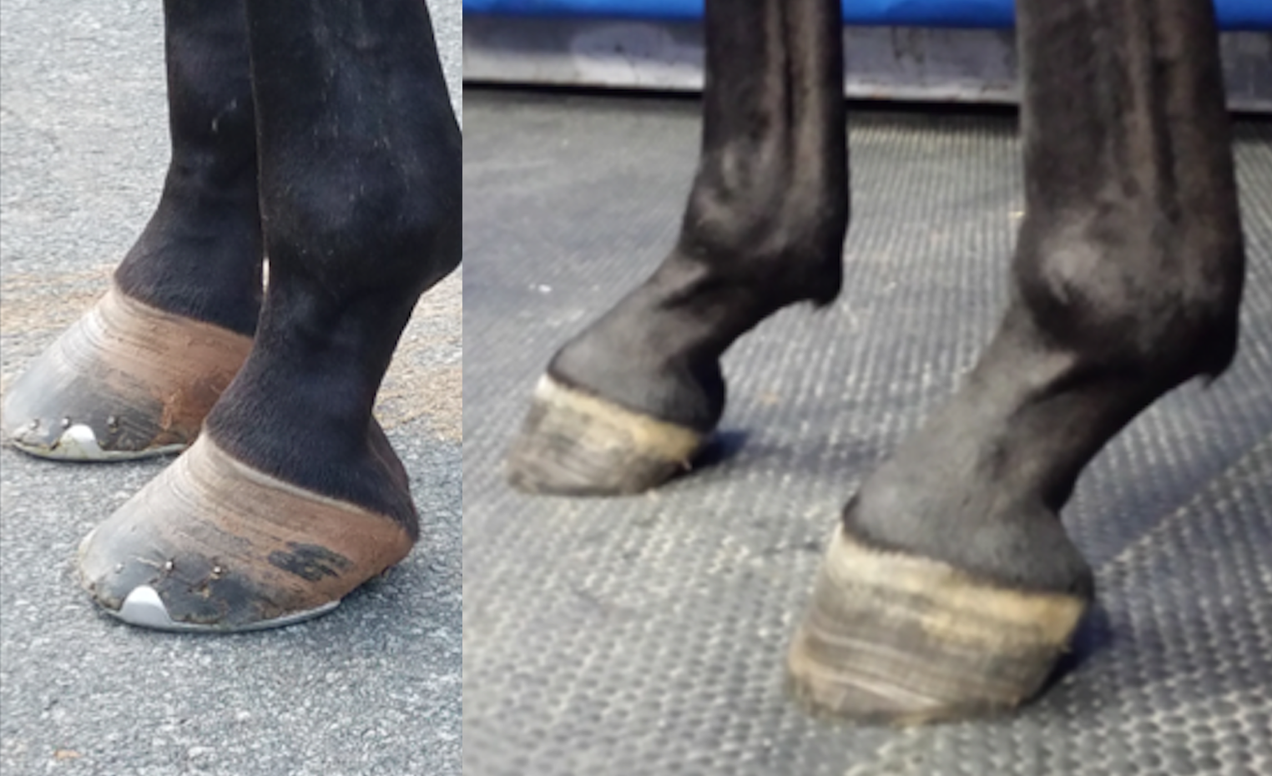
Hoof Pastern Axis

Slide 13
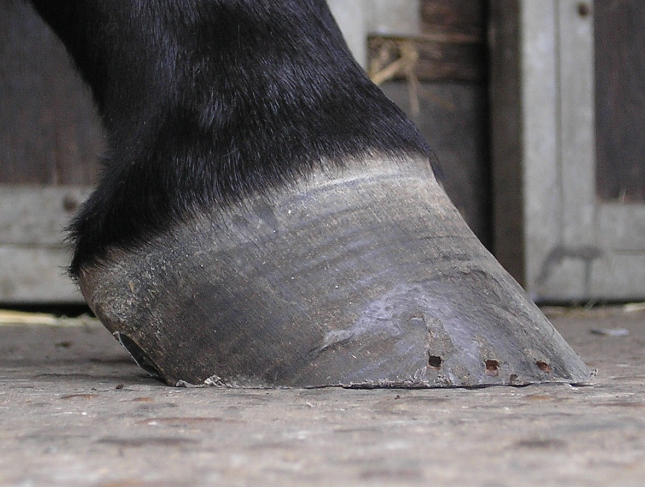
Good Foot Angles

Slide 14
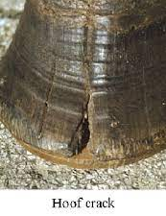
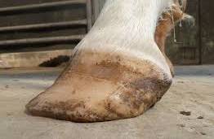
Hoof Wall Distortion
(separation of lamina)

Slide 15
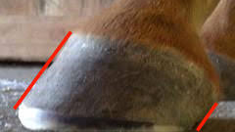
Heel Support
The heels of the hoof capsule extending to the base of the frog
Heel Angle – parallel to dorsal hoof wall

Slide 16
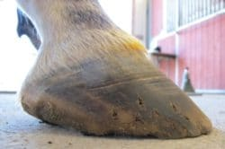

Slide 17
Mediolateral Symmetry
Mediolateral balance refers to dividing the hoof into medial and lateral halves and comparing the symmetry or shape

Slide 18
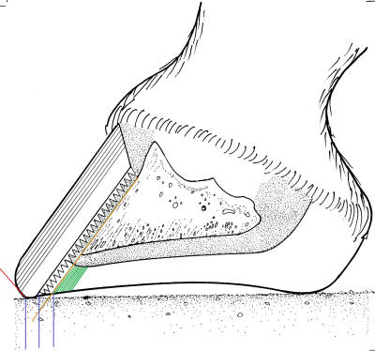
Breakover
The “breakover” is where the last part of the hoof leaves the ground.
    Optimal breakover is determined by drawing a straight line down P3 to the ground surface

Slide 19
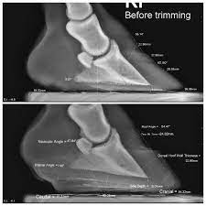
Sole Depth
Sole depth: measured from the tip of the coffin bone to the bearing surface of the foot (the ground). Ideal sole depth is 15 mm give or take a couple mm.
    Too little sole depth, the foot is vulnerable to bruising.
    Too much sole depth and the foot is likely too long causing tripping, lameness and other problems.

Slide 20
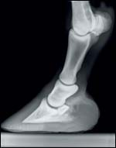
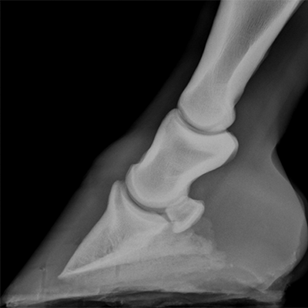
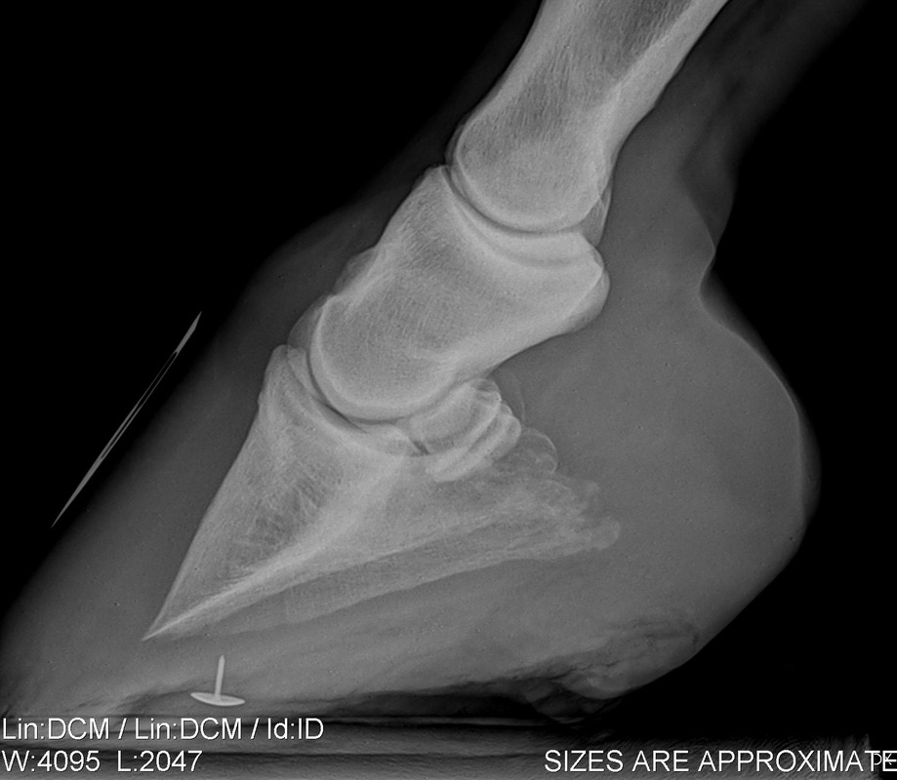
Palmar Angle
Angle of the coffin bone in relation to the weight bearing surface
3-5 degrees

Slide 21
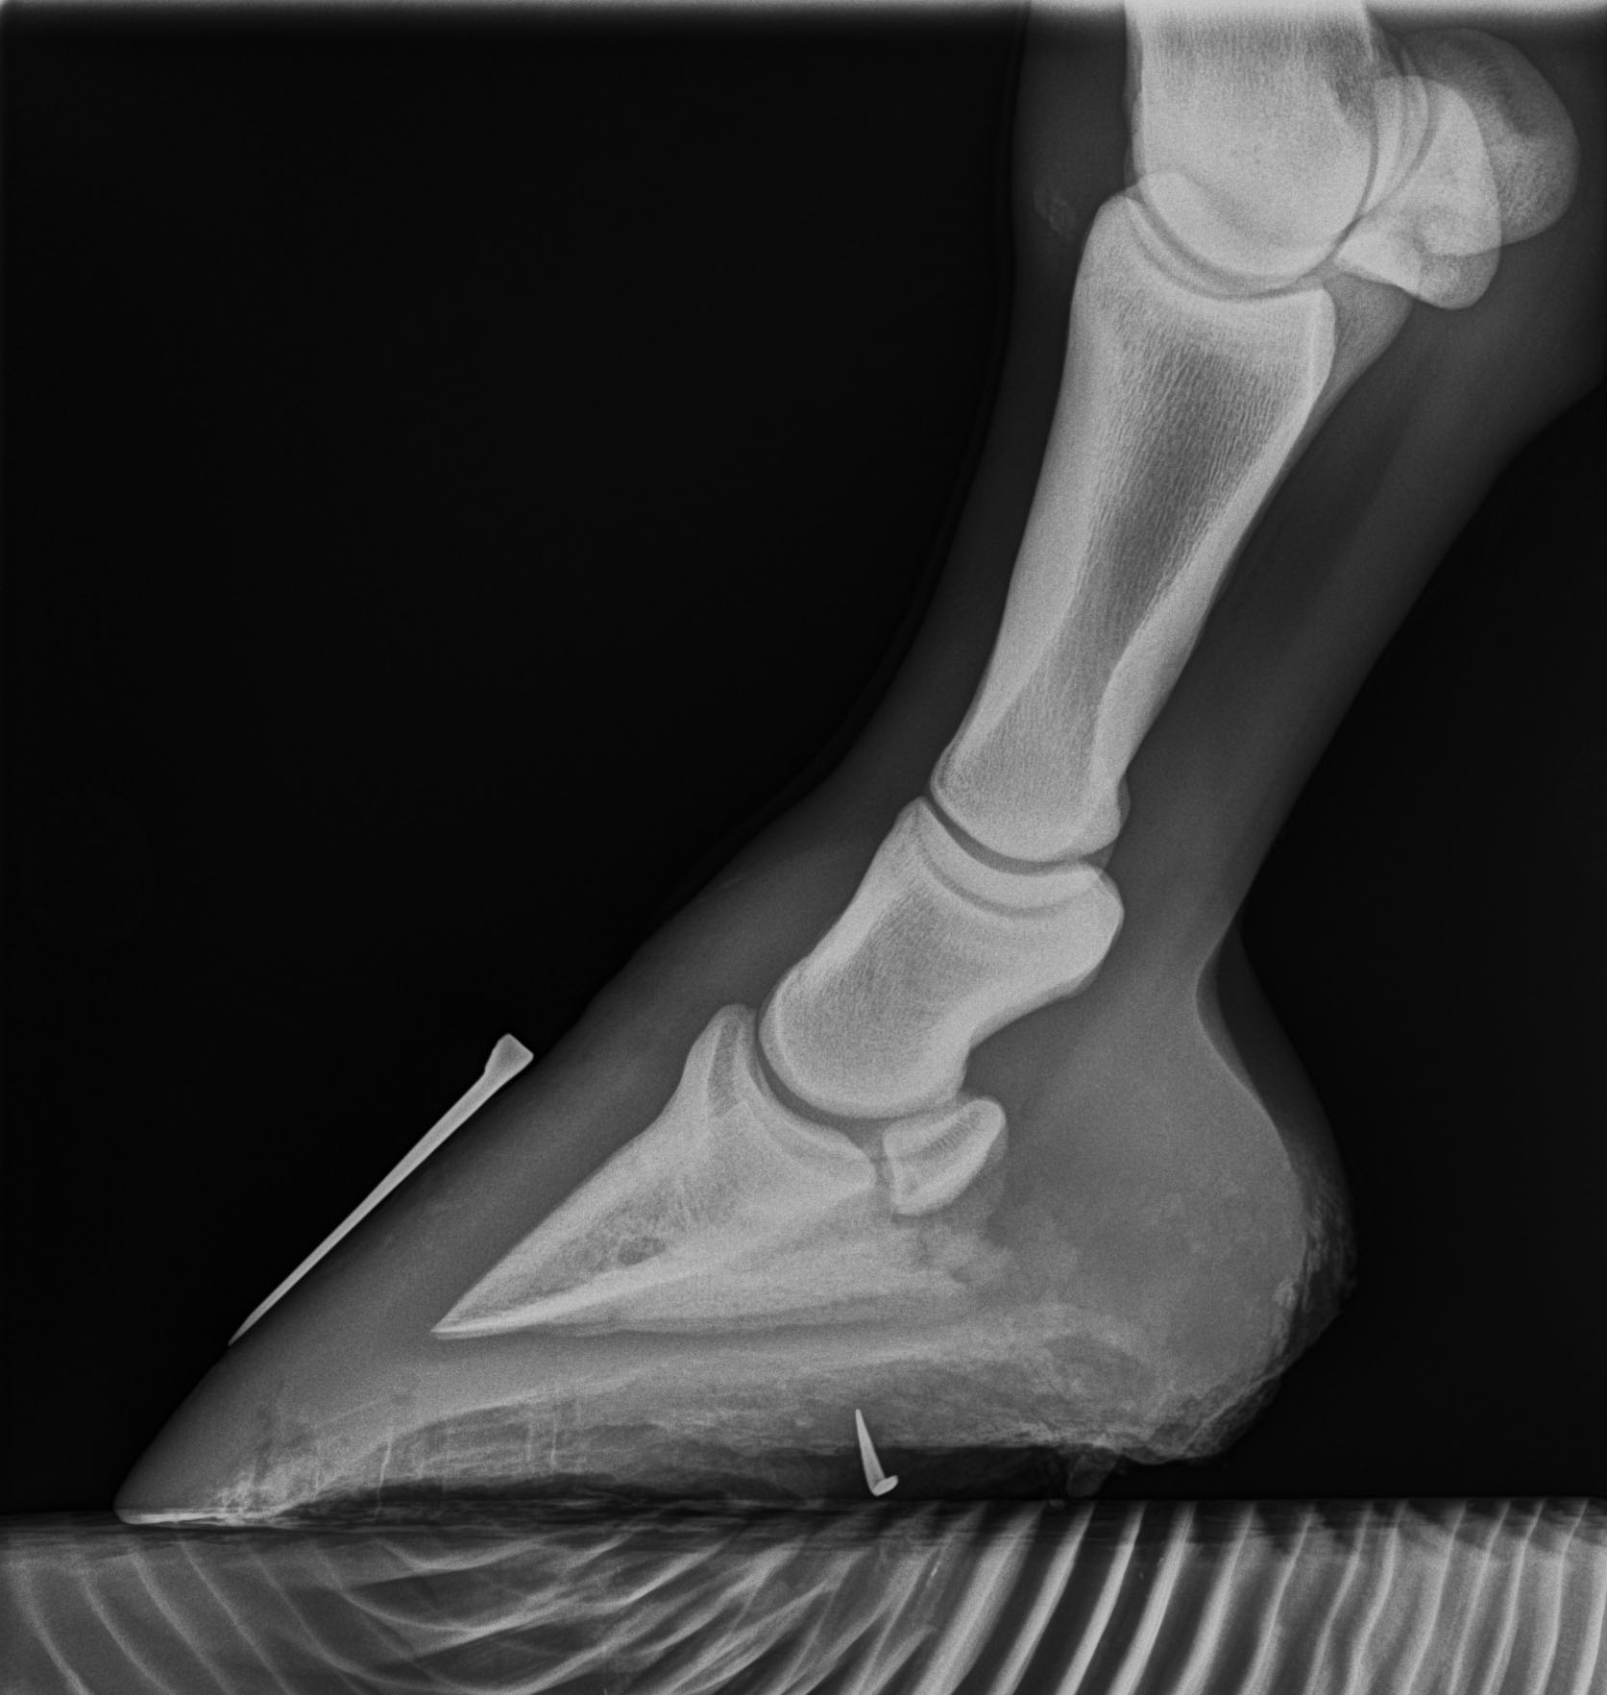
Value of x-ray

Slide 22
Value of x-ray
Hoof Pastern Axis
Broken Back
Sole Depth
Break Over Point
Hoof Wall Distortion
Center of Rotation
Palmar Angle
Problems
Hoof Pastern Axis
Break Over Point
Anterior Posterior
Balance
66%
33%

