Slide 1


Budgets for Successful Small-Scale Operations
Dr. Ruby Ward, Amanda Nelson
Sheriden Hansen

Slide 2
Why Budgets?
Key to understanding your business from financial point of view
Helps with physical and financial planning
Provide data needed for financial analysis

Slide 3
What is a budget?
Estimates the expenses and receipts for a set period of time under a set of production practices.
A section of yield, price, and income
A section containing variable costs
A section of fixed/overhead costs
An estimate of profit or net income per square foot or some other variable.

Slide 4
What is a budget?
Estimates the expenses and receipts for a set period of time under a set of production practices.
A section of yield, price, and income
A section containing variable costs
A section of fixed/overhead costs
An estimate of profit or net income per square foot or some other variable.

Slide 5
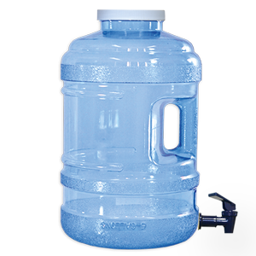
Budget is an estimate of costs and returns for a period of time
Money flows in
Water Level
Money flows out

Slide 6
Budget is an estimate of costs and returns for a period of time
Yields/marketed yields and prices
Money flows in
Profit/net income
“Bottom Line”
Water Level
Variable costs (supplies, labor, etc.)
Fixed/overhead costs
Money flows out

Slide 7
Budget is an estimate of costs and returns for a period of time
Yields/marketed yields and prices
Money flows in
Profit/net income
“Bottom Line”
Water Level
Service debt (principal payments)
Reinvest in business (working capital, down payment, etc.)
Money taken out of business for family
Variable costs (supplies, labor, etc.)
Fixed/overhead costs
Money flows out

Slide 8
How?
Want to know something (Will it make money? Which crops should I plant, will it work?)
Compare actual results to estimates
Gather information
Organize budget and make assumptions
Grow and operate farm keeping track of sales and costs
Make Decisions
Perform financial analysis

Slide 9
Urban Farm Demonstration Garden
At Utah State University Botanical Gardens
Sheriden Hansen, Assistant Professor, Horticulture, USU Extension, Davis County

