Slide 1
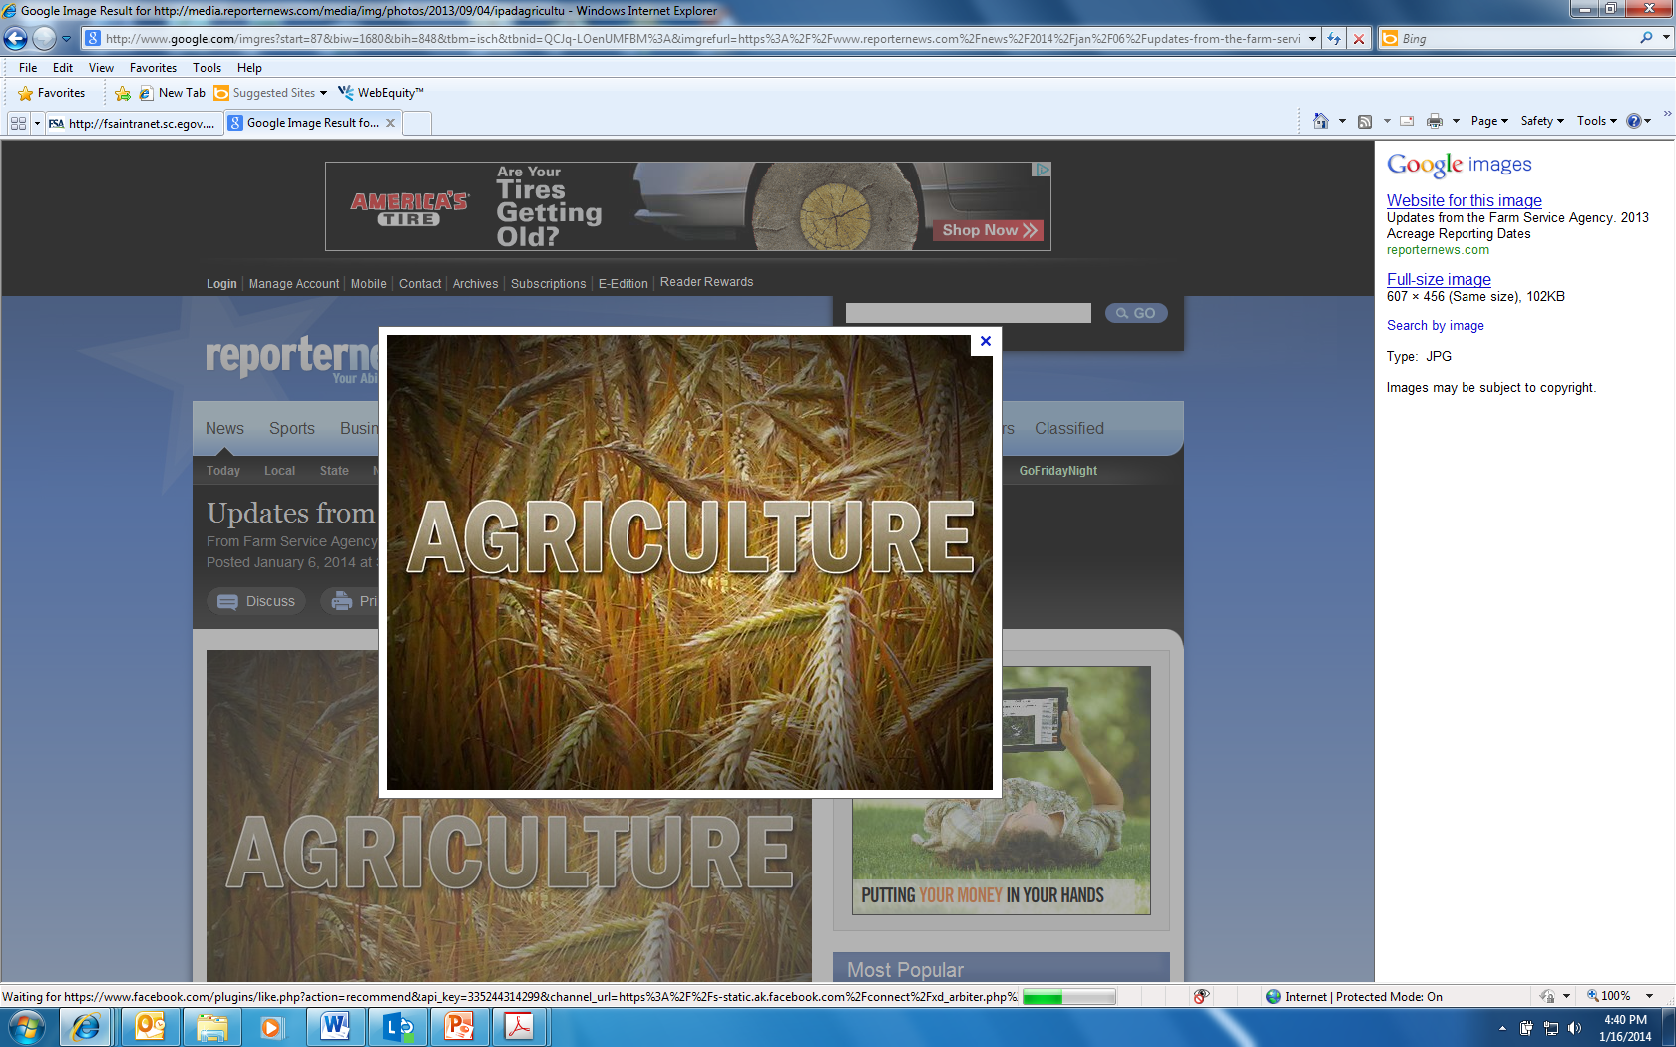
FARM SERVICE AGENCY

Slide 2
Who is FSA
The Farm Service Agency (FSA), is an agency within the United States Department of Agriculture (USDA).
FSA’s Farm Loan Programs (FLP) provide temporary credit to agricultural producers who are unable to obtain private, commercial credit. FSA places special emphasis on providing loans to beginning, minority and women farmers and ranchers.
Goal of FSA’s loan programs is to graduate the borrowers to commercial credit.

Slide 3
Intro to FSA Loan Programs
If you are a farmer or rancher who is unable to obtain credit from another lender to start, purchase, sustain, or expand your family farm you may be able to get a loan through FSA’s Farm Loan Programs.
FSA has different types of loans depending on your current situation and what you need the loan for.

Slide 4
Guaranteed Loans
Commercial lender
EZ Guarantee
Farm Ownership
Operating

Slide 5
TYPE OF LOAN | MAXIMUM LOAN AMT | RATES AND TERMS
EZ Guarantee | $100,000 | Same as guaranteed farm ownership and guaranteed operating.
Farm Ownership | $2,037,000 – adjusted annually for inflation. | Term: Up to 40 years Rate: Determined by lender.
Farm Operating | $2,037,000 – adjusted annually for inflation. | Term: 1-7 years Rate: Determined by lender.

Slide 6
Direct Loans
FSA is the lender
Farm Ownership
Operating
Microloans (Farm Ownership and Operating)
Emergency

Slide 7
Type of Loan | Maximum Loan Amount | Rates and Terms
Farm Ownership | $600,000 | Term: Up to 40 years Interest Rate: Fixed**
Farm Ownership Participation | $600,000 | Term: Up to 40 years Interest Rate: Fixed** At least 50% of loan amount provided by another lender
Direct Down Payment | The lesser of the following: 45% of the farm or ranch purchase price 45% of the appraised value | Term: Up to 20 years Interest Rate: Fixed** Down payment of at least 5% Must be a beginning farmer.
Farm Ownership Microloan | $50,000 | Term: Up to 25 years Interest Rate: Fixed**

Slide 8
Type of Loan | Maximum Loan Amount | Rates and Terms
Direct Operating | $400,000 | Term: 1 to 7 years Interest Rate: Fixed**
Direct Operating Microloan | $50,000 | Term: 1 to 7 years Interest Rate: Fixed**
Emergency | The lowest of the following: 100% of actual or physical losses $500,000 | Term: 1 to 7 years (possibly up to 20 years) for non-real estate purposes Up to 40 years for physical losses on real estate Interest Rate: Fixed**
Youth | $5,000 | Term: 1 to 7 years Interest Rate: Fixed**

Slide 9
Eligibility
Eligibility requirements different for each type of loan
BASICS
Credit history
Credit elsewhere
Managerial experience
Owner operator
Family sized operation

Slide 10
Microloans
The Microloan (ML) program was developed to better serve the unique financial operating needs of beginning, niche and the smallest of family farm operation
The application process for microloans is simpler, requiring less paperwork, to coincide with the smaller loan amount. Requirements for managerial experience have been modified to accommodate smaller farm operations, beginning farmers and those with no farm management experience.

Slide 11
Beginning Farmer
Has not operated a farm for more than 10 years.
Meets the loan eligibility requirements of the program to which he/she is applying.
Substantially participates in the operation of the farm.
Applicants for FO purposes must be participated in the business operations of a farm for at least 3 out of the last 10 years.
For FO purposes, does not own a farm greater than 30 percent of the average size farm in the county, at the time of operation.

Slide 12
Essential Calculators for the Web Standard Loan Calculator Results Operating Loan
Loan Amount: | $400,000.00
Interest Rate: | 4.75%
Number of Years: | 7
Number of Periods Per Year: | 1
Payment Amount: | $68,502.94
Total Interest Paid: | $79,520.57

Slide 13
Essential Calculators for the Web Standard Loan Calculator Results Farm Ownership
Loan Amount: | $400,000.00
Interest Rate: | 4.75%
Number of Years: | 40
Number of Periods Per Year: | 1
Payment Amount: | $22,518.70
Total Interest Paid: | $500,747.93

Slide 14
Things to think about?
Must be producing an agricultural commodity
What are you going to produce?
Where are you going to market the products?
How are you going to repay the loan?
What are your goals for the operation?

Slide 15
FSA Farm Programs
Agriculture Risk Coverage (ARC) and Price Loss Coverage (PLC)
Conservation Reserve Program
Dairy Margin Coverage Program (DMC)
Emergency Assistance for Livestock, Honey Bees as Farm Raised Fish. (ELAP)
Livestock Forage Disaster Program(LFP)
Livestock Indemnity Program (LIP)
Noninsured Crop Disaster Assistance Crop Program (NAP)

Slide 16
Contact Information
Jamie Rex-Farm Loan Manager
jamie.rex@usda.gov
435-336- 5573 Ext. 101
Tyra Jackman, Program Technician
tyra.jackman@usda.gov
(801) 377-5296

