Slide 1
Small Scale Livestock Budgets
Jake Hadfield – USU Extension Juab & Utah Counties

Slide 2
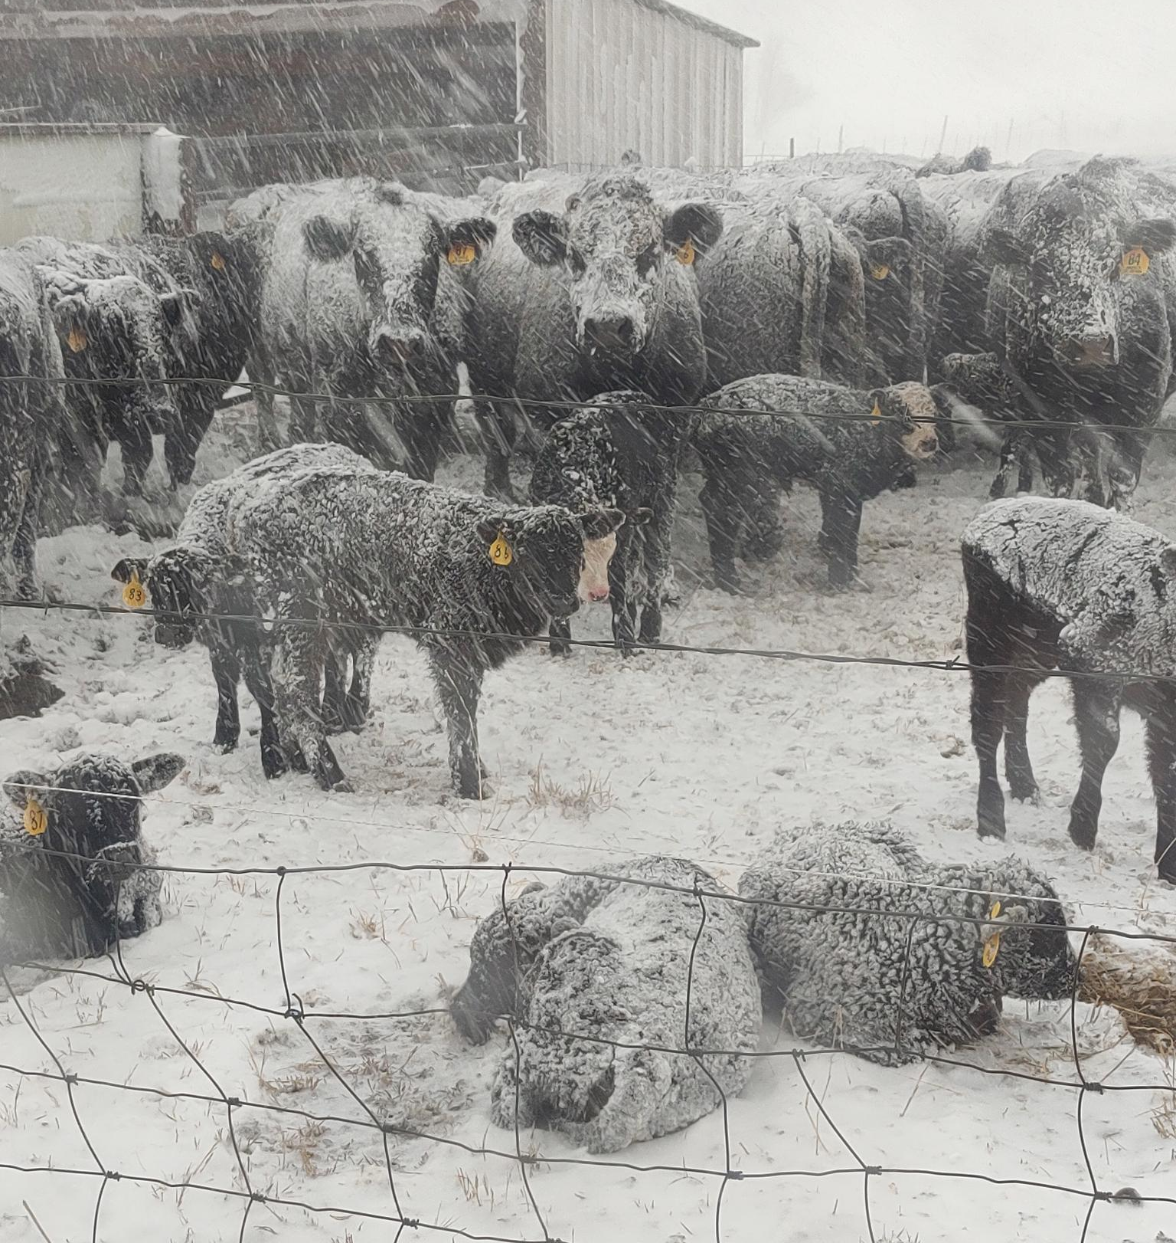
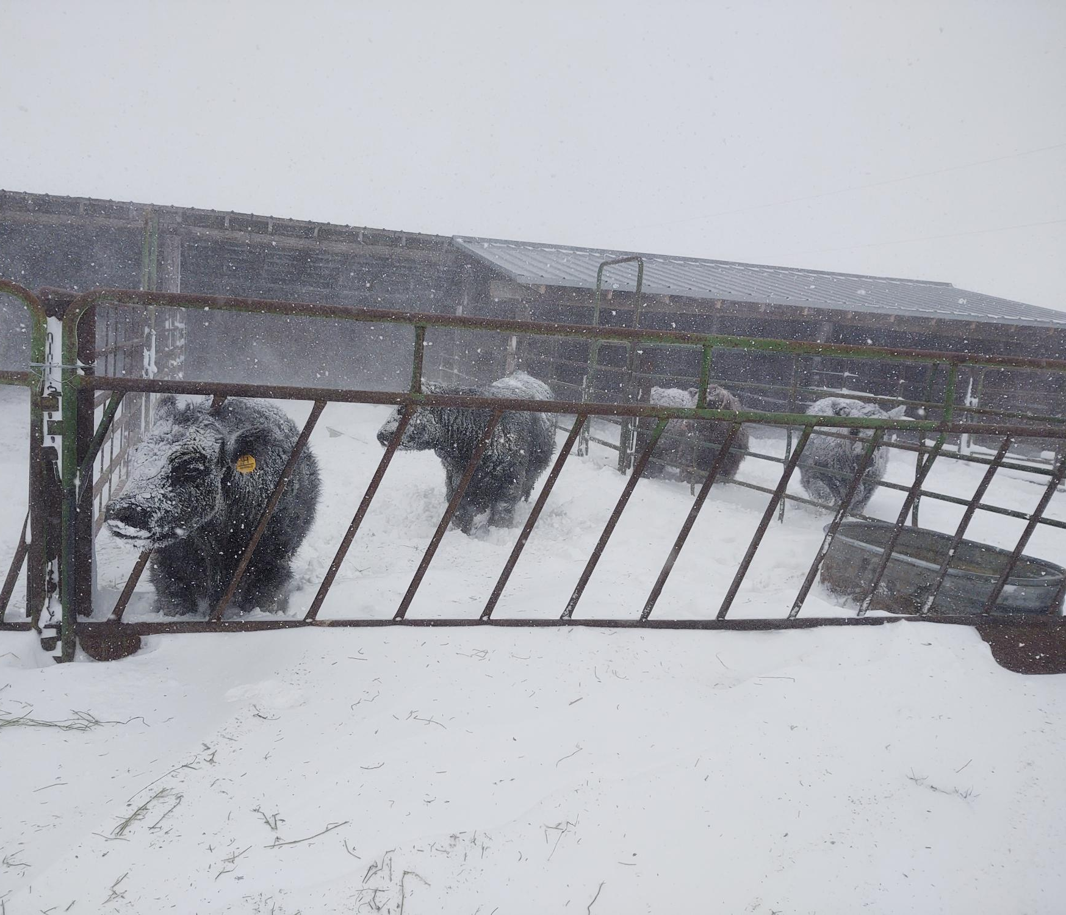

Slide 3


Budgets
Photo by Andrea Piacquadio: https://www.pexels.com/photo/woman-in-white-shirt-showing-frustration-3807738/
Photo by Pixabay: https://www.pexels.com/photo/rolled-20-u-s-dollar-bill-164527/
Helpful or Stressful?

Slide 4

Best Marketing Tool
Cost of Production
$ per pound
$ per dozen eggs
$ per ……….

Slide 5

What is Profit?
$$Profit=Gross Revenue −Total Costs$$

Slide 6

What is Profit?
$$Profit=Gross Revenue −Total Costs$$
$$Gross Revenue=Price per Unit x Total Units$$

Slide 7
What is Profit?
$$Profit=Gross Revenue −Total Costs$$
$$Total Costs=Variable Costs+Fixed Costs$$

Slide 8

Variable Costs
Expenses that vary without output within a production period and result from the use of purchased inputs and owned assets
Example – Livestock Feed, Fertilizer, Hired Labor, Fuel, Oil, and Repairs

Slide 9
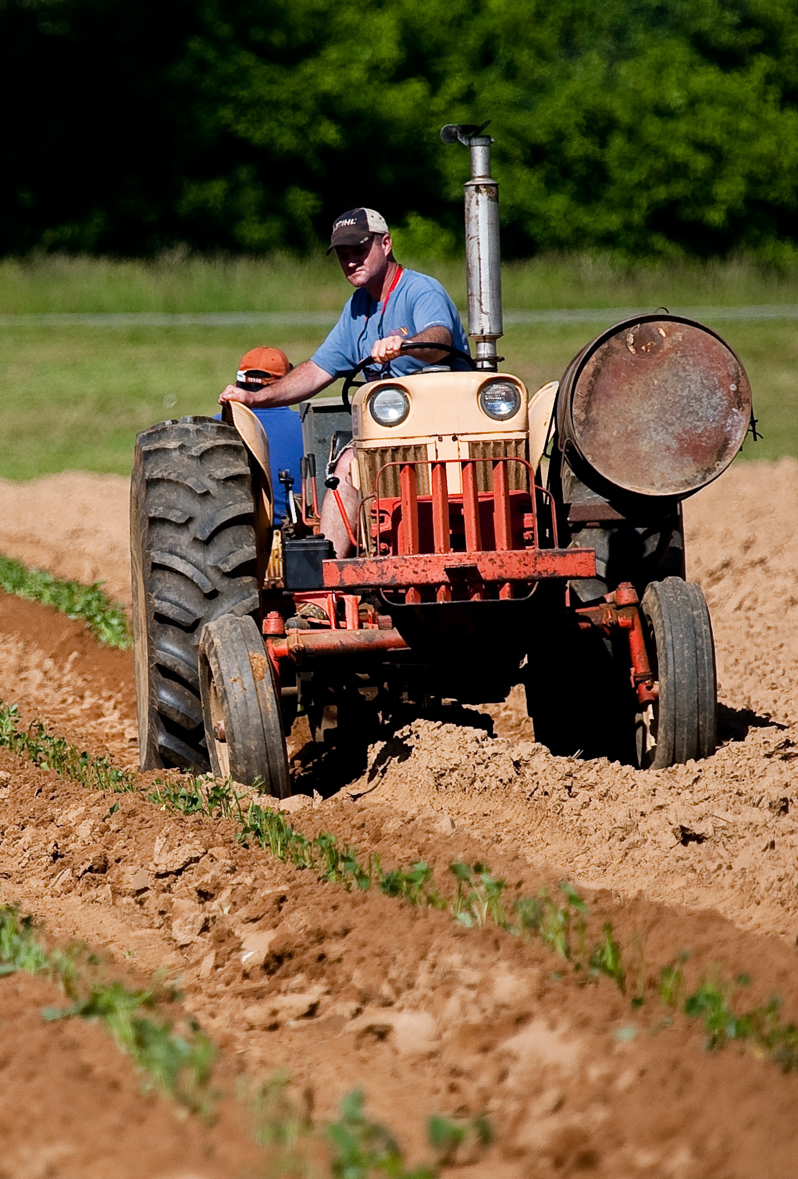
Fixed Costs
Expenses that do not vary with yields and are a result of owning assets
Examples – Depreciation, Taxes, Land

Slide 10
Practice Makes Perfect
Variable or Fixed Cost?
Bedding
Marketing Costs
Insurance
Veterinarian Costs
Fuel

Slide 11
Practice Makes Perfect
Variable or Fixed Cost?
Bedding – Variable Cost
Marketing Costs - Variable Cost
Insurance – Fixed Cost
Veterinarian Costs – Variable Cost
Fuel – Variable Cost

Slide 12

Budget Time

Slide 13
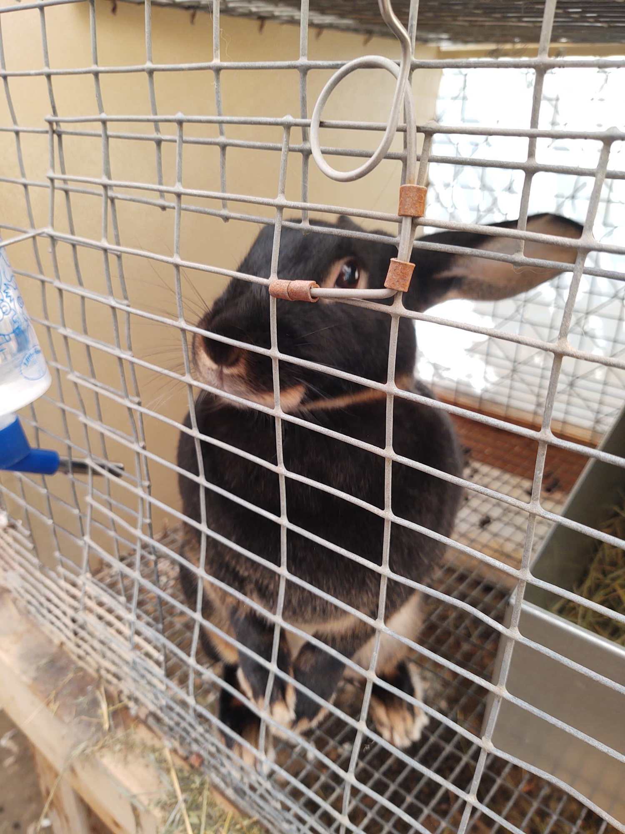
Scenario 1 – Meat Rabbits
Variable Costs
New Livestock – 4 does 2 bucks = $175
Feed – Rabbit Pellet (1 Year) = $280
Always add Wastage
Veterinarian - Pasteurella Vaccination= $12
Total Variable Costs = $467

Slide 14
Scenario 1 – Meat Rabbits
Variable Cost = $467
Fixed Costs
Housing – 6 Cages = $120
Equipment - 4 Nest Boxes = $40
Equipment – Feeders and Waterers = $75
Total Fixed Costs = $235

Slide 15
Scenario 1 – Meat Rabbits
Variable Cost = $467
Fixed Cost = $235
Total Costs
Variable Costs + Fixed Costs = Total Costs
$467 + $235 = $702
Total Costs = $702

Slide 16
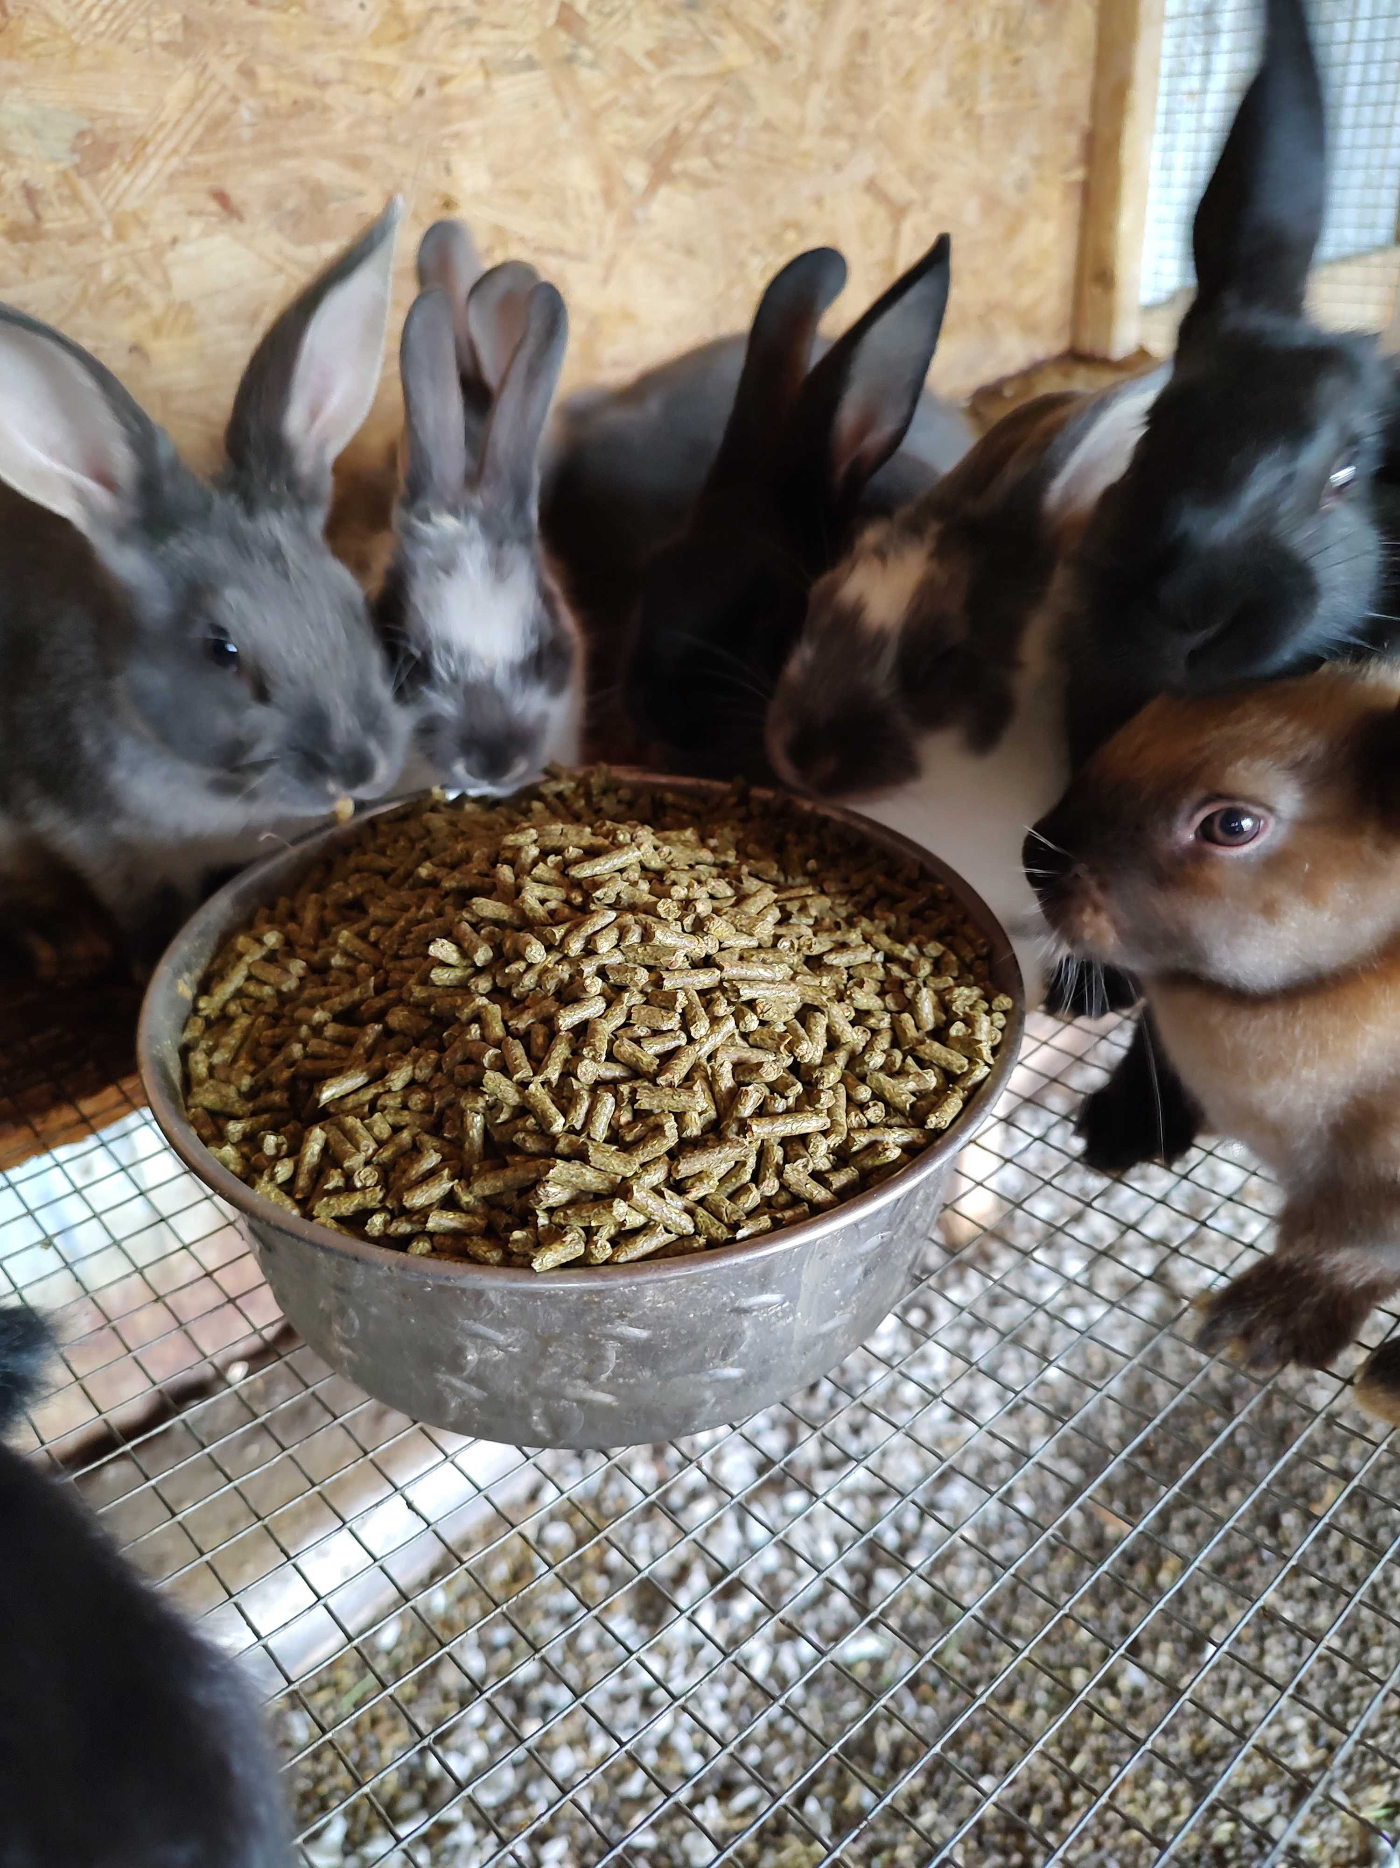
Scenario 1 – Meat Rabbits
Total Costs = $702
Expected Yield
Know your production system
Rabbits
1-month gestation, 1-month to weaning, 1-month rest
3-month breeding cycle
Average 7 kits per litter
Expected yield = 16 litters per year or 112 kits (average)

Slide 17
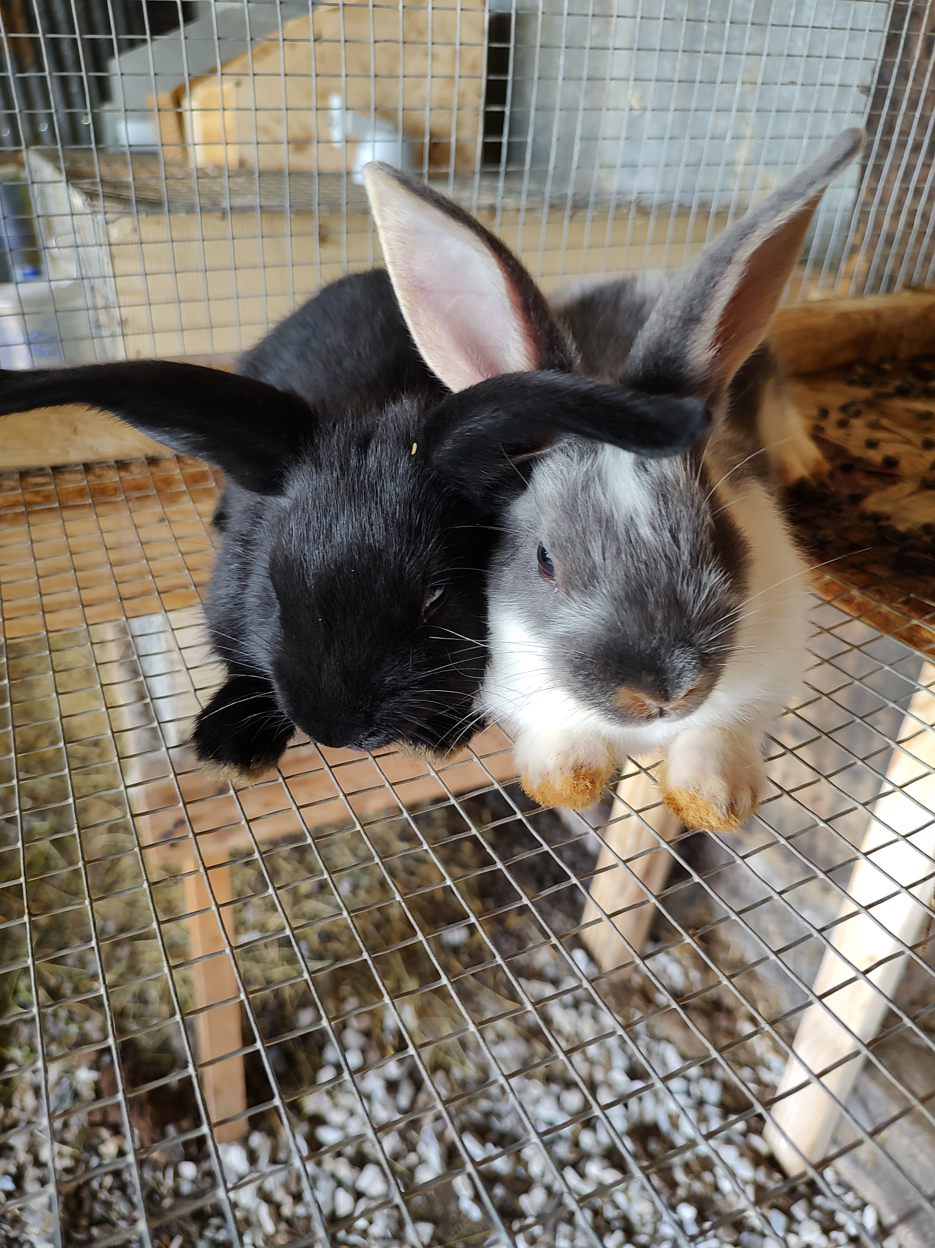
Scenario 1 – Meat Rabbits
Total Costs = $702
Expected Yield = 560 lbs.
Expected Yield
Rabbits sell at 5 lbs. @ $2.20/lb.
112 kits * 5 lbs. per kit = 560 lbs. of rabbit to sell

Slide 18
Scenario 1 – Meat Rabbits
Total Costs = $702
Expected Yield = 560 lbs.
Breakeven Analysis
Breakeven Price = Total Costs / Expected Yield
Breakeven Price = $702 / 560
Breakeven Price = $1.26 / lb.
Also Known as Cost of Production
Breakeven Yield = Total Costs / Expected Price
Breakeven Yield = $702 / $2.20 per lb.
Breakeven Yield = 319 lbs. = 64 kits = 10 Litters

Slide 19
Things to Consider
Projections are not guaranteed!

Slide 20
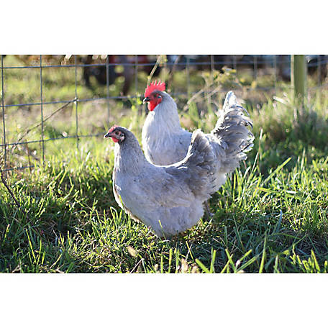
Scenario 2 - Chickens
Variable Costs = $515
Feed – Laying Pellet – $385
New Livestock – 10 Chickens - $130
Fixed Costs = $400
Housing - Chicken Coop - $375
Equipment – Feeders/Waterers - $25
Total Costs = $515 + $400 = $919
https://thegreenestacre.com/lavender-orpington-chickens-breed-profile/

Slide 21
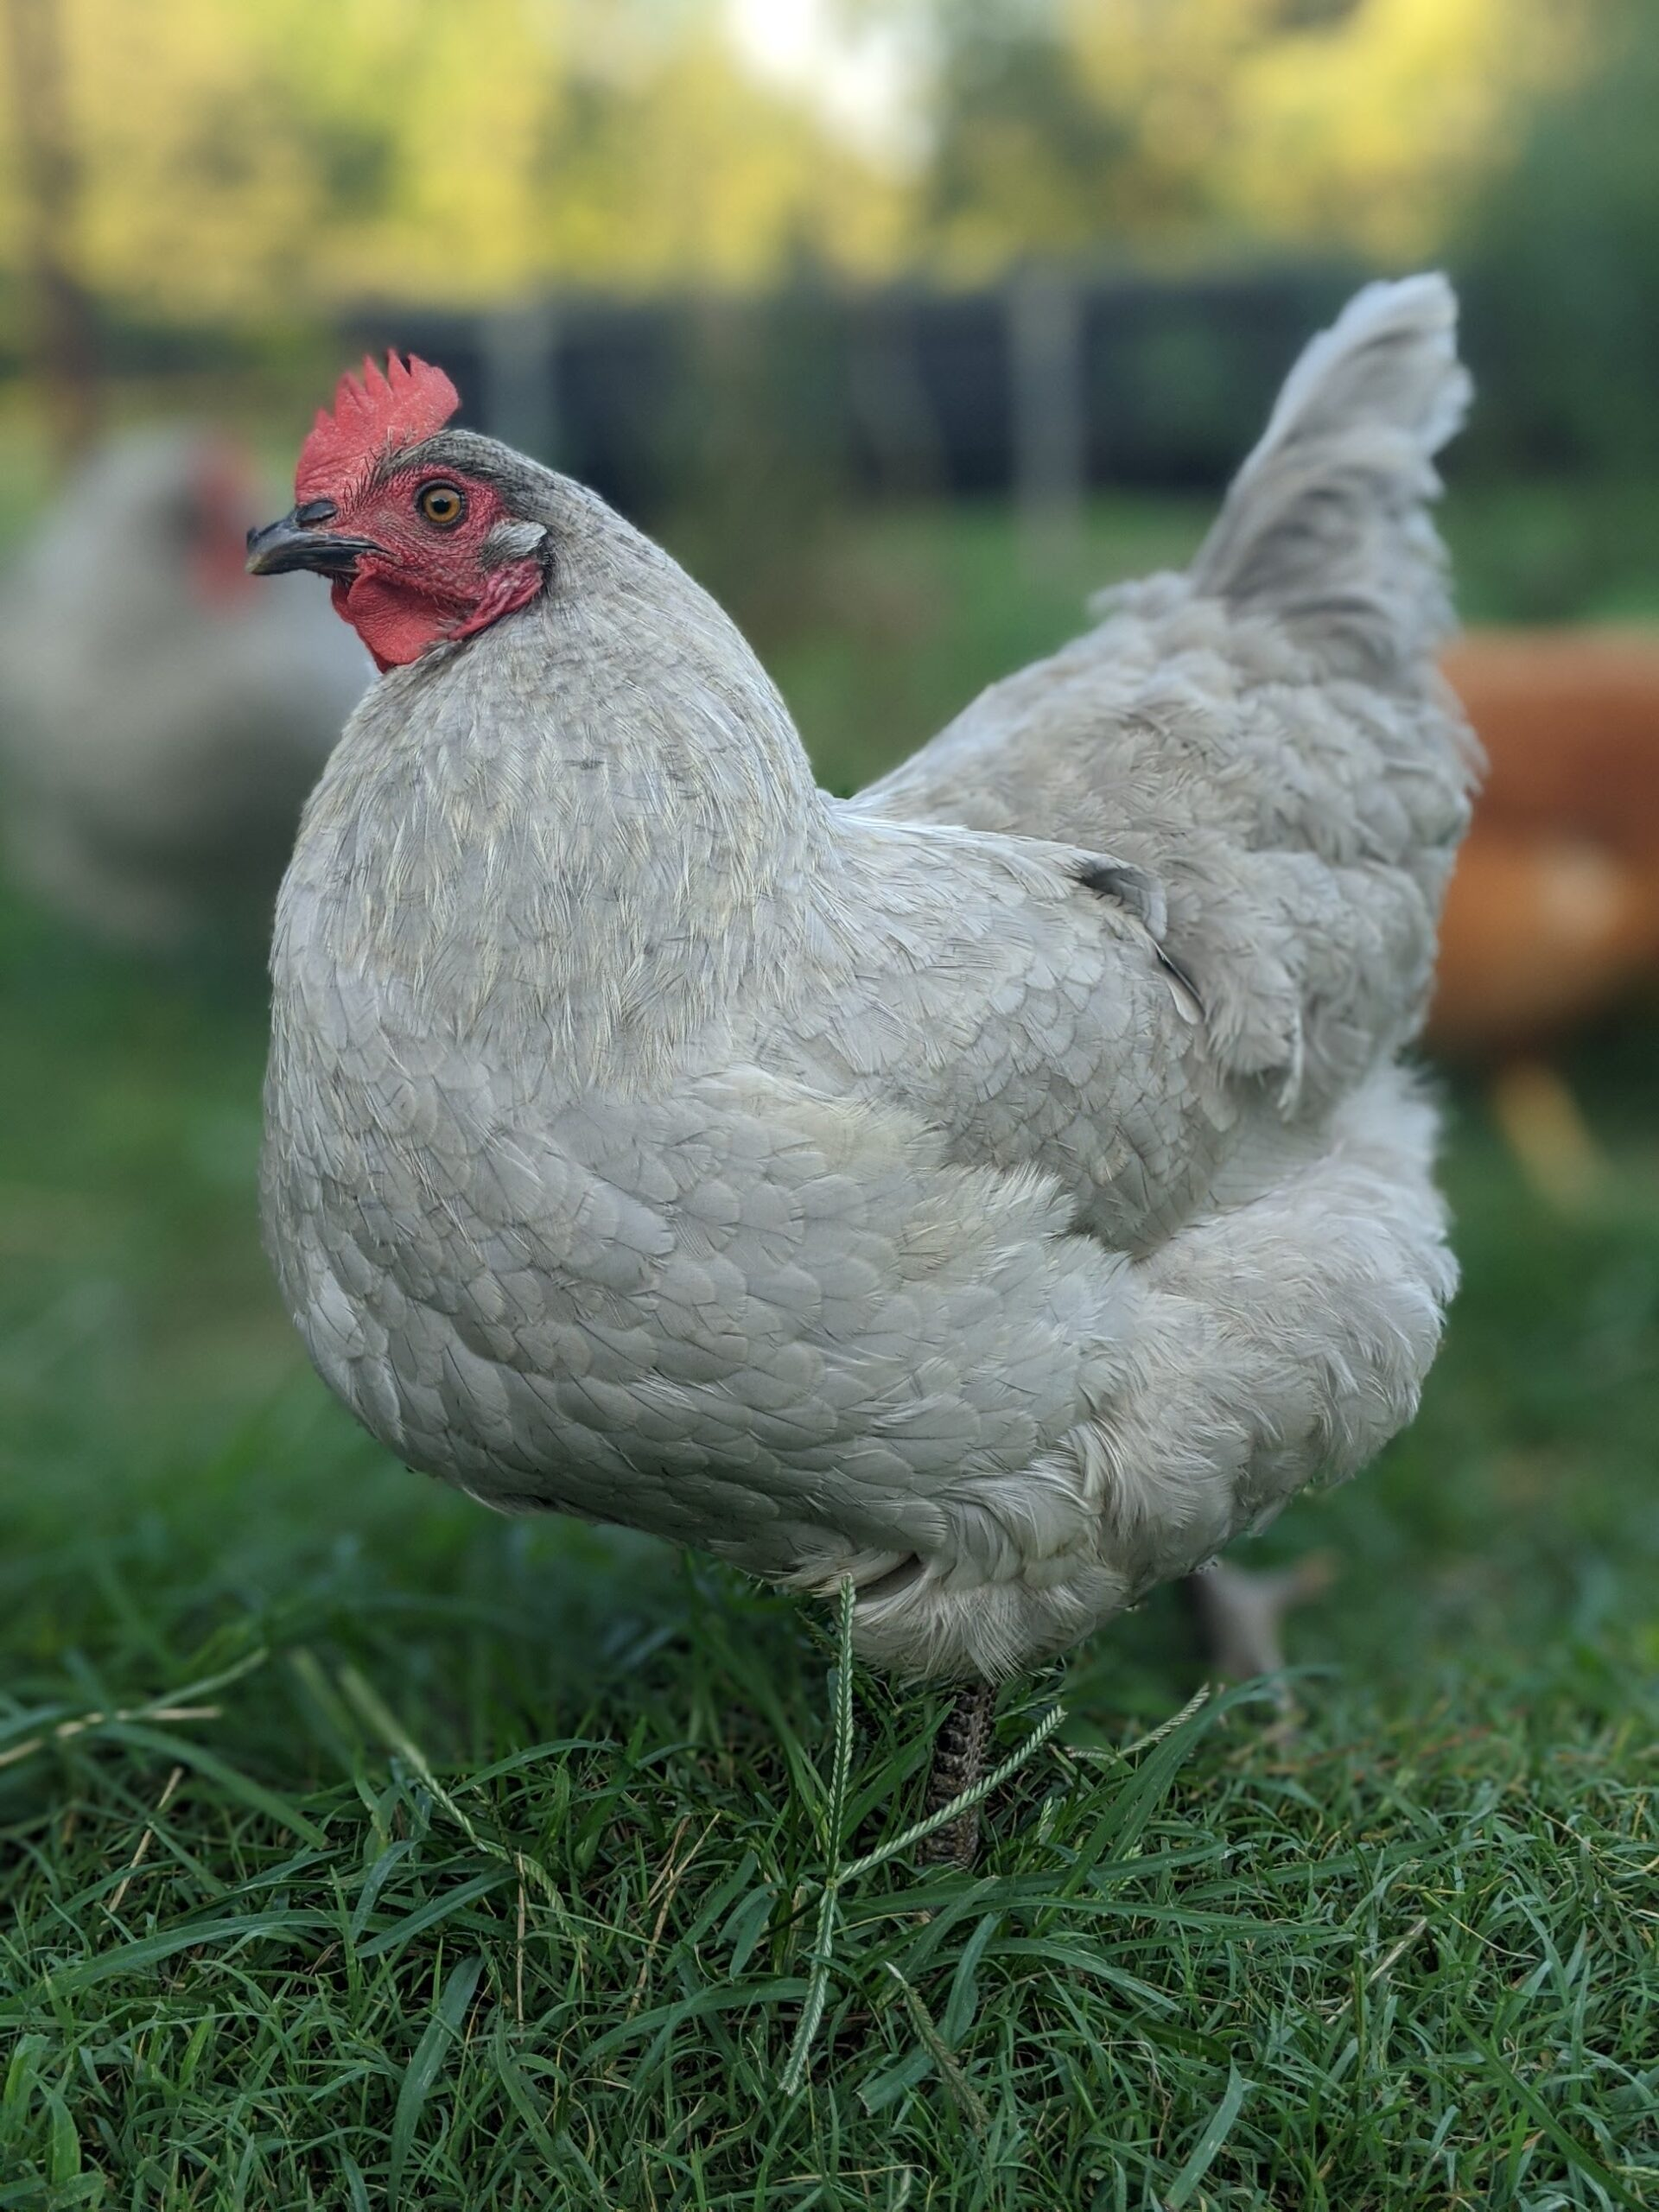
Scenario 2 - Chickens
Total Costs = $919
Expected Yield
Multi-purpose breed
180 eggs per hen per year (Orpington’s)
1800 eggs per year from 10 hens
150 dozen of eggs
Will we get this many eggs our first year?
https://www.tractorsupply.com/tsc/product/hoovers-hatchery-lavender-orpington-chickens-10-count-baby-chicks

Slide 22
Scenario 2 - Chickens
Total Costs = $919
Expected Yield = 150 Dozen
Breakeven Analysis
What is my Breakeven Price per dozen eggs?
What is my Breakeven Yield? @ $4.00/dozen
Breakeven Price = Total Costs / Expected Yield
Breakeven Yield = Total Costs / Expected Price

Slide 23
Scenario 2 - Chickens
Total Costs = $919
Expected Yield = 150 Dozen
Breakeven Analysis
Breakeven Price = Total Costs / Expected Yield
Breakeven Price = $919 / 150 Dozen
Breakeven Price = $6.13 / Dozen Eggs
Breakeven Yield = Total Costs / Expected Price
Breakeven Yield = $919 / $4.00 per Dozen
Breakeven Yield = 230 Dozen

Slide 24
Enterprise Budgets Coming Soon!

Slide 25
Summary
Know your Cost of Production!!!!
Budgets get more precise over time
Projections are not guaranteed
Total Costs = Variable Costs + Fixed Costs
Breakeven Price = Total Costs / Expected Yield
Breakeven Yield = Total Costs / Expected Price
Email – Jacob.hadfield@usu.edu

Slide 26
Sources
Penn State Enterprise Budgets - https://extension.psu.edu/budgeting-for-agricultural-decision-making

