Slide 1
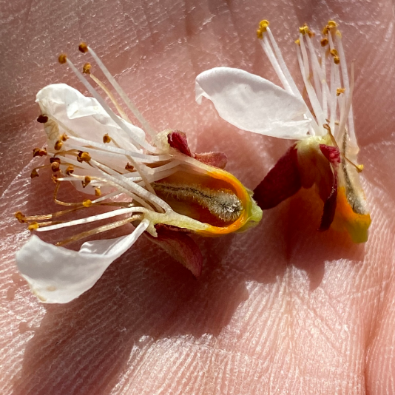
COLD INJURY IN FRUIT
SHERIDEN HANSEN, M.S.
USU EXTENSION | DAVIS COUNTY
HORTICULTURE, HOME ORCHARDS

Slide 2
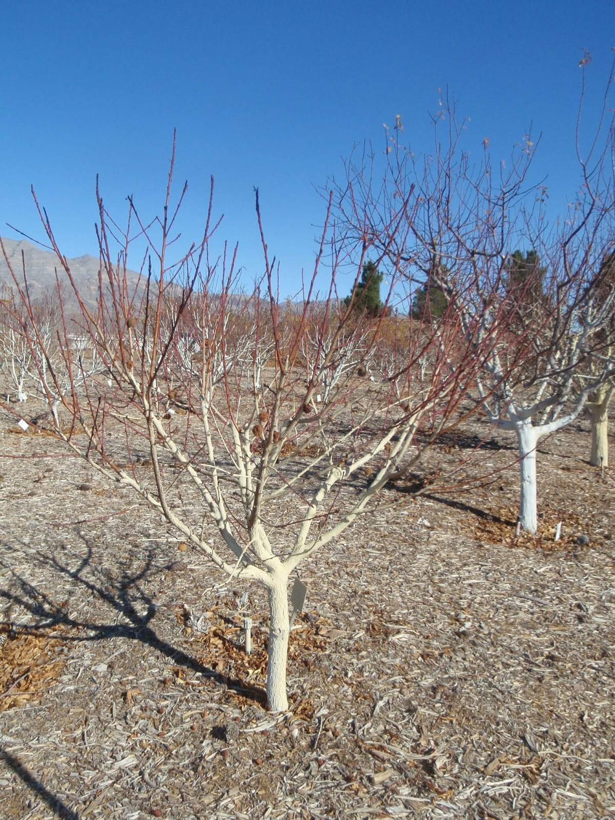
What is Dormancy?
To understand the damage and timing we need to understand dormancy
Sometimes called REST
We correlate it with leaf drop and cessation of growth
Woody plants gradually acclimate to low temperatures
Dormancy consists of three stages

Slide 3
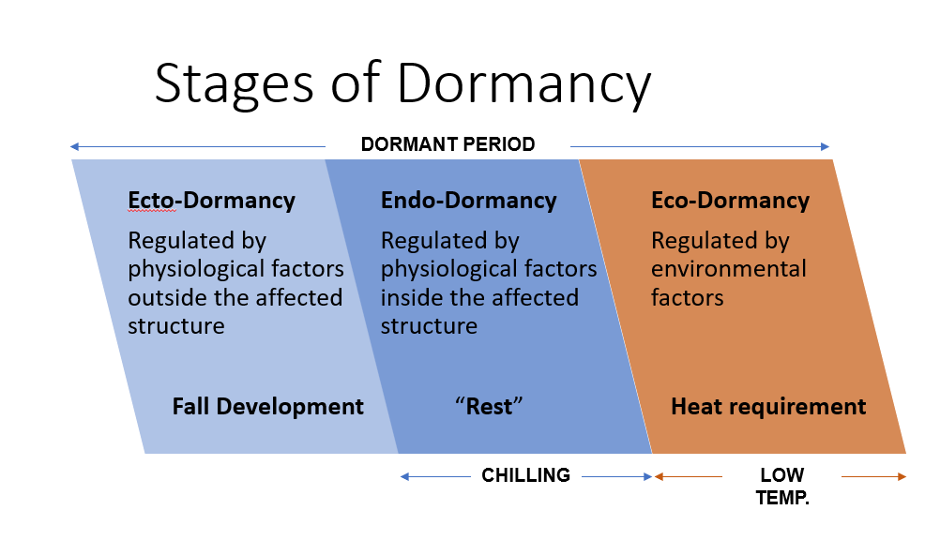
Stages of Dormancy
DORMANT PERIOD
Ecto-Dormancy
Regulated by physiological factors outside the affected structure
Fall Development
Endo-Dormancy
Regulated by physiological factors inside the affected structure
“Rest”
Eco-Dormancy
Regulated by environmental factors
Heat requirement
CHILLING
LOW TEMP.

Slide 4
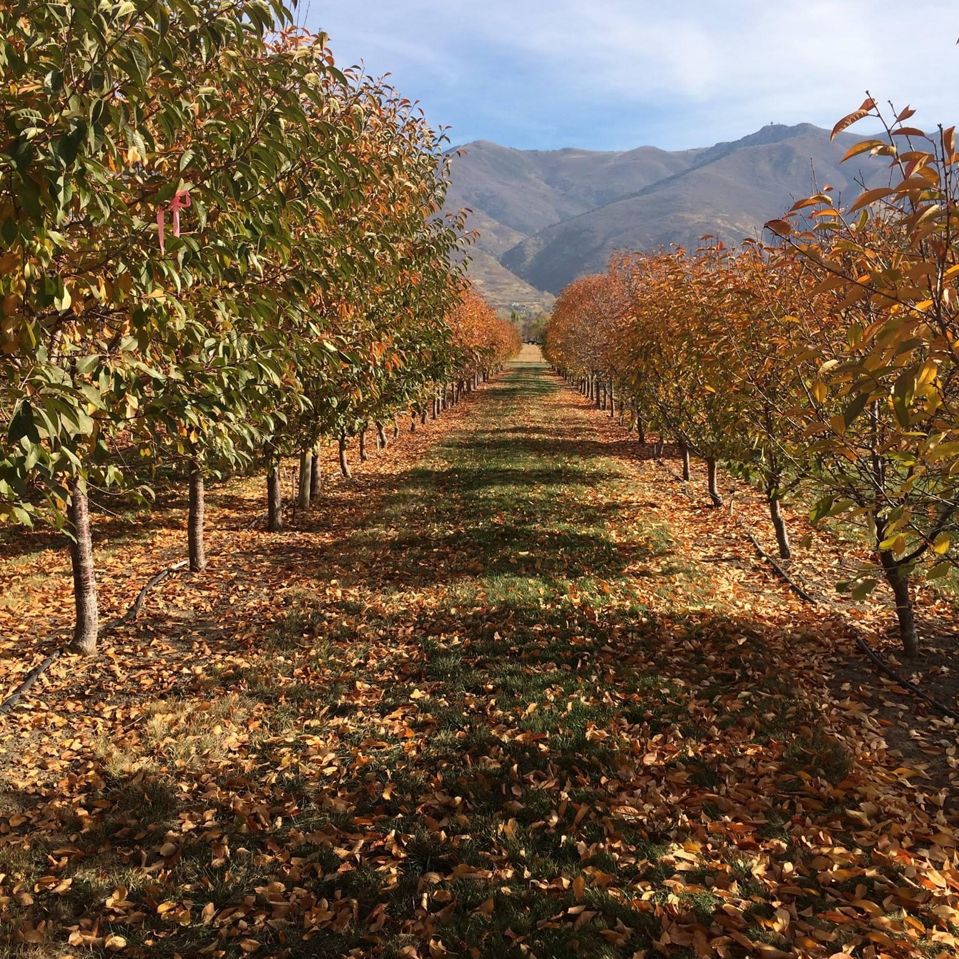
ECTO-DORMANCY
Acclimation to freezing temperatures
Short photoperiods in the fall trigger 10-15° of cold tolerance
Periods of cool, non-freezing temps followed by exposure to subfreezing temps
Trees can be as much as 10° hardier the day after a frost than the previous day
Exposure to temperatures approaching 0° MAXIMUM COLD TOLERANCE

Slide 5
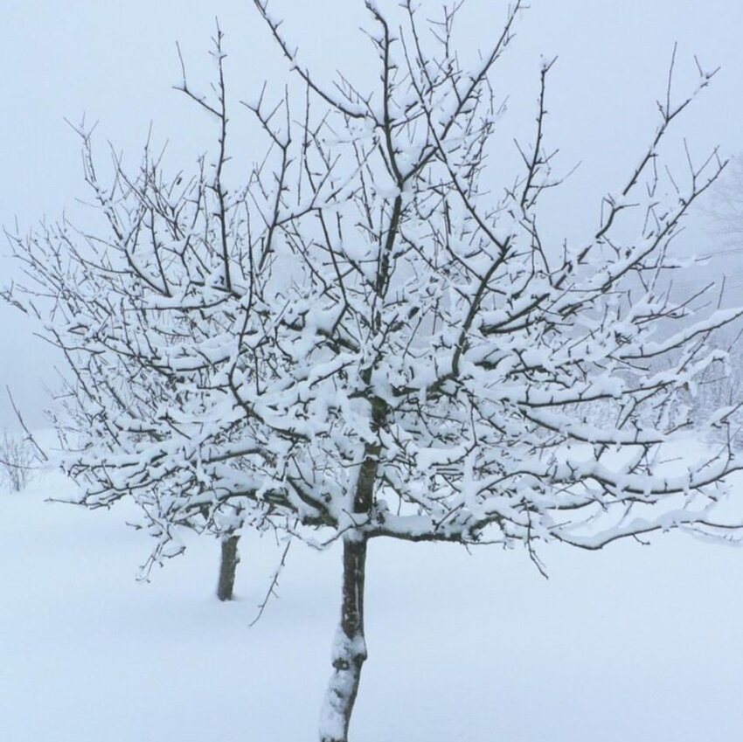
ENDO-DORMANCY
Sometimes called “Rest”
Once plants enter rest phase they will not grow
Need to meet chill hour requirements

Slide 6
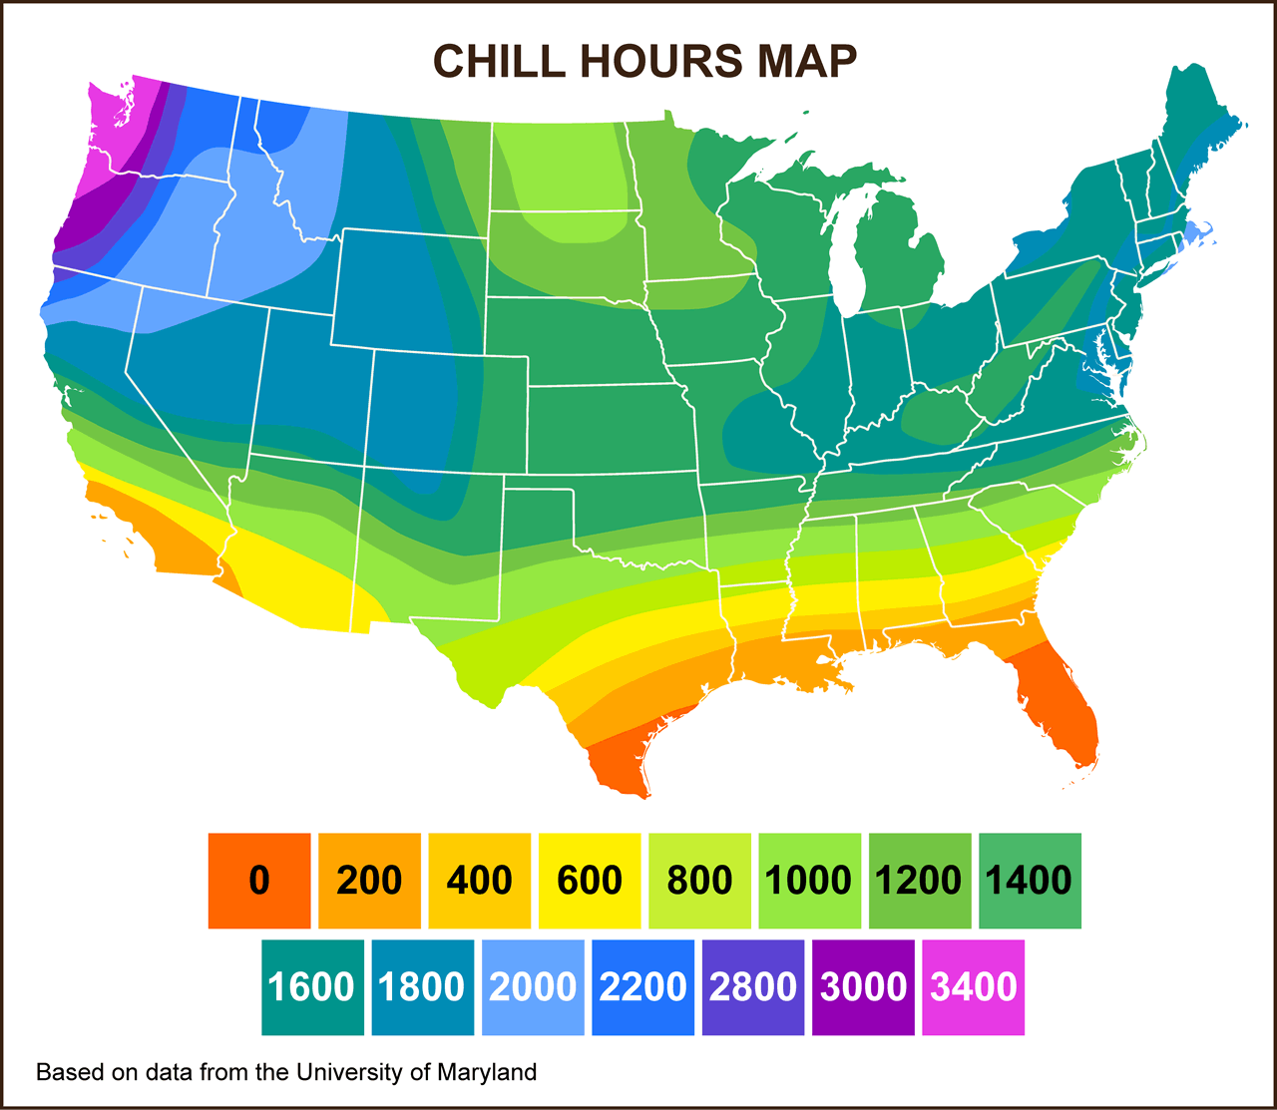
What are CHILL HOURS?
Chill hours are time spent above freezing
Ideally temperatures between 40° to 50° F
Temperatures below 40° F and above 50° F are less effective
Above 60° F, can have a negative effect on the plant
Peaches/Nectarines: 500-1,200
Apples/Pears: 500-1,000
Cherries: 700-1,200

Slide 7
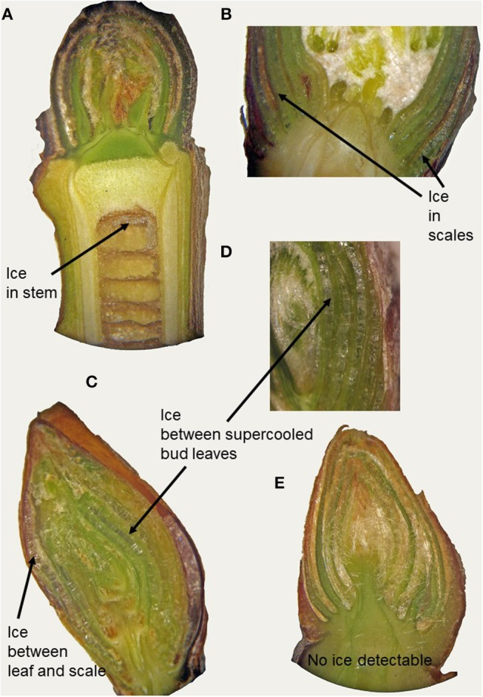
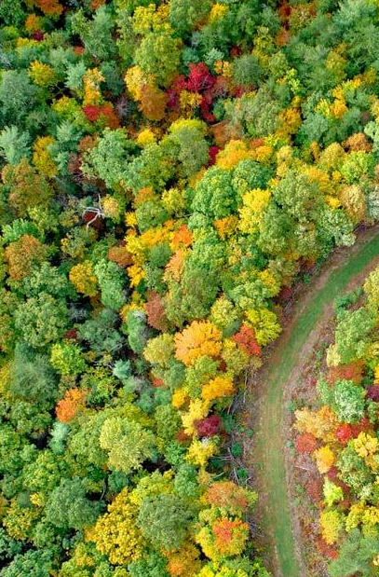
Different Methods of Survival
Using these mechanisms apples can survive temperatures -22 to -58° F
Damage can still occur
Supercooling
Plant moves H₂O out of the cell, concentrating sugars.
Prevents ice formation in the bud cells.
Ice forms in other less-critical tissues
Extraorgan Freezing
Allows for ice formation to occur in less-critical tissues
Sometimes in bud scales or in stems
Neuner, G., Monitzer, K., Kaplenig, D., & Ingruber, J. 2019. Survival mechanism of vegetative buds in temperate trees: deep supercooling and extraorgan freezing vs. ice tolerance. Front Plant Sci : 10:537.

Slide 8
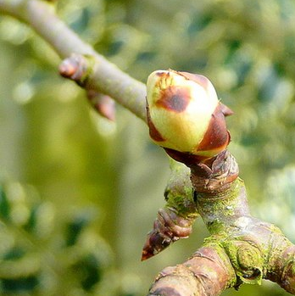
ECO-DORMANCY
After chilling requirement is met usually some time in Jan/Feb, the plant moves into eco-dormancy
Plants remain dormant as long as there is cool weather
Warmer temps in the 40’s will allow growth to begin (visible with bud swell)
Lose the ability to re-adjust to colder temps

Slide 9
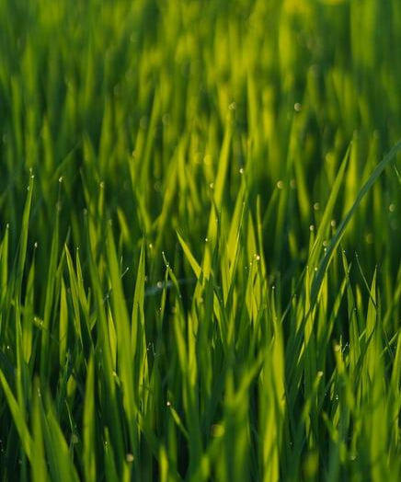
Injury Timing
Most often injury occurs during ecto-dormancy and/or eco-dormancy
Why?
Can damage occur during endo-dormancy?

Slide 10
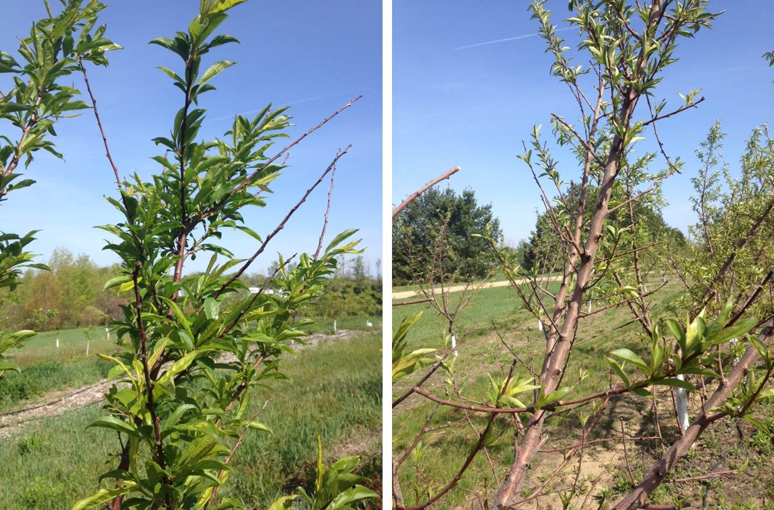
FALL DAMAGE
Ecto-dormancy
Damage occurs due to wide temperature fluxuations coupled with mild fall temperatures
Temperature drops faster than trees can acclimate
Damaged/dead buds, “bud drop”
Branch end die back or sparse leafing out
Whole tree death
Don’t see symptoms until the following spring/summer
Photos: W. Shane, Michigan State University

Slide 11
FALL DAMAGE
Ecto-dormancy
Preventing fall damage
Avoid:
Late season fertilization (after July 1st)
Late season pruning (after July 1st)
Drought stress
Overcropping trees
Planting marginally hardy cultivars/varieties/rootstocks
Do:
Manage trees to promote health and vigor
Control insects and diseases
Photos: W. Shane, Michigan State University

Slide 12
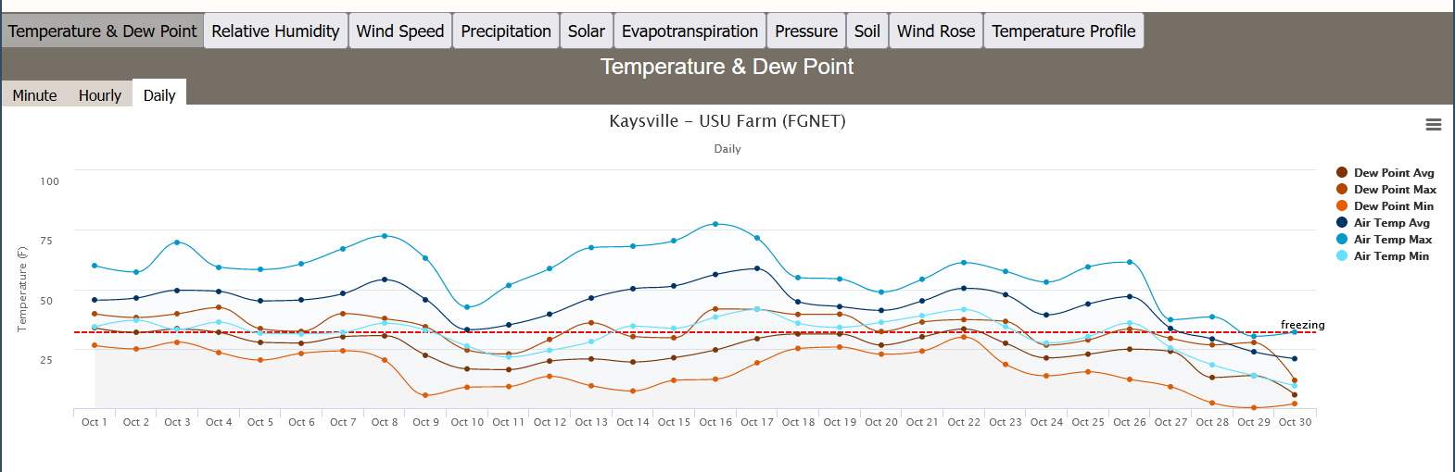
OCTOBER 2019
61°
25°
9°
43° difference overnight, 52° difference from 10/26 to 10/30

Slide 13
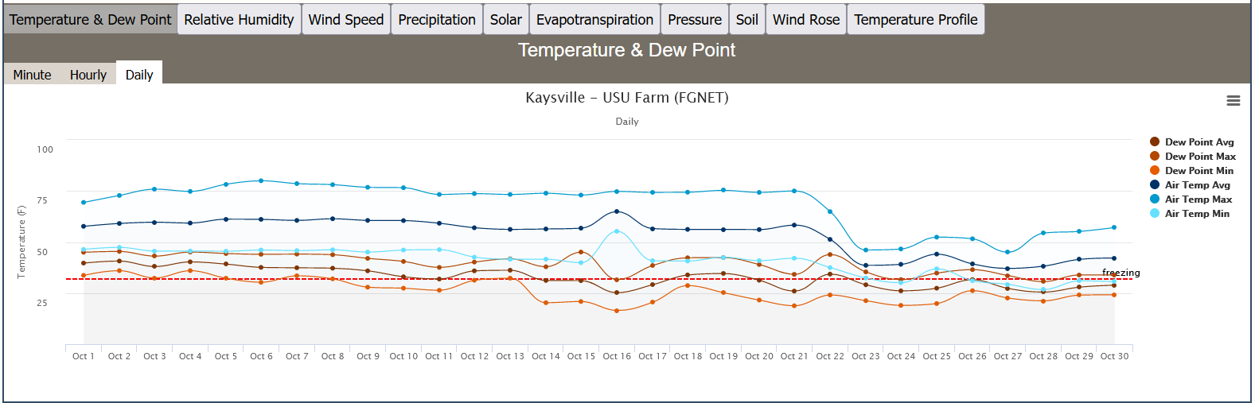
OCTOBER 2022
75°
65°
32°
More mild temperature swing, 43° difference over 2 days

Slide 14
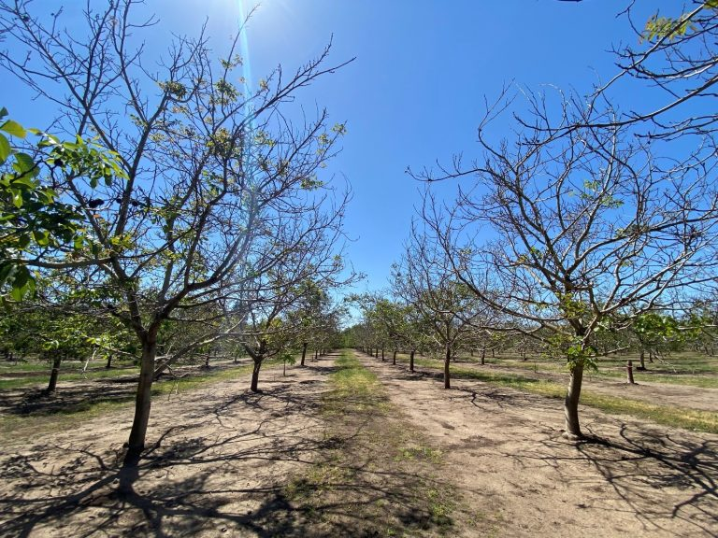
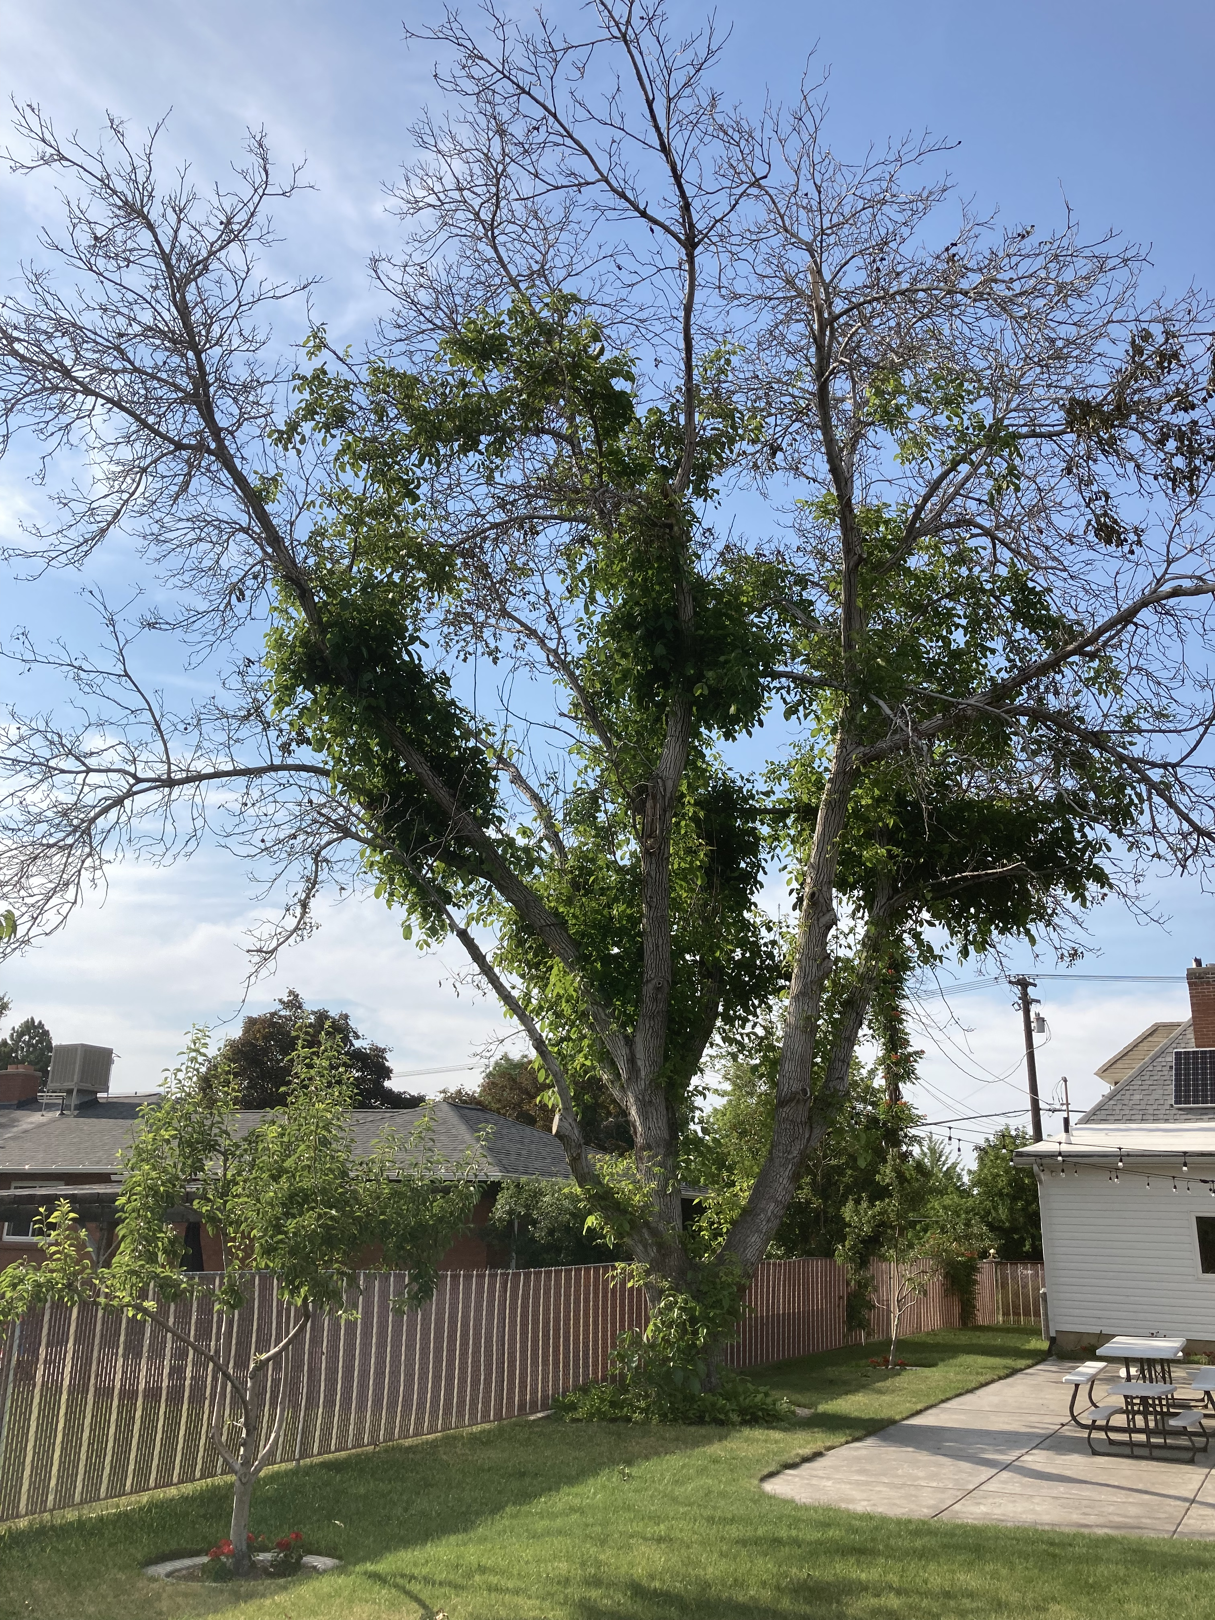
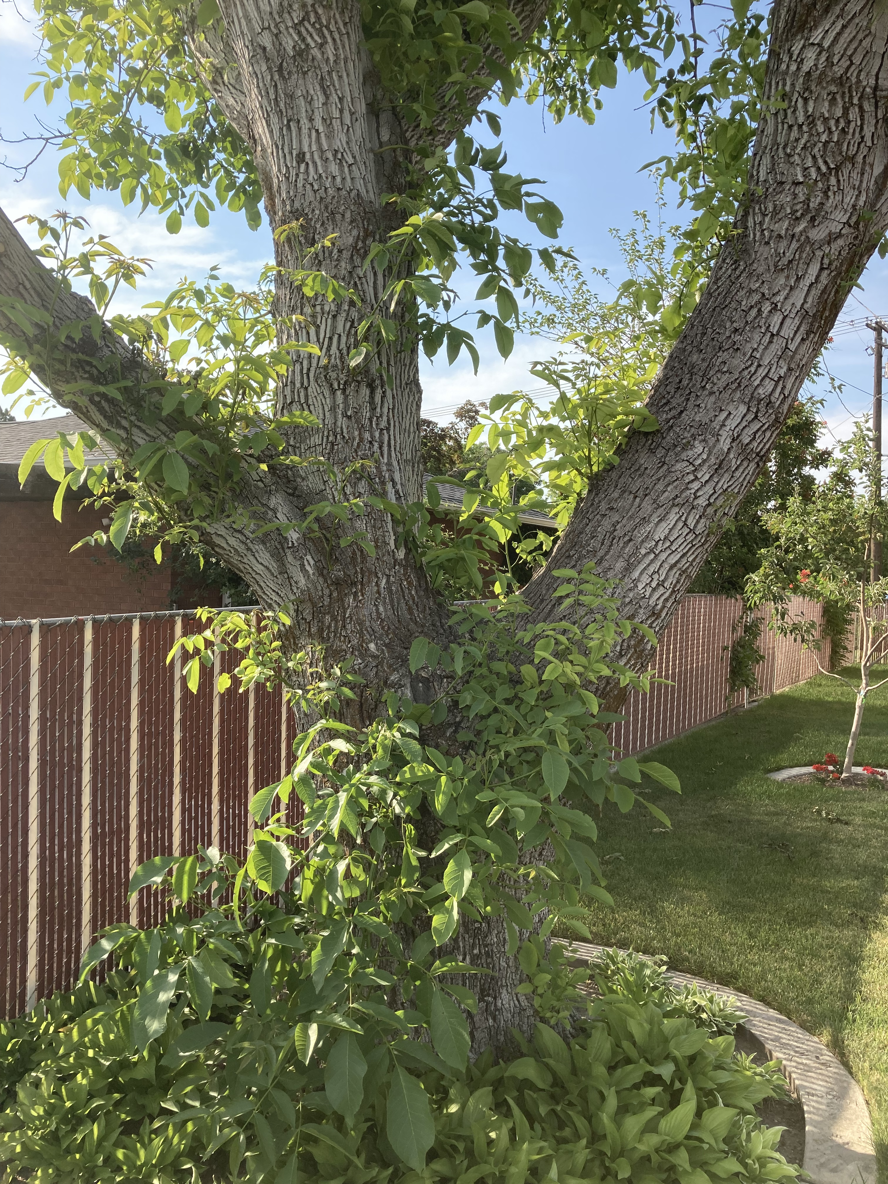
Photo: Luke Milliron, UC Dept. of Agriculture and Natural Resources
WALNUT

Slide 15
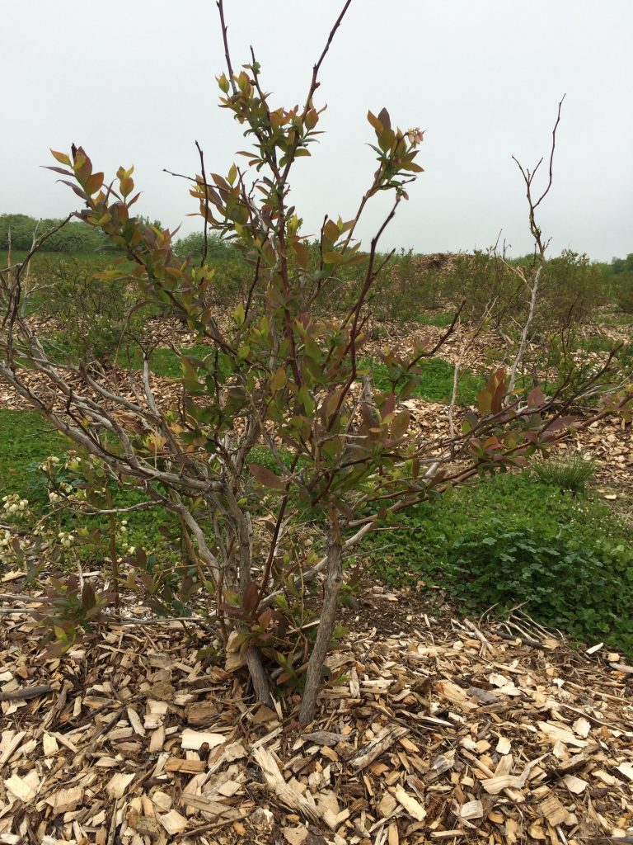
Photos: W. Shane, Michigan State University
Photo: Brian Smith, University of Wisconsin
PEACH & APPLE

Slide 16
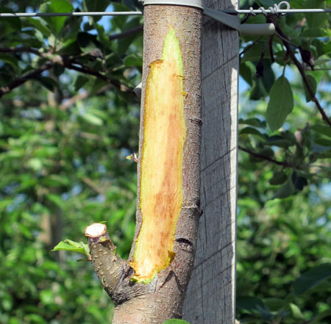
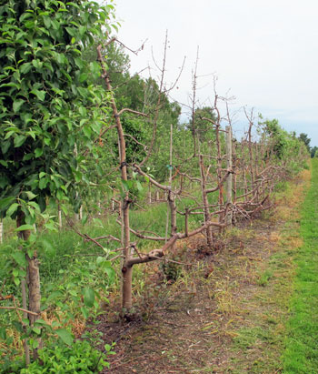
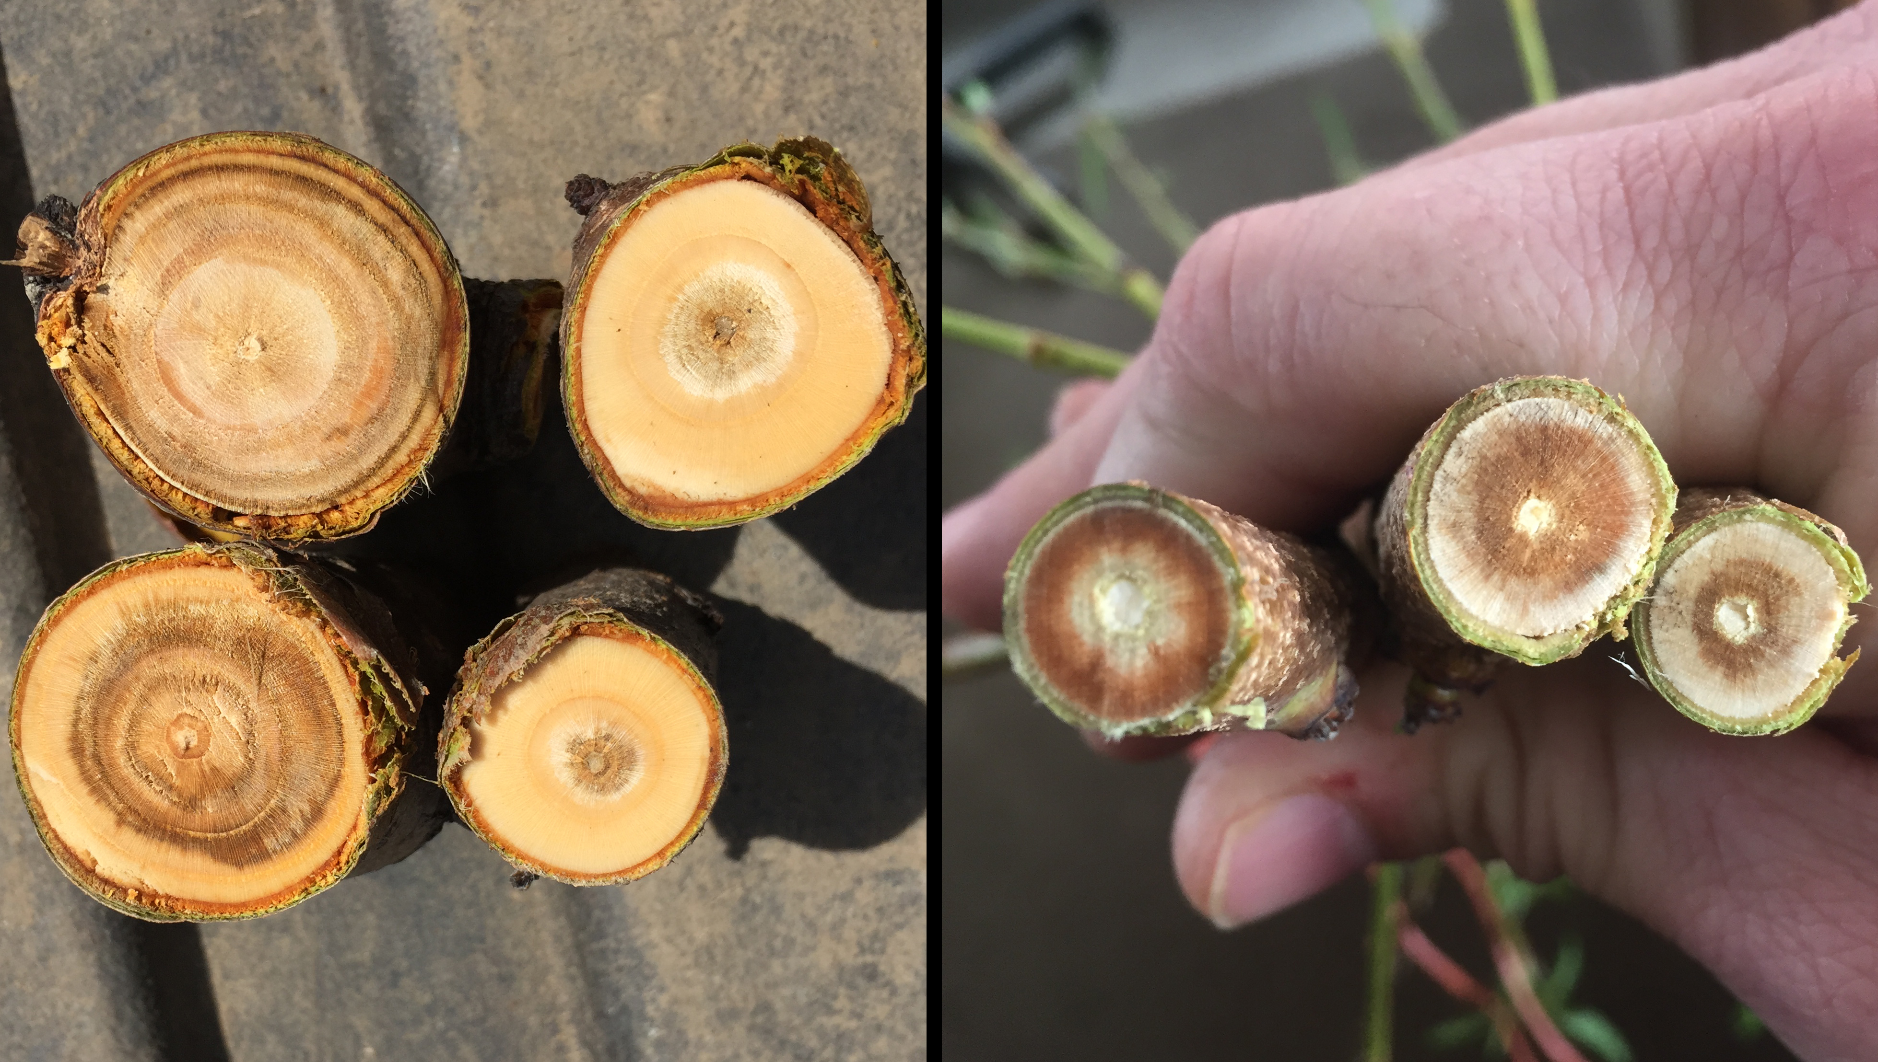
WINTER DAMAGE
Endo-dormancy
Damage occurs due to extreme low temperatures
Temperature drops so low that ice is formed in cells where it typically isn’t formed
Younger wood more susceptible
Results in damage to branches and trunk
Whole tree death
Photos: G. Sundin and N. Rothwell, Michigan State University
One-year-old peach limbs in cross section showing low to moderate browning (left) and significant browning (right) in the xylem tissues due to mid-winter low temperature.

Slide 17
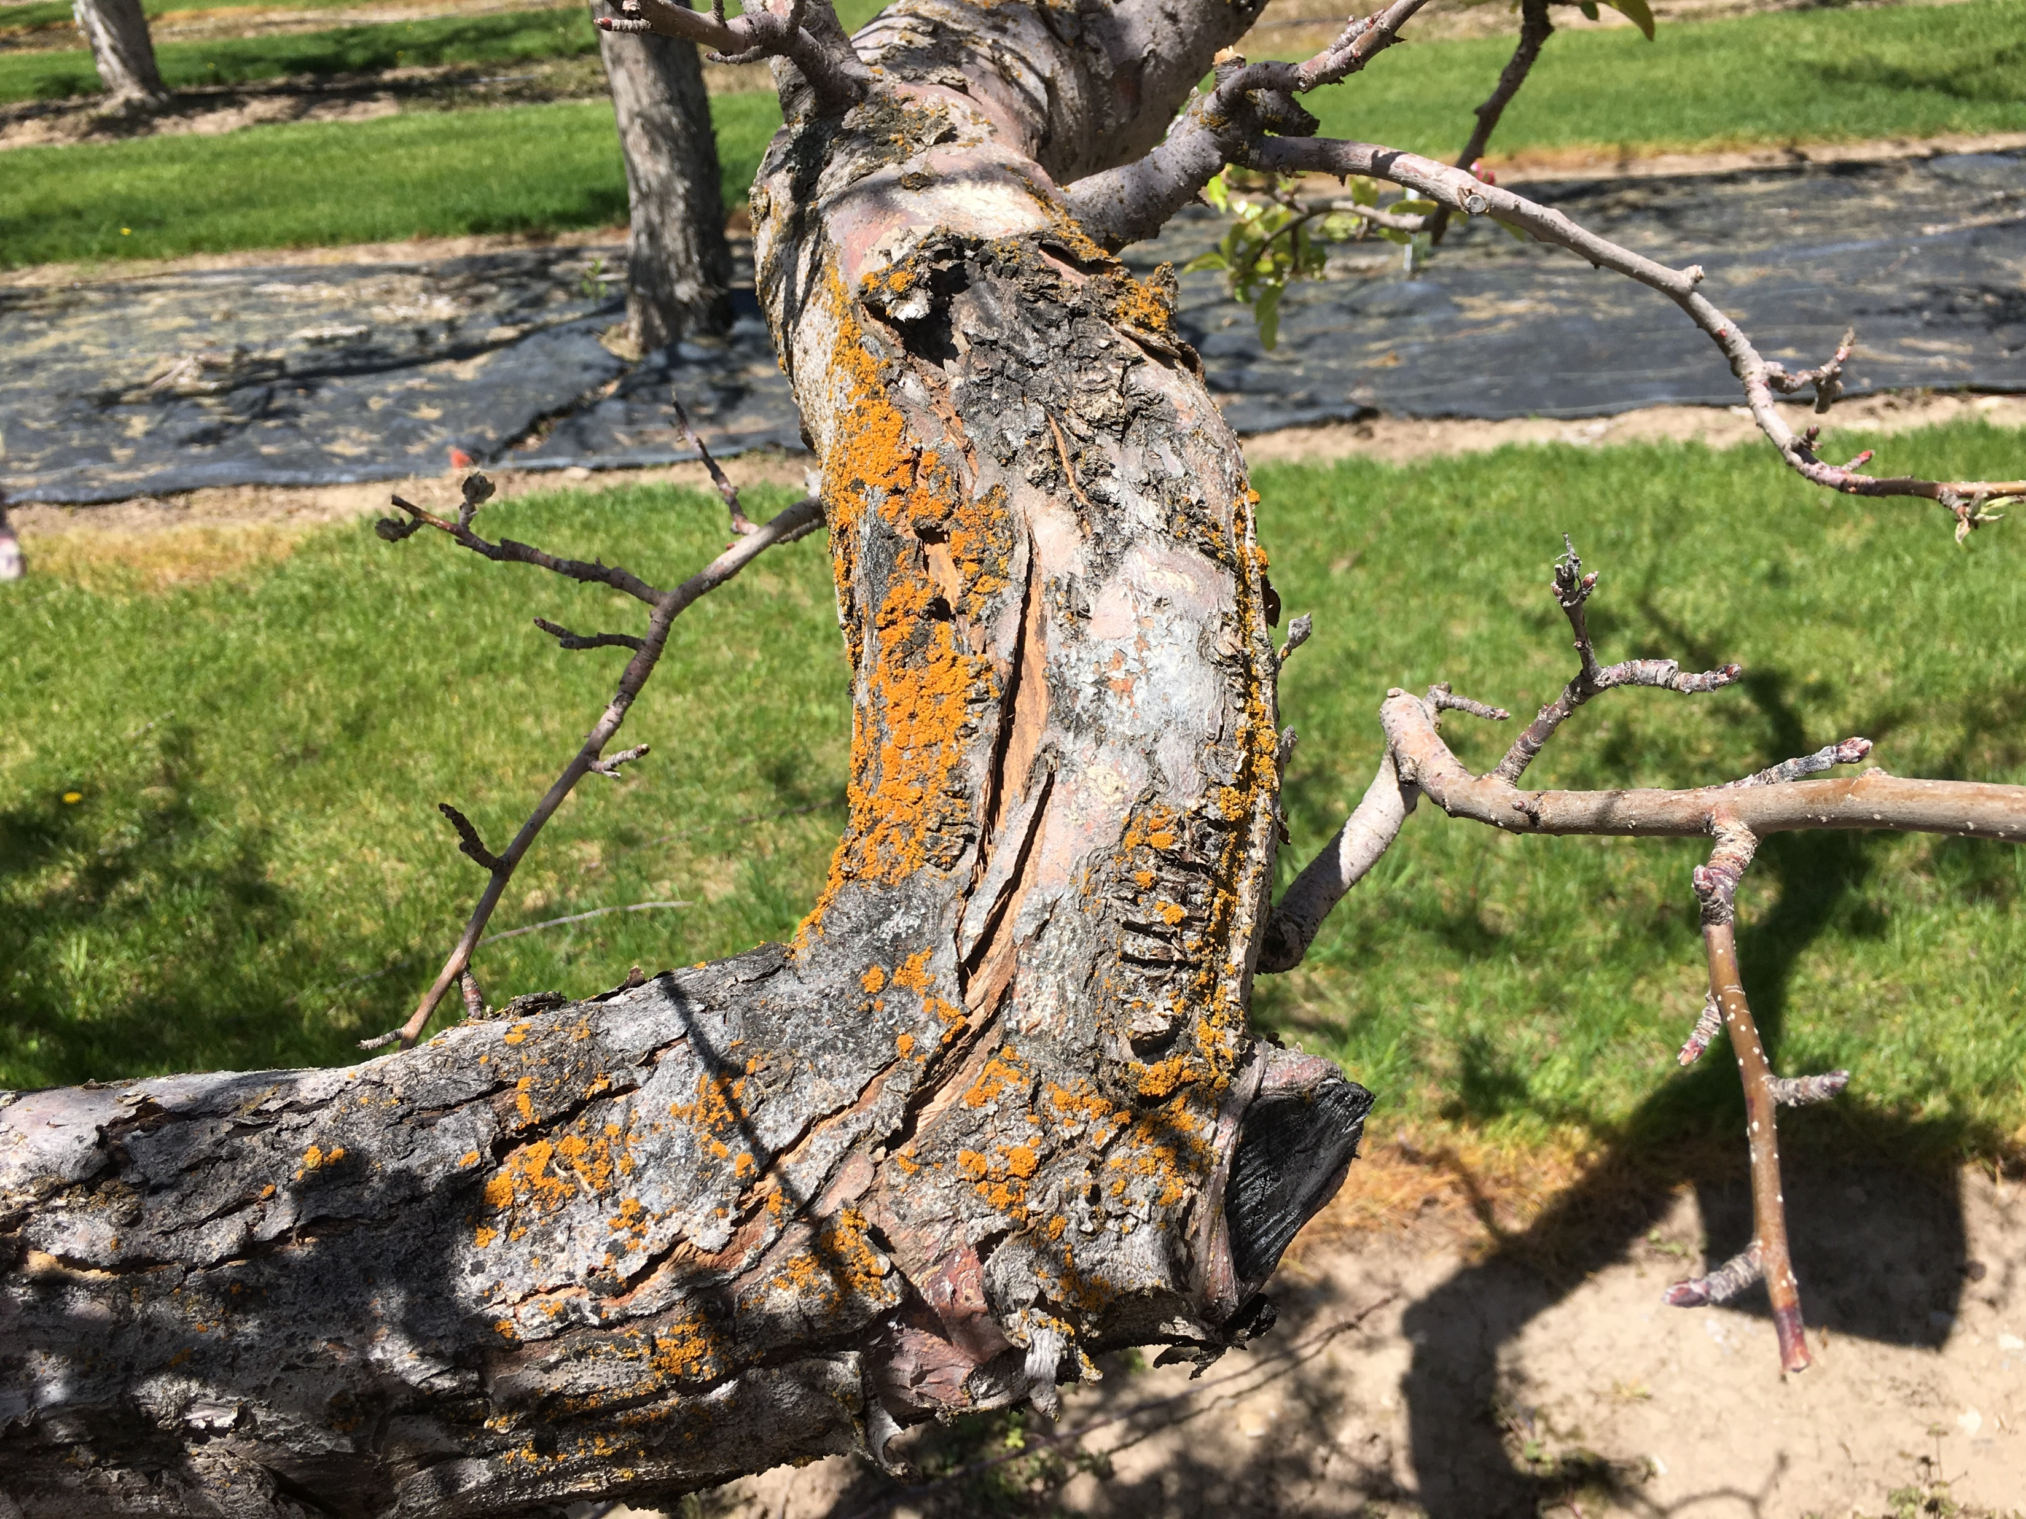
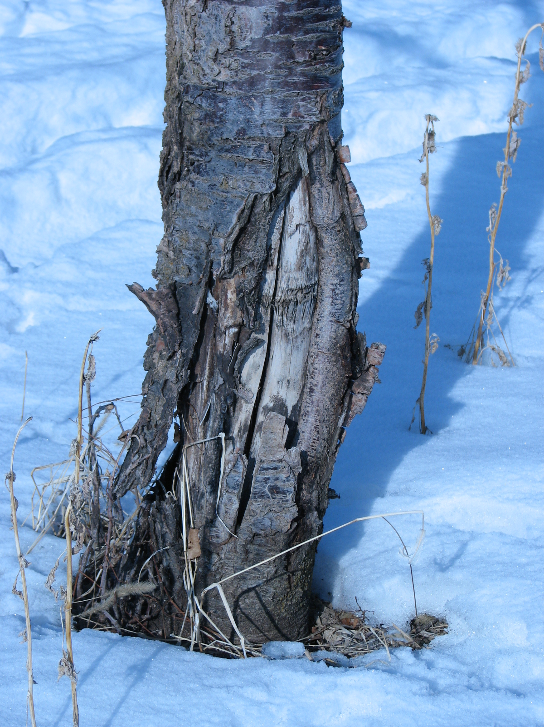
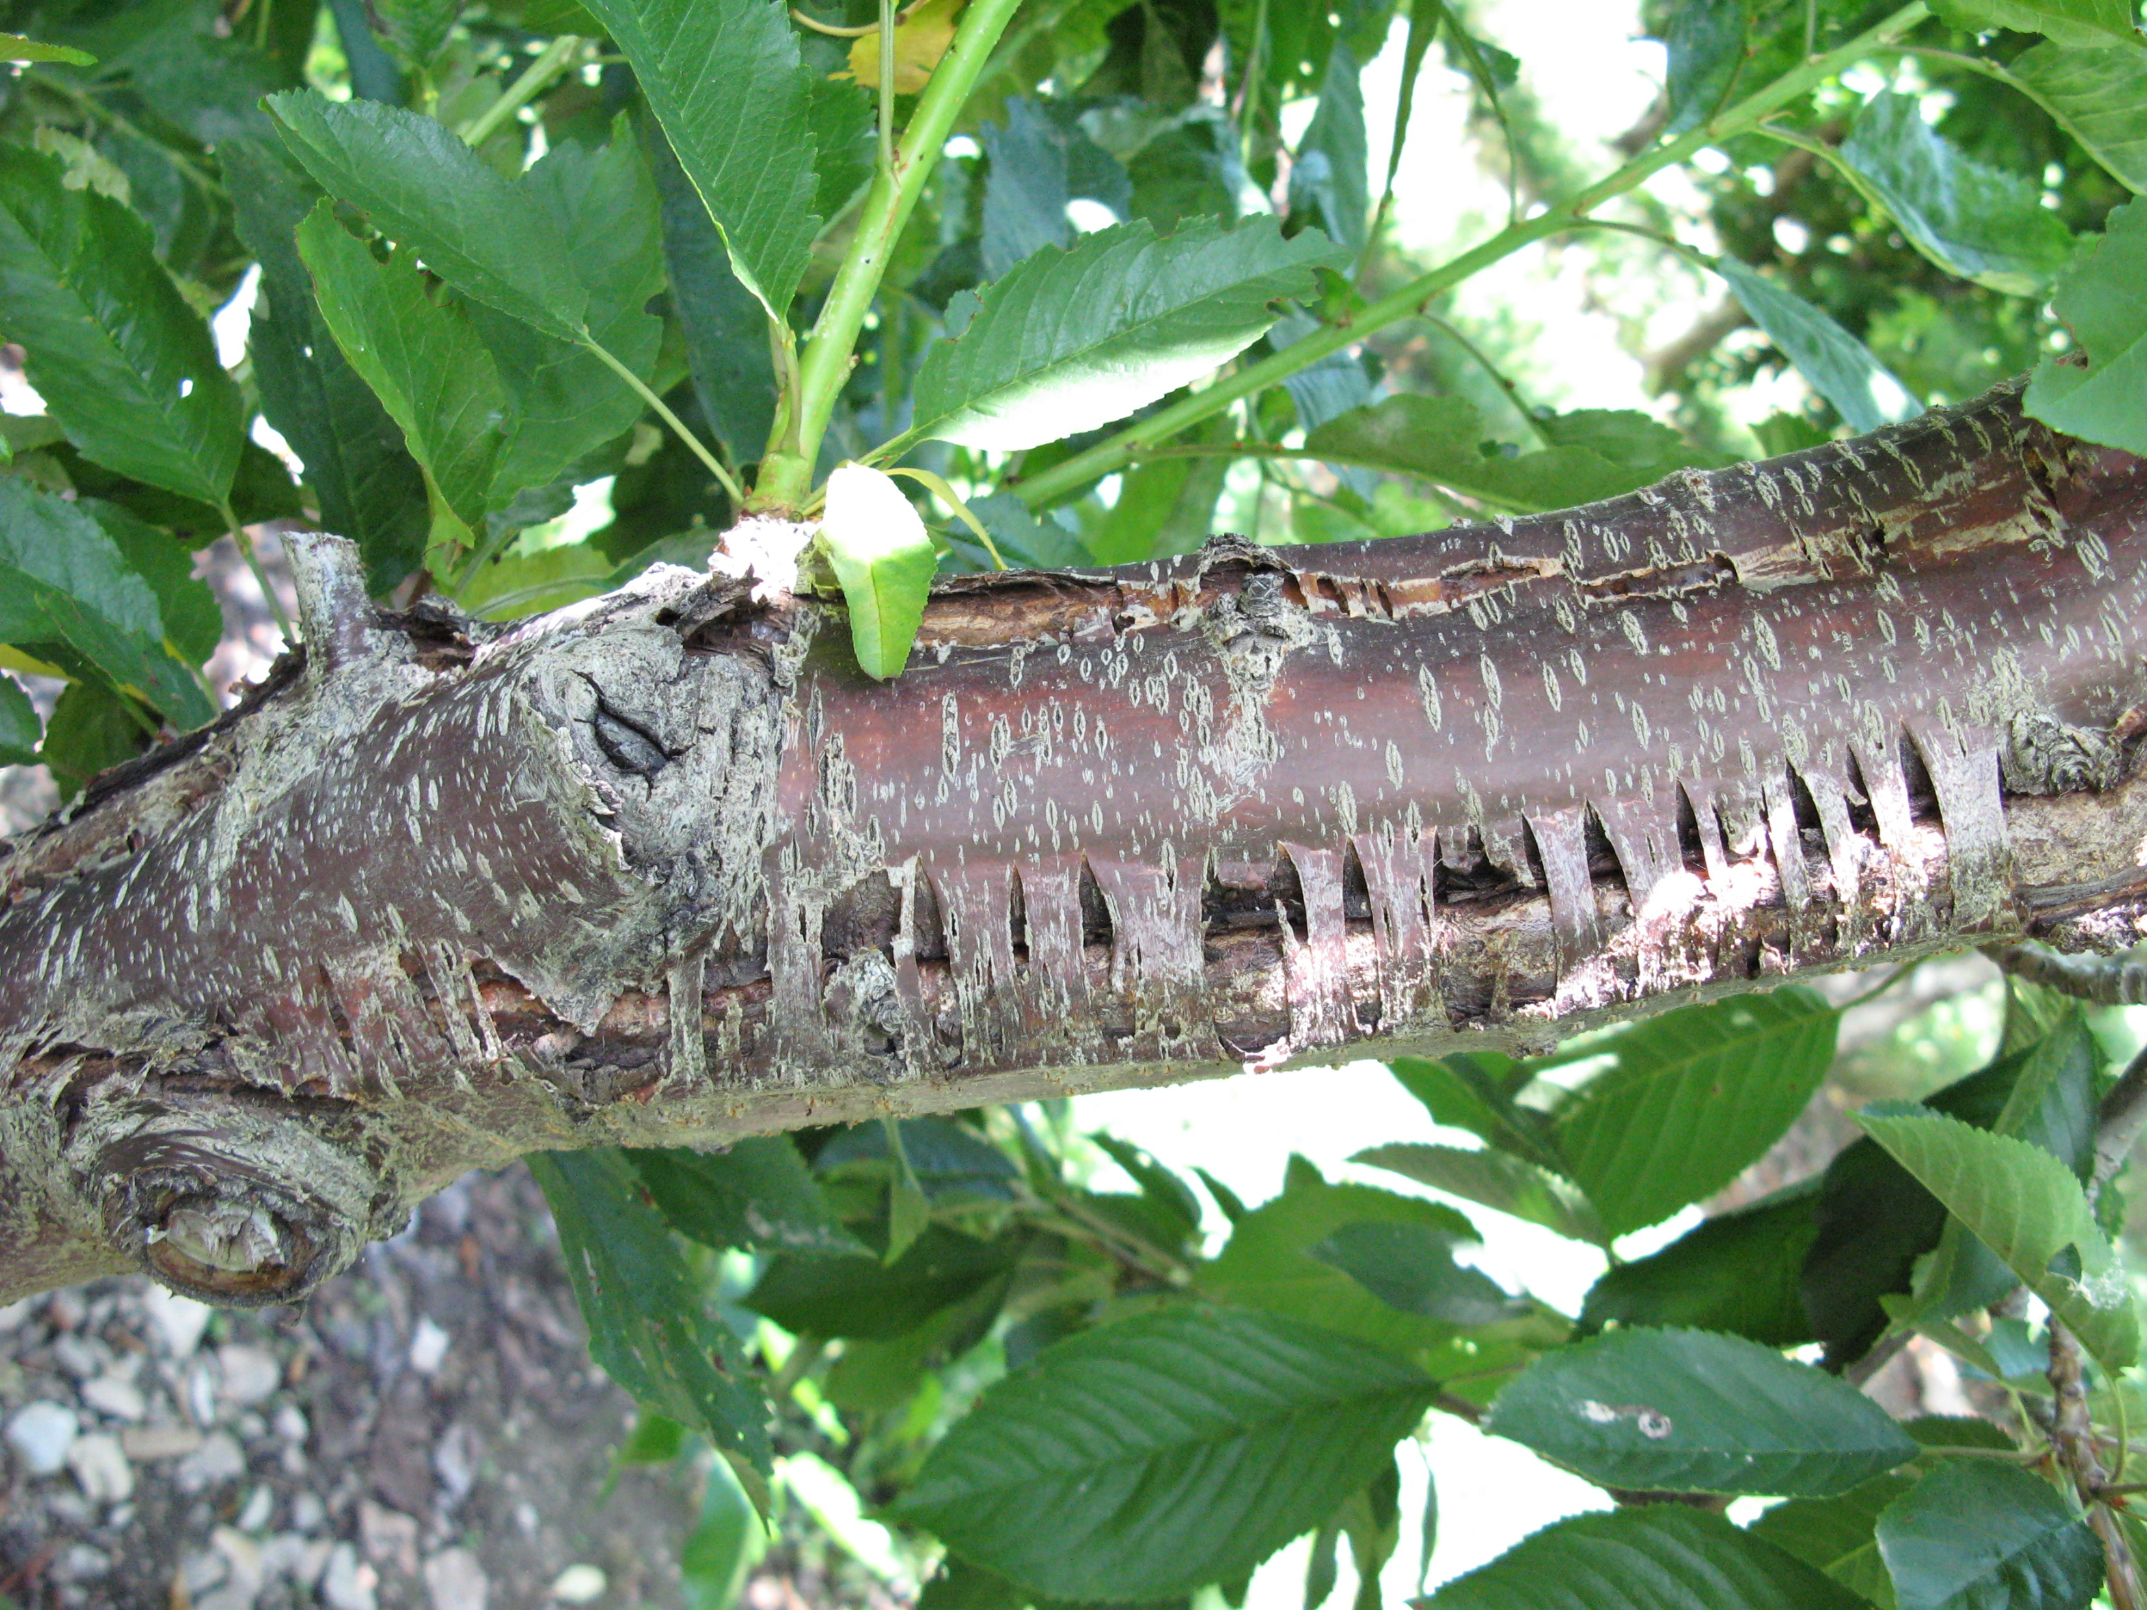
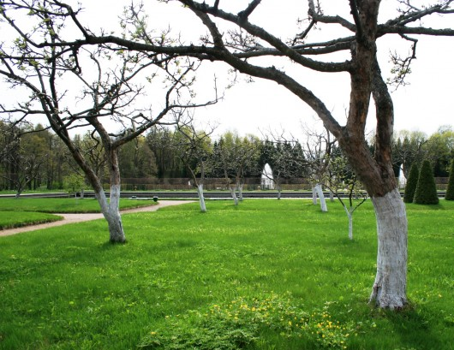
SUNSCALD
Occurs when light is reflected off of the snow
Warms the trunk of the tree during the day
Protective mechanisms reverse in the xylem and phloem
Freezes at night causing trunk splitting/cracking
Trunk wraps, whitewashing 1:1 latex paint:water

Slide 18
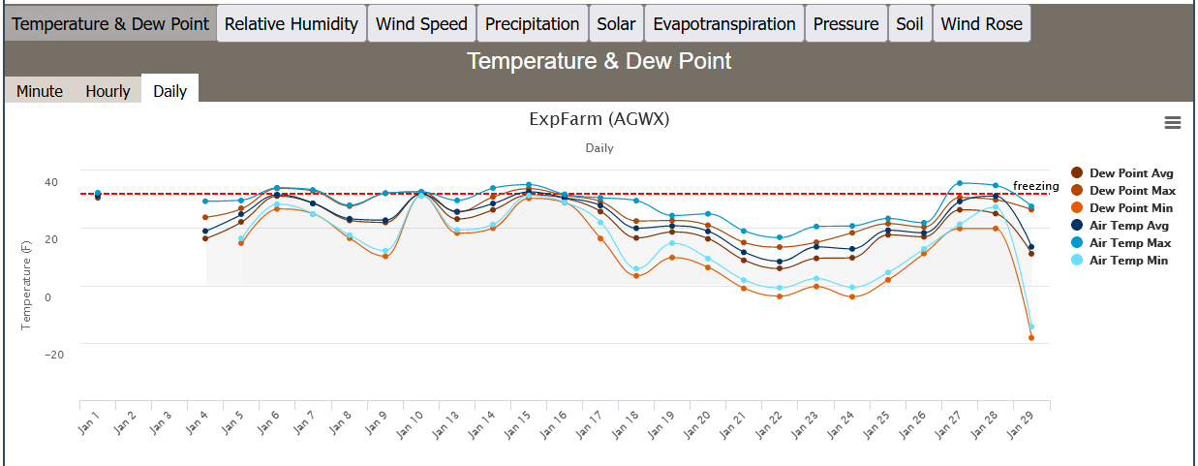
JANUARY 2023
(Hyrum, Ut)
35°
61°
25°
18°
49° temperature swing. Peach buds see significant damage at -13° F
-14.4°

Slide 19
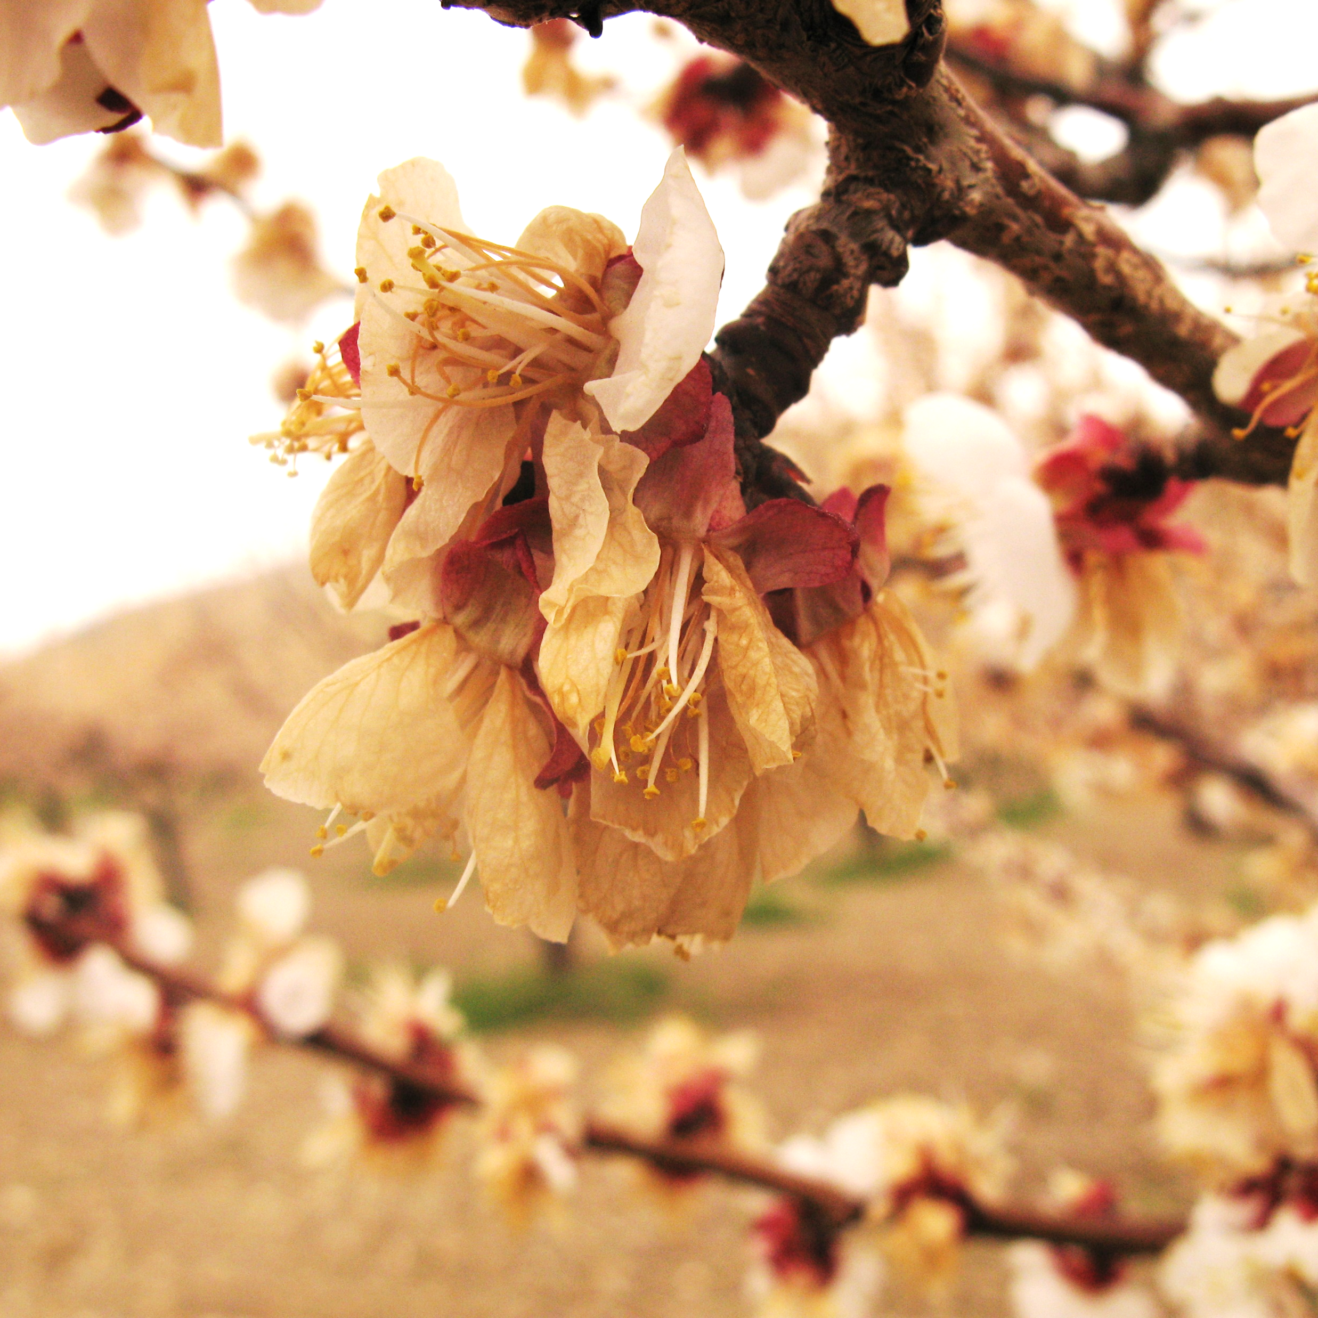
SPRING DAMAGE
Eco-dormancy
Damage occurs due to fluctuations in temperature
Growth has begun and plant tissues are not as hardy
Critical temperatures are for plant exposure for 30 minutes
Type of freeze can play into this

Slide 20
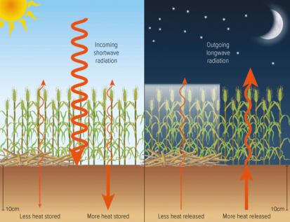
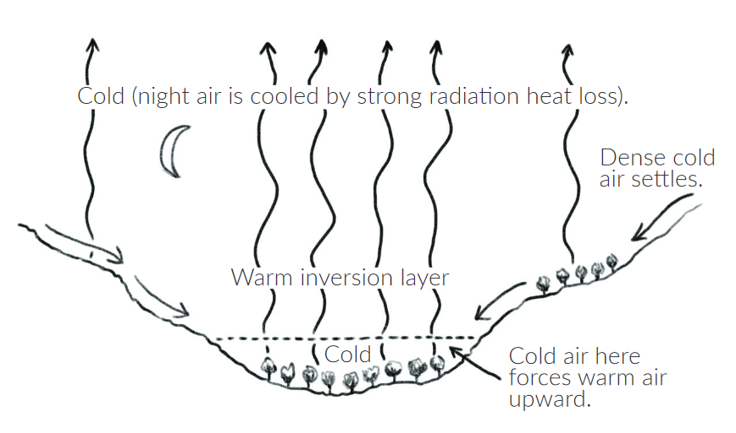
TWO TYPES OF FREEZES:
Advective
Occur when cold (and often) dry air blow into a region.
Usually windy.
Difficult to manage.
Radiative
Occur when clear, calm conditions occur which allow heat to escape out into space.
Frequently coupled with inversion.
Manage with wind machines, orchard heaters, tree covers, etc.

Slide 21
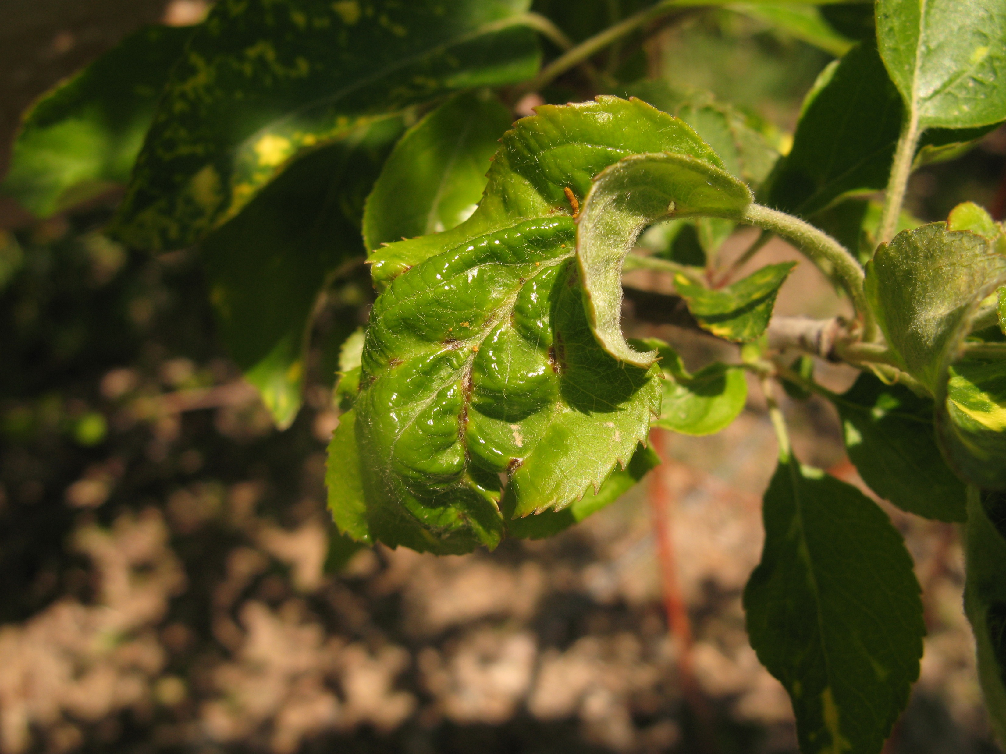
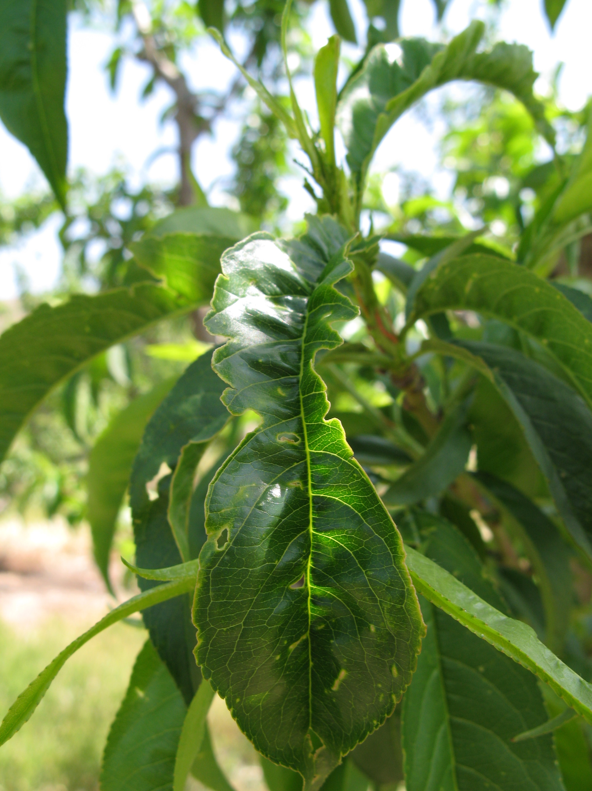
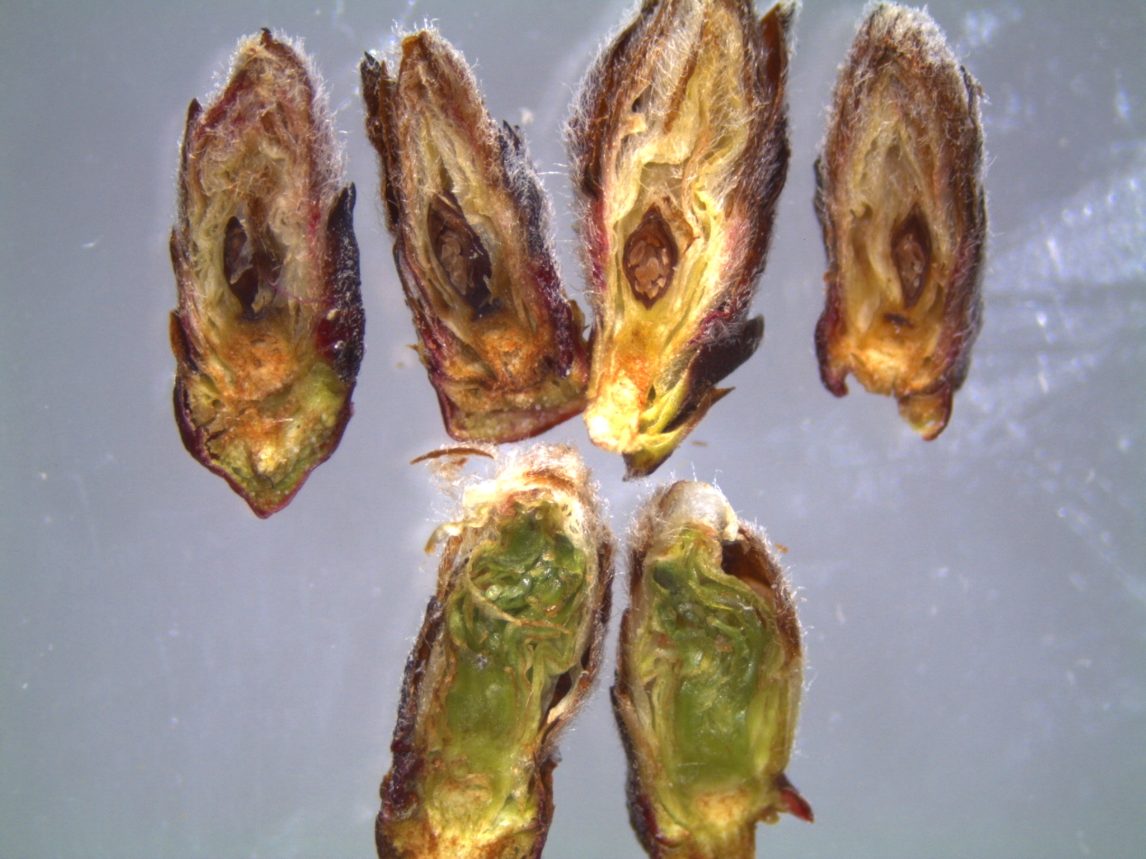
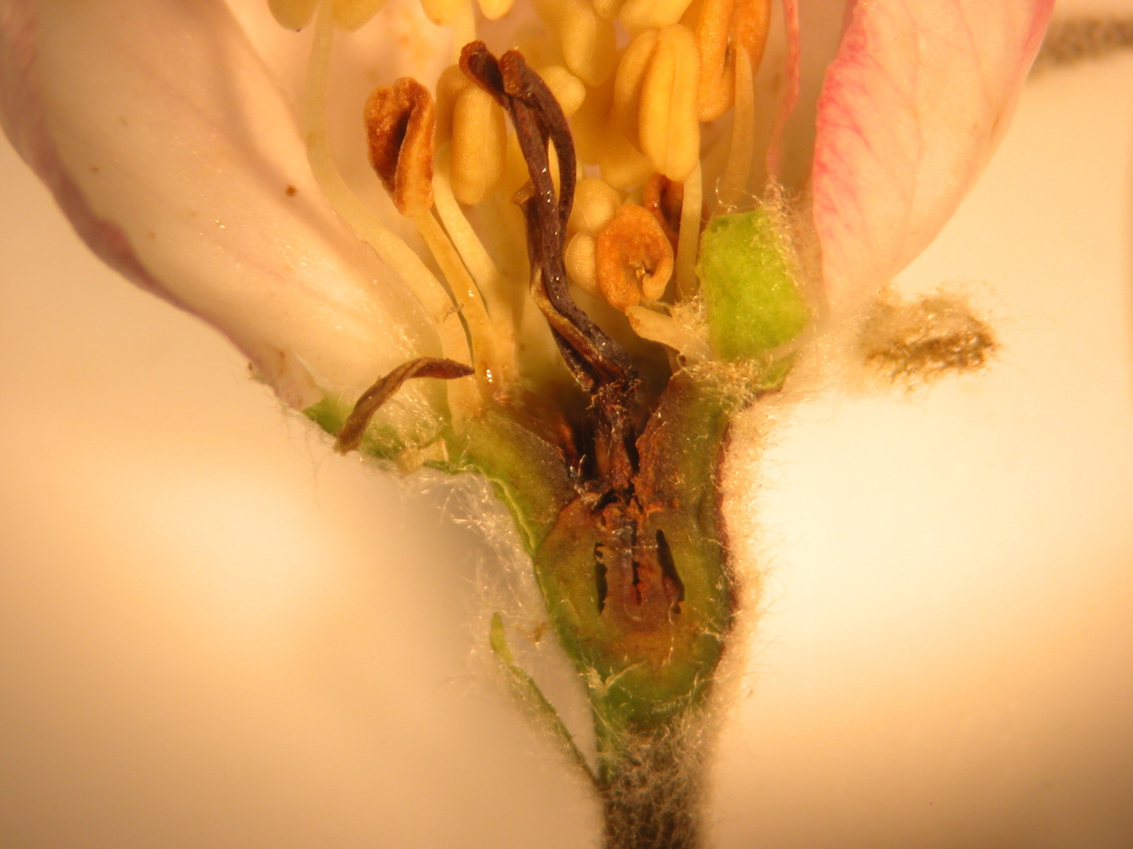
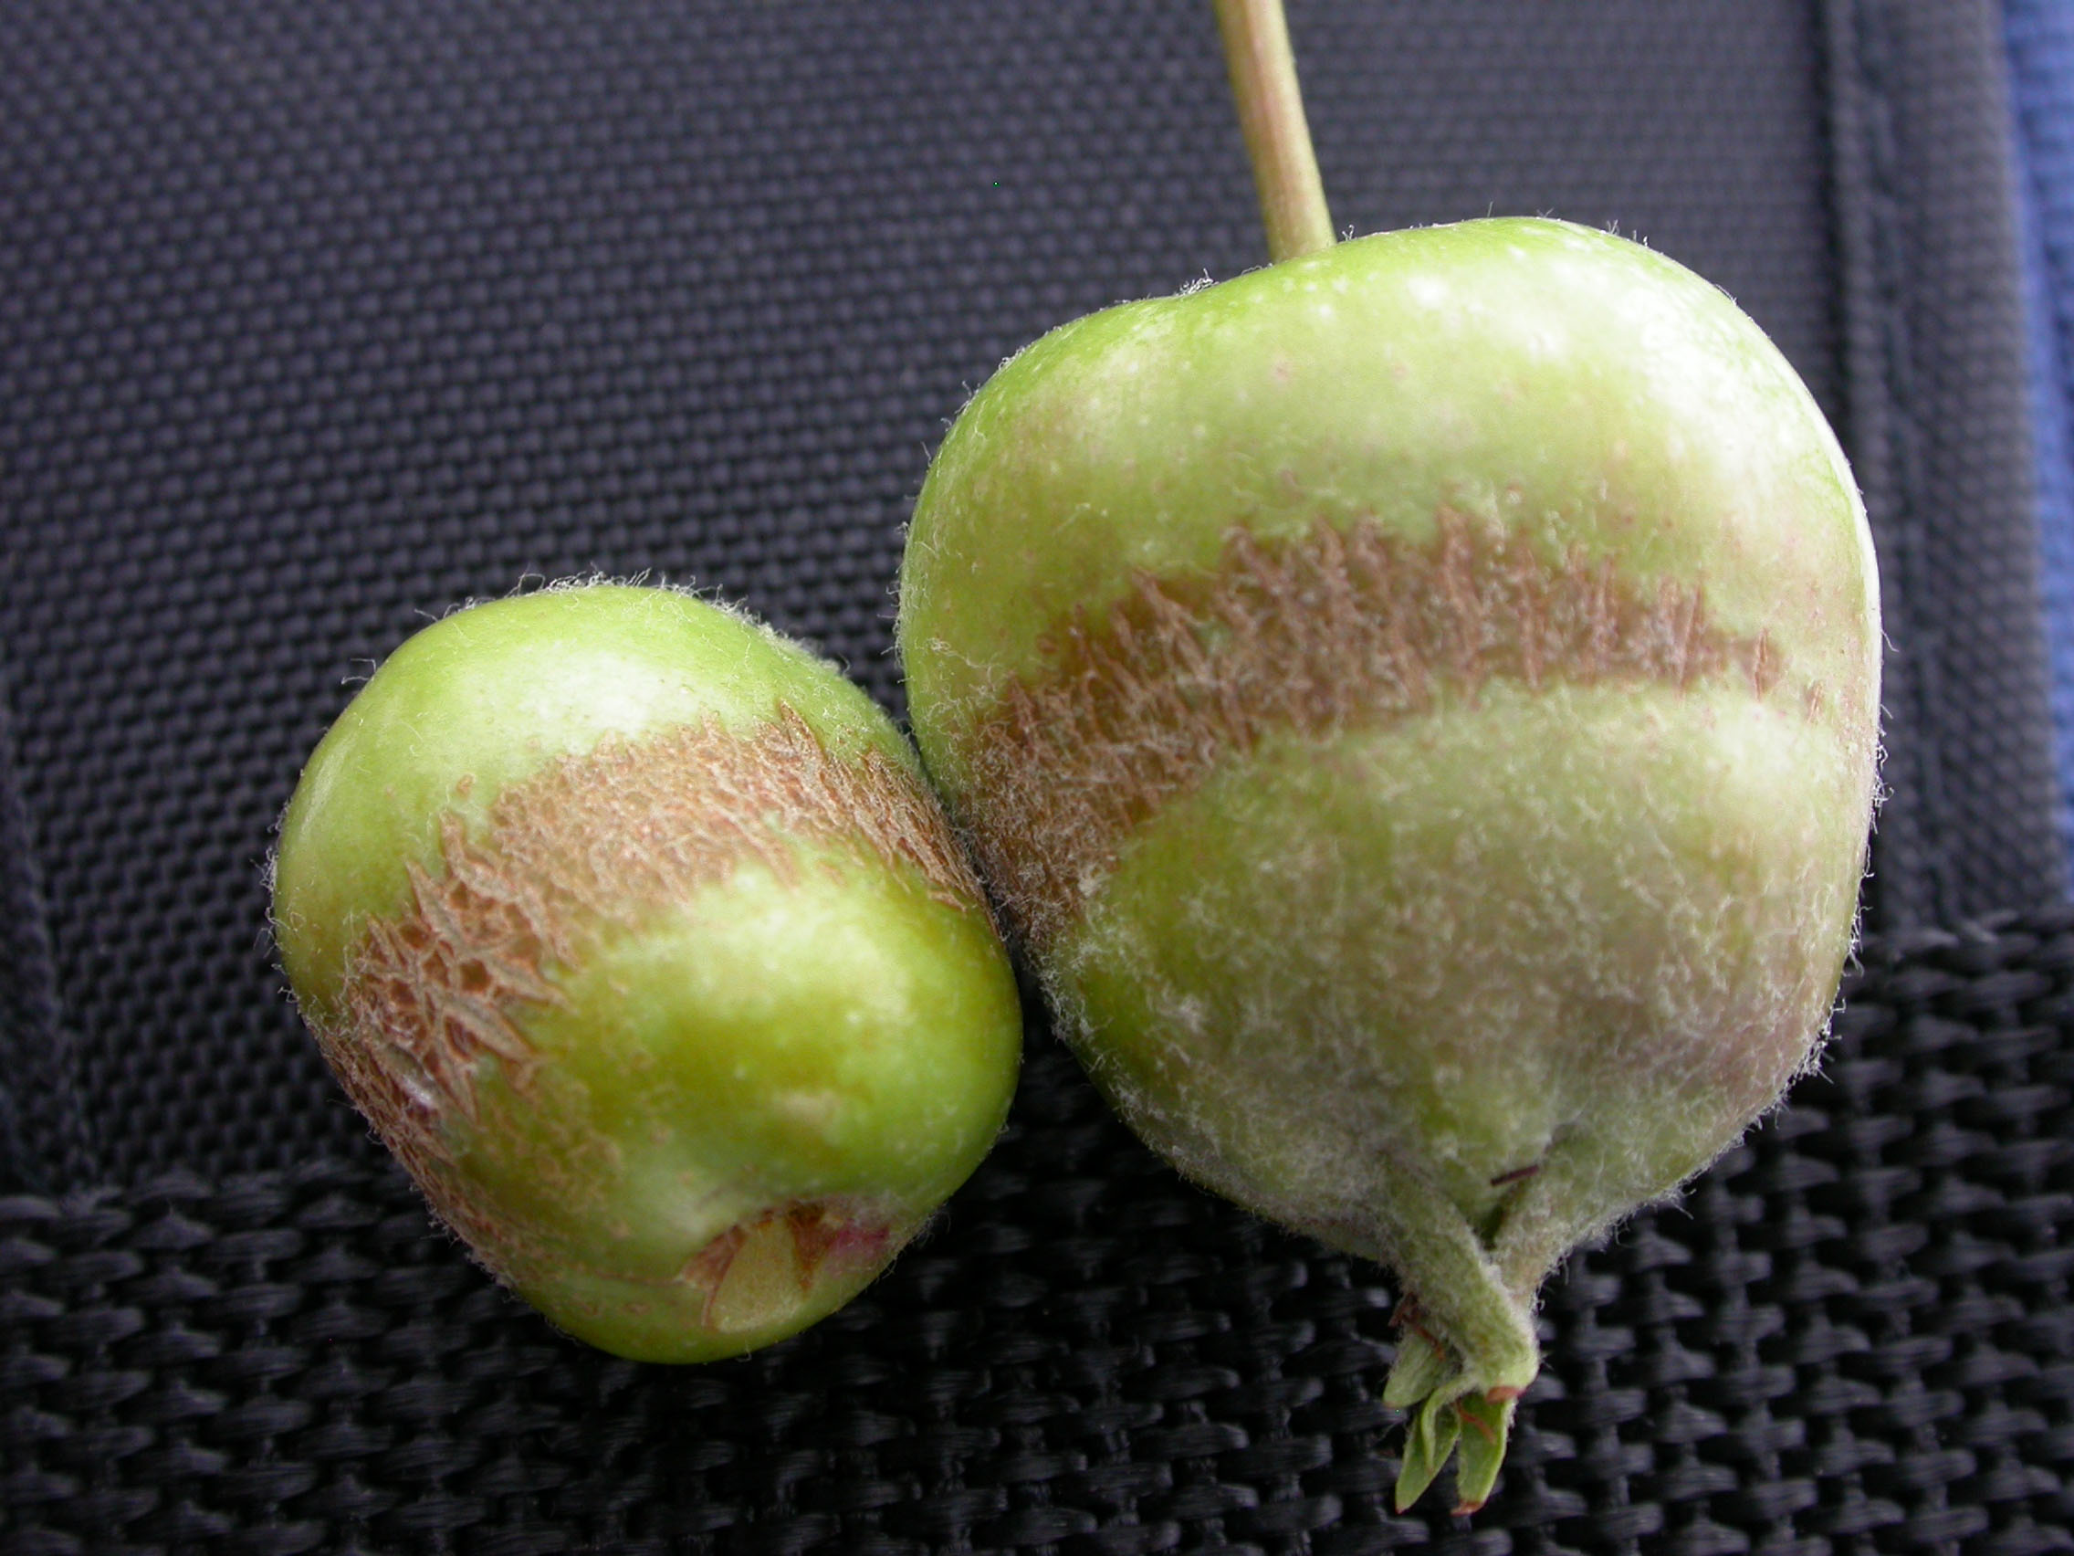
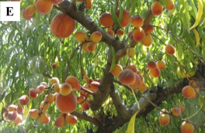
SPRING DAMAGE
Eco-dormancy
Damage occurs on buds, leaves, and fruit
Fruit loss
Russeting
Frost rings
Buttoning (can be genotype specific – ‘Loring’ relatives more prone)
Malformed or marred leaves and fruit
The more open the buds are the more susceptible they are to cold injury
Critical temperatures vary for fruit types and bloom stage (30 min.)

Slide 22
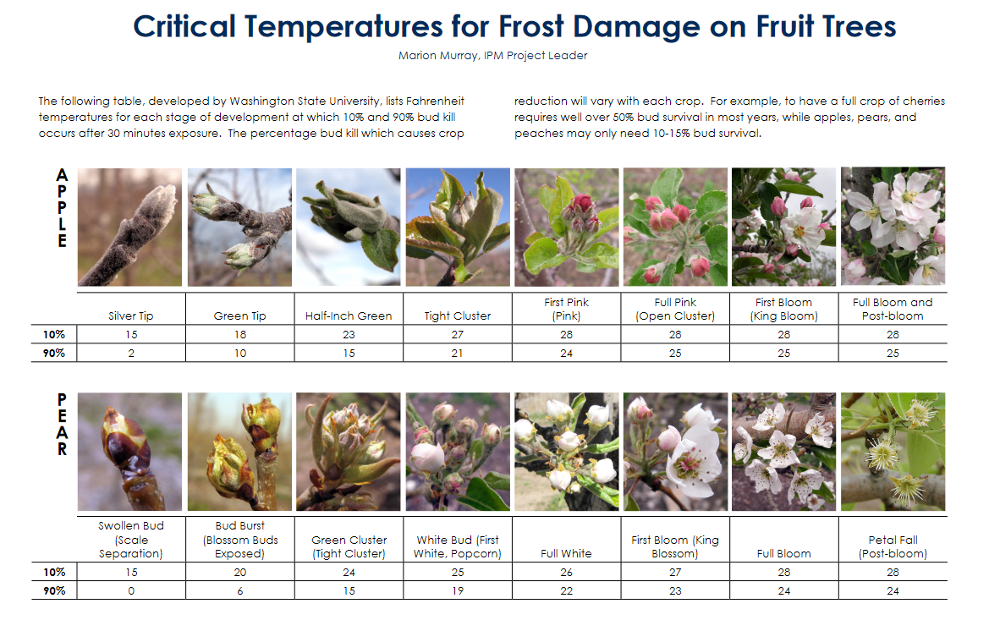

Slide 23
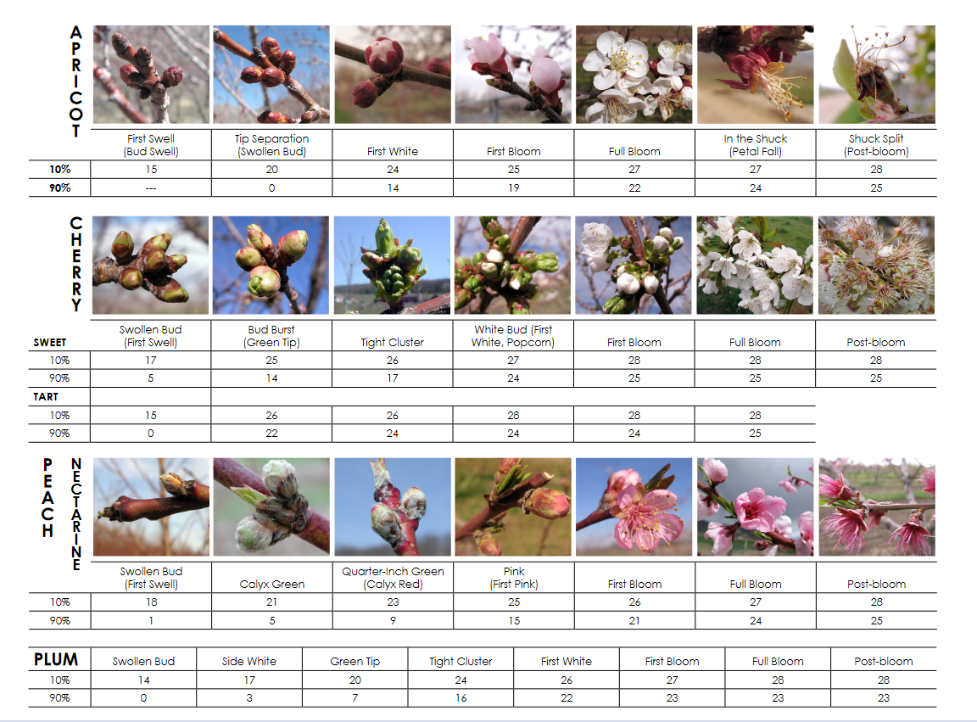

Slide 24
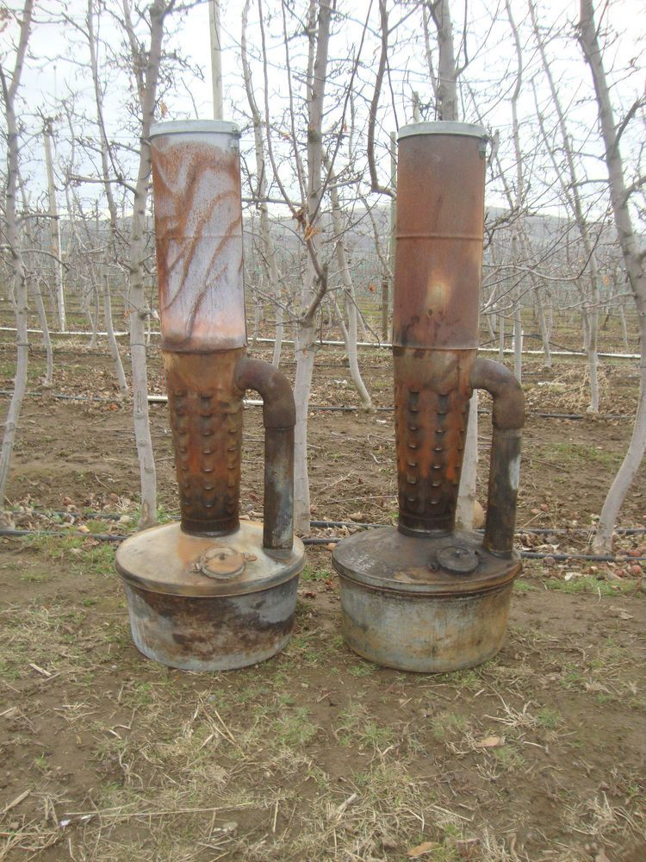
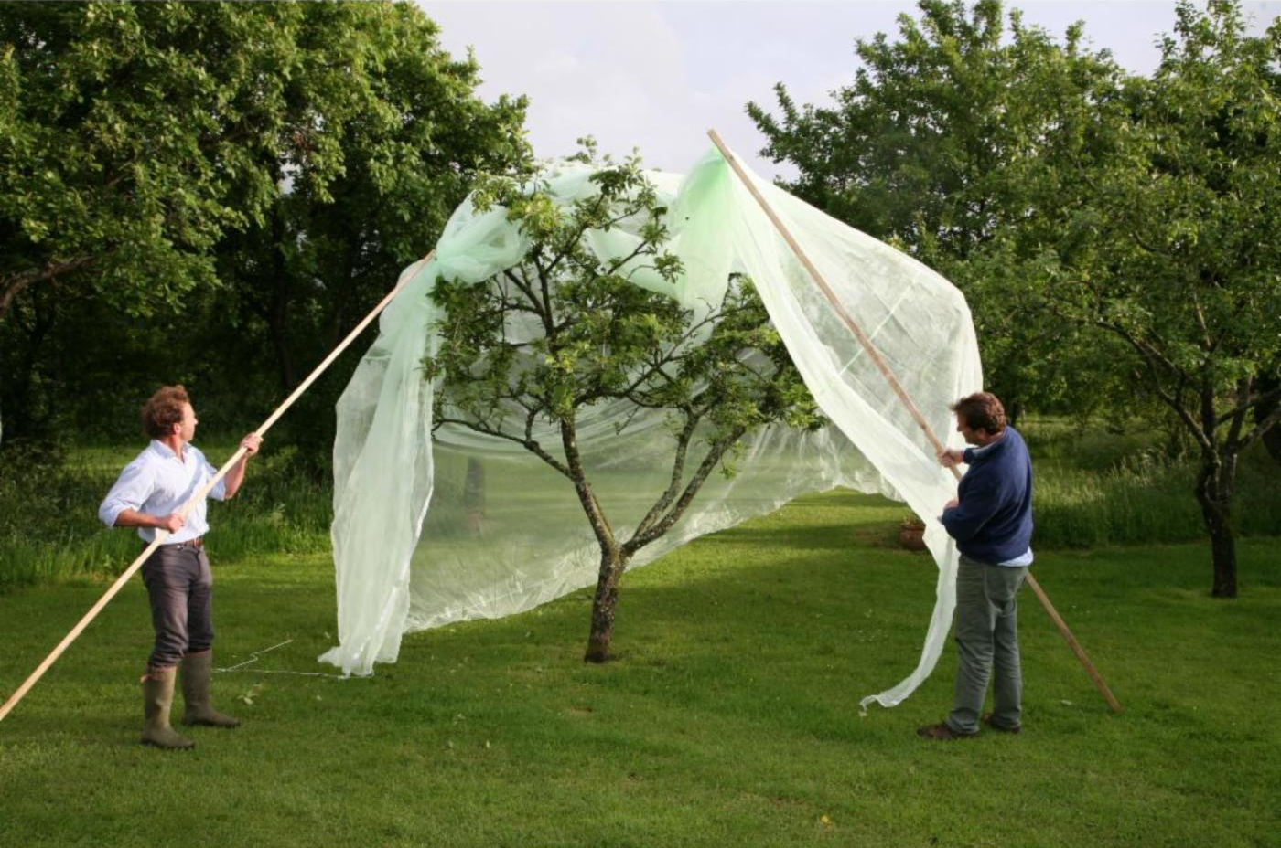
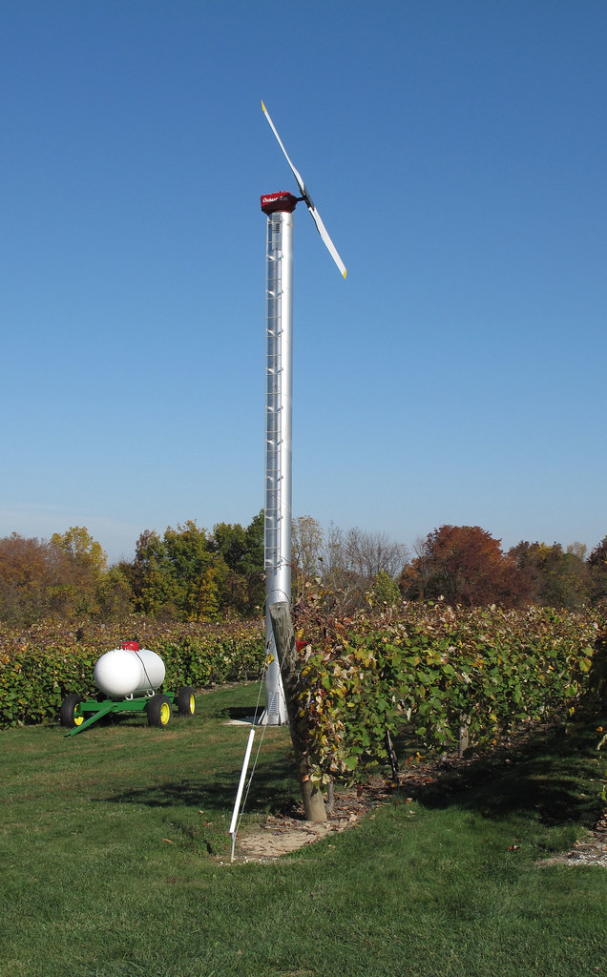
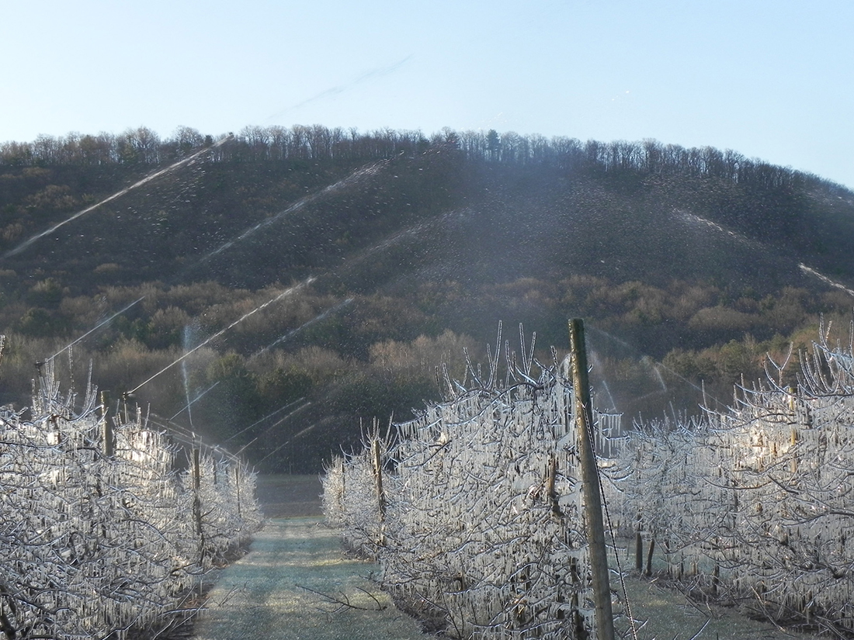
COLD PROTECTION IN SPRING
Wind machines/helicopters
Orchard heaters
Covering individual trees
Freezing water
Plastic mulches
May raise temperature by a few degrees if not covered with snow
Photo: R. Crassweller, Rutgers University

Slide 25
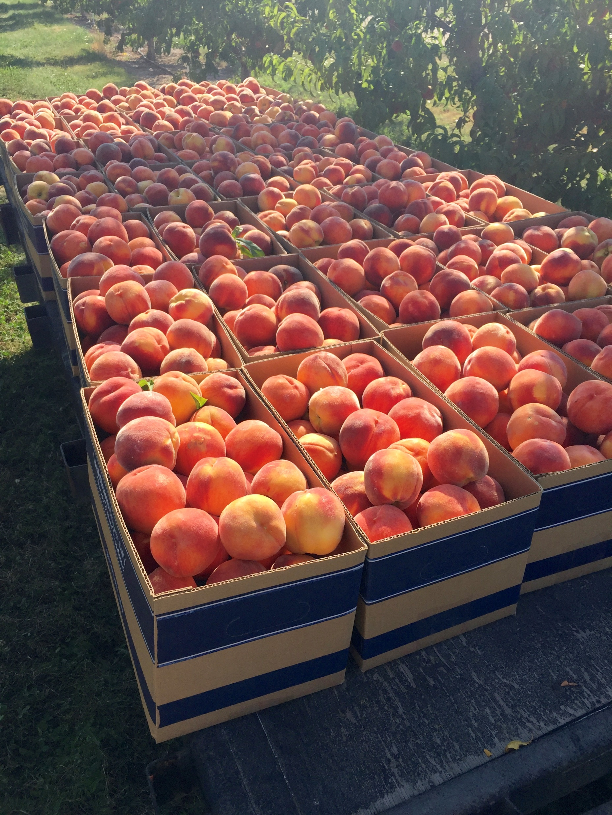
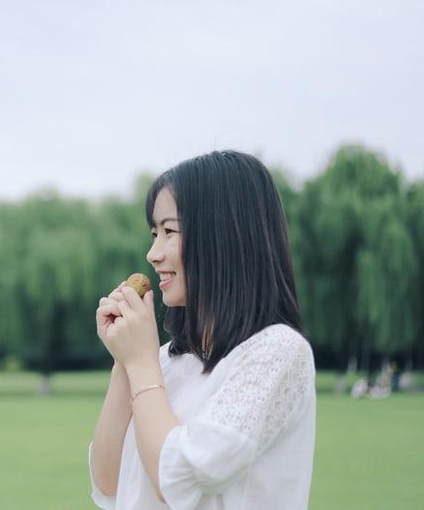
Questions?
Sheriden.Hansen@usu.edu
435-919-1335

