Slide 1

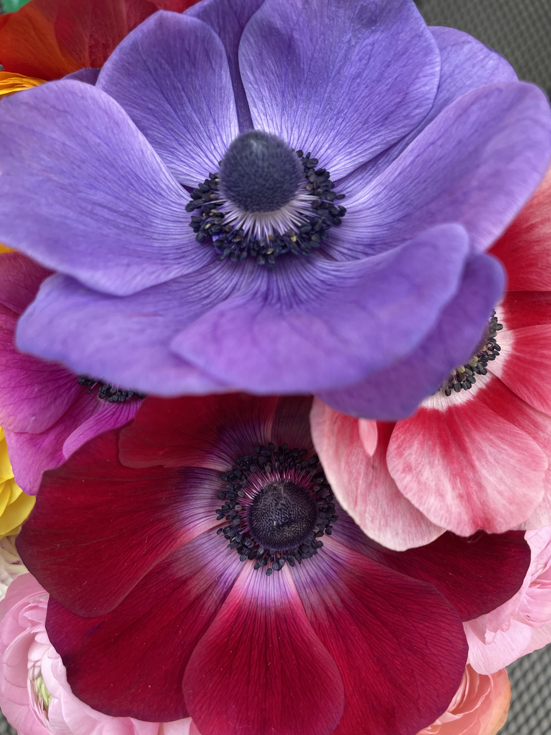
The Market for Local Cut Flowers
Florist Preferences, Needs, & Hurdles
Kynda Curtis, Ph.D.
Extension Food & Ag Marketing Specialist
Applied Economics

Slide 2
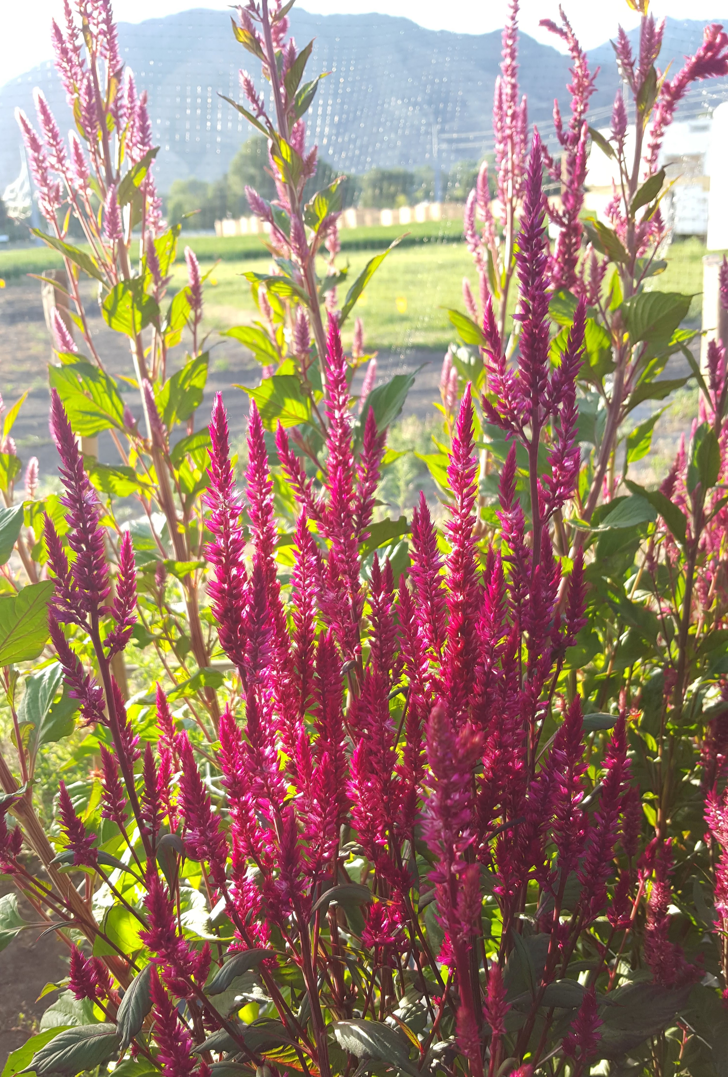
Today’s Discussion
Discuss survey results
  Survey of florists in Utah/surrounding communities
  Conducted by the Utah Cut Flower Association Fall 2021
  Assistance from USU - Kynda Curtis & Melanie Stock
  Online Qualtrics survey distributed to contacts & florist directory
  42 complete responses
Florist respondent characteristics
Local sourcing preferences
Perceived barriers/hurdles to local sourcing
Floral/greenery needs

Slide 3
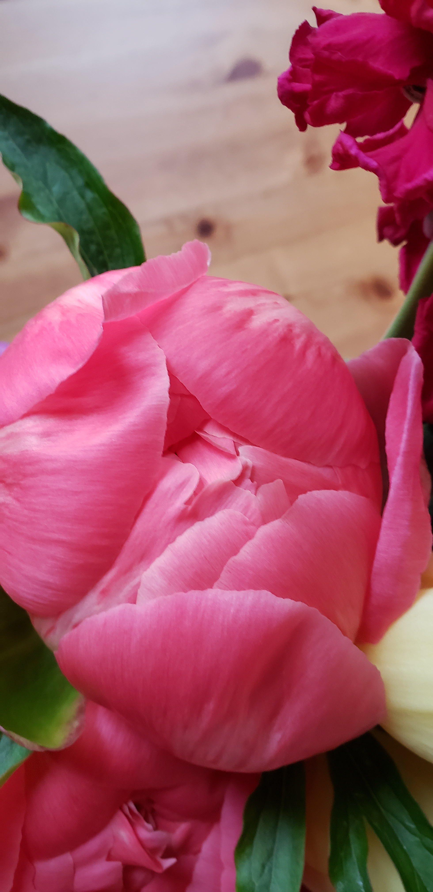
Florist Characteristics
Relatively new to the floral business, 44% less than 5 years
Service weddings, daily flowers, funerals, corporate events
Per wedding income falls primarily between $1,000 and $5,000
2021 went well (sales recovered or increased to 2019 levels and beyond), positive about 2022 sales
Source primarily from local wholesalers
  White, blush, salmon, blue, lavender colors

Slide 4
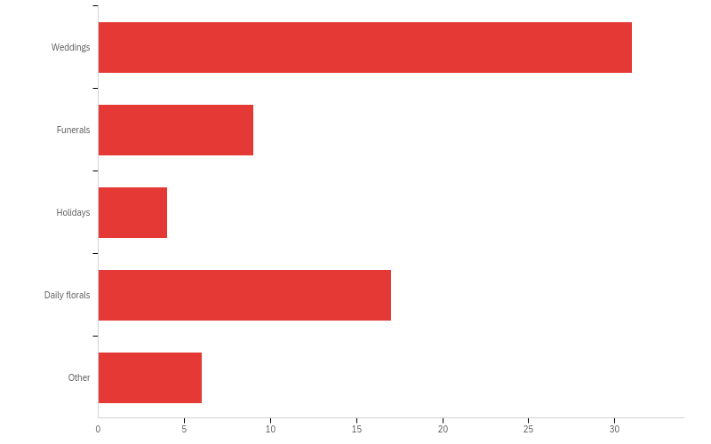
Which of the following best describes your primary clientele? (Select the top two)
Other
Corporate
Flowers subscription clients
Corporate work
Corporate events

Slide 5
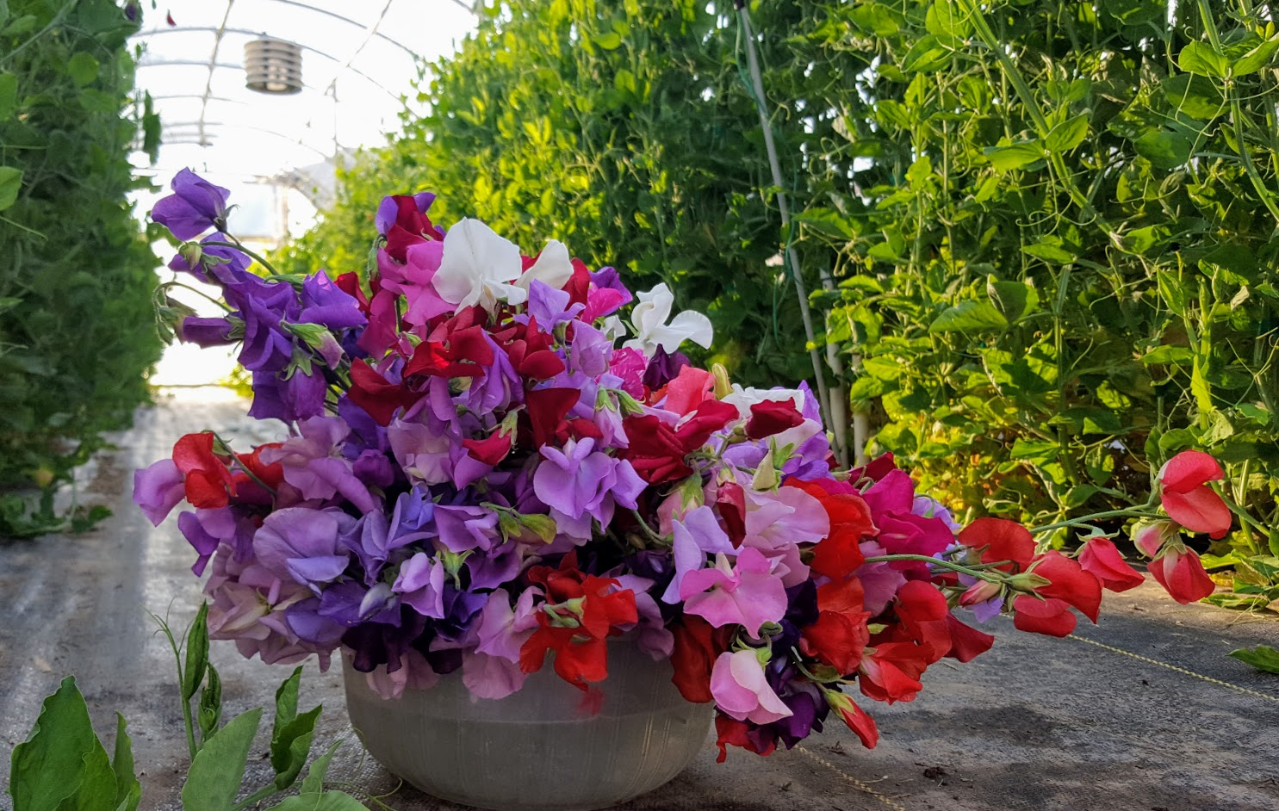
How many years have you operated a floral business?
Years | Percentage | Count
Less than 5 years | 43.59% | 17
6 to 10 years | 25.64% | 10
11 to 20 years | 20.51% | 8
More than 20 years | 10.26% | 4
Total | 100% | 39

Slide 6
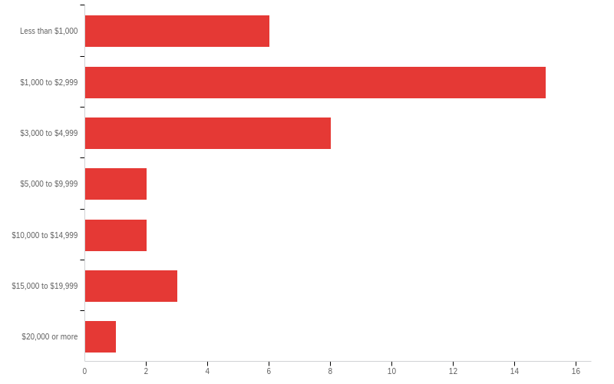
If weddings are part of your business focus, what is your typical wedding size (in dollars)?
Amount | Percentage
Less than $1,000 | 16.22%
$1,000 to $2,999 | 40.54%
$3,000 to $4,999 | 21.62%
$5,000 to $9,999 | 5.41%
$10,000 to $14,999 | 5.41%
$15,000 to $19,999 | 8.11%
$20,000 or more | 2.70%
Total | 100%

Slide 7
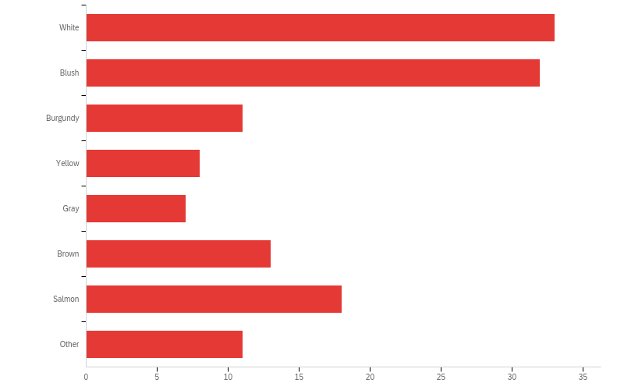
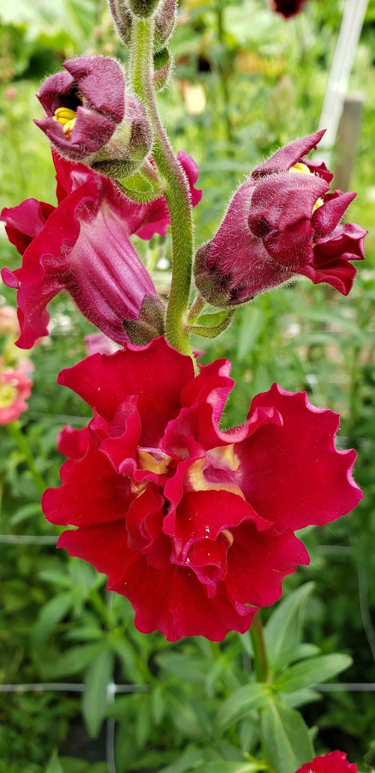
What color trends are you seeing for YOUR business in 2022? (Select the top three)

Slide 8
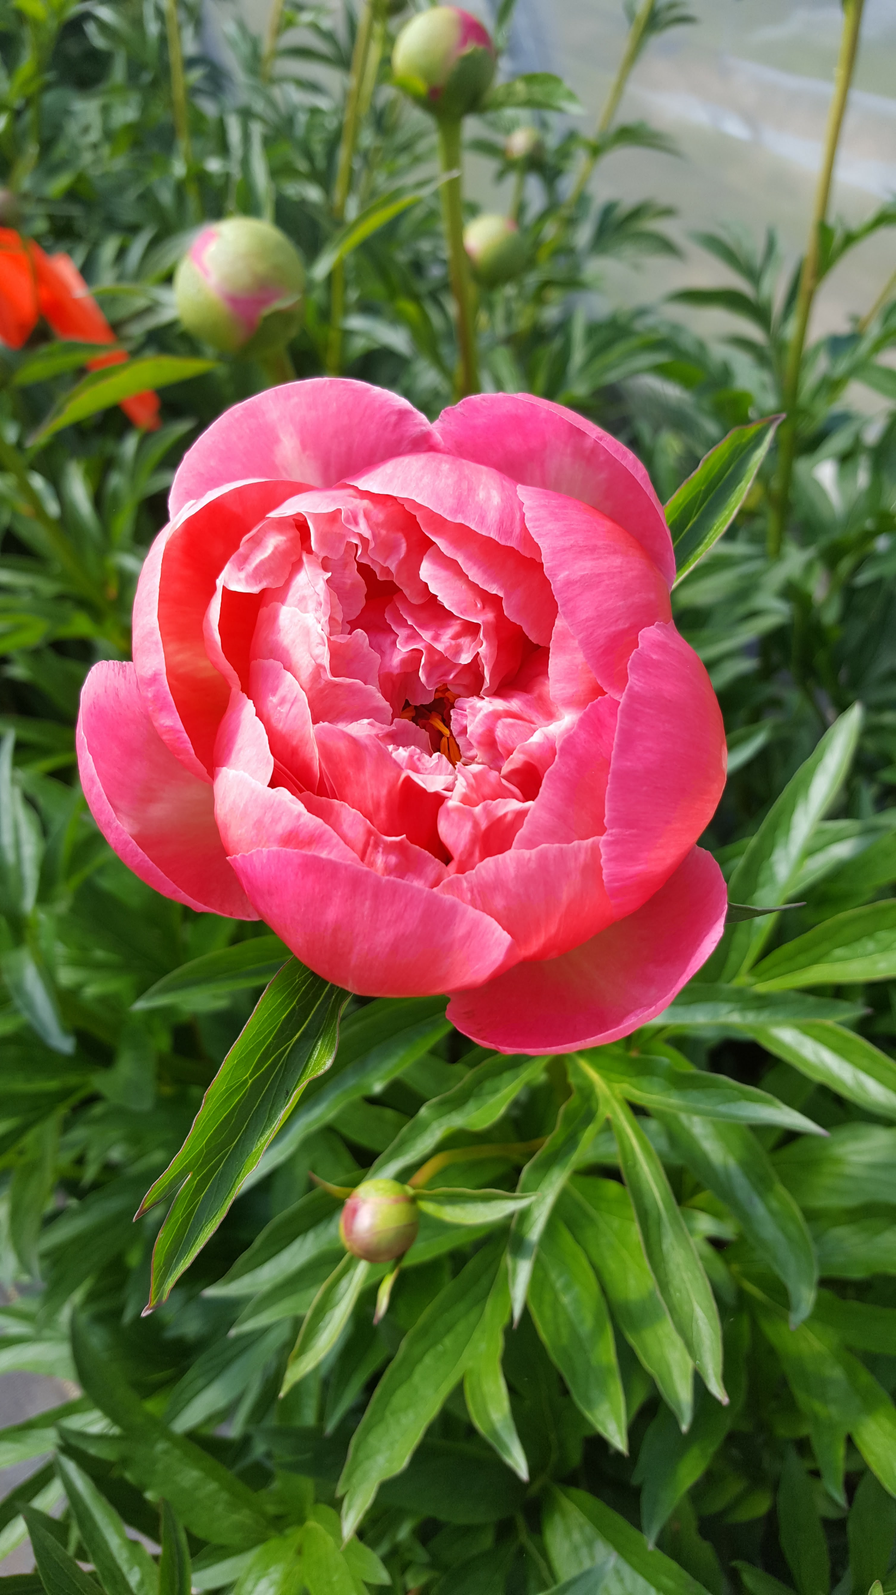
Other
Champagne
Gold tipped roses with floral paint
Lavender, copper, periwinkle, peach
Color is becoming much more popular - but more so, muted colors - so not true yellow but buttery or mustard yellow, lavender, mauve, etc
Blue*, variegated types and unique blends
Neutrals, light blues
Terracotta
Vibrant colors, vibrant as possible

Slide 9
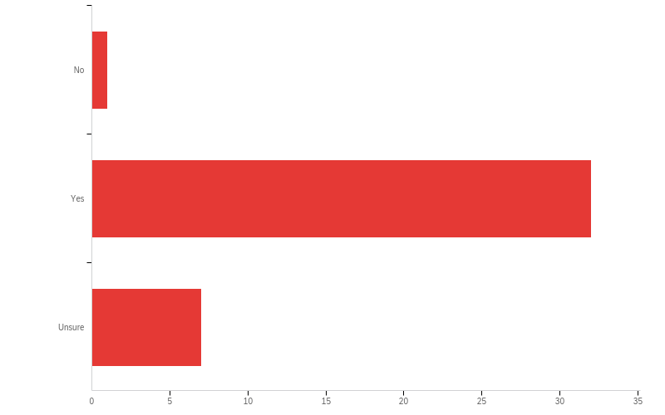
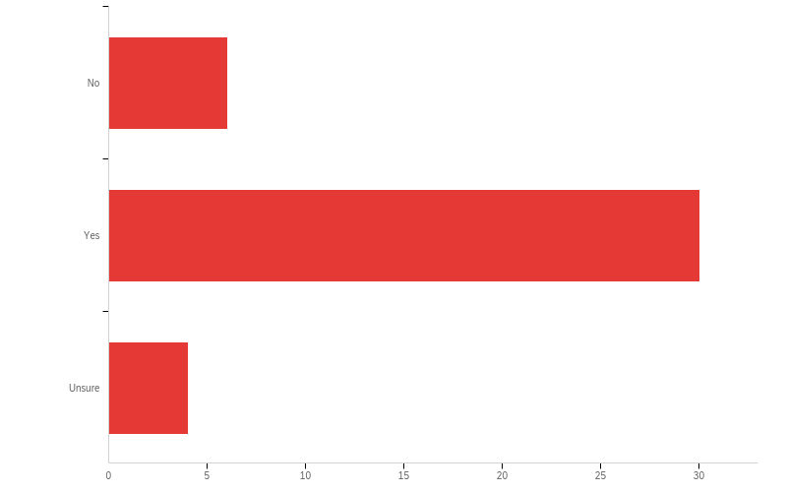
Sales Situation
Did your 2021 floral sales reach 2019 (pre-pandemic) levels?
Do you feel floral sales will increase in 2022?

Slide 10
From which of the following do you source most of your flowers? (Choose only one)
 | Percentage | Count
Local farms | 11.36% | 5
Wholesalers - local | 68.18% | 30
Online | 4.55% | 2
Other | 15.91% | 7
Total | 100% | 44
Other
Mayesh, floral reserve
My own flower farm
Out of state wholesalers
Trader Joe’s, then local farms
Farms in colombia, california and south america

Slide 11
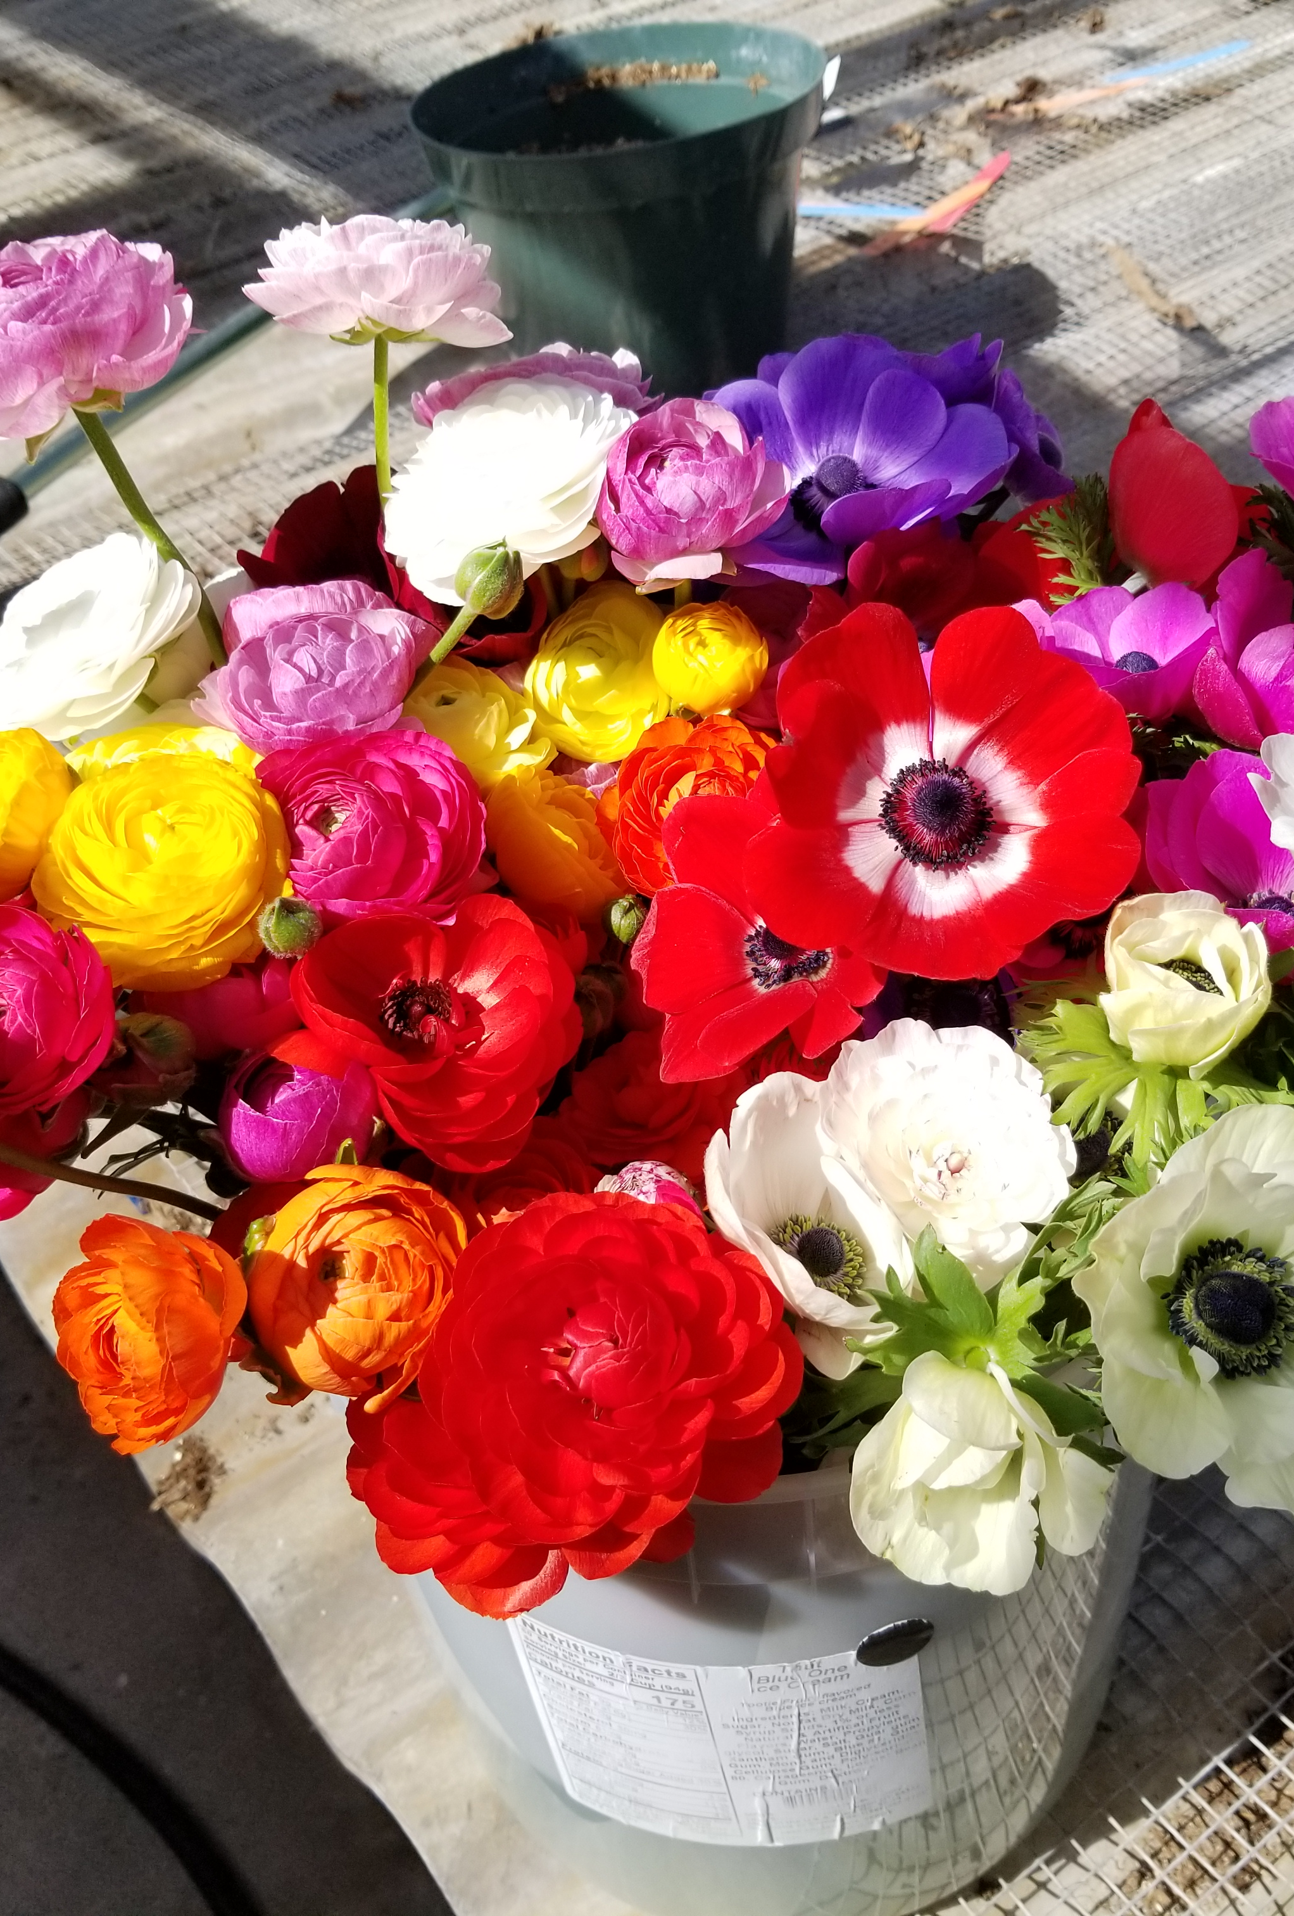
Local Sourcing Preferences
Local sourcing happening but in bunches…(excuse the pun)
  50% sourcing 10% or less from local growers
  40% sourcing 11-50% from local growers
Currently sourcing from only a few local growers (2-4)
Great interest in sourcing from local growers
  Why? Supporting local economy, unique selection, vase life
Willing to pay up to 20% more for local flowers

Slide 12
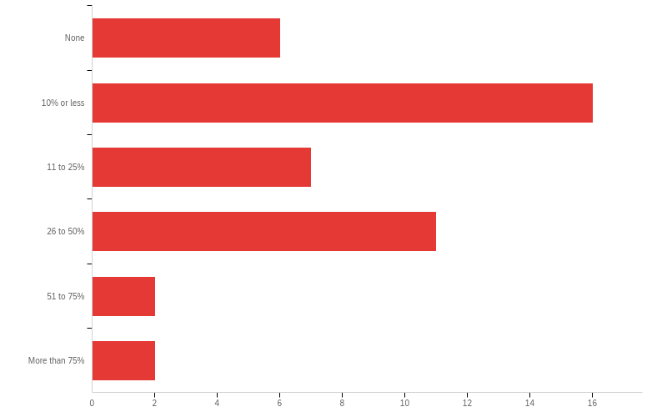
What percentage of the flowers you used in 2021 were sourced from local farms/growers? (Utah, or within 150 miles of your floral business)
 | Percentage
None | 13.64%
10% or less | 36.36%
11 to 25% | 15.91%
26 to 50% | 25.00%
51 to 75% | 4.55%
More than 75% | 4.55%
Total | 100%

Slide 13
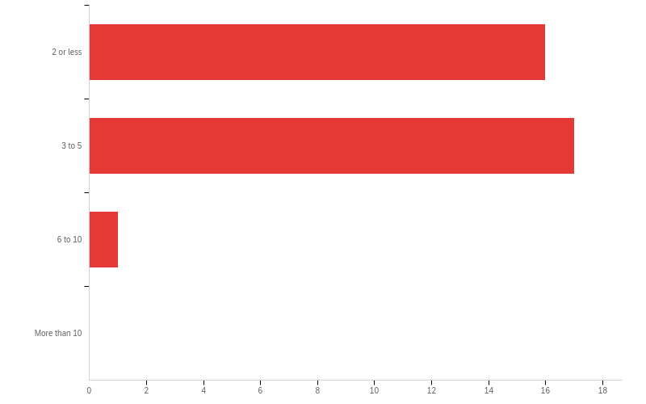
If you sourced flowers locally in 2021, from approximately how many growers/farmers did you source?

Slide 14
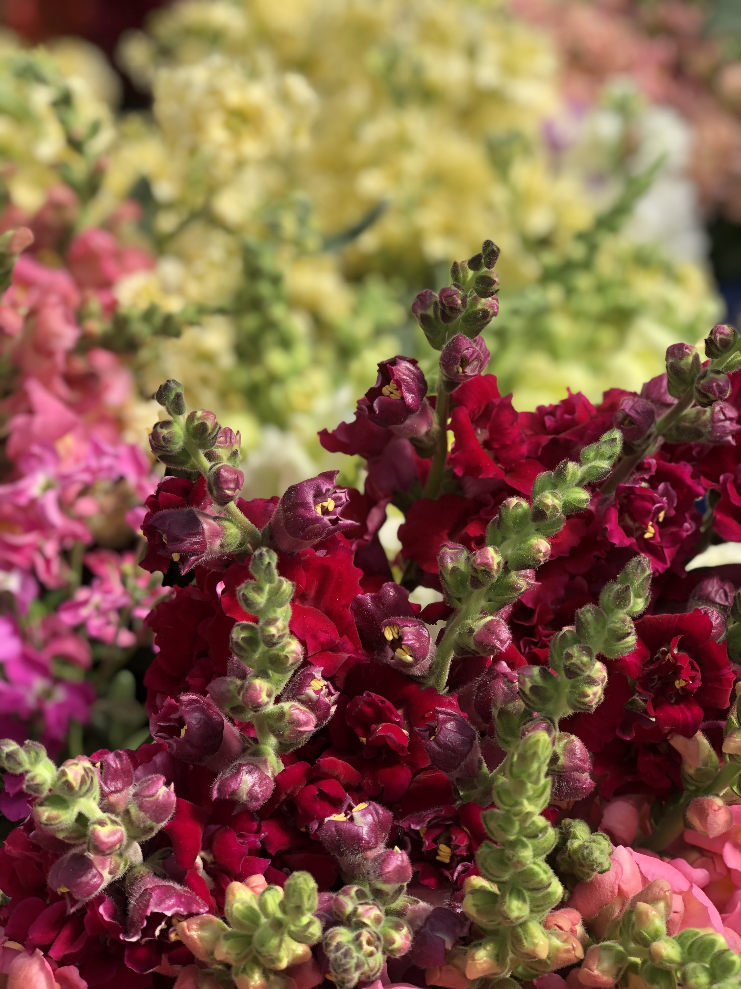
In 2022, what percentage of your flowers would you like to source locally?
 | Percentage | Count
None | 0.00% | 0
10% or less | 7.14% | 3
11 to 25% | 16.67% | 7
26 to 50% | 28.57% | 12
51 to 75% | 26.19% | 11
More than 75% | 21.43% | 9
Total | 100% | 42

Slide 15
What do you feel are the benefits of sourcing flowers locally? (Choose all that apply)
 | Percentage | Count
None | 0.00% | 0
Quality - vase life | 20.59% | 35
Quality - event ready | 14.12% | 24
Unique selection | 18.82% | 32
Reliable supply | 7.06% | 12
Promotional aspects - supporting local economy | 21.18% | 36
Promotional aspects - sustainable production systems | 17.06% | 29
Other | 1.18% | 2
Other
Supporting local businesses
Sustainability

Slide 16
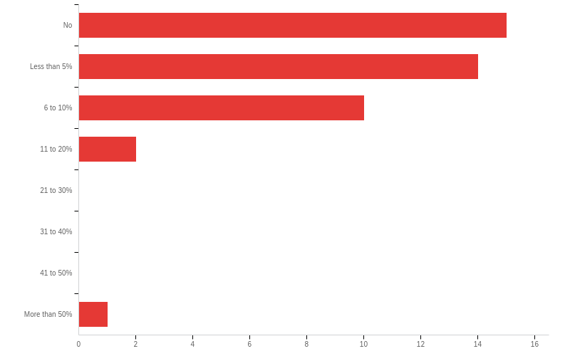
Would you be willing to pay more for locally sourced cut flowers? If so, what percentage over wholesale pricing?
 | Percentage
No | 35.71%
Less than 5% | 33.33%
6 to 10% | 23.81%
11 to 20% | 4.76%
More than 50% | 2.38%

Slide 17
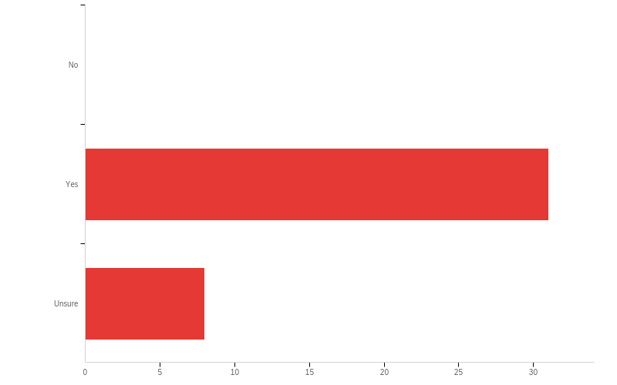
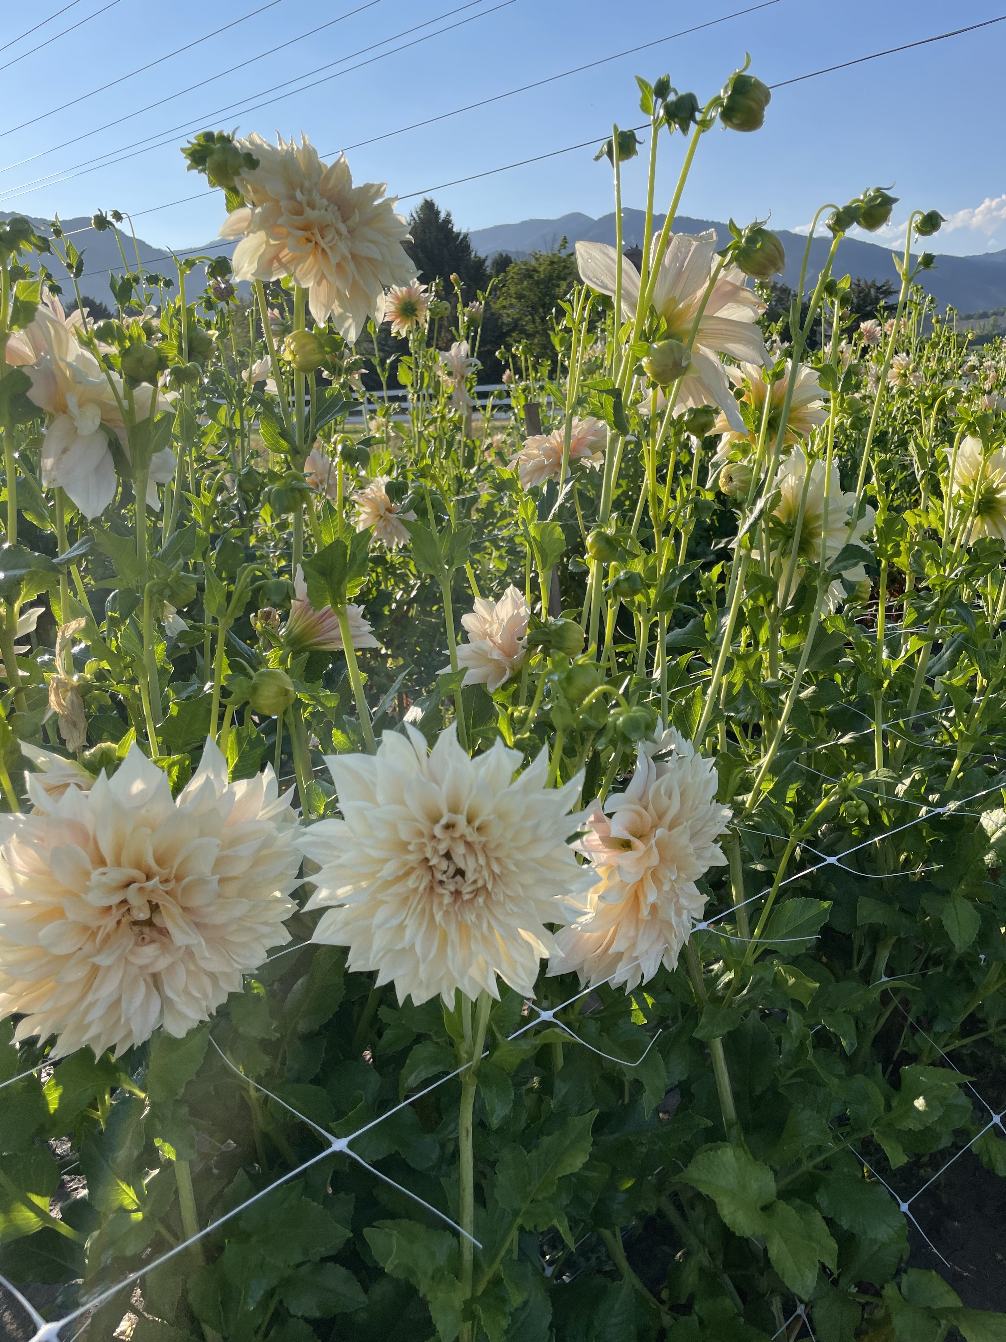
Has the availability of local flowers benefited your floral business?

Slide 18
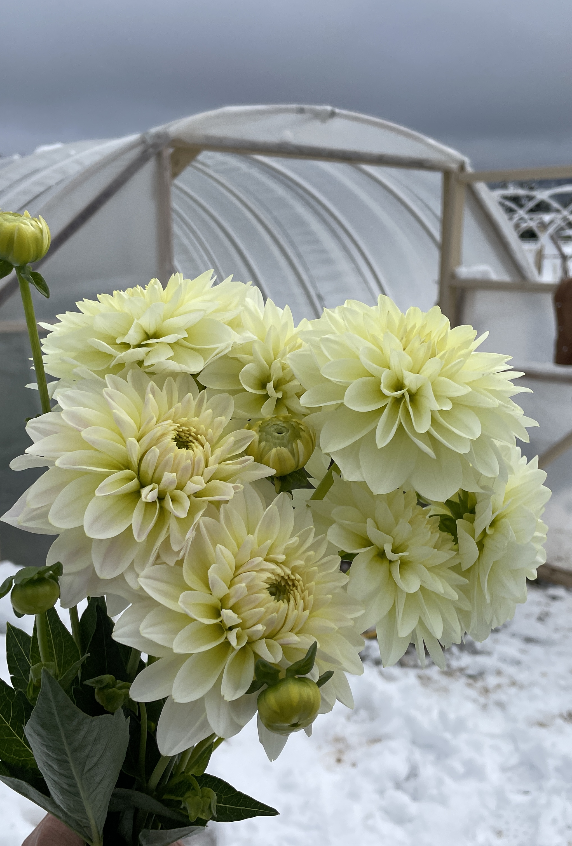
Hurdles to Local Sourcing
Major hurdles to local sourcing
  Lack of inventory/supply (availability, quantities)
  Lack of varieties needed (types)
  Time to communicate with multiple growers
Also, lack of knowledge of who to buy from
  20 respondents would like information on Utah growers
Quantity requirements
  2-5 bunches per flower – 37%
  6-10 bunches per flower – 18%

Slide 19
What barriers do you currently face in sourcing local flowers? (Choose all that apply)
 | Percentage | Count
Don’t know where/from who to purchase | 13.11% | 16
Time required to communicate with many growers/farmers | 15.57% | 19
Pricing | 13.11% | 16
Lack of inventory/supply | 18.85% | 23
Lack of types/varieties needed | 22.13% | 27
Delivery capabilities or issues | 13.11% | 16
Other | 4.10% | 5
Total | 100% | 122
Other
Related to delivery: I love picking up locally grown product but the distance/time to travel prevents me at times.
I need high quantities usually that can’t be met. I need guaranteed crop.
Not being able to order in advance. Feeling confident they will have what I need for the event. Trusting that the product will actually be there. Too last minute with local farmers.

Slide 20
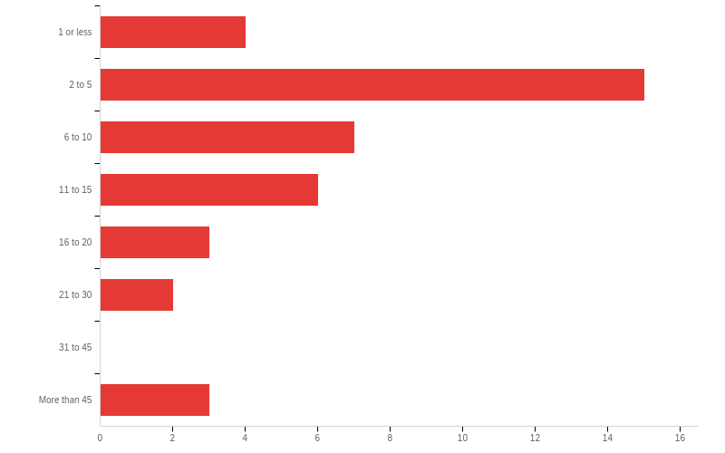
What is the minimum number of bunches per flower you need weekly from a local grower/farmer to meet your quantity goals for a supplier?
 | Percentage
1 or less | 10.00%
2 to 5 | 37.50%
6 to 10 | 17.50%
11 to 15 | 15.00%
16 to 20 | 7.50%
21 to 30 | 5.00%
31 to 45 | 0.00%
More than 45 | 7.50%
Total | 100%

Slide 21
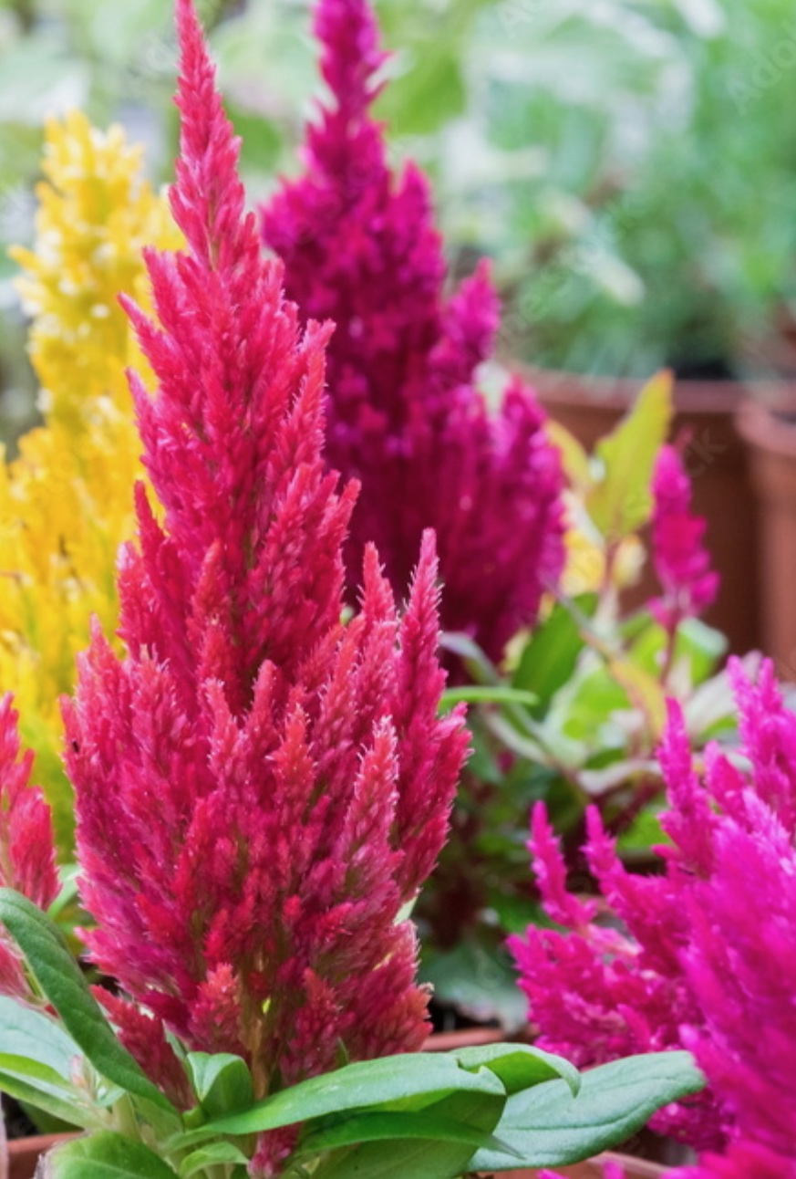
Floral/Greenery Needs
Some difficulty obtaining needed flower types/colors from wholesalers
  Roses, ruscus, dahlia, eucalyptus
  Blue, white, brown, coral, rust, grey
Definite need for locally grown flowers
  Dahlia, tulips, roses, zinnia

Slide 22
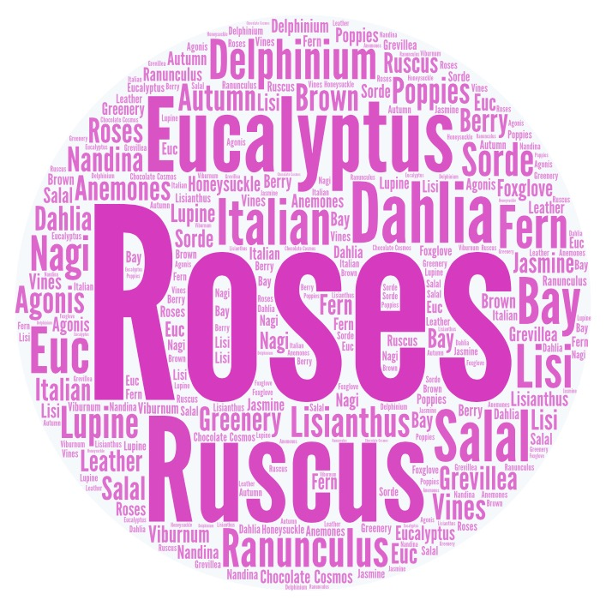
Flower variety/greenery used in more than 50% of your designs that is difficult to obtain from wholesalers

Slide 23
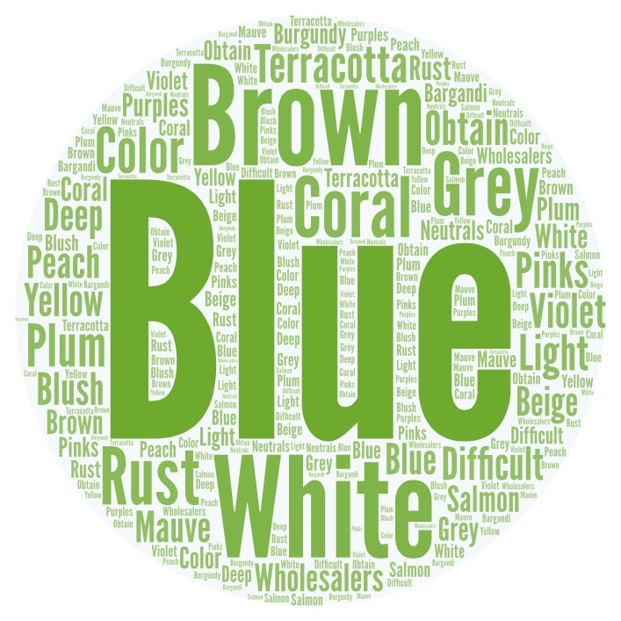
Colors difficult to obtain from wholesalers

Slide 24
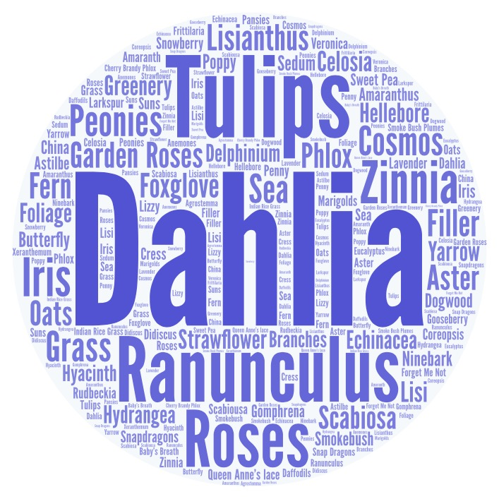
Flower types/varieties preferred from a local grower/farmer

Slide 25
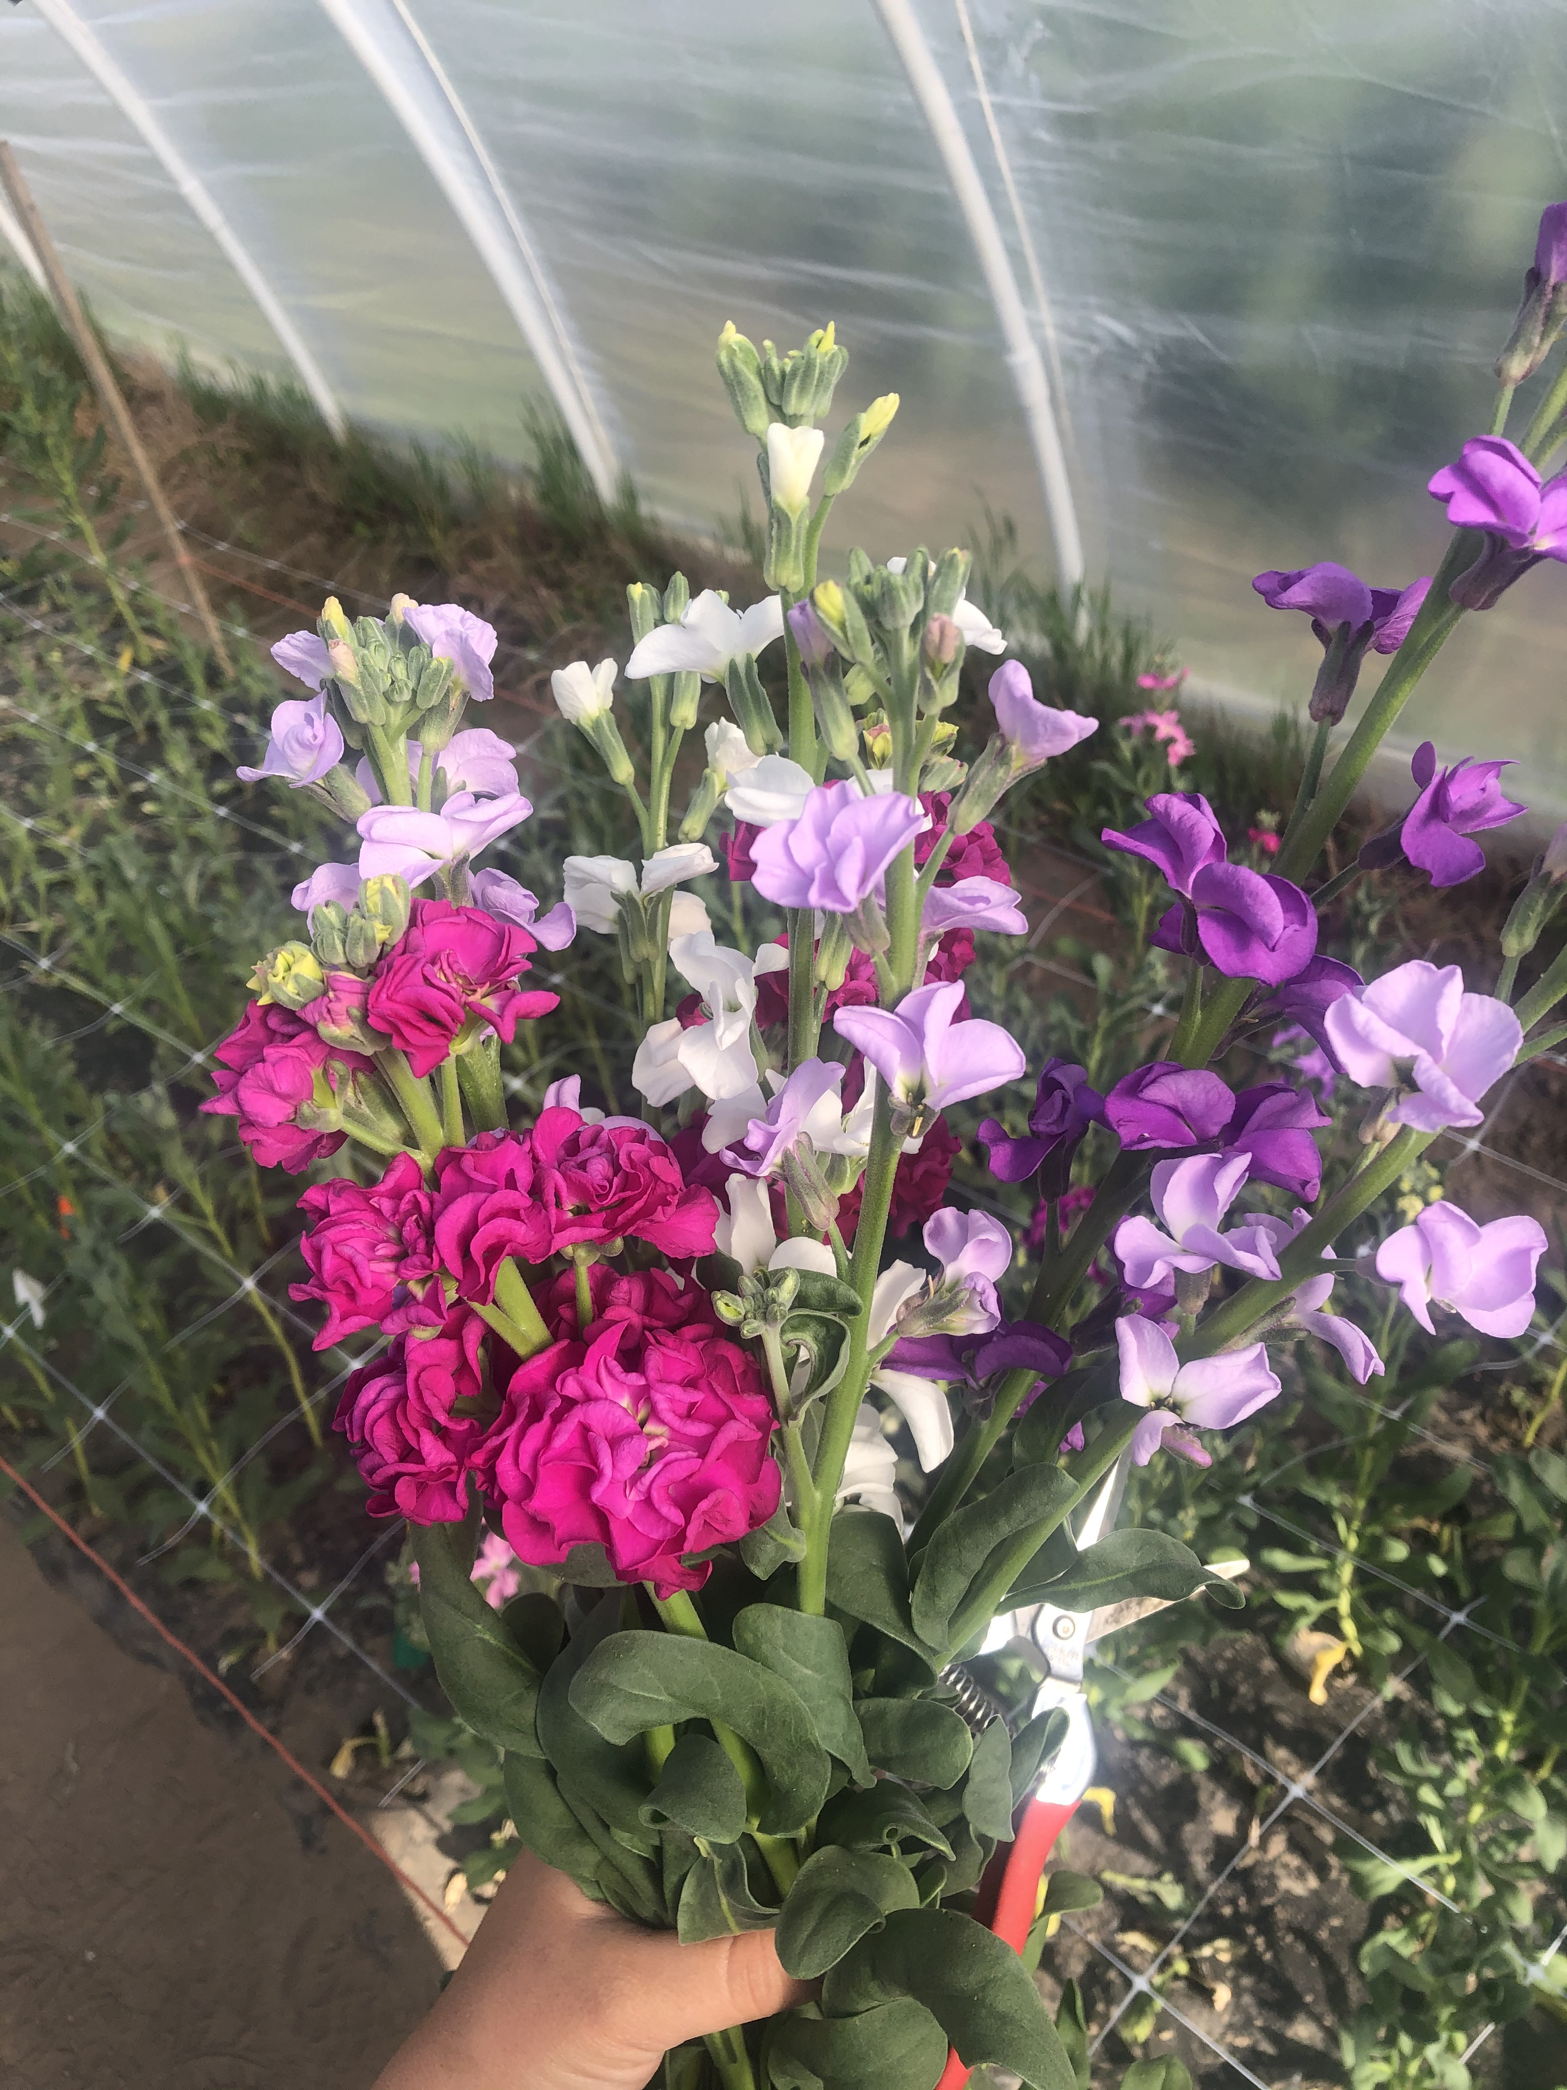
Questions?
Thank you!

