Slide 1
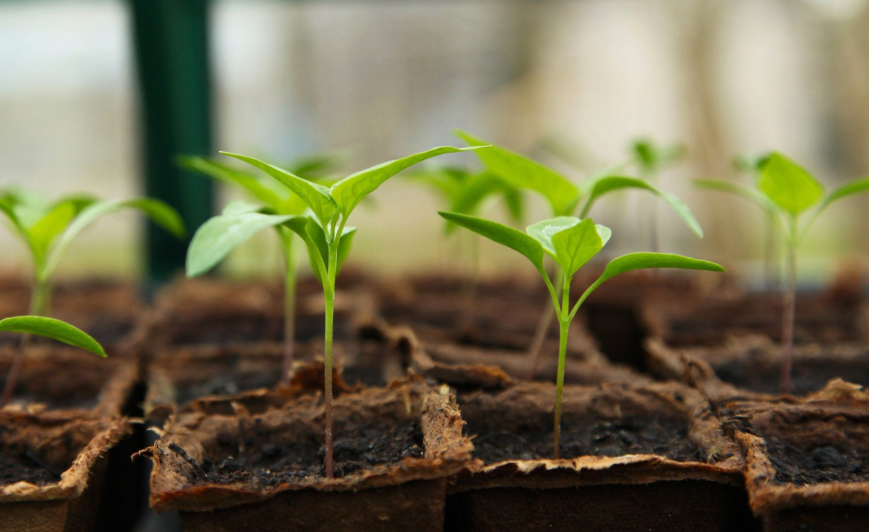
Welcome to Marketing and Management Session
10th Annual Urban and Small Farms Conference
Please use the Q&A to ask your questions (not the chat)
Presenters will answer questions at the END of the presentation
PLEASE fill out the surveys between presenters. It helps us better serve you!
These presentations will be recorded and made available on www.diverseag.org after the conference they should all be done by March 15th.
Closed captioning can be turned off on your personal computer using the controls at the bottom of your screen

Slide 2
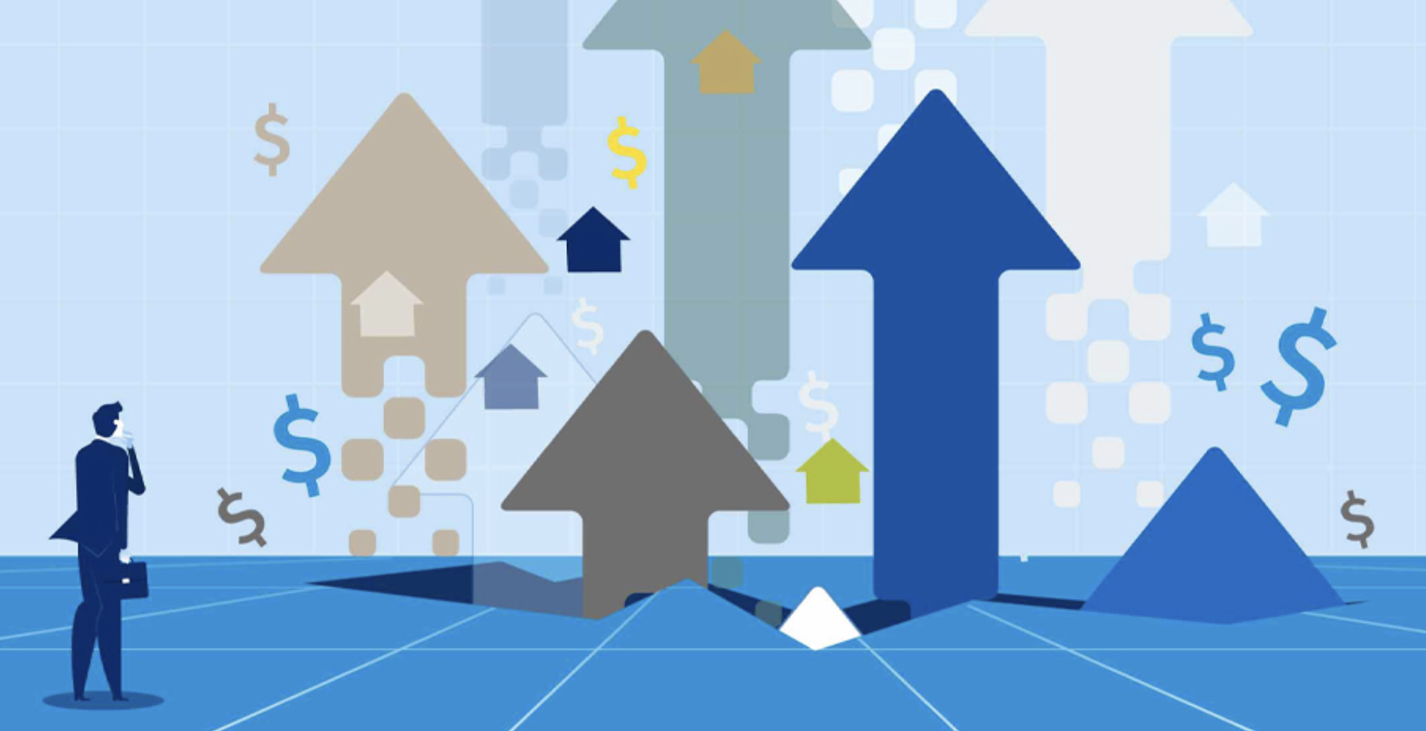
“What’s Up” with Inflation and Input Prices?
Kynda Curtis, Extension Ag & Food Marketing Specialist
Applied Economics, USU Extension

Slide 3
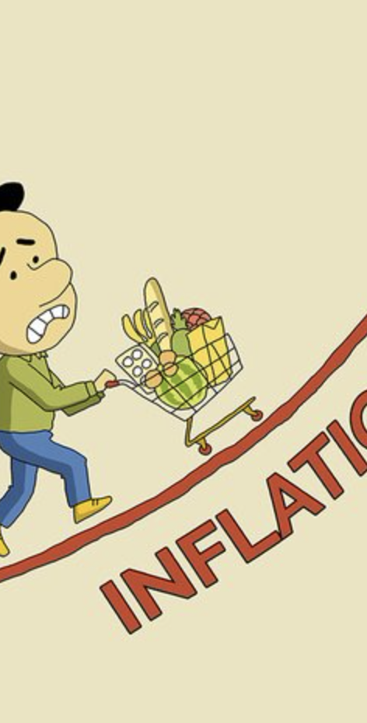
Overview
Inflation overview
  Historical inflation rates
  Drivers of future inflation
Consumer Price Index (CPI) – Food
  Food price drivers
Producer Price Index (PPI) – Food
Upside for producers (farmers/ranchers)
Direct to consumer sales impacts for 2022
Input prices and shortages
Suggestions

Slide 4
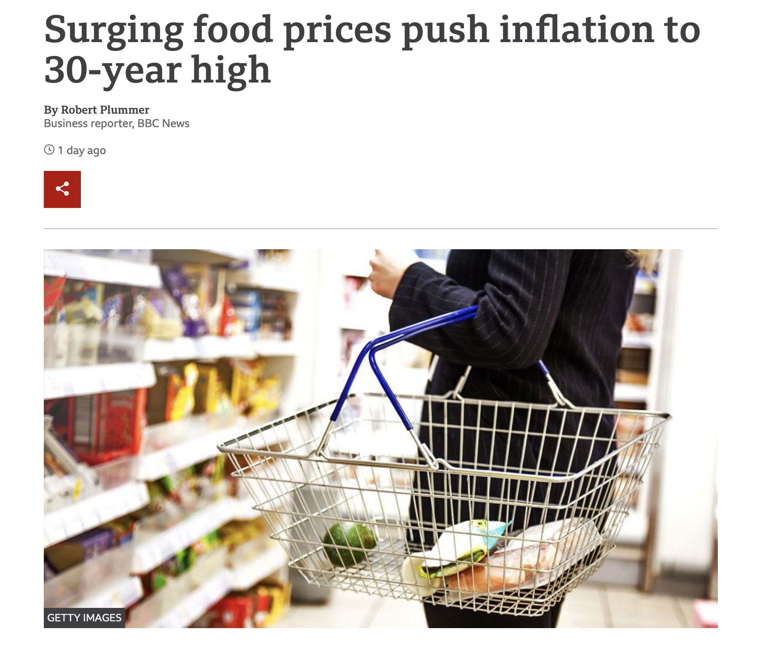

Slide 5
Inflation Overview
US consumer price inflation index rose 7% over the past year before seasonal adjustments, the steepest climb in prices since June 1982
Taking out food and energy costs, inflation rose to 5.5% between December 2020 and December 2021 -- the biggest annual jump since February 1991
The the food price index climbed 6.3%, while grocery prices rose by 6.5% last year
The energy cost index rose 29.3% over the past year
Prices are still nowhere near the historic highs from the 1980s
  Inflation peaked in the spring of 1980 at 14.6% (adjusted)

Slide 6
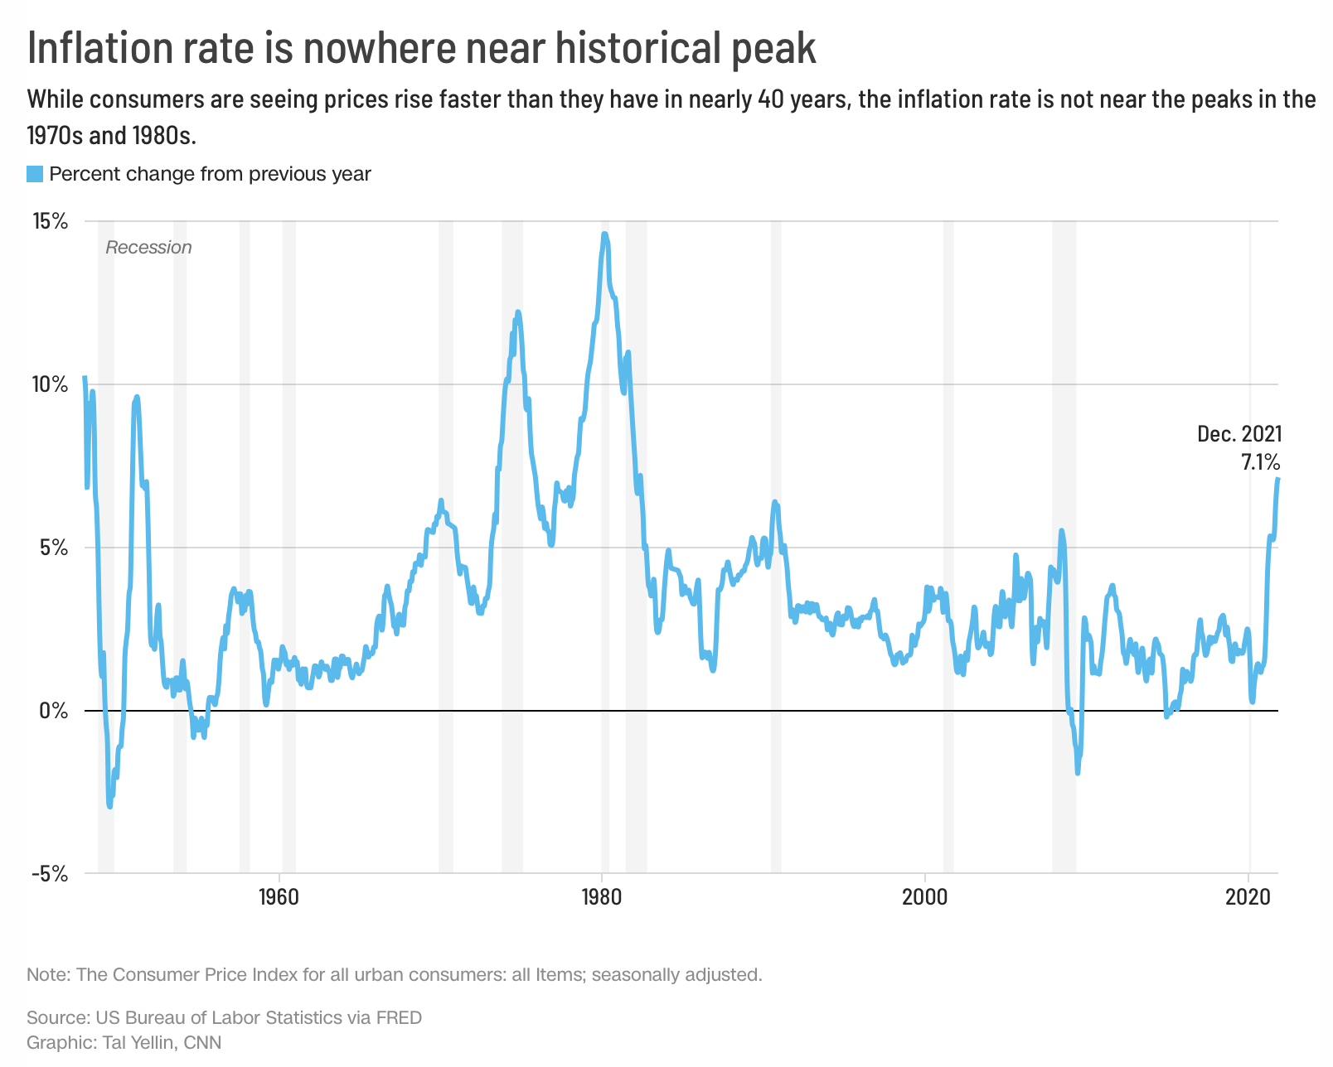
Historical Inflation Rates

Slide 7
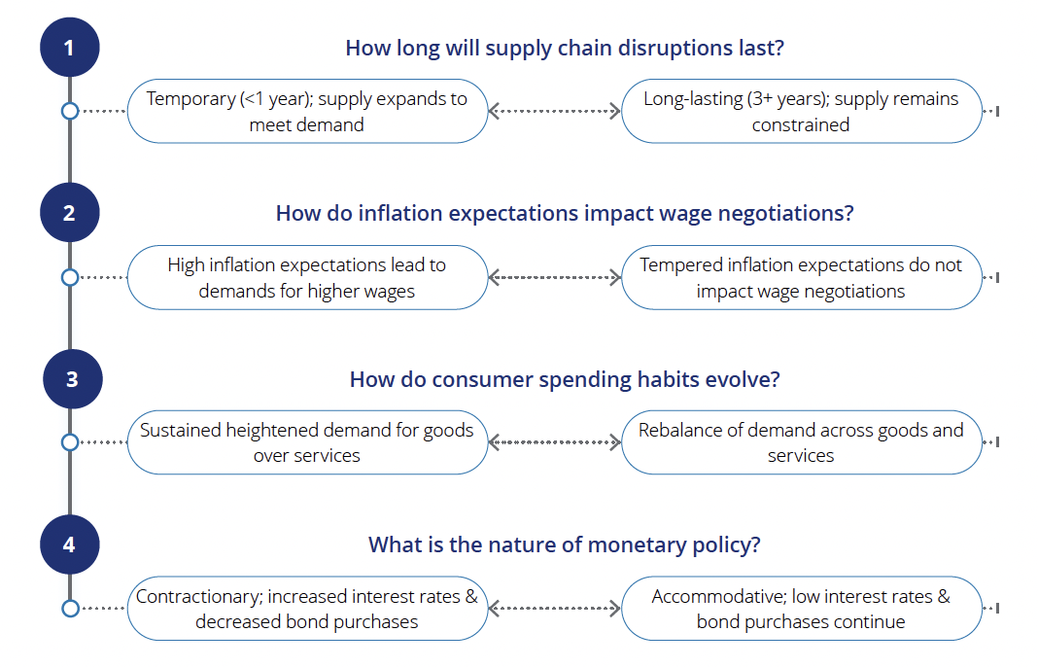
US Inflation Predictions
Drivers deemed to have the greatest potential impact on the future of inflation
Deloitte: The inflation outlook, 2/10/22

Slide 8
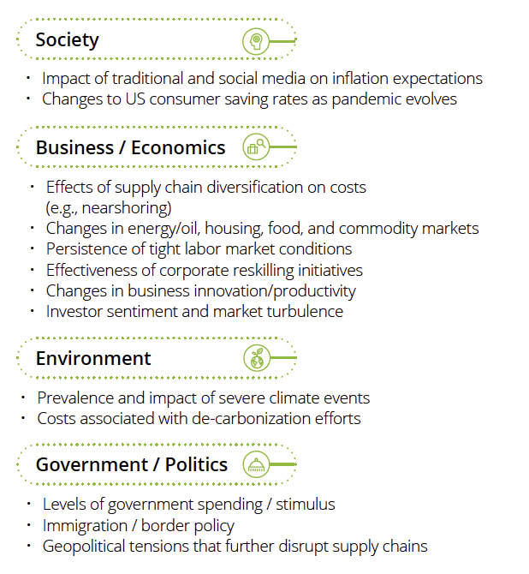
Potential Other Drivers
Deloitte: The inflation outlook, 2/10/22

Slide 9
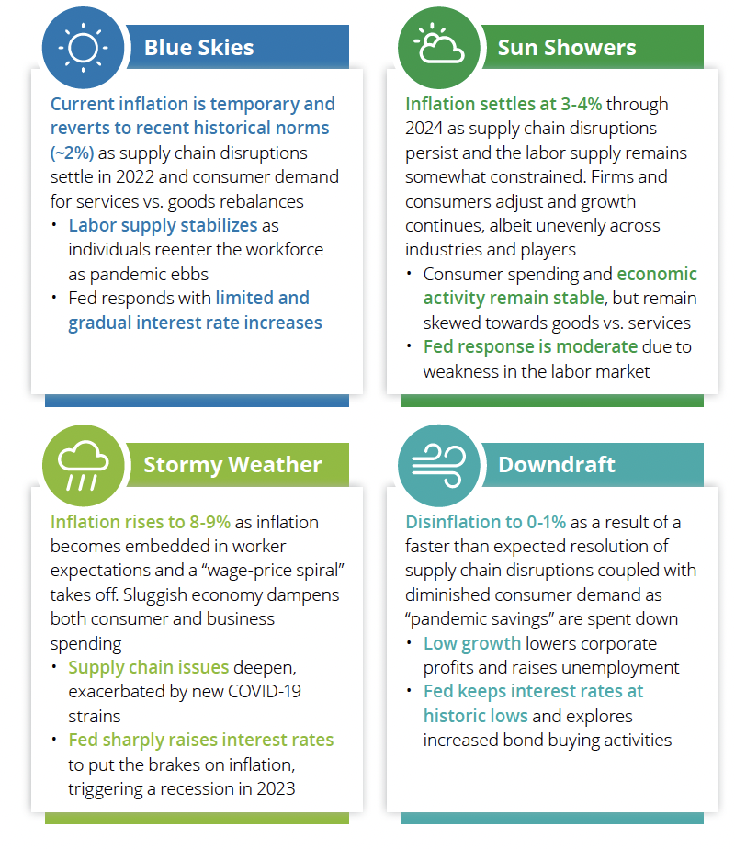
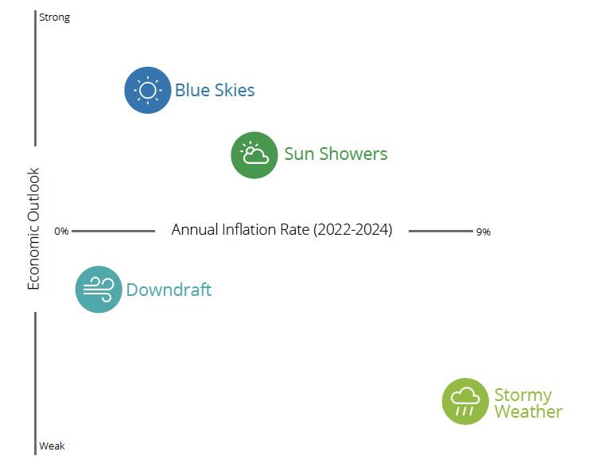
Four Distinct Potential Scenarios
Deloitte: The inflation outlook, 2/10/22

Slide 10
Consumer Price Index - Food
The CPI for food increased as food prices were 6.1% higher in Nov 2021 than Nov 2020
The level of food price inflation varied depending on whether the food was purchased for consumption away from home or at home
  The food-away-from-home (restaurant purchases) CPI increased 5.8%
  The food-at-home (grocery store or supermarket food purchases) CPI increased 6.4%

Slide 11
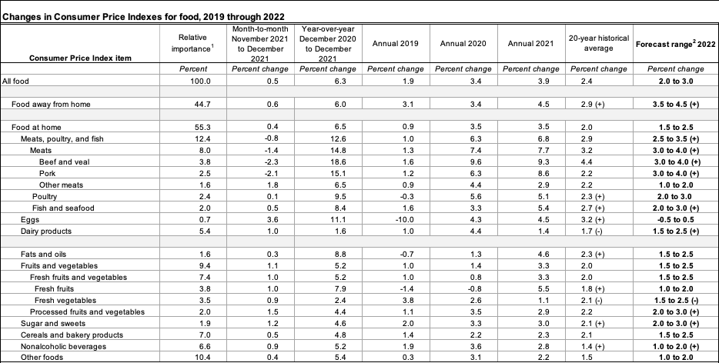
Consumer Price Index - Food
USDA ERS: Food Price Outlook 1/25/22

Slide 12
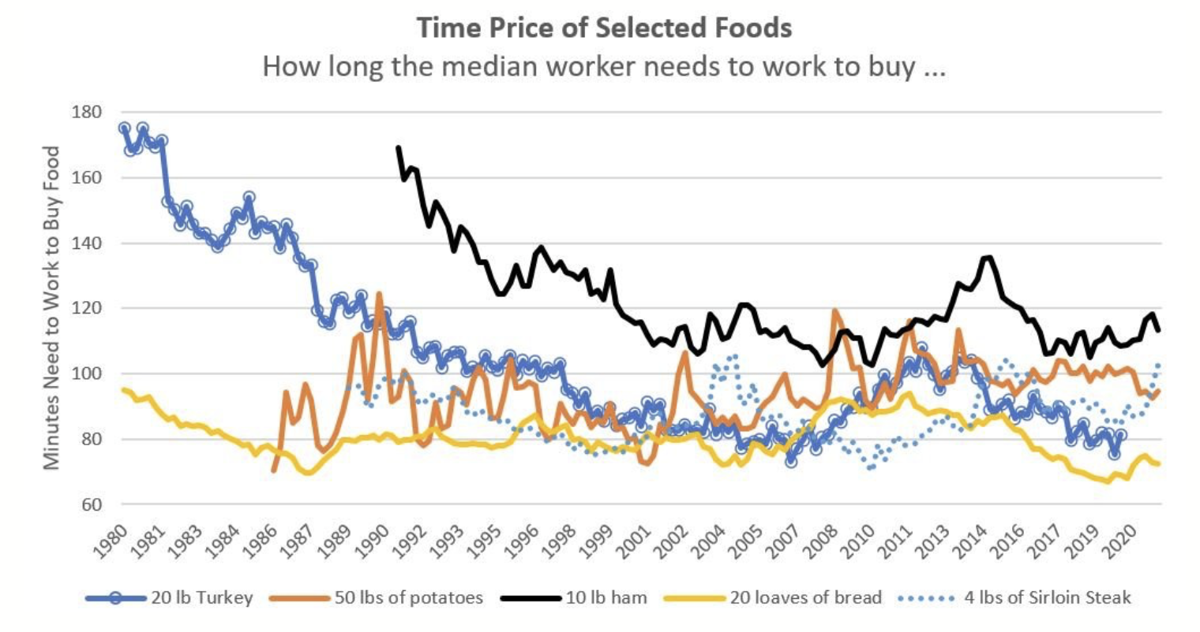
Food Prices – Minutes Worked to Purchase (median weekly salary)
Courtesy of Jayson Lusk

Slide 13
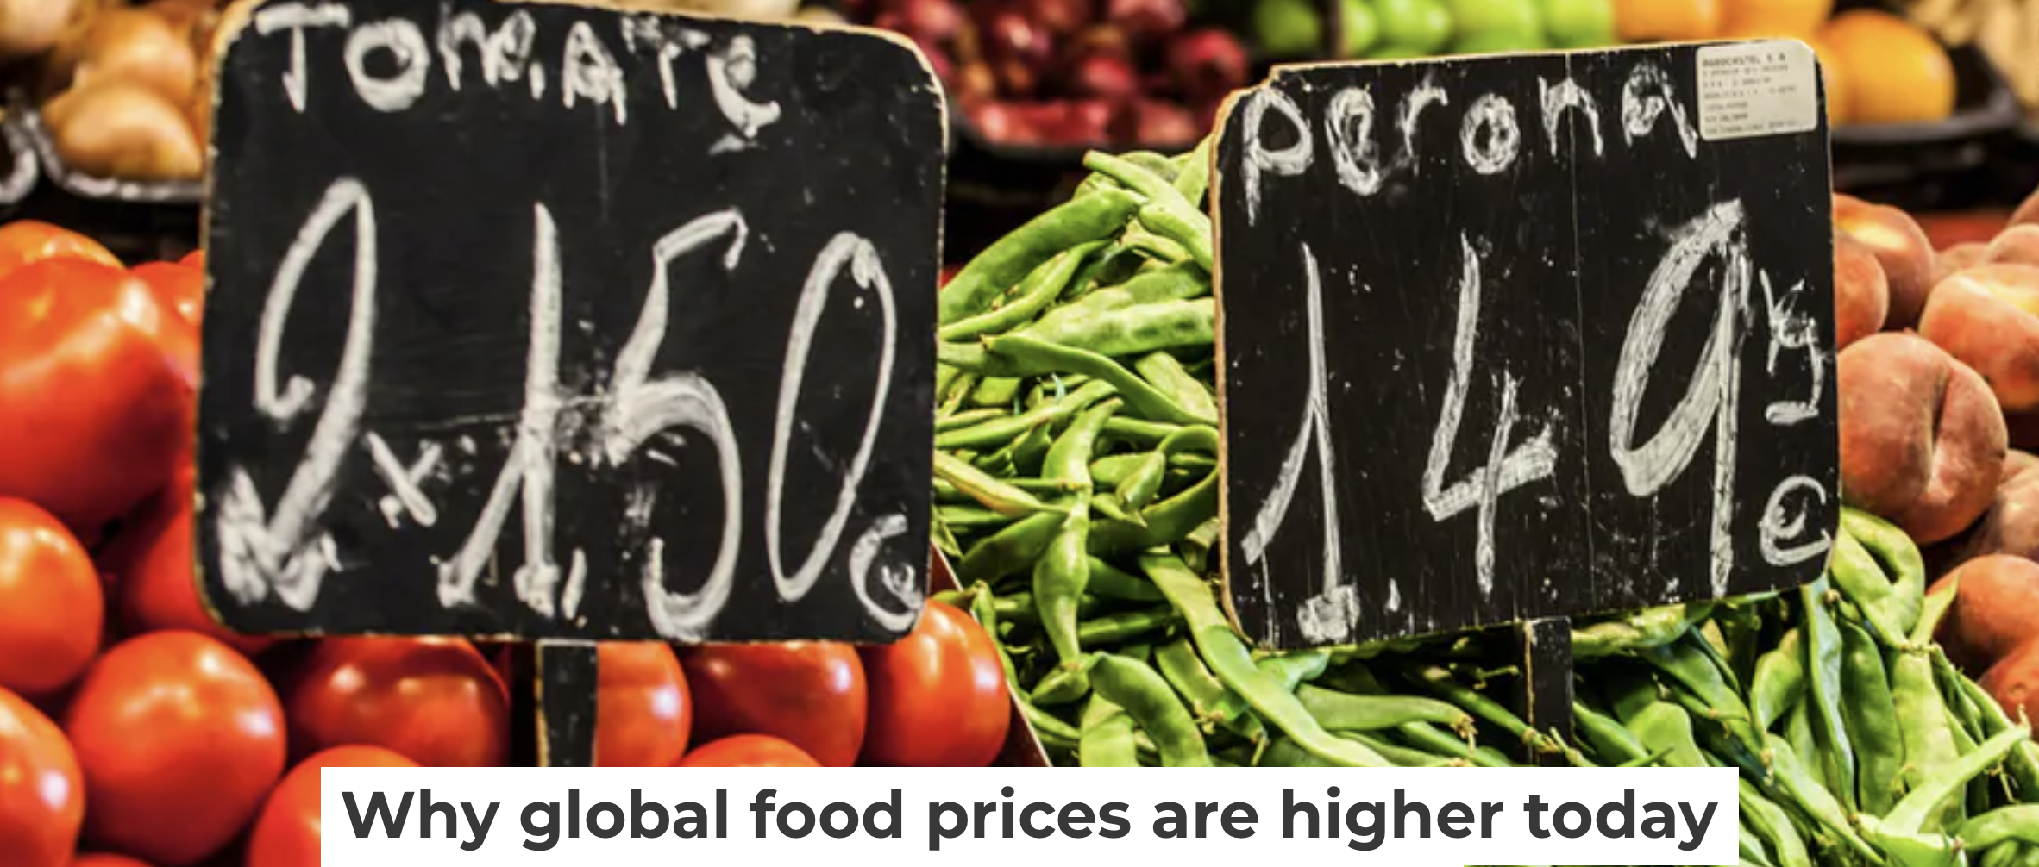
Drivers of Increased Food Prices
Consumer demand higher
  Increasing wages due to labor shortages
  Increased government spending
  Pandemic savings
  Consumer optimism
Supply lower
  Increased costs
    Labor shortages – increased wages
    Shipping/transportation – shortages, fuel prices
  Lack of inputs
  Exiting the market

Slide 14
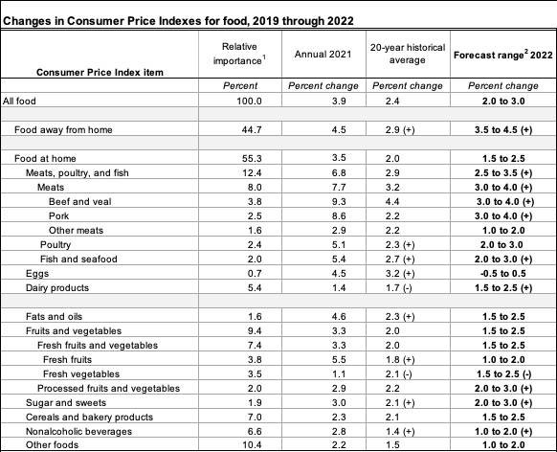
CPI Food Projections 2022
USDA ERS: Food Price Outlook 1/25/22

Slide 15
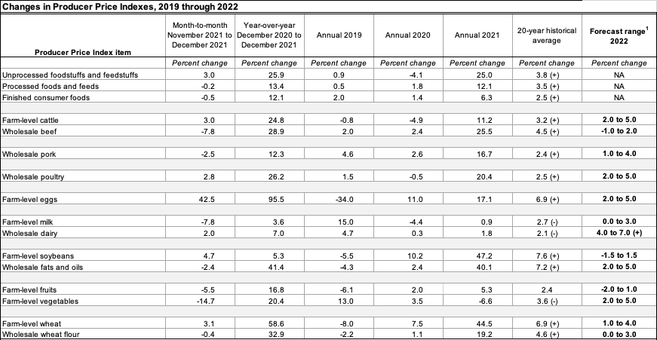
Producer Price Index - Food (Sales Price to Domestic Farmers/Ranchers)
USDA ERS: Food Price Outlook 1/25/22

Slide 16
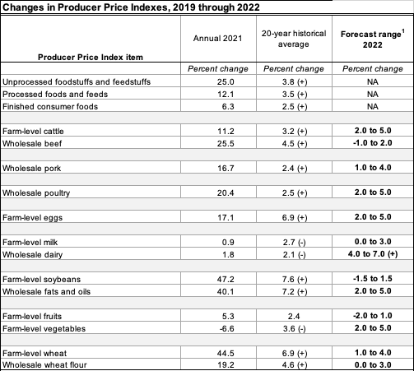
PPI Food Projections 2022
USDA ERS: Food Price Outlook 1/25/22

Slide 17
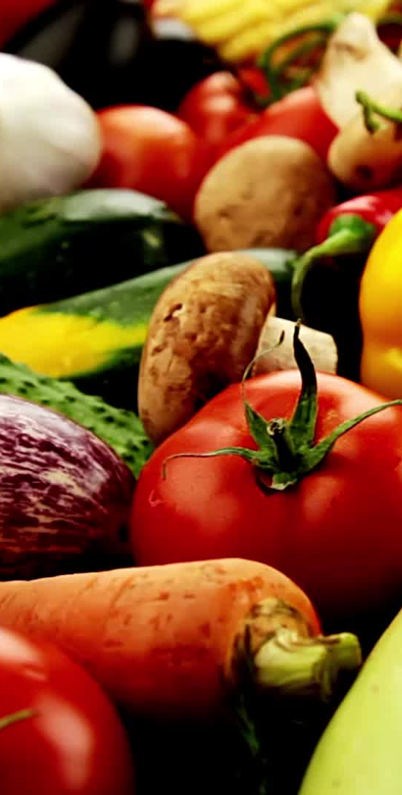
Upside for Producers
Producer price increases outpacing consumer price increases
  Except for eggs and milk
Highest price increases for beef, poultry, and vegetables
Wheat pricing also expanded by 50%
USDA shows net farm income rose 20% in 2020 relative to 2019 and is forecasted to be up 23% for 2021

Slide 18
Direct to Consumer Sales
Consumers seeing higher prices at the grocery store……
Farmer’s market, CSA, etc. price adjustments warranted
  Fresh vegetables and fruit
  Grass-fed and local beef
    More processing facilities coming on in Utah & Idaho
Impacts of covid-based shortages on the demand for local foods remain
  Strong demand for local meats and fresh produce
  Farmers’ market attendance and CSA membership number still above 2019 levels

Slide 19
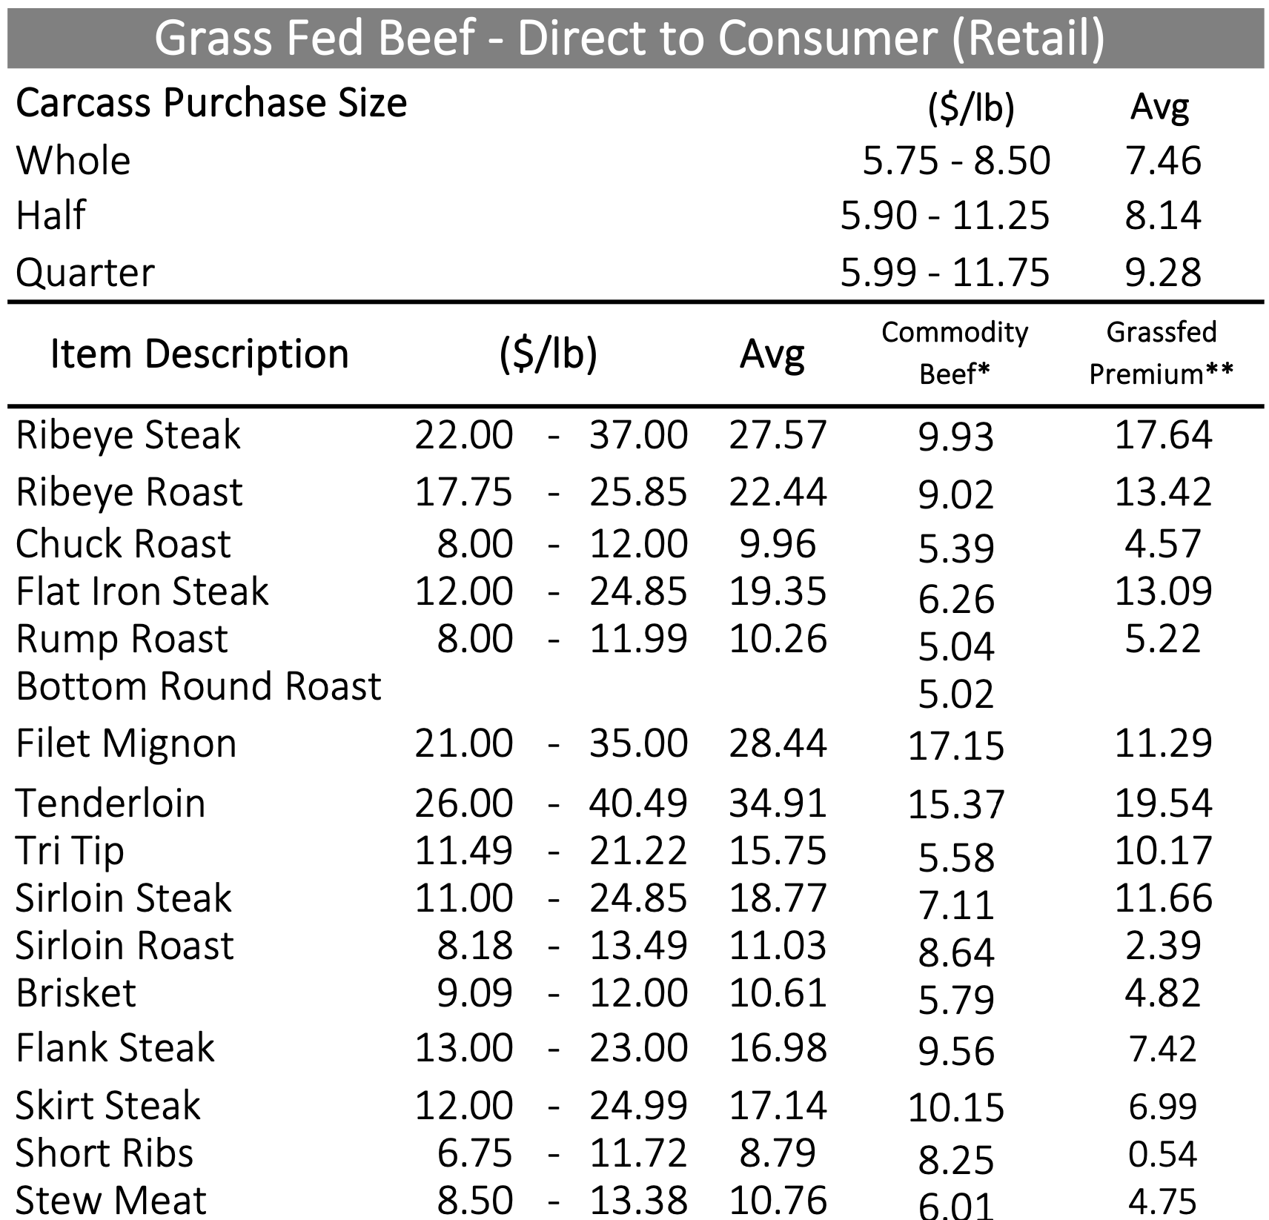
USDA AMS: National Monthly Grass Fed Beef Report, Jan 28, 2022

Slide 20
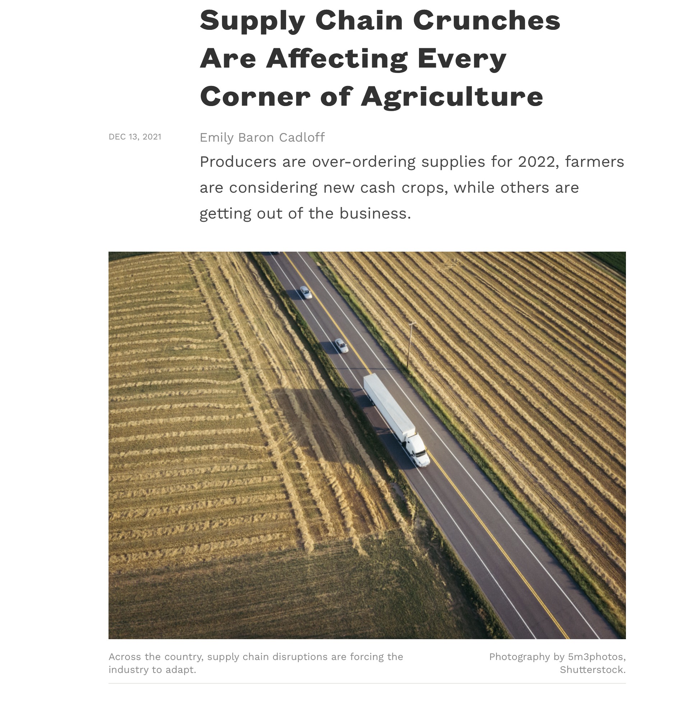

Slide 21
Input Prices & Shortages
Why are we seeing supply chain issues?
Immense online ordering
Transportation capacity
Over ordering
Lack of packaging materials
Labor shortages – increased wages
Shipping/transportation stress
Cost of transportation due to fuel price increases
Cost of fertilizers and other inputs
Fertilizer up 200-300%, bans on some fertilizer imports
For example, corn used in many products, lack of fertilizer is causing reductions in corn production
“I waited a year for my jars”

Slide 22
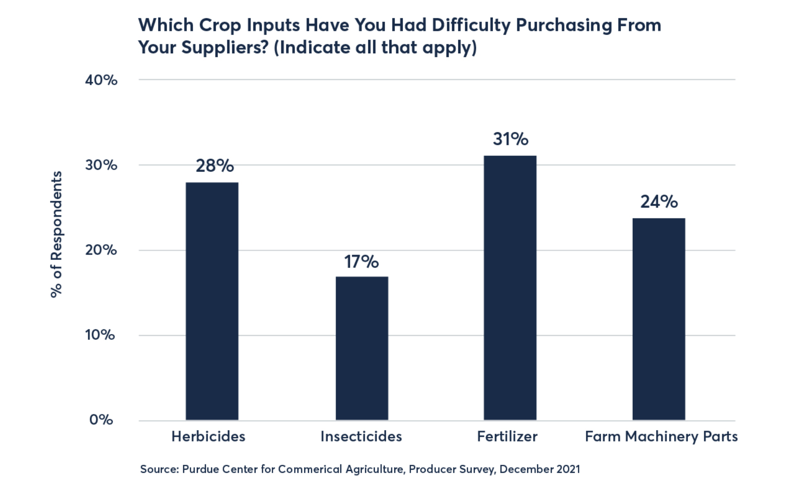
Input Shortages
Texas A&M Agricultural and Food Policy Center suggests that fertilizer prices could increase by more than 80% for the 2022 planting season

Slide 23

Suggestions – Dealing with Input Prices/Shortage
Secure orders early – pre buying
Lock in pricing ahead of time
Source locally when available
Use multiple types of packaging
Share equipment and parts

Slide 24
Resources
USDA ERS Food Price Outlook
  https://www.ers.usda.gov/data-products/food-price-outlook/
Federal Reserve Bank of St. Louis Economic Data
  https://fred.stlouisfed.org
US Wholesale Specialty Crop Prices
  https://www.ams.usda.gov/market-news/fruit-and-vegetable-terminal-markets-standard-reports
National Grass Fed Beef Report
  https://www.ams.usda.gov/mnreports/lsmngfbeef.pdf

Slide 25

Questions?

Slide 26
Thank you!
kynda.curtis@usu.edu

