Slide 1
Engaging with the Environment
4-H Youth Air Force Summer Camp

Slide 2
What do you already know about earth systems and environmental conservation?
Take a moment to think or discuss with a parent, sibling, or friend.

Slide 3
Did You Know???
A glass bottle will take 40,000 years to decompose, if it’s not recycled
27,000 trees are cut down everyday just to make toilet paper
Americans use 380 billion plastic bags each year, about 1,200 bags per person
Clouds can hold millions of tons of water at a time!

Slide 4
Cloud in A Jar Recap
How it works:
When warm water is added to the jar, some turns to water vapor. The water vapor rises to the top because it weighs less and comes in contact with cold air from the ice cubes.
Water vapor condenses when it cools down, but can only condense when it has something to condense on to. In nature, water vapor condenses onto dust, air pollution, pollen, and many other natural particles, but in this experiment, it condensed to hairspray.

Slide 5
Earth System: The Water Cycle
Water covers more than 70% of the Earth’s surface, and all living things need water to survive. The water cycle is nature’s way of purifying, circulating, and replenishing water.
Four basic steps in the water cycle:
Evaporation
Condensation
Precipitation
Collection

Slide 6
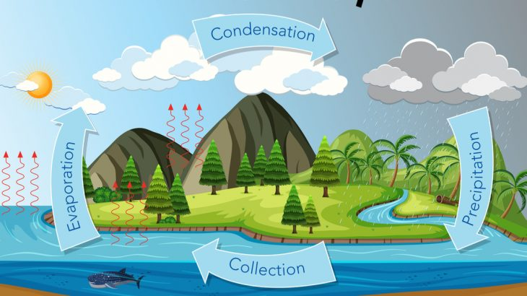
Condensation: When gaseous water vapor cools at high elevations and becomes liquid (or solid) again.
Precipitation: When liquid water (e.g., rain) or solid water (e.g., snow) falls to the ground.
Evaporation: When heat from the sun turns liquid water into gaseous water vapor, causing it to rise into the air.
Collection: When large amounts of water gather in oceans, lakes, rivers, and stream.

Slide 7
Why Clouds Are Important
Clouds help regulate the earth’s temperature by reflecting the sun’s rays to keep earth cool for humans
Clouds supply water to the earth in the forms of rain, snow, hail, and sleet
Clouds attract the tiny particles in the air called aerosols in order to condense into water molecules, like the cloud in the jar

Slide 8
Types of Cloud
The five main types of clouds:
Cirrus
Stratus
Cirrocumulus
Cumulonimbus
Altocumulus
Try pronouncing those with a friend!

Slide 9
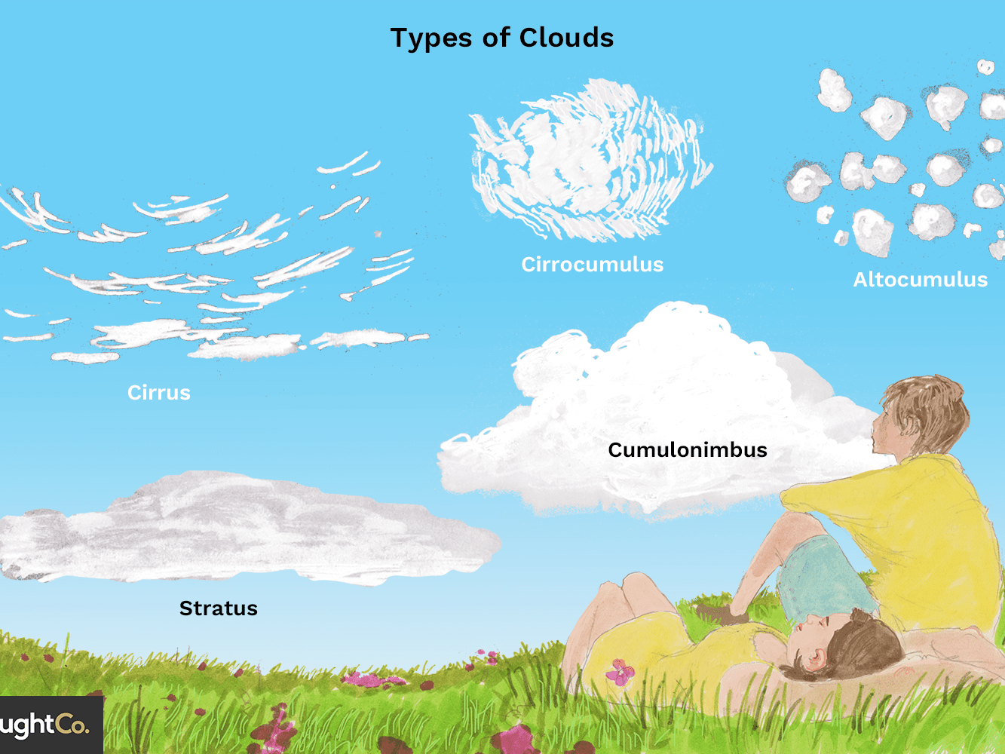

Slide 10
Oil Spill Recap
What did you already know about oil spills?
What kind of engineerings help solve environmental problems?
What sort of damage can they cause in the real world?
Think about these reflection questions or discuss them with a friend.

Slide 11
Oil Spills
Oil spills are usually caused when equipment breaks down or oil companies make mistakes.
Oil spills can cause damage to the environment and the wildlife, like we saw in our oil spill activity.

Slide 12
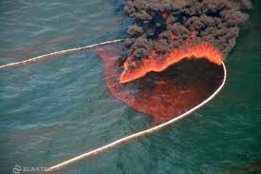
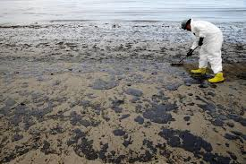
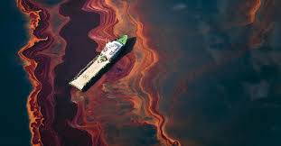
Oil can catch on fire in the ocean, causing environmental damage and air pollution.
Damage to beaches, where oil sticks to the sand.

Slide 13
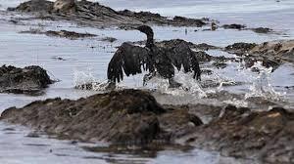
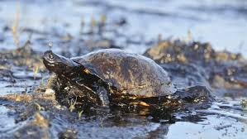
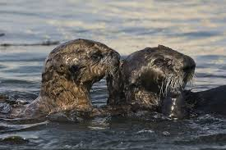
The oil makes birds wings sticky and they can no longer fly.
Oil makes it harder for marine life to swim through the water.
Oil is toxic and can kill animals when they swallow it.

Slide 14
Methods of Clean-Up
In our activity, we used cotton balls, a sponge, and a spoon to try and remove the oil from the ocean. How did those materials work at cleaning up your oil spill?
If a real oil spill were to happen, what could we use to collect the oil and save the environment?

Slide 15
Examples of Oil Spill Technology
Oil Boom: acts like a fence to decrease the spread of the oil
Skimmer: machines designed to suck up the oil from the ocean, kind of like using a spoon from our experiment
Sorbent: a chemical that attracts the oil and makes it easier to remove

Slide 16
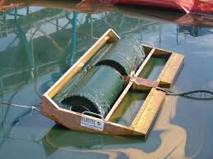
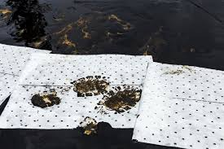
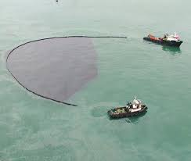
Skimmer
Sorbents
Oil Boom

Slide 17
Environmental Conservation
Environmental Conservation is anything we do to protect our planet and conserve our natural resources.
Natural Resources are anything that is found that humans did not create, such as water, air, minerals, oil, and much more.
Why do you think it is important to protect our planet?

Slide 18
Environmental Conservation Starts At Home!
Saving the planet isn’t one person’s or one companies job, it is everyone’s, even you!
Some ideas you can do to help the planet everyday!
Recycle
Turn off the water
Turn off the lights when you leave a room
Start a garden
Compost
Use reusable grocery bags
Teach others what you have learned today!

Slide 19
Link to Survey with a Do and Snap Picture Challenge!
*insert survey link*

Slide 20
Hope You Enjoyed Engaging with the Environment!

